Slide 1
Single Cycle Processor Design
Bölüm 4
Bilgisayar Mimarisi

Slide 2
Presentation Outline
Designing a Processor: Step-by-Step
Datapath Components and Clocking
Assembling an Adequate Datapath
Controlling the Execution of Instructions
The Main Controller and ALU Controller
Drawback of the single-cycle processor design
Notes:
Here is an outline of today’’s lecture.
Mainly, we will be building a datapath step by step for a subset of the MIPS instruction set.
+1 = 4 min. (X:44)

Slide 3
The Performance Perspective
Recall, performance is determined by:
  Instruction count
  Clock cycles per instruction (CPI)
  Clock cycle time
Processor design will affect
  Clock cycles per instruction
  Clock cycle time
Single cycle datapath and control design:
  Advantage: One clock cycle per instruction
  Disadvantage: long cycle time
I-Count
CPI
Cycle
Notes:
This slide shows how the next two lectures fit into the overall performance picture.
Recalled from one of your earlier lectures that the performance of a machine is determined by 3 factors: (a) Instruction count, (b) Clock cycle time, and (c) Clock cycles per instruction.
Instruction count is controlled by the Instruction Set Architecture and the compiler design so the computer engineer has very little control over it (Instruction Count).
What you as a computer engineer can control, while you are designing a processor, are the Clock Cycle Time and Instruction Count per cycle.
More specifically, in the next two lectures, you will be designing a single cycle processor which by definition takes one clock cycle to execute every instruction.
The disadvantage of this single cycle processor design is that it has a long cycle time.
+2 = 7 min. (X:47)

Slide 4
Designing a Processor: Step-by-Step
Analyze instruction set => datapath requirements
  The meaning of each instruction is given by the register transfers
  Datapath must include storage elements for ISA registers
  Datapath must support each register transfer
Select datapath components and clocking methodology
Assemble datapath meeting the requirements
Analyze implementation of each instruction
  Determine the setting of control signals for register transfer
Assemble the control logic

Slide 5
Review of MIPS Instruction Formats
All instructions are 32-bit wide
Three instruction formats: R-type, I-type, and J-type
  Op⁶: 6-bit opcode of the instruction
  Rs⁵, Rt⁵, Rd⁵: 5-bit source and destination register numbers
  sa⁵: 5-bit shift amount used by shift instructions
  funct⁶: 6-bit function field for R-type instructions
  immediate¹⁶: 16-bit immediate value or address offset
  immediate²⁶: 26-bit target address of the jump instruction
Op⁶
Rs⁵
Rt⁵
Rd⁵
sa⁵
funct⁶
Op⁶
Rs⁵
Rt⁵
immediate¹⁶
Op⁶
immediate²⁶

Slide 6
MIPS Subset of Instructions
Only a subset of the MIPS instructions are considered
  ALU instructions (R-type): add, sub, and, or, xor, slt
  Immediate instructions (I-type): addi, slti, andi, ori, xori
  Load and Store (I-type): lw, sw
  Branch (I-type): beq, bne
  Jump (J-type): j
This subset does not include all the integer instructions
But sufficient to illustrate design of datapath and control
Concepts used to implement the MIPS subset are used to construct a broad spectrum of computers
Notes:
In today’s lecture, I will show you how to implement the following subset of MIPS instructions: add, subtract, or immediate, load, store, branch, and the jump instruction.
The Add and Subtract instructions use the R format. The Op together with the Func fields together specified all the different kinds of add and subtract instructions.
Rs and Rt specifies the source registers. And the Rd field specifies the destination register.
The Or immediate instruction uses the I format. It only uses one source register, Rs. The other operand comes from the immediate field. The Rt field is used to specified the destination register. (Note that dest is the Rt field!)
Both the load and store instructions use the I format and both add the Rs and the immediate filed together to from the memory address.
The difference is that the load instruction will load the data from memory into Rt while the store instruction will store the data in Rt into the memory.
The branch on equal instruction also uses the I format. Here Rs and Rt are used to specified the registers we need to compare.
If these two registers are equal, we will branch to a location offset by the immediate field.
Finally, the jump instruction uses the J format and always causes the program to jump to a memory location specified in the address field.
I know I went over this rather quickly and you may have missed something. But don’t worry, this is just an overview. You will keep seeing these (point to the format) all day today.
+3 = 13 min. (X:53)

Slide 7
Details of the MIPS Subset
Instruction | Meaning | Format
add rd, rs, rt | addition | op⁶ = 0 | rs⁵ | rt⁵ | rd⁵ | 0 | 0x20
sub rd, rs, rt | subtraction | op⁶ = 0 | rs⁵ | rt⁵ | rd⁵ | 0 | 0x22
and rd, rs, rt | bitwise and | op⁶ = 0 | rs⁵ | rt⁵ | rd⁵ | 0 | 0x24
or rd, rs, rt | bitwise or | op⁶ = 0 | rs⁵ | rt⁵ | rd⁵ | 0 | 0x25
xor rd, rs, rt | exclusive or | op⁶ = 0 | rs⁵ | rt⁵ | rd⁵ | 0 | 0x26
slt rd, rs, rt | set on less than | op⁶ = 0 | rs⁵ | rt⁵ | rd⁵ | 0 | 0x2a
addi rt, rs, im¹⁶ | add immediate | 0x08 | rs⁵ | rt⁵ | im¹⁶
slti rt, rs, im¹⁶ | slt immediate | 0x0a | rs⁵ | rt⁵ | im¹⁶
andi rt, rs, im¹⁶ | and immediate | 0x0c | rs⁵ | rt⁵ | im¹⁶
ori rt, rs, im¹⁶ | or immediate | 0x0d | rs⁵ | rt⁵ | im¹⁶
xori rt, im¹⁶ | xor immediate | 0x0e | rs⁵ | rt⁵ | im¹⁶
lw rt, im¹⁶(rs) | load word | 0x23 | rs⁵ | rt⁵ | im¹⁶
sw rt, im¹⁶(rs) | store word | 0x2b | rs⁵ | rt⁵ | im¹⁶
beq rs, rt, im¹⁶ | branch if equal | 0x04 | rs⁵ | rt⁵ | im¹⁶
bne rs, rt, im¹⁶ | branch not equal | 0x05 | rs⁵ | rt⁵ | im¹⁶
j im²⁶ | jump | 0x02 | im²⁶

Slide 8
Register Transfer Level (RTL)
RTL is a description of data flow between registers
RTL gives a meaning to the instructions
All instructions are fetched from memory at address PC
Instruction RTL Description
ADD Reg(Rd) ← Reg(Rs) + Reg(Rt); PC ← PC + 4
SUB Reg(Rd) ← Reg(Rs) – Reg(Rt); PC ← PC + 4
ORI Reg(Rt) ← Reg(Rs) | zero_ext(Im16); PC ← PC + 4
LW Reg(Rt) ← MEM[Reg(Rs) + sign_ext(Im16)]; PC ← PC + 4
SW MEM[Reg(Rs) + sign_ext(Im16)] ← Reg(Rt); PC ← PC + 4
BEQ if (Reg(Rs) == Reg(Rt))
PC ← PC + 4 + 4 × sign_extend(Im16)
else PC ← PC + 4

Slide 9
Instructions are Executed in Steps
R-type Fetch instruction: Instruction ← MEM[PC]
Fetch operands: data1 ← Reg(Rs), data2 ← Reg(Rt)
Execute operation: ALU_result ← func(data1, data2)
Write ALU result: Reg(Rd) ← ALU_result
Next PC address: PC ← PC + 4
I-type Fetch instruction: Instruction ← MEM[PC]
Fetch operands: data1 ← Reg(Rs), data2 ← Extend(imm16)
Execute operation: ALU_result ← op(data1, data2)
Write ALU result: Reg(Rt) ← ALU_result
Next PC address: PC ← PC + 4
BEQ Fetch instruction: Instruction ← MEM[PC]
Fetch operands: data1 ← Reg(Rs), data2 ← Reg(Rt)
Equality: zero ← subtract(data1, data2)
Branch: if (zero) PC ← PC + 4 + 4×sign_ext(imm16)
else PC ← PC + 4

Slide 10
Instruction Execution – cont’d
LW Fetch instruction: Instruction ← MEM[PC]
Fetch base register: base ← Reg(Rs)
Calculate address: address ← base + sign_extend(imm16)
Read memory: data ← MEM[address]
Write register Rt: Reg(Rt) ← data
Next PC address: PC ← PC + 4
SW Fetch instruction: Instruction ← MEM[PC]
Fetch registers: base ← Reg(Rs), data ← Reg(Rt)
Calculate address: address ← base + sign_extend(imm16)
Write memory: MEM[address] ← data
Next PC address: PC ← PC + 4
Jump Fetch instruction: Instruction ← MEM[PC]
Target PC address: target ← PC[31:28] || Imm26 || ‘00’
Jump: PC ← target
concatenation

Slide 11
Requirements of the Instruction Set
Memory
  Instruction memory where instructions are stored
  Data memory where data is stored
Registers
  31 × 32-bit general purpose registers, R0 is always zero
  Read source register Rs
  Read source register Rt
  Write destination register Rt or Rd
Program counter PC register and Adder to increment PC
Sign and Zero extender for immediate constant
ALU for executing instructions

Slide 12
Next . . .
Designing a Processor: Step-by-Step
Datapath Components and Clocking
Assembling an Adequate Datapath
Controlling the Execution of Instructions
The Main Controller and ALU Controller
Drawback of the single-cycle processor design
Notes:
Here is an outline of today’’s lecture.
Mainly, we will be building a datapath step by step for a subset of the MIPS instruction set.
+1 = 4 min. (X:44)

Slide 13
Components of the Datapath
Combinational Elements
  ALU, Adder
  Immediate extender
  Multiplexers
Storage Elements
  Instruction memory
  Data memory
  PC register
  Register file
Clocking methodology
  Timing of writes
32
m
u
x
A
L
U
zero
0
32
16
Extend
32
ALU result
1
32
overflow
ExtOp
select
ALU control
Instruction
32
Data
Memory
32
32
32
Address
32
PC
Address
32
Instruction
Memory
32
Data_out
Data_in
clk
clk
Registers
Mem
Read
Mem
Write
5
BusA
32
RA
5
RB
32
5
BusB
RW
BusW
clk
RegWrite
32

Slide 14
Register Element
Register
  Similar to the D-type Flip-Flop
n-bit input and output
Write Enable (WE):
  Enable / disable writing of register
  Negated (0): Data_Out will not change
  Asserted (1): Data_Out will become Data_In after clock edge
Edge triggered Clocking
  Register output is modified at clock edge
Data_In
n bits
Write
Enable
Register
WE
Clock
n bits
Data_Out
Notes:
As far as storage elements are concerned, we will need a N-bit register that is similar to the D flip-flop I showed you in class.
The significant difference here is that the register will have a Write Enable input.
That is the content of the register will NOT be updated if Write Enable is not asserted (0).
The content is updated at the clock tick ONLY if the Write Enable signal is asserted (1).
+1 = 31 min. (Y:11)

Slide 15
MIPS Register File
RW
RA
RB
Register File consists of 32 × 32-bit registers
  BusA and BusB: 32-bit output busses for reading 2 registers
  BusW: 32-bit input bus for writing a register when RegWrite is 1
  Two registers read and one written in a cycle
Registers are selected by:
  RA selects register to be read on BusA
  RB selects register to be read on BusB
  RW selects the register to be written
Clock input
  The clock input is used ONLY during write operation
  During read, register file behaves as a combinational logic block
    RA or RB valid => BusA or BusB valid after access time
Register
File
5
BusA
32
RA
5
RB
5
BusB
32
RW
Clock
BusW
RegWrite
32
Notes:
We will also need a register file that consists of 32 32-bit registers with two output busses (busA and busB) and one input bus.
The register specifiers Ra and Rb select the registers to put on busA and busB respectively.
When Write Enable is 1, the register specifier Rw selects the register to be written via busW.
In our simplified version of the register file, the write operation will occurs at the clock tick.
Keep in mind that the clock input is a factor ONLY during the write operation.
During read operation, the register file behaves as a combinational logic block.
That is if you put a valid value on Ra, then bus A will become valid after the register file’s access time.
Similarly if you put a valid value on Rb, bus B will become valid after the register file’s access time. In both cases (Ra and Rb), the clock input is not a factor.
+2 = 33 min. (Y:13)

Slide 16
Details of the Register File
RA
5
RB
5
32
Decoder
"0"
Decoder
"0"
Tri-state
buffers
R1
R0 is not used
WE
32
32
RW
R2
.
.
.
WE
Decoder
5
32
.
.
.
32
32
32
BusW
BusA
R31
WE
RegWrite
32
32
Clock
BusB

Slide 17
Tri-State Buffers
Allow multiple sources to drive a single bus
Two Inputs:
  Data_in
  Enable (to enable output)
One Output: Data_out
  If (Enable) Data_out = Data_in
  else Data_out = High Impedance state (output is disconnected)
Tri-state buffers can be
used to build multiplexors
Enable
Data_in
Data_out
Data_0
Output
Data_1
Select

Slide 18
Building a Multifunction ALU
SLL = 00
SRL = 00
SRA = 01
ROR = 11
2
SLT: ALU does a SUB and check the sign and overflow
Shift/Rotate
Operation
Shift Amount
5
Shifter
32
c₀
0
A
32
ALU Result
sign
≠
32
A
d
d
e
r
1
B
32
2
32
Arithmetic
Operation
ADD = 0
SUB = 1
3
overflow
2
zero
Logic Unit
0
ALU
Selection
1
2
Shift = 00
SLT = 01
Arith = 10
Logic = 11
AND = 00
OR = 01
NOR = 10
XOR = 11
Logical
Operation
3
2

Slide 19
Details of the Shifter
Implemented with multiplexers and wiring
Shift Operation can be: SLL, SRL, SRA, or ROR
Input Data is extended to 63 bits according to Shift Op
The 63 bits are shifted right according to S₄S₃S₂S₁S₀
5
sa
SLL
S₄
S₃
S₂
S₁
S₀
16
8
4
2
1
split
0
split
0
split
0
split
0
split
0
32
63
16
31
16
31
47
8
31
8
31
39
4
31
4
31
35
2
31
2
31
33
1
31
1
31
32
Extender
Data
mux
mux
mux
mux
mux
Data_out
31
31
31
31
31
1
1
1
1
1
16
8
4
2
1
2
Shift
op
Shift Right
0 or 16 bits
Shift Right
0 or 8 bits
Shift Right
0 or 4 bits
Shift Right
0 or 2 bits
Shift Right
0 or 1 bit

Slide 20
Details of the Shifter – cont’d
Input data is extended from 32 to 63 bits as follows:
  If shift op = SRL then ext_data[62:0] = 0³¹ || data[31:0]
  If shift op = SRA then ext_data[62:0] = data[31]³¹ || data[31:0]
  If shift op = ROR then ext_data[62:0] = data[30:0] || data[31:0]
  If shift op = SLL then ext_data[62:0] = data[31:0] || 0³¹
For SRL, the 32-bit input data is zero-extended to 63 bits
For SRA, the 32-bit input data is sign-extended to 63 bits
For ROR, 31-bit extension = lower 31 bits of data
Then, shift right according to the shift amount
As the extended data is shifted right, the upper bits will be: 0 (SRL), sign-bit (SRA), or lower bits of data (ROR)

Slide 21
Implementing Shift Left Logical
The wiring of the above shifter dictates a right shift
However, we can convert a left shift into a right shift
For SLL, 31 zeros are appended to the right of data
  To shift left by 0 is equivalent to shifting right by 31
  To shift left by 1 is equivalent to shifting right by 30
  To shift left by 31 is equivalent to shifting right by 0
  Therefore, for SLL use the 1’s complement of the shift amount
ROL is equivalent to ROR if we use (32 – rotate amount)
ROL by 10 bits is equivalent to ROR by (32–10) = 22 bits
Therefore, software can convert ROL to ROR

Slide 22
Instruction and Data Memories
Instruction memory needs only provide read access
  Because datapath does not write instructions
  Behaves as combinational logic for read
  Address selects Instruction after access time
Data Memory is used for load and store
  MemRead: enables output on Data_out
    Address selects the word to put on Data_out
  MemWrite: enables writing of Data_in
    Address selects the memory word to be written
    The Clock synchronizes the write operation
Separate instruction and data memories
  Later, we will replace them with caches
32
Address
32
Instruction
Instruction
Memory
Data
Memory
32
Data_out
32
Address
32
Data_in
Clock
MemRead
MemWrite
Notes:
The last storage element you will need for the datapath is the idealized memory to store your data and instructions.
This idealized memory block has just one input bus (DataIn) and one output bus (DataOut).
When Write Enable is 0, the address selects the memory word to put on the Data Out bus.
When Write Enable is 1, the address selects the memory word to be written via the DataIn bus at the next clock tick.
Once again, the clock input is a factor ONLY during the write operation.
During read operation, it behaves as a combinational logic block.
That is if you put a valid value on the address lines, the output bus DataOut will become valid after the access time of the memory.
+2 = 35 min. (Y:15)

Slide 23
Clocking Methodology
Clocks are needed in a sequential logic to decide when a state element (register) should be updated
To ensure correctness, a clocking methodology defines when data can be written and read
We assume edge-triggered clocking
All state changes occur on the same clock edge
Data must be valid and stable before arrival of clock edge
Edge-triggered clocking allows a register to be read and written during same clock cycle
Combinational logic
Register 1
Register 2
clock
rising edge
falling edge

Slide 24
Determining the Clock Cycle
With edge-triggered clocking, the clock cycle must be long enough to accommodate the path from one register through the combinational logic to another register
T_{clk-q} : clock to output delay through register
T_{max_comb} : longest delay through combinational logic
T_{s} : setup time that input to a register must be stable before arrival of clock edge
T_{h}: hold time that input to a register must hold after arrival of clock edge
Hold time (T_{h}) is normally satisfied since T_{clk-q} > T_{h}
Combinational logic
Register 1
Register 2
clock
writing edge
T_{clk-q}
T_{max_comb}
T_{s}
T_{h}
T_{cycle} ≥ T_{clk-q} + T_{max_comb} + T_{s}

Slide 25
Clock Skew
Clock skew arises because the clock signal uses different paths with slightly different delays to reach state elements
Clock skew is the difference in absolute time between when two storage elements see a clock edge
With a clock skew, the clock cycle time is increased
Clock skew is reduced by balancing the clock delays
T_{cycle} ≥ T_{clk-q} + T_{max_combinational} + T_{setup}+ T_{skew}

Slide 26
Next . . .
Designing a Processor: Step-by-Step
Datapath Components and Clocking
Assembling an Adequate Datapath
Controlling the Execution of Instructions
The Main Controller and ALU Controller
Drawback of the single-cycle processor design
Notes:
Here is an outline of today’’s lecture.
Mainly, we will be building a datapath step by step for a subset of the MIPS instruction set.
+1 = 4 min. (X:44)

Slide 27
Instruction Fetching Datapath
We can now assemble the datapath from its components
For instruction fetching, we need …
  Program Counter (PC) register
  Instruction Memory
  Adder for incrementing PC
Improved datapath increments upper 30 bits of PC by 1
next PC
The least significant 2 bits of the PC are ‘00’ since PC is a multiple of 4
next PC
4
A
d
d
Improved
Datapath
32
+1
32
30
00
32
00
30
32
Instruction
Datapath does not handle branch or jump instructions
Instruction
32
Address
32
Address
PC
PC
Instruction
Memory
Instruction
Memory
clk
clk

Slide 28
Datapath for R-type Instructions
Op⁶
Rs⁵
Rt⁵
Rd⁵
sa⁵
funct⁶
RegWrite
+1
ALUCtrl
30
Instruction
Memory
Registers
32
30
Rs
5
RA
BusA
A
L
U
00
Instruction
32
32
32
Rt
5
RB
PC
Address
Rd
5
BusB
32
RW
ALU result
BusW
clk
Rs and Rt fields select two registers to read. Rd field selects register to write
BusA & BusB provide data input to ALU. ALU result is connected to BusW
Same clock updates PC and Rd register
Control signals
  ALUCtrl is derived from the funct field because Op = 0 for R-type
  RegWrite is used to enable the writing of the ALU result

Slide 29
Datapath for I-type ALU Instructions
Op⁶
Rs⁵
Rt⁵
immediate¹⁶
RegWrite
+1
ALUCtrl
30
Instruction
Memory
Registers
32
30
Rs
5
RA
BusA
A
L
U
00
Instruction
32
32
32
5
RB
32
PC
Address
Rt
5
BusB
32
RW
ALU result
BusW
clk
ExtOp
Same clock edge updates PC and Rt
Rt selects register to write, not Rd
Imm16
Extender
Second ALU input comes from the extended immediate. RB and BusB are not used
Control signals
  ALUCtrl is derived from the Op field
  RegWrite is used to enable the writing of the ALU result
  ExtOp is used to control the extension of the 16-bit immediate

Slide 30
Combining R-type & I-type Datapaths
RegWrite
A mux selects RW as either Rt or Rd
+1
ALUCtrl
30
Instruction
Memory
Registers
32
30
Rs
5
RA
BusA
A
L
U
00
Instruction
32
32
Another mux selects 2nd ALU input as either data on BusB or the extended immediate
32
Rt
5
RB
32
Address
BusB
0
PC
0
RW
1
1
BusW
32
Rd
ExtOp
ALUSrc
clk
RegDst
Extender
ALU result
Imm16
Control signals
  ALUCtrl is derived from either the Op or the funct field
  RegWrite enables the writing of the ALU result
  ExtOp controls the extension of the 16-bit immediate
  RegDst selects the register destination as either Rt or Rd
  ALUSrc selects the 2nd ALU source as BusB or extended immediate

Slide 31
Controlling ALU Instructions
RegWrite = 1
+1
ALUCtrl
For R-type ALU instructions, RegDst is ‘1’ to select Rd on RW and ALUSrc is ‘0’ to select BusB as second ALU input. The active part of datapath is shown in green
30
Instruction
Memory
Registers
32
30
Rs
5
RA
BusA
A
L
U
00
Instruction
32
32
32
Rt
5
RB
32
Address
BusB
0
PC
0
RW
1
Rd
1
BusW
clk
RegDst = 1
ExtOp
ALUSrc = 0
Extender
ALU result
Imm16
RegWrite = 1
For I-type ALU instructions, RegDst is ‘0’ to select Rt on RW and ALUSrc is ‘1’ to select Extended immediate as second ALU input. The active part of datapath is shown in green
+1
ALUCtrl
30
Instruction
Memory
Registers
32
30
Rs
5
RA
BusA
A
L
U
00
Instruction
32
32
32
Rt
5
RB
32
Address
BusB
0
PC
Rd
0
RW
1
1
BusW
clk
RegDst = 0
ExtOp
ALUSrc = 1
Extender
32
ALU result
Imm16

Slide 32
Details of the Extender
Two types of extensions
  Zero-extension for unsigned constants
  Sign-extension for signed constants
Control signal ExtOp indicates type of extension
Extender Implementation: wiring and one AND gate
ExtOp = 0 ⇒ Upper16 = 0
Upper
16 bits
.
.
.
ExtOp = 1 ⇒
Upper16 = sign bit
ExtOp
Imm16
Lower
16 bits
.
.
.

Slide 33
Adding Data Memory to Datapath
A data memory is added for load and store instructions
ExtOp
ALUCtrl
MemRead
MemWrite
Imm16
E
32
ALUSrc
MemtoReg
+1
ALU result
30
Instruction
Memory
Rs
5
Registers
32
Data
Memory
30
RA
BusA
A
L
U
00
Instruction
32
32
0
32
32
Rt
5
RB
Address
32
Address
BusB
0
Data_out
1
PC
Rd
0
RW
Data_in
1
BusW
1
RegDst
32
Reg
Write
clk
ALU calculates data memory address
A 3rd mux selects data on BusW as either ALU result or memory data_out
Additional Control signals
  MemRead for load instructions
  MemWrite for store instructions
  MemtoReg selects data on BusW as ALU result or Memory Data_out
BusB is connected to Data_in of Data Memory for store instructions

Slide 34
Controlling the Execution of Load
ExtOp = 1
ALUCtrl
= ADD
MemRead
= 1
MemWrite
= 0
Imm16
32
ALUSrc
= 1
E
ALU result
MemtoReg
= 1
+1
30
Instruction
Memory
Rs
5
Registers
32
Data
Memory
30
RA
BusA
A
L
U
00
Instruction
32
32
0
32
32
Rt
5
RB
Address
32
Address
BusB
0
Data_out
1
PC
Rd
0
RW
Data_in
1
BusW
1
RegDst
= 0
32
clk
RegWr
= 1
RegDst = ‘0’ selects Rt as destination register
RegWrite = ‘1’ to enable writing of register file
ExtOp = 1 to sign-extend Immmediate16 to 32 bits
ALUSrc = ‘1’ selects extended immediate as second ALU input
ALUCtrl = ‘ADD’ to calculate data memory address as Reg(Rs) + sign-extend(Imm16)
MemRead = ‘1’ to read data memory
MemtoReg = ‘1’ places the data read from memory on BusW
Clock edge updates PC and Register Rt

Slide 35
Controlling the Execution of Store
ExtOp = 1
ALUCtrl
= ADD
MemRead
= 0
MemWrite
= 1
Imm16
32
ALUSrc
= 1
E
ALU result
MemtoReg
= X
+1
30
Instruction
Memory
Rs
5
Registers
32
Data
Memory
30
RA
BusA
A
L
U
00
Instruction
32
32
0
32
32
Rt
5
RB
Address
32
Address
BusB
0
Data_out
1
PC
Rd
0
RW
Data_in
1
BusW
1
RegDst
= X
32
clk
RegWr
= 0
RegDst = ‘X’ because no register is written
RegWrite = ‘0’ to disable writing of register file
ExtOp = 1 to sign-extend Immmediate16 to 32 bits
ALUSrc = ‘1’ selects extended immediate as second ALU input
ALUCtrl = ‘ADD’ to calculate data memory address as Reg(Rs) + sign-extend(Imm16)
MemWrite = ‘1’ to write data memory
MemtoReg = ‘X’ because don’t care what data is put on BusW
Clock edge updates PC and Data Memory

Slide 36
Adding Jump and Branch to Datapath
30
Jump or Branch Target Address
Next PC
J
Beq
30
Bne
+1
Imm26
ALU result
PCSrc
Imm16
zero
Instruction
Memory
Rs
5
Registers
32
Data
Memory
30
RA
BusA
A
L
U
00
Instruction
32
32
0
32
0
Rt
5
RB
Address
32
Address
BusB
0
32
Data_out
1
PC
0
1
Rd
1
RW
E
Data_in
BusW
1
RegDst
32
Reg
Write
clk
ExtOp
ALUSrc
ALUCtrl
Mem
Read
Mem
Write
Mem
toReg
Additional Control Signals
  J, Beq, Bne for jump and branch instructions
  Zero flag of the ALU is examined
  PCSrc = 1 for jump & taken branch
Next PC logic computes jump or branch target instruction address

Slide 37
Details of Next PC
Branch or Jump Target Address
PCSrc
Inc PC
30
A
D
D
30
0
m
u
x
1
Sign-Extension:
Most-significant bit is replicated
30
SE
30
Beq
Imm16
msb
4
Bne
Imm26
26
J
Zero
Imm16 is sign-extended to 30 bits
Jump target address: upper 4 bits of PC are concatenated with Imm26
PCSrc = J + (Beq . Zero) + (Bne . Zero)

Slide 38
Controlling the Execution of Jump
30
Jump Target Address
Next PC
J = 1
Beq = 0
30
Bne = 0
+1
Imm26
ALU result
PCSrc
= 1
Imm16
zero
Instruction
Memory
Rs
5
Registers
32
Data
Memory
30
RA
BusA
A
L
U
00
Instruction
32
32
0
32
0
Rt
5
RB
Address
32
Address
BusB
0
32
Data_out
1
PC
0
1
Rd
1
RW
E
Data_in
BusW
1
RegDst
= x
32
RegWr
= 0
clk
ExtOp
= x
ALUSrc
= x
ALUCtrl
= x
Mem
Read
= 0
Mem
Write
= 0
Mem
toReg
= x
J = 1 to control jump. Next PC outputs Jump Target Address
We don’t care about RegDst, ExtOp, ALUSrc, ALUCtrl, and MemtoReg
MemRead, MemWrite, and RegWrite are 0
Clock edge updates PC register only

Slide 39
Controlling the Execution of Branch
30
Branch Target Address
Next PC
J = 0
Beq = 1
30
Bne = 0
+1
Imm26
ALU result
PCSrc
= 1
Imm16
Zero
= 1
Instruction
Memory
Rs
5
Registers
32
Data
Memory
30
RA
BusA
A
L
U
00
Instruction
32
32
0
32
0
Rt
5
RB
Address
32
Address
BusB
0
32
Data_out
1
PC
0
1
Rd
1
RW
E
Data_in
BusW
1
RegDst
= x
32
RegWr
= 0
clk
Either Beq = 1 or Bne depending on opcode
ExtOp
= x
ALUSrc
= 0
ALUCtrl
= SUB
Mem
Read
= 0
Mem
Write
= 0
Mem
toReg
= x
Next PC outputs branch target address
PCSrc = 1 if branch is taken
ALUSrc = 0 to select value on BusB
RegWrite, MemRead, and MemWrite are 0
ALUCtrl = SUB to generate Zero Flag
Clock edge updates PC register only

Slide 40
Next . . .
Designing a Processor: Step-by-Step
Datapath Components and Clocking
Assembling an Adequate Datapath
Controlling the Execution of Instructions
The Main Controller and ALU Controller
Drawback of the single-cycle processor design
Notes:
Here is an outline of today’’s lecture.
Mainly, we will be building a datapath step by step for a subset of the MIPS instruction set.
+1 = 4 min. (X:44)

Slide 41
Main Control and ALU Control
Instruction
Memory
Datapath
32
A
L
U
Instruction
Address
MemRead
MemtoReg
RegDst
MemWrite
RegWrite
ExtOp
ALUSrc
Beq
Bne
J
Op⁶
ALUCtrl
Main
Control
funct⁶
ALU
Control
Op⁶
Main Control Input:
  6-bit opcode field from instruction
Main Control Output:
  10 control signals for the Datapath
ALU Control Input:
  6-bit opcode field from instruction
  6-bit function field from instruction
ALU Control Output:
  ALUCtrl signal for ALU

Slide 42
Single-Cycle Datapath + Control
30
Jump or Branch Target Address
30
30
Next
PC
J, Beq, Bne
Imm26
PCSrc
+1
ALU result
Instruction
Memory
Registers
Imm16
zero
Rs
5
RA
BusA
Data
Memory
A
L
U
m
u
x
00
30
Instruction
32
E
0
32
m
u
x
Rt
5
Address
0
RB
BusB
m
u
x
32
Address
m
u
x
0
Data_out
1
PC
0
Data_in
1
RW
BusW
1
Rd
1
5
clk
func
ALUop
RegDst
RegWrite
ExtOp
ALU
Ctrl
Op
MemRead
ALUSrc
MemWrite
MemtoReg
Main
Control

Slide 43
Main Control Signals
Signal | Effect when ‘0’ | Effect when ‘1’
RegDst | Destination register = Rt | Destination register = Rd
RegWrite | None | Destination register is written with the data value on BusW
ExtOp | 16-bit immediate is zero-extended | 16-bit immediate is sign-extended
ALUSrc | Second ALU operand comes from the second register file output (BusB) | Second ALU operand comes from the extended 16-bit immediate
MemRead | None | Data memory is read Data_out ← Memory[address]
MemWrite | None | Data memory is written Memory[address] ← Data_in
MemtoReg | BusW = ALU result | BusW = Data_out from Memory
Beq, Bne | PC ← PC + 4 | PC ← Branch target address If branch is taken
J | PC ← PC + 4 | PC ← Jump target address

Slide 44
Main Control Signal Values
Op | Reg Dst | Reg Write | Ext Op | ALU Src | Beq | Bne | J | Mem Read | Mem Write | Mem toReg
R-type | 1 = Rd | 1 | x | 0=BusB | 0 | 0 | 0 | 0 | 0 | 0
addi | 0 = Rt | 1 | 1=sign | 1=Imm | 0 | 0 | 0 | 0 | 0 | 0
slti | 0 = Rt | 1 | 1=sign | 1=Imm | 0 | 0 | 0 | 0 | 0 | 0
andi | 0 = Rt | 1 | 0=zero | 1=Imm | 0 | 0 | 0 | 0 | 0 | 0
ori | 0 = Rt | 1 | 0=zero | 1=Imm | 0 | 0 | 0 | 0 | 0 | 0
xori | 0 = Rt | 1 | 0=zero | 1=Imm | 0 | 0 | 0 | 0 | 0 | 0
lw | 0 = Rt | 1 | 1=sign | 1=Imm | 0 | 0 | 0 | 1 | 0 | 1
sw | x | 0 | 1=sign | 1=Imm | 0 | 0 | 0 | 0 | 1 | x
beq | x | 0 | x | 0=BusB | 1 | 0 | 0 | 0 | 0 | x
bne | x | 0 | x | 0=BusB | 0 | 1 | 0 | 0 | 0 | x
j | x | 0 | x | x | 0 | 0 | 1 | 0 | 0 | x
X is a don’t care (can be 0 or 1), used to minimize logic

Slide 45
Logic Equations for Control Signals
RegDst = R-type
RegWrite = (sw + beq + bne + j)
ExtOp = (andi + ori + xori)
ALUSrc = (R-type + beq + bne)
MemRead = lw
MemtoReg = lw
MemWrite = sw
Op⁶
Decoder
R-type
slti
addi
andi
ori
xori
lw
sw
Logic Equations
RegDst
RegWrite
ExtOp
ALUSrc
MemRead
MemtoReg
MemWrite
Bne
Beq
J

Slide 46
ALU Control Truth Table
Input |  | Output | 4-bit Encoding
Op⁶ | funct⁶ | ALUCtrl
R-type | add | ADD | 0000
R-type | sub | SUB | 0010
R-type | and | AND | 0100
R-type | or | OR | 0101
R-type | xor | XOR | 0110
R-type | slt | SLT | 1010
addi | x | ADD | 0000
slti | x | SLT | 1010
andi | x | AND | 0100
ori | x | OR | 0101
xori | x | XOR | 0110
lw | x | ADD | 0000
sw | x | ADD | 0000
beq | x | SUB | 0010
bne | x | SUB | 0010
j | x | x | x
The 4-bit ALUCtrl is encoded according to the ALU implementation
Other ALU control encodings are also possible. The idea is to choose a binary encoding that will simplify the logic

Slide 47
Next . . .
Designing a Processor: Step-by-Step
Datapath Components and Clocking
Assembling an Adequate Datapath
Controlling the Execution of Instructions
The Main Controller and ALU Controller
Drawback of the single-cycle processor design
Notes:
Here is an outline of today’’s lecture.
Mainly, we will be building a datapath step by step for a subset of the MIPS instruction set.
+1 = 4 min. (X:44)

Slide 48
Drawbacks of Single Cycle Processor
Long cycle time
  All instructions take as much time as the slowest instruction
ALU
Instruction
Fetch
Decode
Reg Read
ALU
Reg
Write
longest delay
Load
Instruction
Fetch
Decode
Reg Read
Compute
Address
Memory Read
Reg
Write
Store
Instruction
Fetch
Decode
Reg Read
Compute
Address
Memory Write
Branch
Instruction
Fetch
Reg Read
Br Target
Compare
& PC Write
Jump
Instruction
Fetch
Decode
PC Write

Slide 49
Timing of a Load Instruction
Clk
Clk-to-q
Old PC
New PC
Instruction Memory Access Time
Old Instruction
Load Instruction = (Op, Rs, Rt, Imm16)
Delay Through Control Logic
Old Control Signal Values
New Control Signal Values
Register File Access Time
Old BusA Value
New BusA Value = Register(Rs)
Delay Through Extender and ALU Mux
Old Second ALU Input
New Second ALU Input = sign-extend(Imm16)
ALU Delay
Old ALU Result
New ALU Result = Address
Data Memory Access Time
Old Data Memory Output Value
Data from DM
Mux delay + Setup time + Clock skew
Write
Occurs
Clock Cycle

Slide 50
Worst Case Timing – Cont'd
Long cycle time: long enough for Slowest instruction
PC Clk-to-Q delay
+ Instruction Memory Access Time
+ Maximum of (
Register File Access Time,
Delay through control logic + extender + ALU mux)
+ ALU to Perform a 32-bit Add
+ Data Memory Access Time
+ Delay through MemtoReg Mux
+ Setup Time for Register File Write + Clock Skew
Cycle time is longer than needed for other instructions
  Therefore, single cycle processor design is not used in practice

Slide 51
Alternative: Multicycle Implementation
Break instruction execution into five steps
  Instruction fetch
  Instruction decode, register read, target address for jump/branch
  Execution, memory address calculation, or branch outcome
  Memory access or ALU instruction completion
  Load instruction completion
One clock cycle per step (clock cycle is reduced)
  First 2 steps are the same for all instructions
Instruction | # cycles | Instruction | # cycles
ALU & Store | 4 | Branch | 3
Load | 5 | Jump | 2

Slide 52
Performance Example
Assume the following operation times for components:
  Instruction and data memories: 200 ps
  ALU and adders: 180 ps
  Decode and Register file access (read or write): 150 ps
  Ignore the delays in PC, mux, extender, and wires
Which of the following would be faster and by how much?
  Single-cycle implementation for all instructions
  Multicycle implementation optimized for every class of instructions
Assume the following instruction mix:
  40% ALU, 20% Loads, 10% stores, 20% branches, & 10% jumps

Slide 53
Solution
Instruction Class | Instruction Memory | Register Read | ALU Operation | Data Memory | Register Write | Total
ALU | 200 | 150 | 180 |  | 150 | 680 ps
Load | 200 | 150 | 180 | 200 | 150 | 880 ps
Store | 200 | 150 | 180 | 200 |  | 730 ps
Branch | 200 | 150 | 180 |  |  | 530 ps
Jump | 200 | 150 |  |  |  | 350 ps
Compare and write PC
Decode and write PC
For fixed single-cycle implementation:
  Clock cycle =
For multi-cycle implementation:
  Clock cycle =
  Average CPI =
Speedup =
880 ps determined by longest delay (load instruction)
max (200, 150, 180) = 200 ps (maximum delay at any step)
0.4×4 + 0.2×5 + 0.1×4+ 0.2×3 + 0.1×2 = 3.8
880 ps / (3.8 × 200 ps) = 880 / 760 = 1.16

Slide 54
Summary
5 steps to design a processor
  Analyze instruction set => datapath requirements
  Select datapath components & establish clocking methodology
  Assemble datapath meeting the requirements
  Analyze implementation of each instruction to determine control signals
  Assemble the control logic
MIPS makes Control easier
  Instructions are of same size
  Source registers always in same place
  Immediates are of same size and same location
  Operations are always on registers/immediates
Single cycle datapath => CPI=1, but Long Clock Cycle

Slide 55
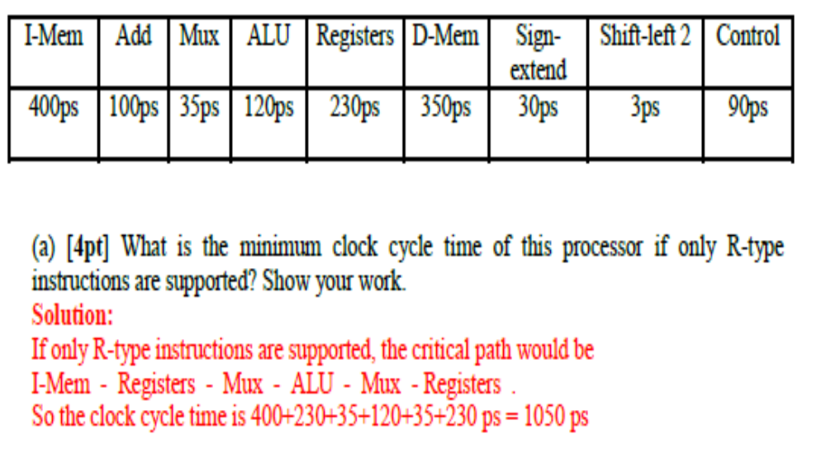

Slide 56
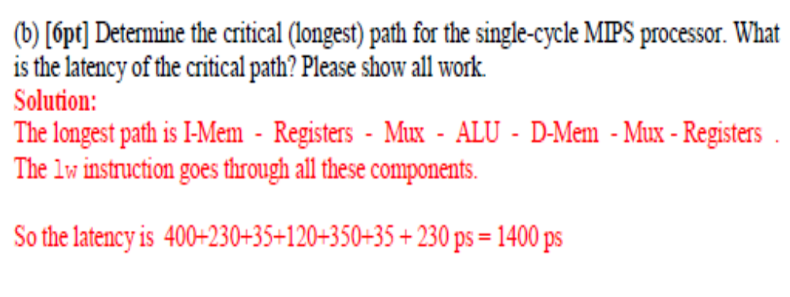

Slide 57
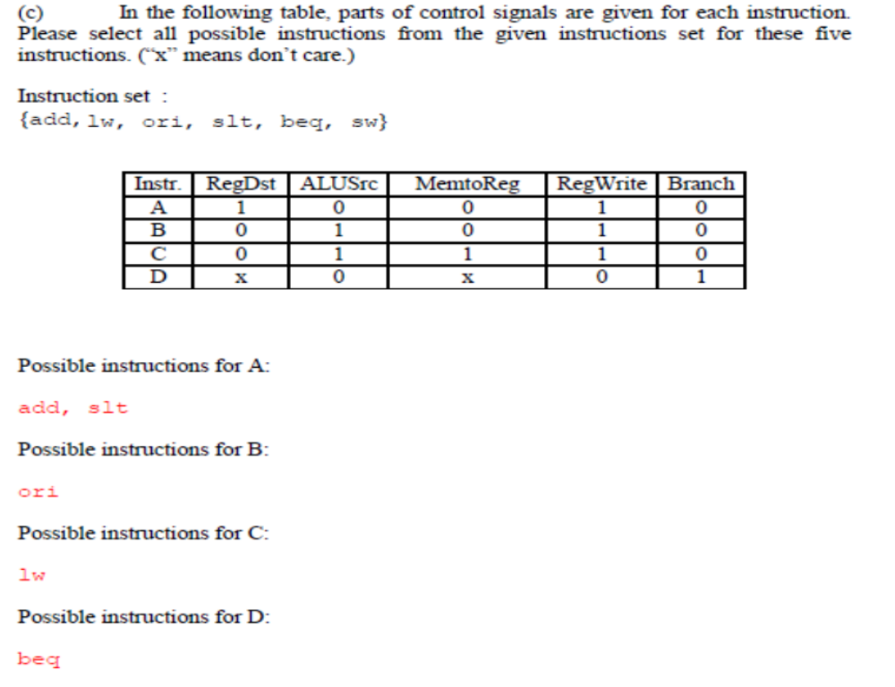

Slide 58
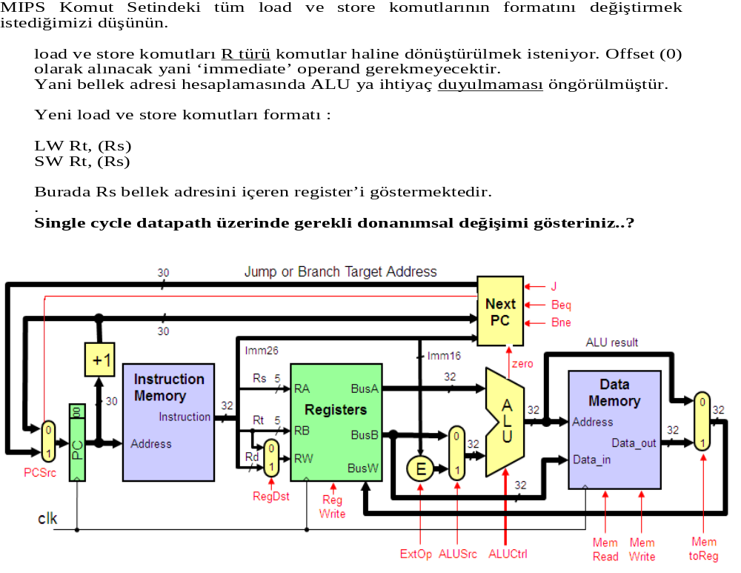

Slide 59
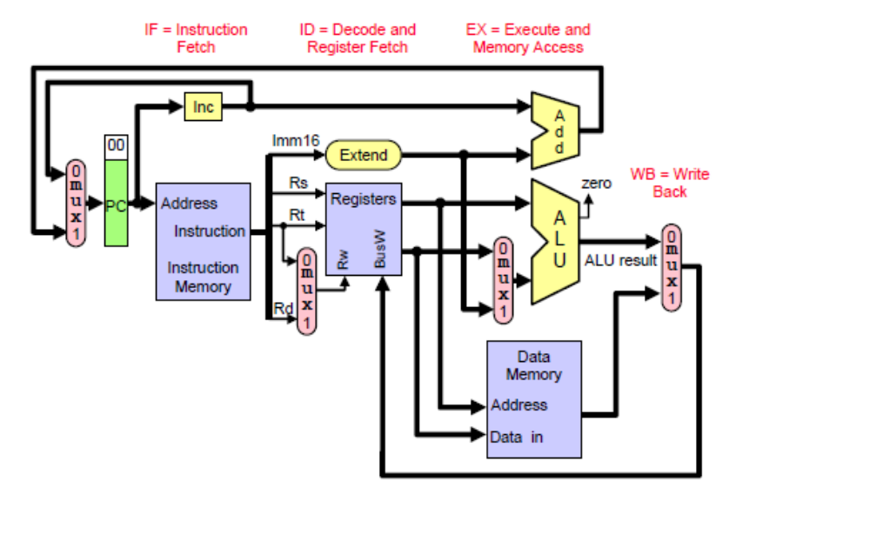

Slide 60
