Slide 1
Computer Architecture
Designing a Multiple Cycle Processor
Notes:
Start X:40

Slide 2
Outline of Today’s Lecture
Introduction to the Concept of Multiple Cycle Processor
Multiple Cycle Implementation of R-type Instructions
What is a Multiple Cycle Delay Path?
Multiple Cycle Implementation of Or Immediate
Multiple Cycle Implementation of Load and Store
Putting it all Together
Notes:
In the next fifteen minutes or so, I will give you an introduction to the concept of multiple cycle processor implementation.
Then I will show you how to build a datapath for a multiple cycle processor by looking at what needs to be done for the different MIPS instructions.
I will also show you a phenomenon called multiple cycle delay path and how to avoid them.
Finally, I will summarize what we learned.
The list of things we want to cover today is long so let’s get on with today’s lecture.
+1 = 6 min. (X:46)

Slide 3
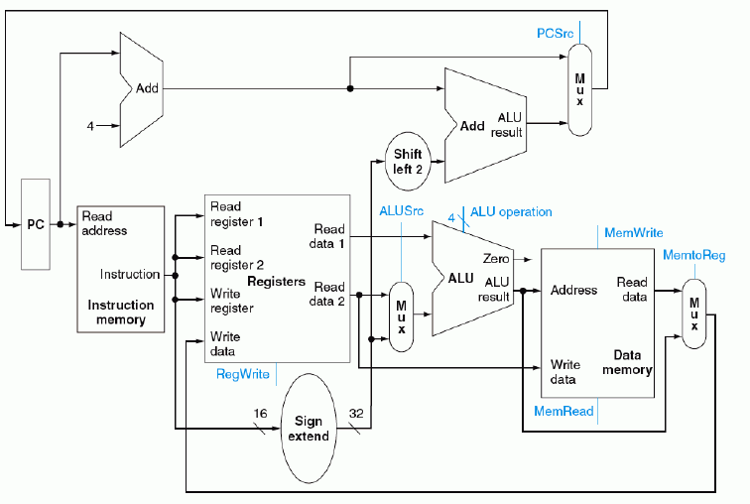

Single cycle Datapath

Slide 4
What’s wrong with our CPI=1 processor?
Arithmetic & Logical
PC
Inst Memory
Reg File
mux
ALU
mux
setup
Load
PC
Inst Memory
Reg File
mux
ALU
Data Mem
mux
setup
Critical Path
Store
PC
Inst Memory
Reg File
mux
ALU
Data Mem
Branch
PC
Inst Memory
Reg File
cmp
mux
Long Cycle Time
All instructions take as much time as the slowest
Real memory is not so nice as our idealized memory
  cannot always get the job done in one (short) cycle

Slide 5
Drawbacks of this Single Cycle Processor
Long cycle time:
  Cycle time must be long enough for the load instruction:
    PC’s Clock -to-Q +
    Instruction Memory Access Time +
    Register File Access Time +
    ALU Delay (address calculation) +
    Data Memory Access Time +
    Register File Setup Time +
    Clock Skew
Cycle time is much longer than needed for all other instructions. Examples:
  R-type instructions do not require data memory access
  Jump does not require ALU operation nor data memory access
Notes:
One of the biggest disadvantage of the single cycle implementation: it has a long cycle time.
More specifically, the cycle time must be long enough for the load instruction which has the following seven components:
(1) Clock to Q time of the Program Counter. (2) Instruction Memory Access Time.
(3) Register File Access Time. (4) ALU delay to perform a 32-bit address calculation.
(5) Data Memory Access Time
(6) And finally the Set Up time for Register File Write and (7) Potential Clock Skew.
Having a long cycle time is a big problem but not the the only problem.
Another problem is that this cycle time (point to the list), which is long enough for the load instruction, is too long for all other instructions. For example:
(1) The R-type instruction does not need to have a cycle time as long as the load
instruction because the R-type instructions do not require any data memory access.
(2) Similarly, the Jump instruction does not need a cycle time this long because the Jump
does not require any data memory access nor ALU operation.
Consequently, for the R-type and Jump instruction, the processor is actually doing nothing at the last part of the clock cycle.
+2 = 8 min. (X:48)

Slide 6
Overview of a Multiple Cycle Implementation
The root of the single cycle processor’s problems:
  The cycle time has to be long enough for the slowest instruction
Solution:
  Break the instruction into smaller steps
  Execute each step (instead of the entire instruction) in one cycle
    Cycle time: time it takes to execute the longest step
    Keep all the steps to have similar length
  This is the essence of the multiple cycle processor
The advantages of the multiple cycle processor:
  Cycle time is much shorter
  Different instructions take different number of cycles to complete
    Load takes five cycles
    Jump only takes three cycles
  Allows a functional unit to be used more than once per instruction
Notes:
Well, the root of these problems of course is that fact that the Single Cycle Processor’s cycle time has to be long enough for the slowest instruction.
The solution is simple. Just break the instruction into smaller steps and instead of executing an entire instruction in one cycle, we will execute each of these steps in one cycle.
Since the cycle time in this case will be the time it takes to execute the longest step, our goal should be keeping all the steps to have similar length when we break up the instruction.
Well the last two bullets pretty much summarize what a multiple cycle processor is all about.
The first advantage of the multiple cycle processor is of course shorter cycle time. The cycle time now only has to be long enough to execute the longest step.
But may be more importantly, now different instructions can take different number of cycles to complete. For example:
(1) The load instruction will take five cycles to complete.
(2) But the Jump instruction will only take three cycles.
This feature greatly reduce the idle time inside the processor.
Finally, the multiple cycle implementation allows a functional unit to be used more than once per instruction as long as it is used on different clock cycles.
For example, as I will show you later in today’s lecture, we can use the ALU to increment the Program Counter as well as doing address calculation.
+3 = 11 min. (X:51)

Slide 7
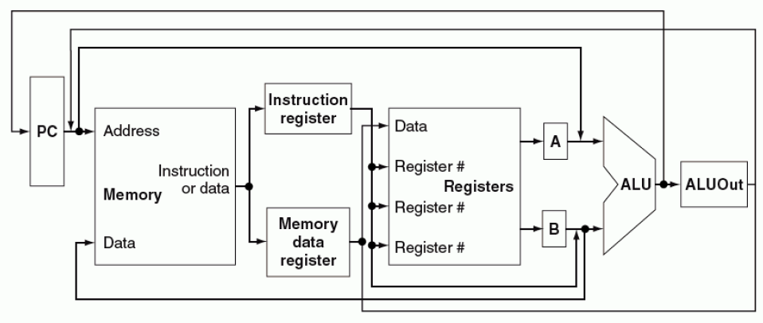
Multi-cyle MIPS Datapath Design

Slide 8
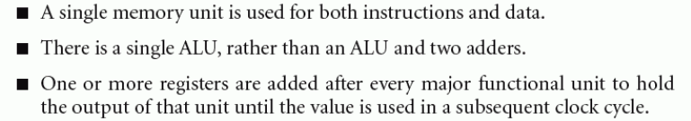
Basic differences from single cycle datapath

Slide 9
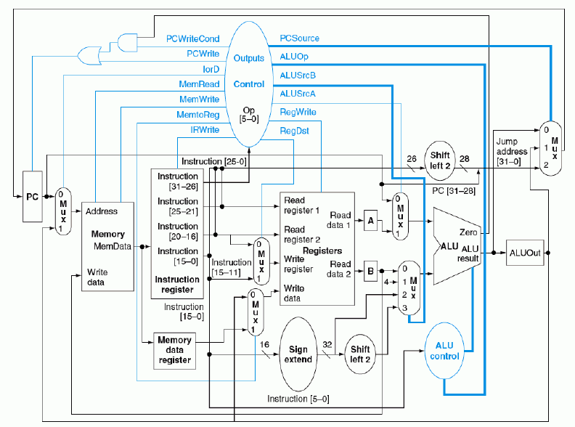

Slide 10
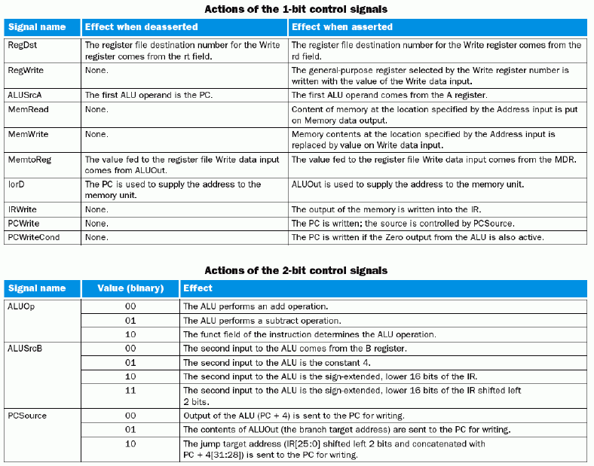

Slide 11
The Five Steps of a Load Instruction
Instruction Fetch
Instr Decode /
Address
Data Memory
Reg Wr
Reg. Fetch
Clk
Clk-to-Q
PC
Old Value
New Value
Instruction Memory Access Time
Rs, Rt, Rd,
Op, Func
Old Value
New Value
Delay through Control Logic
ALUctr
Old Value
New Value
ExtOp
Old Value
New Value
ALUSrc
Old Value
New Value
RegWr
Old Value
New Value
Register File Access Time
busA
Old Value
New Value
Delay through Extender & Mux
Register File Write Time
busB
Old Value
New Value
ALU Delay
Address
Old Value
New Value
Data Memory Access Time
busW
Old Value
New
Notes:
Well let’s take a look at the Load instruction’s timing diagram and see how we can break it up into smaller steps. The biggest contributors to the cycle time appears to be:
(1) Instruction Memory Access Time.
(2) Delay through the Control Logic, which happens in parallel with Register File Access.
(3) ALU Delay.
(4) Data Memory Access Time.
(5) And Register File Write Time.
Therefore, it makes sense to break up the Load instructions into these five steps:
(1) Instruction Fetch.
(2) Instruction Decode “slash” Register Fetch.
(3) Memory Address Calculation.
(4) Data Memory Access.
(5) And finally, Register File Write.
Notice that here I have used the term Register File Write time instead of Register File Write Setup time. The reason is that in a “real” register file, there is no such thing as set up time.
+2 = 13 min. (X:53)

Slide 12
Dual-Port Ideal Memory
Dual Port Ideal Memory
  Independent Read (RAdr, Dout) and Write (WAdr, Din) ports
  Read and write (to different location) can occur at the same cycle
Read Port is a combinational path:
  Read Address Valid -->
  Memory Read Access Delay -->
  Data Out Valid
Write Port is also a combinational path:
  MemWrite = 1 -->
  Memory Write Access Delay -->
  Data In is written into location[WrAdr]
MemWr
00
RAdr<1:0>
<31:2>
30
Ideal
Memory
32
WrAdr
Din
Dout
32
32
Notes:
One important feature of the multiple cycle implementation is that a functional unit can be used more than once per instruction as long as it is used on different clock cycles.
The Ideal Memory is one such unit which our multiple cycle processor will use more than once per instruction. More specifically ...
Unlike the single processor which has separate Instruction and Data memory, the Multiple Cycle Implementation will only have 1 memory unit where instructions and data are stored.
In order to keep things conceptually simple, the Ideal Memory will have independent Read port (Read Address and Data Out) and Write port (Write Address and Data In).
That is, if we put an address on the Read Address inputs, the Data Out bus will be valid after the Memory Read Access Delay time.
On the other hand, if you put an address on the Write Address inputs and THEN assert the Write Enable signal, the value on the Data In bus will be written into memory location specified by the address after the Memory Write Access Delay Time.
+2 = 20 min. (Y:00)

Slide 13




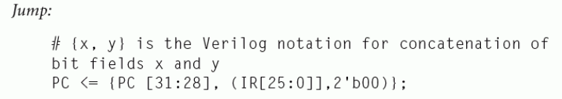

MIPS Instruction Cycles

Slide 14
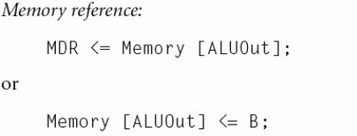



Slide 15
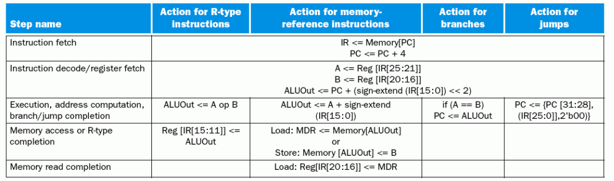

Slide 16
Instruction Fetch Cycle: In the Beginning
Every cycle begins right AFTER the clock tick:
  mem[PC] PC<31:0> + 4
Clk
One “Logic” Clock Cycle
You are here!
PCWr=?
PC
32
MemWr=?
IRWr=?
32
ALU
32
Clk
RAdr
4
32
32
Ideal
Memory
Instruction Reg
ALU
Control
WrAdr
32
32
Dout
Din
32
ALUop=?
32
Clk
Notes:
As far as LOGIC is concerned, I think the easiest way to think about a clock cycle is that a clock cycle begins right AFTER a clock tick and ends at the next clock tick.
I have intentionally shown the L time to be much longer than the H time to emphasis a point: the H and L time does not affect your design as long as you use the simple clocking methodology where all storage elements are triggered at the same clock tick.
The only important thing here is the time between the two clock ticks, the cycle time.
Most of the time, however, the high and low time are the same because it is much easier to generate a clock that has high and low time the same length. Well enough about clock ticks.
Let’s see what happens at the beginning (You are Here) of the Ifetch cycle:
(a) We need to fetch the instruction from Memory so we sent the address to the memory.
(b) We also needs to update the PC so we better send the address to the ALU as well.
***** What values do you think the control signals PCwr and ALUop have at this point?
Well since we are only at the beginning of the cycle (Your are Here), these two signals will still have the old values from the last cycle of the previous value.
+2 = 27 min. (Y:07)

Slide 17
Instruction Fetch Cycle: The End
Every cycle ends AT the next clock tick (storage element updates):
  IR <-- mem[PC] PC<31:0> <-- PC<31:0> + 4
Clk
One “Logic” Clock Cycle
You are here!
PCWr=1
PC
32
MemWr=0
IRWr=1
32
00
ALU
32
Clk
RAdr
4
32
32
Ideal
Memory
Instruction Reg
ALU
Control
32
32
WrAdr
Din
Dout
32
32
ALUOp = Add
Clk
Notes:
As time goes by, the output of the memory will become valid and the ALU, with ALUOp sets to Add, will finish the 32-bit add.
Hopefully, we are smart enough to set the cycle time so the time between the clock tick is long enough to allow these (output of Memory and ALU) to stabilize.
So at the end of the cycle, the clock tick will trigger the Instruction Register to save the current instruction word (output of Instruction Memory).
Similarly, the Program Counter register is triggered (point to the clock input) to save the next instruction’s address (output of ALU).
Unlike the single cycle processor where a 30-bit PC can reduce the length of two adders by two bits, here we are using the 32-bit ALU to do the PC update anyway.
So the only saving we can get for using a 32 bit PC are two register bits. That’s why we didn’t bother to do it and keep a 32-bit Program Counter.
The Memory Unit here is also used to store data and the ALU here is also use for instruction execution. Therefore, we know we will need some MUXes in front of them.
+2 = 29 min. (Y:09)

Slide 18
Instruction Fetch Cycle: Overall Picture
Ifetch
ALUOp=Add
1: PCWr, IRWr
x: PCWrCond
RegDst, Mem2R
Others: 0s
PCWr=1
PCWrCond=x
PCSrc=0
BrWr=0
Zero
IorD=0
MemWr=0
IRWr=1
ALUSelA=0
1
Target
Mux
32
PC
32
32
0
0
Zero
0
Mux
32
Mux
RAdr
32
busA
1
ALU
32
Ideal
Memory
Instruction Reg
32
1
4
0
WrAdr
32
32
32
Din
Dout
busB
32
1
32
32
2
ALU
Control
3
ALUSelB=00
ALUOp=Add
Notes:
For example, the Memory can get its read address from the PC for instruction fetch but it can also get the read address from other part of the datapath for data fetch.
Similarly, the ALU can get its operands from the PC and a constant 4 as I showed you on the last slide, but we know the ALU can also gets its operands from the register file.
We will fill in the details here (Hole) later but for now, we know we need to set the control signals IorD, MemWr, ALUSelA, ALUSelB to zeros and IRWr and PCWr to 1s.
Notice that I have added a MUX in the PC feedback path because we know for the branch instruction, the next PC will have a value OTHER than PC plus 4 (ALU inputs).
We will worry about how we get this “other” value (Target) later. For this cycle, we have to set the MUX control (PCSrc) to zero to select the PC plus 4 value.
The settings of all the control signals are summarized in this circle. Due to space limitation, I have only shown the signals that have values other than zeros.
I want to emphasis that this is the picture at the END of the Instruction Fetch Cycle where evaluation is completed and control signals are settled.
This is the interesting part. The start of the cycle is boring by comparison. Consequently, all the datapath pictures I show from now on are the pictures at end of a cycle.
+2 = 31 min. (Y:11)

Slide 19
Register Fetch / Instruction Decode
busA <- RegFile[rs] ; busB <- RegFile[rt] ;
ALU is not being used: ALUctr = xx
PCWr=0
PCWrCond=0
Zero
PCSrc=x
IorD=x
MemWr=0
IRWr=0
RegDst=x
RegWr=0
ALUSelA=x
1
Mux
32
PC
32
32
0
0
Zero
Rs
Mux
0
Ra
32
Mux
RAdr
Rt
5
32
32
Rb
busA
1
ALU
32
Ideal
Memory
Instruction Reg
5
Reg File
32
1
Rt
0
4
0
WrAdr
32
Mux
Rw
32
32
Din
Dout
Rd
busW
busB
32
1
32
32
1
2
3
ALU
Control
Go to the
Control
Op
6
Imm
ALUSelB=xx
Func
6
16
ALUOp=xx
Notes:
Now that we have the instruction word saved in the IR, the next thing we can do is decode the instruction (Go to the Control) and fetch the registers from the Register file (Rs Rt).
I want to point out at this point, we do not know what instruction we have yet because we are still in the process of decoding the Op and Func field.
Therefore we are “jumping the gun” in fetching the registers Rs and Rt from the register file. The Rt field may not even be a source register if we have a I-type instruction.
But this is OK because if after we decode the instruction, we realize we don’t need the registers, we just don’t use them. No big deal.
Notice that the ALU is not being used in this cycle. That is not good. Instead of just letting the ALU sits idle, we may just as well let it do something.
***** Can we think of anyway we can use this ALU at this cycle?
We cannot do the use the ALU to do anything involves the registers because we are still in the process of reading them-we do not have the register values yet.
+2 = 33 min. (X:13)

Slide 20
Register Fetch / Instruction Decode (Continue)
Rfetch/Decode
busA <- Reg[rs] ; busB <- Reg[rt] ;
Target <- PC + SignExt(Imm16)*4
ALUOp=Add
1: BrWr, ExtOp
ALUSelB=10
x: RegDst, PCSrc
IorD, MemtoReg
PCWr=0
PCWrCond=0
Others: 0s
Zero
PCSrc=x
BrWr=1
IorD=x
MemWr=0
IRWr=0
RegDst=x
RegWr=0
ALUSelA=0
1
Target
Mux
32
PC
32
32
0
0
Zero
Rs
Mux
0
Ra
32
Mux
RAdr
Rt
5
32
32
Rb
busA
1
ALU
32
Ideal
Memory
Instruction Reg
5
Reg File
32
1
Rt
0
4
0
WrAdr
32
Mux
Rw
32
32
Din
Dout
Rd
busW
busB
32
1
32
32
1
2
3
ALU
Control
<< 2
Beq
Control
Rtype
Op
Imm
6
ALUSelB=10
Ori
Func
Extend
Memory
6
16
32
ALUOp=Add
:
ExtOp=1
Notes:
What we can do is to use this ALU to calculate the branch address in advance.
(1) We will set ALUSelA to 0 such that the PC is fed to the ALU input.
(2) The other ALU input will come from (ALUSelB=10) the Sign Extended (ExtOp=1)
version of the 16-bit immediate filed.
Once we added (ALUOp = Add) these two numbers together, we will save the result in the Target register (BrWr = 1). We cannot write the ALU output to the PC yet (PCWr = 0).
The OP and Func is still being decode in this cycle (Control) so we cannot update the PC to this value unless we are SURE we have a branch and the branch condition is met (AND-OR).
Once again, I have summarized all the control signals settings inside this circle. So far this and the Instruction Fetch cycles are shared by all instructions.
But by the end of this cycle, we will know exactly what instruction we have (Control output). Let’s say, we have a branch, what do we do?
+2 = 35 min. (Y:15)

Slide 21
Branch Completion
BrComplete
if (busA == busB)
  PC <- Target
ALUOp=Sub
ALUSelB=01
x: IorD, Mem2Reg
RegDst, ExtOp
1: PCWrCond
PCWr=0
PCWrCond=1
ALUSelA
PCSrc
PCSrc=1
BrWr=0
Zero
IorD=x
MemWr=0
IRWr=0
RegDst=x
RegWr=0
ALUSelA=1
1
Target
Mux
32
PC
32
32
0
0
Zero
Rs
Mux
0
Ra
32
Mux
RAdr
Rt
5
32
32
Rb
busA
1
ALU
32
Ideal
Memory
Instruction Reg
5
Reg File
32
1
Rt
0
4
0
WrAdr
32
Mux
Rw
32
32
Din
Dout
Rd
busW
busB
32
1
32
32
1
2
3
ALU
Control
<< 2
Imm
ALUSelB=01
Extend
16
32
ALUOp=Sub
ExtOp=x
Notes:
We already have the values of registers Rs and Rt on busA and busB from last cycle, all we have to do is perform a Subtract (ALUOp) to compare them (ALUSelA, B).
If they are equal, the ALU’s Zero output will be asserted, and with PCSrc and PCCond set to one, the Branch Target will get written into the Program Counter. The Branch is taken.
If Rs and Rt are not equal, Zero will not be asserted and the Target value will NOT be written into the Program Counter. That is the Branch is NOT taken.
Since I am running out of space in this circle, I did not say it explicitly but all control signals not specified in this circle are default to zeros (point to the datapath for examples).
+1 = 36 min. (Y:16)

Slide 22
Instruction Decode: We have a R-type!
Next Cycle: R-type Execution
PCWr=0
PCWrCond=0
Zero
PCSrc=x
BrWr=1
IorD=x
MemWr=0
IRWr=0
RegDst=x
RegWr=0
ALUSelA=0
1
Target
Mux
32
PC
32
32
0
0
Zero
Rs
Mux
0
Ra
32
Mux
RAdr
Rt
5
32
32
Rb
busA
1
ALU
32
Ideal
Memory
Instruction Reg
5
Reg File
32
1
Rt
0
4
0
WrAdr
32
Mux
Rw
32
32
Din
Dout
Rd
busW
busB
32
1
32
32
1
2
3
ALU
Control
<< 2
Beq
Control
Rtype
Op
Imm
6
ALUSelB=10
Ori
Func
Extend
Memory
6
16
32
ALUOp=Add
:
ExtOp=1
Notes:
Let’s go back to the end of the Register Fetch slash Instruction Decode Cycle.
Assume the result of the Instruction Decode indicates we have a R-type instruction, what do we do then? Well, simple enough: we just go to the R-type execution cycle.
+1 = 37 min. (Y:17)

Slide 23
R-type Execution
RExec
1: RegDst
ALUSelA
ALU Output <- busA op busB
ALUSelB=01
ALUOp=Rtype
x: PCSrc, IorD
PCWr=0
PCWrCond=0
MemtoReg
PCSrc=x
BrWr=0
ExtOp
Zero
IorD=x
MemWr=0
IRWr=0
RegDst=1
RegWr=0
ALUSelA=1
1
Target
Mux
32
PC
32
32
0
0
Zero
Rs
Mux
0
Ra
32
Mux
RAdr
Rt
5
32
32
Rb
busA
1
ALU
32
Ideal
Memory
Instruction Reg
5
Reg File
32
1
Rt
0
4
0
WrAdr
32
Mux
Rw
32
32
Din
Dout
Rd
busW
busB
32
1
32
32
1
2
1
Mux
0
3
ALU
Control
<< 2
Imm
Extend
16
32
ALUOp=Rtype
ExtOp=x
MemtoReg=x
ALUSelB=01
Notes:
Once again, fetching the registers Rs and Rt in the previous cycle pays off. We need these two registers now and they are already on busA and busB, respectively.
So all we need is set the ALUSelA and ALUSelB to feed busA and busB into the ALU and tell the ALU local control we have a R-type instruction (ALUOp).
The ALU will then generate the correct result (ALU output) at the end of this cycle.
Notice that I have set RegDst to 1 here even though we are not writing the register file (RegWr is zero). Register file is not written until the next cycle.
You would think RegDst should be don’t care at this point.
****** Anybody want to guess why I set RegDst to 1 at this point?
Remember: for this Real memory and register file that do not have a clock input , the address (Rw) MUST be stable BEFORE we set Write Enable (RegWr) to one.
Here by setting RegDst to one, I can guarantee the Rw specifier will be stable by the next clock cycle where I will perform the write by setting RegWr to 1.
+2 = 39 min. (Y:19)

Slide 24
R-type Completion
Rfinish
ALUOp=Rtype
R[rd] <- ALU Output
1: RegDst, RegWr
ALUselA
ALUSelB=01
PCWr=0
PCWrCond=0
x: IorD, PCSrc
PCSrc=x
BrWr=0
ExtOp
Zero
IorD=x
MemWr=0
IRWr=0
RegDst=1
RegWr=1
ALUSelA=1
1
Target
Mux
32
PC
32
32
0
0
Zero
Rs
Mux
0
Ra
32
Mux
RAdr
Rt
5
32
32
Rb
busA
1
ALU
32
Ideal
Memory
Instruction Reg
5
Reg File
32
1
Rt
0
4
0
WrAdr
32
Mux
Rw
32
32
Din
Dout
Rd
busW
busB
32
1
32
32
1
2
1
Mux
0
3
ALU
Control
<< 2
Imm
Extend
16
32
ALUOp=Rtype
ExtOp=x
MemtoReg=0
ALUSelB=01
Notes:
So here is the picture where we finish off the R-type instruction by writing the ALU output back to the register file (MemtoReg=0 and RegWr = 1).
Notice that in order to keep the ALU output from changing, the ALUSelA, ALUSelB, and ALUOp control signals must remain the same as the previous cycle.
This brings us to a side topic I want to cover.
+1 = 40 min. (Y:20)

Slide 25
A Multiple Cycle Delay Path
There is no register to save the results between:
  Register Fetch: busA <- Reg[rs] ; busB <- Reg[rt]
  R-type Execution: ALU output <- busA op busB
  R-type Completion: Reg[rd] <- ALU output
Register here to save
outputs of Rfetch?
ALUselA
PCWr
0
Register here to save
outputs of RExec?
Rs
Mux
Zero
Ra
Rt
5
busA
1
32
32
Rb
ALU
Instruction Reg
0
5
Reg File
32
4
Rt
0
Mux
Rw
32
Rd
busW
busB
32
1
32
1
2
1
Mux
0
3
ALU
Control
ALUselB
ALUOp
Notes:
The side topic I want to cover in the next few minutes is called Multiple Cycle Delay Path.
Looking back at the Register Fetch, R-type Execution, and R-type Completion cycles, you will notice that there is no registers in between the cycles to save the results.
That is, at the end of the Register Fetch cycle, registers Rs and Rt are placed on busA and busB but we do not have a registers on busA and busB to save them.
They just sit on the bus and wait until the next cycle, the R-type Execution cycle, when they propagate through the MUXes and into the ALU inputs.
By the end of the R-type Execution cycle, the ALU output is valid and once again, the value is not saved in a register. It just sits there and wait until the R-type Completion cycle begins.
Registers are not needed to save the values of busA and bus B because IRWr is zero so busA and bus B will not change after the Register Fetch cycle.
Similarly, a register is not needed to save the ALU output at the end of the R-type execution cycle because:
(1) We already established that Bus A and busB will not change the values.
(2) And with control signals ALUSelA, ALUSelB, and ALUOp remains constant.
(3) ALU output will not change its value during the R-type completion stage.
+3 = 43 min. (Y:23)

Slide 26
A Multiple Cycle Delay Path (Continue)
Register is NOT needed to save the outputs of Register Fetch:
  IRWr = 0: busA and busB will not change after Register Fetch
Register is NOT needed to save the outputs of R-type Execution:
  busA and busB will not change after Register Fetch
  Control signals ALUSelA, ALUSelB, and ALUOp
  will not change after R-type Execution
  Consequently ALU output will not change after R-type Execution
In theory (P. 316, P&H), you need a register to hold a signal value if:
  The signal is computed in one clock cycle and used in another.
Notes:
In theory, you ONLY need a register to hold a signal value if:
(1) The signal is computed in one clock cycle and used in another.
(2) AND the inputs to the functional block that computes this signal can change before this
this signal can change before this signal is written into a state element.
In other words, you do not need register even if Cond 1 is true as long as Cond 2 is not true.
That is as long as the input to the functional element that compute the signal does not change, we do not need a register to save its output. This is the case in our example here.
However in practice, if you do not use a register to save a signal’s value when Cond 1 is true, you will introduce a multiple cycle delay path into your design.
By definition, a Multiple Cycle Delay path is a COMBINATIONAL logic delay path that takes multiple cycles to propagate from one storage element to the next storage element.
Let me show you what I mean by this.
+2 = 45 min. (Y:25)

Slide 27
Instruction Decode: We have an Ori!
Next Cycle: Ori Execution
PCWr=0
PCWrCond=0
Zero
PCSrc=x
BrWr=1
IorD=x
MemWr=0
IRWr=0
RegDst=x
RegWr=0
ALUSelA=0
1
Target
Mux
32
PC
32
32
0
0
Zero
Rs
Mux
0
Ra
32
Mux
RAdr
Rt
5
32
32
Rb
busA
1
ALU
32
Ideal
Memory
Intruction Reg
5
Reg File
32
1
Rt
0
4
0
WrAdr
32
Mux
Rw
32
32
Din
Dout
Rd
busW
busB
32
1
32
32
1
2
3
ALU
Control
<< 2
Beq
Control
Rtype
Op
Imm
6
ALUSelB=10
Ori
Func
Extend
Memory
6
16
32
ALUOp=Add
:
ExtOp=1
Notes:
Let’s go back to the end of the Register Fetch slash Instruction Decode Cycle.
Assume the result of the Instruction Decode indicates we have a OR immediate instruction, what do we do then? Well, we go to the OR immediate execution cycle.
+1 = 56 min. (Y:36)

Slide 28
Ori Execution
ALUOp=Or
OriExec
ALU output <- busA or ZeroExt[Imm16]
1: ALUSelA
ALUSelB=11
x: MemtoReg
IorD, PCSrc
PCWr=0
PCWrCond=0
PCSrc=x
BrWr=0
Zero
IorD=x
MemWr=0
IRWr=0
RegDst=0
RegWr=0
ALUSelA=1
1
Target
Mux
32
PC
32
32
0
0
Zero
Rs
Mux
0
Ra
32
Mux
RAdr
Rt
5
32
32
Rb
busA
1
ALU
32
Ideal
Memory
Instruction Reg
5
Reg File
32
1
Rt
0
4
0
WrAdr
32
Mux
Rw
32
32
Din
Dout
Rd
busW
busB
32
1
32
32
1
2
1
Mux
0
3
ALU
Control
<< 2
Imm
Extend
16
32
ALUOp=Or
ExtOp=0
MemtoReg=x
ALUSelB=11
Notes:
The first operand of OR immediate comes from register Rs. It is already on busA so we just set ALUSelA to 1.
The second operand, on the other hand, does NOT come from Rt. It comes from the Zero Extended (ExtOp = 0) version of the immediate field (ALUSelB = 11).
Once we have the operands, all we have to do is to ask the ALU to OR (ALUop) them together and the ALU output will have the correct result at the end of this cycle.
Notice that I have set RegDst to zero so the Rt field of the instruction word will be stable at Register File’s Rw address port before the next cycle.
What do we do in the next cycle?
+2 = 58 min. (Y:38)

Slide 29
Ori Completion
OriFinish
ALUOp=Or
Reg[rt] <- ALU output
x: IorD, PCSrc
ALUSelB=11
1: ALUSelA
PCWr=0
PCWrCond=0
RegWr
PCSrc=x
BrWr=0
Zero
IorD=x
MemWr=0
IRWr=0
RegDst=0
RegWr=1
ALUSelA=1
1
Target
Mux
32
PC
32
32
0
0
Zero
Rs
Mux
0
Ra
32
Mux
RAdr
Rt
5
32
32
Rb
busA
1
ALU
32
Ideal
Memory
Instruction Reg
5
Reg File
32
1
Rt
0
4
0
WrAdr
32
Mux
Rw
32
32
Din
Dout
Rd
busW
busB
32
1
32
32
1
2
1
Mux
0
3
ALU
Control
<< 2
Imm
Extend
16
32
ALUOp=Or
ExtOp=0
MemtoReg=0
ALUSelB=11
Notes:
Well we do a register write (RegWr=1).
Once again, I have set up the register write address Rw in advance (RegDst = 0) during the previous cycle so I can guarantee Rw is stable when I assert RegWr in this cycle.
Also, remember we have a multiple cycle delay path from the Instruction Register to the Register File Write Port.
Therefore, IRWr must be 0 and ALUSelA & B, and ALUOp must remain the same as the previous cycle in order to guarantee ALU output to be stable during register write.
+1 = 59 min. (Y:39)

Slide 30
Memory Address Calculation
AdrCal
1: ExtOp
ALUSelA
ALUSelB=11
ALU output <- busA + SignExt[Imm16]
ALUOp=Add
x: MemtoReg
PCSrc
PCWr=0
PCWrCond=0
PCSrc=x
BrWr=0
Zero
IorD=x
MemWr=0
IRWr=0
RegDst=x
RegWr=1
ALUSelA=1
1
Target
Mux
32
PC
32
32
0
0
Zero
Rs
Mux
0
Ra
32
Mux
RAdr
Rt
5
32
32
Rb
busA
1
ALU
32
Ideal
Memory
Instruction Reg
5
Reg File
32
1
Rt
0
4
0
WrAdr
32
Mux
Rw
32
32
Din
Dout
Rd
busW
busB
32
1
32
32
1
2
1
Mux
0
3
ALU
Control
<< 2
Imm
Extend
16
32
ALUOp=Add
ExtOp=1
MemtoReg=x
ALUSelB=11
Notes:
How do we calculate the memory address?
Simple, we have to add the contents of register Rs (busA) to the Sign Extended (ExtOp=1) version of the Immediate field (ALUSelB = 11).
With the ALUOp set to add, the memory address will be valid at the ALU output by the end of this cycle.
Let’s say we do have a store instruction and see what happens next.
+1 = 61 min. (Y:41)

Slide 31
Memory Access for Store
1: ExtOp
SWmem
MemWr
ALUSelA
ALUSelB=11
mem[ALU output] <- busB
ALUOp=Add
PCWr=0
PCWrCond=0
x: PCSrc,RegDst
PCSrc=x
BrWr=0
MemtoReg
Zero
IorD=x
MemWr=1
IRWr=0
RegDst=x
RegWr=0
ALUSelA=1
1
Target
Mux
32
PC
32
32
0
0
Zero
Rs
Mux
0
Ra
32
Mux
RAdr
Rt
5
32
32
Rb
busA
1
ALU
32
Ideal
Memory
Instruction Reg
5
Reg File
32
1
Rt
0
4
0
WrAdr
32
Mux
Rw
32
32
Din
Dout
Rd
busW
busB
32
1
32
32
1
2
1
Mux
0
3
ALU
Control
<< 2
Imm
Extend
16
32
ALUOp=Add
ExtOp=1
MemtoReg=x
ALUSelB=11
Notes:
Well, the address is already set up at the Memory’s write address port.
The data is also already available on the Memory’s data port via busB.
Therefore, all we have to do is to set MemWr to 1.
Notice that it is very important that we keep ALUSelA, ALUSelB, and ALUOp the same as the previous cycle, the Memory Address calculation cycle.
Otherwise, if any of these control signals changes during Memory Write, the address will also change because we do not have a register to save the ALU output.
Any changes in the address during this cycle with MemWr = 1 will have catastrophic result. We will end up destroying data stored in memory by writing to the wrong address location.
+2 = 63 min. (Y:43)

Slide 32
Memory Access for Load
LWmem
1: ExtOp
ALUSelA, IorD
ALUSelB=11
Mem Dout <- mem[ALU output]
ALUOp=Add
x: MemtoReg
PCSrc
PCWr=0
PCWrCond=0
PCSrc=x
BrWr=0
Zero
IorD=1
MemWr=0
IRWr=0
RegDst=0
RegWr=0
ALUSelA=1
1
Target
Mux
32
PC
32
32
0
0
Zero
Rs
Mux
0
Ra
32
Mux
RAdr
Rt
5
32
32
Rb
busA
1
ALU
32
Ideal
Memory
Instruction Reg
5
Reg File
32
1
Rt
0
4
0
WrAdr
32
Mux
Rw
32
32
Din
Dout
Rd
busW
busB
32
1
32
32
1
2
1
Mux
0
3
ALU
Control
<< 2
Imm
Extend
16
32
ALUOp=Add
ExtOp=1
MemtoReg=x
ALUSelB=11
Notes:
If after the Memory Address calculation cycle, we realize we have a load.
We then enter the Load Memory Access cycle.
All we have to do is set the control signal IorD to 1 then after the memory read access delay, the data we want will be available at the output of the Ideal Memory (Dout).
Once again, we need to set RegDst to zero in this cycle so Rt will be stabilized at the Register file’s write address port (Rw) before next cycle.
+2 = 45 min. (Y:45)

Slide 33
Write Back for Load
LWwr
1: ALUSelA
RegWr, ExtOp
MemtoReg
Reg[rt] <- Mem Dout
ALUSelB=11
ALUOp=Add
PCWr=0
PCWrCond=0
x: PCSrc
PCSrc=x
BrWr=0
IorD
Zero
IorD=x
MemWr=0
IRWr=0
RegDst=0
RegWr=1
ALUSelA=1
1
Target
Mux
32
PC
32
32
0
0
Zero
Rs
Mux
0
Ra
32
Mux
RAdr
Rt
5
32
32
Rb
busA
1
ALU
32
Ideal
Memory
Instruction Reg
5
Reg File
32
1
Rt
0
4
0
WrAdr
32
Mux
Rw
32
32
Din
Dout
Rd
busW
busB
32
1
32
32
1
2
1
Mux
0
3
ALU
Control
<< 2
Imm
Extend
16
32
ALUOp=Add
ExtOp=1
MemtoReg=1
ALUSelB=11
Notes:
Because in this next cycle, the Write Back cycle, we will write the data from memory (MemtoReg = 1) into the register specified by the Rt field of the instruction.
+1 = 66 min. (Y:46)

Slide 34
Putting it all together: Multiple Cycle Datapath
PCWr
PCWrCond
PCSrc
BrWr
Zero
IorD
MemWr
IRWr
RegDst
RegWr
ALUSelA
1
Target
Mux
32
PC
32
32
0
0
Zero
Rs
Mux
0
Ra
32
Mux
RAdr
Rt
5
32
32
Rb
busA
1
ALU
32
Ideal
Memory
Instruction Reg
5
Reg File
32
1
Rt
0
4
0
WrAdr
32
Mux
Rw
32
32
Din
Dout
Rd
busW
busB
32
1
32
32
1
2
1
Mux
0
3
ALU
Control
<< 2
Imm
Extend
16
32
ALUOp
ExtOp
MemtoReg
ALUSelB
Notes:
Putting it all together, here it is: the multiple cycle datapath we set out to built.
+1 = 47 min. (Y:47)

Slide 35
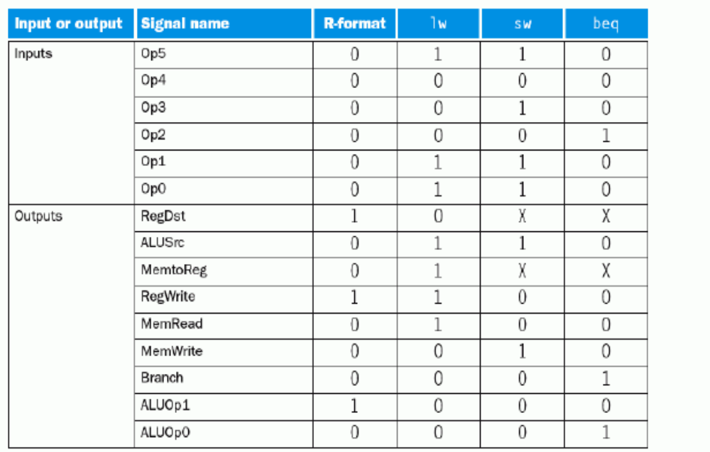

Slide 36
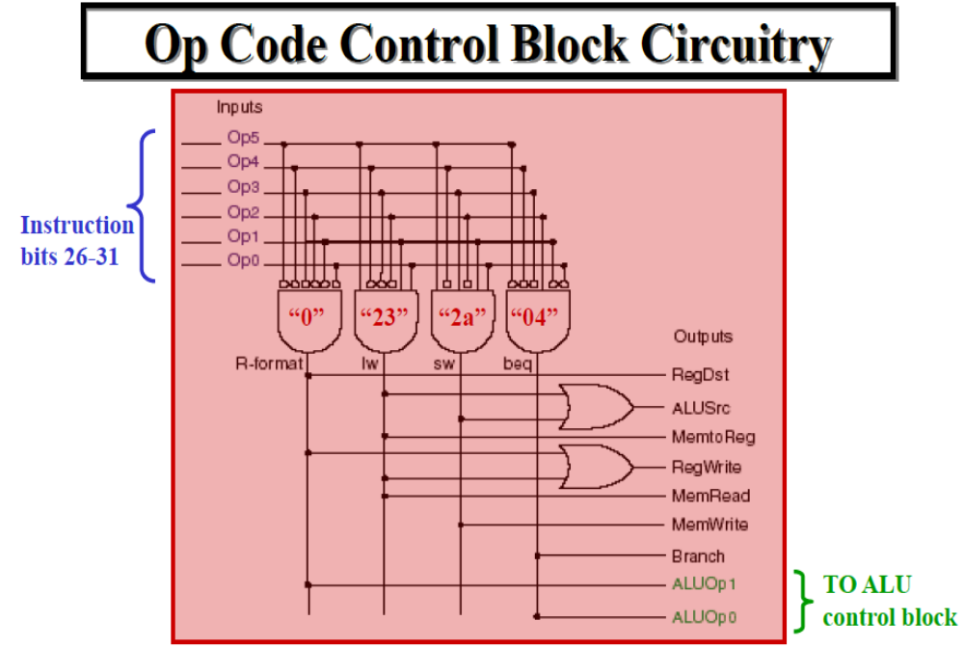

Slide 37
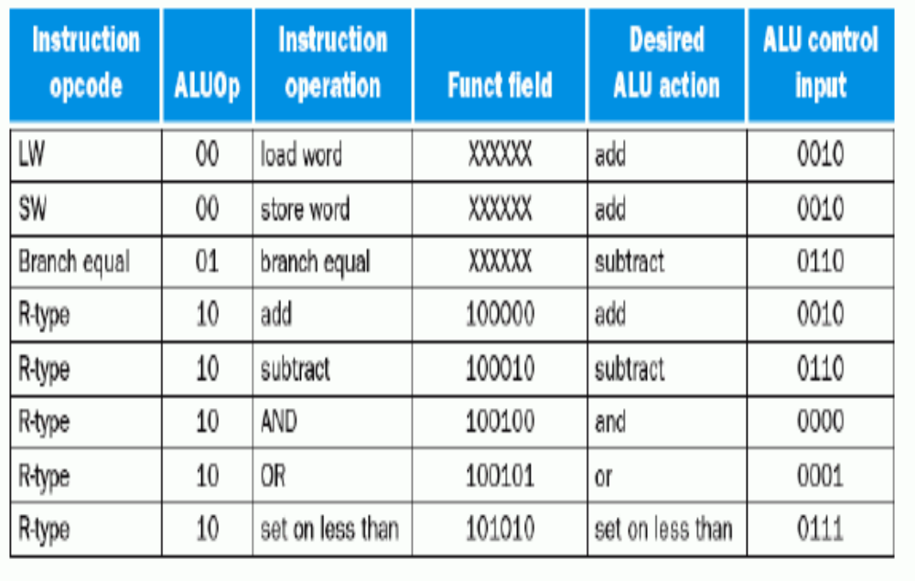

Slide 38
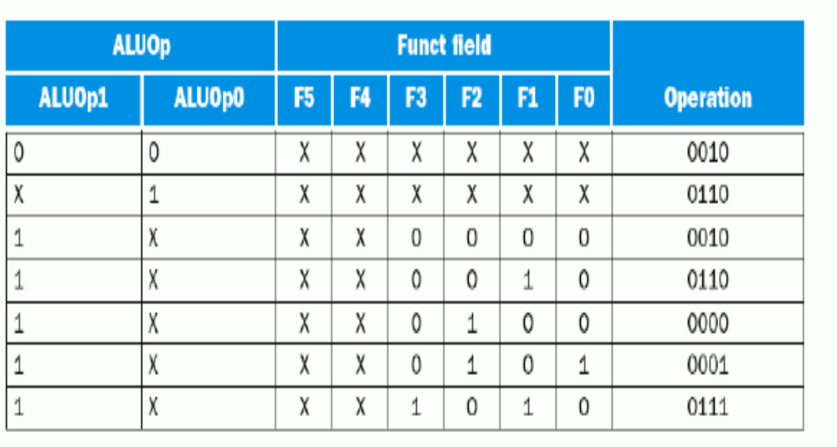

Slide 39
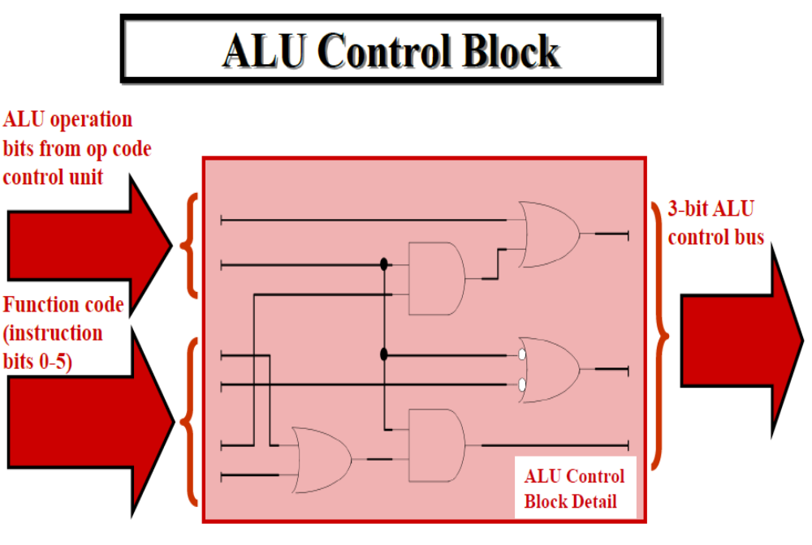

Slide 40
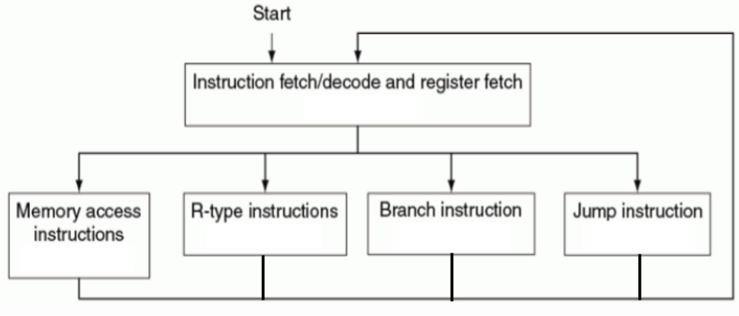

Slide 43
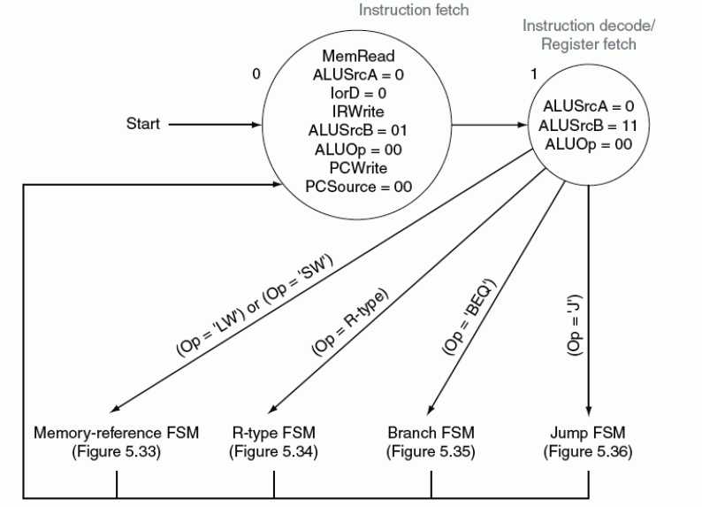

Slide 44
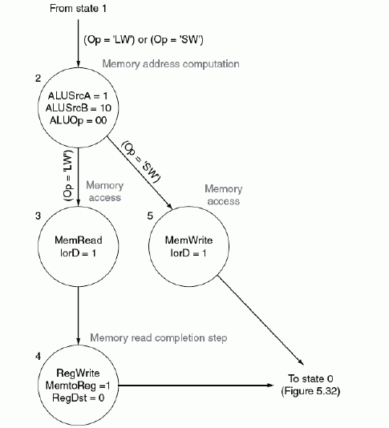

Slide 45
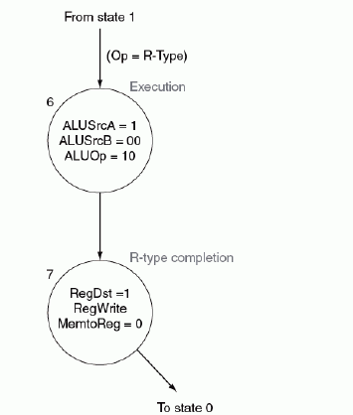

Slide 46
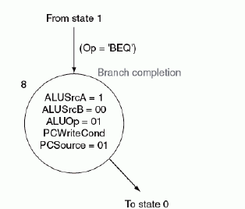
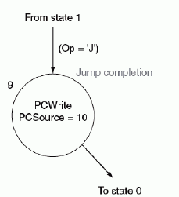

Slide 47
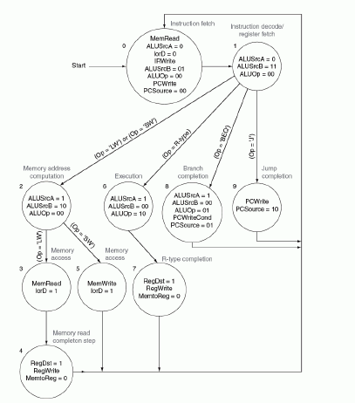

Slide 49
Summary
Disadvantages of the Single Cycle Processor
  Long cycle time
  Cycle time is too long for all instructions except the Load
Multiple Cycle Processor:
  Divide the instructions into smaller steps
  Execute each step (instead of the entire instruction) in one cycle
Do NOT confuse Multiple Cycle Processor with Multiple Cycle Delay Path
  Multiple Cycle Processor executes each
  instruction in multiple clock cycles
  Multiple Cycle Delay Path: a combinational logic path between two storage elements that takes more than one clock cycle to complete
It is possible (desirable) to build a MC Processor without MCDP:
  Use a register to save a signal’s value whenever a signal is generated in one clock cycle and used in another cycle later
Notes:
Let me summarized what we learned doday.
First we look at the single cycle processor we built and pointed out its two disadvantages:
(1) First of all, it has a long cycle time.
(2) And may be more importantly, this long cycle time is too long for all instructions except ...
I then show you how to design a multiple cycle processor by:
(1) Divide the instructions into smaller steps.
(2) Then execute each step (instead of the entire instruction) in one clock cycle.
We also cover a side topic called the Multiple Cycle Delay path.
Do NOT confuse the muliple cycle processor with the multiple cycle delay path.
They are two different things:
(1) A multiple cycle processor executes each instruction in multiple clock cycles.
(2) A multiple cycle delay path refers to a combinational logic delay path between two
storage elements that takes more than one clock cycles to complete.
It is possible, actually it is desirable, to build a multiple clock cycle processor that does NOT have multiple cycle delay path in it.
All you have to do is to use a register to save a signal’s value whenever a signal is generated in one clock cycle and being used in another cycle or cycles later.
+3 = 70 min. (Y:50)

