Slide 1
Bölüm 9
COMPUTER ARITHMETIC
Algorithms and Circuit Design

Slide 2
What Goes on Inside ALU?
  Machine instr.: add $t1, $s1, $s2
  What it means to computer:
  000000 10001 10010 01000 00000 100000
Arithmetic Logic Unit
(ALU)
Control unit
Flags
Registers
Registers
Fall 08, Nov 21
ELEC 5200-001/6200-001 Lecture 10

Slide 3
Basic Idea
Hardware can only deal with binary digits, 0 and 1.
Must represent all numbers, integers or floating point, positive or negative, by binary digits, called bits.
Devise electronic circuits to perform arithmetic operations: add, subtract, multiply and divide, on binary numbers.
Fall 08, Nov 21
ELEC 5200-001/6200-001 Lecture 10

Slide 4
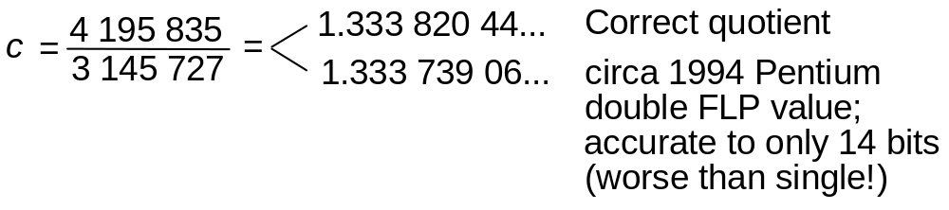
Motivation Example 1
Pentium Division Bug (1994-95): Pentium’s radix-4 SRT algorithm occasionally gave incorrect quotient
First noted in 1994 by T. Nicely who computed sums of reciprocals of twin primes:
1/5 + 1/7 + 1/11 + 1/13 + . . . + 1/p + 1/(p + 2) + . . .
Worst-case example of division error in Pentium:
Sep. 2005
Computer Arithmetic, Number Representation
Slide <number>

Slide 5
Motivation Example 2
Finite Precision Can Lead to Disaster
Example: Failure of Patriot Missile (1991 Feb. 25)
Source http://www.math.psu.edu/dna/455.f96/disasters.html
American Patriot Missile battery in Dharan, Saudi Arabia, failed to intercept incoming Iraqi Scud missile
The Scud struck an American Army barracks, killing 28
Cause, per GAO/IMTEC-92-26 report: “software problem” (inaccurate calculation of the time since boot)
Problem specifics:
Time in tenths of second as measured by the system’s internal clock was multiplied by 1/10 to get the time in seconds
Internal registers were 24 bits wide
1/10 = 0.0001 1001 1001 1001 1001 100 (chopped to 24 b)
Error ≈ 0.1100 1100 × 2^{–23} ≈ 9.5 × 10^{–8}
Error in 100-hr operation period
≈ 9.5 × 10 –8 × 100 × 60 × 60 × 10 = 0.34 s
Distance traveled by Scud = (0.34 s) × (1676 m/s) ≈ 570 m
Sep. 2005
Computer Arithmetic, Number Representation
Slide <number>

Slide 6
Computer Arithmetic in the 1940s
Machine arithmetic was crucial in proving the feasibility of computing with stored-program electronic devices
Hardware for addition/subtraction, use of complement representation, and shift-add multiplication and division algorithms were developed.
A seminal report by A.W. Burkes, H.H. Goldstein, and J. von Neumann contained ideas on choice of number radix, carry propagation chains, fast multiplication via carry-save addition, and restoring division
State of computer arithmetic circuit 1950:
Overview paper by R.F. Shaw [Shaw50]
Oct. 2005
Slide <number>

Slide 7
Computer Arithmetic in the 1950s
The focus shifted from feasibility to algorithmic speedup methods and cost-effective hardware realizations
By the end of the decade, virtually all important fast-adder designs had already been published or were in the final phases of development
Residue arithmetic, SRT division, CORDIC algorithms were proposed and implemented
Snapshot of the field circa 1960:
Overview paper by O.L. MacSorley [MacS61]
Oct. 2005
Slide <number>

Slide 8
Computer Arithmetic in the 1960s
Tree multipliers, array multipliers, high-radix dividers, convergence division, redundant signed-digit arithmetic were introduced
Implementation of floating-point arithmetic operations in hardware or firmware (in microprogram) became prevalent
Many innovative ideas originated from the design of early supercomputers, when the demand for high performance,
along with the still high cost of hardware, led designers to novel
and cost-effective solutions
Examples reflecting the sate of the art near the end of this decade:
IBM’s System/360 Model 91 [Ande67]
Control Data Corporation’s CDC 6600 [Thor70]
Oct. 2005
Slide <number>

Slide 9
Computer Arithmetic in the 1970s
Advent of microprocessors and vector supercomputers
Early LSI chips were quite limited in the number of transistors or logic gates that they could accommodate
Microprogrammed control (with just a hardware adder) was a natural choice for single-chip processors which were not yet expected to offer high performance
For high end machines, pipelining methods were perfected to allow the throughput of arithmetic units to keep up with computational demand in vector supercomputers
Examples reflecting the state of the art near the end of this decade:
Cray 1 supercomputer and its successors
Oct. 2005
Slide <number>

Slide 10
Computer Arithmetic in the 1980s
Spread of VLSI triggered a reconsideration of all arithmetic designs in light of interconnection cost and pin limitations
For example, carry-lookahead adders, thought to be ill-suited to VLSI, were shown to be efficiently realizable after suitable modifications. Similar ideas were applied to more efficient VLSI tree and array multipliers
Bit-serial and on-line arithmetic were advanced to deal with severe pin limitations in VLSI packages
Arithmetic-intensive signal processing functions became driving forces for low-cost and/or high-performance embedded hardware: DSP chips
Oct. 2005
Slide <number>

Slide 11
Computer Arithmetic in the 1990s
No breakthrough design concept
Demand for performance led to fine-tuning of arithmetic algorithms and implementations (many hybrid designs)
Increasing use of table lookup and tight integration of arithmetic unit and other parts of the processor for maximum performance
Clock speeds reached and surpassed 100, 200, 300, 400, and 500 MHz in rapid succession; pipelining used to ensure smooth flow of data through the system
Examples reflecting the state of the art near the end of this decade:
Intel’s Pentium Pro (P6) → Pentium II
Several high-end DSP chips
Oct. 2005
Slide <number>

Slide 12
Computer Arithmetic in the 2000s
Partial list, based on the first half of the decade
Continued refinement of many existing methods, particularly those based on table lookup
New challenges posed by multi-GHz clock rates
Increased emphasis on low-power design
Reexamination of the IEEE 754 floating-point standard
Oct. 2005
Slide <number>

Slide 13
Design: Shift of attention from algorithms to optimizations at the level of transistors and wires
This explains the proliferation of hybrid designs
Technology: Predominantly CMOS, with a phenomenal rate of improvement in size/speed
Applications: Shift from high-speed or high-throughput designs in mainframes to embedded systems requiring
Low cost
Low power
Oct. 2005
Slide <number>

Slide 14
Aspects of, and Topics in, Computer Arithmetic
Hardware (our focus in this book) Software
––––––––––––––––––––––––––––––––––––––––––––––––– ––––––––––––––––––––––––––––––––––––
Design of efficient digital circuits for Numerical methods for solving
primitive and other arithmetic operations systems of linear equations,
such as +, –, ×, ÷, √, log, sin, cos partial differential equations, etc.
Issues: Algorithms Issues: Algorithms
Error analysis Error analysis
Speed/cost trade-offs Computational complexity
Hardware implementation Programming
Testing, verification Testing, verification
General-purpose Special-purpose
–––––––––––––––––––––– –––––––––––––––––––––––
Flexible data paths Tailored to
Fast primitive applications like:
operations like Digital filtering
+, –, ×, ÷, √ Image processing
Benchmarking Radar tracking
The scope of computer arithmetic.
Oct. 2005
Slide <number>

Slide 15
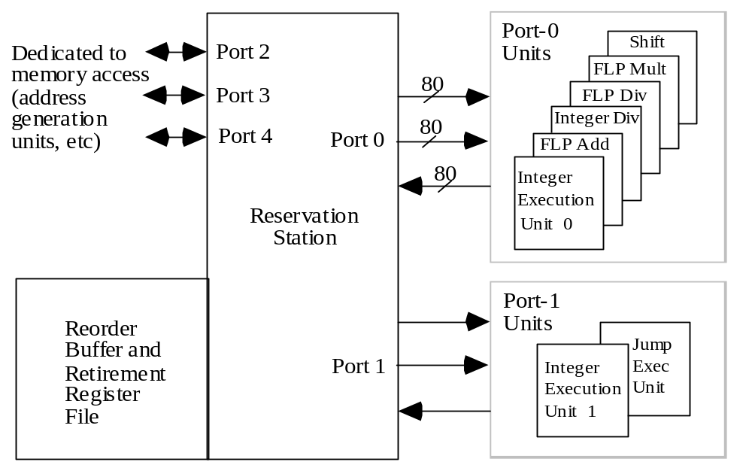
Arithmetic in the Intel Pentium Pro Microprocessor
Key parts of the CPU in the Intel Pentium Pro (P6) microprocessor.
Oct. 2005
Slide <number>

Slide 16
Ongoing Debates and New Paradigms
Renewed interest in bit- and digit-serial arithmetic as mechanisms to reduce the VLSI area and to improve packageability and testability
Synchronous vs asynchronous design (asynchrony has some overhead, but an equivalent overhead is being paid for clock distribution and/or systolization)
New design paradigms may alter the way in which we view or design arithmetic circuits
Neuronlike computational elements
Optical computing (redundant representations)
Multivalued logic (match to high-radix arithmetic)
Configurable logic
Arithmetic complexity theory
Oct. 2005
Slide <number>

Slide 17
The Need for Low-Power Design
Portable and wearable electronic devices
Nickel-cadmium batteries: 40-50 W-hr per kg of weight
Practical battery weight < 1 kg (< 0.1 kg if wearable device)
Total power ≅ 3-5 W for a day’s work between recharges
Modern high-performance microprocessors use 10s Watts
Power is proportional to die area × clock frequency
Cooling of micros not yet a problem; but for MPPs . . .
New battery technologies cannot keep pace with demand
Demand for more speed and functionality (multimedia, etc.)
-
Oct. 2005
Slide <number>

Slide 18
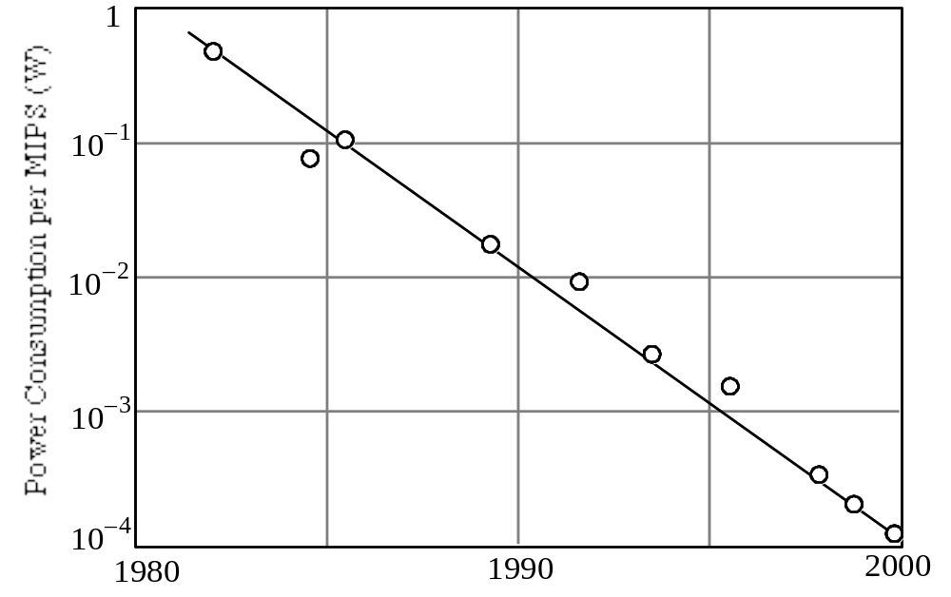
Processor Power Consumption Trends
Power consumption per MIPS (W)
Power consumption trend in DSPs [Raba98].
Oct. 2005
Slide <number>

Slide 19
Sources of Power Consumption
Both average and peak power are important
Average power determines battery life or heat dissipation
Peak power impacts power distribution and signal integrity
Typically, low-power design aims at reducing both
Power dissipation in CMOS digital circuits
Static: Leakage current in imperfect switches (< 10%)
Dynamic: Due to (dis)charging of parasitic capacitance
P_{avg} ≅ α f C V ²
Square of voltage
“activity”
data rate
(clock frequency)
Capacitance
Oct. 2005
Slide <number>

Slide 20
Power Reduction Strategies: The Big Picture
For a given data rate f, there are but 3 ways to reduce the power requirements:
1. Using a lower supply voltage V
2. Reducing the parasitic capacitance C
3. Lowering the switching activity α
P_{avg} ≅ α f C V ²
Example: A 32-bit off-chip bus operates at 5 V and 100 MHz and drives a capacitance of 30 pF per bit. If random values were put on the bus in every cycle, we would have α = 0.5. To account for data correlation and idle bus cycles, assume α = 0.2. Then:
P_{avg} ≅ α f C V ² = 0.2 × 10⁸ × (32 × 30 × 10^{–12}) × 5² = 0.48 W
Oct. 2005
Slide <number>

Slide 21
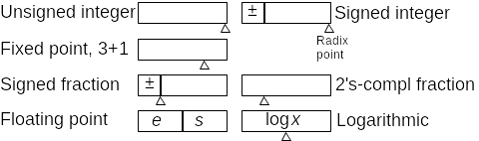
Numbers and Their Encodings
Some 4-bit number representation formats
Exponent in
{−2, −1, 0, 1}
Significand in
{0, 1, 2, 3}
Base-2
logarithm
Oct. 2005
Slide <number>

Slide 22
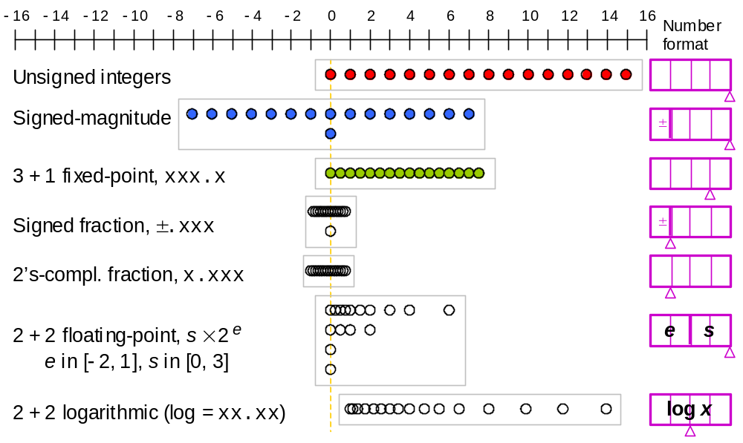
Encoding Numbers in 4 Bits
Fig. 1.2 Some of the possible ways of assigning 16 distinct codes to represent numbers.
Oct. 2005
Slide <number>

Slide 23
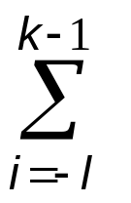
1.1. Fixed-Radix Positional Number Systems
( x_{k–1}x_{k–2} . . . x₁x₀ . x_{–1}x_{–2} . . . x_{–l} )_{r} = x_{i} r ^{i}
One can generalize to:
Arbitrary radix (not necessarily integer, positive, constant)
Arbitrary digit set, usually {–α, –α+1, . . . , β–1, β} = [–α, β]
Example 1.1. Balanced ternary number system:
Radix r = 3, digit set = [–1, 1]
Example 1.2. Negative-radix number systems:
Radix –r, r ≥ 2, digit set = [0, r – 1]
The special case with radix –2 and digit set [0, 1]
is known as the negabinary number system
Oct. 2005
Slide <number>

Slide 24
More Examples of Number Systems
Example 1.3. Digit set [–4, 5] for r = 10:
(3 –1 5)ten represents 295 = 300 – 10 + 5
Example 1.4. Digit set [–7, 7] for r = 10:
(3 –1 5)ten = (3 0 –5)ten = (1 –7 0 –5)ten
Example 1.7. Quater-imaginary number system:
radix r = 2j, digit set [0, 3]
Oct. 2005
Slide <number>

Slide 25
Classes of Number Representations
Integers (fixed-point), unsigned
Integers (fixed-point), signed
Signed-magnitude, biased, complement
Signed-digit, including carry/borrow-save
( using redundancy for faster arithmetic,
not how to represent signed values)
Residue number system:
( use of parallelism for faster arithmetic,
not how to represent signed values)
Real numbers, floating-point
Real arithmetic
Real numbers, exact:
Continued-fraction, slash, . . .
Oct. 2005
Slide <number>

Slide 26
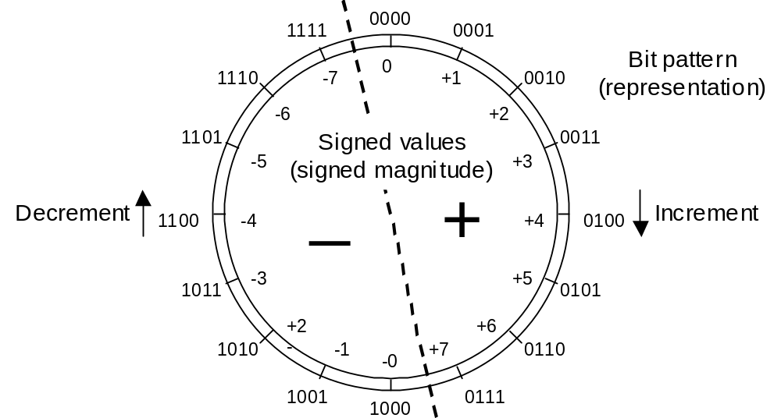
Signed-Magnitude Representation
-
Fig. 2.1 Four-bit signed-magnitude number representation system for integers.
Oct. 2005
Slide <number>

Slide 27
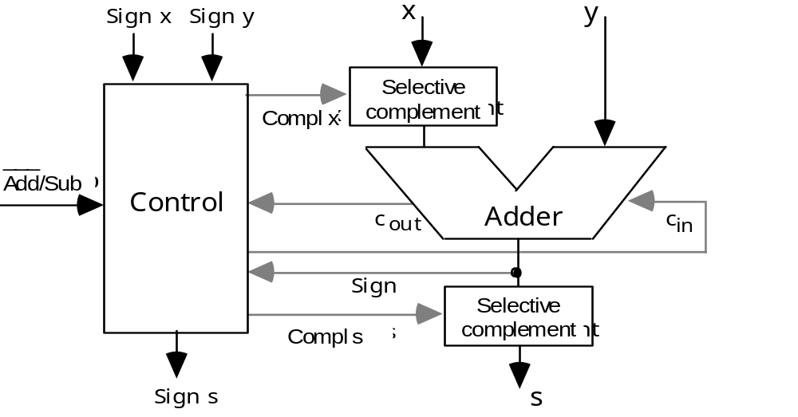
Signed-Magnitude Adder
Fig. 2.2 Adding signed-magnitude numbers using precomplementation and postcomplementation.
Oct. 2005
Slide <number>

Slide 28
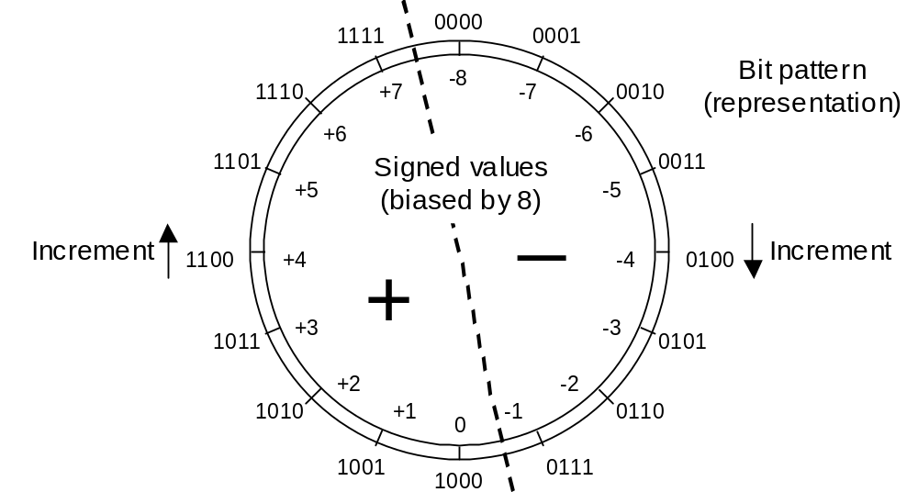
Biased Representations
Fig. 2.3 Four-bit biased integer number representation system with a bias of 8.
Oct. 2005
Slide <number>

Slide 29
Arithmetic with Biased Numbers
Addition/subtraction of biased numbers
x + y + bias = (x + bias) + (y + bias) – bias
x – y + bias = (x + bias) – (y + bias) + bias
A power-of-2 (or 2ª – 1) bias simplifies addition/subtraction
We seldom perform arbitrary arithmetic on biased numbers
Main application: Exponent field of floating-point numbers
Oct. 2005
Slide <number>

Slide 30
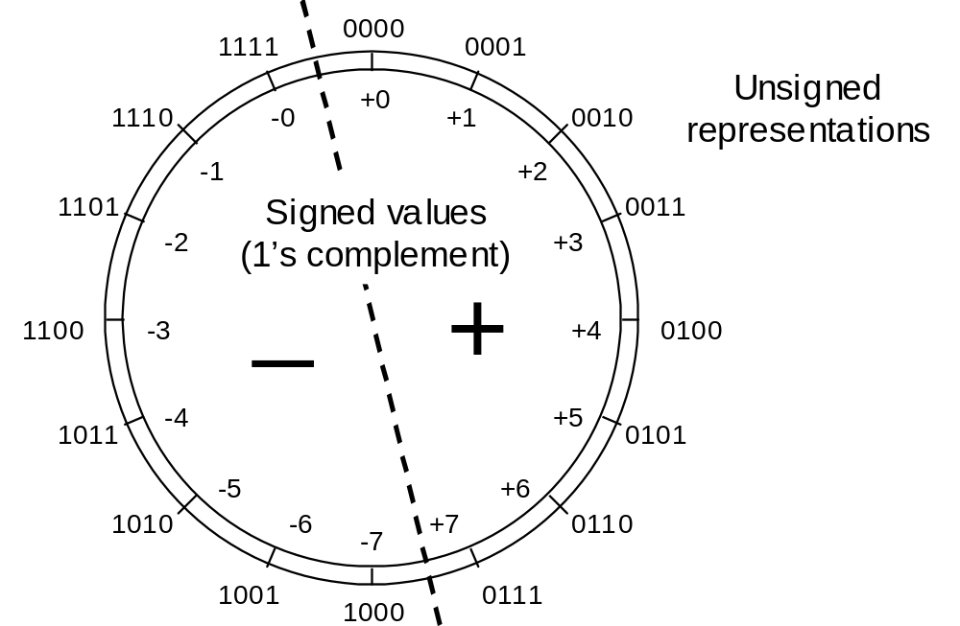
One’s-Complement Number Representation
One’s complement = digit complement (diminished radix complement) system for r = 2
M = 2^{k} – ulp
(2^{k} – ulp) – x = x^{compl}
Range of representable numbers in with k whole bits:
from –2^{k–1} + ulp to 2^{k–1} – ulp
Fig. 2.6 A 4-bit 1’s-complement number representation system for integers.
Oct. 2005
Slide <number>

Slide 31
Three Representations
Sign-magnitude
000 = +0
001 = +1
010 = +2
011 = +3
100 = - 0
101 = - 1
110 = - 2
111 = - 3
1’s complement
000 = +0
001 = +1
010 = +2
011 = +3
100 = - 3
101 = - 2
110 = - 1
111 = - 0
2’s complement
000 = +0
001 = +1
010 = +2
011 = +3
100 = - 4
101 = - 3
110 = - 2
111 = - 1
(Preferred)
Fall 08, Nov 21
ELEC 5200-001/6200-001 Lecture 10

Slide 32
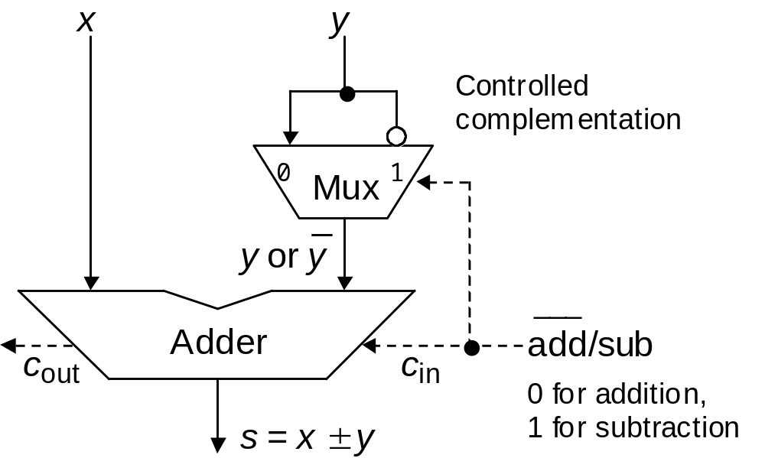
Why 2’s-Complement Is the Universal Choice
Fig. 2.7 Adder/subtractor architecture for 2’s-complement numbers.
Oct. 2005
Slide <number>

Slide 33
Addition
Adding bits:
    0 + 0 = 0
    0 + 1 = 1
    1 + 0 = 1
    1 + 1 = (1) 0
Adding integers:
carry
1 1 0
0 0 0 . . . . . . 0 1 1 1 _{two} = 7_{ten}
+ 0 0 0 . . . . . . 0 1 1 0 _{two} = 6_{ten}
= 0 0 0 . . . . . . 1 (1)1 (1)0 (0)1 _{two} = 13_{ten}
Fall 08, Nov 21
ELEC 5200-001/6200-001 Lecture 10

Slide 34
Subtraction
Direct subtraction
Two’s complement subtraction
0 0 0 . . . . . . 0 1 1 1 _{two} = 7_{ten}
- 0 0 0 . . . . . . 0 1 1 0 _{two} = 6_{ten}
= 0 0 0 . . . . . . 0 0 0 1_{two} = 1_{ten}
1 1 1 . . . . . . 1 1 0
0 0 0 . . . . . . 0 1 1 1 _{two} = 7_{ten}
+ 1 1 1 . . . . . . 1 0 1 0 _{two} = - 6_{ten}
= 0 0 0 . . . . . . 0 (1) 0 (1) 0 (0)1 _{two} = 1_{ten}
Fall 08, Nov 21

Slide 35
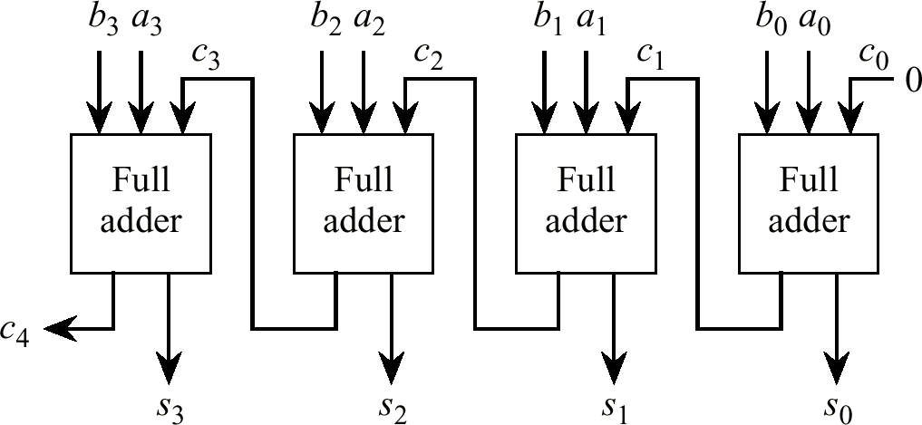
Ripple Carry Adder
  • Two binary numbers A and B are added from right to left, creating a sum and a carry at the outputs of each full adder for each bit position.

Slide 36
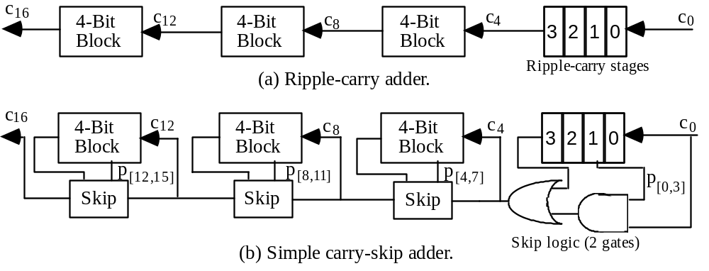
Simple Carry-Skip Adders
Fig. 7.1 Converting a 16-bit ripple-carry adder into a simple carry-skip adder with 4-bit skip blocks.
Oct. 2005
Computer Arithmetic, Addition/Subtraction
Slide <number>

Slide 37
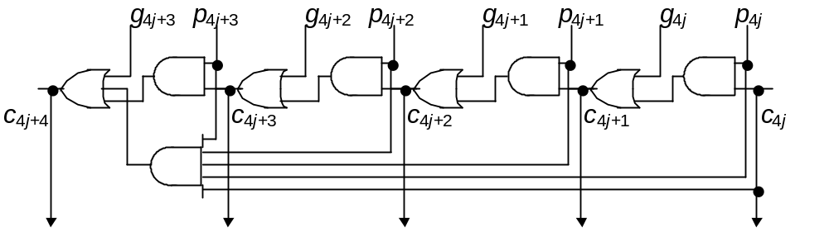
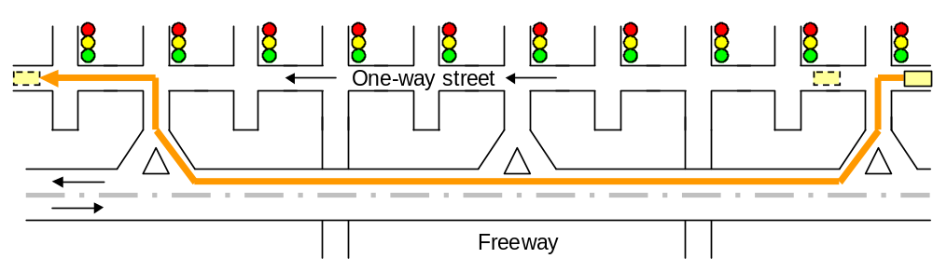
Another View of Carry-Skip Addition
Street/freeway analogy for carry-skip adder.
Oct. 2005
Computer Arithmetic, Addition/Subtraction
Slide <number>

Slide 38
Carry-Skip Adder with Fixed Block Size
Block width b; k/b blocks to form a k-bit adder (assume b divides k)
T_{fixed-skip-add} = (b – 1) + 0.5 + (k/b – 2) + (b – 1)
in block 0 OR gate skips in last block
≅ 2b + k/b – 3.5 stages
dT/db = 2 – k/b² = 0 ⇒ b ^{opt} = √k/2
T ^{opt} = 2√2k – 3.5
. . .
Example: k = 32, b ^{opt} = 4, T ^{opt} = 12.5 stages
(contrast with 32 stages for a ripple-carry adder)
Oct. 2005
Computer Arithmetic, Addition/Subtraction
Slide <number>

Slide 39
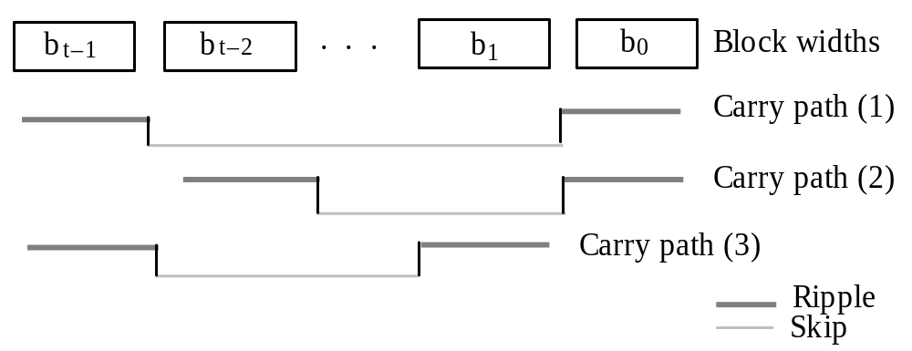
Carry-Skip Adder with Variable-Width Blocks
Fig. 7.2 Carry-skip adder with variable-size blocks and three sample carry paths.
The total number of bits in the t blocks is k:
2[b + (b + 1) + . . . + (b + t/2 – 1)] = t(b + t/4 – 1/2) = k
b = k/t – t/4 + 1/2
T_{var-skip-add} = 2(b – 1) + 0.5 + t – 2 = 2k/t + t/2 – 2.5
dT/db = –2k/t ² + 1/2 = 0 ⇒ t ^{opt} = 2√k
T ^{opt} = 2√k – 2.5 (a factor of √2 smaller than for fixed-block)
Oct. 2005
Computer Arithmetic, Addition/Subtraction
Slide <number>

Slide 40
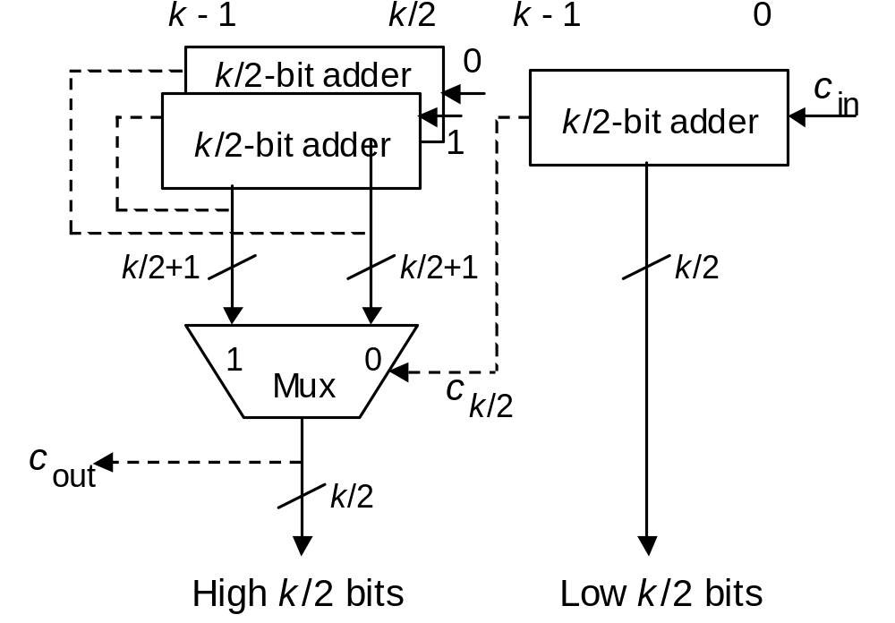
Carry-Select Adders
Fig. 7.9 Carry-select adder for k-bit numbers built from three k/2-bit adders.
C_{select-add}(k) = 3C_{add}(k/2) + k/2 + 1
T_{select-add}(k) = T_{add}(k/2) + 1
Oct. 2005
Computer Arithmetic, Addition/Subtraction
Slide <number>

Slide 41
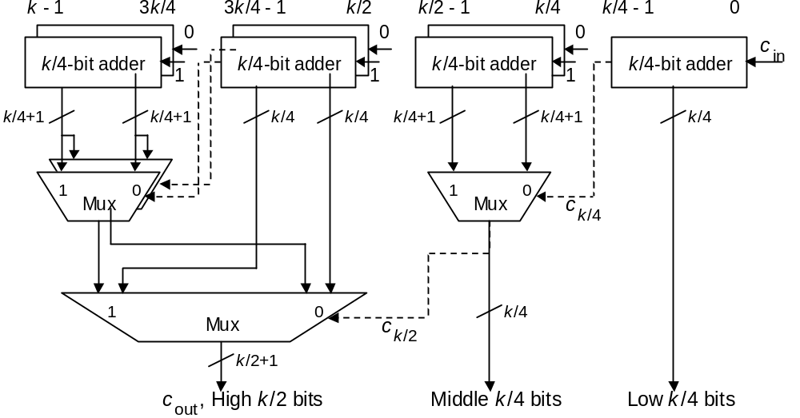
Multilevel Carry-Select Adders
Fig. 7.10 Two-level carry-select adder built of k/4-bit adders.
Oct. 2005
Computer Arithmetic, Addition/Subtraction
Slide <number>

Slide 42
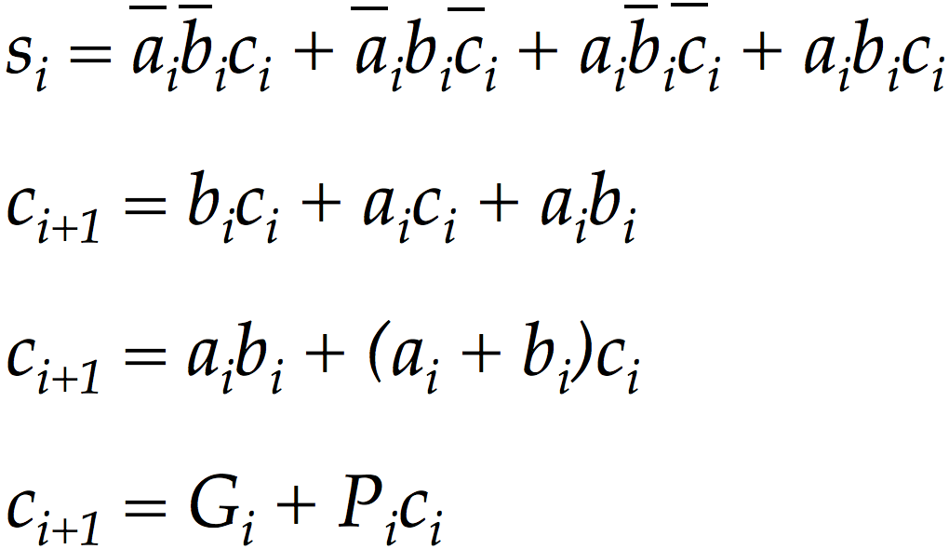
Carry-Lookahead Addition
  s_{i} = a_{i}b_{i}c_{i} + a_{i}b_{i}c_{i} + a_{i}b_{i}c_{i} +
  c_{i+1} = b_{i}c_{i} + a_{i}c_{i} + a_{i}b_{i}
  c_{i+1} = a_{i}b_{i} + (a_{i} + b_{i})c_{i}
  G_{i} = a_{i}b_{i} and P_{i} = a_{i} + b_{i}
  c₀ = 0
  c₁ = G₀
  c₂ = G₁ + P₁G₀
  c₃ = G₂ + P₂G₁ + P₂P₁G₀
  c₄ = G₃ + P₃G₂ + P₃P₂G₁ + P₃P₂P₁G₀
• Carries are represented in terms of G_{i} (generate) and P_{i} (propagate) expressions.

Slide 43
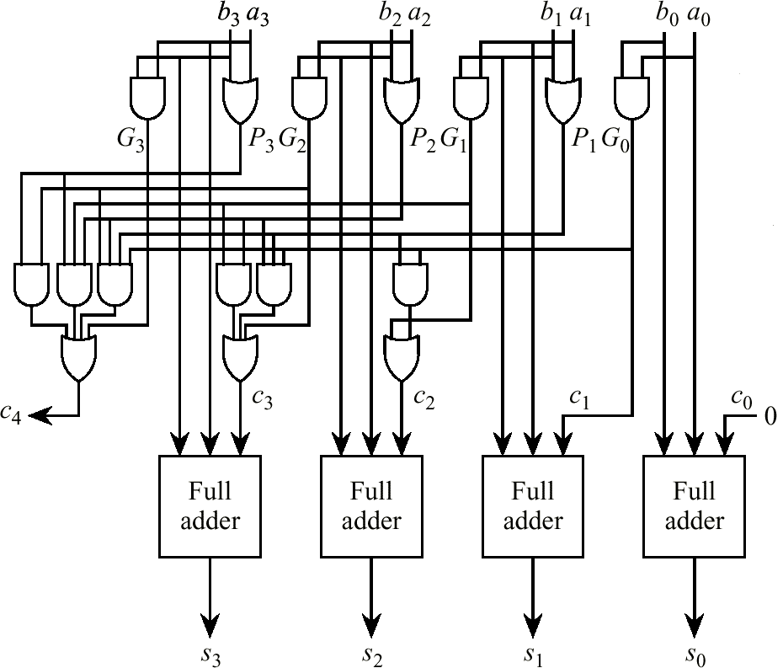
Carry Lookahead Adder

Slide 44
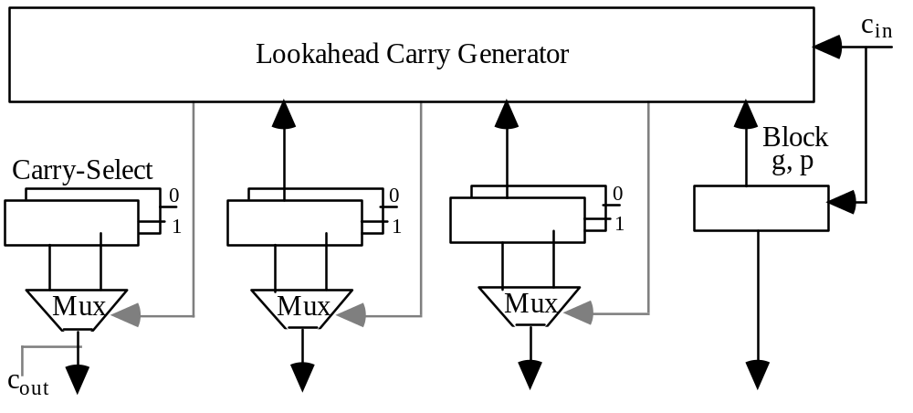
Hybrid Adder Designs
The most popular hybrid addition scheme:
Fig. 7.12 A hybrid carry-lookahead/carry-select adder.
Oct. 2005
Computer Arithmetic, Addition/Subtraction
Slide <number>

Slide 45
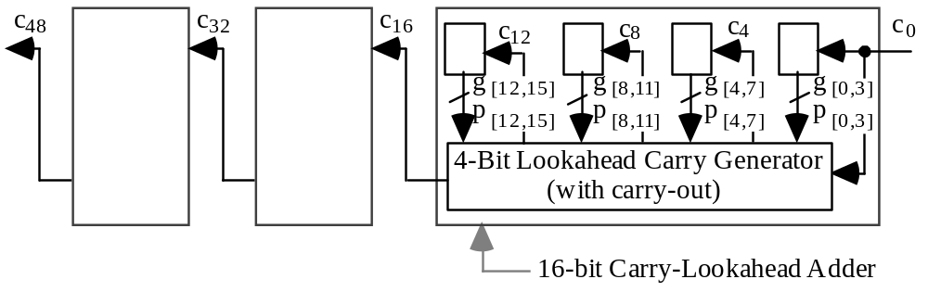
Any Two Addition Schemes Can Be Combined
Fig. 7.13 Example 48-bit adder with hybrid ripple-carry/carry-lookahead design.
Other possibilities: hybrid carry-select/ripple-carry
hybrid ripple-carry/carry-select
. . .
Oct. 2005
Computer Arithmetic, Addition/Subtraction
Slide <number>

Slide 46
N-bit Adder Design Options
Type of adder | Time complexity (delay) | Space complexity (size)
Ripple-carry | O(N) | O(N)
Carry-lookahead | O(log₂N) | O(N log₂N)
Carry-skip | O(√N) | O(N)
Carry-select | O(√N) | O(N)
Reference: J. L. Hennessy and D. A. Patterson, Computer Architecture: A Quantitative Approach, Second Edition, San Francisco, California, 1990, page A-46.
Fall 08, Nov 21
ELEC 5200-001/6200-001 Lecture 10

Slide 47
Sequential (Ardışık) Multiplication
Çarpan X=x_{n-1}x_{n-2}...x₁x₀
Çarpılan A=a_{n-1}a_{n-2}...a₁a₀.
Burada x_{n-1} ve a_{n-1} işaret bitleridir.
Ardışık çarpma işlemi n-1 adımdan oluşur.
Bu işlemde, herhangi bir x_{j} bitine bakılır ve x_{j}A önceki kısmi çarpımla (P^{(j)}) toplanır.
P^{(j+1)}=( P^{(j)}+x_{j}.A).2⁻¹
Oct. 2005
Slide <number>

Slide 48
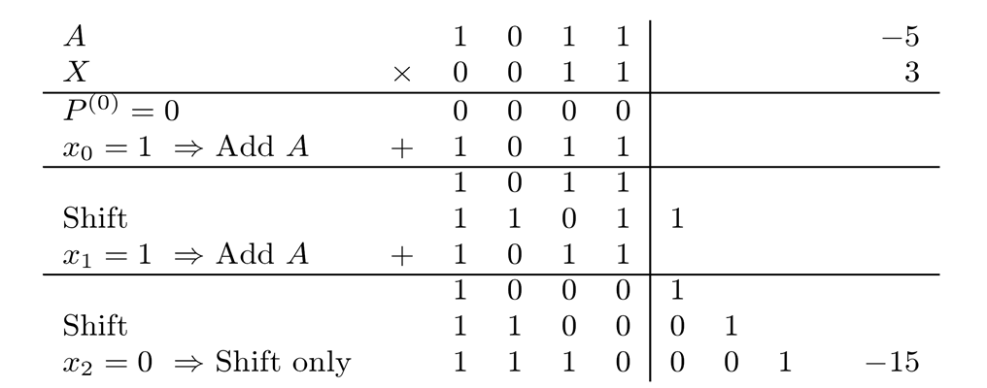
Example
Oct. 2005
Slide <number>

Slide 49
Speeding Up Multiplication
Multiplication involves 2 basic operations - generation of partial products + their accumulation
2 ways to speed up - reducing number of partial products and/or accelerating accumulation
3 types of high-speed multipliers:
Sequential multiplier - generates partial products sequentially and adds each newly generated product to previously accumulated partial product
Parallel multiplier - generates partial products in parallel, accumulates using a fast multi-operand adder
Array multiplier - array of identical cells generating new partial products; accumulating them simultaneously
  No separate circuits for generation and accumulation
  Reduced execution time but increased hardware complexity

Slide 50
Reducing Number of Partial Products
Examining 2 or more bits of multiplier at a time
Requires generating A (multiplicand), 2A, 3A
Reduces number of partial products to n/2 - each step more complex
Several algorithm which do not increase complexity proposed - one is Booth's algorithm
Fewer partial products generated for groups of consecutive 0’s and 1’s

Slide 51
Fast Multiplication: Booth’s Algorithm
Group of consecutive 0’s in multiplier - no new partial product - only shift partial product right one bit position for every 0
Group of m consecutive 1's in multiplier - less than m partial products generated
...01…110... = ...10...000... - ...00...010...
Using SD (signed-digit) notation =...100...010...
Example:
...011110... = ...100000... - ...000010... = ...100010... (decimal notation: 15=16-1)
Instead of generating all m partial products - only 2 partial products generated
First partial product added - second subtracted - number of single-bit shift-right operations still m
-
-

Slide 52
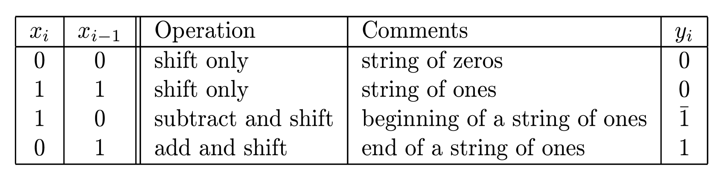
Booth’s Algorithm - Rules
Recoding multiplier xn-1 xn- 2...x1 x0 in SD code
Recoded multiplier yn-1 yn-2 ... y1 y0
xi,xi-1 of multiplier examined to generate yi
Previous bit - xi-1 - only reference bit
i=0 - reference bit x-1=0
Simple recoding - yi = xi-1 - xi
No special order - bits can be recoded in parallel
Example: Multiplier 0011110011(0) recoded as 0100010101 - 4 instead of 6 add/subtracts
-
-

Slide 53
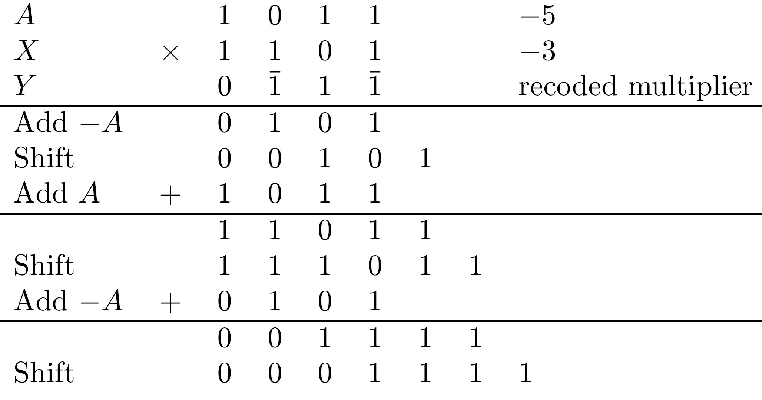
Booth Algorithm Example

Slide 54
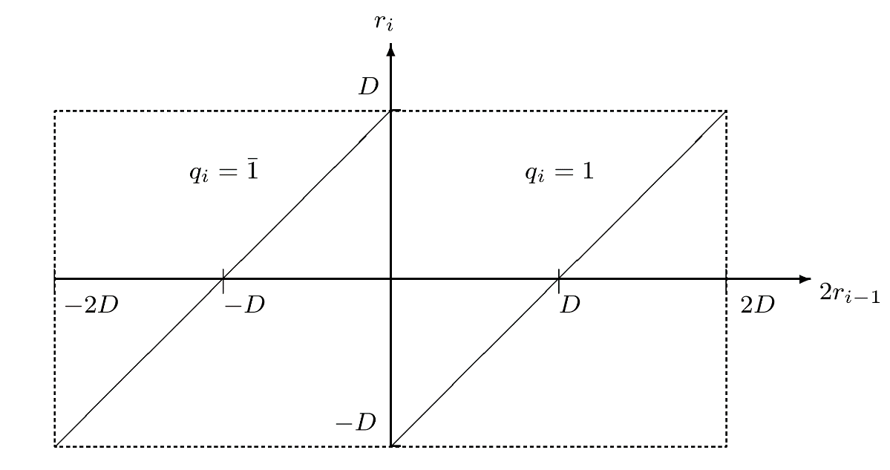
Nonrestoring Division
Simpler and faster than selection rule for restoring division - 2ri-1 compared to 0 instead of to D
Same equation for remainder - qi = 2ri-1-qiD
Divisor D subtracted if 2ri-1 >0 , added if <0
  |ri-1|<D
  qi selected so |ri|<D
  qi≠0 - at each step, either addition or subtraction is performed
Not SD representation no redundancy in representation of quotient
Exactly m add/subtract and shift operations

Slide 55


Non-Restoring Division
r₀=X
j=0
Restore işlemi yoktur, q_{j}={ }
r_{j}<0
hayır
evet
q_{j+1}=1
r_{j+1}=2r_{j}-D
q_{j+1}=-1
r_{j+1}=2r_{j}+D
j==n
j=j+1
hayır
evet
Q’nun dönüşümü
Q=Q⁺-Q⁻
Q=Q
R=r_{n}2^{-n}
hayır
r_{j}<0
evet
Q=Q-2^{-n}
R=r_{n}+D

Slide 56
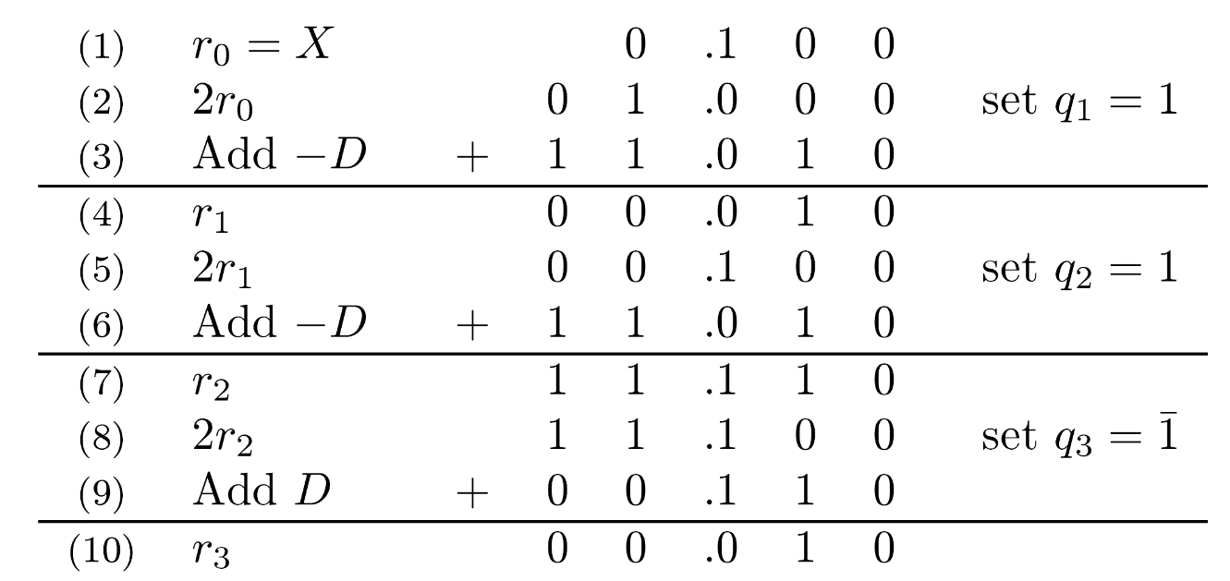
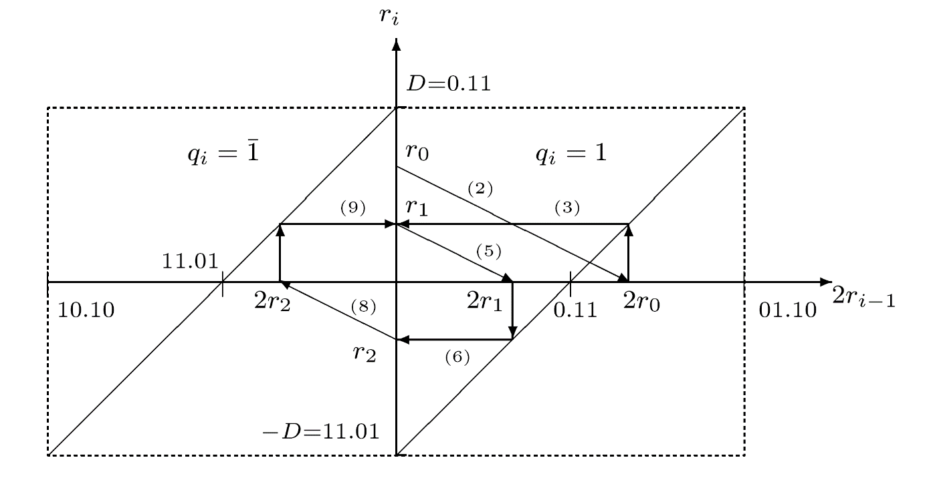
Nonrestoring Division - Example 1
X=(0.100000)2=1/2
D=(0.110)2=3/4
Final remainder - as before
Q=0.111=0.1012=5/8
Graphical representation
  Horizontal lines - add ±D
  Diagonal lines - multiply by 2
-

Slide 57
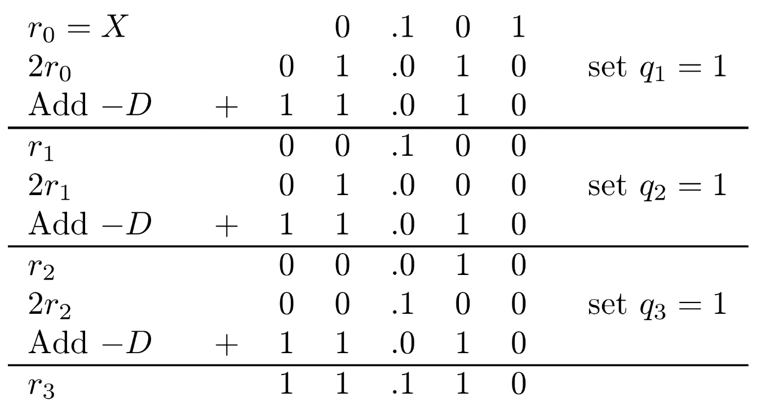
Nonrestoring Division - Example 2
X=0.1102= 5/8
D=0.1102= 3/4
Final remainder negative - dividend positive
Correct final remainder by adding D to r3 - 1.110+0.110=0.100
Correct quotient - Qcorrected = Q - ulp
Q=0.111 - Qcorrected=0.1102=3/4

Slide 58
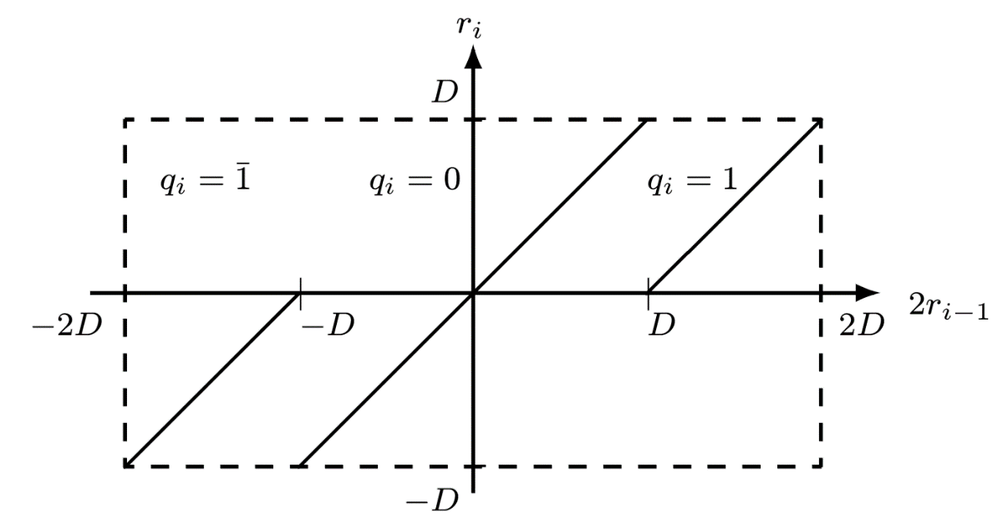
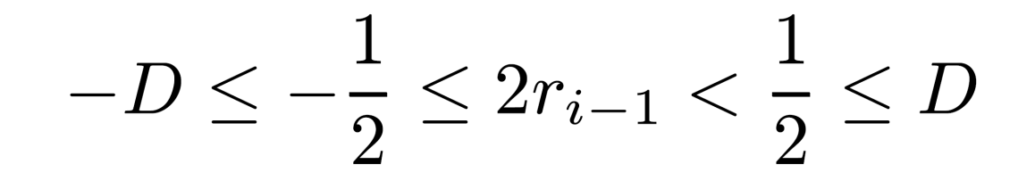
Modified Nonrestoring Division –
Fast Division Algorithm: SRT
Problem: full comparison of 2ri-1 with either D or -D required
Solution: restricting D to normalized fraction 1/2≤|D|<1
Region of 2ri-1 for which qi=0 reduced to

Slide 59
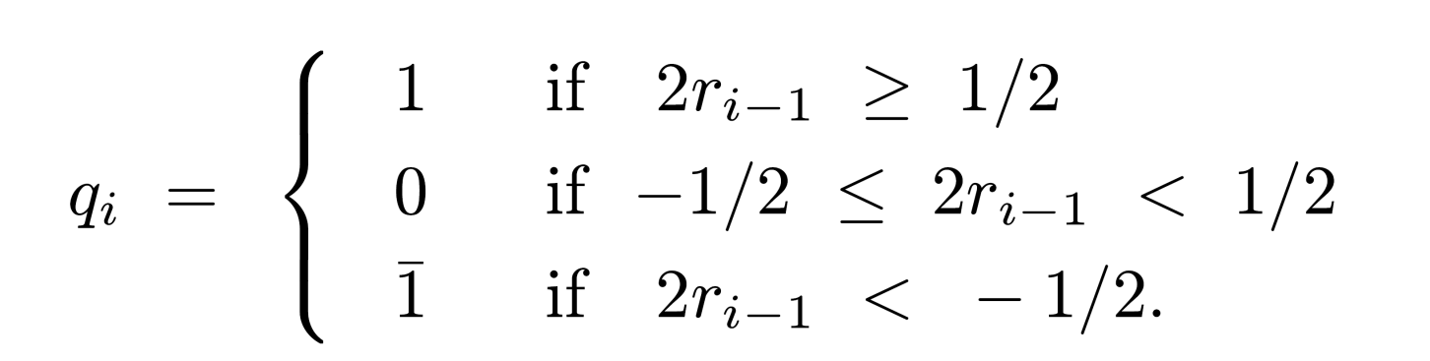
Modified Nonrestoring → SRT
Advantage: Comparing partial remainder 2ri-1 to 1/2 or -1/2, not D or -D
Binary fraction in two's complement representation
  ≥ 1/2 if and only if it starts with 0.1
  ≤ -1/2 if and only if it starts with 1.0
Only 2 bits of 2ri-1 examined - not full comparison between 2ri-1 and D
  In some cases (e.g., dividend X>1/2) - shifted partial remainder needs an integer bit in addition to sign bit - 3 bits of 2ri-1 examined
Selecting quotient digit:

Slide 60
r₀=X
j=0
2r_{j}≥1/2
2r_{j}
2r_{j}<-1/2
q_{j+1}=1
r_{j+1}=2r_{j}-D
q_{j+1}= -1
r_{j+1}=2r_{j}+D
Aksi halde
q_{j+1}=0
r_{j+1}=2r_{j}
j==n
j=j+1
hayır
evet
Q’nun dönüşümü
Q=Q⁺-Q⁻
Q=Q
R=r_{n}2^{-n}
hayır
r_{n}<0
evet
Q=Q-2^{-n}
R=r_{n}+D

Slide 61
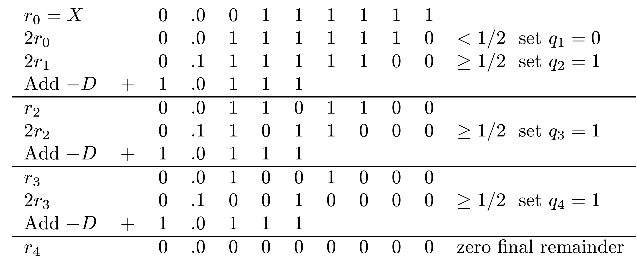
Example
X=(0.00111111)2=63/256 D=(0.1001)2=9/16
Q =0.01112=7/16 - not a minimal representation in SD form
Number of add/subtracts can be reduced further

Slide 62
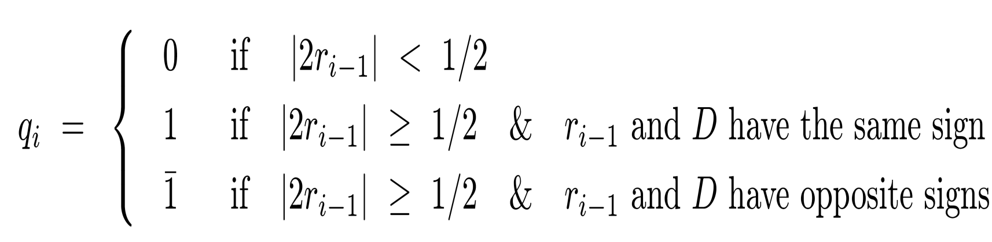
Extension to Negative Divisors
_

Slide 63
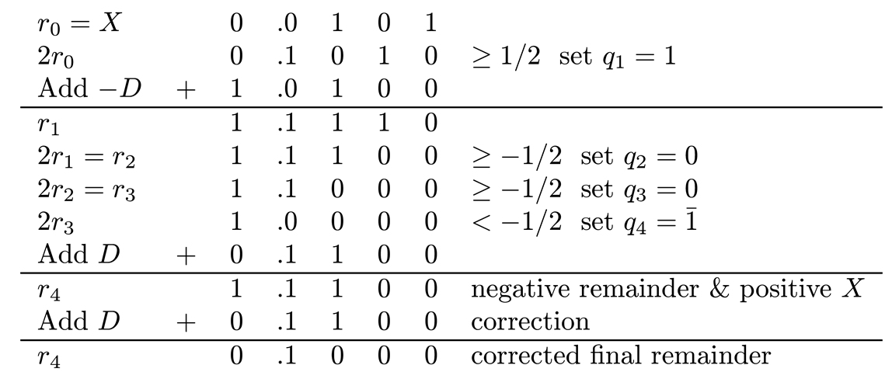
Dividend X=(0.0101)=5/16
Divisor D=(0.1100)=3/4
Before correction Q=(Q+)- (Q-) = 0.1000 – 0.0001
minimal SD repr. of Q=0.0111 - minimal number of add/subtracts
After correction, Q = 0.0111-ulp = 0.0110 = 3/8; final remainder = 1/2 * 1/16=1/32

Slide 64
Arithmetic Functions
Karekök Alma / Square-Roothing
Üstel Fonksiyonlar / Exponential Functions
Logaritmik Fonksiyonlar
Trigonometrik Fonksiyonlar
Hiperbolik Fonksiyonlar

Slide 65
Referanslar
Textbook: Computer Arithmetic Algorithms, I. Koren, 2nd Edition, A.K. Peters, Natick, MA, 2002
Textbook web page: http://www.ecs.umass.edu/ece/koren/arith
Recommended Reading:
  B. Parhami, Computer Arithmetic: Algorithms and Hardware Design, Oxford University Press, 2000
  M. Ercegovac and T. Lang, Digital Arithmetic, Morgan Kaufman, 2003

