Slide 1

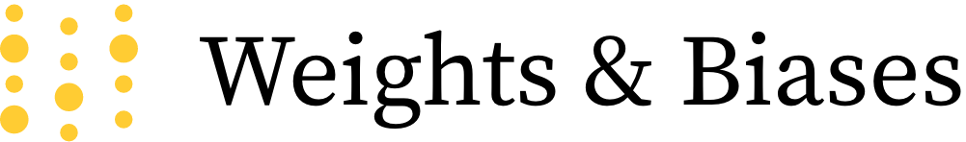
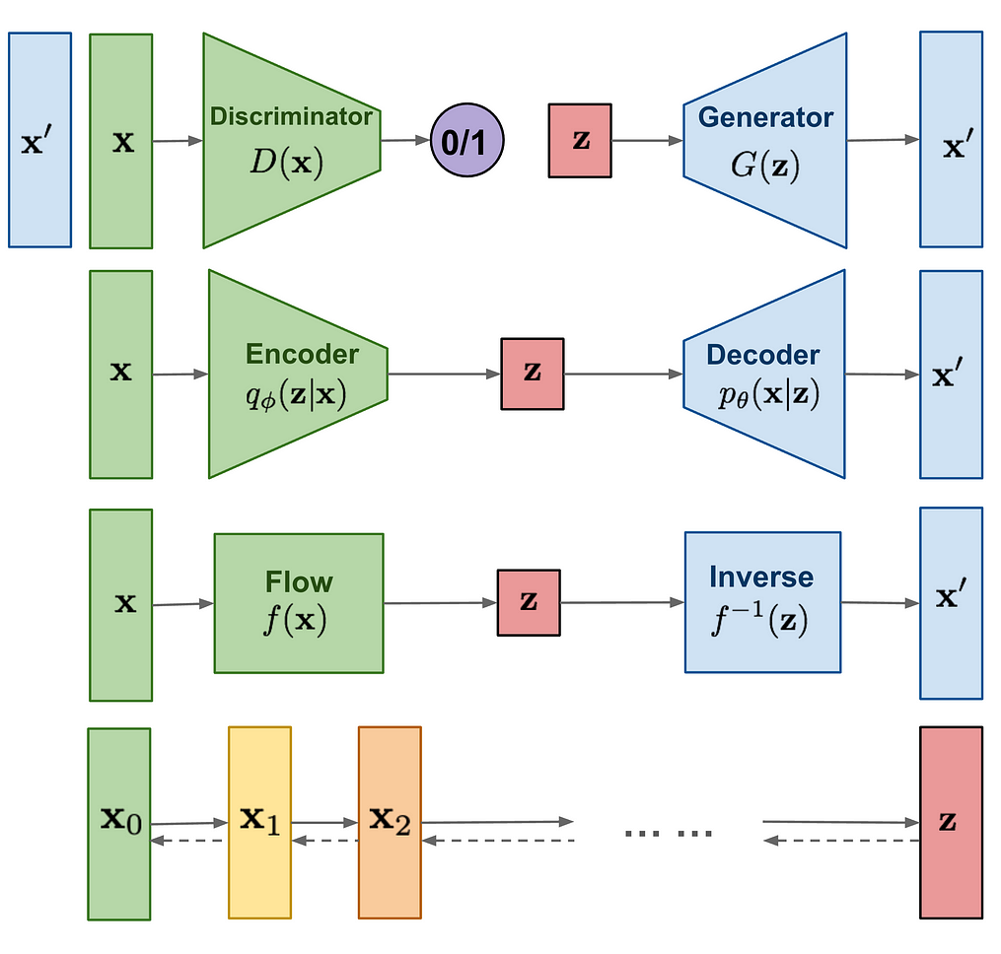
X
GAN
Adversarial training
VAE
Maximize variatiaonal
lower bound
Flow
Invertible transform of distributions
Diffusion
Models
Gradually add Gaussian noise and reverse

