Slide 1
Comparing Random Graph Models

Slide 2
Model 1
Add edge based on probability b**(-dist)

Slide 3
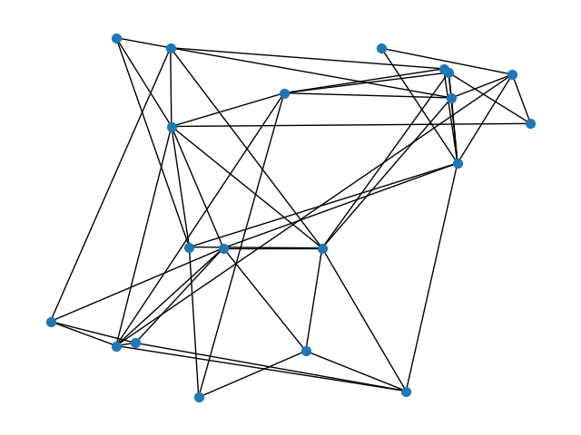
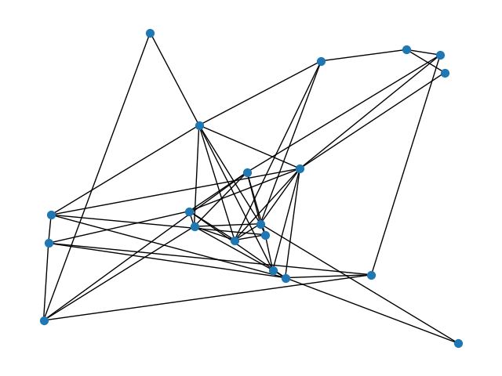
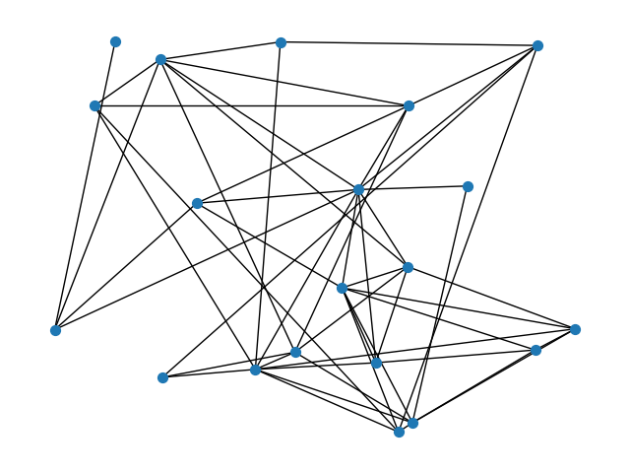
20 vertices
Seed: 13
Base: 19.5
Seed: 47
Base: 28
Seed: 50
Base: 29

Slide 4
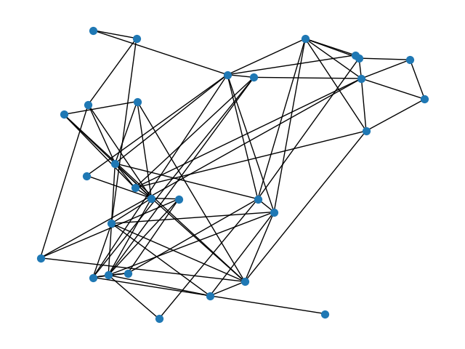
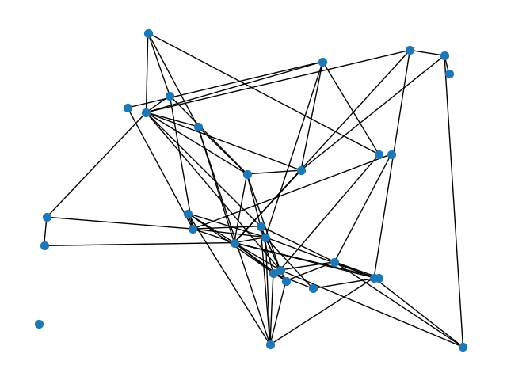
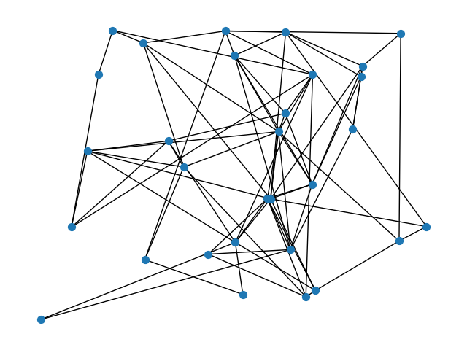
30 vertices
Seed: 13
Base: 90
Seed: 47
Base: 150
Seed: 50
Base: 75

Slide 5
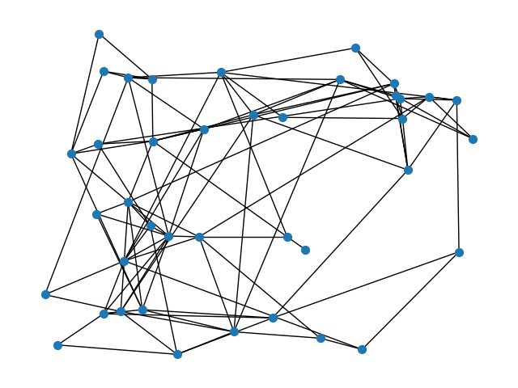
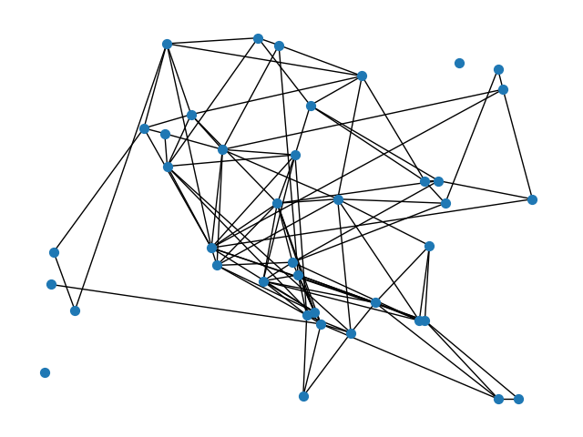
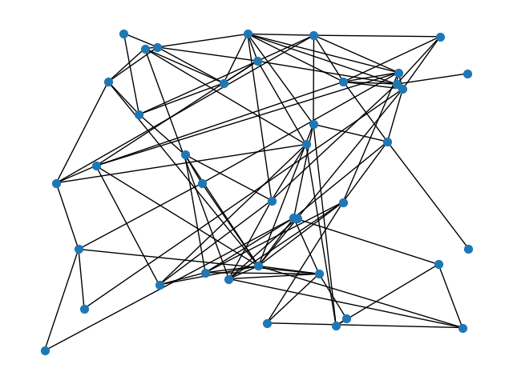
40 vertices
Seed: 13
Base: 240
Seed: 47
Base: 400
Seed: 50
Base: 120

Slide 6
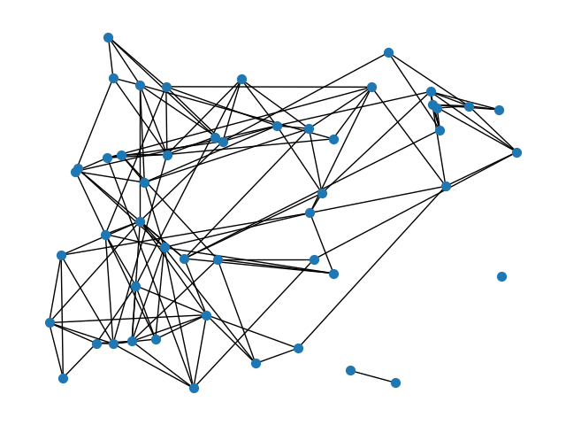
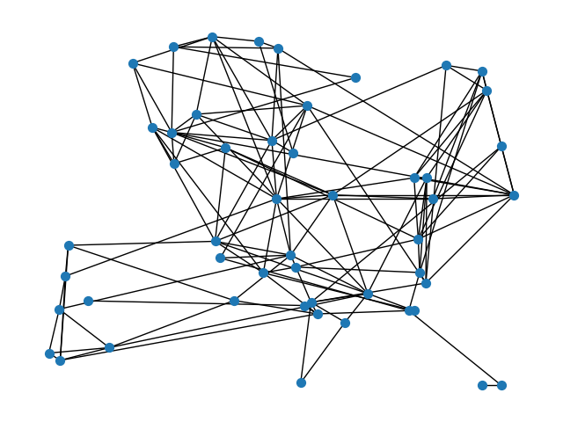
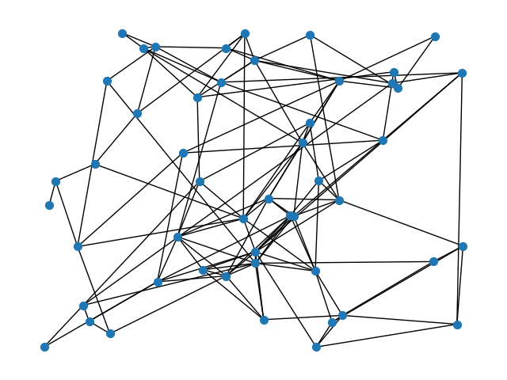
50 vertices
Seed: 13
Base: 750
Seed: 47
Base: 420
Seed: 50
Base: 470

Slide 7
Model 2
Add the (5.2n) shortest edges
All graphs have an avg degree of 10.4

Slide 8
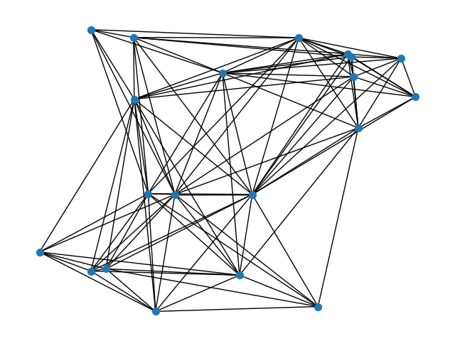
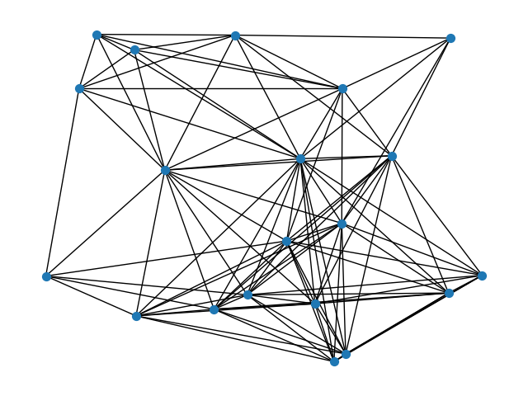
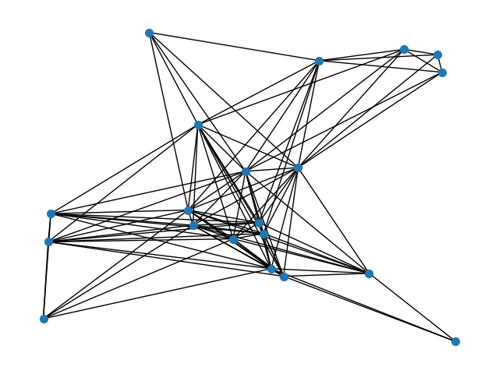
20 vertices
Seed 13
Seed 47
Seed 50

Slide 9
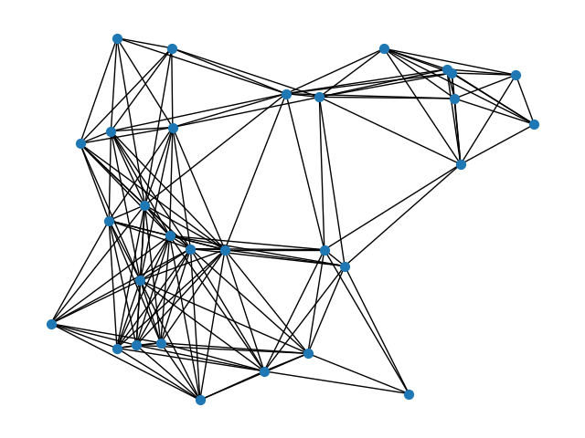
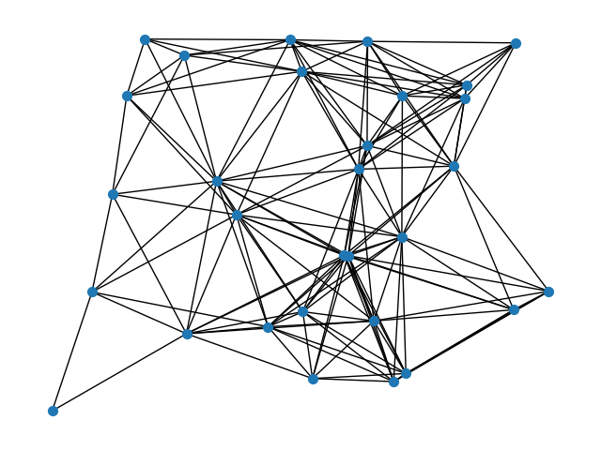
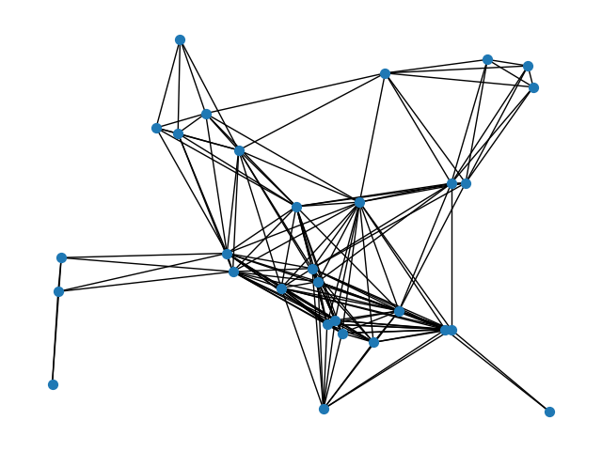
30 vertices
Seed 13
Seed 47
Seed 50

Slide 10
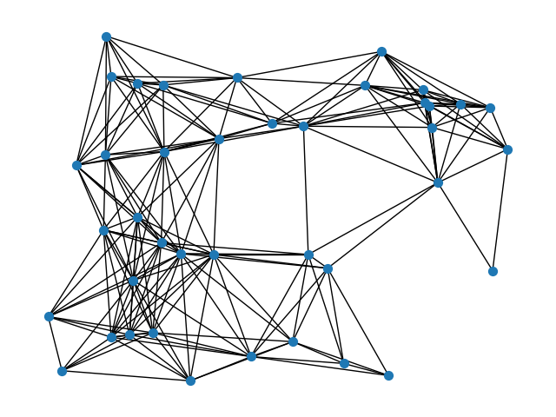
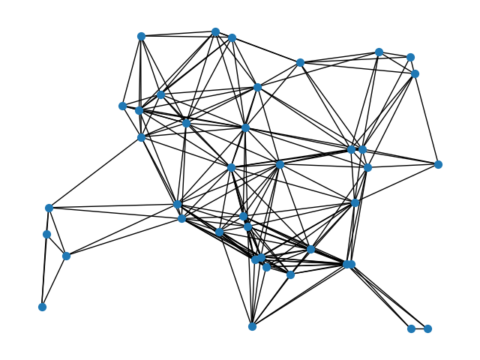
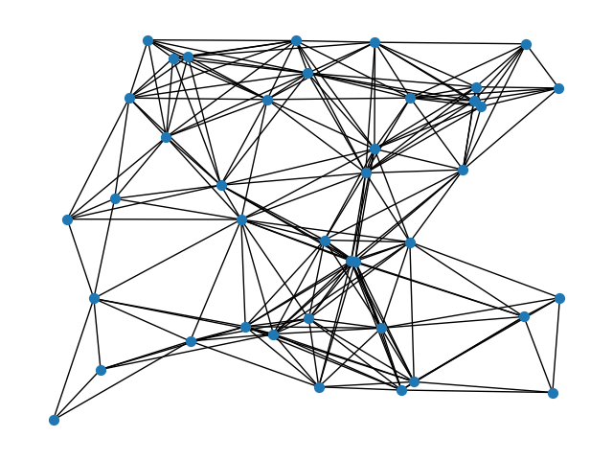
40 vertices
Seed 13
Seed 47
Seed 50

Slide 11
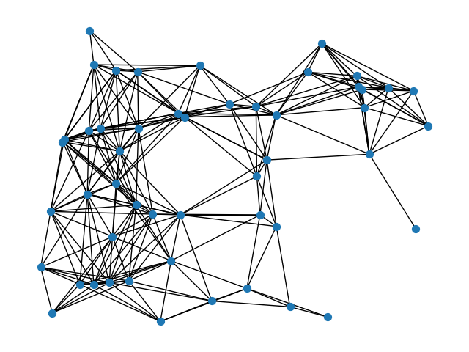
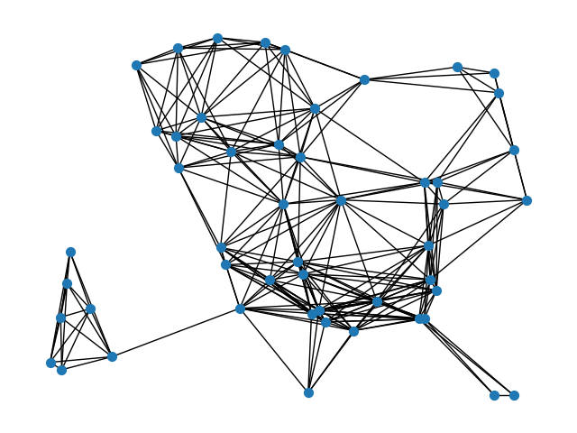
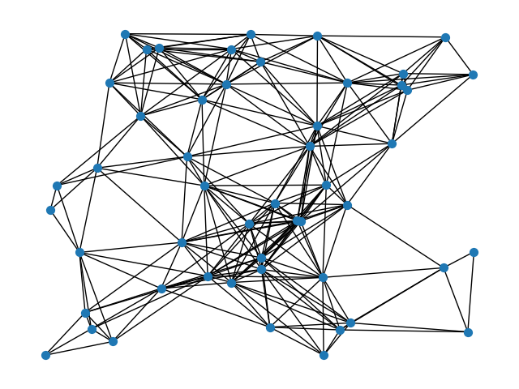
50 vertices
Seed 13
Seed 47
Seed 50

Slide 12
Model 3
Delaunay Triangulation

Slide 13
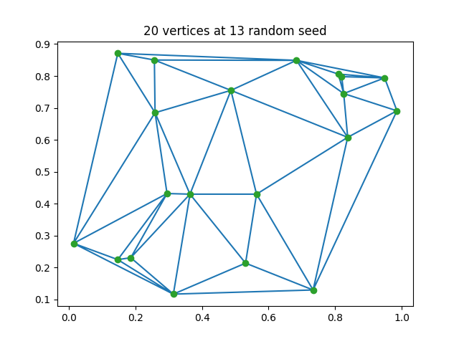
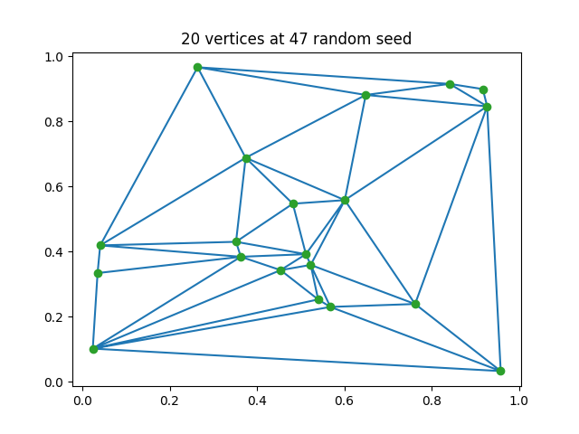
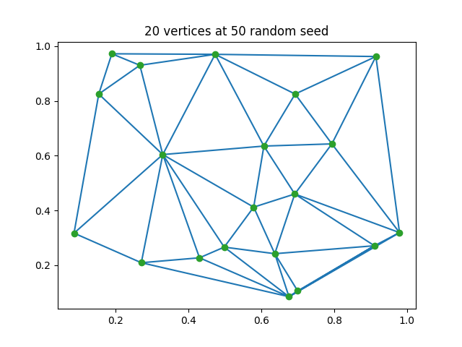
20 vertices

Slide 14
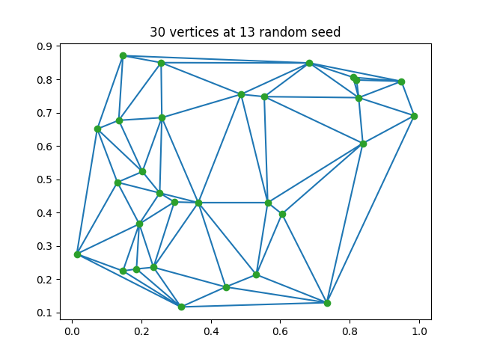
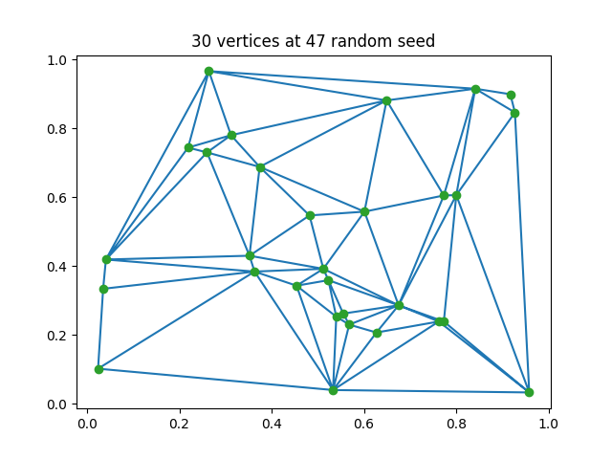
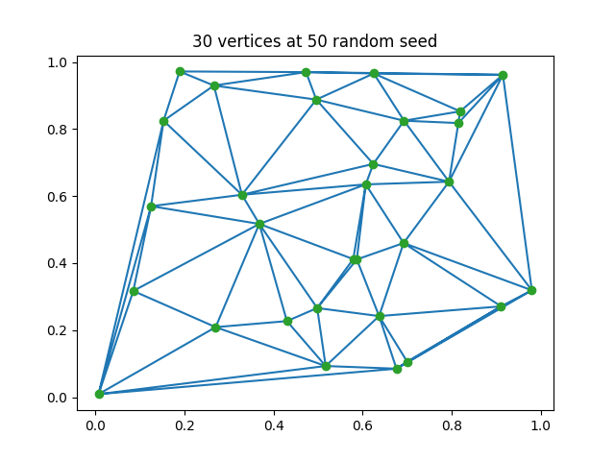
30 vertices

Slide 15
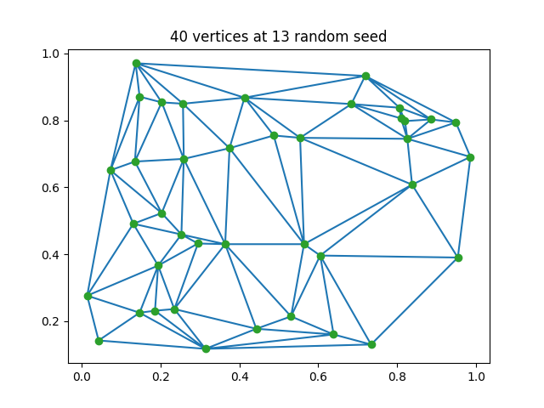
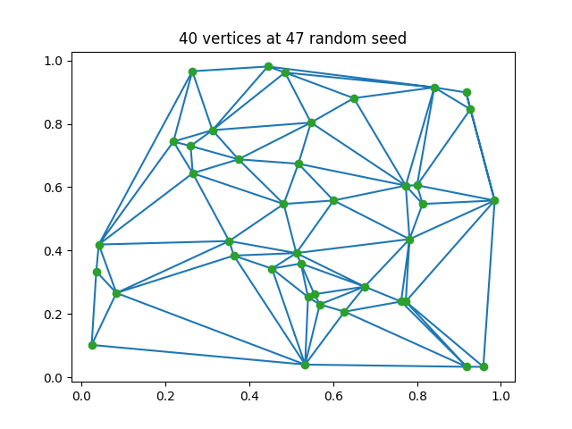
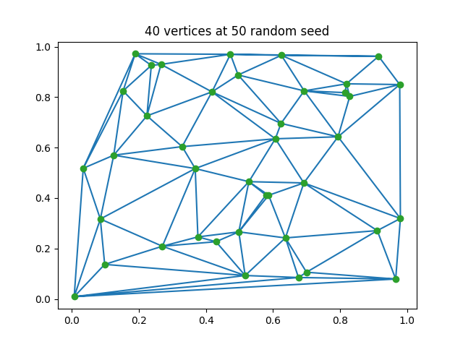
40 vertices

Slide 16
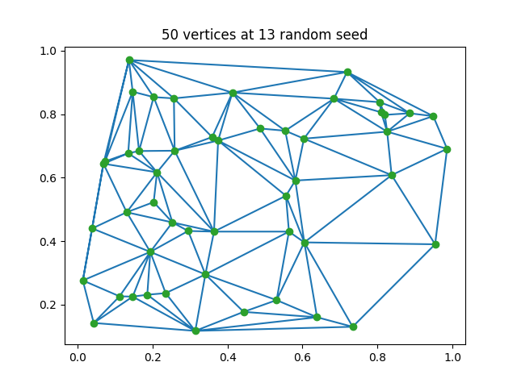
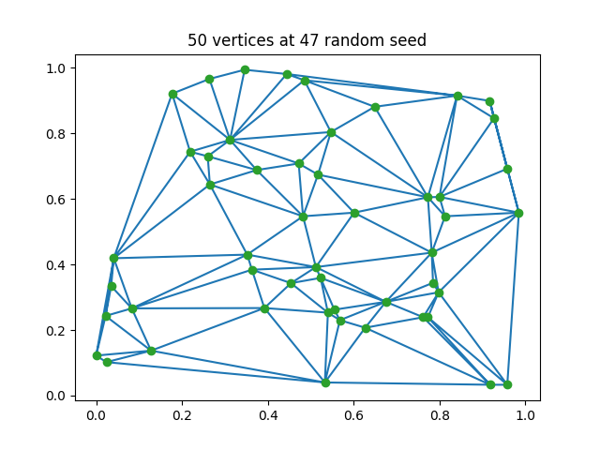
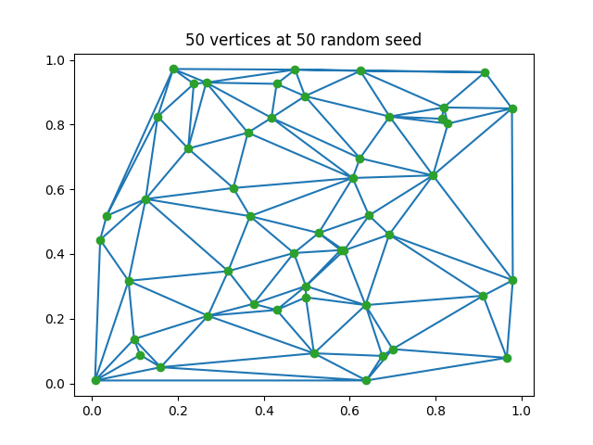
50 vertices

Slide 17
Compare Models by Seed 13

Slide 18
20 vertices
Model One
Base: 19.5
Model Two
Add (5.2n) shortest edges
Model Three
Delauney Triangulation

Slide 19
30 vertices
Model One
Base: 90
Model Two
Add (5.2n) shortest edges
Model Three
Delauney Triangulation

Slide 20
40 vertices
Model One
Base: 240
Model Two
Add (5.2n) shortest edges
Model Three
Delauney Triangulation

Slide 21
50 vertices
Model One
Base: 750
Model Two
Add (5.2n) shortest edges
Model Three
Delauney Triangulation

