Slide 1

TaskManager: Task Management System
Author: [Adrian Flores]
Date: [19/05/2025]
Built with Spring Boot, MySQL, JWT

Slide 2
Project Goal
Develop a secure REST API for managing users and tasks with:
- JWT authentication and authorization
- Role-based access control
- Persistence with MySQL
- API documentation using Swagger

Slide 3
System Architecture
Spring Boot: Controllers, Services, Repositories
Spring Security with JWT for authentication and authorization
MySQL as relational database
Use of DTOs to secure data transfer
Swagger/OpenAPI for documentation and testing
Diagram idea:
Client → Controller → Service → Repository → Database

Slide 4

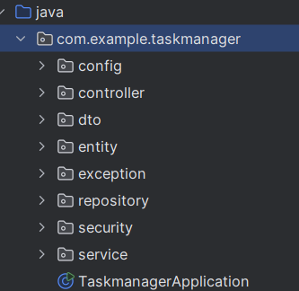

System Architecture
A look of the project structure

Slide 5
Key Features
User registration and login with JWT token
Roles: ROLE_USER and ROLE_ADMIN with priority levels
CRUD operations for tasks with validation and access control
Centralized exception handling with GlobalExceptionHandler
Use of DTOs to avoid exposing internal entities
Swagger UI for API documentation and testing

Slide 6
Security and JWT
Stateless authentication using JWT tokens
Custom JWT filter intercepting requests
Role-based access with priorities for fine-grained control
Spring Security configuration to secure endpoints

Slide 7



Challenges and Solutions
Integration of JWT filter within Spring Security filter chain
Mapping entities to DTOs to enhance security and modularity
Implementing roles with priorities to manage access rights
Handling CORS and CSRF security features properly
Using springdoc-openapi for automatic API documentation

Slide 8
Quick Demo (Screenshots)
User registration endpoint
User login and JWT token generation
Creating tasks with authorization
Fetching user-specific tasks
Admin viewing all users with task counts

Slide 9
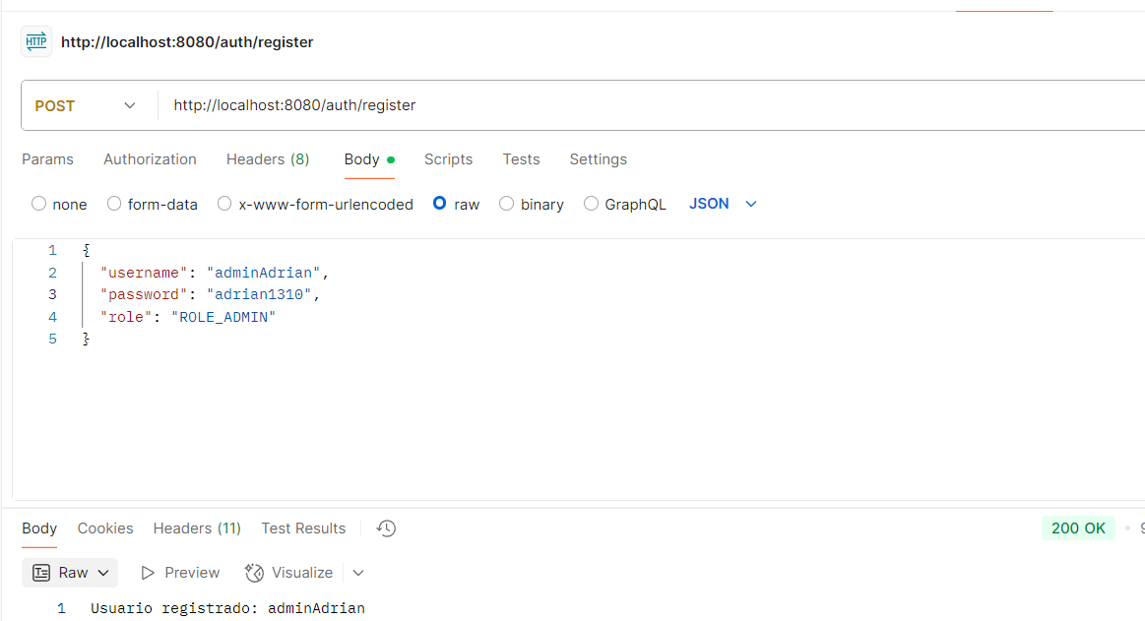
Quick Demo (Screenshots) Register Admin

Slide 10
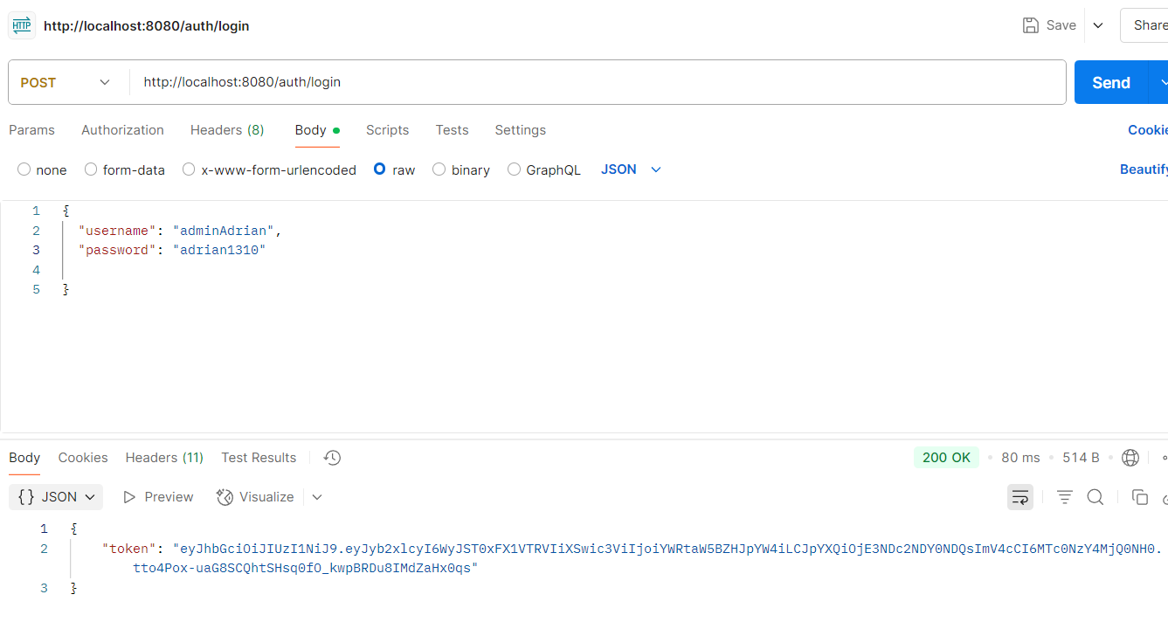
Quick Demo (Screenshots) Login Admin

Slide 11
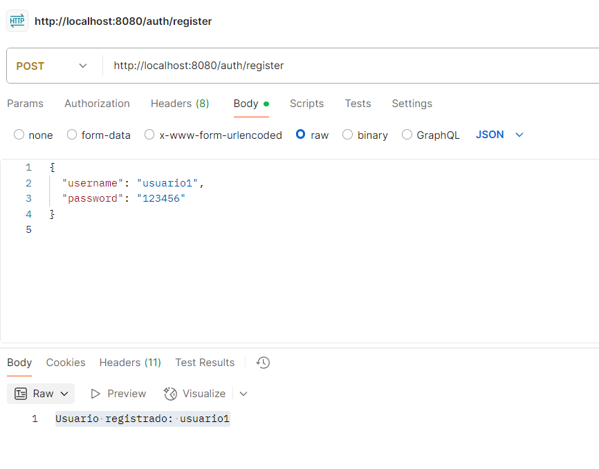
Quick Demo (Screenshots) Register User

Slide 12
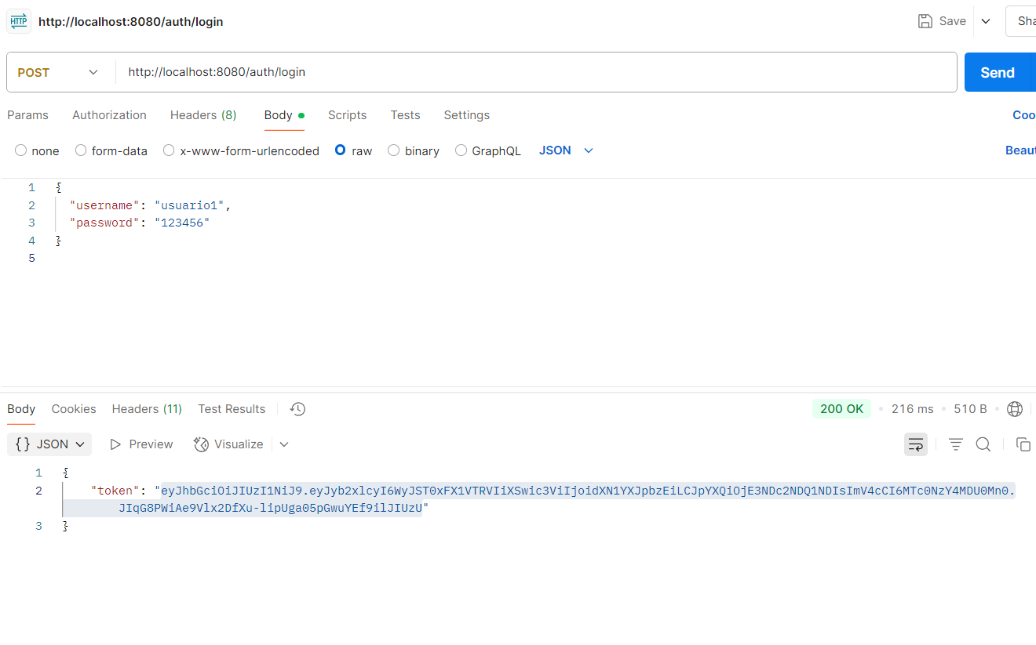
Quick Demo (Screenshots) Login User

Slide 13
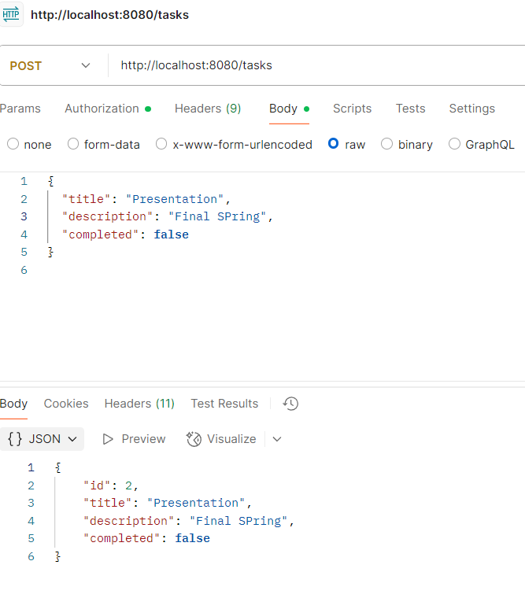
Quick Demo (Screenshots) Create Task

Slide 14
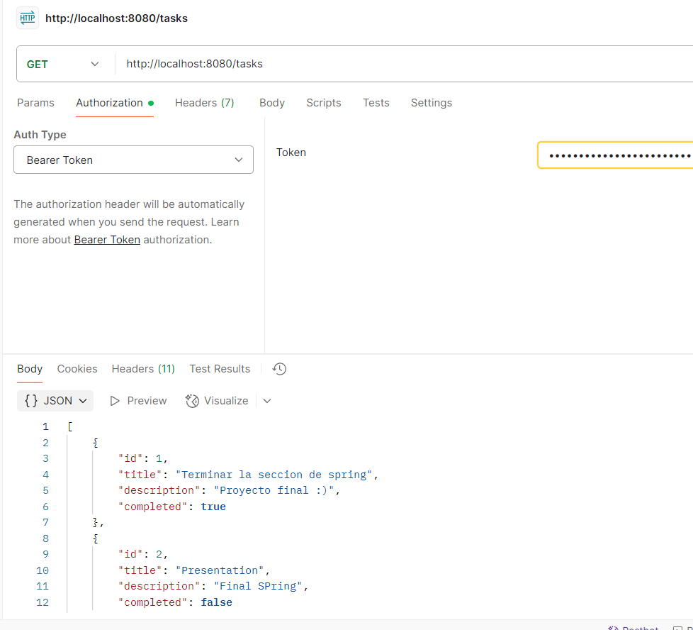
Quick Demo (Screenshots) List Task

Slide 15
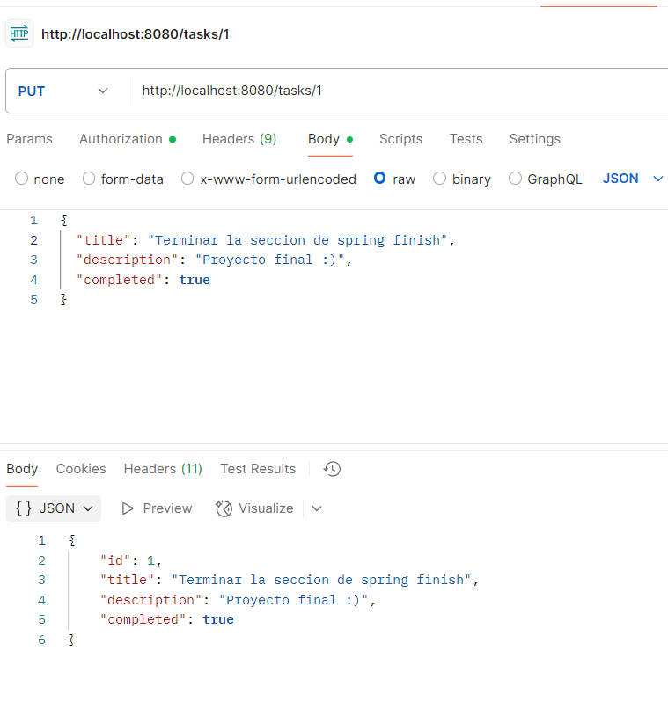
Quick Demo (Screenshots) Edit Task

Slide 16
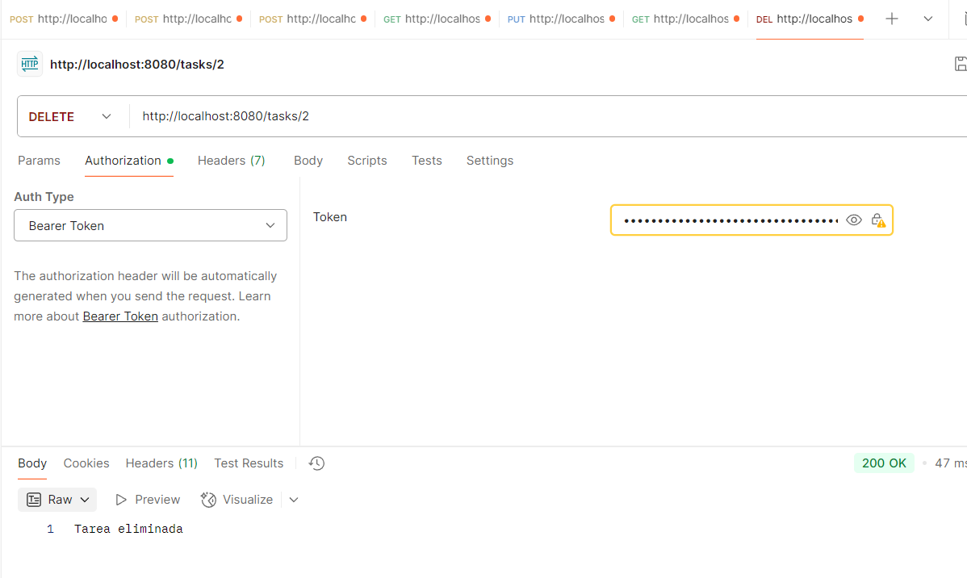
Quick Demo (Screenshots) Delete Task

Slide 17
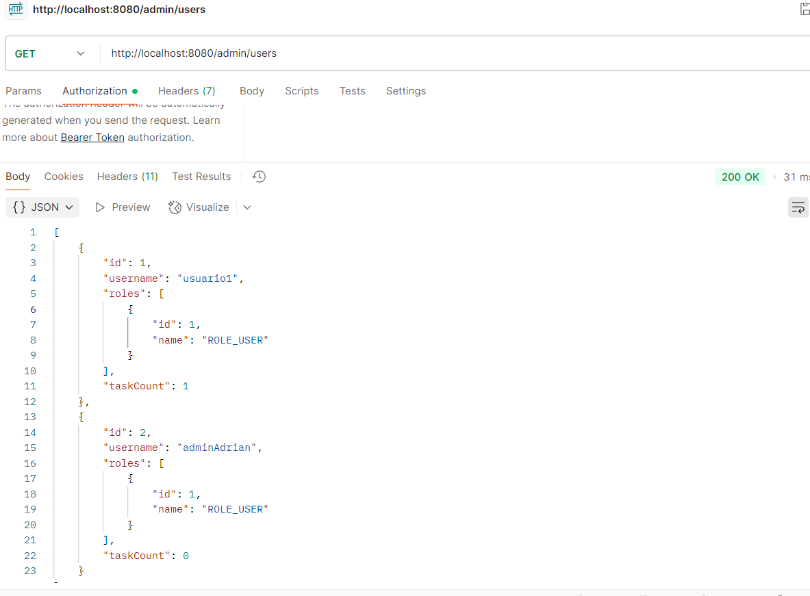
Quick Demo (Screenshots) List User Only admin

Slide 18
Conclusions and Future Work
Fully functional and secure task management system
Clean and modular architecture
Future improvements: pagination, advanced filtering, email notifications
Frontend integration and deployment to cloud environments

Slide 19
Contact
Contact: afr.1993@gmail.com
Thank you for your attention!

