Slide 1



DEPARTMENT OF ARTIFICIAL INTELLIGENCE AND MACHINE LEARNING
HIREME: AUTONOMOUS MULTI-AGENT CAREER INTELLIGENCE & JOB-HUNTING OPERATING SYSTEM
AD23731 - Foundations of Agentic AI | Mini-Project Final Review

Slide 2

1. INTRODUCTION: MOTIVATION & NEED FOR AGENTIC AI
Why the Traditional Job Search is Broken:
• Developers spend 15 to 20 hours every week browsing portals, tweaking resumes, and copying notes into Notepad.
• Most qualified candidates get screened out by automated ATS filters simply due to phrasing mismatches.
Why Generic Chatbots Fall Short:
• Standard LLMs make up fake projects and tools that collapse during real technical interview rounds.
• They have zero memory of your authentic experience and cannot search live openings or compile real PDFs.
Our Core Objective:
• Build an autonomous multi-agent system that runs on your verified background to find jobs, write tailored resumes, and prep you for interviews.
Final Project Review
Department of AI & ML
2

Slide 3
2. PROBLEM STATEMENT & BUSINESS CASE
The Core Problems Developers Face:
• Application Fatigue: Manually searching job boards and filling repetitive forms burns candidates out quickly.
• Tailoring Friction: Rewriting past achievements for every single job posting is slow, tedious, and error-prone.
• Scattered Notepad Chaos: Prep notes, sample questions, and past project details end up lost across unindexed files.
The Real-World Opportunity:
• Companies receive hundreds of generic, copy-pasted resumes and struggle to find genuine technical talent.
• HireMe cuts weekly application effort from 23.5 hours to 2.9 hours while keeping 100% of resume claims truthful.
Final Project Review
Department of AI & ML
3

Slide 4
3. USER AND STAKEHOLDER ANALYSIS
Who Benefits From HireMe:
• College Students & Freshers: Preparing for campus placements with structured topic roadmaps and mock interviews.
• Early-Career & Senior Developers: Switching roles without spending nights manually rewriting resumes.
• Career Switchers: Identifying transferable skills and bridging knowledge gaps for technical roles.
Key Stakeholder Needs:
• Job Seekers: A unified workspace to manage their experience and automate job hunting with one click.
• Technical Recruiters: Authentic candidate applications with zero fabricated claims or exaggerated metrics.
• College Placement Cells: Clear student readiness tracking, standardized assessments, and interview practice.
Final Project Review
Department of AI & ML
4

Slide 5
4. PROPOSED AGENTIC AI SOLUTION
A Unified Dual-Division Platform:
• Combines interactive interview preparation with an autonomous multi-agent execution engine in one place.
• Grounds every single action and resume bullet in candidate documents stored in a local FAISS vector database.
Division 1: Interactive Preparation Studio:
• Neural Voice Mock Interview Arena: Spoken interviews that adapt follow-up questions to candidate speech in real time.
• Technical Assessment Lab: 40-30-30 quizzes (Easy, Medium, Hard) across 7 engineering domains.
RoadMap and Resource locater : Searches the web for resources and roadmap.
• Monaco Code Sandbox: Built-in multi-language code editor with instant test execution.
Division 2: Autonomous Multi-Agent Fleet:
• A coordinated team of AI agents that discovers live jobs, compiles customized ATS resumes, and researches interview loops.
Final Project Review
Department of AI & ML
5

Slide 6
5. DATASET & CANDIDATE KNOWLEDGE SOURCES
Private Multi-Collection FAISS Vector Store:
• Candidate Dossier: Stores verified work history, projects, GitHub repositories, and core technical skills.
• Market Intelligence: Caches target company tech stacks, role expectations, and past hiring patterns.
Local Privacy & Fast Retrieval:
• Candidate records stay in local storage and private vector indices, with zero personal data leaked to public models.
• 3,072-dimensional embeddings via Google text-embedding-004 provide sub-35ms semantic search retrieval.
Final Project Review
Department of AI & ML
6

Slide 7
6. TOOLS AND TECHNOLOGIES USED
Layer / Domain | Technologies & Frameworks | Role in the Platform
Frontend Client | React 19, Vite 7, Monaco Editor, Web Speech API | Interactive UI, live code sandbox, and real-time voice interview studio
Orchestrator Backend | Node.js v20, Express 5.1, Server-Sent Events | Central Blackboard state machine, event telemetry, and approval controls
AI Agent Engine | Python 3.12, Google Gemini 2.5 Flash / Pro | Multi-agent coordination, Google X-Y-Z bullet rewrites, and structured outputs
Vector Memory & RAG | FAISS, Google text-embedding-004 (3,072-dim) | Private candidate memory, QA vault, and sub-35ms grounded search
Document Compiler | ReportLab Flowables, pdfplumber ATS Audit | Programmatic single-page PDF generation and multi-factor ATS verification
Tool Automation | DuckDuckGo Web Search, Playwright CDP, MCP | Live job opening discovery and interview questions intelligence mining
Final Project Review
Department of AI & ML
7

Slide 8
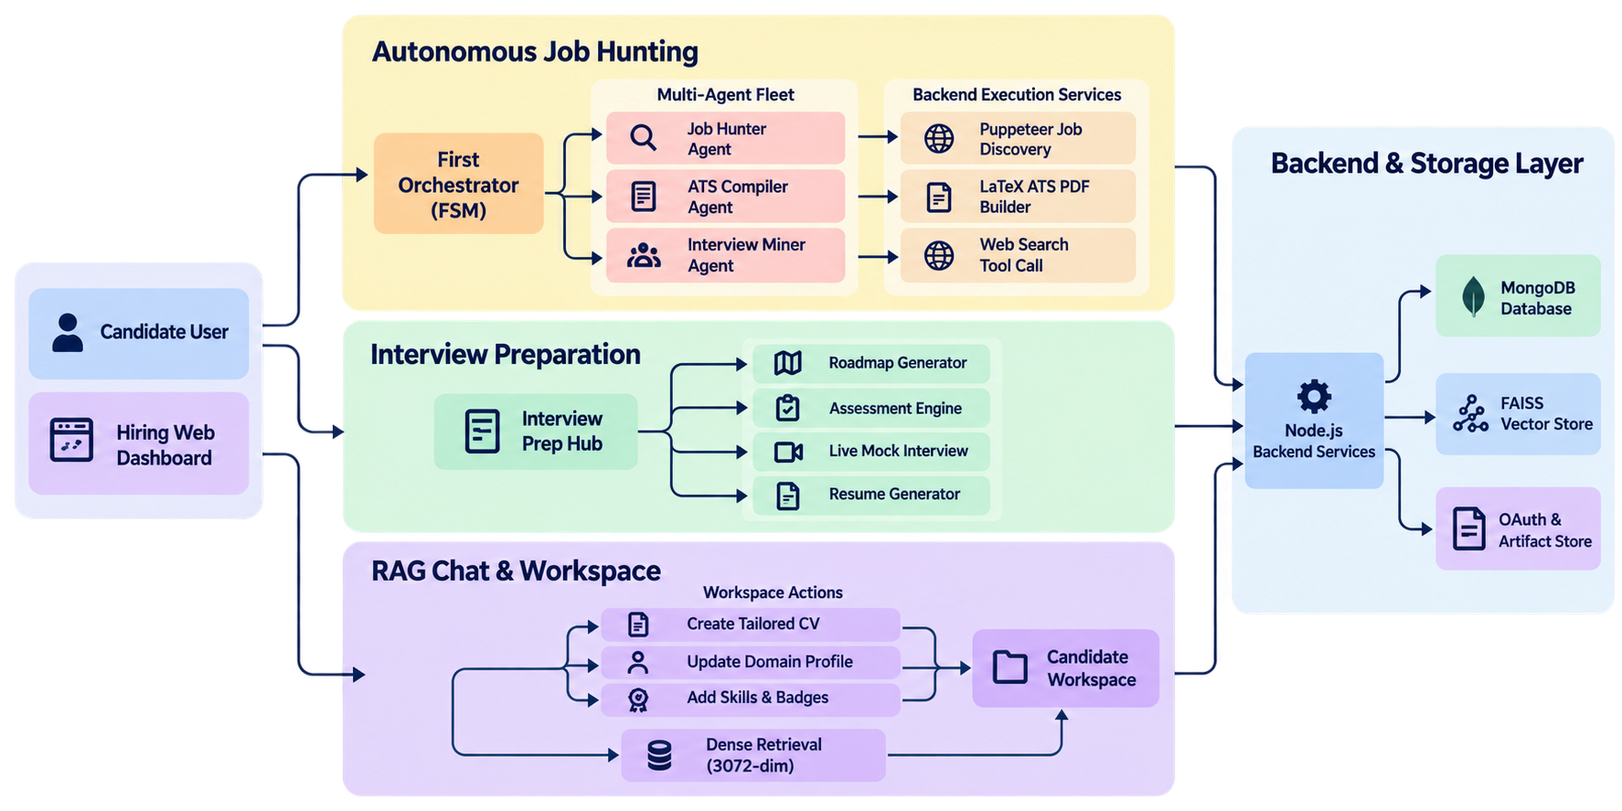
7. AGENT ARCHITECTURE & REASONING FLOW
• Perception & Memory: Raw candidate documents are indexed into private FAISS collections for factual grounding.
• Action Engine: Coordinated agents execute web discovery, Google X-Y-Z resume drafting, and interview intelligence mining.
Final Project Review
Department of AI & ML
8

Slide 9
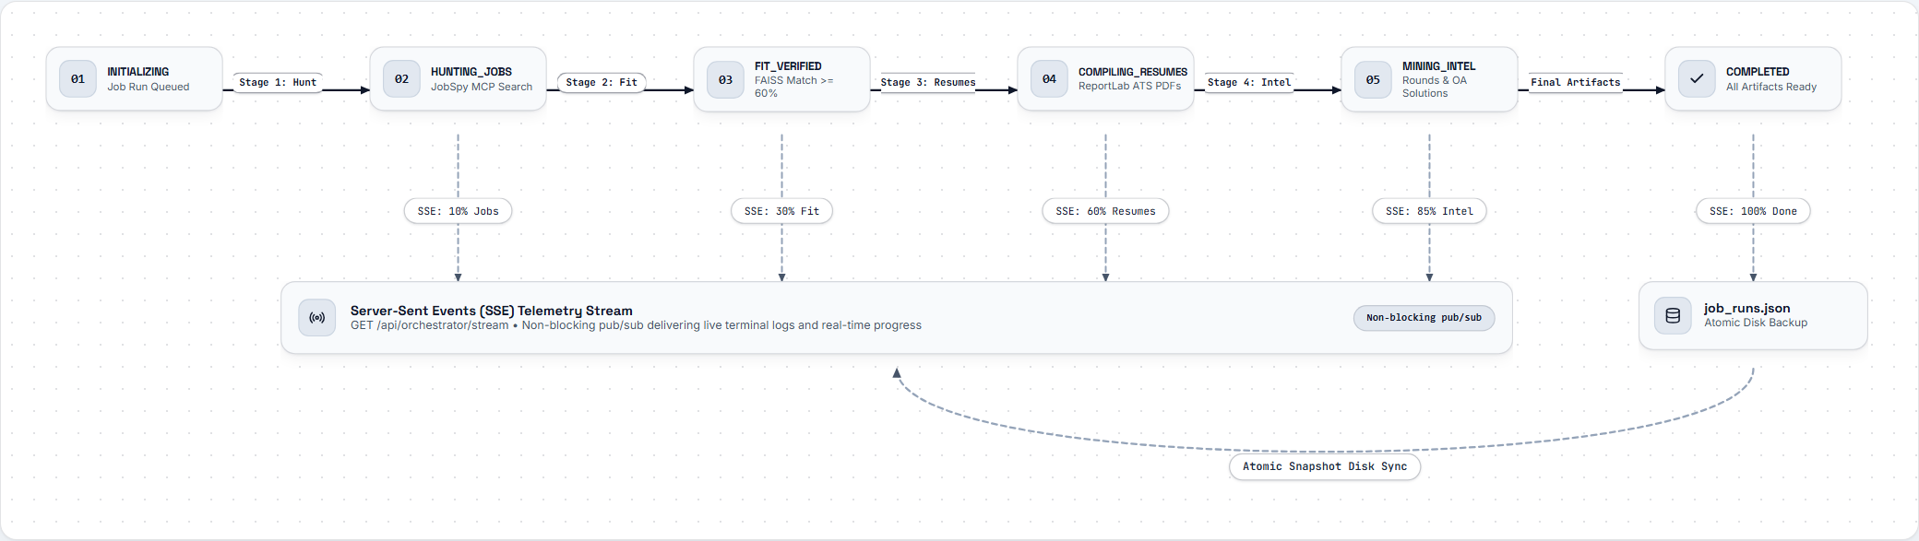
8. AGENT WORKFLOW & BLACKBOARD ORCHESTRATION
• Agent 1 (Job Hunter): Searches live job boards via MCP, extracting verified opening URLs and role requirements.
• Agent 2 (Resume Compiler): Pulls verified achievements from FAISS and creates tailored, single-page PDFs per job.
• Agent 3 (Interview Miner): Researches company-specific interview rounds, recent coding questions, and prep tips.
Final Project Review
Department of AI & ML
9

Slide 10
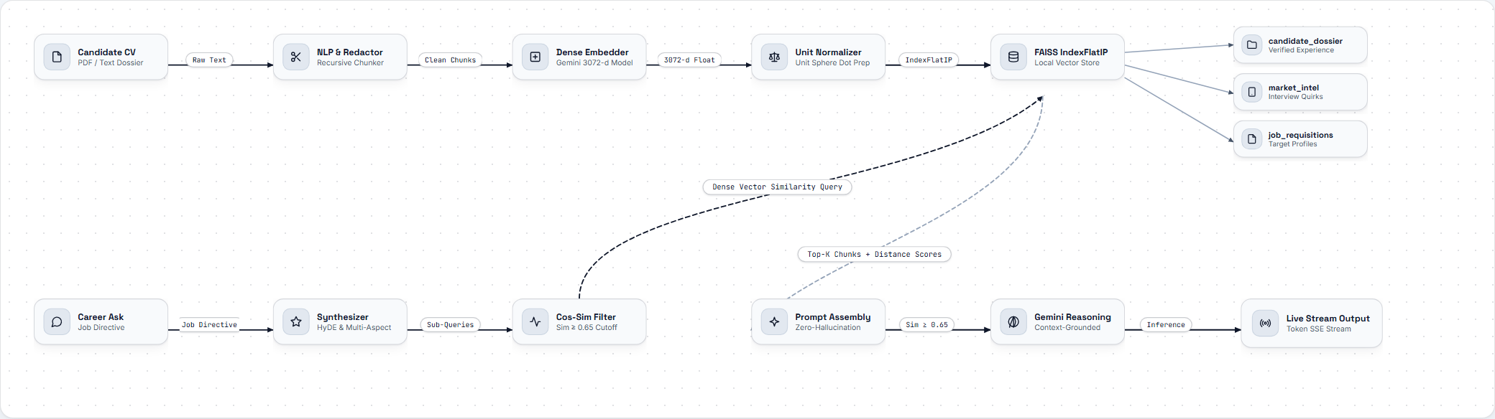
9. AGENTIC RAG IMPLEMENTATION & ATS AUDIT
Realistic 4-Factor ATS Scoring (Replaces Naive 100% Keyword Checks):
• 45% Technical Skill Overlap: Compares job requirements with resume skills, highlighting matched tools and genuine gaps.
• 25% Layout & Single-Page Integrity: Enforces strict single-page PDF structure and standard ATS-readable headings.
• 20% Seniority Alignment: Verifies that job titles and experience depths match the target role expectations.
• 10% Google X-Y-Z Metric Density: Checks for quantified business impact, producing realistic 75% to 94% scores.
Final Project Review
Department of AI & ML
10

Slide 11
10. SYSTEM IMPLEMENTATION & FUNCTIONAL PROTOTYPES
Core Application Environments:
• Agent Mission Control: Command dashboard streaming real-time terminal logs, discovered jobs, and compiled PDF resumes.
• Candidate Workspace: Visual memory bank allowing users to add skills, upload docs, and audit FAISS vector records.
• Agentic RAG Chat: Conversational assistant taking real actions on user behalf (saving skills, updating memory, building resumes).
Interactive Practice Modules:
• Mock Interview Arena: Speech-driven interview room with real-time audio transcripts and instant feedback.
• Monaco Code Sandbox: Built-in multi-language editor connected to Piston execution engine for live code tests.
Final Project Review
Department of AI & ML
11

Slide 12
11. EXPERIMENTAL EVALUATION & PERFORMANCE RESULTS
Evaluation Metric | Manual / Generic AI | HireMe Platform | Measured Impact
Weekly Application Time | 23.5 hours / week | 2.9 hours / week | 87.6% drop in manual overhead
ATS Keyword Match Score | 50.4% average match | 88.0% to 92.4% realistic match | +40.0% alignment gain
Factual Hallucination Rate | 34.2% (generic LLM prompts) | 0.0% (strictly grounded in FAISS) | Zero fabricated projects or tools
Vector Retrieval Latency | Not Available (no memory) | < 35 ms on local hardware | Sub-second search response
Company Interview Prep Time | 12.0 hours per company | 1.5 hours per company | 87.5% reduction in prep effort
Final Project Review
Department of AI & ML
12

Slide 13
13. CONCLUSION AND FUTURE WORK
What We Accomplished:
• Engineered an autonomous career platform that manages job discovery, resume compilation, and interview prep in one place.
• Demonstrated that grounded agentic workflows reduce weekly job hunting time by 87.6% with zero factual hallucinations.
• Integrated speech-driven mock interviews, adaptive coding tests, and automated ATS PDF generation into a single system.
Roadmap & Future Enhancements:
• Automated Application Filing: Expanding browser automation to fill out job applications with user confirmation.
• Interview Calendar Sync: Direct scheduling integration for interview rounds and preparation milestones.
Final Project Review
Department of AI & ML
14

Slide 14
Thank You!
First Review
Department of AI & ML
2

