Slide 1

CMat: describing the language and its Python-implemented interpreter
(term project)
Antonio Franques
CS 598 DHP Scripting Languages - Design and Implementation, Fall 2015
Department of Computer Science
University of Illinois at Urbana-Champaign

Slide 2
Outline
Introduction/Motivation of the project Description of CMat syntax CMat’s interpreter implementation (in Python) Performance results Future improvements

Slide 3
Outline
Introduction/Motivation of the project Description of CMat syntax CMat’s interpreter implementation (in Python) Performance results Future improvements

Slide 4
1. Introduction/Motivation of the project
Problems 1st year Engineering/CS undergrads → Basic or non-existing programming knowledge Poor motivation for some topics (AST, statically typed langs…) Solutions Prepare material for a motivational class Introduction to plain programming (arith. ops, assignments, loops, if-else…) → CMat Awake students curiosity to bigger challenges (interpreter) → use of Python → Plain programming not enough → Classes and Methods (introduction to OOP) Show (poor) performance of interpreter implem. → Motivate to learn better compiler/interpreter implem. strategies (e.g. by AST)

Slide 5
Outline
Introduction/Motivation of the project Description of CMat syntax CMat’s interpreter implementation (in Python) Performance results Future improvements

Slide 6
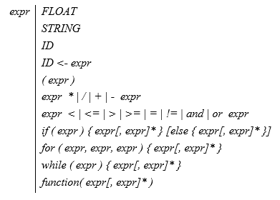
2. Description of CMat syntax
Subset of C, with Matlab functions and Cool assignment op. Expressions separated by “;” (except inside structure bodies) Any characters followed by “%” → treated as comment up to next new line

Slide 7
2. Description of CMat syntax
¿Why this syntax? Assignments denoted by “←” for similarity to “by hand” notation. Also avoids confusion with equality (“=”, used as Boolean op.) Arithmetic (“+”, “-”, “*”, “/”) and Boolean (“<”, “<=”, “>”, “>=”, “and”, “or”…) ops. clearly follow standard math notation, for intuition Method dispatch also follows standard math notation: fun(arg1, arg2…) which is equivalent to say “function fun operating somehow over arg1, arg2…” Loops and “if-else” kept equal to C, C++, Java… for coherence and ease of transition

Slide 8
Outline
Introduction/Motivation of the project Description of CMat syntax CMat’s interpreter implementation (in Python) Performance results Future improvements

Slide 9
3. CMat’s interpreter implementation
¿Why Python? Dynamically typed → Easier programming (no type restrictions, no definitions…) Native-implemented functions to ease tokenizing string of chars (through reg. exprs.) Important for students to write clean/indented code (mandatory in Python)

Slide 10
3. CMat’s interpreter implementation
Interpreter strategy breakdown Read CMat code as string of chars Text-match it (tokenizing) according to list of regs. exprs. For each match in regs. exprs. → create object Token with 2 parameters (type, value), then append to vector of Tokens Interpret directly whole vector of Tokens (without AST)

Slide 11
3. CMat’s interpreter implementation
Interpreter strategy breakdown Read CMat code as string of chars Text-match it (tokenizing) according to list of regs. exprs. For each match in regs. exprs. → create object Token with 2 parameters (type, value), then append to vector of Tokens Interpret directly whole vector of Tokens (without AST)

Slide 12
3. CMat’s interpreter implementation
Interpret directly whole vector of tokens Divide original vector of Tokens into subvectors delimited by semicolons (Token.type==SEMIC) One expr. per subvector Create Interpreter instance (for each subvector) with subvector as a constructor argument Run interpreter by calling Interpreter.expr() expr() is main method of Interpreter class

Slide 13
3. CMat’s interpreter implementation
Interpret directly whole vector of tokens Divide original vector of Tokens into subvectors delimited by semicolons (Token.type==SEMIC) One expr. per subvector Create Interpreter instance (for each subvector) with subvector as a constructor argument Run interpreter by calling Interpreter.expr() expr() is main method of Interpreter class

Slide 14
3. CMat’s interpreter implementation
Run interpreter by calling Interpreter.expr() Different expressions start with different token types → Easy to separate schemes Schemes (in order as executed): If first token type is ID and next is type ASSIGN → eval. right expr. and save into entry of symbol table corresponding to variable name (we do lookup with ID value) Else-if is ID/FLOAT/LPAREN → Boolean/arithmetic op. → check length: Length 1 → If FLOAT, return value, otherwise (ID), return entry of symbol table (by doing lookup of ID value) Length > 1 → Check if AND or OR outside parentheses, if so, evaluate both sides and return and/or-ize, if not, check if LT/LE/GT… outside paren. and proceed analogously, if not, check PLUS/MINUS/MUL/DIV and if not, remove parentheses (this way we set precedence)

Slide 15
3. CMat’s interpreter implementation
Schemes (cont.): Else-if is STRING → remove quotes and return value Else-if is IF → new vector with all tokens inside pred. → eval. it If eval. return true → new vector and eval. for each element of “if”-body (delimited by COMA) If eval. return false → check if there’s ELSE and if so, new vector and eval. for each element of “else”-body; otherwise, do nothing Else-if is WHILE → new vector with all tokens inside pred.→ eval. it If eval. return true → new vector and eval. for each element of “while”-body, then eval. predicate again and repeat process. If eval. return false → do nothing Else-if is FOR → new vector and eval. 1st part of pred. (up to 1st COMA), then save and eval. 2nd part (up to 2nd COMA) If 2nd part eval. return true → new vector and eval. for each element of “for”-body, then save and eval. 3rd part of pred (up to right-most RPAREN) and re-eval 2nd part of pred, if this return true, repeat process, otherwise, do nothing If 2nd part eval. return false → do nothing

Slide 16
3. CMat’s interpreter implementation
Schemes (cont.): Else-if is METHOD → lookup method name (value of METHOD token) in methods’ symbol table. If match → new vector with tokens inside parentheses, then call Python-method (expressively created for that CMat function) and send vector to it. The called Python-method will deal with it, by separating, evaluating and operating over arguments separated by COMA; finally return value if necessary. If no match → display error (method not recognized) Else → display error (expression not recognized)

Slide 17
Outline
Introduction/Motivation of the project Description of CMat syntax CMat’s interpreter implementation (in Python) Performance results Future improvements

Slide 18
4. Performance results
Machine: Intel Core i7-3537U (1st gen) @ 2.5 GHz 8 GB of memory OS: Ubuntu 14.04 (64 bits) Four (scalar) micro benchmarks: Finding a Fibonacci sequence (Fib) Obtaining a list of prime numbers up to certain one (Prime) Calculating Greatest Common Divisor of 2 values (GCD) Obtaining Mandelbrot set for certain squared surface (Man) Comparison of execution time over Matlab and Python For Matlab: R2014b version For Python: version 3.5

Slide 19
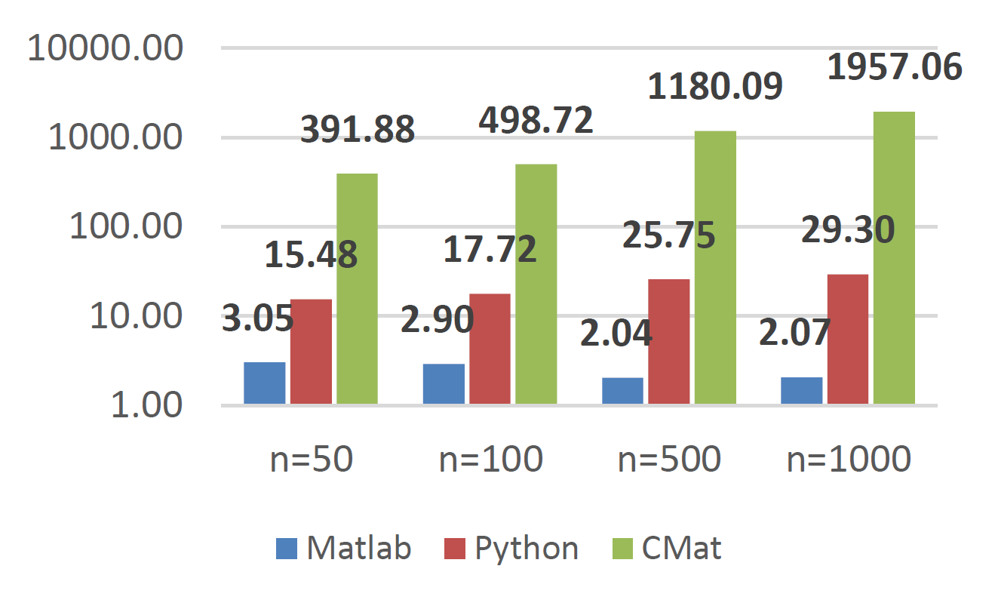
4. Performance results
Fib micro benchmark Bigger input values → more iters. → bigger relative SD of CMat

Slide 20
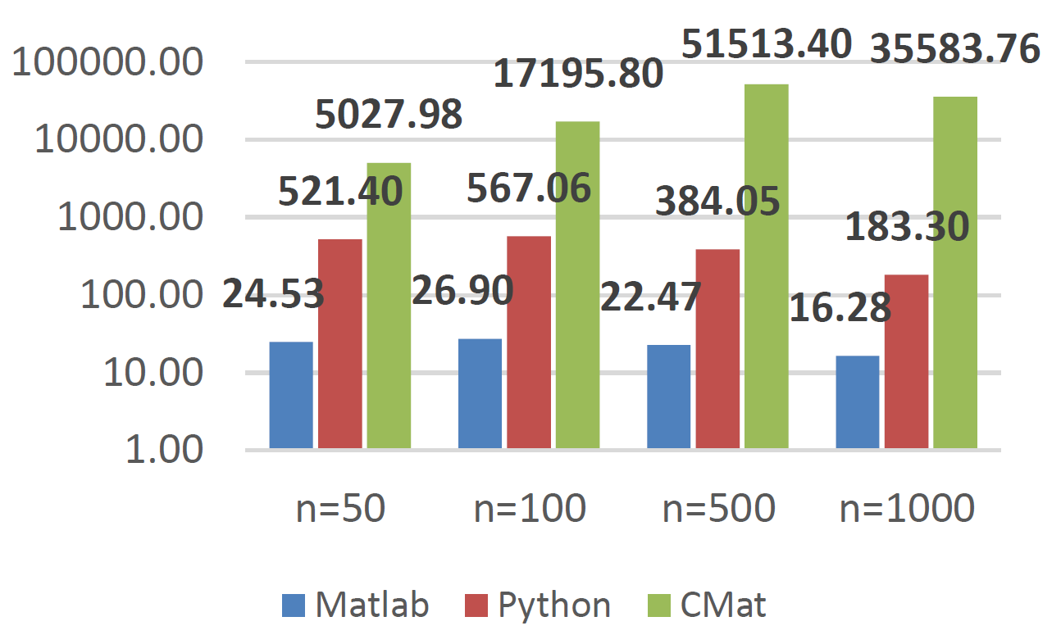
4. Performance results
Prime micro benchmark Bigger input values → more iters. → bigger relative SD of CMat

Slide 21
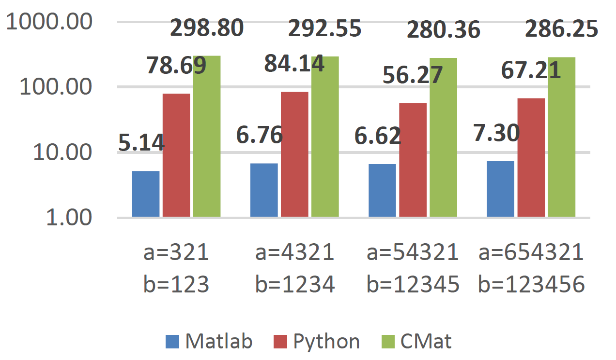
4. Performance results
GCD micro benchmark Bigger numbers but not (necessarily) more iters. → constant SD

Slide 22
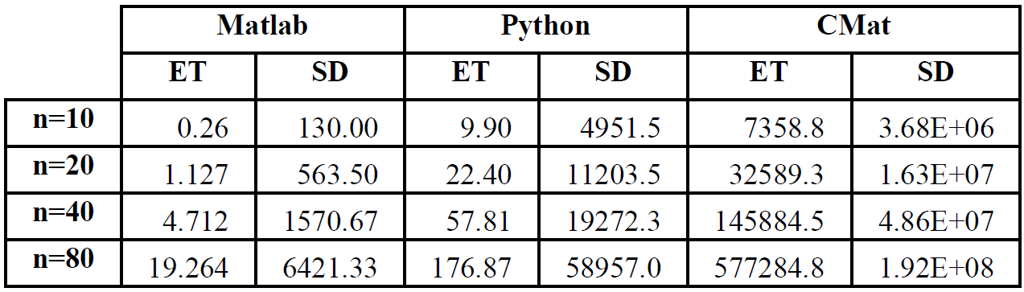
4. Performance results
Man micro benchmark (ET = Execution Time in miliseconds, SD = Slowdown relative to C) Bigger input values → more iters. → bigger relative SD of CMat (ET=Execution Time in mili seconds, SD=Slowdown)

Slide 23
4. Performance results
Conclusions: Fib, Prime and Man experience longer relative SD because we run more iters. of loops → more interpretations → emphasize poor structured interpreter. GCD constant behavior → bigger values doesn’t imply more iters. of loops → shows that problem of our interpreter is not bigger values but amount of interpretations Our implementation useful for small scripts, otherwise SD increases notoriously → We need to drastically modify structure design Matlab remains (mainly) constant over C → shows robustness and goal to look up to Now obvious for students that need to learn on two disciplines: Programming langs. Interpreters/compilers

Slide 24
Outline
Introduction/Motivation of the project Description of CMat syntax CMat’s interpreter implementation (in Python) Performance results Future improvements

Slide 25
5. Future improvements
Difficult to improve this implementation without drastic changes, but for students to keep practicing Python: Complex numbers notation, as in Matlab, with use of “i” (e.g. 3+4i) → Be careful, arithmetic/bool ops. implement. change Array notation → Be careful with ID calls and assignments More functions (e.g. modulus, rand, mean, max/min, sort, plot…) Allow CMat users to create and call their own-written functions → Modify methods’ symbol table on the fly

Slide 26
Thank you

