Slide 1
FISH MONITOR SYSTEM

Slide 2
Objectives
Measure pond or lake depth (bathymetry) in real-time.
Monitor water and surface temperature accurately.
Assess water quality using turbidity and pressure sensors.
Provide live camera feed of the aquaculture environment.
Detect and track fish behavior using OpenCV on a laptop.

Slide 3
Intro
Smart system for monitoring aquaculture ponds and lakes.
Uses ESP32-S3 with sensors (water & surface temperature, pressure, turbidity).
Captures live images of the pond using a camera.
Sends real-time environmental data to a web dashboard.
Detects and tracks fish behavior using OpenCV on a laptop.

Slide 4
Existing System
Manual measurement of pond depth using rods or sounding lines.
Water temperature checked occasionally with thermometers.
Water quality assessed visually or using simple test kits.
Fish behavior observed manually by farmers.
No real-time data or automated monitoring; dependent on human effort.

Slide 5
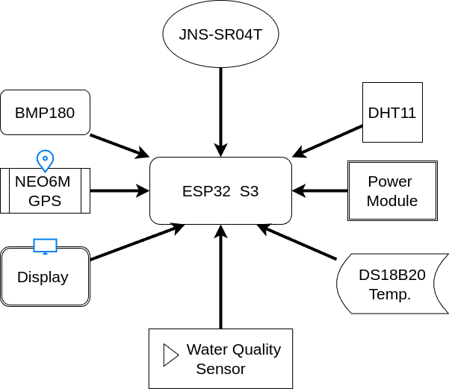
Block Diagram

Slide 6
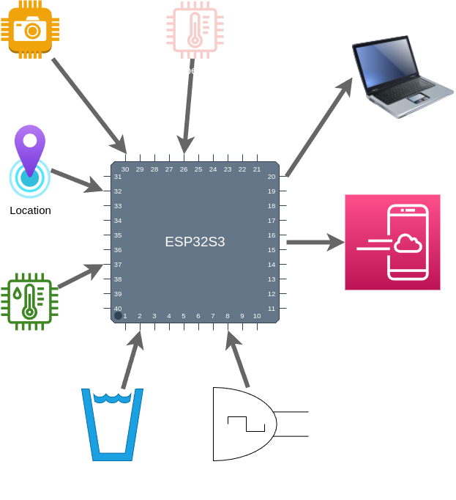
Work Flow

Slide 7
Software
Arduino IDE
Python & OpenCV
HTML, CSS, JavaScript (Chart.js)

Slide 8
Hardware
ESP32-S3 Camera Module
Ultrasonic Sensor
DS18B20 Water Temperature Sensor
DHT11 Temperature Sensor
BMP180 Pressure Sensor
Turbidity Sensor
Buck Converter
12v PS

Slide 9
Methodology
Data Acquisition
Deploy sensors in pond/lake:
• Ultrasonic sensor → Measures depth of water/land.
• DS18B20 & DHT11 → Water & surface temperature.
• BMP180 → Pressure & altitude data.
• Turbidity sensor → Water quality assessment.
ESP32-S3 reads all sensor data periodically.
Live camera captures images of pond/lake.

Slide 10
Data Acquisition
Deploy sensors in pond/lake:
• Ultrasonic sensor → Measures depth of water/land.
• DS18B20 & DHT11 → Water & surface temperature.
• BMP180 → Pressure & altitude data.
• Turbidity sensor → Water quality assessment.
ESP32-S3 reads all sensor data periodically.
Live camera captures images of pond/lake.

Slide 11
Visualization & Analysis
Web dashboard displays:
• Depth measurements over time (graph).
• Water & surface temperature, pressure, turbidity readings.
• Water quality status (Good/Bad).
Fish activity visualized via OpenCV analysis.
Enables real-time monitoring and informed aquaculture decisions.

Slide 12
Merits
Real-time monitoring of pond/lake depth and water parameters
Automated fish detection and behavior tracking using OpenCV
Live camera feed for remote observation
Accurate water quality assessment using sensors
Reduces manual effort and human error
Data visualization via web dashboard for informed decisions

Slide 13
Demerits
Initial setup cost can be high
Requires continuous power supply for ESP32 and sensors
WiFi range may limit remote monitoring
Sensor accuracy can be affected by environmental conditions
Camera and processing may lag in large ponds/lakes

Slide 14
Result & Conclusion
Real-time monitoring of pond/lake depth and environmental parameters achieved.
Live camera feed provides visual observation of the aquaculture site.
Fish detection and tracking implemented successfully using OpenCV.
Data visualization on web dashboard enables easy analysis and decision-making.
System reduces manual effort, improves water quality management, and is scalable for larger ponds/lakes.

Slide 15
Reference
H. Liu, X. Ma, Y. Yu, L. Wang & L. Hao, Application of Deep Learning-Based Object Detection Techniques in Fish Aquaculture: A Review, J. Mar. Sci. Eng., 2023 — discusses DL object detection for fish counting & behavior analysis.
M. Hamzaoui et al., An Improved Deep Learning Model for Underwater Species Recognition in Aquaculture, Fishes, 2023 — presents an enhanced YOLO‑based model for fish recognition.
G. Li et al., Deep Learning-Based Fish Detection Using Above‑Water Infrared Camera for Deep‑Sea Aquaculture, Sensors, 2024 — explores DL models for fish detection with infrared imaging.
Md. M. Hemal et al., An Integrated Smart Pond Water Quality Monitoring and Fish Farming Recommendation Aquabot System, Sensors, 2024 — IoT‑based water quality system for aquaculture.
S. Zhang et al., Research Progress on Fish Farming Monitoring Based on Deep Learning Technology, Trans. Chinese Soc. Agricultural Eng., 2024 — surveys DL advances in fish farm monitoring.

Slide 16
“AquaYOLO: Advanced YOLO‑based fish detection for optimized aquaculture pond monitoring,” Sci. Rep., 2025 — YOLO‑based fish detection in aquaculture ponds.
“Deep learning based optimal fish species identification to maximize production in fish ponds,” Scientific Reports, 2025 — DL for fish species identification from pond data.
“Artificial intelligence in aquaculture: Advancing sustainable fish farming,” Aquaculture, 2026 — recent review on AI for aquaculture monitoring & optimization.
(Optional emerging) J. Yang et al., FinSight‑Net: Physics‑Aware Network for Underwater Fish Detection in Smart Aquaculture, arXiv 2026 — cutting‑edge DL model designed for smart aquaculture fish detection.
“Monitoring water quality metrics of ponds with IoT sensors and machine learning to predict fish species survival,” Microprocessors and Microsystems, 2023 — IoT + ML for pond water monitoring.

Slide 17
Thank You

