Slide 1
🚢
TITANIC
Survival Prediction
A Machine Learning Classification Project
Afraz Hussain
Data Science Internship — eduexpose

Slide 2
Introduction
🌊
On April 15, 1912, the RMS Titanic sank after striking an iceberg, resulting in the loss of over 1,500 of the 2,224 passengers and crew aboard — one of the deadliest peacetime maritime disasters in history.
⚓
While survival involved an element of chance, data shows it was far from random. Certain groups — women, children, and first-class passengers — had a significantly higher chance of survival due to evacuation protocols.
This project applies machine learning to uncover and quantify these survival patterns — turning a century-old tragedy into a structured, data-driven classification problem.

Slide 3
Problem Statement
Q
The Question
G
The Goal
Given a passenger's attributes — class, sex, age, fare, family size — can we predict whether they survived the Titanic disaster?
Build a supervised machine learning classification model that predicts a binary survival outcome (0 = Did Not Survive, 1 = Survived).
T
The Type
V
The Value
This is a binary classification problem, solved using the Titanic dataset published on Kaggle.
Demonstrates the complete ML pipeline: cleaning, EDA, feature engineering, model training, and evaluation.

Slide 4
Dataset
🧾
🔍
📋
🌐
891
418
12
Kaggle
Training Records
Test Records
Total Features
Data Source
Survived
Target: 0 = Did not survive, 1 = Survived
Pclass / Sex / Age
Ticket class, gender, and age of passenger
SibSp / Parch
Siblings/spouses and parents/children aboard
Fare / Cabin / Embarked
Ticket fare, cabin number, port of boarding

Slide 5
Data Cleaning
01
Age — Missing Values
Filled with the median age (robust to outliers and skew).
02
Embarked — Missing Values
Filled with the mode (most frequent boarding port).
03
Cabin — Missing Values
Filled with placeholder "Unknown" rather than dropped.
04
Categorical Encoding
Sex and Embarked converted to numeric using Label Encoding.

Slide 6
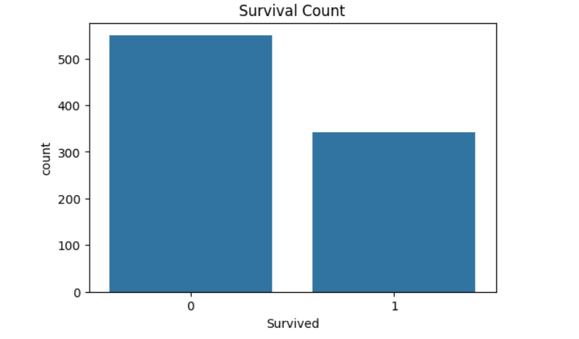
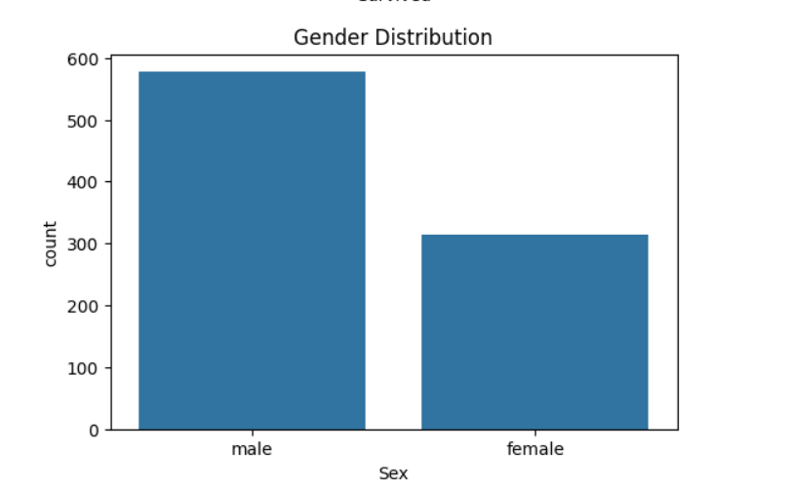
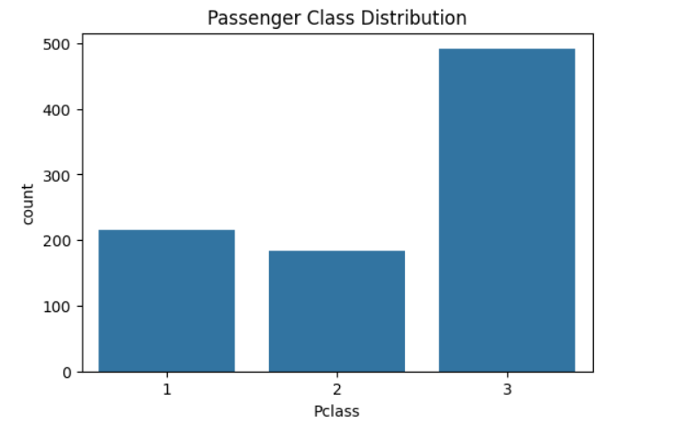
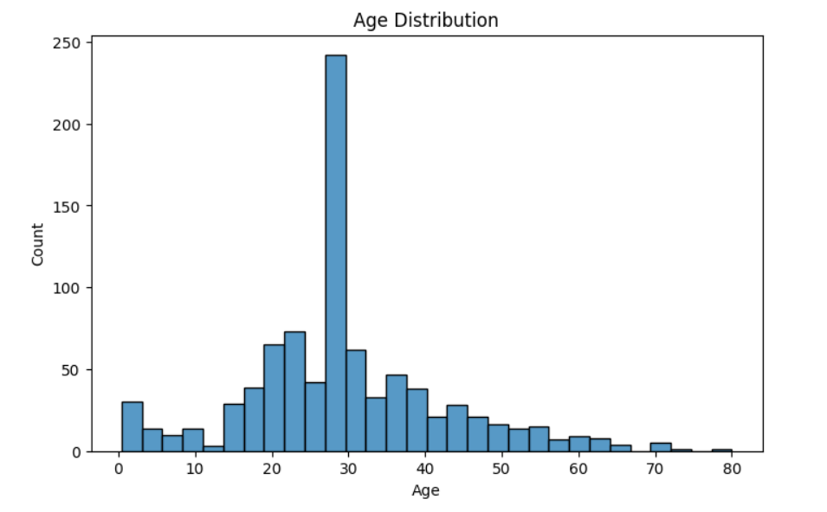
Visualizations — Survival Patterns
Survival Count
Gender Distribution
Passenger Class
Age Distribution

Slide 7
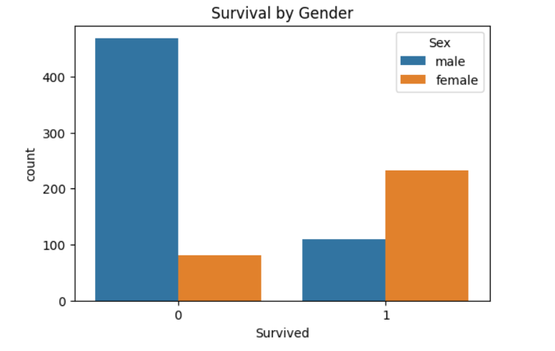
Visualizations — Survival by Gender
Key Insight
Female passengers had a dramatically higher survival rate than male passengers.
This directly reflects the “women and children first” evacuation protocol followed during the disaster, and is one of the clearest signals in the entire dataset.
Sex became the #1 predictor in the model

Slide 8
Machine Learning Model
🧹
🔤
🔎
✂️
🌲
Clean
Dataset
Encode
Features
Select
Features
Train/Test
Split
Random
Forest
Algorithm: Random Forest Classifier
Model Configuration
Pclass
Sex
Algorithm: RandomForestClassifier
Age
SibSp
n_estimators: 100
Parch
Fare
Train / Test: 80% / 20%
Embarked
Random State: 42

Slide 9
Results
Model
Random Forest (100 trees)
MODEL ACCURACY
Validation Accuracy
82.12%
82.12%
Train / Test Split
80% / 20%
Total Features Used
7
Random Forest Classifier
validated on 20% hold-out set
The model correctly predicted survival outcome for roughly 4 out of every 5 passengers in the validation set — a strong result for a 7-feature baseline model.

Slide 10
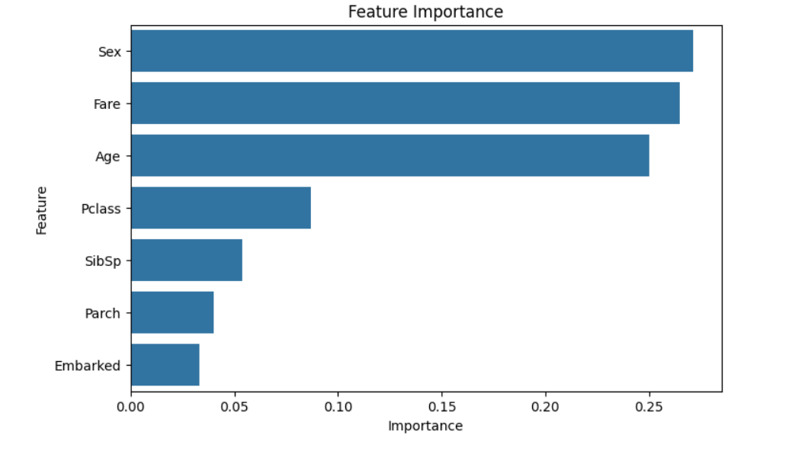
Feature Importance
Top Predictors
1
Sex
2
Fare
3
Age
Gender, fare, and age together account for the majority of the model's predictive power — closely matching the historical evacuation pattern.

Slide 11
Conclusion
✅ Model Performance
🚺 Key Finding
Random Forest Classifier achieved 82.12% accuracy predicting passenger survival from 7 key features.
Sex was the single strongest predictor — female passengers had far higher survival rates than male passengers.
💰 Supporting Factors
📚 Skills Demonstrated
Fare and Age were the next most influential, reflecting socioeconomic status and evacuation priority.
End-to-end ML pipeline: cleaning, EDA, encoding, model training, evaluation, and interpretation.

Slide 12
Future Scope
🚀
Try advanced models — XGBoost, LightGBM, Gradient Boosting — for higher accuracy.
🛠️
Engineer new features: Title (from name), Family Size, and Deck (from cabin).
🎛️
Tune hyperparameters using GridSearchCV or RandomizedSearchCV.
🔁
Apply k-fold cross-validation for a more robust accuracy estimate.
🌐
Deploy the model as an interactive web app using Flask or Streamlit.

Slide 13
⚓
Thank You
Afraz Hussain • Data Science Internship • eduexpose

