Slide 1
Quad Trees
By JJ Shepherd

Slide 2
Introduction
So far we’ve only used binary trees to solve problems
Sort data
Search data
Confuse students
Trees are not just limited to having two children

Slide 3
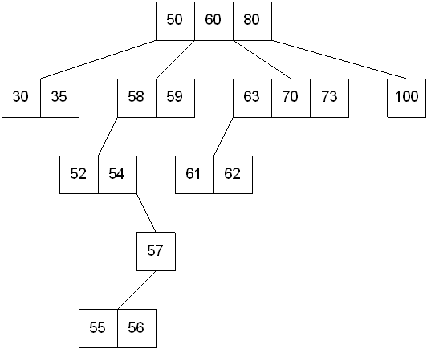
Introduction
Multi-way (M-way) trees are useful in different applications
They are not limited to just having two children

Slide 4
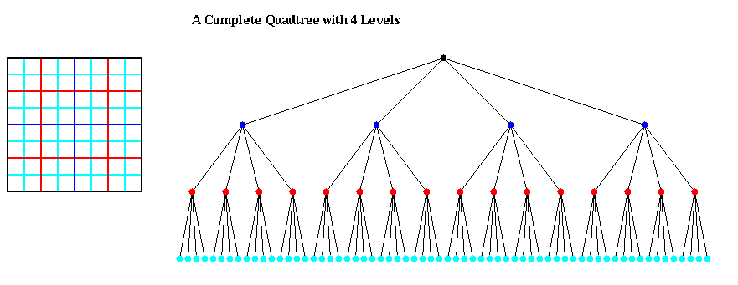
Quad Trees
A quad tree is defined as a tree for each node it has four children
This type of tree can be used for subdividing 2D spaces into smaller regions

Slide 5
Quad Trees
Generally when a quad tree is used for 2D spatial decomposition it has these properties
Has 4 children
If it is dynamic then each node has a “bucket” and when that bucket’s max value is reach it splits
Otherwise it is static and the tree is fixed in size and the “bucket” is sizable
Each node corresponds to a smaller decomposition of it’s parent

Slide 6
Quad Trees
When a new value is added
Check to see if it is fully contained in the node’s region
If it is then check to see if it is fully contained in its children
If it is fully contain in a child’s region repeat this process
Otherwise add this data into the current node’s bucket

Slide 7
Quad Trees
Each child in this demo goes in order Top Left, Top Right, Bottom Left, Bottom Right

Slide 8
Quad Trees
Each child in this demo goes in order Top Left, Top Right, Bottom Left, Bottom Right
1
2
1
2
3
4
3
4

Slide 9
Quad Trees
Each child in this demo goes in order Top Left, Top Right, Bottom Left, Bottom Right
1
2
3
4
1
2
3
4

Slide 10
Quad Trees
Add this circle

Slide 11
Quad Trees
Is it contained in the root? YES! Check the children

Slide 12
Quad Trees
The node is fully contained in the Top Left Node now check its children

Slide 13
Quad Trees
The node is fully contained in the Top Left Node since there are no children insert into bucket

Slide 14
Quad Trees
What about an object that straddles a line?

Slide 15
Quad Trees
The object is contained in the root so check the children

Slide 16
Quad Trees
The object is contained in the bottom right child so check the children

Slide 17
Quad Trees
Since it wasn’t fully contained in any of the children insert into this bucket

Slide 18
Quad Trees
This structure is great for
Collision detection
Graphics
Path finding

Slide 19
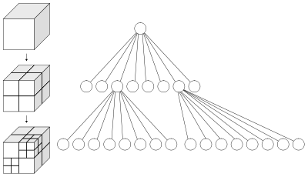
Oct Trees
Adding another dimension the same structure then becomes an oct tree
Great for all of the above but now in 3D

