Slide 1
HIST 111: United States History to 1865
First Half Review

Slide 2
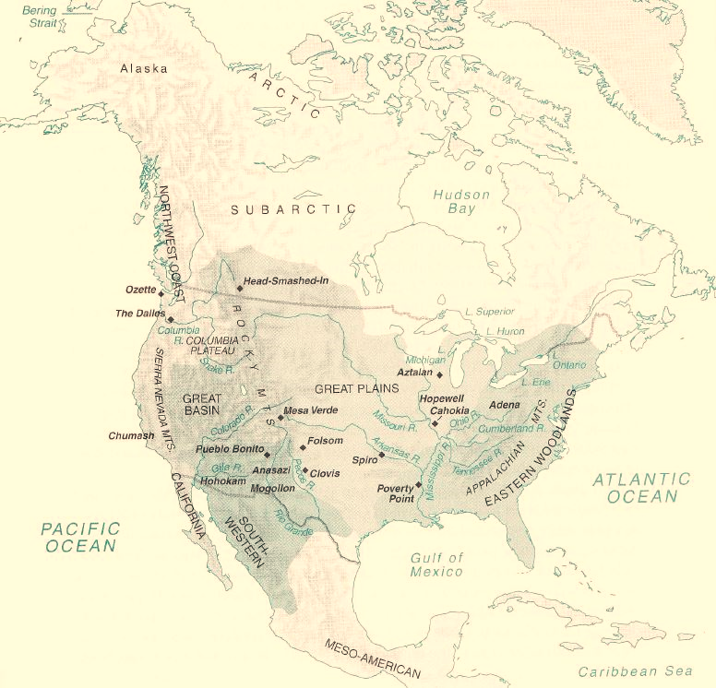
Review
In Facing East from Indian Country, historian Daniel Richter challenges his reader to encounter the world from Native territory.
“Facing East from Indian Country”
Beginning in the lower Mississippi valley around 700 and displaying evidence of Mesoamerican influences, Mississippian cultures spread north to the Great Lakes and east to Florida and the Carolinas, reaching their height between 11000 and 1300.
Mississippian societies, such as Cahokia were typically stable, agriculturally based settlements, close to floodplains, with relatively large populations and complex ceremonial and political structures.
Mississippi Valley Civilization
Indian peoples in the from the Midwest to the East Coast developed a system of agriculture based on corn, beans and squash—known as the “sacred three sisters” by the Iroquois-supplemented with a variety of other crops.
“sacred three sisters”

Slide 3
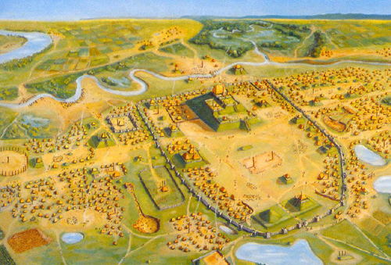
Review
Identify the following image and give the larger significance:
Cahokia founded around AD 700 near the confluence of the Missouri, Mississippi, and Illinois rivers and occupied for about seven hundred years. At its height it had a population of between 10,000 and 30,000 people or about the population of medieval London. Largest settlement to have existed North of the Rio Grande before the end of the eighteenth century, when it was surpassed by New York, and Philadelphia.

Slide 4
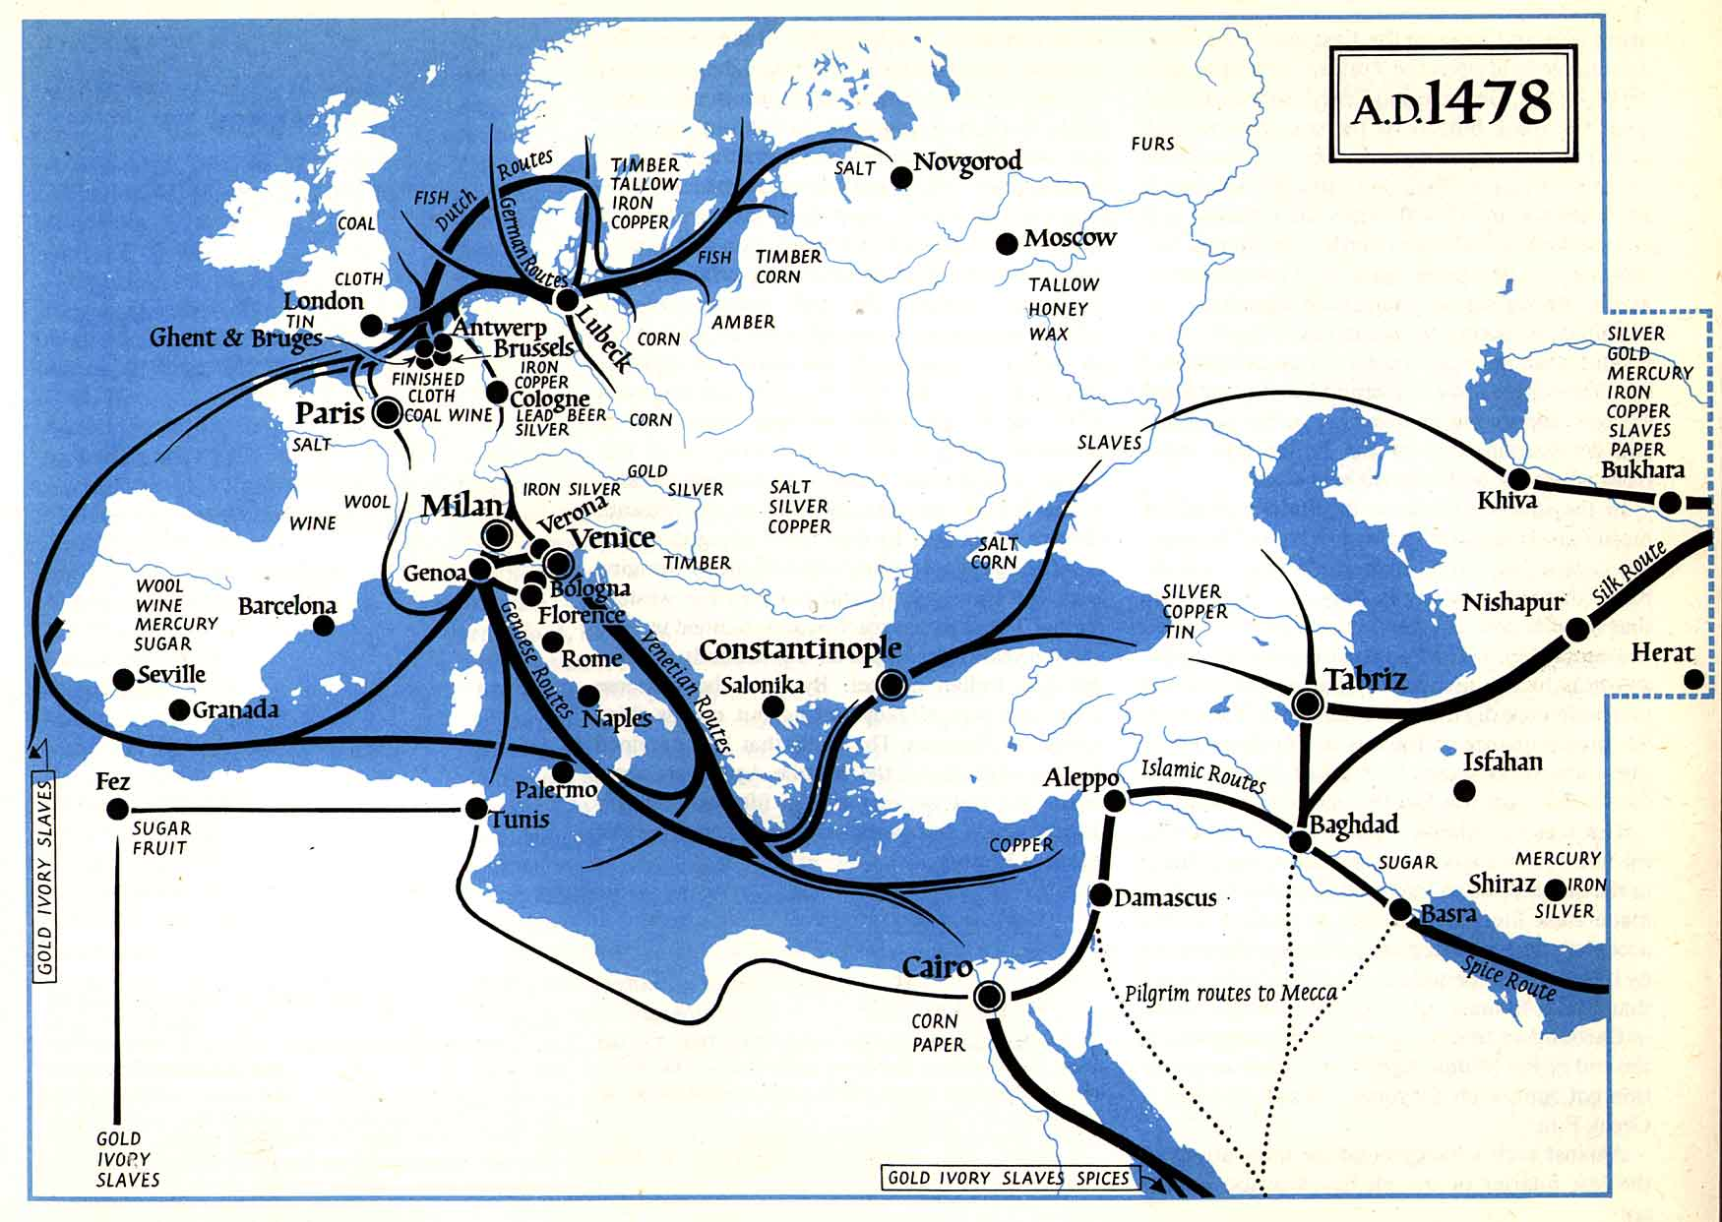
Review
Regions whose inhabitants are socially, politically and economically enmeshed with one another. Historians talk about the phenomena by labeling places as either Centers or Peripheries: Center of Native North America were the large cities-state of the Southwest and Mississippi valley civilization. The periphery, as Richter argues, were the sites of encounter such as Plymouth and the coastal locals. The center of the non American world system is not Europe, it is the Middle East or perhaps the Indian Subcontinent.
world system
The post 1492 interconnection between the Americas, Europe, Africa and Asia. The physical isolation of the Americas meant that plant, animal and diseases were cut off from the rest of the world.
The Columbian Exchange
virgin soil epidemic
A virgin soil epidemic occurs when bacteria or viruses are introduced into an area where no similar diseases have ever occurred before. Lacking even partial immunity, populations are devastated by such epidemics. Many scholars believe that the severity of Native American loss of life during the first decades of European colonization was due to the fact that these were virgin soil epidemics.

Slide 5
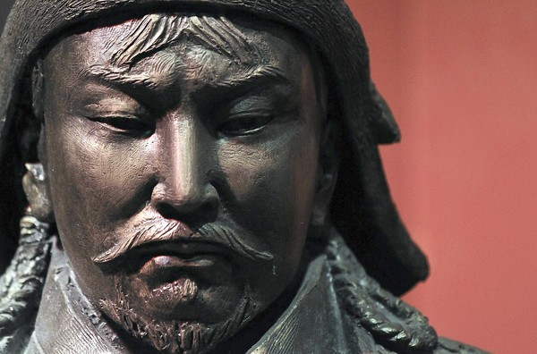
Review
Identify the following image and give the larger significance:
Genghis Khan, first leader of the Mongal Empire. He opened up trade to the West and was able to police the safety of the trade roads throughout his kingdom

Slide 6
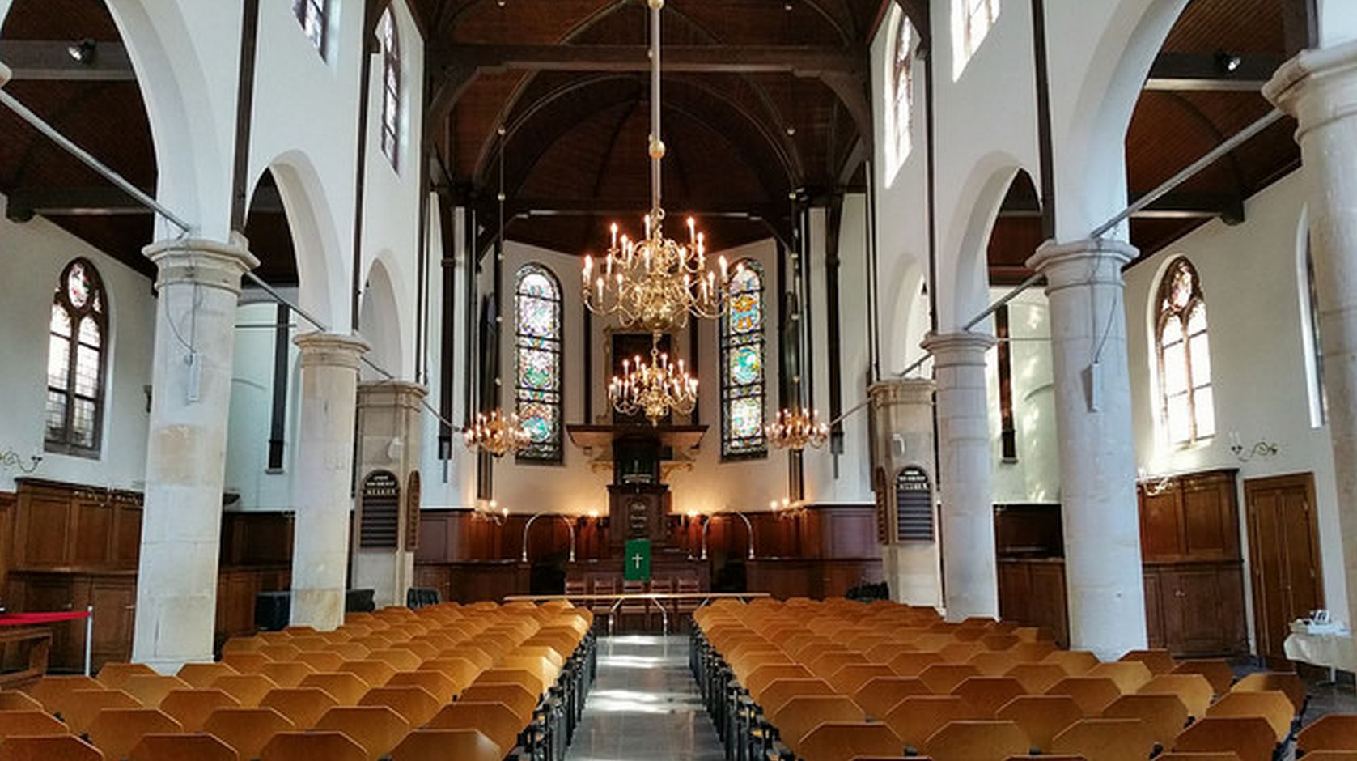
Review
A Key to the Language of America
Book written by Roger Williams published in London, 1643. Was the first English book length focused on an Native American Language, Narraganset.
In 1644 Roger Williams famous wrote of a “wall of separation between the garden of the church and the wilderness of the word,” which served as the basis for the articulation of the separation of church and state asserted over a century later by Thomas Jefferson.
“wall of separation”
Separatist
Separatists, also known as Pilgrims, believed that the Church of England was too corrupt to be salvaged and were the first religious dissenters to move to New England. These beliefs stood in contrast to the Puritans who believed that reform from within the Church of England was possible and sought to purify the church by serving as an example, a “city on a hill.”

Slide 7
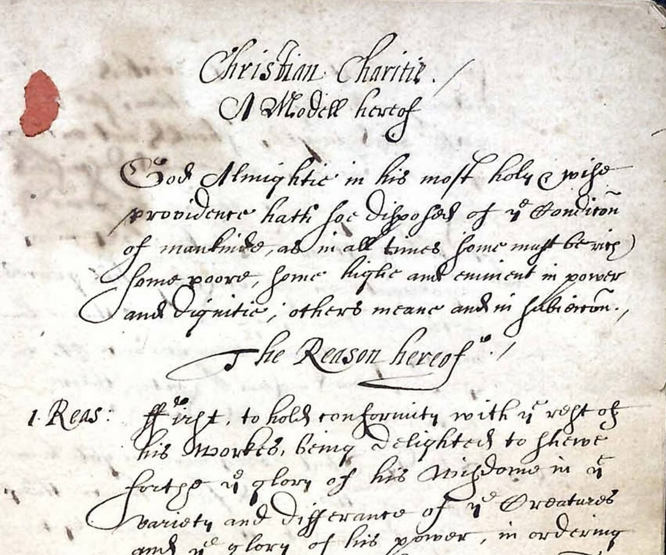
Review
Identify the following image and give the larger significance
“A Model of Christian Charity” John Winthrop (1630). Speech given by Winthrop on board the Arbella before disembarking for America. Espoused communal, covenantal community in Massachusetts Bay as Puritan example for the Church of England.

Slide 8
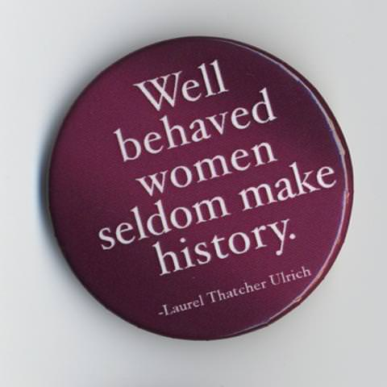
Review
Mary Black and Candy
Two women accused of witchcraft in Salem who were, unlike Tituba, of African descent. Although their racial and cultural difference made them more prone to accusation, their early confession spared their lives. Their stories were folded into the popular image of Tituba, although the historical Tituba was a Spanish Indian slave.
An example of a Dutch businesswoman who managed her family’s Hudson valley farm. Her life reflected the change in elite women’s cultural status from the seventeenth to the eighteenth century; her business activities diminished during the early decades of the eighteenth century mirroring a cultural shift which relegated all women, regardless of status, to the private realm.
Alida Schuyler Livingston
A “fictive widow” is a seventeenth century English term describing a woman whose husband has, for one reason or another, allowed his wife to take the lead. Anne Hutchinson is an example of a fictive widow because her husband William acknowledged her superiority in the spiritual things of the household. As a result, he was accused by some people in seventeenth century New England of being “impotent” for not fulfilling his role as spiritual head of the household.
“Fictive Widow”

Slide 9
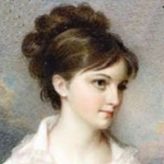
Review
Identify the following image and give the larger significance
This is a portrait of Eliza Lucas Pinckney who as born in Antigua in the British West Indies in 1722 and emigrated to South Carolina in 1738, after her father inherited three plantations. Drawing on the knowledge of slaves and overseers from the Caribbean, Eliza Lucas developed the planting and processing techniques for Indigo in the 1740s that were later adopted throughout South Carolina. Many of her writings still survive (especially her letters with husband Charles Pinckney) and show changes in the personal nature of diaries as well as the ascendency of romantic love during the 18th century.

Slide 10
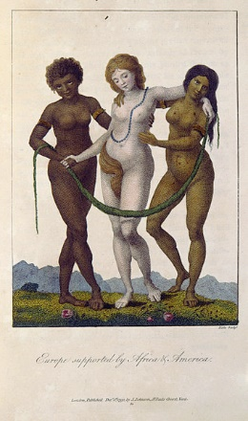
Review
As early as 1690 the Chesapeake contained more slaves than English indentured servants. By 1710 people of African descent composed 1/5 of the regions population. By the 1720s American born slaves already outnumbered their African-born counterparts in the Chesapeake.
Describe the shift from indentured servitude to slavery in the Chesapeke.
Slaves in the Chesapeake worked Gang Labor system: 10 to 15 workers housed together and supervised by an Anglo American overseer. Each man was expected to cultivate about two acres of tobacco a year.
Gang Labor System
Bacon’s Rebellion
Uprising of ex-servants unable to acquire land who wanted territory reserved by treaty for the Virginia Indians. Led by recent immigrant, the gentlemen Nathaniel Bacon, 1676-77. Aftermath enshrined racial difference in the Chesapeake.
“Europe supported by Africa and America” painting by William Blake 1796

Slide 11
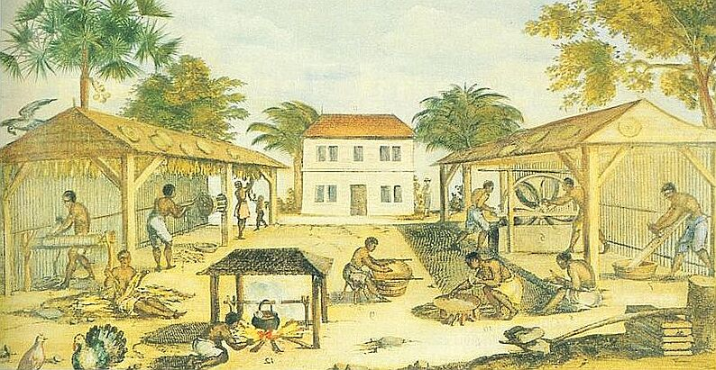
Review
Identify the following image and give the larger significance
Depiction of an eighteenth century tobacco plantation. Depicts African slaves doing varied tasks involved in tobacco cultivation.

Slide 12
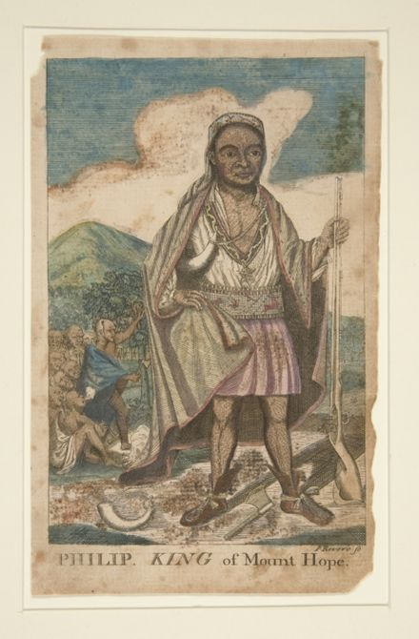
Review
Describe recent theories on the origin of “red” as racial category
Term red likely originated with Native peoples. It may have been a response to European settlers to the southeast referring to themselves as “white,” or to distinguish themselves from “black” slaves. Some Indians many have considered themselves red before European contact.
In 1708 enslaved Indians composed as much as 14% of the South Carolina population, which was a result of the ready market for war captives in Charles Town. Some native groups used the slave trade as means of ridding themselves of real or potential rivals.
Indian Slave Trade
Metacomet or Metacom
Native leader during King Phillips’ war who adopted the English name "King Philip" in honor of the previously-friendly relations between his father, Massasoit, and the original Mayflower Pilgrims.

Slide 13
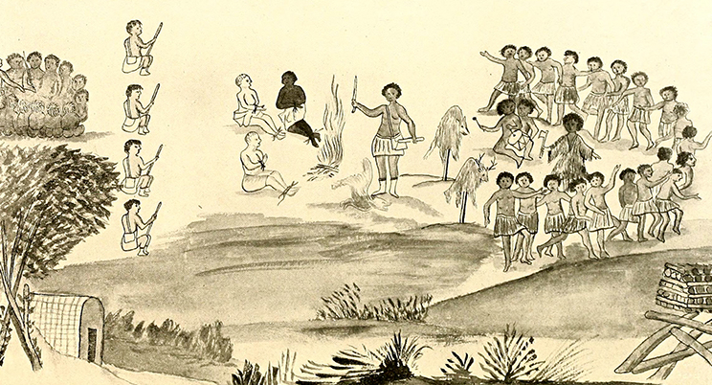
Review
Identify the following image and give the larger significance
Baron Christoph von Graffenried's drawing of when the Tuscarora captured him, John Lawson and the two black slaves they had brought along to survey the mouth of the Neuse river. Although von Graffenried and the enslaved men were spared, Lawson was the first casualty of the Tuscarora war.

Slide 14
Review
Mary Black and Candy
Two women accused of witchcraft in Salem who were, unlike Tituba, of African descent. Although their racial and cultural difference made them more prone to accusation, their early confession spared their lives. Their stories were folded into the popular image of Tituba, although the historical Tituba was a Spanish Indian slave.
An example of a Dutch businesswoman who managed her family’s Hudson valley farm. Her life reflected the change in elite women’s cultural status from the seventeenth to the eighteenth century; her business activities diminished during the early decades of the eighteenth century mirroring a cultural shift which relegated all women, regardless of status, to the private realm.
Alida Schuyler Livingston
A “fictive widow” is a seventeenth century English term describing a woman whose husband has, for one reason or another, allowed his wife to take the lead. Anne Hutchinson is an example of a fictive widow because her husband William acknowledged her superiority in the spiritual things of the household. As a result, he was accused by some people in seventeenth century New England of being “impotent” for not fulfilling his role as spiritual head of the household.
“Fictive Widow”

Slide 15
Review
Identify the following image and give the larger significance
This is a portrait of Eliza Lucas Pinckney who as born in Antigua in the British West Indies in 1722 and emigrated to South Carolina in 1738, after her father inherited three plantations. Drawing on the knowledge of slaves and overseers from the Caribbean, Eliza Lucas developed the planting and processing techniques for Indigo in the 1740s that were later adopted throughout South Carolina. Many of her writings still survive (especially her letters with husband Charles Pinckney) and show changes in the personal nature of diaries as well as the ascendency of romantic love during the 18th century.

Slide 16
Review
Describe recent theories on the origin of “red” as racial category
Term red likely originated with Native peoples. It may have been a response to European settlers to the southeast referring to themselves as “white,” or to distinguish themselves from “black” slaves. Some Indians many have considered themselves red before European contact.
In 1708 enslaved Indians composed as much as 14% of the South Carolina population, which was a result of the ready market for war captives in Charles Town. Some native groups used the slave trade as means of ridding themselves of real or potential rivals.
Indian Slave Trade
Metacomet or Metacom
Native leader during King Phillips’ war who adopted the English name "King Philip" in honor of the previously-friendly relations between his father, Massasoit, and the original Mayflower Pilgrims.

Slide 17
Review
Identify the following image and give the larger significance
Baron Christoph von Graffenried's drawing of when the Tuscarora captured him, John Lawson and the two black slaves they had brought along to survey the mouth of the Neuse river. Although von Graffenried and the enslaved men were spared, Lawson was the first casualty of the Tuscarora war.

Slide 18
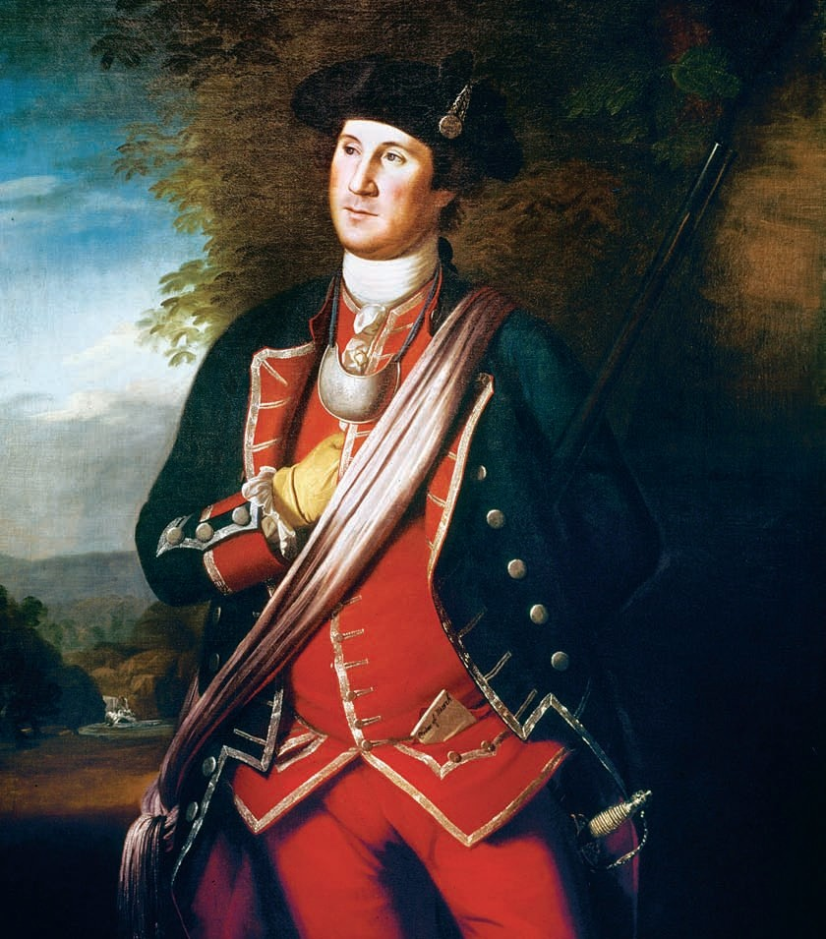
Review
During the mid 18th century, native-born colonial elites sought to distinguish themselves form ordinary folk in a variety of ways as they consolidated their hold on the local economy and political power. Colonists who acquired wealth through trade, agriculture, or manufacturing spent their money ostentatiously, dressing fashionably, traveling in horse-drawn carriages driven by uniformed servants, and entertaining one another at lavish parties.
The Refinement of America
The Great Awakening, was an evangelical and revitalization movement that swept Protestant Europe and British America, and especially the American colonies in the 1730s and 1740s, leaving a permanent impact on American Protestantism. It resulted from powerful preaching that gave listeners a sense of deep personal revelation of their need of salvation by Jesus Christ. Changed the religious culture of the South for both the free and enslaved.
The Great Awakening
In the Treaty of Paris (1763) at the end of the seven years war, France ceded its major North American holdings to Britain. Spain, an ally of France toward the end of the war, gave Florida to the victors. France, meanwhile, ceded Louisiana west of the Mississippi to Spain, in partial compensation for its ally’s losses elsewhere. The British thus gained control of the continent’s fur trade. No longer would the English seacoast colonies have to worry about the threat to their existence posed by France’s extensive North American territories.
The Treaty of Paris (1763)

Slide 19
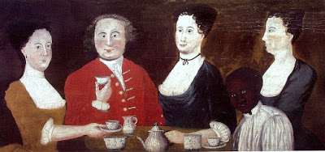
Review
Identify the following image and give the larger significance
Eighteenth century Rhode Island family drinking tea. This portrait illustrates how tea was a female-dominated leisure activity. Also, the inclusion in the portrait of an enslaved child serving the tea, reflects how closely intertwined slavery was with notions of gentility throughout the British colonies.

