Slide 1
Peer to Peer Lending Final Project Proposal
Justin Schneider, Anthony Frazier, James Edwards, Anna Hettermann

Slide 2

What is Peer to Peer Lending?
Peer to Peer lending is a practice to lending money to individuals or businesses through online services that match lenders directly with borrowers.
Data provided by:

Slide 3
Domain: Peer to Peer Lending 2007-2011
Problem statement:
Visualizing Peer to Peer lending geographically from 2007-2011
Using the recession as a critical point of change
Questions to be answered:
How did the recession effect peer to peer lending acceptance and rejection status?
Who gets loans? (homeowners, mortgage, rent, blue collar/white collar) What do they want the loans for? car, debt consolidation?
How many grade A - F loans were before and after the recession?
How often can people pay back certain percent's of loans without defaulting? 10%, 20%, 30%, etc

Slide 4
Presenting the Data
Datasets: Issue date of the loan, and Location of the loan
Loan amount
Grade of the loan
Homeownership status
Annual Income
Status of the loan
Data Manipulations and Cleaning
Loan Title: Borrower gave insufficient information to categorize.
Member ID, Loan ID, Employer’s Name: Not useful information
Generated new data: For example to determine who was blue/white collar

Slide 5
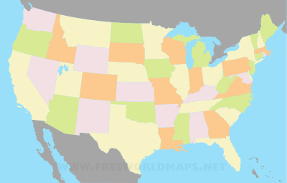
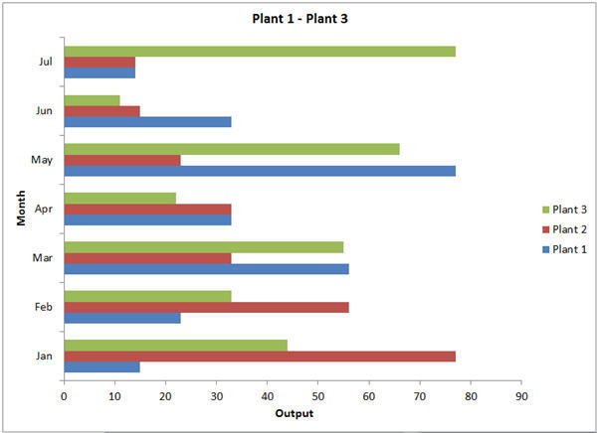
Data Visualization
Primary View:
A map of the US showing the percentage of people being accepted or rejected in each state.
Secondary View:
A secondary graph showing more detailed information about each state.
For example If they are homeowners, the most common grade of loans, blue/white collar, loan purpose, etc.

Slide 6



Tools and Implementation
Visuals: Considering using D3.js because of the interactive visuals and compatibility with HTML. Tableau makes visualizing and Data Wrangling easy.

Slide 7
Questions?

