Slide 1
NYC
Restaurant Inspection Results Analysis
Afreen Azim Shaikh
as11152n@pace.edu
https://github.com/afreenazimshaikh/NYC_RIR

Slide 2
OUTLINE
Afreen Azim Shaikh as11152n@pace.edu
INTRODUCTION
ABOUT THE DATA
BACKGROUND
APPROACH
METHODOLOGY & TOOLS
RESULTS
SUMMARY & FUTURE WORK
REFERENCES

Slide 3
INTRODUCTION
Afreen Azim Shaikh as11152n@pace.edu
The Department of Health and Mental Hygiene (DOHMH) conducts a two-step inspection program at restaurants in New York City.
The following are the sanitary inspection score: Score 0 to 13 points = A; Score 14 to 27 points = B; Score 28 or more points = C
Any score below grade A leads to a re-inspection in scope of better score.
If the all the above inspection results are presented to the consumers making it available on search platforms, will this upgrade get people to chance their options of dining.
QUESTION: SHOULD AN INSPECTION-BASEDRATING SYSTEM FOR THE RESTAURANTS ET PEOPLE TO CHANGE THEIR RESTAURANT SELECTION?

Slide 4
ABOUT THE DATA
Afreen Azim Shaikh as11152n@pace.edu
SOURCE: https://data.cityofnewyork.us/Health/DOHMH-New-York-City-Restaurant-Inspection-Results/43nn-pn8j
The dataset contains all the information about the inspections held in New York City restaurants and is updated on a daily basis.
Number of Rows: 396,077
Number of Columns: 26
Provider: Department of Health and Mental Hygiene(DOHMH)

Slide 5
BACKGROUND
Afreen Azim Shaikh as11152n@pace.edu
A positive impact was observed after the grading system of restaurant inspections.
A possible way to include an inspection score on search platforms for people to judge a restaurant not only on the rating system.

Slide 6
APPROACH
Afreen Azim Shaikh as11152n@pace.edu
Using scikit-learn library to perform predictive analytics using regression algorithm.
NYC_RIR Data
The end.
Conducting Exploratory Data Analysis
Data Cleaning in Python
Conducting Descriptive Analysis

Slide 7
METHODOLOGY & TOOLS
Afreen Azim Shaikh as11152n@pace.edu
LANGUAGE: PYTHON
PYTHON PACKETS: PANDAS SCIKIT-LEARN NUMPY
ALGORITHMS: DESCRIPTIVE ANALYSIS EXPLORATORY DATA ANALYSIS PREDICTIVE ANALYTICS USING LOGISTIC REGRESSION ALGORITHM
SOFTWARES: JUPYTER NOTEBOOK

Slide 8
RESULTS
Afreen Azim Shaikh as11152n@pace.edu

Slide 9
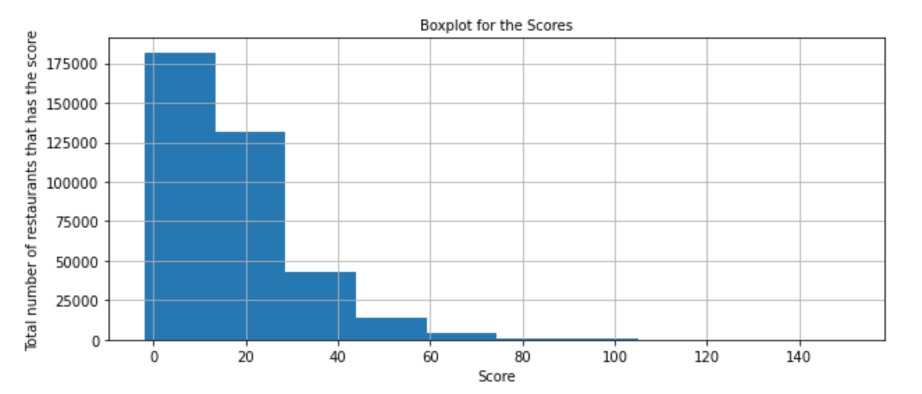
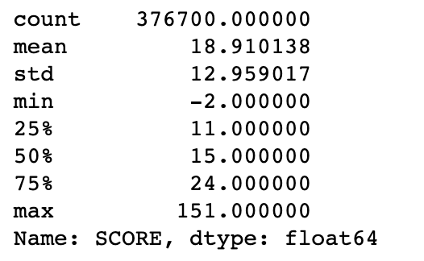
SCORE
Afreen Azim Shaikh as11152n@pace.edu

Slide 10
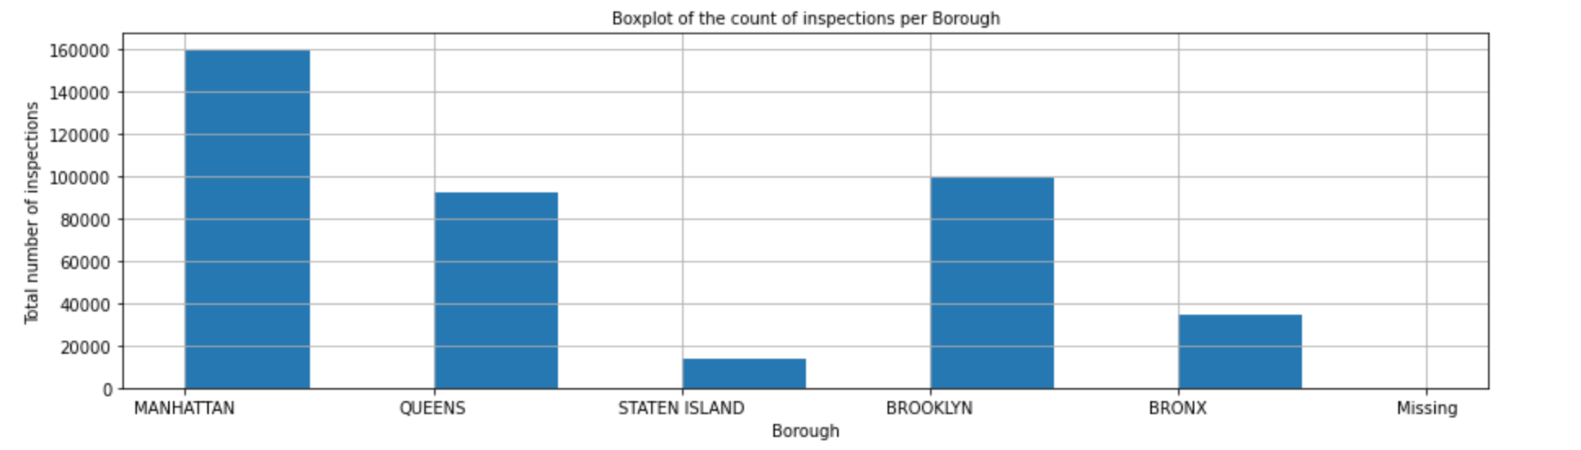
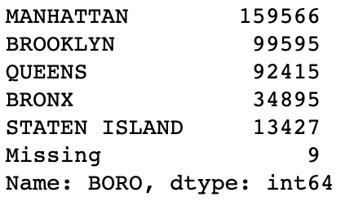
BOROUGHS
Afreen Azim Shaikh as11152n@pace.edu

Slide 11
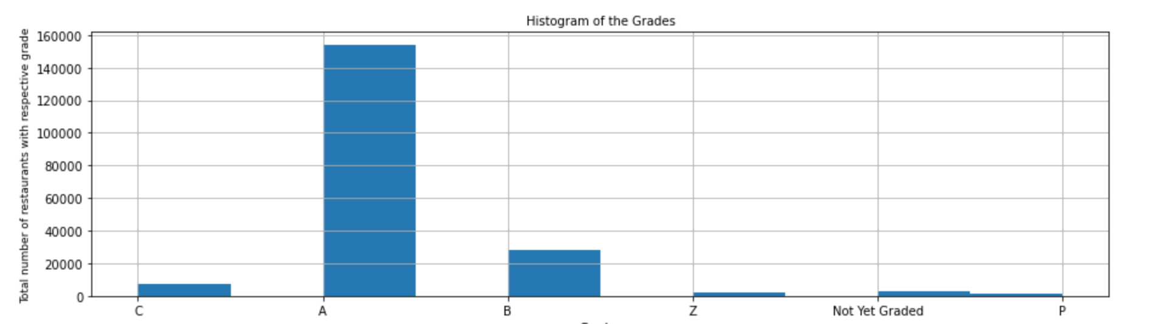
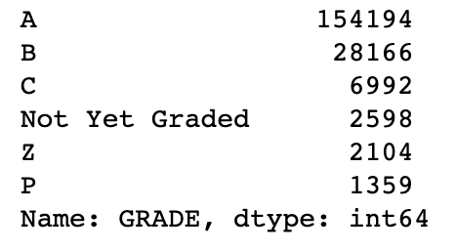
GRADES
Afreen Azim Shaikh as11152n@pace.edu

Slide 12
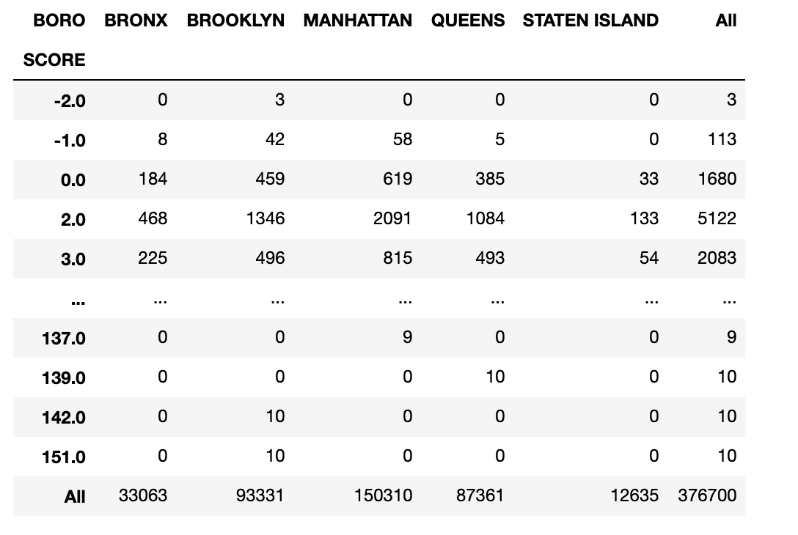
BOROUGHS
AND
SCORE
Afreen Azim Shaikh as11152n@pace.edu

Slide 13
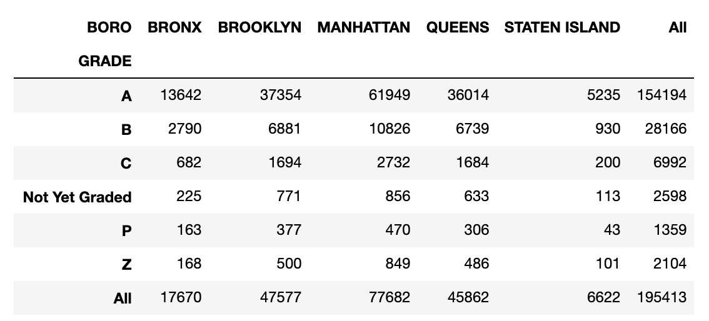
BOROUGH
AND
GRADE
Afreen Azim Shaikh as11152n@pace.edu
• N= Not Yet Graded
• A = Grade A
• B = Grade B
• C = Grade C
• Z = Grade Pending
• P=Grade Pending issued on re-opening following an initial inspection that resulted in a closure.

Slide 14
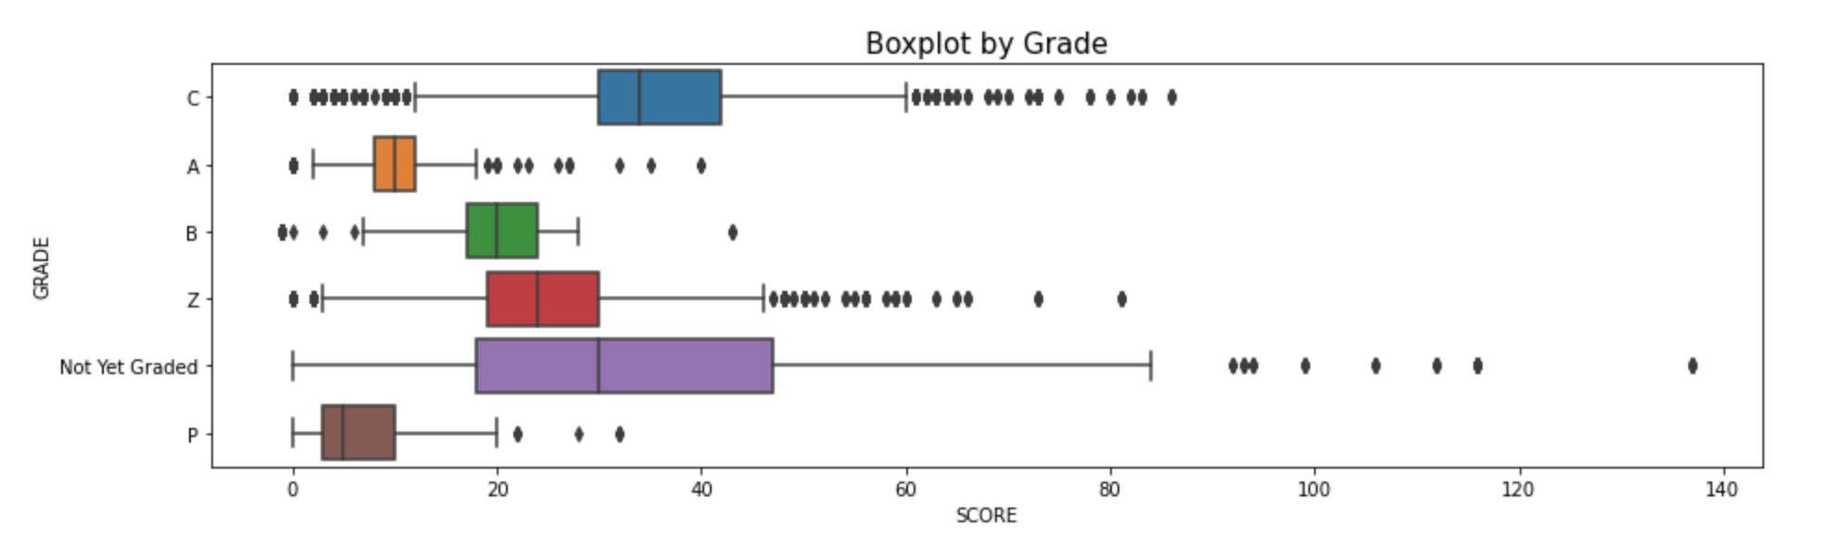
SCORE AND GRADES
Afreen Azim Shaikh as11152n@pace.edu

Slide 15
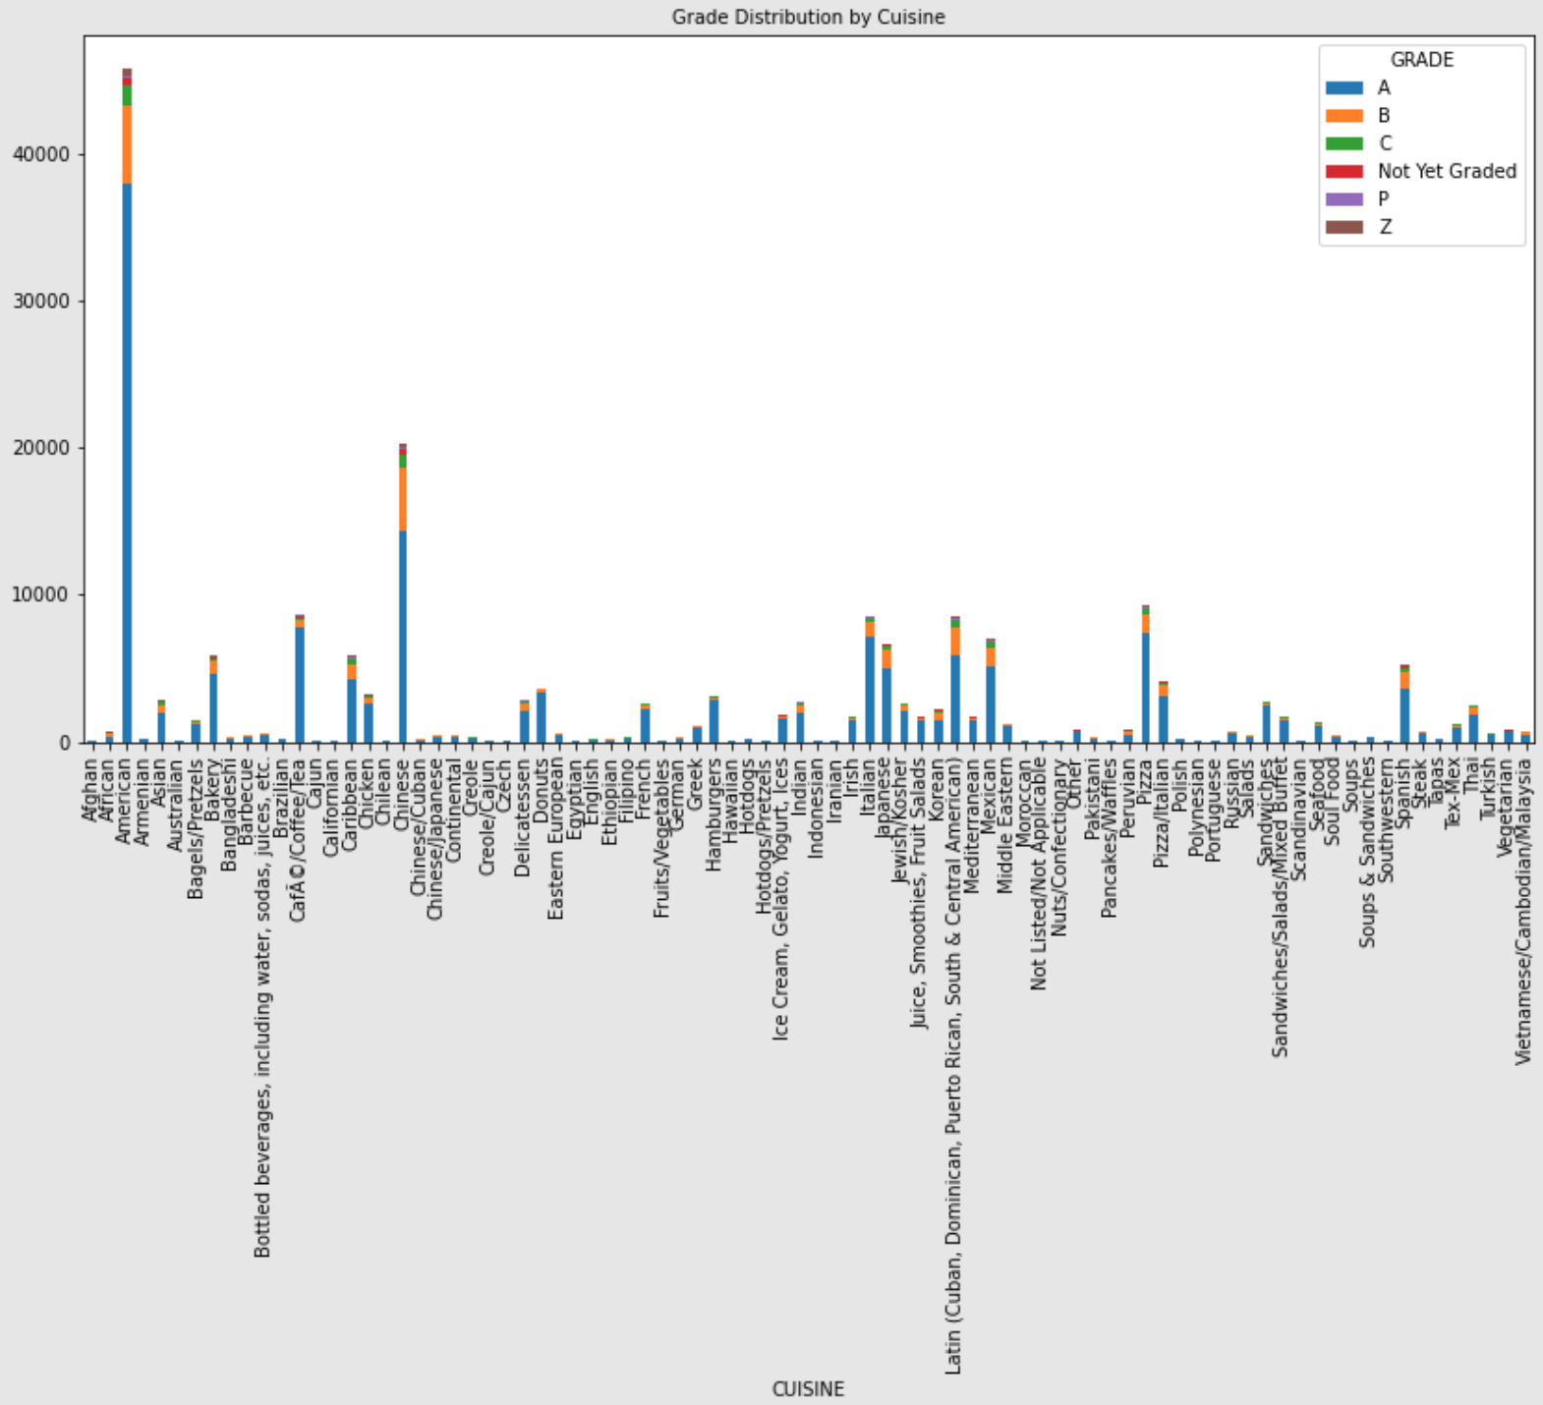
GRADE AND CUISINE
Afreen Azim Shaikh as11152n@pace.edu

Slide 16
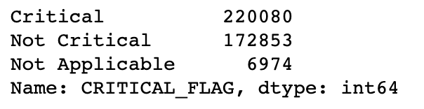
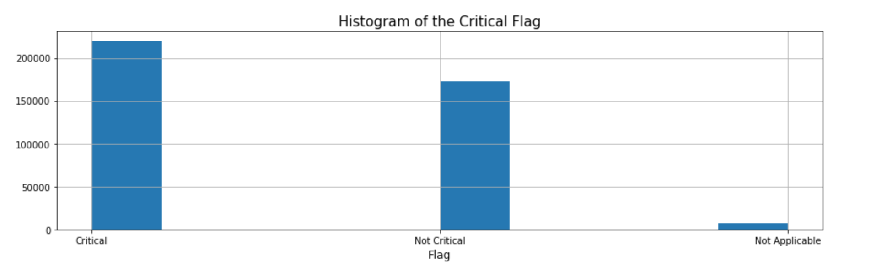
CRITICAL FLAGS
Afreen Azim Shaikh as11152n@pace.edu

Slide 17
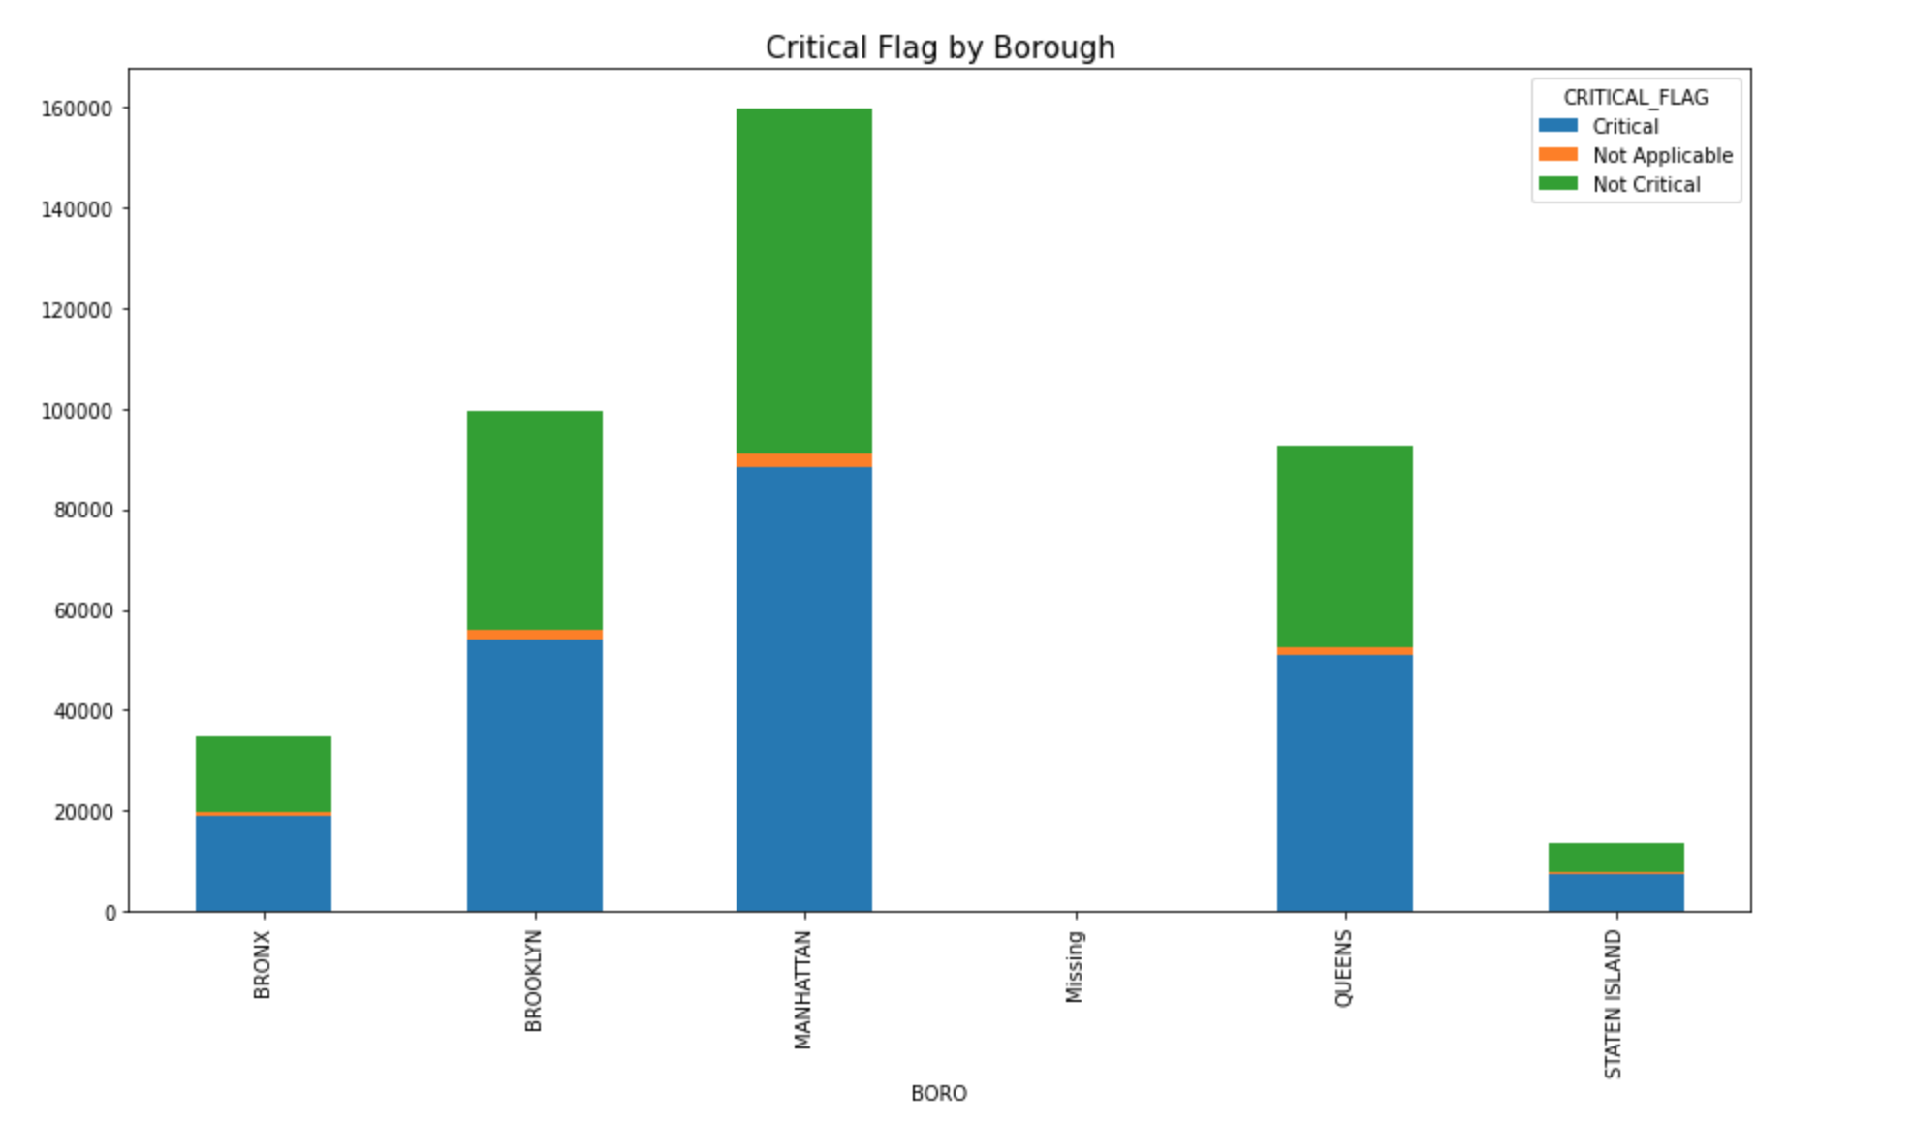
BOROUGH AND CRITICAL FLAG
Afreen Azim Shaikh as11152n@pace.edu

Slide 18
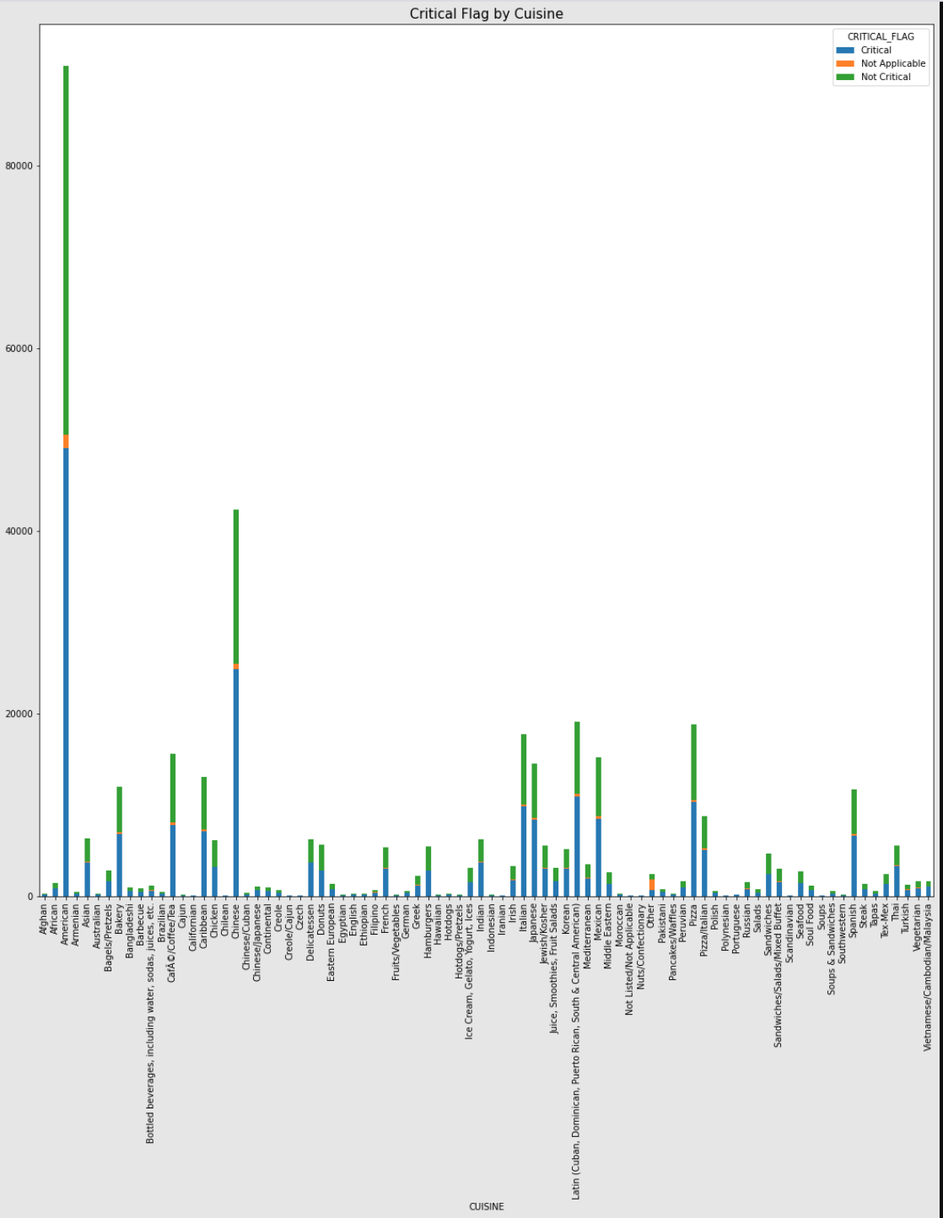
CRITICAL FLAG AND CUISINE
Afreen Azim Shaikh as11152n@pace.edu

Slide 19
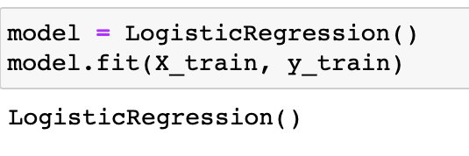
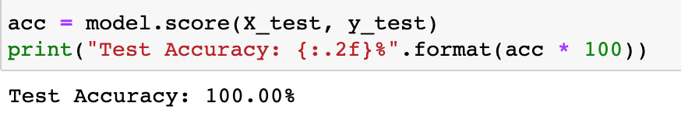
LOGISTIC REGRESSION TO PREDICT IF THE RESTAURANT WILL HAVE A CRITICAL FLAG OR NOT
Afreen Azim Shaikh as11152n@pace.edu

Slide 20
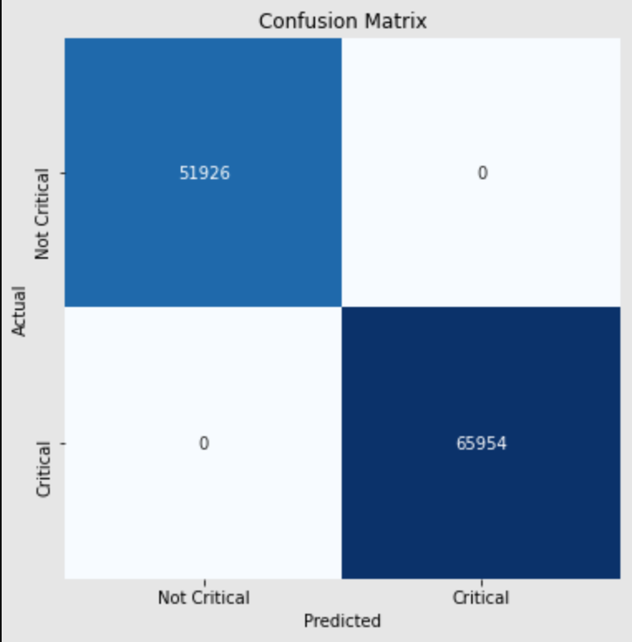
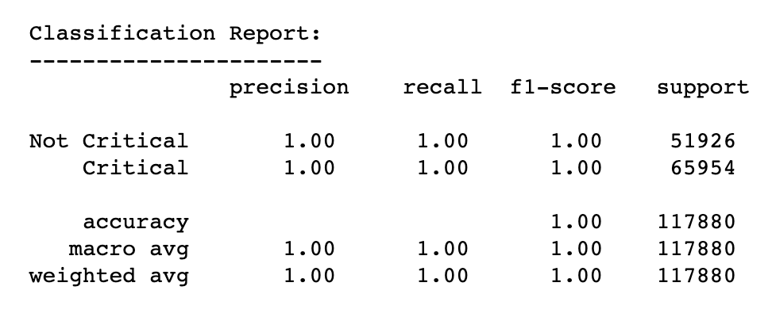
CONFUSION MATRIX AND CLASSIFICATION
Afreen Azim Shaikh as11152n@pace.edu

Slide 21
SUMMARY & FUTURE WORK
Afreen Azim Shaikh as11152n@pace.edu
THE RESTAURANTS WILL HAVE CRITICAL FLAGS AS THEY ARE RELATED TO THE VIOLATION CODE RESULTING IN THE INCREASE OF SCORE AND DEGRADATION IF A RE-INSPECTION TAKES PLACE.
SEARCH PLATFORM IMPLEMENTATION: IMPLEMENTING THESE INSPECTION RESULTS ON SEARCH ENGINE PLATFORMS WOULD EVENTUALLY LEAD PEOPLE TO LOOK AT THE INSPECTION SCORE RATHER THAN THE AVERAGE RATING GIVEN BY CONSUMERS.

Slide 22
REFERENCES
Afreen Azim Shaikh as11152n@pace.edu
https://data.cityofnewyork.us/Health/DOHMH-New-York-City-Restaurant-Inspection-Results/rs6k-p7g6
https://en.wikipedia.org/wiki/Restaurant#Types
Impact of a Letter-Grade Program on Restaurant Sanitary Conditions and Diner Behavior in New York City, Melissa R. Wong, MPH, Wendy McKelvey, PhD, Kazuhiko Ito, PhD, Corinne Schiff, JD, J. Bryan Jacobson, MPH, and Daniel Kass, MSPH, PMID: 25602861 https://www.ncbi.nlm.nih.gov/pmc/articles/PMC4330857/pdf/AJPH.2014.302404.pdf

Slide 23
THANK YOU
Afreen Azim Shaikh as11152n@pace.edu

