Slide 1
A\
CodeReview AI
Multi-Agent Code Analysis · Security · Performance · Quality · Tests
Powered by Groq · FastAPI · React

Slide 2
The Problem
Why manual code review falls short
⏱
Slow & Inconsistent
📉
Performance Gaps
Human reviewers miss patterns, fatigue sets in, and standards vary across team members.
Inefficient loops, bad DB patterns, and memory leaks slip into production unnoticed.
🔒
Security Blind Spots
🧪
Zero Test Coverage
SQL injections, weak hashing, hardcoded secrets — easy to miss without dedicated tooling.
Critical edge cases and exception paths never get flagged during review.

Slide 3
How It Works
5-agent pipeline — runs in parallel, delivers instant feedback
1
2
3
4
▶
▶
▶
Code Input
4 AI Agents
Final Verdict
Cleaned Code
User pastes code
into the editor
Security · Perf
Quality · Tests
Score, summary
& priority fixes
Rewritten version
following best practices
Tech Stack: FastAPI (Python) · React + Vite · Groq LLaMA 3.3 70B · Pydantic · CORS Middleware

Slide 4
The 4 Review Agents
Each agent is an LLM prompt specialist — returns structured JSON with score + issues
Security Auditor
Code Quality Judge
🔒
✨
▸ SQL injection & input validation
▸ SOLID principles
▸ Weak hashing (MD5, SHA-1)
▸ Naming & readability
▸ Hardcoded secrets & credentials
▸ DRY / code duplication
▸ Insecure error handling
▸ Documentation coverage
Performance Analyzer
Test Coverage Advisor
⚡
🧪
▸ Time & space complexity
▸ Missing unit tests
▸ Inefficient loops & N+1 queries
▸ Edge & null cases
▸ Memory leaks
▸ Exception handling gaps
▸ Redundant computations
▸ Integration test needs

Slide 5
Verdict Engine
The 5th agent synthesizes all reviews into an actionable deployment report
75–100
50–74
25–49
0–24
Good
Average
Poor
Critical
Minor or no issues
Moderate issues
Serious issues
Not deployable
Verdict Output Includes:
📊 Overall score out of 100 — weighted across all four agents
🚀 Deployment ready badge — yes or no, with justification
📝 Summary of major findings in plain language
🔧 Priority fixes list — top issues ranked by severity
💡 Cleaned & rewritten code — following best practices

Slide 6
Live Results
Real analysis runs — poor code vs refactored code
❌ Poor Code — Before
✅ Refactored Code — After
Security
Security
0
50
Performance
Performance
25
75
Code Quality
Code Quality
25
90
Test Coverage
Test Coverage
25
75
Overall: 25 / 100 · Not Ready
Overall: 73 / 100 · Approaching Ready

Slide 7
Architecture
Clean separation of concerns — frontend ↔ API ↔ agents ↔ LLM
Frontend
FastAPI Backend
AI Agents (Groq)
› React + Vite (JSX)
› POST /review endpoint
› LLaMA 3.3 70B model
› IBM Plex Mono editor
› Parallel agent calls
› JSON-only responses
› Score ring SVG charts
› Pydantic validation
› Retry logic (rate limits)
› Real-time loading state
› CORS middleware
› extract_json parser
› Responsive 50/50 layout
› Error fallback results
› Structured scoring

Slide 8
Key Features
🤖
Multi-Agent LLM
⚡
Instant Feedback
📊
Visual Scoring
Four specialist agents run against your code — each tuned for one domain, producing scored JSON output.
Groq's LPU hardware delivers LLaMA 3.3 70B responses in under 5 seconds per agent.
Animated SVG score rings, color-coded labels, and a final verdict badge give immediate clarity.
♻️
Cleaned Code
🔄
Rate-Limit Retry
🌐
Zero Config Deploy
The verdict agent rewrites your code following best practices — ready to copy and deploy.
Automatic exponential backoff handles Groq free-tier limits gracefully with 3-retry logic.
FastAPI backend + Vite frontend — deployable on any cloud with a single .env for the API key.

Slide 9
Ship Code You're
Confident In.
CodeReview AI — because great code starts with great feedback.
FastAPI
React
Groq LLaMA 3.3 70B
4 AI Agents
< 20s review

Slide 10
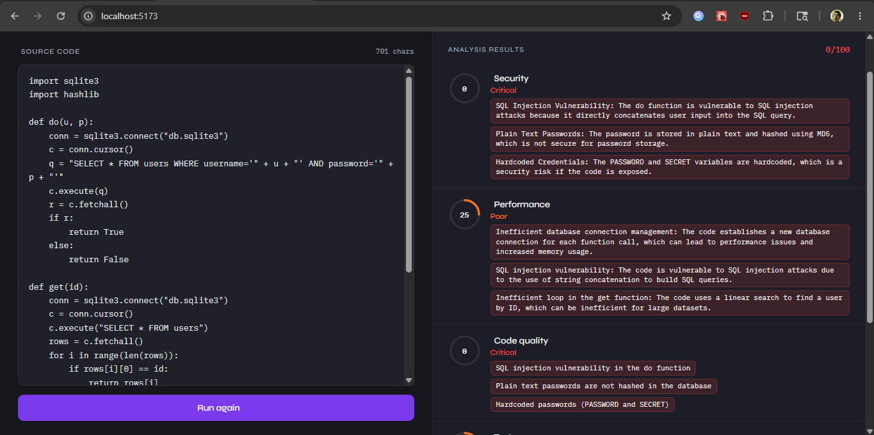

Slide 11
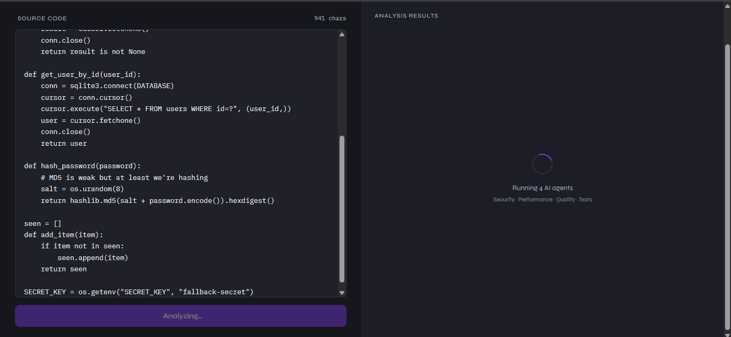

Slide 12
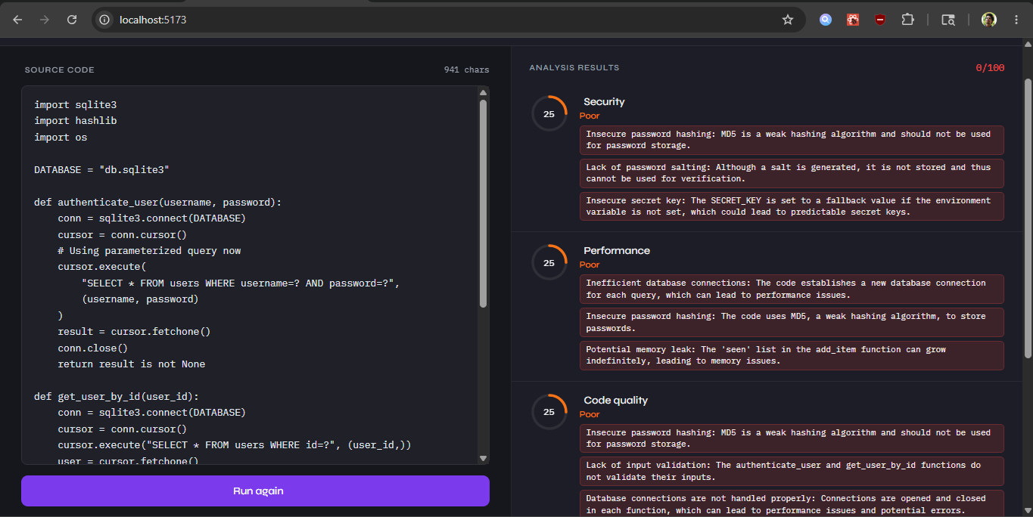

Slide 13
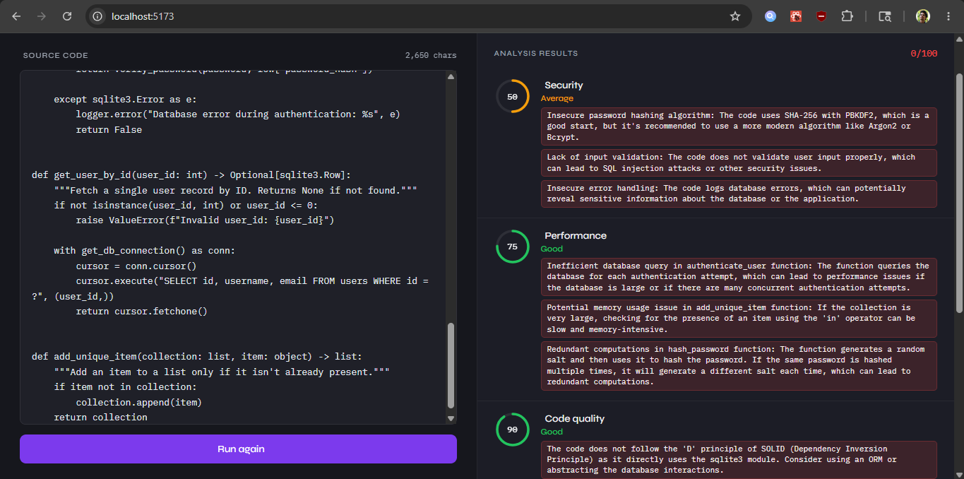

Slide 14
