Slide 1
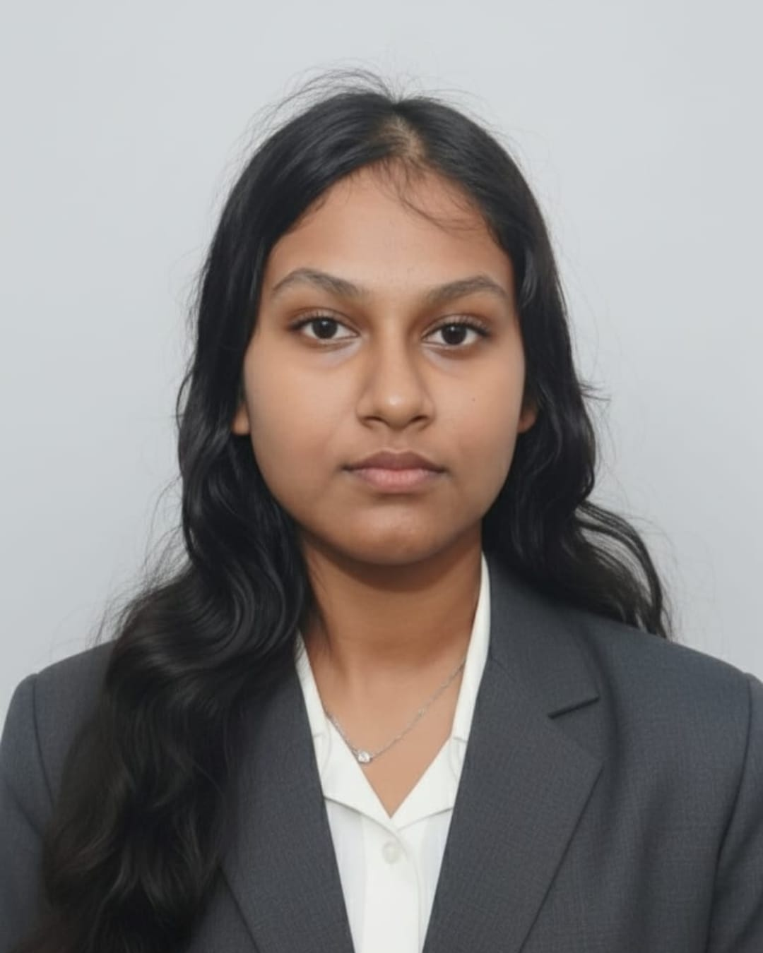
NutriBot
AI-Powered Personalized Nutrition Assistant
IBM watsonx.ai Powered Chatbot
Afreen Thasneem
B.E Computer Science & Engineering
J.N.N Institute of Engineering

Slide 2
OVERVIEW
Problem Statement & Objectives
Why NutriBot?
Bridging the gap between people and reliable, personalized nutritional guidance using the power of Generative AI.
The Problem
1
People lack access to personalized nutrition guidance; online information is often confusing, unreliable, or requires expensive expert consultation.
Growing Need
2
Healthy meal planning demands expert knowledge, and there is a rapidly growing demand for AI-powered intelligent health assistants.
Our Objectives
3
Develop an intelligent nutrition chatbot that delivers personalized dietary recommendations and promotes healthy eating through conversational AI.

Slide 3
ARCHITECTURE
System Architecture
Frontend
Flask Backend
HTML, CSS & JavaScript user interface for entering queries and displaying AI responses.
Python-powered Flask server processes requests and bridges the frontend with IBM watsonx.ai API.
IBM watsonx.ai
Granite Foundation Model authenticates via IBM Cloud API and generates intelligent, personalized nutrition responses.
User Interface
→
Flask Backend
→
IBM watsonx.ai
→
Granite AI Response
HTML, CSS & JavaScript
Python server and routing
API for model inference
Processed reply to UI

Slide 4
STACK
Technology Stack
Category | Technologies
Frontend | HTML, CSS, JavaScript
Backend | Python, Flask
AI Platform | IBM watsonx.ai, Granite Foundation Model
Configuration | Python Dotenv, REST API
Development | Git, Virtual Environment
Web Frontend
Responsive chat interface for seamless user interaction.
AI Backend
Scalable IBM Cloud-powered intelligence engine.

Slide 5
WORKFLOW
How NutriBot Works
User Query
Key Capabilities
→
Natural Language Understanding
Frontend Request
Interprets free-text nutrition questions contextually.
Flask Processing
→
Personalized Recommendations
Tailors dietary advice to the individual user.
Cloud Auth
→
Real-time AI Responses
Instant answers powered by Granite Foundation Model.
NutriBot seamlessly connects the user's question to a powerful AI engine and returns intelligent, personalized nutrition guidance in real time.

Slide 6
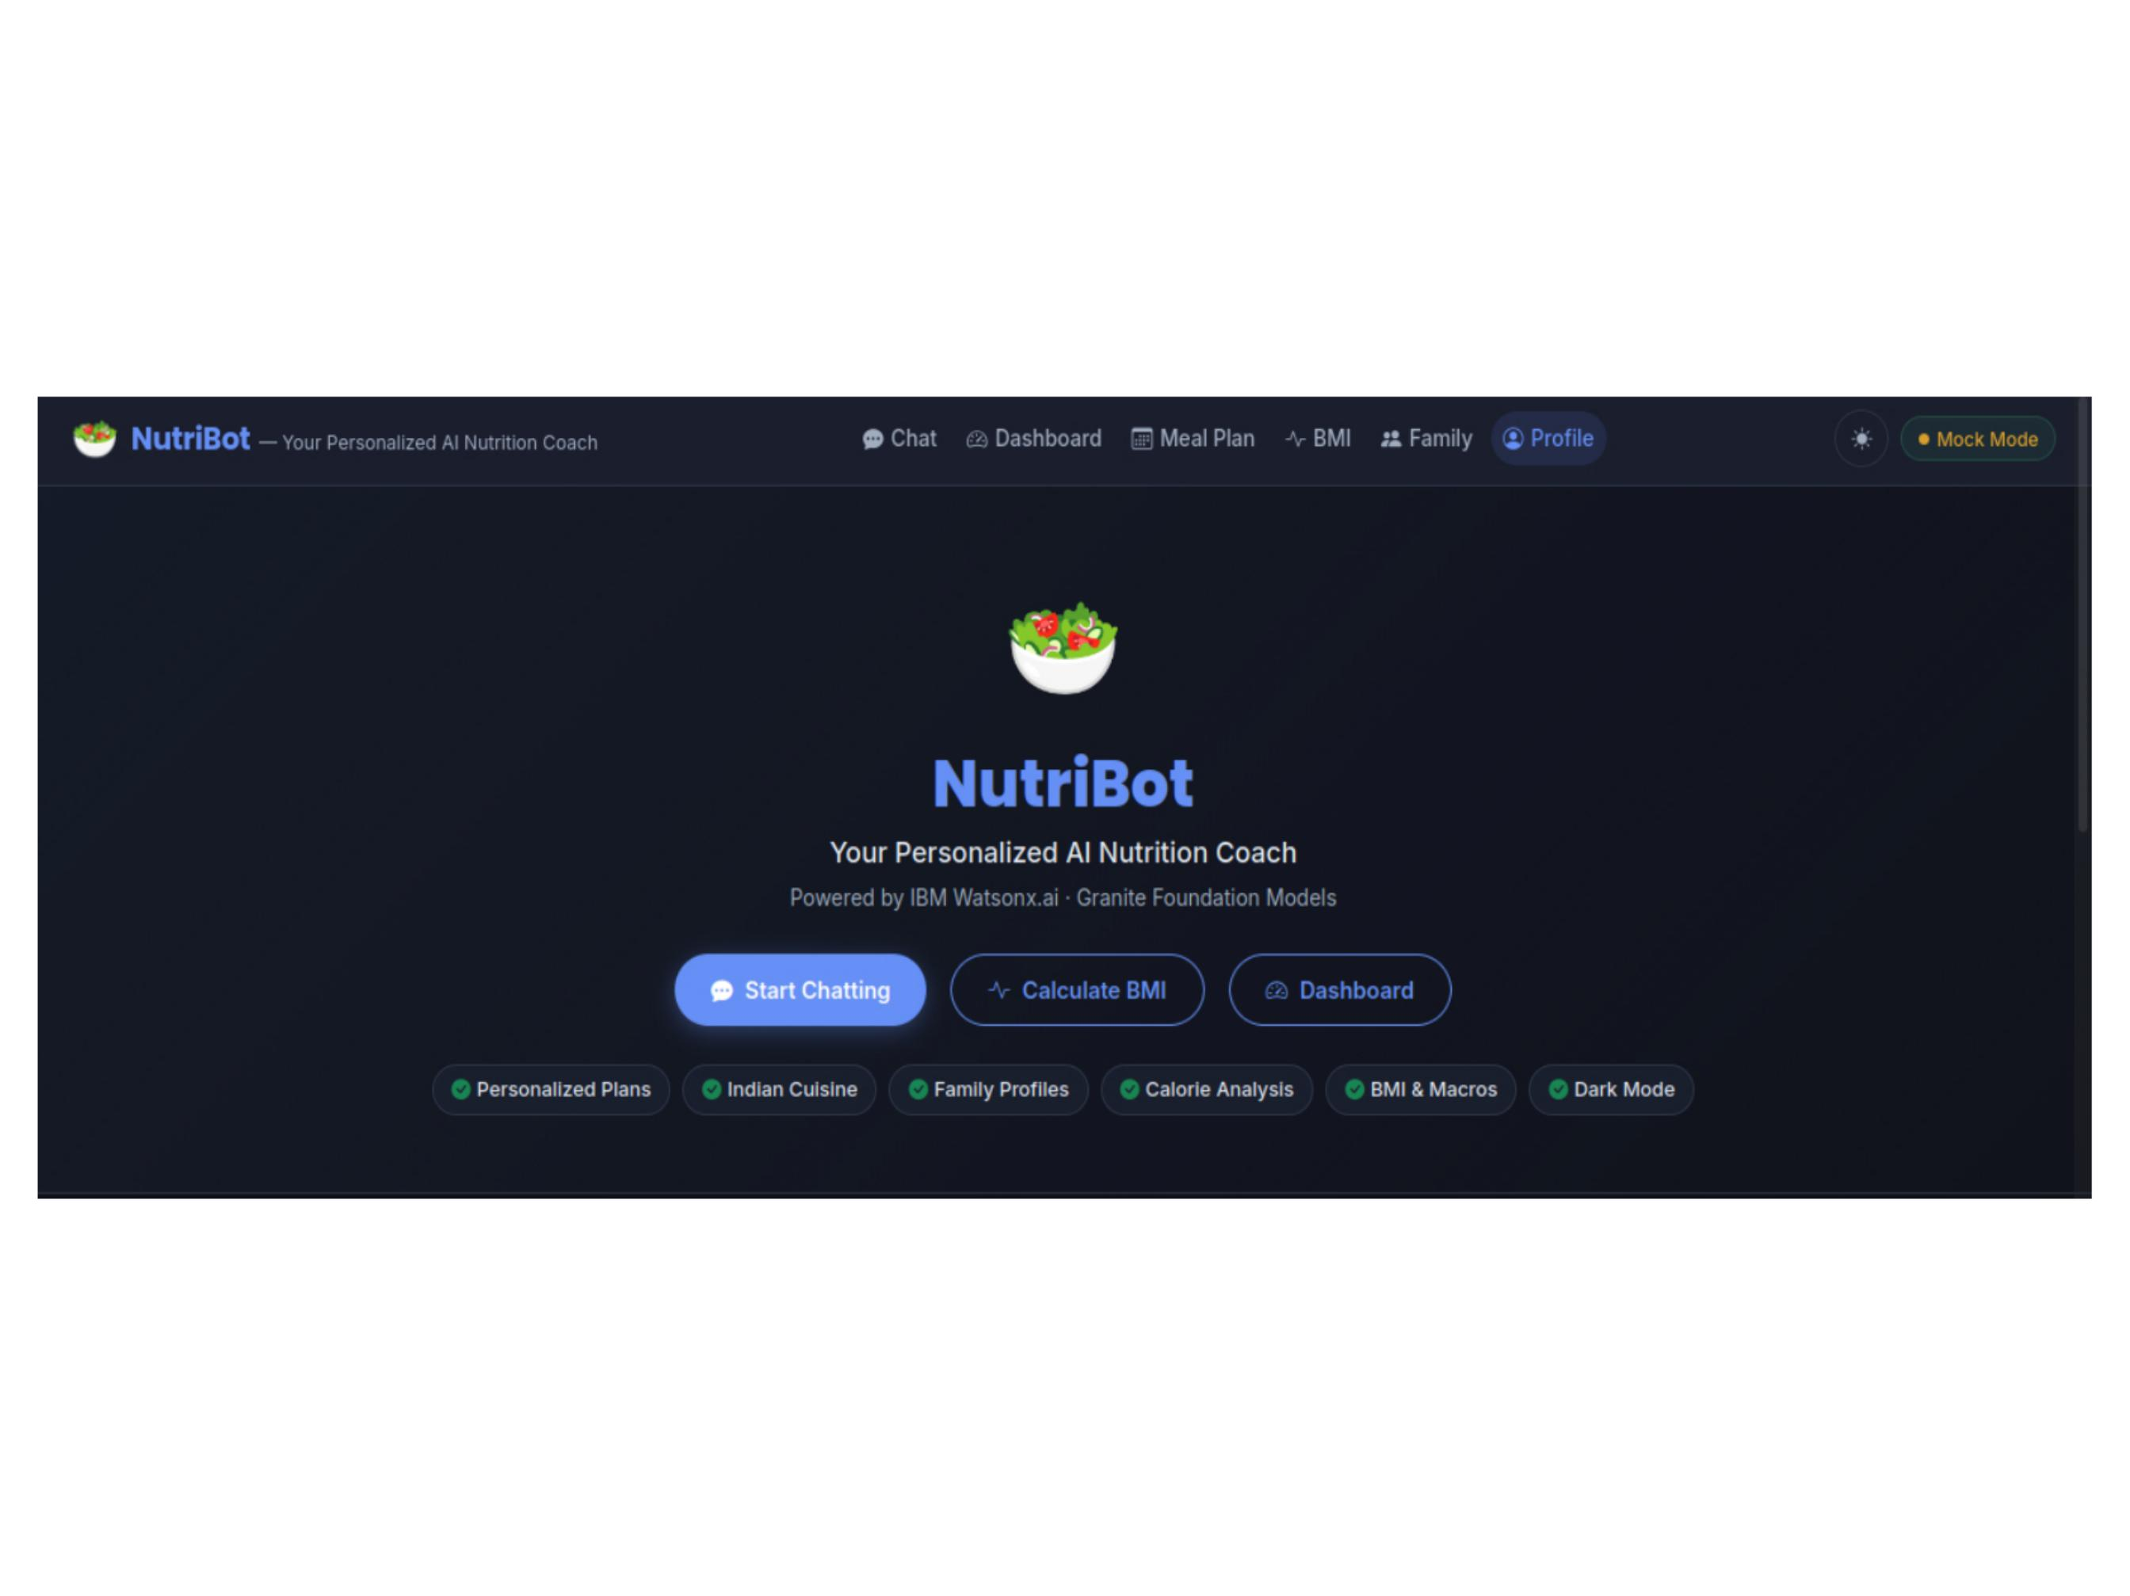

Slide 7
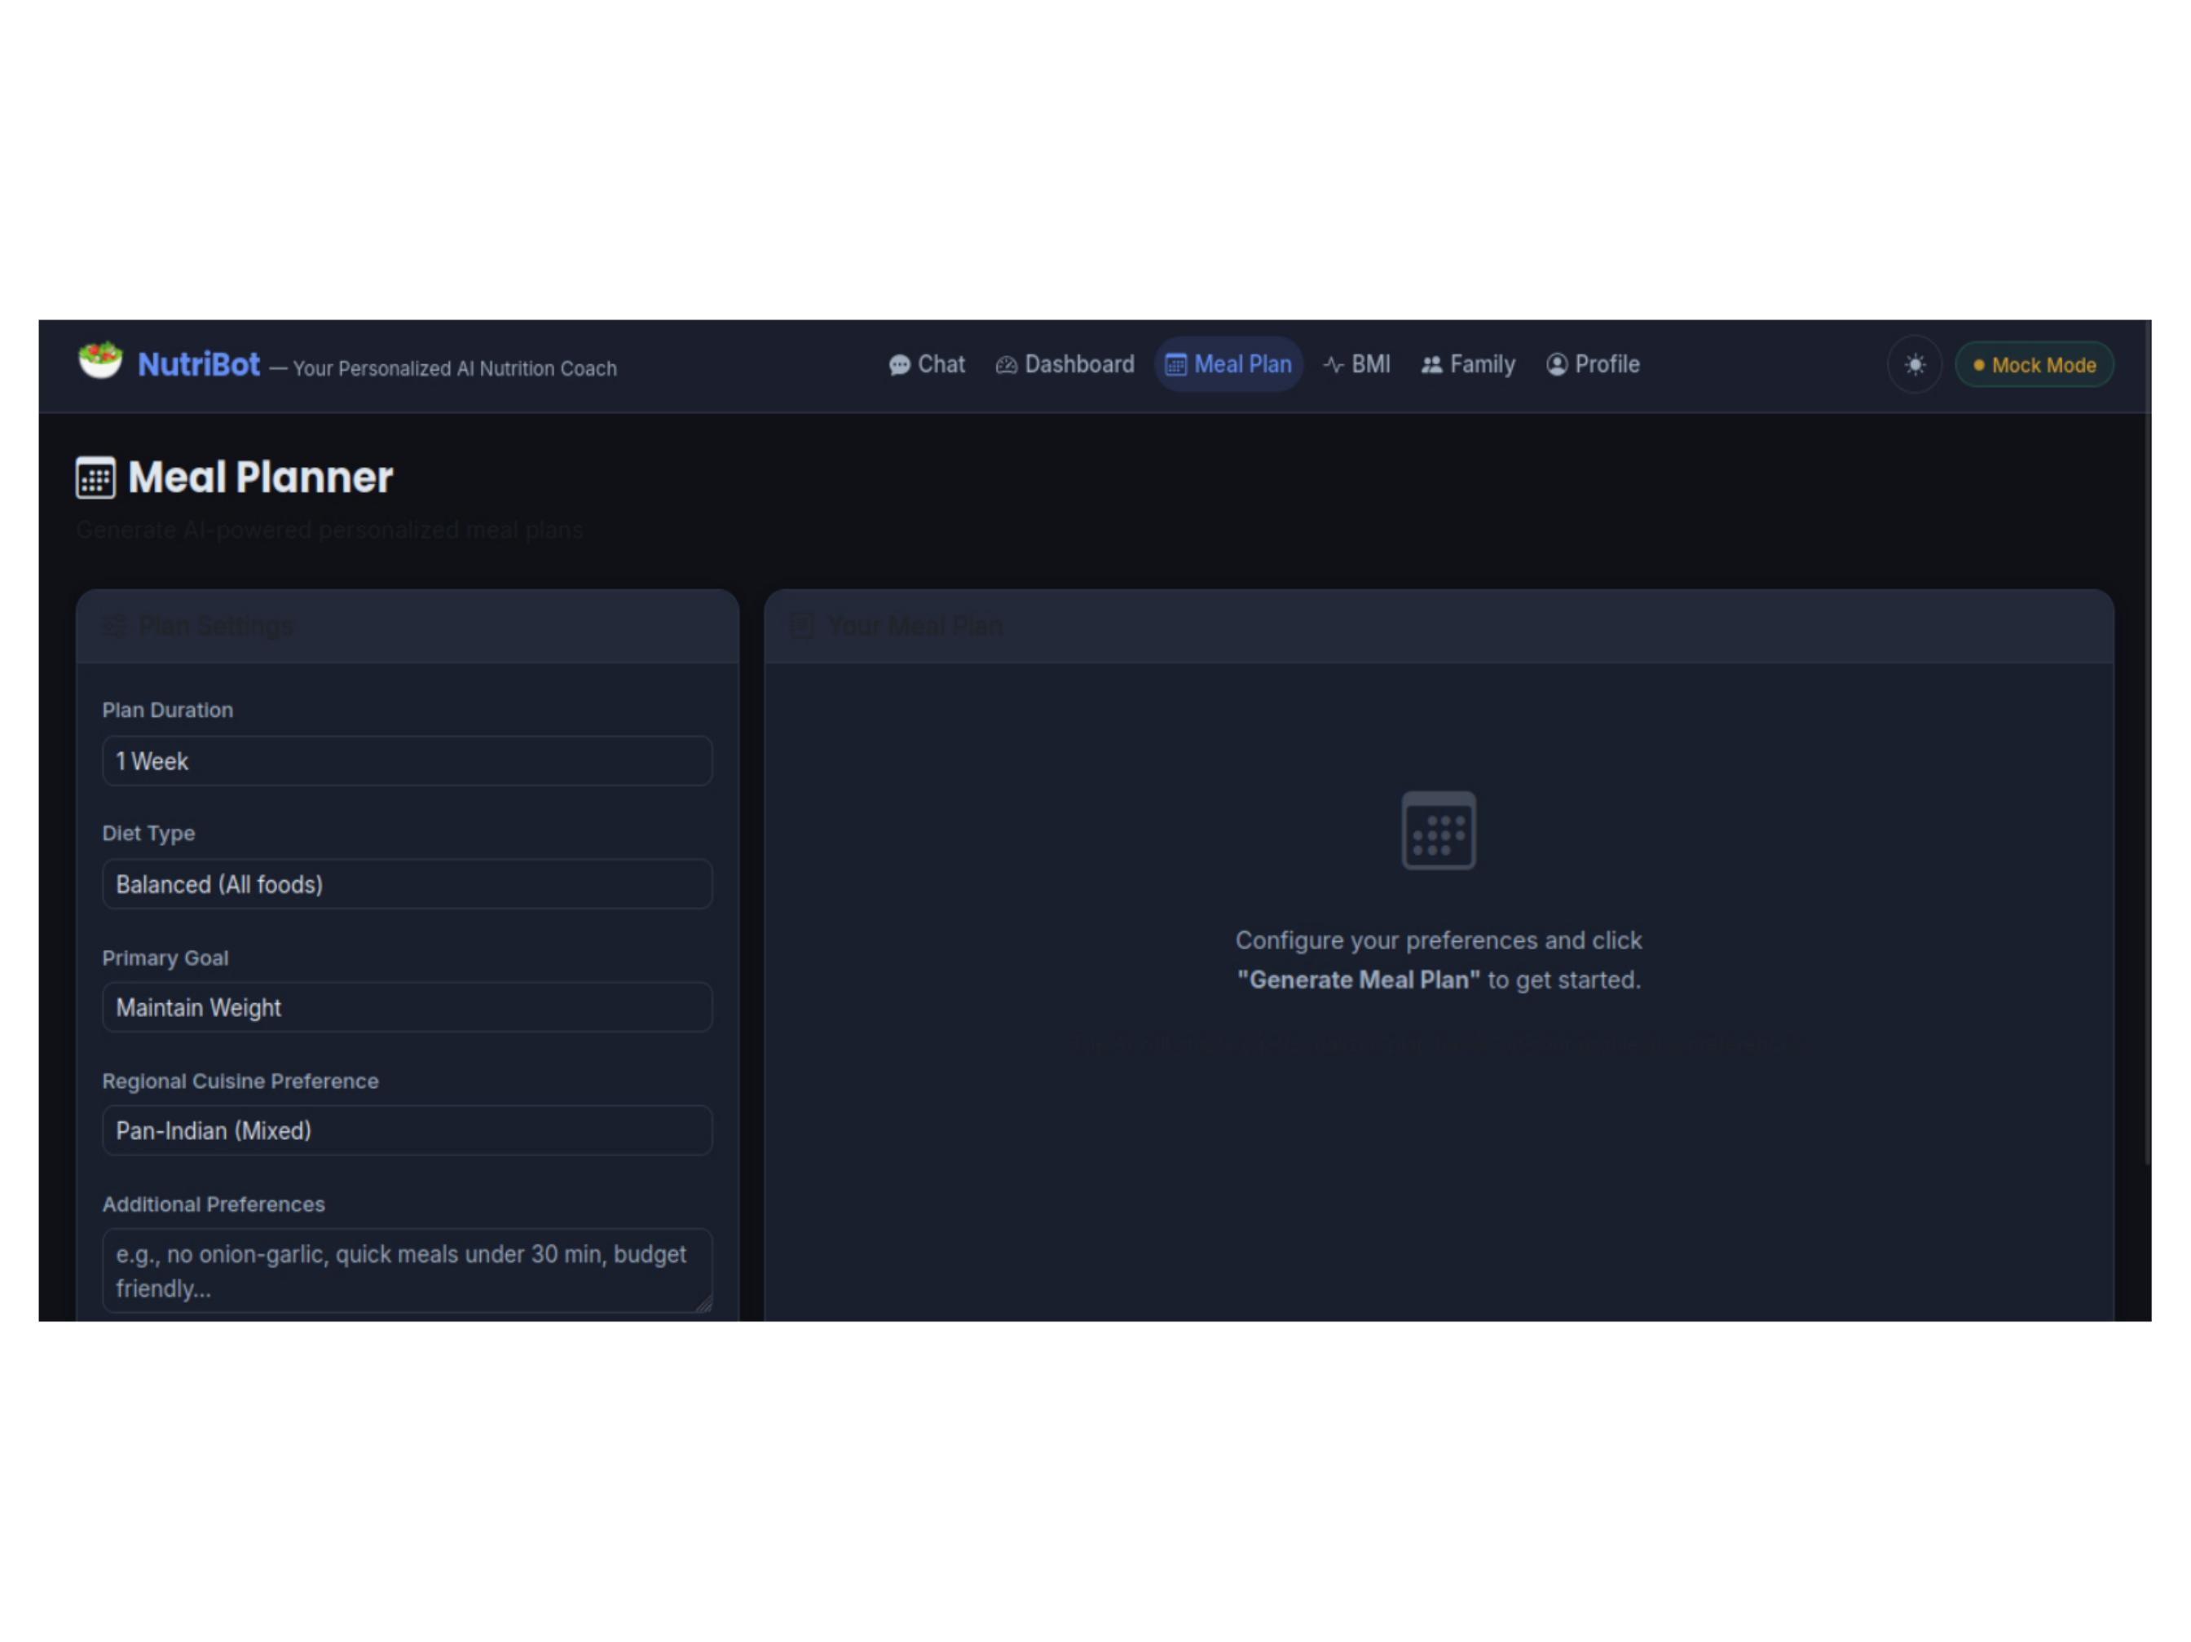

Slide 8
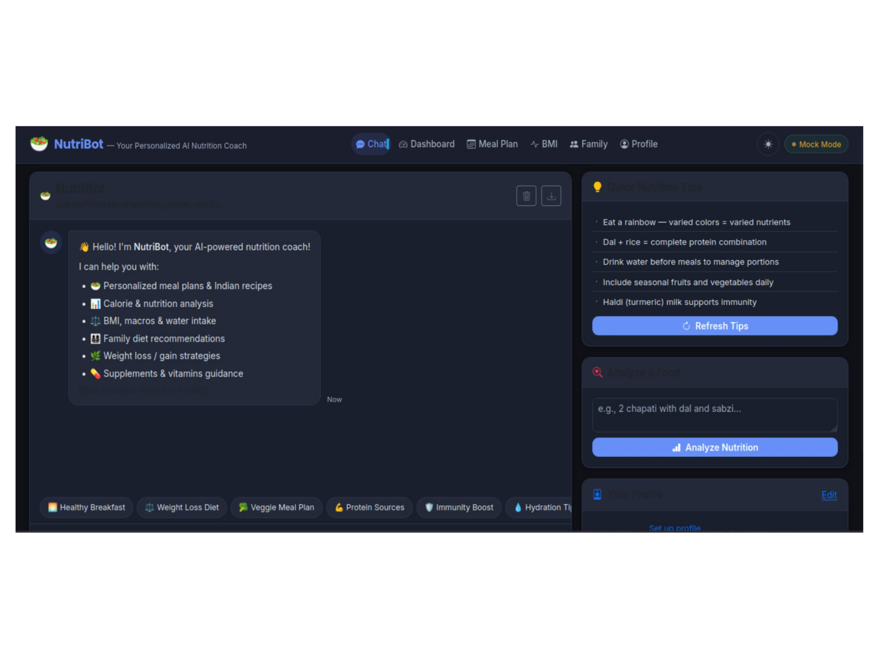

Slide 9
FEATURES
Features & Applications
What NutriBot Offers
A versatile AI-powered nutrition platform serving individuals, healthcare professionals, and organizations alike.
Key Features
Applications
1
2
3
Personal health management
AI Nutrition Assistant
Intelligent Responses
User-Friendly Interface
Fitness and wellness coaching
Personalized meal suggestions and healthy diet recommendations via interactive chatbot.
Fast, accurate, AI-generated answers with secure IBM Cloud integration.
Simple conversational UI accessible to all users without technical expertise.
Hospitals and clinics
Dietitian support tools
Educational institutions
Corporate wellness programs

Slide 10
GROWTH
Advantages & Future Enhancements
Current Advantages
Available 24×7 with a user-friendly interface; delivers accurate AI-generated responses on a scalable, cloud-integrated architecture that improves nutrition awareness.
Near-Term Enhancements
Voice-enabled chatbot, multilingual support, image-based food recognition, and a calorie tracking dashboard.
Long-Term Vision
Mobile application, wearable device integration, and personalized health analytics for comprehensive wellness management.

Slide 11
Conclusion & Thank You
Transforming Nutrition Guidance with Generative AI
NutriBot demonstrates how IBM watsonx.ai and the Granite Foundation Model can power an intelligent healthcare chatbot that delivers personalized nutritional guidance through natural language conversations.
Generative AI in healthcare makes nutrition advice more accessible, interactive, and efficient for everyone.
Project Impact
Technology Showcase
Thank You
Practical application of Generative AI in healthcare, bridging the gap between users and expert nutritional knowledge.
End-to-end integration of IBM watsonx.ai, Granite Foundation Model, Flask, and a responsive web frontend.
Questions & Discussion — Presented by Afreen Thasneem, B.E CSE, J.N.N Institute of Engineering.

