Slide 1
分布式系统
云资源管理
南开百度联合实验室

Slide 2
提纲
云游戏中的资源管理
搜索引擎中的资源管理
AI 在资源管理中的应用

Slide 3
提纲
云游戏中的资源管理
搜索引擎中的资源管理
AI 在资源管理中的应用

Slide 4
云游戏
Server 端运行游戏，并将压缩的视频传给 Client
Client 只负责解压、显示视频

Slide 5
云游戏
优点: 将 load 从客户端转移到 Cloud
Gaming anywhere, anytime, on any device

Slide 6
挑战
延迟
双倍网络延迟 (Client - Server - Client)
带宽
最低要求：3~5 Mbps
成本
每台 server 同时只能运行几个游戏

Slide 7
总体研究目标
优化成本
所有 server 的总运行时间最短
Play Request
servers
Server 的总运行时间由请求调度算法决定
Notes:
考虑虚拟化

Slide 8
Example
游戏请求 r1, r2, r3
r1
r2
r3
假设每台 server 只能同时运行两个游戏
0
1
10
time

Slide 9
Example
r1
r1
r2
r2
r3
r3
r2
总时间: 10 + 10 = 20
总时间: 10 + 1 = 11

Slide 10
研究工作
理论
经典调度算法在云游戏请求调度上的表现
算法
预测请求结束时间，优化请求调度算法
考虑游戏部署开销
系统
考虑游戏interference

Slide 11
理论-经典算法
Any Fit (一系列算法)
只有当前正在运行的 server 都满负载时，才开一台新的
First Fit
在所有有空闲的 server 中，选择最早开始运行的那台 server
Best Fit
在所有有空闲的 server 中，选择空闲最少的那台 server
First Fit
Best Fit
item

Slide 12
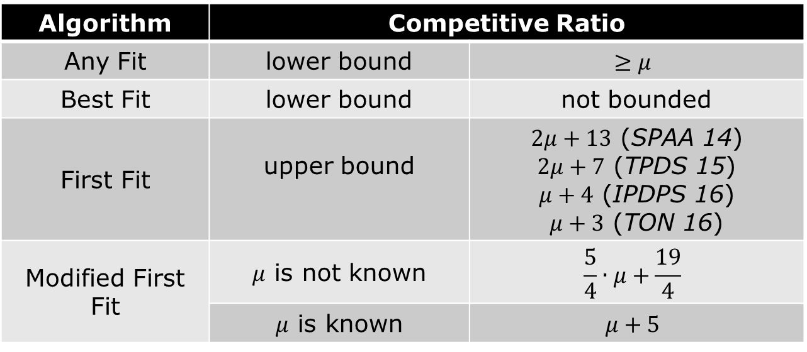
理论-经典算法分析
Worst Case Ratio 分析
Algorithm | Competitive Ratio
Any Fit | lower bound | $$≥μ$$
Best Fit | lower bound | not bounded
First Fit | upper bound | $2μ+13$ (SPAA 14) $2μ+7$ (TPDS 15) $μ+4$ (IPDPS 16) $μ+3$ (TON 16)
Modified First Fit | $μ$ is not known | $$\frac{5}{4}∙μ+\frac{19}{4}$$
 | $μ$ is known | $$μ+5$$

Slide 13
理论-经典算法分析
Stochastic 分析
调度算法统计学上的平均性能

Slide 14
算法-基于请求结束时间预测
游戏请求的 Daily Pattern
Wasted Running Hours
First Fit/Best Fit 在“下坡阶段”浪费大量服务器

Slide 15
算法-基于请求结束时间预测
请求结束时间预测
Dota, WoT 等“match-based”游戏，结束时间可预测

Slide 16
算法-基于请求结束时间预测
基于请求结束时间预测的调度算法
r1
r2
r2
r1
r3
r3
将差不多同一时间结束的请求放到同一台 server 上

Slide 17
算法-基于请求结束时间预测
基于请求结束时间预测的调度算法
NetGames 2014、TCSVT 2017

Slide 18
算法-考虑游戏布局
游戏部署开销
Servers
Trade-Off：
每台 server 装更多游戏，开销变大，但需要的 server 总数较少
每台 server 装较少游戏，开销变小，但可能需要更多 server
SSD
SSD
游戏软件
即使 server 空闲，但是如果没有安装相应的游戏，也无法满足游戏请求

Slide 19
算法-考虑游戏布局
目标
如何部署游戏使得总开销最小
分析
Stochastic, Markov models
算法
Simple Algorithms
Dynamic Programming Algorithms
Heuristic Algorithms
ACM MM 2017、TOMM 2018

Slide 20
系统-考虑游戏interference
Contention on shared resources, e.g., CPU, GPU, cache
Various performance degradations observed

Slide 21
When games are co-located
If performance degradations can be predicted, more efficient resource allocations are enabled
a. Given a set of game requests, minimizing resource usage (number of servers) with QoS guarantees
b. Given a fixed number of servers, maximizing overall performance (e.g. average frame rate)

Slide 22
Design of Benchmark
We design the benchmark which can cause tunable pressure on the shared resource
Shared resource includes :CPU cores,lastlevel cache,memory bandwidth,GPU cores,GPU memory bandwidth,GPU L2 cache and PCIe bandwidth.
The benchmark should not cause significant contention in other shared resources.

Slide 23
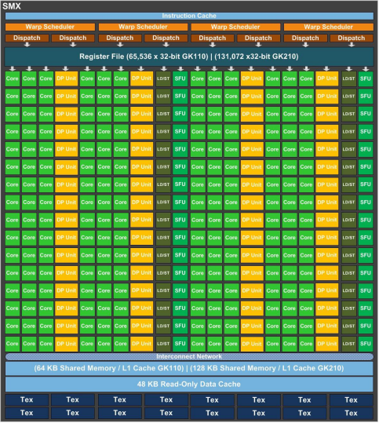
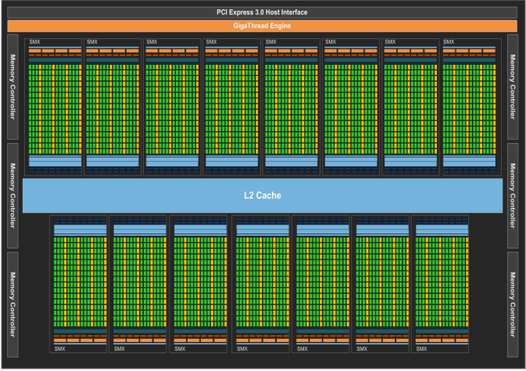
Benchmark Design:GPU cores
Kepler GPU GK110 Architecture
Streaming Multiprocessor (SMX) Architecture

Slide 24
Benchmark Design:GPU cores
As we can see,GPU have a massively parallel thread running on thousands of cores
We repeatedly launch a thread on each core,so that all the cores execute the same kernel in parallel
Between two rounds,we add a sleep and the sleep time will determine the utilization of each core,by tuning the sleep time,GPU utilization gets tunable

Slide 25
Benchmark Design:Bandwidth
Main Memory Bandwidth:copy data from one address space to another address space using a cache bypass
instruction _mm_stream_si64x(),and then insert sleep
between rounds
Global Memory Bandwidth:copy data from one address space to another address space.Benchmark for PCIe is
similar

Slide 26
Traditional Approach
Predict performance of game A when co-located with game B
Profiling
Step 1:
Collect sensitivity curve of A
Co-locate A with benchmark with tunable intensity
sensitivity curve of A

Slide 27
Traditional Approach
Predict performance of game A when co-located with game B
Profiling
Step 2:
Compute intensity of B
Design a reporter
Co-locate reporter with benchmark
Co-locate B with reporter
0.3
Suppose the performance degradation of reporter is 0.6 when co-located with B, B’s intensity is 0.3
sensitivity curve of reporter

Slide 28
Traditional Approach
Predict performance of game A when co-located with game B
Prediction
Step 3:
Compute performance degradation of A
0.5
A’s sensitivity curve & B’s intensity
A’s performance
(predicted)
sensitivity curve of A
B’s intensity is 0.3

Slide 29
Challenges for multiple resources
Profiling
A has multiple sensitivity curves
One for each resource
sensitivity curves of A

Slide 30
Challenges for multiple resources
Profiling
B’s intensity is a vector
One item corresponds to one resource
<0.1, 0.15, 0.2>
Intensity on GPU
Intensity on CPU
sensitivity curves of reporter
Intensity on memory

Slide 31
Challenges for multiple resources
Prediction
How to combine A’s sensitivity curves and B’s intensity vector to predict A’s final performance?
sensitivity curves of A

Slide 32
Existing Approaches
Approach | Resources | Colocation Size | Assumptions
Bubble-up | Single | Two | -
Cuanta | Single | Multiple | -
Paragon/Quasar | Multiple | Multiple | Intensities of different applications is addictive
SMiTe | Multiple | Two | Sensitivity is linear to pressure; Performance degradation from each shared dimension is addictive;

Slide 33
Observations
Diversity of sensitivity and intensity of games
Different games have different sensitivity to the same shared resource
Different games have different intensity on the same shared resource
Each game has different sensitivity to different shared resources
Sensitivity curves are not linear to pressure
*Need to use the whole curve to characterize sensitivity, instead of using slope only

Slide 34
Observations
Memory and GPU-memory are insignificant
Large pressure can increase the game loading time and stutter
90% games have less than 4% performance degradation against pressure 1.0
*If game can be loaded, the fps is almost not affected; otherwise, the game is not playable;

Slide 35
Observations
Intensities of multiple games are not addictive
The overall intensity of A + B is not equal to A’s intensity + B’s intensity
Reporter cannot perfectly mimic the behavior of game
Intensity will change when against different pressures
*non-linear relationship needs to be captured

Slide 36
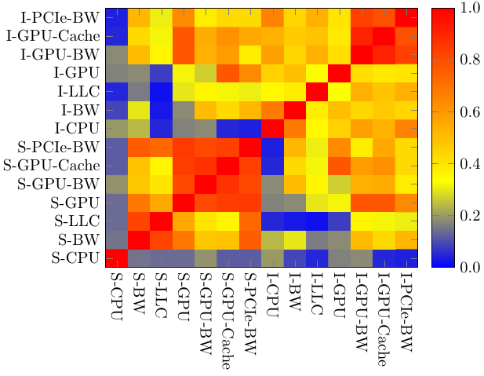
Observations
Correlations between sensitivities and intensities across different resources
Large Pearson coefficiency indicates higher linear relationship
*cache and mem-bw are somehow related; gpu, gpu-bw, gpu-L2, pcie-bw are somehow related
*none of the resource can be completely represented by another resource

Slide 37
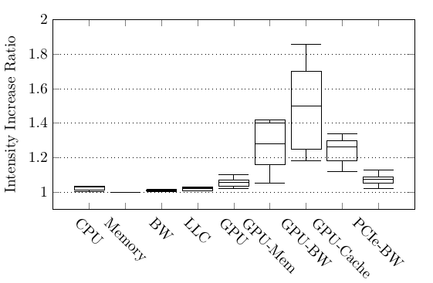
Observations
Impact of resolution – on intensity
Intensity of CPU, memory, LLC are not affected by resolution (<5%)
Intensity of GPU related resources are linear to the # of pixels
Correlation between resolution and intensity
GPU | GPU-Memory | GPU-BW | GPU-L2 | PCIe
0.94 | 0.98 | 0.99 | 0.99 | 0.99
*Profiling two resolutions for each resource, others can be derived

Slide 38
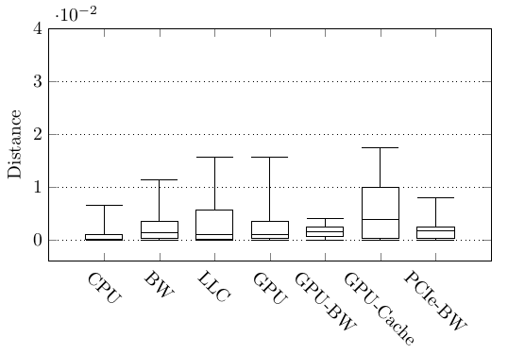
Observations
Impact of resolution – on sensitivity
Distance among sensitivity curves of different resolution is very small
*Even initial fps is different for different resolutions, sensitivity curves are not affected by resolutions
*Strong negative linear relationship (coefficient: -0.98) between fps and resolution (# of pixels)

Slide 39
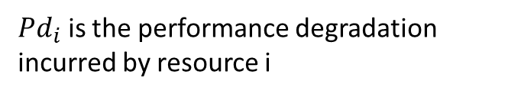
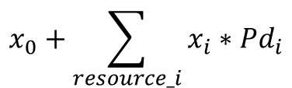
Observations
Performance degradation incurred by each resource is not addictive
Assume resources are independent, and A’s performance degradation is equal to
$$x_{0}+\sum_{resource_i}{x_{i}∗{Pd}_{i}}$$
${Pd}_{i}$ is the performance degradation incurred by resource i
*large prediction errors (34%) are observed, non-linear relationship needs to be mined

Slide 40
Proposed Approach
Machine learning
Efficient to mine non-linear relationships
Model 1: Classification
To predict whether game A satisfies QoS when co-located with B, C, …
1 satisfy
(A’s initial fps, A’s sensitivity, B’s intensity, C’s intensity, …) ->
0 not satisfy
Input
Output

Slide 41
Proposed Approach
Machine learning
Efficient to mine non-linear relationships
Model 2: Regression
To predict game A’s performance when co-located with B, C, …
(A’s sensitivity, B’s intensity, C’s intensity, …) -> A’s performance degradation
Input
Output

Slide 42
Proposed Approach
Machine learning
(A’s sensitivity, B’s intensity, C’s intensity, …) ->
Output
Input
7 curves, each curve has 10 sampling points, 70 columns
a vector of 7 columns
a vector of 7 columns
Problems:
Too many columns
The number of columns is not fixed

Slide 43
Proposed Approach
Machine learning
(A’s sensitivity, B’s intensity, C’s intensity, …) ->
Output
7 curves, each curve has 10 sampling points, 70 columns
Each curve is represented by 4 values: (min, 1/4quantile, mean, 3/4quantile)
Proof: compute distances between each pair of games, using 10 values and 4 values respectively, obtain the correlation between these two set of distances
CPU | LLC | Mem-BW | GPU | GPU-BW | GPU-L2 | PCIe
0.98 | 0.99 | 0.99 | 0.99 | 0.99 | 0.99 | 0.99
*Linear relationship exists, indicating 4 values can represent 10 values

Slide 44
Proposed Approach
Machine learning
(A’s sensitivity, B’s intensity, C’s intensity, …) ->
Output
Input
Use statistical data to represent the intensities of multiple games
<0.1, 0.2, 0.1, 0.3, 0.5, 0.1, 0.3>
<0.2, 0.1, 0.1, 0.2, 0.4, 0.2, 0.3>
{3, (sum1, var1), (sum1, var1), …, (sum1, var1)}
<0.2, 0.2, 0.3, 0.5, 0.1, 0.1, 0.2>
Number of games
Sum and variance of each column for all games
*The intensity of any number of games can be represented by 15 columns

Slide 45
Evaluation
Design of benchmarks
Linear increase of intensity
Each benchmark only generates pressure on the specific shared resource

Slide 46
Evaluation
Experimental environment
Server with 4 Cores Intel i7-7700 3.4 GHz CPU, 8GB RAM and an NVIDIA GeForce GTX 1060 GPU
100 popular games with various genres
ASTER: Multiseat for Windows 10 (support multiple games running concurrently)
Over 2000 co-locations for 2 games, 500 co-locations for 3 games and 500 co-locations for 4 games

Slide 47
Evaluation
Prediction Accuracy (classification)
Colocations of 3-games
Full intensity data
Simplified intensity data
 | 35 | 72 | 108 | 255
DTC | 0.72 | 0.84 | 0.85 | 0.86
GBDT | 0.73 | 0.84 | 0.85 | 0.91
RF | 0.72 | 0.86 | 0.87 | 0.91
SVC | 0.71 | 0.81 | 0.88 | 0.93
 | 35 | 72 | 108 | 255
DTC | 0.81 | 0.82 | 0.85 | 0.90
GBDT | 0.76 | 0.83 | 0.87 | 0.94
RF | 0.76 | 0.86 | 0.87 | 0.94
SVC | 0.71 | 0.82 | 0.83 | 0.92
*The simplified intensity also works well

Slide 48
Evaluation
Prediction Accuracy (classification)
Training with colocations of 2, 3 games
Testing with colocations of 2, 3, 4 games
QoS = 50 fps
 | 175 | 351 | 526 | 1229
DTC | 0.88 | 0.90 | 0.90 | 0.93
GBDT | 0.90 | 0.91 | 0.92 | 0.95
RF | 0.86 | 0.91 | 0.91 | 0.93
SVC | 0.87 | 0.89 | 0.90 | 0.93
QoS = 55 fps
 | 165 | 330 | 496 | 1157
DTC | 0.83 | 0.83 | 0.86 | 0.90
GBDT | 0.86 | 0.88 | 0.89 | 0.93
RF | 0.84 | 0.88 | 0.89 | 0.93
SVC | 0.86 | 0.87 | 0.89 | 0.91
QoS = 60 fps
 | 165 | 330 | 496 | 1157
DTC | 0.76 | 0.81 | 0.89 | 0.93
GBDT | 0.85 | 0.90 | 0.93 | 0.96
RF | 0.83 | 0.84 | 0.90 | 0.94
SVC | 0.77 | 0.84 | 0.87 | 0.90

Slide 49
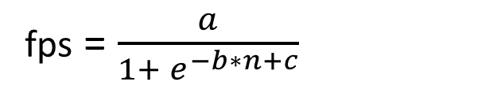
Evaluation
Prediction Accuracy (regression)
Alternatives:
Sigmoid Approach
fps = $\frac{a}{1+ e^{−b∗n+c}}$
a, b, c are parameters, n is the number of games colocated

Slide 50
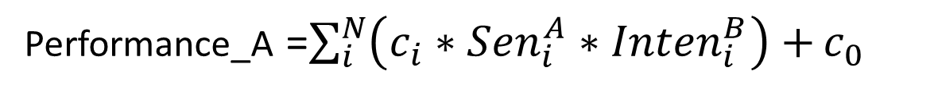
Evaluation
Prediction Accuracy (regression)
Alternatives:
SMiTe Approach (for two games)
Performance_A =$\sum_{i}^{N}{\left(c_{i}∗{Sen}_{i}^{A}∗{Inten}_{i}^{B}\right)+}c_{0}$
B’s intensity on resource i
Parameter for resource i
A’s sensitivity against maximum intensity

Slide 51
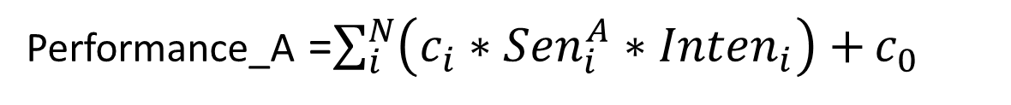
Evaluation
Prediction Accuracy (regression)
Alternatives:
SMiTe Approach + Paragon (for more games)
Performance_A =$\sum_{i}^{N}{\left(c_{i}∗{Sen}_{i}^{A}∗{Inten}_{i}\right)+}c_{0}$
Sum of intensity of all games on resource i
Parameter for resource i
A’s sensitivity against maximum intensity

Slide 52
Evaluation
Prediction Accuracy (classification)
Colocations of 3-games
Full intensity data
Simplified intensity data
 | 36 | 73 | 109 | 256
DTR | 0.157 | 0.118 | 0.109 | 0.100
GBRT | 0.144 | 0.118 | 0.096 | 0.096
RF | 0.255 | 0.147 | 0.124 | 0.109
SVR | 0.133 | 0.112 | 0.100 | 0.098
 | 36 | 73 | 109 | 256
DTR | 0.136 | 0.117 | 0.117 | 0.103
GBRT | 0.134 | 0.121 | 0.098 | 0.090
RF | 0.229 | 0.143 | 0.137 | 0.102
SVR | 0.121 | 0.108 | 0.100 | 0.094
*The simplified intensity also works well

Slide 53
Evaluation
Prediction Accuracy (classification)
Colocations of 2-games (compare with SMiTe, Sigmoid)
 | 168 | 336 | 504 | 1176
DTR | 0.101 | 0.095 | 0.085 | 0.076
GBRT | 0.084 | 0.082 | 0.080 | 0.072
RF | 0.090 | 0.083 | 0.080 | 0.069
SVR | 0.096 | 0.095 | 0.090 | 0.082
SMiTe | 0.2 | 0.19 | 0.19 | 0.185
Sigmoid | 0.470 | 0.470 | 0.460 | 0.460

Slide 54
Evaluation
Prediction Accuracy (classification)
Training with colocations of 2, 3 games
Testing with colocations of 2, 3, 4 games
 | 186 | 373 | 560 | 1308
DTR | 0.118 | 0.106 | 0.102 | 0.086
GBRT | 0.108 | 0.096 | 0.095 | 0.074
RF | 0.107 | 0.106 | 0.102 | 0.075
SVR | 0.116 | 0.115 | 0.114 | 0.089
SMiTe* | 0.22 | 0.215 | 0.208 | 0.204
Sigmoid | 0.460 | 0.460 | 0.460 | 0.450

Slide 55
Applications
Minimizing resource usage
A given set of requests, a predefined QoS threshold, to pack the requests to servers with minimum number of servers
Algorithm (lnK):
Generate all the feasible game co-locations according to the proposed prediction approach (classification)
Sort the feasible game co-locations according to size
Repeat until all the requests are packed
3.1 Each time, select the feasible co-location with the largest size
3.2 If the remaining requests can cover the selected co-location, remove all the covered requests, and increase the number of servers used, otherwise, remove the co-location;
Compare: vector bin packing, according to the initial CPU, GPU, memory

Slide 56
Applications
Minimizing resource usage
Feasible colocations of 10 selected games generated by two approaches
*our approach has more feasible colocations

Slide 57
Applications
Minimizing resource usage
Number of servers used for packing 5000 requests
*our approach can save 20%~40% depending on various QoS

Slide 58
Applications
Maximizing performance
A given set of requests, a set of servers, to pack the requests to servers for maximizing the overall performance
Algorithm:
Pack each request in some predefined order
For each request, select the server that minimize the performance degradation
Compare:
vector bin packing with worst-fit policy
SMiTe
Sigmoid

Slide 59
Applications
Maximizing performance
Average fps by different packing approaches
*Our approach achieves higher performance

Slide 60
Applications
Maximizing performance
CDF of fps of all games (2000 server)

Slide 61
Discussions
Dynamic changes of frame rates
Impact of different game configurations
Latency in Cloud Gaming
Impact of Video Encoding/Streaming in Cloud Gaming

Slide 62
Future Work
Interference-aware resource allocation/partition
Partition multiple CPU cores
Partition multiple GPU cards
Cache partition
Virtual GPU partition (AMD MxGPUs)

Slide 63
提纲
云游戏中的资源管理
搜索引擎中的资源管理
AI 在资源管理中的应用

Slide 64
实例分布调整
问题描述
IDC 中有多种 service，每个 service 有很多实例
对已有实例的分布进行调整，达到负载均衡
约束条件
Resource Constraints (CPU, Memory, SSD)
Conflict Constraints
No Service Interruption (Online)

Slide 65
实例分布调整
挑战
大规模调整复杂度高、小规模调整效果差
线上调整对安全性、可靠性有极高要求
调整过程约束条件多
Transient Constraint:
25
20
有些资源在原 server 和目标 server 上都需要消耗
25
30

Slide 66
实例分布调整
调整算法
局部搜索
25
25
45
25
25
Shift: 移动一个实例到另一台 server

Slide 67
实例分布调整
调整算法
局部搜索
10
30
50
30
50
50
Swap: 交换位于不同 server 上的两个实例

Slide 68
实例分布调整
调整算法
局部搜索
BigMove：移动实例到一台 server, 同时移走 server 上若干实例

Slide 69
实例分布调整
调整算法
局部搜索
10
30
50
20
50
50
50
30
20
10
30
20
50
50
50

Slide 70
实例分布调整
调整算法
局部搜索
第二轮
10
30
50
30
20
20
50
50
50
第一轮

Slide 71
实例分布调整
调整算法
局部搜索
以server为单位多轮迭代，直到所有server变为不可调状态
(1) 每次迭代选取当前cpu使用率最高的server进行调整
(2) 依次对server上的每一个实例进行如下操作：
(a) 依次尝试shift, swap和BigMove调整
(b) 如果上述任意一个尝试成功，本次迭代结束，跳至步骤(1)
(c) 如果全部尝试失败，标记此实例为失败
(3) 如果server上所有的实例都失败，标记此server为不可调(以后不参与调整)，结束本次迭代，跳至步骤(1)

Slide 72
实例分布调整
调整效果
 | top 1% | top 5% | top 10% | cpu_idl 系统均值
调整前 | 0.27 | 0.37 | 0.42 | 0.53
贪心算法 | 0.36 | 0.4 | 0.44 | 0.53
局部搜索 | 0.46 | 0.47 | 0.48 | 0.53
某机房调整前后 CPU-Idle 对比
ICDCS 2017

Slide 73
副本策略
实例副本
每个 service 通常有多个实例副本，以满足大量并发请求
副本个数影响单实例资源消耗
Observation: 单实例消耗的CPU近似与实例个数成反比，而内存与实例个数无关

Slide 74
副本策略
副本策略的影响
A: 总 CPU 需求 6.0, 单实例内存需求 0.5
B: 总 CPU 需求 4.0, 单实例内存需求 0.5

Slide 75
副本策略
目标
寻找合理的副本策略，使得所用资源最少
算法
全局搜索
时间复杂度高、结果较优
最少副本策略
副本最少、单实例较大，不利于调整
固定资源占比策略
异构场景不友好
Online 调整策略
ICPP 2018

Slide 76
提纲
云游戏中的资源管理
搜索引擎中的资源管理
AI 在资源管理中的应用

Slide 77
AI在资源管理中的应用
磁盘故障预测
负载预测
智能运维（Cache预充、故障定位、根因分析等）
Interference预测

Slide 78
References
Ren R, Tang X, Li Y, et al. Competitiveness of Dynamic Bin Packing for Online Cloud Server Allocation[J]. IEEE/ACM Transactions on Networking, 2017, 25(99):1-8.
Li Y, Tang X, Cai W. Dynamic Bin Packing for On-Demand Cloud Resource Allocation[J]. IEEE Transactions on Parallel & Distributed Systems, 2015, 27(1):157-170.
Yusen Li, Yunhua Deng, Xueyan Tang, Wentong Cai, Xiaoguang Liu, Gang Wang:
On Server Provisioning for Cloud Gaming. ACM Multimedia 2017: 492-500
Yusen Li, Xueyan Tang, Wentong Cai:Dynamic Bin Packing for On-Demand Cloud Resource Allocation. IEEE Trans. Parallel Distrib. Syst. 27(1): 157-170 (2016)
Xueyan Tang, Yusen Li, Runtian Ren, Wentong Cai:On First Fit Bin Packing for Online Cloud Server Allocation. IPDPS 2016: 323-332
Yunhua Deng, Yusen Li, Xueyan Tang, Wentong Cai:Server Allocation for Multiplayer Cloud Gaming. ACM Multimedia 2016: 918-927
Yusen Li, Xueyan Tang, Wentong Cai:Play Request Dispatching for Efficient Virtual Machine Usage in Cloud Gaming. IEEE Trans. Circuits Syst. Video Techn. 25(12): 2052-2063 (2015)
Yusen Li, Xueyan Tang, Wentong Cai:On dynamic bin packing for resource allocation in the cloud. SPAA 2014: 2-11

Slide 79

h
谢谢！

