Slide 1
大数据并行处理
by 胡泽瑞
Notes:
1

Slide 2
系统研发中的“平衡”理念
大数据背景的数据访问模式
CONTENTS
大数据系统的构建
LSbM-tree
本次报告的内容基于2018龙星计划——大数据的并行处理系统课程。
系统的并发控制
SSD的基本特性及应用

Slide 3

系统研发中的“平衡”理念

Slide 4
Major Resources in Computing and Network Systems
Good News in supply
CPU cycles: oversupplied for many applications.
Memory bandwidth: improved dramatically.
Memory capacity: increasingly large and at low cost.
I/O bandwidth: improved dramatically.
Disk capacity: huge and at very low cost.
Cluster and Internet bandwidths: very rich.
Bad News in demand
CPU cycles per Watt decreases. (less energy efficient).
Cache capacity: always limited.
Improvement of data access latencies very slow.
Networking and energy costs are increasingly high
Adam Smith: commodity price is defined by an “invisible hand” in the market. We need to balance
Oversupplied cycles, large storage capacity, fast networks
High demand of low latency accesses, low energy cost
Notes:
The major resources we are concerned in computer and distributed systems are:

Slide 5


Data Communication in Computer Systems
Transfer Bandwidth Time
Source
Destination
Latency Time
Destination-perceived latency reduction is still limited due
to imbalanced improvement of bandwidth and latency
Notes:
Data communication is a basic operation among differnet components in current computer systems.
For example, between cpu and memory.
The data transfer time is decided by the latency time and bandwidth.
Latency:
Bandwidth:
Client perceived latency is mainly from data transfer time. It is still challenging due to the imbalanced improvments of bandwidth and latency.

Slide 6
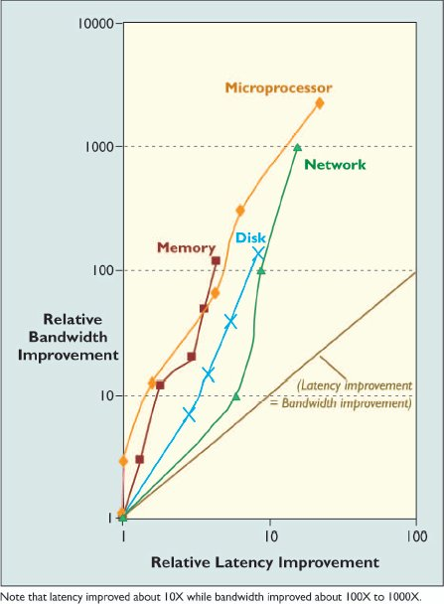
Latency Lags Bandwidth (CACM, Patterson)
In the last 20 years,
100–2000X improvement in bandwidth
5-20X improvement in latency
Between CPU and on-chip cache:
bandwidth: 2250X increase
latency: 20X reduction
Between off-cache and DRAM:
bandwidth: 125X increase
Latency: 4X reduction
Between DRAM and disk:
bandwidth: 150X increase
latency: 8X reduction
Between two nodes via a LAN:
bandwidth: 100X increase
latency: 15X reduction

Slide 7
How is Resource Supply/Demand Balanced?
Slowdown CPU Speed
Earth Simulator: NEC AP, 500 MHz (4-way SU, a VU).
Blue Gene/L: IBM Power PC 440, 700 MHz.
Columbia: SGI Altix 3700 (Intel Itanium 2), 1.5 GHz. (commodity processors, no choice for its high speed)
Very low latency data accesses:
Earth Simulator: 128K L1 cache and 128 large registers.
Blue Gene/L: on-chip L3 cache (2 MB).
Columbia: on-chip L3 cache (6 MB).
Fast accesses to huge/shared memory
Earth Simulator: cross bar switches between AP and memory.
Blue Gene/L: cached DRAM memory, and 3-D torus connection.
Columbia: SGI NUMALink’s data block transfer time: 50 ns.
Further latency reductions: prefetching and caching.

Slide 8
系统的可扩展性是一个延迟和吞吐量平衡的结果
最佳点
延迟
吞吐量
并发进程的数量

Slide 9
大数据背景的数据访问模式

Slide 10
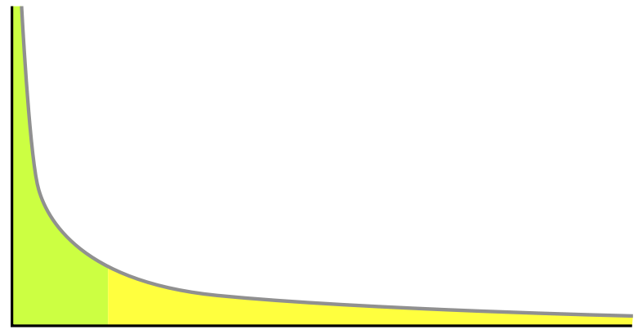
Big Data and Power Law
# of hits to
each data object
Popularity ranks
for each data object
To the rights (the yellow region) is the long tail of lower 80% objects; to the left are the few that dominate (the top 20% objects). With limited space to store objects and limited search ability to a large volume of objects, most attentions and hits have to be in the top 20% objects, ignoring the long tail.

Slide 11
Zipf distribution is believed the general model of data access patterns
Zipf distribution (power law)
Characterizes the property of scale invariance
Heavy tailed, scale free
80-20 rule
Income distribution: 80% of social wealth owned by 20% people (Pareto law)
Web traffic: 80% Web requests access 20% pages (Breslau, INFOCOM’99)
System implications
Objectively caching the working set in proxy
Significantly reduce network traffic
log y
y
slope: -α
heavy tail
log i
i
α: 0.6~0.8
i : rank of objects
y_{i} : number of references

Slide 12
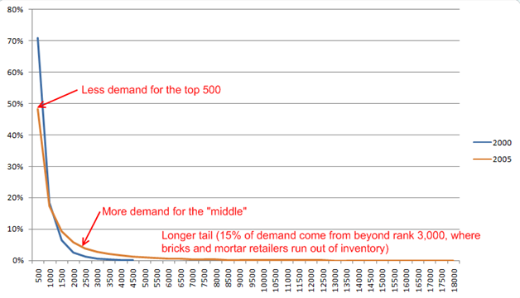
Distribution Changes in DVDs in Netflix 2000 to 2011
2011 predicted
The growth of Netflix selections ( today: 30 million US users, 40 million users total, 1/3 streaming traffic of Internet)
2000: 4,500 DVDs, 2005: 18,000 DVDs
2011: over 100,000 DVDs (the long tail would be dropped even more slowly for more demands)
Note: “breaks and mortar retailers”: face-to-face sell shops.

Slide 13
Why Shifting from Highly Focused Data sets to Big Data?
Time and space with rapid advancement of computer/Internet
Fast search and processing technology of high volume of data
Low cost and high capacity of storage, advanced caching techniques
Data are easy to produce, store, and access at low costs with less and less time and space constraint
Data in the long tail are very valuable
New demand/supply, new knowledge and new discovery
In data minding, with big data, simple algorithms are most effective
Big data challenges traditional concept of 80-20 rule
80-20 rule: 20% products (data) account for 80% sales (results)
The 98% rule: almost every product (data) contribute in its own way
Big data creates a world of abundance
In contrast to a world of scarcity, we must change our thinking/actions:
Building low cost tools/systems to produce and store meaningful big data
Building low cost tools/systems to process continuously growing big data
Linking them to all applications for advancement of the society.

Slide 14
Research Objectives
Find a general distribution model of Internet media access patterns as a case for big data
Comprehensive measurements and experiments
Rigorous mathematical analysis and modeling
Insights into media system designs

Slide 15
Workload summary
16 workloads in different media systems
Web, VoD, P2P, and live streaming
Both client side and server side
Different delivery techniques
Downloading, streaming, pseudo streaming
Overlay multicast, P2P exchange, P2P swarming
Data set characteristics
Workload duration: 5 days - two years
Number of users: 10³ - 10⁵
Number of requests: 10⁴ - 10⁸
Number of objects: 10² - 10⁶
nearly all workloads available on the Internet
all major delivery techniques
data sets of different scales

Slide 16
Stretched exponential distribution
Media reference rank follows stretched exponential distribution (passed Chi-square test)
log y
Probability distribution: Weibull
fat head
c: stretch factor
Rank distribution:
fat head and thin tail in log-log scale
straight line in logx-y^{c} scale
thin tail
log i
y^{c}
c: stretch factor
i : rank of media objects (N objects)
y : number of references
b
slope: -a
log i

Slide 17
Evidences: Web media systems (server logs)
fat head
thin tail
*HPLabs-99 (120 MB)
ST-SVR-01 (15 MB)
*HPC-98 (14 MB)
powered scale y^{c}
log scale
c = 0.22
R² ~ 1
log scale in x axis
x: rank of media object, y: number of references to the object. Title: workload name (median file size)
data in stretched exponential scale
data in log-log scale
R²: coefficient of determination (1 means a perfect fit)
HPC-98: enterprise streaming media server logs of HP corporation (29 months)
HPLabs: logs of video streaming server for employees in HP Labs (21 months)
ST-SVR-01: an enterprise streaming media server log workload like HPC-98 (4 months)

Slide 18
Evidences: Web media systems (req packets)
fat head
thin tail
ST-CLT-04 (2 MB)
ST-CLT-05 (4.5 MB)
PS-CLT-04 (1.5 MB)
powered scale y^{c}
log scale
log scale in x axis
All collected from a large cable network hosted by a well-known ISP
PS-CLT-04: first IP packets of HTTP requests for media objects (downloading and pseudo streaming), 9 days
ST-CLT-04: RTSP/MMS streaming requests (on-demand media), 9 days
ST-CLT-05: RTSP/MMS streaming requests (on-demand media), 11 days

Slide 19
Evidences: VoD media systems
fat head
thin tail
*mMoD-98 (125 MB)
*CTVoD-04 (300 MB)
powered scale y^{c}
log scale
mMoD-98: logs of a multicast Media-on-Demand video server, 194 days
CTVoD-04: streaming serer logs of a large VoD system by China telecom, 219 days, reported as Zipf in EUROSYS’06
IFILM-06: number of web page clicks to video clips in IFILM site, 16 weeks (one week for the figure)
YouTube-06: cumulative number of requests to YouTube video clips, by crawling on web pages publishing the data
log scale in x axis
IFILM-06 (2.25 MB)
YouTube-06 (3.4 MB)

Slide 20
Evidences: P2P media systems
*KaZaa-02 (300 MB)
*KaZaa-03 (5 MB)
BT-03 (636 MB)
KaZaa-02: large video file (> 100 MB. Files smaller than 100 MB are intensively removed) transferring in KaZaa network, collected in a campus network, 203 days.
KaZaa-03: music files, movie clips, and movie files downloading in KaZaa network, 5 days,
reported as Zipf in INFOCOM’04.
BT-03: 48 days BitTorrent file downloading (large video and DVD images) recorded by two tracker sites

Slide 21
Evidences: Live streaming and other systems
Akamai-03
Movie-02
IMDB-06
Akamai-03: server logs of live streaming media collected from akamai CDN, 3 months, reported as two-mode Zipf in IMC’04
Movie-02: US movie box office ticket sales of year 2002.
IMDB-06: cumulative number of votes for top 250 movies in Internet Movie Database web site

Slide 22
Two Distribution Models are Based on Different Storage Requirements
Accesses to big data (e.g. Internet media) follows stretched exponential distribution
log y
The SE curve implies a wide range access
distribution in long period of time.
fat head
Rank distribution:
fat head and thin tail in log-log scale
weak locality needs a huge and distributed storage
thin tail
log i
log y
The sharp zipf slope implies a concentrated access distribution on a small number of objects
strong locality makes proxy cache very effective
slope: -a
log i

Slide 23
大数据背景的数据访问模式

Slide 24
MapReduce Operations on Hadoop
Get average salary of each of 2 organizations in a huge file.
{name: (org., salary)}
{org.: avg. salary}
Key
Value
Key
Value
Original key/value pairs: all the person names associated with each org name and their salaries
Result key/value pairs: two entries showing the org name and corresponding average salary
Name | (dept. ,salary)
Alice | (Org-1, 3000)
Bob | (Org-2, 3500)
… | …
dept. | avg. salary
Org-1 | …
Org-2 | …

Slide 25
MapReduce Operations on Hadoop
Calculate the average salary of every organization
{name: (org., salary)}
{org.: avg. salary}
HDFS
A HDFS block
Hadoop Distributed File System (HDFS)

Slide 26
MapReduce Operations on Hadoop
Calculate the average salary of every department
{name: (org., salary)}
{org.: avg. salary}
HDFS
Map
Map
Map
Each map task takes 4 HDFS blocks as its input and extract {org.: salary} as new key/value pairs, e.g. {Alice: (org-1, 3000)} to {org-1: 3000}
3 Map tasks concurrently process input data
Records of “org-1”
Records of “org-2”

Slide 27
MapReduce Operations on Hadoop
Calculate the average salary of every department
{name: (org., salary)}
{org.: avg. salary}
HDFS
Map
Map
Map
Shuffle the data using org. as Partition Key (PK)
Records of “org-1”
Records of “org-2”

Slide 28
MapReduce Operations on Hadoop
Calculate the average salary of every department
{name: (org., salary)}
{org.: avg. salary}
HDFS
Map
Map
Map
Calculate the average salary for “org-1”
Calculate the average salary for “org-2”
Reduce (Avg.)
Reduce (Avg.)
HDFS
Notes:
2 Reduce tasks concurrently perform aggregation on the data of each department and then generate the final output to HDFS

Slide 29


MR(Hadoop) Job Execution Patterns
MR program (job)
The execution of a MR job involves 6 steps
Map Tasks
Reduce Tasks
Control level work, e.g. job scheduling and task assignment
Data is stored in a Distributed File System (e.g. Hadoop Distributed File System)
1: Job submission
Master node
Worker nodes
Worker nodes
2: Assign Tasks
Do data processing work specified by Map or Reduce Function
Notes:
Let’s quickly review the execution of a MapReduce job, or be specific Hadoop Job. In a Hadoop cluster, there is master node, which will take care all of control level work, such as job scheduling and task assignment. There are a bunch of worker nodes, which will do data processing work specified by Map or Reduce function. In the cluster, data is stored in a distributed file system, in hadoop, it is hadoop distributed file system. The execution of a MR job has 6 steps. Firstly, a user will submit his or her MR program, or called MR job. Then, when this job is ready to be executed, the master will assign map and reduce tasks to worker nodes.

Slide 30
MR(Hadoop) Job Execution Patterns
MR program
The execution of a MR job involves 6 steps
Map Tasks
Reduce Tasks
1: Job submission
Map output
Master node
Worker nodes
Worker nodes
Map output will be shuffled to different reduce tasks based on Partition Keys (PKs) (usually Map output keys)
3: Map phase
Concurrent tasks
4: Shuffle phase

Slide 31
MR(Hadoop) Job Execution Patterns
MR program
The execution of a MR job involves 6 steps
Map Tasks
Reduce Tasks
1: Job submission
6: Output will be stored back to Distributed File System
Master node
Worker nodes
Worker nodes
Reduce output
3: Map phase
Concurrent tasks
4: Shuffle phase
5: Reduce phase
Concurrent tasks
Notes:
There are three phases in the job execution. First one is map phase, in this phase, the worker nodes associated with map tasks will concurrently process the input data and generate intermediate key/value pairs. Then, in the shuffle phase, the intermediate results will be distributed to worker nodes associated with reduce tasks. All key/value pairs with same key will be distributed to the same reduce tasks. After that, the worker nodes associated with reduce tasks will concurrently process the intermediate key/value pairs and generate the results of this job. Finally, the output will be stored back to HDFS.

Slide 32
MR(Hadoop) Job Execution Patterns
MR program
The execution of a MR job involves 6 steps
Map Tasks
Reduce Tasks
1: Job submission
6: Output will be stored back to Distributed File System
Master node
Worker nodes
Worker nodes
A MapReduce (MR) job is resource-consuming:
1: Input data scan in the Map phase => local or remote I/Os
2: Store intermediate results of Map output => local I/Os
3: Transfer data across in the Shuffle phase => network costs
4: Store final results of this MR job => local I/Os + network costs (replicate data)
Reduce output
3: Map phase
Concurrent tasks
4: Shuffle phase
5: Reduce phase
Concurrent tasks
Notes:
Although mapreduce programming model hide the complex parallel programming work, programmers should know a MR job is resources consuming. There are three kinds of nontrivial costs. First is the job-scheduling and task-startup costs. Second is the network transfer in the shuffle phase. Finally, the third one is the potential costs on remotely access map input data once a map task is not co-located with its input data.

Slide 33

A big data warehouse is built on top of Hadoop
Notes:
Hive是基于Hadoop的数据仓库解决方案。由于Hadoop本身在数据存储和计算方面有很好的可扩展性和高容错性，因此使用Hive构建的数据仓库也秉承了这些特性。
简单来说，Hive就是在Hadoop上架了一层SQL接口，可以将SQL翻译成MapReduce去Hadoop上执行，这样就使得数据开发和分析人员很方便的使用SQL来完成海量数据的统计和分析，而不必使用编程语言开发MapReduce那么麻烦。

Slide 34

Hive is a data warehouse system
SQL queries
Scalable & Fault-tolerant by Hadoop
Hive
Large volume
e.g.
300PB@FB
…
Large scale cluster
Notes:
Hive exposes a SQL interface to users. It can manage a large volume of data in a large scale cluster. For example, FB has more than 300PB hive data.
Hive provides SQL interface for users. It manages and process data in a scalable and fault-tolerant way. The ability to scale to lots of nodes is one of the main reason that Hive was created in the year of 2007. The amount of data managed by Hive can be huge. For example, Hive data in FB is more than 300PB.
The objective of hive is to manage and process data in a scalable and fault-tolerant way. And, this objective is achieved every day.
http://www.dbms2.com/2009/05/11/facebook-hadoop-and-hive/
Why hive was built (in 2007) and in what circumstance.
- to handle increasingly high volume of data on a scalable cluster system
- conventional data warehouse is not designed for this
The goal of Hive: continuous increase of the throughput as the workload size and cluster sizes increase
Facebook decided in 2007 to move what was then a 15 terabyte big-DBMS-vendor data warehouse to Hadoop — augmented by Hive — rather than to an MPP data warehouse DBMS. Major drivers of the choice included:
License/maintenance costs. Free is a good price.
Open source flexibility. Facebook is one of the few users I’ve ever spoken with that actually cares about modifying open source code.
Ability to run on cheap hardware. Facebook runs real-time MySQL instances on boxes that cost $10K or so, and would expect to pay at least as much for an MPP DBMS node. But Hadoop nodes run on boxes that cost no more than $4K, and sometimes (depending e.g. on whether they have any disk at all) as little as $2K. These are “true” commodity boxes; they don’t even use RAID.
Ability to scale out to lots of nodes. Few of the new low-cost MPP DBMS vendors have production systems even today of >100 nodes. (Actually, I’m not certain that any except Netezza do, although Kognitio in a prior release of its technology once built a 900ish node production system.)
Inherently better performance. Correctly or otherwise, the Facebook guys thought that Hadoop had performance advantages over DBMS, due to the lack of overhead associated with transactions and so on.

Slide 35
Major Differences of Hive from Conventional Data Warehouse Systems
Conventional DWS
Hive
Compiler
Compiler
Runtime
Data Processing Engine
(MapReduce and Tez)
Storage
Distributed File System
(HDFS)
Notes:
Hive and conventional data warehouse systems are fundamentally different in the following way.
A traditional DBMS does have its own storage system (e.g., sequential files, B-trees, and columnstores stored in binary OS files). It also has operators like scan/seek/filter/group-by-aggregate/join, and a runtime engine to run the operators, managing threads, processes, communication (for scale out systems) and memory.
Talk a little bit more about apache tez. Tez is new data processing engine. It generalize the data processing model of MapReduce. A Tez job is a DAG of operations instead of just having map, shuffle and reduce phases like MR. Tez can significantly reduce the execution time by eliminating overhead introduced by MR.

Slide 36
Hive Works as a Relational DB
Operator tree
Stage 3
GBY
Query
SELECT t1.key1,
t1.key2,
COUNT(t2.value)
FROM t1 JOIN t2
ON (t1.key1 = t2.key1)
GROUP BY t1.key2;
SEL
Stage 2
JOIN
SEL
SEL
Stage 1
t1
t2
Notes:
To process a query, Hive first generates an operator tree based on the operations in the query.
Then, Hive breaks the operator tree to multiple stage based on when data needs to be repartitioned. In this example, JOIN and GBY need to repartition their input datasets. So, we have three stages for this query.

Slide 37
But execution engine is MapReduce
Stage 3
GBY
Job 1
tmp
SEL
SEL
Job 2
Stage 2
JOIN
GBY
JOIN
SEL
SEL
SEL
SEL
t1
t2
tmp
Stage 1
Two MapReduce jobs
t1
t2
Notes:
After breaking the operator tree to multiple stages, Hive generates jobs based on those stages. For MapReduce, because an MR job can only shuffle data once, we may generate multiple MR jobs for a query. In this example, we have 2 MR jobs. For Tez, Hive only generates a single Tez job which have three stages.

Slide 38
Two Critical Components under HDFS
GBY
Query planner:
The efficiency of query plans
- Minimizing data movements
SEL
JOIN
SEL
SEL
File format:
Storage/network efficiency
Data reading efficiency
HDFS
Notes:
Let’s take a look at what are performance critical components in Hive.
For a query, its input datasets are stored on HDFS as files. The file format of those files determines how those datasets are physically stored. Thus, the file format is crucial to the storage efficiency and the efficiency of reading data from HDFS.
The query plan of a query is generated by query planner. The query planner determines the efficiency of query plans and when data will be moved (repartitioned).
At runtime, the query plan is executed by those operators. Implementations of those operators determine the execution model and the runtime efficiency.
In the following of this talk, we will introduce major improvements of these three components.

Slide 39
File Format: Distributed Data Placement
GBY
SEL
JOIN
SEL
SEL
File format:
Storage/network efficiency
Data reading efficiency
HDFS
Notes:
File format
Not easy to achieve both simultaneously.

Slide 40




Data Format: how to place a table to a cluster
How to store a table over a cluster of servers ?
answer = table placement method
Server 1
Server 2
Server 3
Notes:
narrow down the scope
big data analytics -> sql-like
big data -> 2-dimensional table in relational db (arbitrary # rows, fixed # columns)
the storage end consists of a cluster of servers
question -> how should we divide and distribute the data to each server, and how we organize them on each local disk
we call each answer to this question, a table placement method

Slide 41
Existing Data Placement Methods
Row-Store: partitioning a table by rows to store
Merit 1: fast data loading
Merit 2: all columns in a row are in one HDFS block
Limit 1: not all columns to be used (unnecessary I/O)
Limit 2: row-based data compression may not be efficient
Column-Store: partitioning a table by columns to store
Merit 1: only read the useful columns (I/O efficient)
Merit 2: Efficient compression under the same data type
Limit 1: Column grouping need intra-network communication
Limit 2: Column partitioning operations can be an overhead

Slide 42
RCFile: Partition Table into Row Groups
A HDFS block consists of one
or multiple row groups
Table
A
…
B
…
C
…
D
…
HDFS Blocks
Store Block 1
Store Block 2
Store Block 3
Store Block 4
…
A Row Group
101
102
103
104
105
201
202
203
204
205
301
302
303
304
305
401
402
403
404
405
…
…
…
…
Notes:
Consistent format to the previous presentations of row-store and column-store

Slide 43

Data Placement under HDFS
HDFS Blocks
NameNode
(A part of the Master node)
Store Block 1
Store Block 2
Store Block 3
DataNode 1
DataNode 2
DataNode 3
HDFS (Hadoop Distributed File System) blocks are distributed
A limited ability to specify for users to define a data placement policy
e.g. to specify which blocks should be co-located
Goals of data placement:
Minimizing I/O operations in local disks and intra network communication

Slide 44

Inside each Row Group
Metadata
Store Block 1
101
102
103
104
105
201
202
203
204
205
301
302
303
304
305
401
402
403
404
405
Notes:
No duplication

Slide 45
RCFile: Inside each Row Group
Compressed Metadata
Compressed Column A
Compressed Column B
Compressed Column C
Compressed Column D
101
102
103
104
105
101 | 102 | 103 | 104 | 105
201
202
203
204
205
301
302
303
304
305
201 | 202 | 203 | 204 | 205
401
402
403
404
405
301 | 302 | 303 | 304 | 305
401 | 402 | 403 | 404 | 405
Notes:
No duplication

Slide 46
Benefits of RCFile
Minimize unnecessary I/O operations
In a row group, table is partitioned by columns
Only read needed columns from disks
Minimize network costs in row construction
All columns of a row are located in same HDFS block
Comparable data loading speed to Row-Store
Only adding a vertical-partitioning operation in the data loading procedure of Row-Store
Applying efficient data compression algorithms
Can use compression schemes used in Column-store

Slide 47
Benefits of RCFile
Minimize unnecessary I/O operations
In a row group, table is partitioned by columns
Only read needed columns from disks
Minimize network costs in row construction
All columns of a row are located in same HDFS block
Comparable data loading speed to Row-Store
Only adding a vertical-partitioning operation in the data loading procedure of Row-Store
Applying efficient data compression algorithms
Can use compression schemes used in Column-store

Slide 48
Query Planner in Hive
GBY
SEL
JOIN
Query planner:
The efficiency of query plans
Data movements
SEL
SEL
HDFS

Slide 49
MR programming is not that “simple”!
public static class Reduce extends Reducer<IntWritable,Text,IntWritable,Text> {
private Text result = new Text();
public void reduce(IntWritable key, Iterable<Text> values,
Context context
) throws IOException, InterruptedException {
double sumQuantity = 0.0;
IntWritable newKey = new IntWritable();
boolean isDiscard = true;
String thisValue = new String();
int thisKey = 0;
for (Text val : values) {
String[] tokens = val.toString().split("\\|");
if (tokens[tokens.length - 1].compareTo("l") == 0){
sumQuantity += Double.parseDouble(tokens[0]);
}
else if (tokens[tokens.length - 1].compareTo("o") == 0){
thisKey = Integer.valueOf(tokens[0]);
thisValue = key.toString() + "|" + tokens[1]+"|"+tokens[2];
}
else
continue;
}
if (sumQuantity > 314){
isDiscard = false;
}
if (!isDiscard){
thisValue = thisValue + "|" + sumQuantity;
newKey.set(thisKey);
result.set(thisValue);
context.write(newKey, result);
}
}
}
public int run(String[] args) throws Exception {
Configuration conf = new Configuration();
String[] otherArgs = new GenericOptionsParser(conf, args).getRemainingArgs();
if (otherArgs.length != 3) {
System.err.println("Usage: Q18Job1 <orders> <lineitem> <out>");
System.exit(2);
}
Job job = new Job(conf, "TPC-H Q18 Job1");
job.setJarByClass(Q18Job1.class);
job.setMapperClass(Map.class);
job.setMapOutputKeyClass(IntWritable.class);
job.setMapOutputValueClass(Text.class);
job.setReducerClass(Reduce.class);
job.setOutputKeyClass(IntWritable.class);
job.setOutputValueClass(Text.class);
FileInputFormat.addInputPath(job, new Path(otherArgs[0]));
FileInputFormat.addInputPath(job, new Path(otherArgs[1]));
FileOutputFormat.setOutputPath(job, new Path(otherArgs[2]));
return (job.waitForCompletion(true) ? 0 : 1);
}
public static void main(String[] args) throws Exception {
int res = ToolRunner.run(new Configuration(), new Q18Job1(), args);
System.exit(res);
}
}
package tpch;
import java.io.IOException;
import java.util.ArrayList;
import org.apache.hadoop.conf.Configuration;
import org.apache.hadoop.conf.Configured;
import org.apache.hadoop.fs.Path;
import org.apache.hadoop.io.DoubleWritable;
import org.apache.hadoop.io.IntWritable;
import org.apache.hadoop.io.Text;
import org.apache.hadoop.mapreduce.Job;
import org.apache.hadoop.mapreduce.Mapper;
import org.apache.hadoop.mapreduce.Reducer;
import org.apache.hadoop.mapreduce.Mapper.Context;
import org.apache.hadoop.mapreduce.lib.input.FileInputFormat;
import org.apache.hadoop.mapreduce.lib.input.FileSplit;
import org.apache.hadoop.mapreduce.lib.output.FileOutputFormat;
import org.apache.hadoop.util.GenericOptionsParser;
import org.apache.hadoop.util.Tool;
import org.apache.hadoop.util.ToolRunner;
public class Q18Job1 extends Configured implements Tool{
public static class Map extends Mapper<Object, Text, IntWritable, Text>{
private final static Text value = new Text();
private IntWritable word = new IntWritable();
private String inputFile;
private boolean isLineitem = false;
@Override
protected void setup(Context context
) throws IOException, InterruptedException {
inputFile = ((FileSplit)context.getInputSplit()).getPath().getName();
if (inputFile.compareTo("lineitem.tbl") == 0){
isLineitem = true;
}
System.out.println("isLineitem:" + isLineitem + " inputFile:" + inputFile);
}
public void map(Object key, Text line, Context context
) throws IOException, InterruptedException {
String[] tokens = (line.toString()).split("\\|");
if (isLineitem){
word.set(Integer.valueOf(tokens[0]));
value.set(tokens[4] + "|l");
context.write(word, value);
}
else{
word.set(Integer.valueOf(tokens[0]));
value.set(tokens[1] + "|" + tokens[4]+"|"+tokens[3]+"|o");
context.write(word, value);
}
}
}
This complex code is for a simple MR job
Low Productivity!
We all want to simply write:
“SELECT * FROM Book WHERE price > 100.00”?
Notes:
Although MR model provide a much easier environment for parallel programming. But the programming work is not that easy. You can easily write a lots of codes even for a simple MR job. Thus, the productivity of MR programming is actually quite low. To enhance the productivity, High-level languages, such as SQL-like declarative languages, on top of MapReduce is desired.

Slide 50



Query Planner: generating optimized MR tasks
A job description in SQL-like declarative language
SQL-to-MapReduce Translator
Query planner does this in automation
Write MR programs (jobs)
MR programs (jobs)
Workers
Hadoop Distributed File System (HDFS)
Notes:
With SQL-like declarative languages, users do not need to write MR jobs or even know how to write MR jobs. They can quickly use SQL-like languages to describe their data processing procedure in a few lines of query. Then, a SQL-to-MapReduce translator will translate these SQL-like queries to one or multiple MR jobs. Then, the MR framework will execute these jobs. Right now, Hive and Pig are two representative translators on top of hadoop.

Slide 51
LSbM-tree:一个读写兼优的大数据存储结构

Slide 52
New Challenges to Access Performance in Big Data
52
Sequentially archived data
Can we massively process both reads and writes concurrently?
but LSM-tree favors writes and B+-tree favors reads
Relational tables
Tables must partitioned/placed among many nodes, e.g. Apache Hive
How to minimize data transfers among nodes and from local disks?
Key-value store
Key indexing becomes a bottleneck as # concurrent requests increase
How to accelerate data accesses for in-memory key-value store?

Slide 53
What is LSM-tree?
It is a Log-structured merge-tree (1996):
Multiple levels of sorted data, (e.g. each by a B+ tree)
Each level increases exponentially, forming a “pyramid”
The smallest level is in memory and the rest on disk
C₀
DRAM
HDD
C₀
C₁
C₁
C₂
C₂
Notes:
LSM-tree maintains multiple levels of sorted data for efficient random data access and range query
The data size of each level increases exponentially
The top level is located in memory as a write buffer, and the rest levels are on disks
All new data are inserted into the write buffer first and then being merged onto on-disk levels in cascade mode(级联模式).

Slide 54
Log Structured Merge（LSM）

Slide 55
Basic Functions of Buffer Cache
Buffer cache is in DRAM or other fast devices
Data entries in buffer cache refer to disk blocks (page)
Cache the frequently read disk blocks for reuse
Buffer cache
a
b
c
disk
a
c
b

Slide 56
Buffer Cache in LSM-tree
DRAM
HDD
C₀
get a
C₁
index structure
a b c d e f
C₂
a-f
root
multi-page
block
a-c
d-f
Queries are conducted level by level
In each level, an index is maintained in memory to map keys to disk blocks
The index is checked to locate the disk block for the key/key range
The found disk block(s) will be loaded into buffer cache and serve there
a
buffer cache
disk
single-page
block
a
b
c
d
e
f

Slide 57
Buffer Cache in LSM-tree
DRAM
HDD
C₀
get a
C₁
index structure
a b c d e f
C₂
a-f
root
multi-page
block
a-c
d-f
Any future request on the same key/key range still need to go through the index
The found disk block(s) can be served from the buffer cache directly after then
a
buffer cache
disk
single-page
block
a
b
c
d
e
f

Slide 58
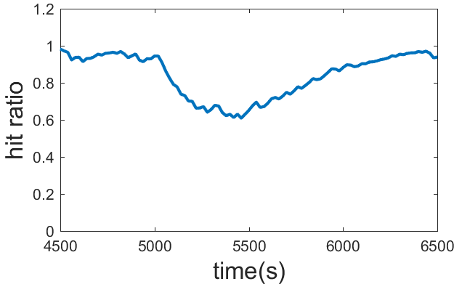
LSM-tree induced Buffer Cache invalidations
Buffer cache
DRAM
writes
a
a
c
d
disk
HDD
b
a
b
c
d
c
C₀
a e
merges
a c e
C₁
a
b
c
d
e
f
a b c d e f
a
e
b d f
C₂
b
d
f
a
c
e
Read buffer (buffer cache) and LSM-tree write buffer (C0) are separate
Frequent compactions for sorting
Referencing addresses changed
Cache invalidations => misses
Notes:
Insert data into write buffer will not update the data in the read buffer

Slide 59
LSbM-tree: aided by a compaction buffer
LSbM-tree
Retains all the merits of an LSM-tree by maintaining the structure
Compaction buffer re-enable buffer caching
Compaction buffer directly maps to buffer cache
Slow data movement to reduce cache invalidations
Keep cached data in compaction buffer for cache hits
writes
Buffer cache
C₀
append
c
a
merges
C₁
c
B₁
C₂
a
B₂
underlying LSM-tree
Compaction buffer

Slide 60
Compaction Buffer: a cushion(缓冲) between LSM-tree and cache
DRAM
writes
HDD
append
c
C₀
a c e
append
c
a
e
merges
a e
C₁
B₁
a b c d e f
b d f
B₂
b d f
C₂
underlying LSM-tree
compaction buffer
During a compaction from Ci to Ci+1, Ci is also appended to Bi+1
E.g. while data in C0 is merged to C1 in LSM-tree, it is also appended to B1 in compaction buffer
No additional I/O, but only index modification and additional space
Buffer cache
c
a
b
d
disk
c
a
e
a
b
c
d
e
f
a
e
b
d
f
a
c
e

Slide 61
Compaction Buffer: a cushion between LSM-tree and cache
DRAM
writes
HDD
C₀
merges
C₁
c
a
e
B₁
a b c d e f
C₂
a c e
b d f
B₂
underlying LSM-tree
compaction buffer
During a compaction from Ci to Ci+1, Ci is also appended to Bi+1
E.g. while data in C0 is merged to C1 in LSM-tree, it is also appended to B1 in compaction buffer
No additional I/O, but only index modification and additional space
As Ci is merged into Ci+1, the data blocks in B_{i} are removed gradually
Buffer cache
a
c
c
a
b
d
disk
c
a
e
a
b
c
d
e
f
b
d
f
a
c
e

Slide 62
Buffer Trimming: Who should stay or leave?
DRAM
writes
HDD
C₀
newly
appended
merges
C₁
B₁
removed
a b c d e f
C₂
a c e
b d
f
B₂
underlying LSM-tree
compaction buffer
To keep the cached data only, the compaction buffer is periodically trimmed
In each level, the most recently appended data blocks stay
For other data blocks, make them stay only if they are cached in the buffer cache
The removed data blocks are noted in the index for future queries
Buffer cache
a
c
b
d
disk
a
b
c
d
e
f
b
d
f
a
c
e
Notes:
In each level, most recently appended data blocks stay, that’s because those data blocks may still being actively loaded into the buffer cache

Slide 63
Birth and Death of the compaction buffer
Workloads | Dynamics in compaction buffer
Read only | No data is appended into compaction buffer (no birth)
Write only | All data are deleted from compaction buffer by the trim process (dying soon)
Read & write | Only frequently visited data are kept in the compaction buffer (dynamically alive)

Slide 64
Why LSbM-tree is effective?
Underlying LSM-tree
Contains the entire dataset
Fully sorted at each level
Efficient for on-disk range query
Updated frequently for merge
LSM-tree induced buffer cache misses are high
Compaction buffer
Attempt to keep cached data
Not fully sorted at each level
Not be used for on-disk range query
Not updated frequently
LSM-tree induced buffer cache misses are minimized
LSbM best utilizes both the underlying LSM-tree and
the compaction buffer for queries of different access patterns

Slide 65
Querying LSM-tree
i=0
Any block in C_{i} holding k?
yes
Use the block found in C_{i}
no
no
Is level i the last level?
Is the block in cache?
yes
i++
no
yes
Load the block into cache
Parse out K-V pair from the block
Not found
Found
Notes:
Queries are conducted level by level until the last level is reached, or the target key is found
In traditional LSM-tree, once an on-disk block is found that contain the target key, it will be loaded directly from buffer cache or disk
In LSbM-tree, we further check the same level of the compaction buffer to see whether any data block in it contains the target key. If found, serve the read from the compaction buffer other wise, from the underlying LSM-tree.

Slide 66
Querying LSbM-tree
i=0
Any block in C_{i} holding k?
yes
Any block in B_{i} holding k?
yes
no
Use the block found in C_{i}
Use the block found in B_{i}
no
no
Is level i the last level?
Is the block in cache?
yes
i++
no
yes
Load the block into cache
Parse out K-V pair from the block
Not found
Found
Notes:
Queries are conducted level by level until the last level is reached, or the target key is found
In traditional LSM-tree, once an on-disk block is found that contain the target key, it will be loaded directly from buffer cache or disk
In LSbM-tree, we further check the same level of the compaction buffer to see whether any data block in it contains the target key. If found, serve the read from the compaction buffer other wise, from the underlying LSM-tree.

Slide 67
系统的并发控制

Slide 68
Concurrency Control (CC)
CC ensures correct results for concurrent operations
A basic component in OS, DS, multiprocessors, databases, PL, …
Ensures serializability of data accesses to the shared data sets
Get results fast for high throughput and scalability
Optimistic Concurrency Control (OCC, Kung and Johnson, 1981) has been used in several production systems
E.g., Microsoft Hekaton, Google App Engine, CoucDB, Silo, …

Slide 69
OCC: How It Works
OCC executes a transaction in three phases:
Phase 1: concurrent local processing
Reads tuples into a read set
Buffers writes into a write set
Phase 2: Validation in critical section
Validates whether serializability is guaranteed:
Has any tuple in the read set been modified?
Phase 3: Commit the results in critical section or abort
Aborts: aborts the transaction if validation fails
Commits: installs the write set and commits the transaction

Slide 70
OCC: An Example
Tuple A in T1’s read set has been changed by T2, thus T1 must be aborted.
Thread1
Thread2
T1:
B = A + B;
T2:
A = A * 1.1;
T2’s read set remains unchanged, thus T2 is allowed to commit
BEGIN
BEGIN
T1’s read set:
A (100)
B (100)
R(A);
R(A);
T2’s read set:
A (100)
T1’s write set:
B (200)
R(B);
W(A);
A (110)
T2’s write set:
W(B);
Commit
Validation
Thread-local memory
Validation
Abort
Thread-local memory
Time
Database
storage
ID | Value
A | 110
B | 100
ID | Value
A | 100
B | 100

Slide 71
OCC’s Advantages
Simple validation, which achieves high throughput and scalability at low contention
Phase 1: Read
Reads data into a read set
Buffers writes into a write set
Phase 2: Validation
Validates whether serializability is guaranteed:
Has any tuple in the read set been modified?
Phase 3: Write
Aborts: aborts the transaction if validation is failed
Commits: installs the write set and commits the transaction
Operates in private workspace; rare inter-thread synchronization (optimistic)
Needs synchronization, but usually very short at low contention

Slide 72
OCC’s Problem: False Aborts
False abort
Some transactions aborted by OCC could have been allowed to commit without causing an unserializable schedule
T1:
B = A + B;
Thread1
Thread2
T2:
A = A * 1.1;
No cycle is formed
OCC only allows serialized execution of T2, T1, but is not able to recognize serialized execution of T1, T2.
T1 is falsely aborted.
If it commits, it is serialized T1, T2.
BEGIN
BEGIN
R(A);
rw
R(A);
R(B);
W(A);
W(B);
Commit
Abort

Slide 73
Issues and Challenges
False aborts happen in high contention environment
False aborts increase latency and decrease throughput
Detecting cycles eliminates false aborts, but non-affordable
Can we reduce false aborts in high contention?

Slide 74
Basic Structure of BCC
BCC is OCC based, retaining its merits
If OCC validation fails, BCC validation checks again

Slide 75
BCC Validation is Complex
Goal: capture all essential patterns at the right time
T₁
T₂
T₁
T₂
T₁
T₂
T₁
T₂
Begin
Begin
Begin
Begin
Begin
Begin
Begin
Begin
W(A)
wr
R(B)
W(A)
ww
R(B)
R(A)
R(B)
Snapshot
W(A)
rw
rw
Commit
Commit
Commit
Commit
R(A)
W(A)
W(A)
R(A)
Commit
Commit
Commit
Commit
Created at the time when T₂ commits
Created at the time when T₁ commits

Slide 76
SSD的基本特性及应用

Slide 77
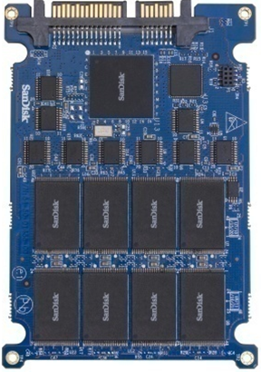
Flash Memory based Solid State Drive
Solid State Drive (SSD)
A semiconductor device
Mechanical components free
Technical merits
Low latency (e.g. 75µs)
High bandwidth (e.g. 250MB/sec)
Low power: 0.06 (idle)~2.4w (active)
Shock resistance
Lifespan: 100GB/day → 5 years (X25-M)

Slide 78
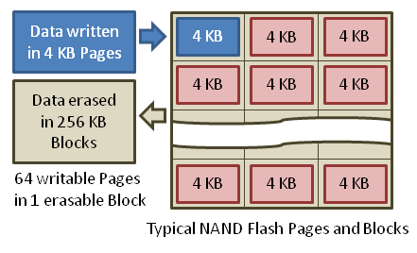
SSD Internal 1: Write and Erase
Data write: data cannot be overwritten (erase before write)
Data unit to write is page (4K-8K), and can only write in an erased unit
Data Erase: to prepare another write in SSD
Data unit to erase is a block (e.g. 64-128 pages)
Flash memory can be only programmed and erased a limited number of times (P/E cycles: e.g. SLC for 100,000, MLC for 10,000)

Slide 79
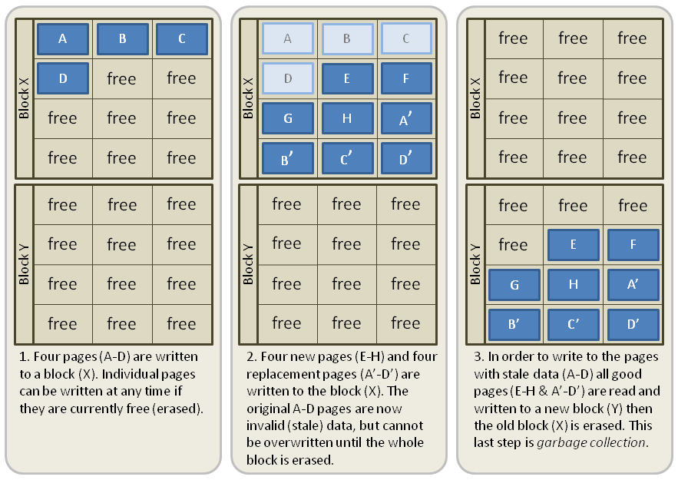
SSD Internal 2: Garbage Collection
As some pages in block X are no longer needed (stale), GC does
(1) valid pages are moved to free block Y, (2) entire block X is erased
The process is expensive and can be done as a background process

Slide 80
SSD Internal 3: Write Amplification
Measurement
(data written to the flash memory) / (data written by the host)
Worst case
To write a 4K page to a 512K block, where only one page is invalid
Garbage collection writes 127 valid pages (508K data) to a free block, and then erase the entire block before writing the 4K page to the new block
Write Amplification = 512K / 4K = 128
Notes:
We identified three critical issues blocking us from effectively and efficiently exploiting SSD’s great performance
We lack insights into the internal structures of SSDs, which makes performance dynamics. We don’t know how and why they could happen.
In a practical system, high price and limited capacity of SSDs makes a full-ssd solution unaffordable.
A hidden resource in SSD is the internal parallelism of SSDs, without an effective solution to exploit it, we will leave resource underutilized greatly.

Slide 81
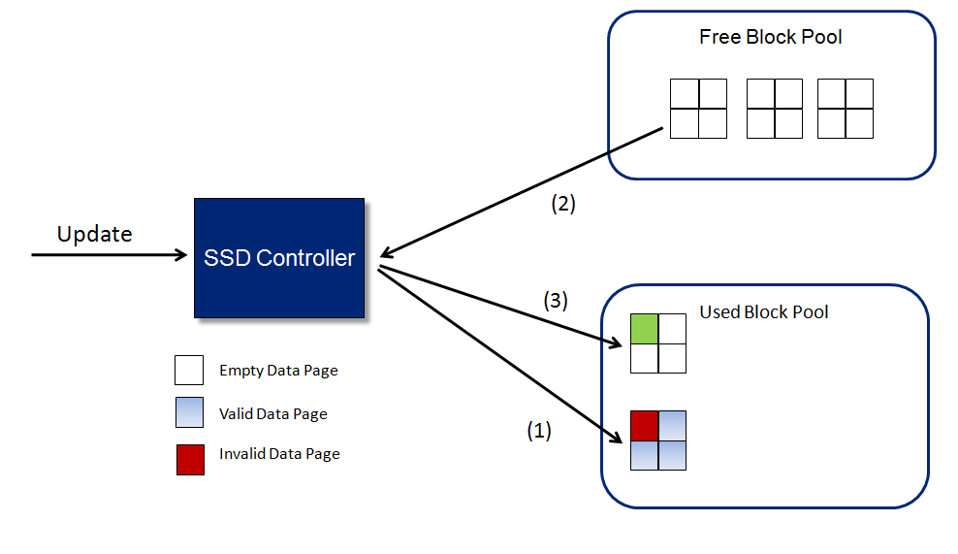
SSD Internal 4: Wear Leveling
Balance the demand and supply between used and free block pools
(1) upon an update request, mark the page invalid, (2) fetch an empty block from free pool, (3) update the page and return the block to the used pool

Slide 82
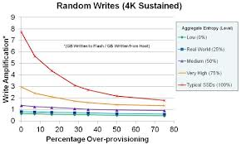
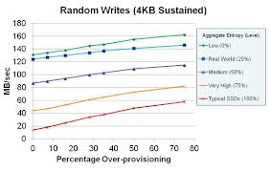
SSD Internal 5: Over-Provisioning(预留空间)
Definition
SSD reserves a portion of total flash memory to the controller to perform various memory management functions
Implications
Reduce the number of garbage collections and the write amplification
Notes:
We identified three critical issues blocking us from effectively and efficiently exploiting SSD’s great performance
We lack insights into the internal structures of SSDs, which makes performance dynamics. We don’t know how and why they could happen.
In a practical system, high price and limited capacity of SSDs makes a full-ssd solution unaffordable.
A hidden resource in SSD is the internal parallelism of SSDs, without an effective solution to exploit it, we will leave resource underutilized greatly.

Slide 83
A Framework for a hybrid storage system
SSD Sketcher – Detecting SSD internal structures
Hystor – Providing hybrid storage services
Prefetcher – utilizing the internal resources of SSD
Other efforts by applications to fully utilize parallelisms.
Applications
App.
Applications
SSD
Sketcher
Buffer Cache
Buffer Cache
Informed Prefetcher
OS
kernel
File System
Block I/O layer
Block Device Driver
Hybrid Dev.Driver
Block Dev.Driver
Hybrid
Storage
Device
HDD
SSD
HDD
SSD
* Collaborated work at Intel® Labs
Notes:
To address the three critical issues, we are building a system framework to integrate the SSDs into the existing storage systems with three major system solutions.
First, we present a set of experimental techniques to detect the internal structures of SSD, which facilitates(促进，帮助) our insightful understanding about SSD performance, and explains the performance dynamics.
Second, we designed and implemented a cost-efficient hybrid storage system to make deliver SSD performance at HDD cost.
Third, we

Slide 84
Outline
Introduction
Sketching SSD internals
Hystor: A hybrid storage system
Exploiting Internal Parallelism
Conclusion
Future Work
App.
Applications
SSD
Sketcher
Buffer Cache
Buffer Cache
Informed Prefetcher
OS
kernel
File System
Block I/O layer
Hybrid Dev.Driver
Block Dev.Driver
Device
Hybrid
Storage
HDD
SSD

Slide 85
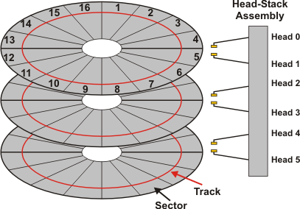

Physical data layout in HDD
0
Data are stored on the surfaces of disk platters
An array of logical block addresses (LBAs) as a logical interface
LBAs are statically mapped to physical block addresses (PBAs) in an almost consistant way
1
2
3
4
5
Host
6
LBA
Read (LBA, size)
Write(LBA, size)

Slide 86
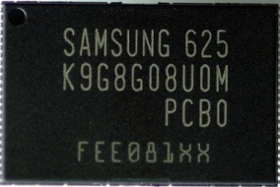
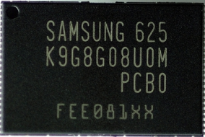
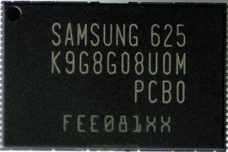
Physical data layout in SSD
0
10
11
Data are stored in flash memory chips
SSD uses the standard LBA interface to host
A mapping table tracks LBA/PBA mappings
Internal data mapping is dynamic on the fly
1
1
21
Idle!
RAM
ECC
The physical data mapping is an architectural feature, we must know the internal structures of SSDs.
2
2
23
Idle!
ECC
3
6
43
Controller
4
28
4
Busy!
ECC
5
31
Host
55
ECC
Idle!
6
12
6
7
91
97
The best case
Read (LBA, size)
The worst case
LBA
PBA
Write(LBA, size)
Notes:
ECC = error correction code. Read/Write (starting LBA address, plus the offset size of blocks).
On the fly 飞速写入

Slide 87
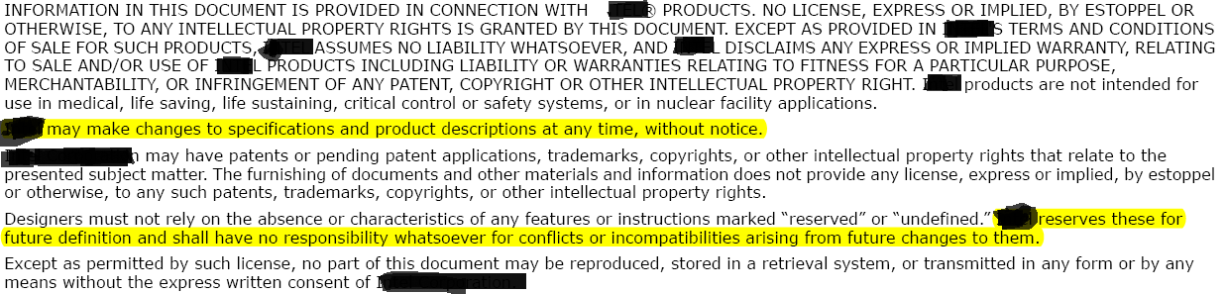



Asking for help from SSD manufacturers?
Intellectual property issues
Limited unreliable info in specification
The strictly defined standard interface
An example specification
How to get the architectural-level information without modifying the interface and hardware?

Slide 88
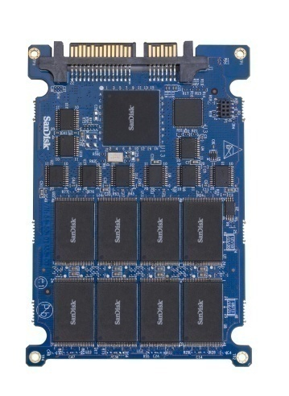
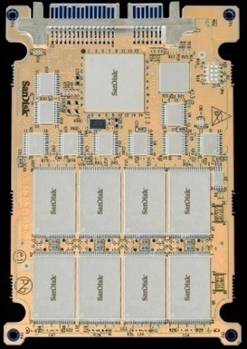
Our approach
Treat an SSD as a black-box
Assume a repeatable but unknown pattern
Inject I/O traffic to probe the device
Observe the reactions of SSD in B/W and latencies
Enumerate possible policies based on open documents*
Speculate the internal structures
Match!
Policy #1
Policy
#1
I/O traffic
Policy #2
Latencies
B/W
*USENIX’08, ISCA’09, etc.

Slide 89
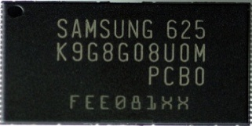



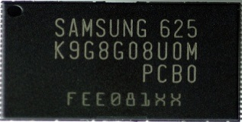
A general model
Domain #0
0
4
8
12
16
Domain
A set of connected chips (how many?)
10x domains
Chunk
A basic unit of data block (how large?)
4KB (the page size)
Mapping
How chunks are allocated from their LBA to their PBA?
To be discussed later
Domain #1
1
5
9
13
17
Resource sharing:
e.g. channel, ECC, et. al.
Domain #2
2
6
10
14
18
Domain #3
3
7
11
15
19
Intel® X25-E SSD
Notes:
Domain: a group of chips connects together as one unit to share internal resources.
Chuck:

Slide 90
LBN-based Mapping
Domain #0
Incoming writes (LBN)
8
Domain #1
1
5
11
5
1
3
8
6
Domain #2
6
11%4
=3
5%4
=1
1%4
=1
3%4
=3
8%4
=0
6%4
=2
Domain #3
3
11
N=4
A block with a logical block number (LBN)
N domains
The mapping domain (LBN mod N)

Slide 91
Write-order based Mapping
Domain #0
6
5
Incoming writes (LBN)
Domain #1
8
11
11
5
1
3
8
6
Domain #2
3
5%4
=1
4%4
=0
3%4
=3
2%4
=2
1%4
=1
0%4
=0
Domain #3
1
N=4
The T_{th} block being written in a sequence
N domains
Domain: (T mod N)
Notes:
Advantages:
(1) for random accessed blocks in terms of LBAs, they will be evenly distributed among the flash chips.
(2) Fully utilize the parallelism, and evenly use the cells.

Slide 92
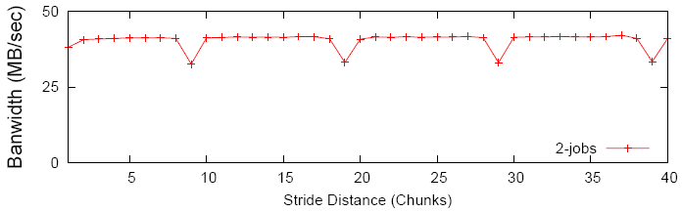
Detecting the mapping policy
Low
Throughput
4
0
0
Domain #0
0
4
8
12
16
Reads in 2 domains (High points)
Domain #1
1
1
5
9
13
17
Domain #2
High
Throughput
2
6
10
14
18
Domain #3
3
7
11
15
19
Reads in 1 domain (Low points)
Sequential overwrite
Fact 1: Sequential LBN writes evenly distribute blocks across domains
Fact 2: Concurrent reads to two domains are faster than to 1 domain

Slide 93
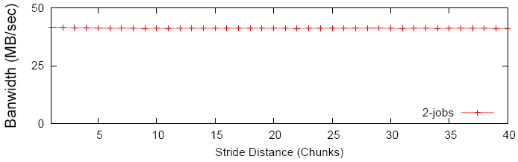
LBN-based Mapping?
LBN-mapping:
The same set of blocks
Domain #0
0
8
4
4
8
0
12
16
16
12
Anticipated Results
Domain #1
1
1
5
13
9
9
13
5
17
17
Domain #2
2
14
6
6
10
18
14
10
18
2
Domain #3
3
3
7
11
11
19
15
15
19
7
Observed Results
Sequential overwrite
Random overwrite
Randomize SSD space in each domain by reordering writes of 4KB
Repeat the same experiment
LBN-based Mapping: the same pattern should reappear
Notes:
Now we leverage the two facts to detect if LBN-based mapping is used in Intel x25-E ssd.

Slide 94
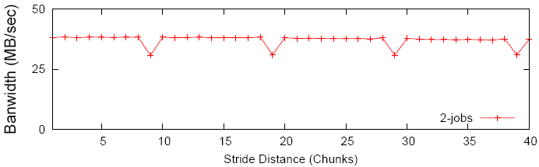
Write-order based Mapping?
1
8
Low
Throughput
8
Domain #0
0
8
4
1
8
0
12
16
16
12
Anticipated Results
Domain #1
1
4
5
14
9
9
13
5
17
4
17
Domain #2
2
13
6
6
10
18
14
3
18
High
Throughput
2
Domain #3
3
10
7
11
11
19
15
15
19
7
Observed Results
Sequential overwrite
Random overwrite
Randomize SSD space by a file with random order blocks of 4KB
Read the blocks in the order of writes
Write-order based Mapping: Similar pattern should reappear
Result: Intel X25-E SSD adopts write-order-based mapping

Slide 95
Distinguishing LBN & Write-order Mappings
Write a set of blocks in a random order to SSD
Read them in the same random order
Write-order, If a regular pattern flat/drop curve is observed.
LBA, if no such a regular pattern
Read them sequentially based on the LBA order
LBA, if a regular pattern of flat/drop curve is observed
Write-order, if no such a regular pattern
Write a set of blocks sequentially in LBA order to SSD
Read them sequentially, no distinction (regular patterns)
Read them randomly, no distinction (no regular patterns)

Slide 96
Outline
Introduction
Sketching SSD internals
Hystor: A hybrid storage system
Exploiting Internal Parallelism
Conclusion
Future Work
App.
Applications
SSD
Sketcher
Buffer Cache
Buffer Cache
Informed Prefetcher
OS
kernel
File System
Block I/O layer
Hybrid Dev.Driver
Block Dev.Driver
Device
Hybrid
Storage
HDD
SSD

Slide 97




Integrating SSD and HDD together
Cache-based solutions
SSD – a secondary-level cache
HDD– the permanent storage
Cache replacement policy
Limitations
Weak locality memory misses
Intensive write traffic
Non-trivial system changes
High-cost on-line replacement
Frequent on-access updates
10-20x Larger SSD space
SSD-cached Disk
Disk-cached SSD
Hybrid Storage
Conquest [USENIX’02]
SmartSaver [ISLPED’06]
ReadyBoost [MS’06]
TurboMemory[ToS’08]
L2ARC [CACM’08]
FlashCache [ISCA’08]
other …
Soundararajan [FAST’10]
Hystor

Slide 98


Hystor: A cost-efficient hybrid storage*
SSD
High-performance, high-cost
HDD
Low-cost, high-capacity
A small data set
Semantically critical – F/S metadata blocks
Performance critical – High-cost data blocks
A large data set
Low-priority data (e.g. movie files)
A prototype system at Intel® Labs for future storage system solution.
* Collaborated work at Intel® Labs

Slide 99

Impact of Hystor
Hystor received the Best Paper Award in 2011 ACM International Conference on Supercomputing (ICS 2011)
Hystor has made impact on Apple hybrid storage product Fusion Drive
- A new storage product on the market since October 23, 2012
- Consisting of a small SSD and a large hard drive
- The hybrid storage is managed by OS in a single space
Comments on Hystor from Apple:
Hystor is a well-designed system, and its paper discussed several key systems trade-offs in details. The Apple software engineers had carefully and systematically evaluated Hystor. This work had a significant influence in the design of Apple's Fusion Drive. Some design elements and algorithms in Hystor have been directly used in Apple's Fusion Drive.
Steve Jobs’ Philosophy on technology transfer for Apple:
Picasso had a saying “Good artists copy, great artists steal”. We have always been shameless about stealing great ideas …

Slide 100
谢谢
Notes:
100

