Slide 1
面向大数据处理的内存系统
崔立骁

Slide 2
概述
内存墙问题（Memory Wall）
Memory Hierarchy
AMAT(Average Memory Access Time)
Cache & Cache Optimizations
C-AMAT(Concurrent-AMAT)
Layered Performance Matching

Slide 3


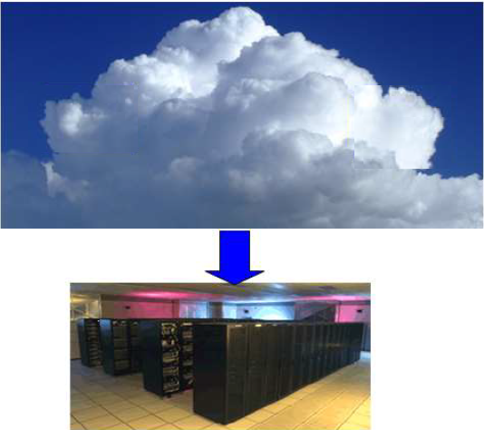
大数据时代

Slide 4
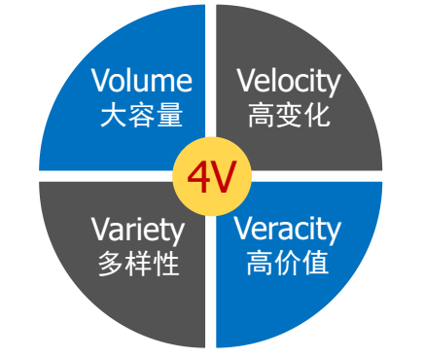
大数据时代(cont.)
计算密集型负载 数据密集型负载
I/O成为数据处理的瓶颈
内存也是数据处理的瓶颈
内存墙问题
图片来源：舒继武教授ppt

Slide 5
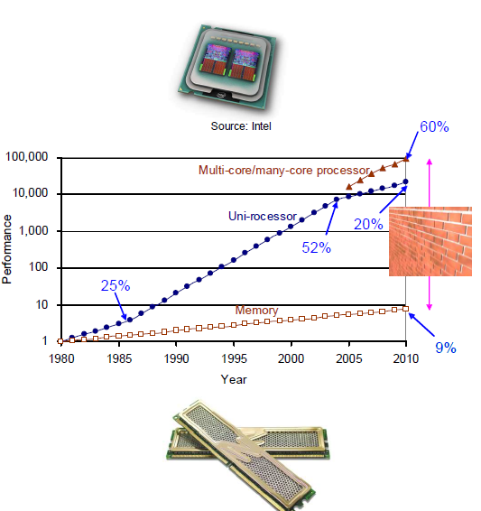
内存墙问题
处理器性能快速提升
单核处理器2004年增长约52%
多核处理器每年增长约60%
内存性能增长缓慢
每年增长约9%
内存与处理器之间的速度
差距不断变大
图源：计算机体系结构：量化研究方法

Slide 7
Memory Hierarchy Introduction
• Programmers want unlimited amounts of memory with low latency
• Fast memory technology is more expensive per bit than slower memory
• Solution: organize memory system into a hierarchy
– Entire addressable memory space available in largest,
slowest memory
– Incrementally smaller and faster memories, each containing
a subset of the memory below it, proceed in steps up toward
the processor
• Temporal and spatial locality insures that nearly all
references can be found in smaller memories

Slide 8
多核处理器带来更严重的内存墙问题
Memory hierarchy design becomes more crucial with recent multi-core processors:
– Aggregate peak bandwidth grows with # cores:
• Intel Core i7 can generate two references per core per
clock
• Four cores and 3.2 GHz clock
25.6 billion 64-bit data references/second +
12.8 billion 128-bit instruction references
= 409.6 GB/s!
• DRAM bandwidth is only 6% of this (25 GB/s)
• Requires:
– Two levels of cache per core
– Shared third-level cache on chip

Slide 9
现代内存层次
- 用最廉价的技术向用户提供尽可能多的内存
- 用最快的技术提供尽可能好的访问性能。
图片来源：龙星计划

Slide 10
Memory Technology Metrics
• Memory access latencies impact how quickly the information is available to the processor
– 100s of ps (CPU registers) to 10s… 100s of ns (main memory) for primary storage
• Memory bandwidth defines the maximum rate at which information is available for processing, preventing processor starvation
– 10s of GB/s for registers and L1 cache, single GB/s for main memory
• Capacity: determines maximum problem size possible to compute
– Capacities range from few bytes per register, few of KB to tens of MB for CPU caches, 100sof GB to 1 TB for hard disks
• Capacity density: determines additional costs associated with assembling storage of required capacity.

Slide 11
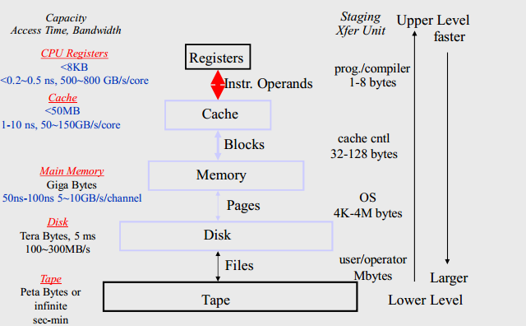
内存层次带来的改进
图片来源：龙星计划

Slide 12
cache
Cache – Originally referring to the first level of the memory hierarchy – The principle of locality applies to many levels
Hit: data appears in some block in the upper level – Hit Rate: the fraction of memory accesses found in the upper level – Hit Time: Time to access the upper level , which consists of RAM access time + Time to determine hit/miss

Slide 13
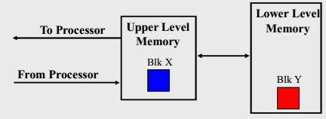
cache(cont.)
Miss: data needs to be retrieve from a block in the lower level (Block Y) – Miss Rate = 1 - (Hit Rate) – Miss Penalty: Time to replace a block in the upper level + Time to deliver the block the processor
Hit Time << Miss Penalty
图源：龙星计划

Slide 14
cache(cont.)
Causes of misses – Compulsory First reference to a block – Capacity Blocks discarded and later retrieved – Conflict Program makes repeated references to multiple addresses from different blocks that map to the same location in the cache
Coherence Misses: – in multiprocessor systems and multi-core processors – Sometimes are false sharing

Slide 15
AMAT(Average Memory Access Time)
AMAT = HitCycle + MR×AMP MR is the miss rate of cache accesses; and AMP is the average miss penalty
AMAT is Recursive - AMAT = HitCycle + MR×AMAT2 = HitCycle + MR×(H2 + MR2×AMP2)
-AMAT = HitCycle + MR×(H2 + MR2× AMAT3 ) = HitCycle + MR×(H2 + MR2×(H3 + MR3×AMP3))
-Etc

Slide 16
内存层次的性能优化表现
Third
level
cache
main memory
First-level
cache
Second
level
cache
1 clk
10 clk
20 clk
300 clk
– Miss rate: L1=10%, L2=5%, L3=1% (Be careful miss rate definition)
AMAT = 1 + 1 + 0.1 + 0.015
= 2.115
2.115 vs. 31 (if no L2, L3 memory hierarchy)

Slide 17
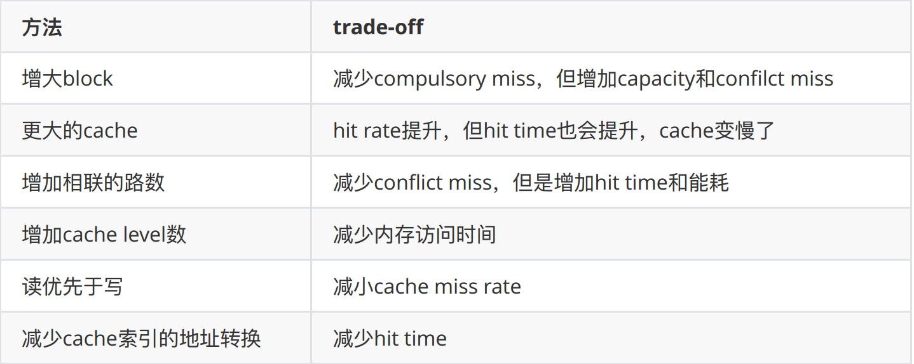
Cache optimizations
Six basic cache optimizations:

Slide 18
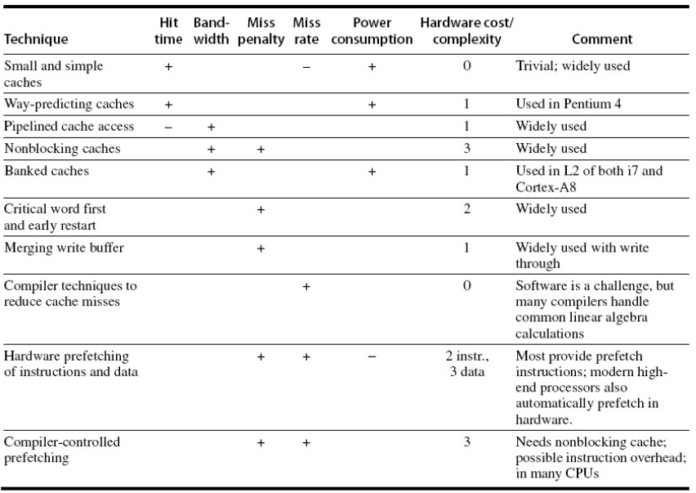
Cache Optimizations(cont.)
Advanced Optimizations
图源：计算机体系结构:量化研究方法(第五版)

Slide 19
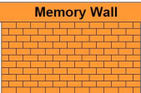

Cache Optimizations(cont.)
Memory Concurrency
Pipelining Cache
Nonblocking Cache
Multi-banked Cache
Prefetching (hardware and software)
……
…
L2
L1

Slide 20
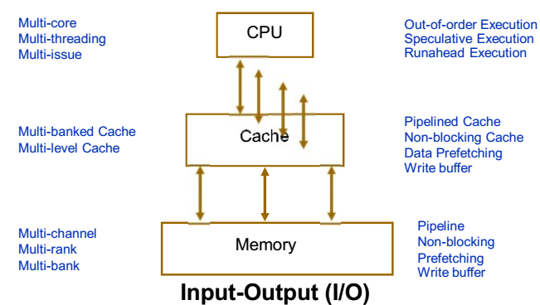
Memory Hierarchy & Parallelism
图源：龙星计划

Slide 21
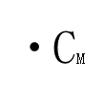
C-AMAT(Concurrent-AMAT)
The traditional AMAT(Average Memory Access Time) : AMAT = HitCycle + MR×AMP
MR is the miss rate of cache accesses; and AMP is the average miss penalty
Concurrent-AMAT (C-AMAT): C-AMAT = HitCycle/CH+ pMR×pAMP/CM
CH hit concurrency ; pure miss concurrency
pMR and pAMP are pure miss rate and average pure miss penalty
X.-H. Sun and D. Wang, "Concurrent Average Memory Access Time", in IEEE Computers, vol. 47, no. 5, pp. 74-80,May 2014.(IIT Technical Report,IIT/CS-SCS-2012-05)

Slide 22
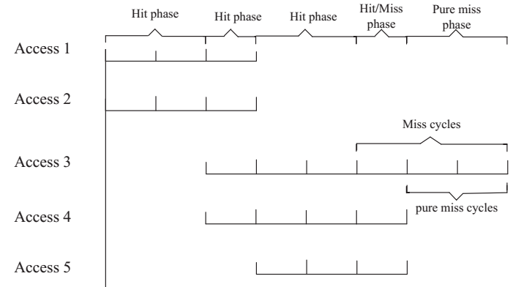
C-AMAT(cont.)
Miss is not important
Pure miss is important
孙贤和，“C-AMAT：大数据时代的数据存取模型”，中国计算机学会通讯，2014年6月第6期

Slide 23
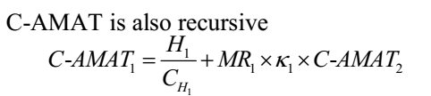
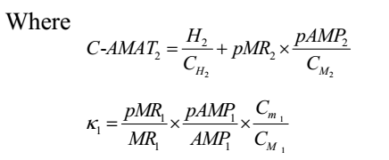
C-AMAT is Recursive
AMAT1 = HitCycle1 + MR1×AMAT2
Where AMAT2 = (HitCycle2 + MR2×AMP2)
X.-H. Sun, “Concurrent-AMAT: a mathematical model for Big Data access,” HPC-Magazine, May 12, 2014

Slide 24
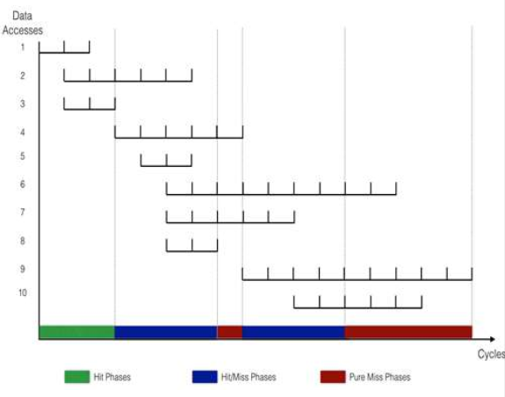
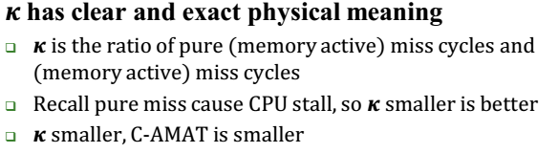
Physical meaning of κ in C − AMAT
Miss cycle = 14
Pure miss cycle = 6
Κ=6/14
图源：龙星计划

Slide 25

The meaning of C-AMAT
Third
level
cache
main memory
Hit Concurrency 2
First-level
cache
Second
level
cache
4
6
3
1 clk
10 clk
20 clk
300 clk
AMAT=2.115

Slide 26
The meaning of C-AMAT(cont.)
C-AMAT is an extension of AMAT to consider concurrency
The same as AMAT, if no concurrency present
C-AMAT introduces the Pure Miss concept
Only pure miss causes performance penalty
High locality may hurt performance
High locality may lead to pure miss
Two contributions of concurrency
Increase bandwidth
Latency hiding (overlapping)

Slide 27
The meaning of C-AMAT(cont.)
Optimal ≠ Optimal Locality + Optimal Concurrence
Balance locality, concurrency and Overlapping with CAMAT

Slide 28
APC(access per cycle)
APC is measured as the number of memory accesses per cycle
Each memory level has its own APC value
Benefits of APC
Separate memory evaluation from CPU evaluation
A better understanding of memory system as a whole
APC is measured as the number of memory accesses per memory active cycle or Access Per Memory Active Cycle

Slide 29
APC(access per cycle)
APC = A/T
Measure T based on memory (active) cycle
Can be measured for each layer of a memory hierarchy
Measure A based on the overlapping mode
When there are several memory accesses co-existing during the same clock cycle, T only increases by one
C-AMAT = 1/APC

Slide 30
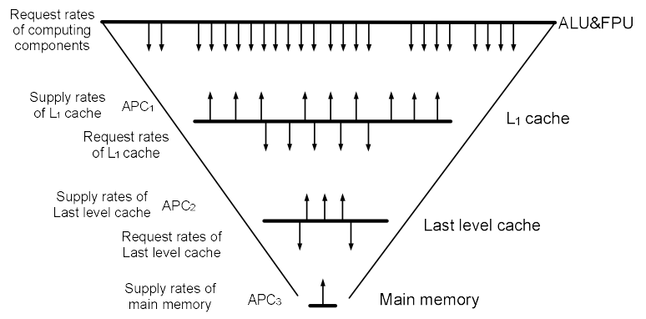
Application: Layered Performance Matching
图源：龙星计划

Slide 31
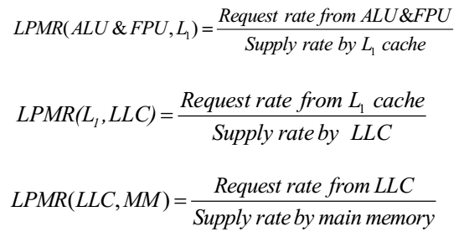
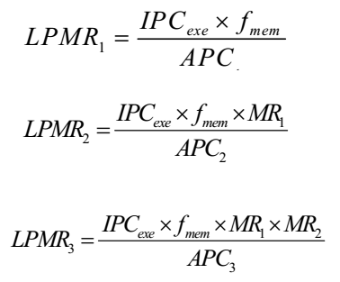
Match the Request with Supply
Match at each memory layer
Adjust the supply performance with concurrency

Slide 32
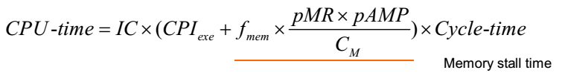

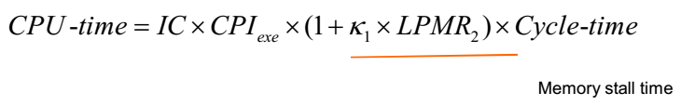
C-AMAT in Action
（1）
（2）
（3）
C-AMAT = HitCycle/CH+ pMR×pAMP/CM
C-AMAT=1/APC
Y. Liu and X.-H. Sun, "Reevaluating Data Stall Time with the Consideration of Data
Access Concurrency," Journal of Computer Science and Technology (JCST), March, 2015

Slide 33
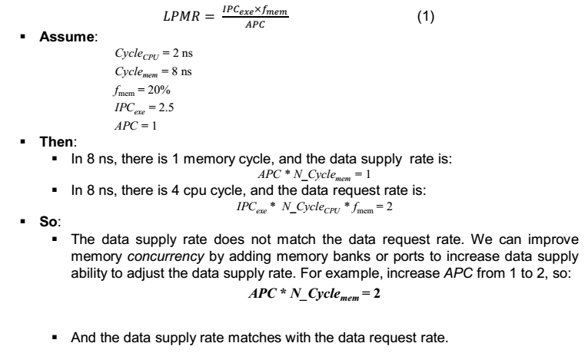
A Example

Slide 34
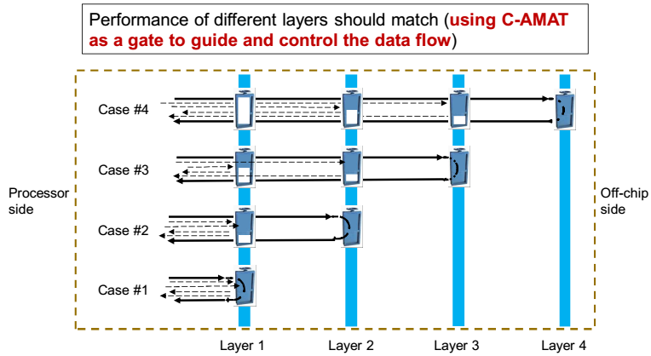
Sluice Gate Theory(存储闸门理论)
X.-H. Sun and Y.-H. Liu, "Utilizing Concurrency Data Access: A New Theory," in
Proc. of LCPC2016 (position paper), Sept, 2016, New York, USA

Slide 35
Match approaches
增加访存的并发度
降低pure miss rate
降低pure miss penalty
……
具体实现
Hardware technology
Compiler technology
Application algorithm technology

Slide 36
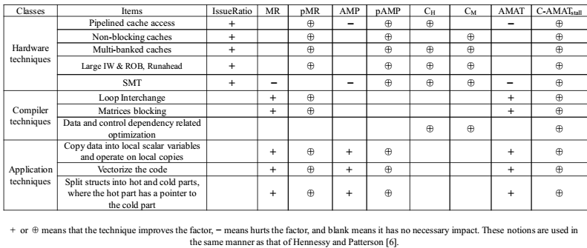
Optimization Technique

Slide 37
Sluice Gate Theory(存储闸门理论)
It’s possible to reduce stall time from 60% to 1%!
Maybe we can solve memory wall problem!!

Slide 38
Thanks for your time! Questions & Answers

