Slide 1
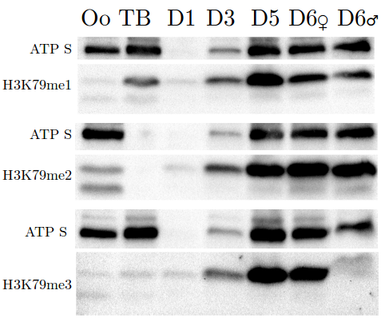
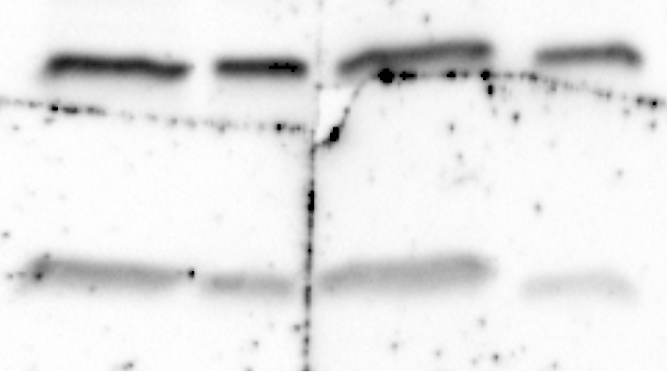

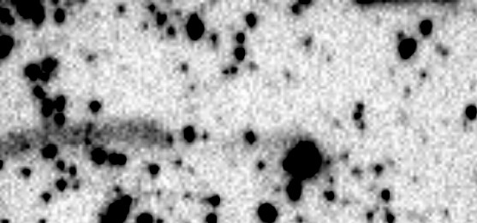
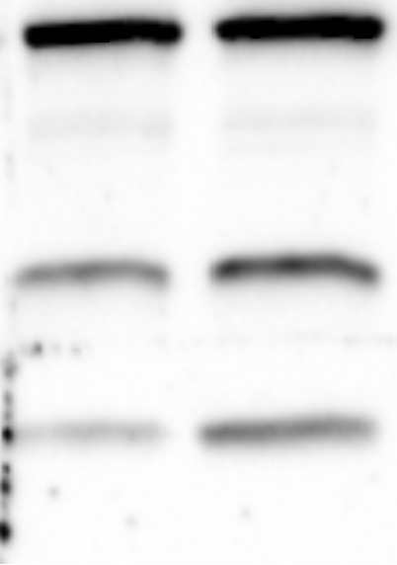
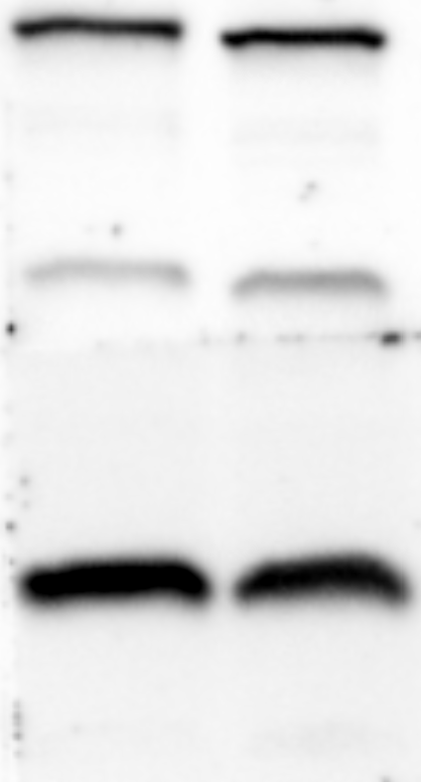
The use of H3K79me in Oikopleura
H3K79me1
H3K79me2
H3K79me3
C
T
C
T
C
T
0.65
0.38
0.00
H2BK123ub1
H3S10p
C
T
C
T
1.49
0.56

Slide 2
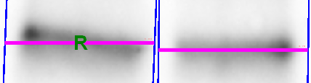
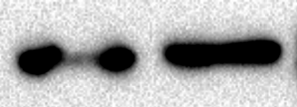
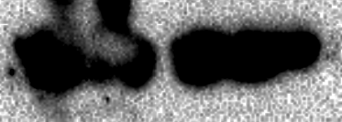

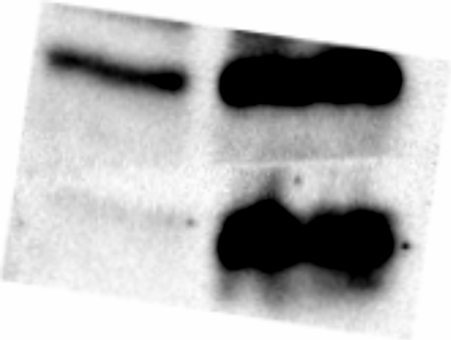
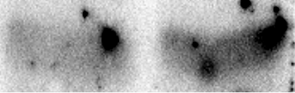
Dot1 inhibition – D5
Impact on other histone modificaitons
H3K79me1
H3K79me2
H3K79me3
C
T
C
T
C
T
0.41
0.96
0.07
H2BK123ub1
4.14
H3K4me3
1.48
Histone turnover as a factor

