Slide 1

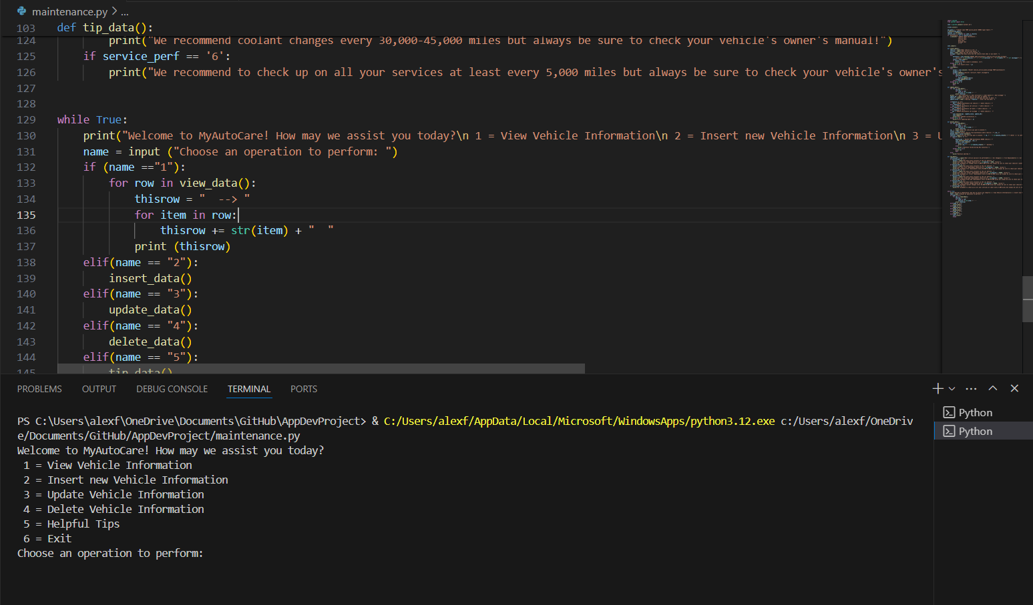
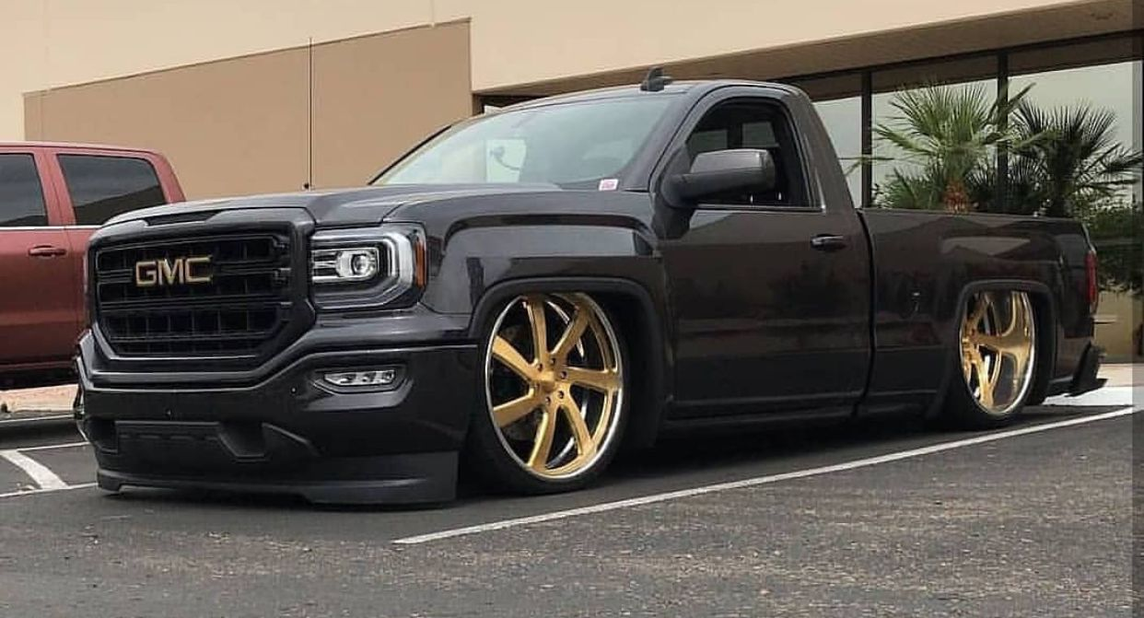
Track your auto maintenance with basic information!
+
Get caring tips/ideas!
MyAutoCare
Don't ignore your car's health! Let me help you with it!
By. Alejandro Frias
ksu-is/MyAutoCare: Auto Maintenance using sqlLite (github.com)

Slide 2
MyAutoCare
Idea:
-I’m into all types of cars and I know firsthand that checking up on your car’s health is very important. I personally cannot remember when I need to check up on my maintenance, so I believe that a program like this can help any car owner.
-Build a program that uses SQL Lite to create a small database that helps users track and manage vehicle maintenance.
-Source Code from Dominic Thomas Python Teaching Code (DB in Python) and CoreyMSchafer (sqlite_demo.py)
Process:
-Original idea was to scrape data (vehicle info, maintenance recommendations, etc.) -> beautiful soup
-Stuck with only incorporating a DB with sqlite3
-CoreyMSchafer used 'aifc' to import 'error' and had to import it through sqlite3
-Creating and importing the DB took a while
Future?
-Add a data scraper
-OBD2 Scanner

