Slide 1
Moyom (MYM) Utility Token
Of ipparts exchange (Ippaex)

Slide 2
Background
Current Capitalism = Imparting of ideas with “intelligence” systems + printing of money + exclusion of “creators” + development by “brothers and sisters”.
Funding gap, Info gap between the time good ideas originate and funding development of good ideas.
Ipparts Exchange (IPPAEX) closes the funding gap by capturing good ideas in brand tokens
When Moyom (MYM) is liquid it will fund brand development by paying for buying of listed brand tokens on (IPPAEX).
Know Your Client (KYC) Exchange must be developed.

Slide 3
Know Your Client (KYC) Exchange
Two systematic thefts of IPPAEX cryptocurrency working capital showed unacceptable risk, if KYC is not applicable.
Communication platform between brand token holders and brand owners to gather good ideas and remunerate for good ideas.
GIRO payment system and integration with VISA and Mastercard.
Fees will be minimum fees according to Intequinism to maximise the value of Africahead Ipparts (AFA) brand tokens.
Other brand tokens listing on IPPAEX need not comply with Intequinism.

Slide 4
Timeline
Timeline not possible currently because it is dependent on investors buying MYM, Africahead Ipparts (AFA) and equity in Africahead.
Will probably buy an existing exchange platform, thus platform can be established quickly.
Hiring staff will take longer.

Slide 5
Team
To date Marquard Dirk Pienaar (MDP) did most of the work with independent others.
MDP qualified as chartered accountant (CA(SA)) during 1994 and with an M-degree in and of Philosophy during 2015, focusing on intequity (capital of ideas). He worked 10 years in banking and financial management, 10 years with entrepreneurship and researched his experience in academia for 10 years. Currently he is a businessman in Africahead and politician in Federal Party SA – FPSA, a new pllitical party in South Africa.
A paid team focusing on the attributes honesty and loving behavior will be appointed when capital is available. MDP does not have sufficient computer coding knowledge to continue on his own.

Slide 6
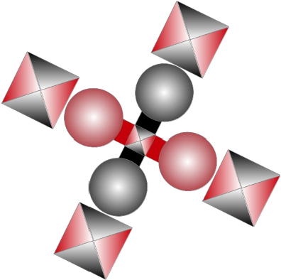
Logo

Slide 7
Token Attributes
Ethereum ERC20
Total supply = 1'000'000'000'000’000 (one quadrillion)
Decimals = 18
Name = Moyom
Ticker Symbol = MYM
Contract address = 0xb9892f9a892f3e251fc58b9076c56add528eb8a6

Slide 8
Terms of Issue
Governing authority = Financial Services Conduct Authority (FSCA) of South Africa.
Long term project not for short term profit or for retirement.
Current exchange platform = app.ledgerdex.com of Singapore
MYM is not a security and brand tokens listing on IPPAEX may not be securities.

