Slide 1
Transactions Introduction and Concurrency Control
SUN YAT-SEN UNIVERSITY
Notes:
1

Slide 2
Review
Database
Tables
Pages
数据库中的数据对象层次
数据库操作
  读：select
  写：insert,delete,update
完整性约束：域约束、主键约束、外键约束…
Tuples

Slide 3
Concurrency Control and Recovery
Concurrency Control(并发控制)
  Provide correct and highly available(高可用) data access in the presence of concurrent access by many users.
Recovery(崩溃恢复)
  Ensures database is fault tolerant(容错), and not corrupted by software, system or media failure
  24x7 access to mission critical data
A boon to application authors!
  Existence of CC&R allows applications to be written without explicit concern for concurrency and fault tolerance.
Notes:
Allows DMBS to have concurrent execution and recovery from system failure, esp involving mission critical data.
Users to write applications without having to worry about concurrent control and recovery. Increased programmer productivity and allows new applications to be added more easily and safely to existing system.

Slide 4
Structure of a DBMS
Query Optimization
and Execution
Relational Operators
Files and Access Methods
These layers must consider concurrency
control and recovery
(Transaction, Lock, Recovery Managers)
Buffer Management
Disk Space Management
DB

Slide 5
Transactions and Concurrent Execution
事务和并发执行
Transaction (“xact”):
DBMS’s abstract view of a user program (or activity)
  A sequence of reads and writes of database objects.
  Batch of work that must commit or abort as an atomic unit
Transaction Manager controls execution of xacts.
  User’s program logic is invisible to DBMS!
    Arbitrary computation possible on data fetched from the DB
    The DBMS only sees data read/written from/to the DB.
  Challenge: provide atomic xacts to concurrent users!
    Given only the read/write interface.
Notes:
While one transaction is waiting for a page to be read in from disk, CPU can process another transaction. Overlapping I/O and CPU activity reduces the amount of time disk and processors are idle and increases system throughput (useful work completed per unit time)
In serial execution, a short transaction can get stuck behind a long transaction. Interleaving the execution of a short transaction with a long transaction allows the short transaction to complete quickly.
Transaction is defined as any one execution of a user program in a DBMS and differs from an execution outside the DBMS.

Slide 6
A Sample Transaction
1: Begin_Transaction
2: get (K1, K2, CHF) from terminal
3: Select BALANCE Into S1 From ACCOUNT Where ACCOUNTNR = K1;
4: S1 := S1 - CHF;
5: Update ACCOUNT Set BALANCE = S1 Where ACCOUNTNR = K1;
6: Select BALANCE Into S2 From ACCOUNT Where ACCOUNTNR = K2;
7: S2 := S2 + CHF;
8: Update ACCOUNT Set BALANCE = S2 Where ACCOUNTNR = K2;
9: Insert Into BOOKING(ACCOUNTNR,DATE,AMOUNT,TEXT)
Values (K1, today, -CHF, 'Transfer');
10: Insert Into BOOKING(ACCOUNTNR,DATE,AMOUNT,TEXT)
Values (K2, today, CHF, 'Transfer');
12: If S1<0 Then Abort_Transaction
11: End_Transaction

Slide 7
Concurrency: Why bother? 动机
The latency(延迟) argument
  Response time: the average time taken to complete an xact.
    A short xact could get stuck behind a long xact, leading to unpredictable delays in response time.
The throughput(吞吐量) argument
  Throughput: the average number of xacts completed in a given time.
    Overlapping I/O and CPU activity reduces the amount of time disks and CPU are idle.

Slide 8
ACID properties of Transaction Executions
A tomicity –原子性:
  All actions in the Xact happen, or none happen.
C onsistency-一致性:
  If the DB (Database) starts consistent, it ends up consistent at end of Xact.
I solation-隔离性:
  Execution of one Xact is isolated from that of other Xacts.
D urability-持久性:
  If an Xact commits, its effects persist.
Notes:
Transaction executions are said to respect the following 4 properties.

Slide 9
Implications of Atomicity and Durability
A transaction ends in one of two ways:
  commit (提交)after completing all its actions
    “commit” is a contract with the caller of the DB
  abort (中止,or be aborted by the DBMS) after executing some actions.
    Or system crash while the xact is in progress; treat as abort.
Atomicity means the effect of aborted xacts must be removed
Durability means the effects of a committed xact must survive failures.
DBMS ensures the above by logging all actions:
  Undo the actions of aborted/failed xacts.
  Redo actions of committed xacts not yet propagated to disk when system crashes.
Notes:
1) Users should not have to worry about the effect of incomplete transactions (say when a system crash occurs)

Slide 10
Transaction Consistency
Xacts preserve DB consistency
  Given a consistent DB state, produce another consistent DB state
DB consistency expressed as a set of declarative Integrity Constraints
  CREATE TABLE/ASSERTION statements
Xacts that violate ICs are aborted
  That’s all the DBMS can automatically check!
Notes:
Bank transfer example.

Slide 11
Isolation (Concurrency)
DBMS interleaves actions of many xacts
  Actions = reads/writes of DB objects
Users should be able to understand an xact without considering the effect of other concurrently executing xacts.
Each xact executes as if it were running by itself.
  Concurrent accesses have no effect on an xact’s behavior
  Net effect must be identical to executing all xacts for some serial order.
Notes:
Sees only the state of a database that could occur if the transaction were the only one running against the database and produce only the results that it could produce if it were running alone.

Slide 12
Schedule of Executing Transactions
A schedule(调度) is
  a list of actions (READ, WRITE, ABORT, or COMMIT) from a set of xacts,
  and the order in which two actions of an xact T appears in a schedule must be the same as the order in which they appear in T.
A complete schedule(完全调度) is
  A schedule that contains either an abort or a commit for each xact.

Slide 13
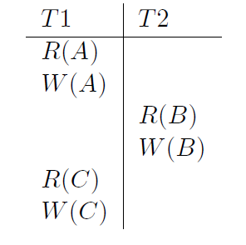
A Schedule Involving Two Transactions:
An Incomplete Schedule

Slide 14
Serial Schedule
Serial schedule(串行调度)
  Each xact runs from start to finish, without any intervening actions from other xacts.
an example : T1; T2.

Slide 15
Serializable Schedule-可串行化调度
Two schedules are equivalent if:
  They involve the same actions of the same xacts,
  and they leave the DB in the same final state.
A serializable schedule over a set S of xacts is
  a schedule whose effect on any consistent database instance is guaranteed to be identical to that of some complete serial schedule over the set of committed xacts in S.

Slide 16
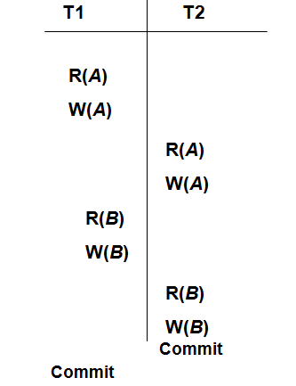
A Serializable Schedule of Two Transactions
The result of this schedule is equivalent to the result of the serial schedule:
T1; T2.

Slide 17
Important Points of Serializability
T1; T2.
Executing xacts serially in different orders may produce different results,
  but all are presumed to be acceptable;
  the DBMS makes no guarantees about which of them will be the outcome of an interleaved execution.
  Uncommitted xacts can appear in a serializable schedule S, but their effects are cancelled out by UNDO.
T2; T1.

Slide 18
Conflicting Actions-冲突操作
Need an easier check for equivalence of schedules
  Use notion of “conflicting” actions
    Anomalies with interleaved execution are simply caused by conflicting actions.
Two actions are said conflict if:
  They are by different xacts,
  they are on the same object,
  and at least one of them is a write.
  Three kinds of conflicts: Write-Read (WR) conflict, Read-Write (RW) and Write-Write (WW) conflicts.

Slide 19
Conflicts: Anomalies with Interleaved Execution
Reading Uncommitted Data (WR Conflicts, “dirty reads-脏读”):
Unrepeatable Reads (RW Conflicts),不可重复的读:
T1: R(A), W(A), R(B), W(B), Abort
T2: R(A), W(A), Commit
T1: R(A), R(A), W(A), Commit
T2: R(A), W(A), Commit

Slide 20
Conflicts (Continued)
Overwriting Uncommitted Data (WW Conflicts):
丢失更新
T1: W(A), W(B), Commit
T2: W(A), W(B), Commit

Slide 21
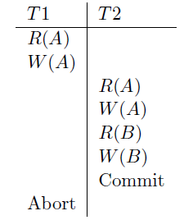
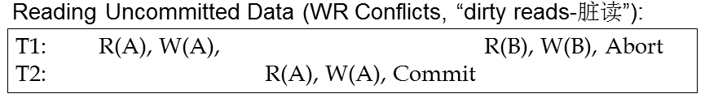
Schedules Involving Aborted Xacts
An Unrecoverable Schedule:
  T2 has already committed, and so can not be undone.
Serializability relies on UNDOing aborted xacts completely, which may be impossible in some situations.

Slide 22
Recoverable Schedule-可恢复调度
In a recoverable schedule, xacts commit only after (and if) all xacts whose changes they read commit.
  If xacts read only the changes of committed xacts, not only is the schedule recoverable,
  but also can avoid cascading aborts(级联中止).

Slide 23
Conflict Serializable Schedules
冲突可串行化调度
Two schedules are conflict equivalent(冲突等价) if:
  They involve the same set of actions of the same xacts,
  and they order every pair of conflicting actions of two committed xacts in the same way.
Schedule S is conflict serializable if:
  S is conflict equivalent to some serial schedule.
Note, some serializable schedules are NOT conflict serializable.
  A price we pay to achieve efficient enforcement.

Slide 24
Conflict Serializability – Intuition
A schedule S is conflict serializable if:
  You can transform S into a serial schedule by swapping consecutive non-conflicting operations of different xacts.
Example:
R(A)
W(A)
R(B)
W(B)
R(A)
W(A)
R(B)
W(B)
R(A)
W(A)
R(B)
W(B)
R(A)
W(A)
R(B)
W(B)

Slide 25
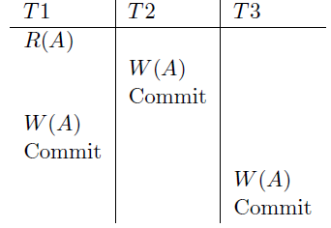
Serializable Schedule That is Not Conflict Serializable
This schedule is equivalent to the serial schedule : T1; T2; T3.
However it is not conflict quivalent to the serial schedule because the writes of T1 and T2 are ordered differently.

Slide 26
Dependency Graph
依赖图,优先图
We use a dependency graph, also called a precedence graph, to capture all potential conflicts between the xacts in a schedule.
The dependency graph for a schedule S contains:
  A node for each committed xact
  An edge from T_{i} to T_{j} if an action of T_{i} precedes and conflicts with one of T_{j}’s actions.
Theorem: Schedule is conflict serializable if and only if its dependency graph is acyclic.(无环路)

Slide 27
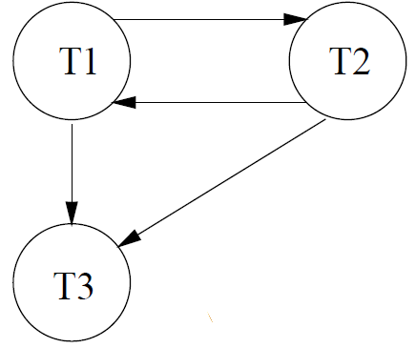
Example of Dependency Graph

Slide 28
Two-Phase Locking (2PL)
两阶段加锁
The most common scheme for enforcing conflict serializability.
“Pessimistic”-悲观的
  Sets locks for fear of conflict
  The alternative scheme is called Optimistic (乐观) Concurrency Control.

Slide 29
Two-Phase Locking (2PL)
 | S | X
S | √ | –
X | – | –
Lock
Compatibility
Matrix
rules:
  An xact must obtain
    a S (shared) lock before reading, 共享锁
    and an X (exclusive) lock before writing. 排斥锁
  An xact cannot request additional locks once it releases any lock.

Slide 30


Two-Phase Locking (2PL), cont.
acquisition phase
release phase
# locks held
time
2PL guarantees conflict serializability 反证？
But, does not prevent Cascading Aborts.

Slide 31
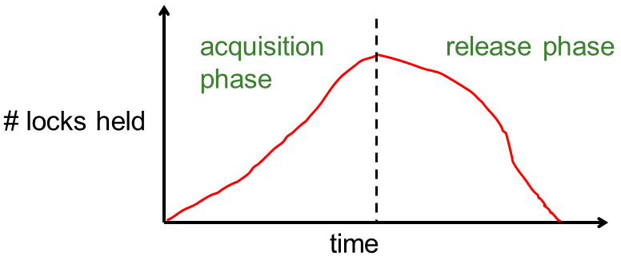
Strict 2PL
严格的2PL
Problem: Cascading Aborts
Example: rollback of T1 requires rollback of T2!
Strict Two-phase Locking (Strict 2PL) protocol:
  Same as 2PL, except:
  Locks released only when an xact completes
  i.e., either:
  (a) the xact has committed (commit record on disk),
  or
  (b) the xact has aborted and rollback is complete.
T1: R(A), W(A), R(B), W(B), Abort
T2: R(A), W(A)

Slide 32
Strict 2PL (continued)
acquisition phase
# locks held
release all locks at end of xact
time
T1: R(A), W(A), R(B), W(B), Commit/Abort
T2: R(A), W(A)
xacts read only the changes of committed xacts

Slide 33
Next ...
A few examples

Slide 34
Non-2PL, A= 1000, B=2000, Output =?
Lock_X(A)
Read(A) | Lock_S(A)
A: = A-50
Write(A)
Unlock(A)
 | Read(A)
 | Unlock(A)
 | Lock_S(B)
Lock_X(B)
 | Read(B)
 | Unlock(B)
 | PRINT(A+B)
Read(B)
B := B +50
Write(B)
Unlock(B)

Slide 35

2PL, A= 1000, B=2000, Output =?
Lock_X(A)
Read(A) | Lock_S(A)
A: = A-50
Write(A)
Lock_X(B)
Unlock(A)
 | Read(A)
 | Lock_S(B)
Read(B)
B := B +50
Write(B)
Unlock(B) | Unlock(A)
 | Read(B)
 | Unlock(B)
 | PRINT(A+B)

Slide 36
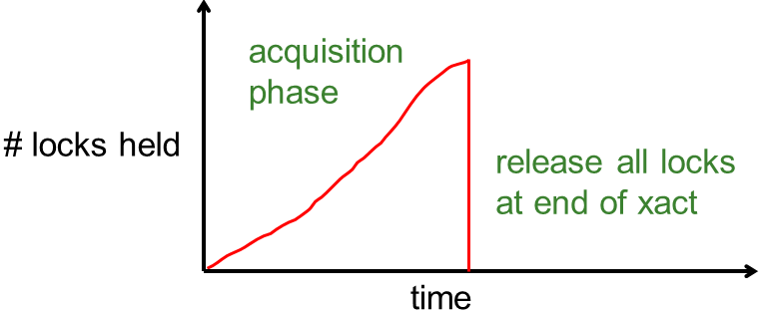
Strict 2PL, A= 1000, B=2000, Output =?
Lock_X(A)
Read(A) | Lock_S(A)
A: = A-50
Write(A)
Lock_X(B)
Read(B)
B := B +50
Write(B)
Unlock(A)
Unlock(B)
 | Read(A)
 | Lock_S(B)
 | Read(B)
 | PRINT(A+B)
 | Unlock(A)
 | Unlock(B)
编程好处:,只需定义事务即可
提高并发度的情况: 无冲突

Slide 37
Venn Diagram for Schedules
All Schedules
View Serializable
Conflict Serializable
Avoid Cascading Abort
Serial

Slide 38

Which schedules does Strict 2PL allow?
All Schedules
View Serializable
Conflict Serializable
Avoid Cascading Abort
Serial

Slide 39
Lock Management 加锁管理
Lock and unlock requests handled by Lock Manager.
LM keeps an entry for each currently held lock.
Entry contains:
  某个数据对象标识
  List of xacts currently holding lock
  Type of lock held (shared or exclusive)
  Queue of lock requests

Slide 40
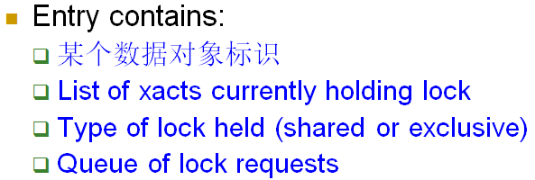
Lock Management (Contd.)
When lock request arrives:
  Does any other transaction hold a conflicting lock?
    If no, grant the lock.
    If yes, put requestor into wait queue.
Lock upgrade(锁升级):
  A transaction with shared lock can request to upgrade to exclusive.

Slide 41
Deadlocks-死锁
Deadlock: Cycle of transactions waiting for locks to be released by each other.
Ways of dealing with deadlocks:
  prevention 预防
  Detection 检测
  avoidance 避免
Many systems just punt and use Timeouts
  What are the dangers with this approach?

Slide 42
Deadlock Prevention 死锁预防
Common technique in operating systems
Standard approach: resource ordering 资源排序
  Screen < Network Card < Printer
Why is this problematic for Xacts in a DBMS?

Slide 43
Deadlock Detection 死锁检测
Create and maintain a “waits-for” graph 等待图
Periodically check for cycles in graph

Slide 44
Deadlock Detection (Continued)
“waits-for” graph 等待图
Example:
T1: S(A), S(D), S(B)
T2: X(B), X(C)
T3: S(D), S(C), X(A)
T4: X(B)
T1
T2
T4
T3
be aborted by the DBMS

Slide 45
Deadlock Avoidance 死锁避免
Assign priorities based on timestamps(时间戳).
Say Ti wants a lock that Tj holds
Two policies are possible:
  Wait-Die(等待-死亡): If Ti has higher priority, Ti waits for Tj; otherwise Ti aborts.
  Wound-wait(伤害-等待): If Ti has higher priority, Tj aborts; otherwise Ti waits.
Why do these schemes guarantee no deadlocks?
Important detail: If a transaction re-starts, make sure it gets its original timestamp. -- Why?
高→低
T1
T2
低→高
T3

Slide 46
Locking Granularity(加锁粒度)
Hard to decide what granularity to lock (tuples vs. pages vs. tables).
why? 锁开销和并发度

Slide 47
Multiple-Granularity Locks
多粒度锁
Shouldn’t have to make same decision for all transactions!
Data “containers” are nested:
Database
Tables
contains
Pages
Tuples

Slide 48
Solution: New Lock Modes, Protocol
Database
Allow Xacts to lock at each level, but with a special protocol using new “intent” locks:
意向锁
Still need S and X locks, but before locking an item, Xact must have proper intent locks on all its ancestors in the granularity hierarchy.
Tables
IS – Intent to get S lock(s) at finer granularity. 部分读
IX – Intent to get X lock(s) at finer granularity. 部分写
SIX mode: Like S & IX at the same time. Why useful?
Pages
Tuples
全读 全写

Slide 49
Multiple Granularity Lock Protocol
Database
Each Xact starts from the root of the hierarchy.
To get S or IS lock on a node, must hold IS or IX on parent node.
  What if Xact holds S on parent? SIX on parent?
To get X or IX or SIX on a node, must hold IX or SIX on parent node.
Must release locks in bottom-up order.
Tables
Pages
Tuples
Protocol is correct in that it is equivalent to directly setting
locks at the leaf levels of the hierarchy.

Slide 50
Lock Compatibility Matrix
Database
IS
IX
SIX
S
X
Tables
-
S 全读
X 全写
IS 部分读
IX 部分写
IS
√
√
√
√
Pages
-
-
-
IX
√
√
√
-
-
-
-
Tuples
SIX
S
√
-
-
√
-
-
-
-
-
-
IS – Intent to get S lock(s) at finer granularity.
IX – Intent to get X lock(s) at finer granularity.
SIX mode: Like S & IX at the same time.
X

Slide 51
Examples – 2 level hierarchy
Tables
T1 scans R, and updates a few tuples:
  T1 gets an SIX lock on R, then get X lock on tuples that are updated.
T2 uses an index to read only part of R:
  T2 gets an IS lock on R, and repeatedly gets an S lock on tuples of R.
T3 reads all of R:
  T3 gets an S lock on R.
  OR, T3 could behave like T2; can use lock escalation(锁升级) to decide which.
    Lock escalation dynamically asks for
    coarser-grained locks when too many
    low level locks acquired
Tuples
IS
IX
SIX
S
X
IS
√
√
√
√
IX
√
√
SIX
√
S
√
√
X

Slide 52
Just so you’re aware: Optimistic CC
Basic idea: let all transactions run to completion
  Make tentative updates on private copies of data
  At commit time, check schedules for serializability
  If you can’t guarantee it, restart transaction
  else “install” updates in DBMS
Pros & Cons
  No waiting or lock overhead in serializable cases
  Restarted transactions waste work, slow down others
OCC a loser to 2PL in traditional DBMSs
  Plays a secondary role in some DBMSs
Generalizations:
  Multi-version and Timestamp CC manage the multiple copies in a permanent way

Slide 53
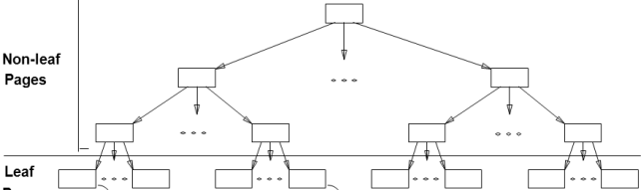
Just So You’re Aware: Indexes
2PL on B+-tree pages is a rotten idea.
  Why?
Instead, do short locks (latches) in a clever way
  Idea: Upper levels of B+-tree just need to direct traffic correctly. Don’t need to be serializably handled!
  Different tricks to exploit this
Note: this is pretty complicated!

Slide 54
Just So You’re Aware: Phantoms-幻影
Suppose you query for sailors with rating between 10 and 20, using a B+-tree
  Tuple-level locks in the Heap File
I insert a Sailor with rating 12
You do your query again
  Yikes! A phantom!
  Problem: Serializability assumed a static DB!
What we want: lock the logical range 10-20
  Imagine that lock table!
What is done: set locks in indexes cleverly

Slide 55
Summary
Correctness criterion for isolation is “serializability”.
  In practice, we use “conflict serializability,” which is somewhat more restrictive but easy to enforce.
Two Phase Locking and Strict 2PL: Locks implement the notions of conflict directly.
  The lock manager keeps track of the locks issued.
  Deadlocks may arise; can either be prevented or detected.
Multi-Granularity Locking:
  Allows flexible tradeoff between lock “scope” in DB,
  and locking overhead in RAM and CPU
More to the story
  Optimistic/Multi-version/Timestamp CC
  Index “latching”, phantoms

Slide 56
Summary
要求:
  理解串行调度、可串行化调度、冲突可串行化调度、
  可恢复调度、避免级联中止、严格调度的概念
    有脏读X-R（但后提交） 无脏读X-R 无脏读/写 X-R/X
  能够根据给定的一个调度，绘制其优先图，从而判断是否冲突可串行化调度？
  理解2PL、严格2PL协议，能够绘制等待图并判断是否存在死锁？

