Slide 1
Chapter 3: Introduction to SQL

Slide 2
Chapter 3: Introduction to SQL
Overview of the SQL Query Language
Data Definition
Basic Query Structure
Additional Basic Operations
Set Operations
Null Values
Aggregate Functions
Nested Subqueries
Modification of the Database
Notes:
1

Slide 3
History
来源：IBM Sequel language developed as part of System R project at the IBM San Jose Research Laboratory
  Renamed Structured Query Language (SQL)
ANSI and ISO standard SQL:
  SQL-86, SQL-89, SQL-92
  SQL:1999, SQL:2003, SQL:2008
Commercial systems offer most(not all) SQL-92 features, plus varying feature sets from later standards and special proprietary features.
  Not all examples here may work on your particular system.

Slide 4
Data Definition Language
The SQL data-definition language (DDL) allows the specification of information about relations, including:
The schema for each relation.
The domain of values associated with each attribute.
Integrity constraints
And as we will see later, also other information such as
  The set of indices to be maintained for each relations.
  Security and authorization information for each relation.
  The physical storage structure of each relation on disk.

Slide 5
Domain Types in SQL
char(n). Fixed length character string, with user-specified length n.
varchar(n). Variable length character strings, with user-specified maximum length n.
int. Integer (a finite subset of the integers that is machine-dependent).
smallint. Small integer (a machine-dependent subset of the integer domain type).
numeric(p,d). Fixed point number, with user-specified precision of p digits, with d digits to the right of decimal point.
real, double precision. Floating point and double-precision floating point numbers, with machine-dependent precision.
float(n). Floating point number, with user-specified precision of at least n digits.
More are covered in Chapter 4.

Slide 6
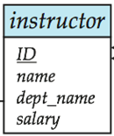
Create Table Construct
An SQL relation is defined using the create table command:
create table r (A₁ D₁, A₂ D₂, ..., A_{n} D_{n},
(integrity-constraint₁),
...,
(integrity-constraint_{k}))
  r is the name of the relation
  each A_{i} is an attribute name in the schema of relation r
  D_{i} is the data type of values in the domain of attribute A_{i}
Example:
create table instructor (
ID char(5),
name varchar(20) not null,
dept_name varchar(20),
salary numeric(8,2))
insert into instructor values ('10211', 'Smith', 'Biology', 66000);
insert into instructor values ('10211', null, 'Biology', 66000);

Slide 7
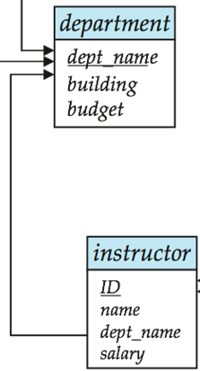
Integrity Constraints in Create Table
not null
primary key (A₁, ..., A_{n} )
foreign key (A_{m}, ..., A_{n} ) references r
Example: Declare dept_name as the primary key for department
.
create table instructor (
ID char(5),
name varchar(20) not null,
dept_name varchar(20),
salary numeric(8,2),
primary key (ID),
foreign key (dept_name) references department)
primary key declaration on an attribute automatically ensures not null

Slide 8
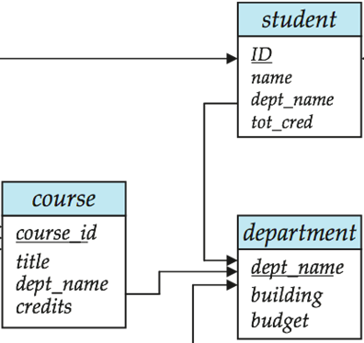
And a Few More Relation Definitions
create table student (
ID varchar(5),
name varchar(20) not null,
dept_name varchar(20),
tot_cred numeric(3,0),
primary key (ID),
foreign key (dept_name) references department) );
create table course (
course_id varchar(8) primary key,
title varchar(50),
dept_name varchar(20),
credits numeric(2,0),
foreign key (dept_name) references department) );
  Primary key declaration can be combined with attribute declaration as shown above

Slide 9

And more still
create table takes (
ID varchar(5),
course_id varchar(8),
sec_id varchar(8),
semester varchar(6),
year numeric(4,0),
grade varchar(2),
primary key (ID, course_id, sec_id, semester, year),
foreign key (ID) references student,
foreign key (course_id, sec_id, semester, year) references section );
  Note: sec_id can be dropped from primary key above, to ensure a student cannot be registered for two sections of the same course in the same semester

Slide 10
Drop and Alter Table Constructs
drop table student
  Deletes the table and its contents
delete from student
  Deletes all contents of table, but retains table
alter table
  alter table r add A D
    where A is the name of the attribute to be added to relation r and D is the domain of A.
    All tuples in the relation are assigned null as the value for the new attribute.
  alter table r drop A
    where A is the name of an attribute of relation r
    Dropping of attributes not supported by many databases

Slide 11
Basic Query Structure
The SQL data-manipulation language (DML) provides the ability to query information, and insert, delete and update tuples
A typical SQL query has the form:
select A₁, A₂, ..., A_{n}
from r₁, r₂, ..., r_{m}
where P
  A_{i} represents an attribute
  R_{i} represents a relation
  P is a predicate.
The result of an SQL query is a relation.
Notes:
2

Slide 12
The select Clause
The select clause list the attributes desired in the result of a query
  corresponds to the projection operation of the relational algebra
Example: find the names of all instructors:
select name
from instructor
NOTE: SQL names are case insensitive (i.e., you may use upper- or lower-case letters.)
  E.g. Name ≡ NAME ≡ name
  Some people use upper case wherever we use bold font.
Notes:
3

Slide 13
The select Clause (Cont.)
SQL allows duplicates in relations as well as in query results.
To force the elimination of duplicates, insert the keyword distinct after select.
  例：Find the names of all departments with instructor, and remove duplicates
select distinct dept_name
from instructor
The keyword all specifies that duplicates not be removed.
select all dept_name
from instructor
Notes:
4

Slide 14
The select Clause (Cont.)
An asterisk in the select clause denotes “all attributes”
select *
from instructor
The select clause can contain arithmetic expressions involving the operation, +, –, ∗, and /, and operating on constants or attributes of tuples.
  例：The query:
select ID, name, salary/12
from instructor
would return a relation that is the same as the instructor relation, except that the value of the attribute salary is divided by 12.
Notes:
5

Slide 15
The where Clause
The where clause specifies conditions that the result must satisfy
  Corresponds to the selection predicate of the relational algebra.
例：To find all instructors in Comp. Sci. dept with salary > 80000 select name
from instructor
where dept_name = 'Comp. Sci.' and salary > 80000
Comparison results can be combined using the logical connectives and, or, and not.
Comparisons can be applied to results of arithmetic expressions.
Notes:
6

Slide 16
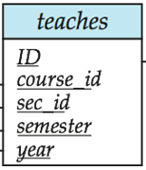
The from Clause
The from clause lists the relations involved in the query
  Corresponds to the Cartesian product operation of the relational algebra.
例：Find the Cartesian product instructor X teaches
select ∗
from instructor, teaches
  generates every possible instructor – teaches pair, with all attributes from both relations
Cartesian product not very useful directly, but useful combined with where-clause condition (selection operation in relational algebra)
Notes:
8

Slide 17



Cartesian Product: instructor X teaches
instructor
teaches

Slide 18
Joins
For all instructors who have taught some course, find their names and the course ID of the courses they taught.
select name, course_id
from instructor, teaches
where instructor.ID = teaches.ID

Slide 19
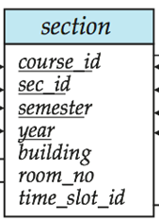
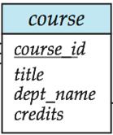
Joins
Find the course ID, semester, year and title of each course offered by the Comp. Sci. department
select section.course_id, semester, year, title
from section, course
where section.course_id = course.course_id and
dept_name = 'Comp. Sci.'

Slide 20
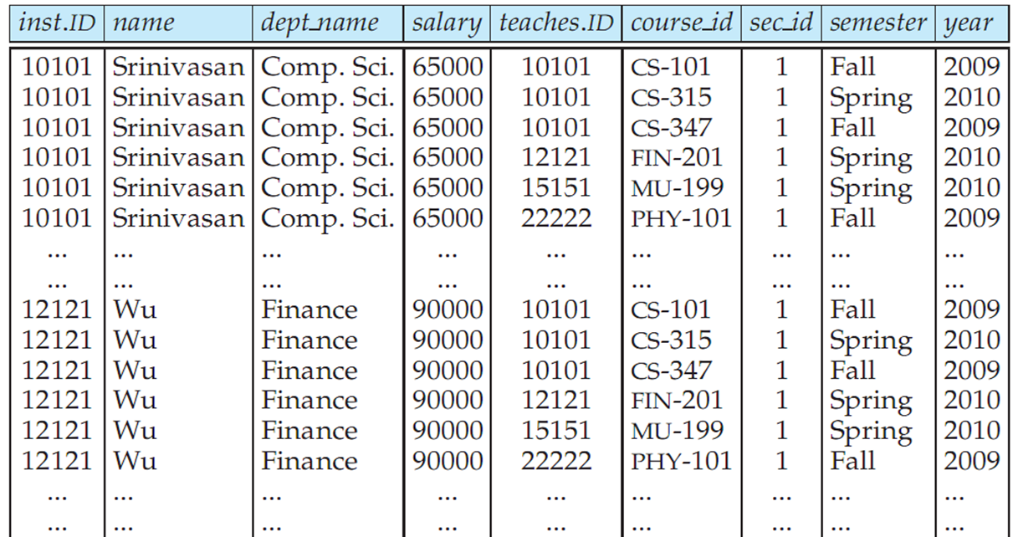

Natural Join
Natural join matches tuples with the same values for all common attributes, and retains only one copy of each common column
select *
from instructor natural join teaches;

Slide 21
Natural Join Example
List the names of instructors along with the course ID of the courses that they taught.
  select name, course_id
  from instructor, teaches
  where instructor.ID = teaches.ID;
  select name, course_id
  from instructor natural join teaches;

Slide 22
Natural Join (Cont.)
Danger in natural join: beware of unrelated attributes with same name which get equated incorrectly
例：List the names of instructors along with the titles of courses that they teach
  Incorrect version (makes course.dept_name = instructor.dept_name)
    select name, title
    from instructor natural join teaches natural join course;
  Why? 一个系的老师可以教授另一个系的课程
  Correct version
    select name, title
    from instructor natural join teaches, course
    where teaches.course_id = course.course_id;
  Another correct version
    select name, title
    from (instructor natural join teaches)
    join course using(course_id);

Slide 23
The Rename Operation
The SQL allows renaming relations and attributes using the as clause:
old-name as new-name
  E.g.
    select ID, name, salary/12 as monthly_salary
    from instructor
Find the names of all instructors who have a higher salary than
some instructor in 'Comp. Sci'.
  select distinct T. name
  from instructor as T, instructor as S
  where T.salary > S.salary and S.dept_name = 'Comp. Sci.'
  Keyword as is optional and may be omitted
  instructor as T ≡ instructor T
  Keyword as must be omitted in Oracle
Notes:
9

Slide 24
String Operations
SQL includes a string-matching operator for comparisons on character strings. The operator “like” uses patterns that are described using two special characters:
  percent (%). The % character matches any substring.
  underscore (_). The _ character matches any character.
例：Find the names of all instructors whose name includes the substring “dar”.
select name
from instructor
where name like '%dar%'
转义字符：Match the string “100 %”
like '100 \%' escape '\'

Slide 25
String Operations (Cont.)
Pattern are case sensitive.
Pattern matching examples:
  'Intro%' matches any string beginning with “Intro”.
  '%Comp%' matches any string containing “Comp” as a substring.
  '_ _ _' matches any string of exactly three characters.
  '_ _ _ %' matches any string of at least three characters.
SQL supports a variety of string operations such as
  concatenation (using “||”)
  converting from upper to lower case (and vice versa)
  finding string length, extracting substrings, etc.

Slide 26
Ordering the Display of Tuples
List in alphabetic order the names of all instructors
select distinct name
from instructor
order by name
We may specify desc for descending order or asc for ascending order, for each attribute; ascending order is the default.
  Example: order by name desc
Can sort on multiple attributes
  Example: order by dept_name, name

Slide 27
Where Clause (特殊)Predicates
SQL includes a between comparison operator
  Example: Find the names of all instructors with salary between $90,000 and $100,000 (that is, ≥ $90,000 and ≤ $100,000)
  select name
  from instructor
  where salary between 90000 and 100000
Tuple comparison
  select name, course_id
  from instructor, teaches
  where (instructor.ID, dept_name) = (teaches.ID, 'Biology');
Notes:
7

Slide 28
Duplicates
In relations with duplicates, SQL can define how many copies of tuples appear in the result.
Multiset（多重集） versions of some of the relational algebra operators – given multiset relations r₁ and r₂:
  1. σ_{θ} (r₁): If there are c₁ copies of tuple t₁ in r₁, and t₁ satisfies selections σ_{θ,}, then there are c₁ copies of t₁ in σ_{θ} (r₁).
  2. Π_{A} (r₁ ): For each copy of tuple t₁ in r₁, there is a copy of tuple Π_{A} (t₁) in Π_{A} (r₁) where Π_{A} (t₁) denotes the projection of the single tuple t₁.
  3. r₁ x r₂ : If there are c₁ copies of tuple t₁ in r₁ and c₂ copies of tuple t₂ in r₂, there are c₁ x c₂ copies of the tuple t₁. t₂ in r₁ x r₂

Slide 29

Duplicates (Cont.)
Example: Suppose multiset relations r₁ (A, B) and r₂ (C) are as follows:
r₁ = {(1, a) (2,a)} r₂ = {(2), (3), (3)}
  Then Π_{B}(r₁) would be {(a), (a)}, while Π_{B}(r₁) x r₂ would be
{(a,2), (a,2), (a,3), (a,3), (a,3), (a,3)}
SQL duplicate semantics:
select A₁,, A₂, ..., A_{n}
from r₁, r₂, ..., r_{m}
where P
is equivalent to the multiset version of the expression:

Slide 30
Set Operations
Find courses that ran in Fall 2009 or in Spring 2010
(select course_id from section where sem = 'Fall' and year = 2009)
union
(select course_id from section where sem = 'Spring' and year = 2010)
Find courses that ran in Fall 2009 and in Spring 2010
(select course_id from section where sem = 'Fall' and year = 2009)
intersect
(select course_id from section where sem = 'Spring' and year = 2010)
Find courses that ran in Fall 2009 but not in Spring 2010
(select course_id from section where sem = 'Fall' and year = 2009)
except
(select course_id from section where sem = 'Spring' and year = 2010)

Slide 31
Set Operations
Set operations union, intersect, and except
  Each of the above operations automatically eliminates duplicates
To retain all duplicates use the corresponding multiset versions union all, intersect all and except all.
i.e. Suppose a tuple occurs m times in r and n times in s, then, it occurs:
  m + n times in r union all s
  min(m,n) times in r intersect all s
  max(0, m – n) times in r except all s

Slide 32
Null Values
It is possible for tuples to have a null value, denoted by null, for some of their attributes
  null signifies an unknown value or that a value does not exist.
相关运算
  The result of any arithmetic expression involving null is null
    Example: 5 + null returns null
  The predicate is null can be used to check for null values.
    Example: Find all instructors whose salary is null.
  select name
  from instructor
  where salary is null

Slide 33
Null Values and Three Valued Logic
Any comparison with null returns unknown
  Example: 5 < null or null <> null or null = null
Three-valued logic using the truth value unknown:
  OR: (unknown or true) = true,
  (unknown or false) = unknown
  (unknown or unknown) = unknown
  AND: (true and unknown) = unknown,
  (false and unknown) = false,
  (unknown and unknown) = unknown
  NOT: (not unknown) = unknown
相关运算
  “P is unknown” evaluates to true if predicate P evaluates to unknown
  Result of where clause predicate is treated as false if it evaluates to unknown

Slide 34
Aggregate Functions
avg: average value
min: minimum value
max: maximum value
sum: sum of values
count: number of values
These functions operate on the multiset of values of a column of a relation, and return a value

Slide 35
Aggregate Functions (Cont.)
Find the average salary of instructors in the Computer Science department
  select avg (salary)
  from instructor
  where dept_name= 'Comp. Sci.';
Find the total number of instructors who teach a course in the Spring 2010 semester
  select count (distinct ID)
  from teaches
  where semester = 'Spring' and year = 2010
Find the number of tuples in the course relation
  select count (*)
  from course;

Slide 36


Aggregate Functions – Group By
Find the average salary of instructors in each department
  select dept_name, avg (salary)
  from instructor
  group by dept_name;
  Note: departments with no instructor will not appear in result

Slide 37
Aggregation (Cont.)
Attributes in select clause outside of aggregate functions must appear in group by list
  /* erroneous query */
  select dept_name, ID, avg (salary)
  from instructor
  group by dept_name;

Slide 38
Aggregate Functions – Having Clause
Find the names and average salaries of all departments whose average salary is greater than 42000
select dept_name, avg (salary)
from instructor
group by dept_name
having avg (salary) > 42000;
Note: predicates in the having clause are applied after the
formation of groups
whereas predicates in the where clause are applied before
forming groups

Slide 39
Null Values and Aggregates
Total all salaries
select sum (salary )
from instructor
  Above statement ignores null amounts
  Result is null if there is no non-null amount
All aggregate operations except count(*) ignore tuples with null values on the aggregated attributes
What if collection has only null values?
  count returns 0
  all other aggregates return null

Slide 40
Nested Subqueries
SQL provides a mechanism for the nesting of subqueries.
A subquery is a select-from-where expression that is nested within another query.
A common use of subqueries is to perform tests for set membership, set comparisons, and set cardinality.

Slide 41
Example Query
Find courses offered in Fall 2009 and in Spring 2010
select distinct course_id
from section
where semester = 'Fall' and year= 2009 and
course_id in (select course_id
from section
where semester = 'Spring' and year= 2010);
Find courses offered in Fall 2009 but not in Spring 2010
select distinct course_id
from section
where semester = 'Fall' and year= 2009 and
course_id not in (select course_id
from section
where semester = 'Spring' and year= 2010);

Slide 42
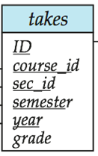
Example Query
Find the total number of (distinct) students who have taken course sections taught by the instructor with ID 10101
select count (distinct ID)
from takes
where (course_id, sec_id, semester, year) in
(select course_id, sec_id, semester, year
from teaches
where teaches.ID= 10101);
Note: Above query can be written in a much simpler manner. The
formulation above is simply to illustrate SQL features.

Slide 43
Set Comparison
Find names of instructors with salary greater than that of some (at least one) instructor in the Biology department.
select distinct T.name
from instructor as T, instructor as S
where T.salary > S.salary and S.dept_name = 'Biology';
Same query using > some clause
select name
from instructor
where salary > some (select salary
from instructor
where dept_name = 'Biology');

Slide 44
Definition of Some Clause
F <comp> some r ⇔ ∃ t ∈ r such that (F <comp> t )
Where <comp> can be: <, ≤, >, =, ≠
0
(5 < some
5
) = true
(read: 5 < some tuple in the relation)
6
0
(5 < some
5
) = false
0
(5 = some
) = true
5
0
(5 ≠ some
5
) = true (since 0 ≠ 5)
(= some) ≡ in
However, (≠ some) ≡ not in

Slide 45
Example Query
Find the names of all instructors whose salary is greater than the salary of all instructors in the Biology department.
select name
from instructor
where salary > all (select salary
from instructor
where dept_name = 'Biology');

Slide 46
Definition of all Clause
F <comp> all r ⇔ ∀ t ∈ r (F <comp> t)
0
(5 < all
5
) = false
6
6
(5 < all
) = true
10
4
(5 = all
) = false
5
4
(5 ≠ all
) = true (since 5 ≠ 4 and 5 ≠ 6)
6
(≠ all) ≡ not in
However, (= all) ≡ in

Slide 47
Test for Empty Relations
The exists construct returns the value true if the argument subquery is nonempty.
exists r ⇔ r ≠ Ø
not exists r ⇔ r = Ø

Slide 48
Correlation Variables
Yet another way of specifying the query “Find all courses taught in both the Fall 2009 semester and in the Spring 2010 semester”
select course_id
from section as S
where semester = 'Fall' and year= 2009 and
exists (select *
from section as T
where semester = 'Spring' and year= 2010
and S.course_id= T.course_id);
Correlated subquery
Correlation name or correlation variable

Slide 49
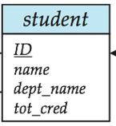
Not Exists
Find all students who have taken all courses offered in the Biology department.
select distinct S.ID, S.name
from student as S
where not exists ( (select course_id
from course
where dept_name = 'Biology')
except
(select T.course_id
from takes as T
where S.ID = T.ID));
Note that X – Y = Ø ⇔ X ⊆ Y
Note: Cannot write this query using = all and its variants

Slide 50
Test for Absence of Duplicate Tuples
The unique construct tests whether a subquery has any duplicate tuples in its result.
  (Evaluates to “true” on an empty set)
Find all courses that were offered at most once in 2009
  select T.course_id
  from course as T
  where unique (select R.course_id
  from section as R
  where T.course_id= R.course_id
  and R.year = 2009);

Slide 51
Subqueries in the From Clause
SQL allows a subquery expression to be used in the from clause
Find the average instructors' salaries of those departments where the average salary is greater than $42,000.
  select dept_name, avg_salary
  from (select dept_name, avg (salary) as avg_salary
  from instructor
  group by dept_name)
  where avg_salary > 42000;
  Note that we do not need to use the having clause
Another way to write above query
  select dept_name, avg_salary
  from (select dept_name, avg (salary)
  from instructor
  group by dept_name)
  as dept_avg (dept_name, avg_salary)
  where avg_salary > 42000;

Slide 52
Subqueries in the From Clause (Cont.)
And yet another way to write it: lateral clause
  select name, salary, avg_salary
  from instructor I1,
  lateral (select avg(salary) as avg_salary
  from instructor I2
  where I2.dept_name= I1.dept_name);
Lateral clause permits later part of the from clause (after the lateral keyword) to access correlation variables from the earlier part.
Note: lateral is part of the SQL standard, but is not supported on many database systems; some databases such as SQL Server offer alternative syntax

Slide 53
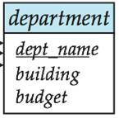
With Clause
The with clause provides a way of defining a temporary view whose definition is available only to the query in which the with clause occurs.
Find all departments with the maximum budget
with max_budget (value) as
(select max(budget)
from department)
select dept_name,budget
from department, max_budget
where department.budget = max_budget.value;

Slide 54
Complex Queries using With Clause
With clause is very useful for writing complex queries
  Supported by most database systems, with minor syntax variations
Find all departments where the total salary is greater than the average of the total salary at all departments
with dept_total (dept_name, value) as
(select dept_name, sum(salary)
from instructor
group by dept_name),
dept_total_avg(value) as
(select avg(value)
from dept_total)
select dept_name
from dept_total, dept_total_avg
where dept_total.value >= dept_total_avg.value;

Slide 55
Scalar Subquery
Scalar subquery is one which is used where a single value is expected
E.g. select dept_name,
(select count(*)
from instructor
where department.dept_name = instructor.dept_name)
as num_instructors
from department;
E.g. select name
from instructor
where salary * 10 >
(select budget from department
where department.dept_name = instructor.dept_name)
Runtime error if subquery returns more than one result tuple

Slide 56
Modification of the Database
Deletion of tuples from a given relation
Insertion of new tuples into a given relation
Updating values in some tuples in a given relation

Slide 57
Modification of the Database – Deletion
Delete all instructors
delete from instructor
Delete all instructors from the Finance department
delete from instructor
where dept_name= 'Finance';
Delete all tuples in the instructor relation for those instructors associated with a department located in the Watson building.
delete from instructor
where dept_name in (select dept_name
from department
where building = 'Watson');

Slide 58
Deletion (Cont.)
Delete all instructors whose salary is less than the average salary of instructors
delete from instructor
where salary< (select avg (salary) from instructor);
  Problem: as we delete tuples from deposit, the average salary changes
  Solution used in SQL:
  1. First, compute avg salary and find all tuples to delete
  2. Next, delete all tuples found above (without recomputing avg or
  retesting the tuples)

Slide 59
Modification of the Database – Insertion
Add a new tuple to course
insert into course
values ('CS-437', 'Database Systems', 'Comp. Sci.', 4);
or equivalently
insert into course (course_id, title, dept_name, credits)
values ('CS-437', 'Database Systems', 'Comp. Sci.', 4);
Add a new tuple to student with tot_creds set to null
insert into student
values ('3003', 'Green', 'Finance', null);

Slide 60
Insertion (Cont.)
Add all instructors to the student relation with tot_creds set to 0
insert into student
select ID, name, dept_name, 0
from instructor
The select from where statement is evaluated fully before any of its results are inserted into the relation
  otherwise queries like
  insert into table1 select * from table1
  would cause problems, if table1 did not have any primary key defined.

Slide 61
Modification of the Database – Updates
Increase salaries of instructors whose salary is over $100,000 by 3%, and all others receive a 5% raise
  Write two update statements:
  update instructor
  set salary = salary * 1.03
  where salary > 100000;
  update instructor
  set salary = salary * 1.05
  where salary <= 100000;
  The order is important
  Can be done better using the case statement (next slide)

Slide 62
Case Statement for Conditional Updates
Same query as before but with case statement
update instructor
set salary = case
when salary <= 100000 then salary * 1.05
else salary * 1.03
end

Slide 63
Updates with Scalar Subqueries
Recompute and update tot_creds value for all students
update student S
set tot_cred = ( select sum(credits)
from takes natural join course
where S.ID= takes.ID and
takes.grade <> 'F' and
takes.grade is not null);
特殊情况：Sets tot_creds to null for students who have not taken any course
Instead of sum(credits), use:
case
when sum(credits) is not null then sum(credits)
else 0
end

Slide 64
End of Chapter 3

