Slide 1

科技论文的阅读与写作
赖韩江
中山大学
http://www.scholat.com/laihanj
邮箱：laihanj3@mail.sysu.edu.cn

Slide 2


Slide 3
科技论文的结构
Abstract
Introduction
Related work
Proposed method
Experiments
Conclusions and future work

Slide 4
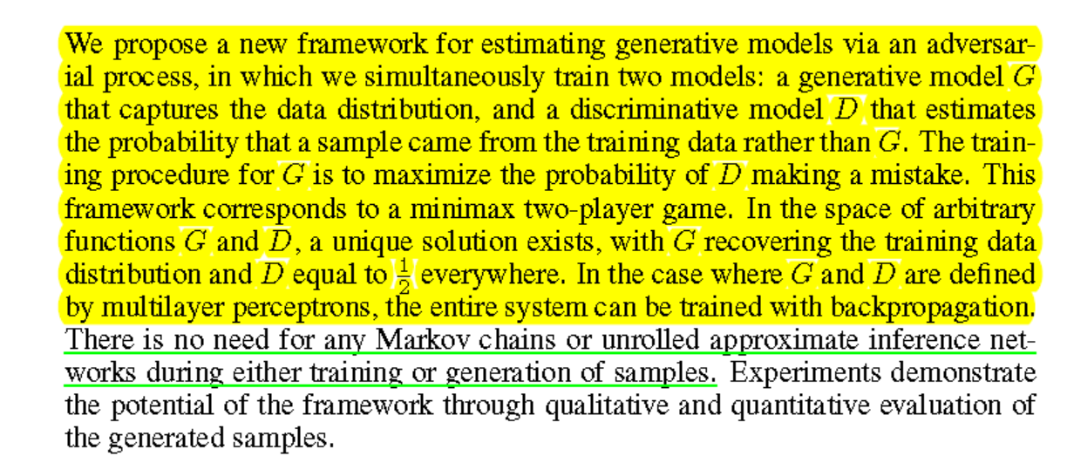
摘要
用一段话将研究的动机、方法、结果讲清楚

Slide 5
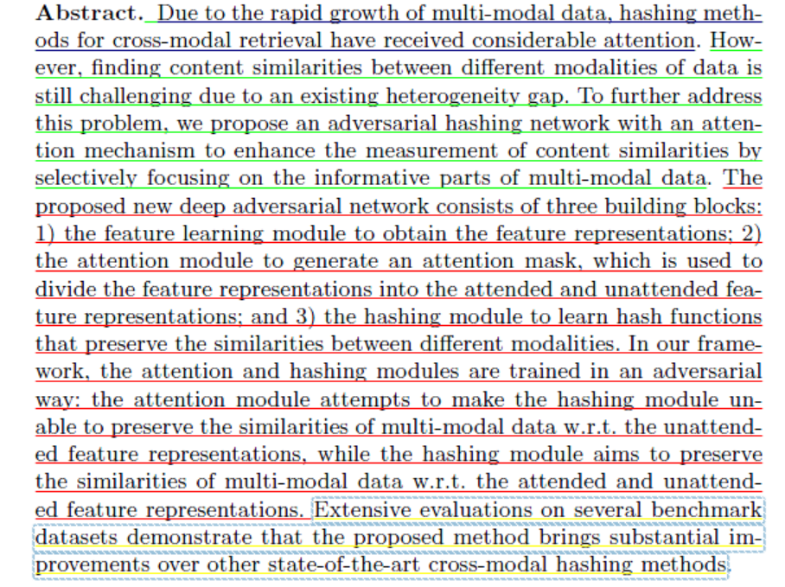
摘要
用一段话将研究的动机、方法、结果讲清楚

Slide 6
摘要
Inspired by how humans summarize long documents, we propose an accurate and fast summarization model that first selects salient sentences and then rewrites them abstractively (i.e., compresses and paraphrases) to generate a concise overall summary. We use a novel sentence-level policy gradient method to bridge the nondifferentiable computation between these two neural networks in a hierarchical way, while maintaining language fluency. Empirically, we achieve the new state-of-theart on all metrics (including human evaluation) on the CNN/Daily Mail dataset, as well as significantly higher abstractiveness scores. Moreover, by first operating at the sentence-level and then the word-level, we enable parallel decoding of our neural generative model that results in substantially faster (10-20x) inference speed as well as 4x faster training convergence than previous long-paragraph encoder-decoder models. We also demonstrate the generalization of our model on the test-only DUC2002 dataset, where we achieve higher scores than a state-of-the-art model.

Slide 7
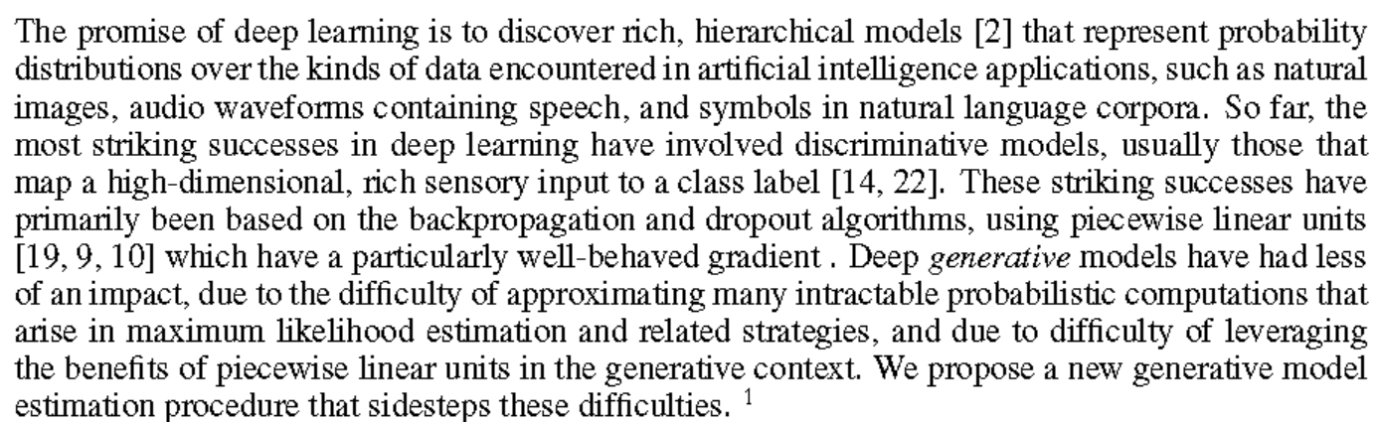
介绍
介绍是摘要的更详细的描述
  提出问题
  介绍研究目标、最近工作、已有研究的不足或没考虑的问题

Slide 8
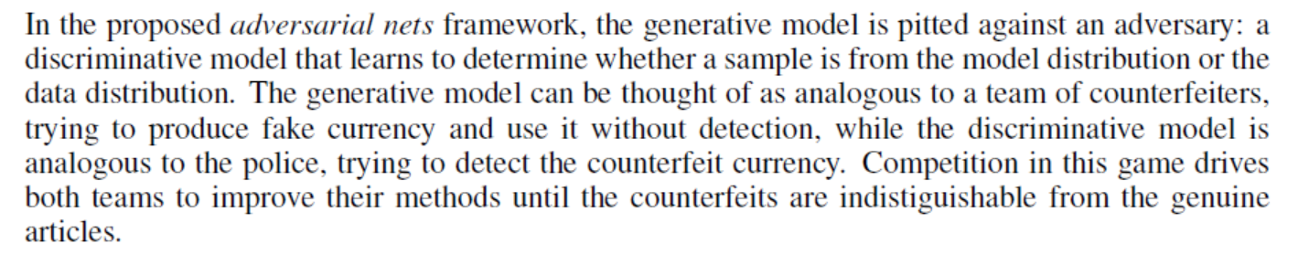
介绍
介绍是摘要的更详细的描述
  解决问题
  针对已有的难点，提出了自己的工作

Slide 9
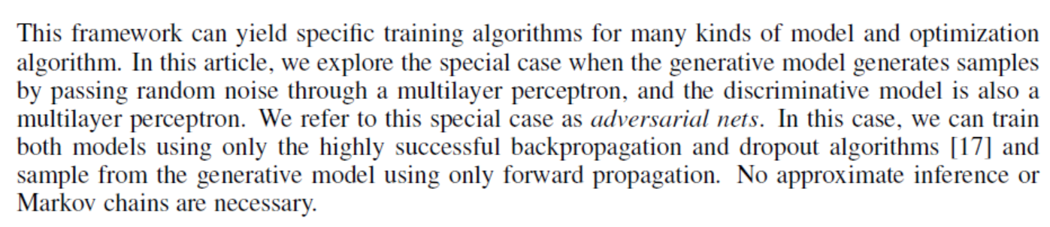
介绍
介绍是摘要的更详细的描述
  解决效果
  提出了自己的工作，可以达到那些效果

Slide 10
介绍
介绍是摘要的更详细的描述
  总结贡献
  总结一下自己论文的主要贡献
  Overall, our contribution is three fold: First we propose a novel sentence-level RL technique for the well-known task of abstractive summarization, effectively utilizing the word-then-sentence hierarchical structure without annotated matching sentence-pairs between the document and ground truth summary. Next, our model achieves the new state-of-the-art on all metrics of multiple versions of a popular summarization dataset (as well as a test-only dataset) both extractively and abstractively, without loss in language fluency (also demonstrated via human evaluation and abstractiveness scores). Finally, our parallel decoding results in a significant 10-20x speed-up over the previous best neural abstractive summarization system with even better accuracy

Slide 11
什么最重要
  阿尔伯特· 爱因斯坦曾经说：“ 提出一个问题往往比解决一个问题更重要。因为解决问题也许仅是一个数学上或实验上的技能而已，而提出新的问题，却需要有创造性的想象力，而且标志着科学的真正进步。”

Slide 12
其它章节
相关工作（Related work)
介绍跟所提方法最相关的工作，可简单描述跟已有工作不同与创新
提出方法（Proposed Approach)
  为了解决问题，描述所提出的方法，理论模型，框架等。
实验（Experiments)
  如实汇报实验结果，让实验结果来支持研究的观点。
结论 (Conclusions/Future Work/Discussions)
  总结论文的主要理论和贡献，有些还加一些后期工作。

Slide 13
GAN
“There are many interesting recent development in deep learning. The most important one, in my opinion, is adversarial training (also called GAN for Generative Adversarial Networks). This, and the variations that are now being proposed is the most interesting idea in the last 10 years in ML, in my opinion.” – Yann LeCun

Slide 14
课后作业
实现图像生成（用GAN方法）
  (例如： 年青人 -> 老年人， 父+母 -> 孩子）
  提交代码和实验报告
  9月29号deadline
  同时交分组名单给助教（张熙）

