Slide 1

SonarQube
Setting up Jenkins & SonarQube
Presented By :
Amrit Choudhary

Slide 2
SonarQube/Jenkins Installation Steps
Install SonarQube using docker-compose file
git clone https://github.com/trainmefordevsecops/SonarQube-Jenkins.git
cd SonarQube-Jenkins/SonarQube
docker-compose up –d
Install Jenkins using docker-compose file
cd SonarQube-Jenkins/Jenkins
docker-compose up -d

Slide 3
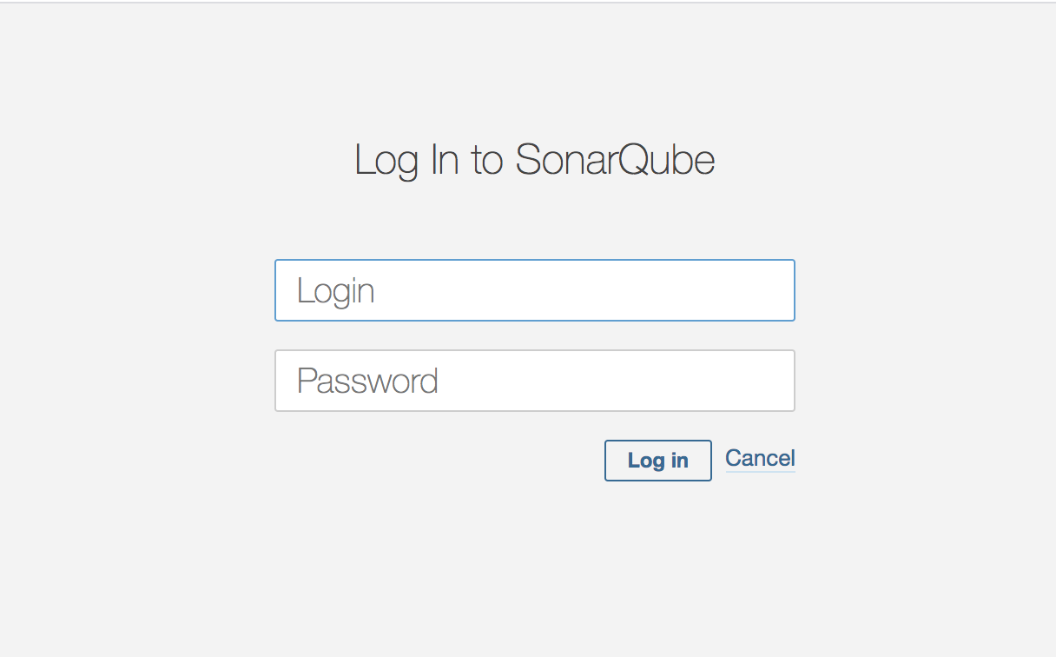
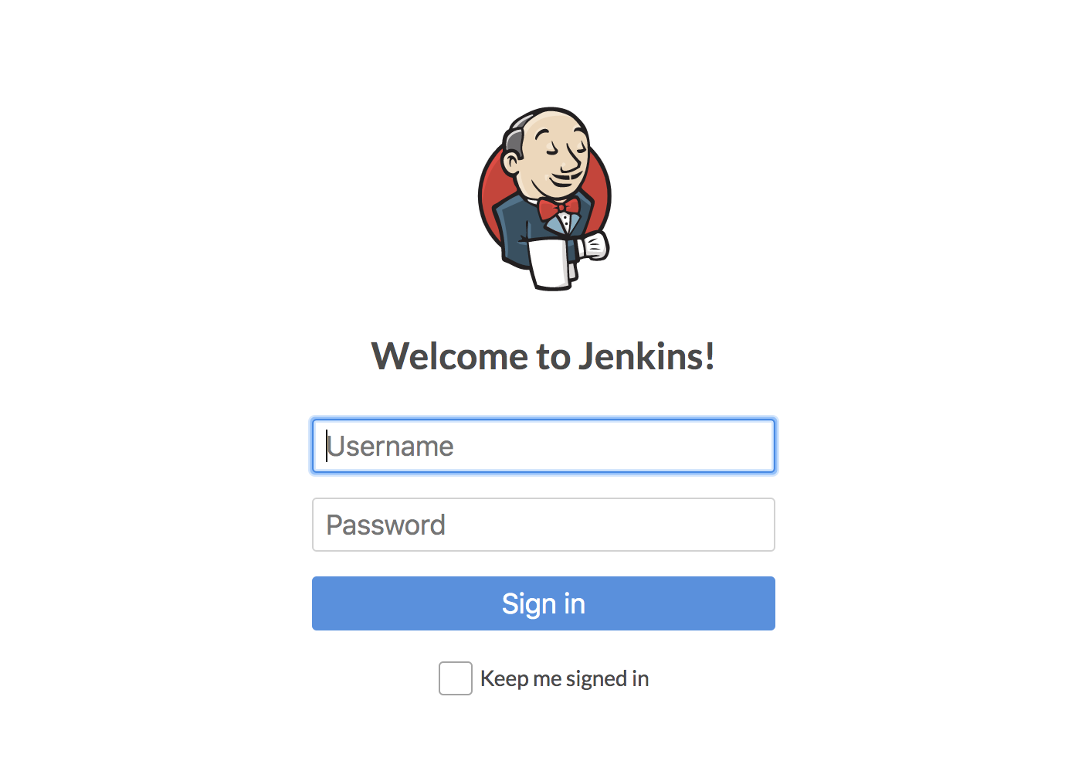
SonarQube & Jenkins Dashboard

Slide 4
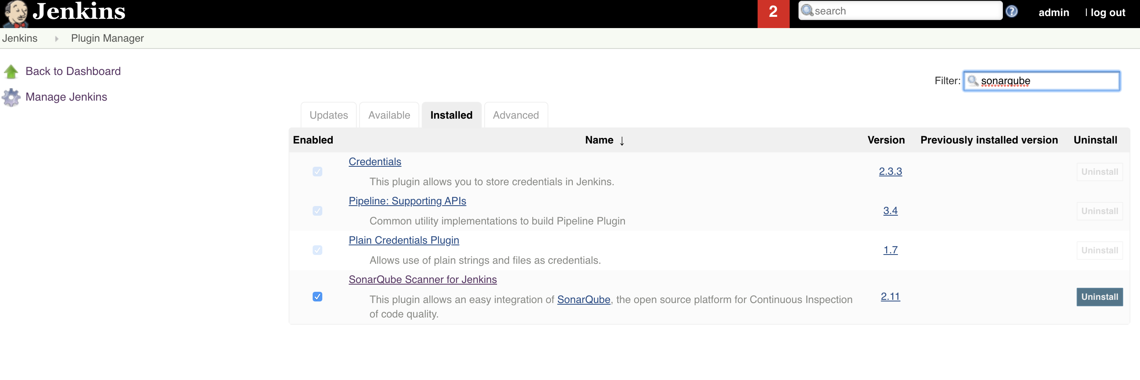
Install SonarQube Pluggin Jenkins

Slide 5
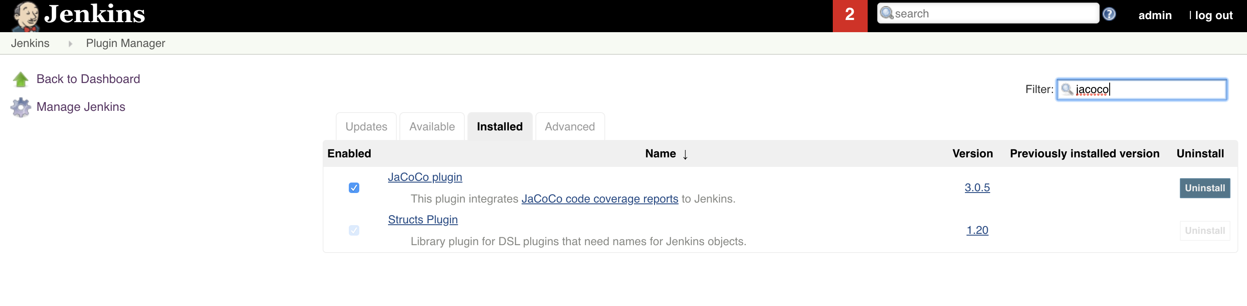
Install Coverage Pluggin Jenkins
Install Jacoco : coverage pluggin

Slide 6
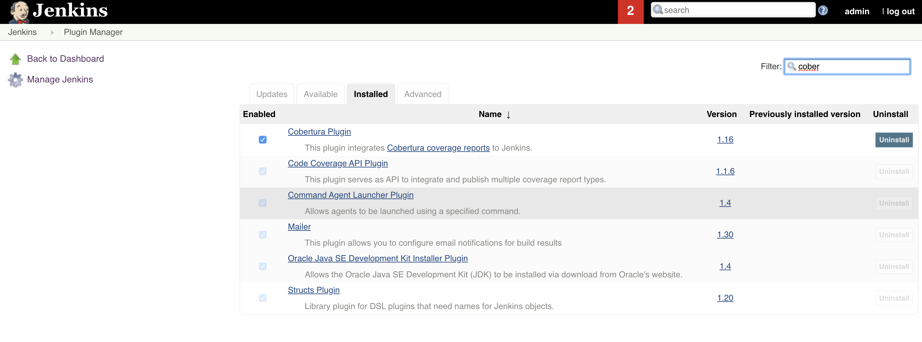
Install Coverage Pluggin Jenkins
Install cobertura : Coverage pluggin

Slide 7
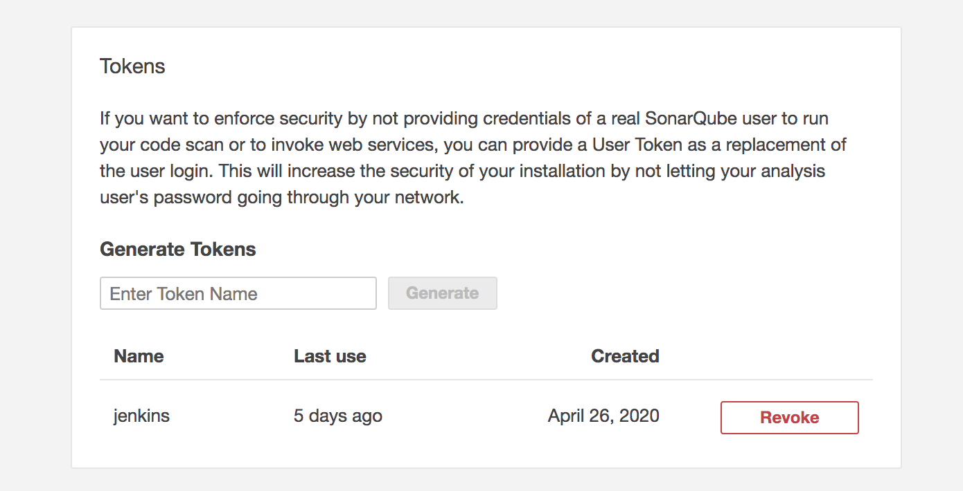
SonarQube Token Setup for Jenkins

Slide 8
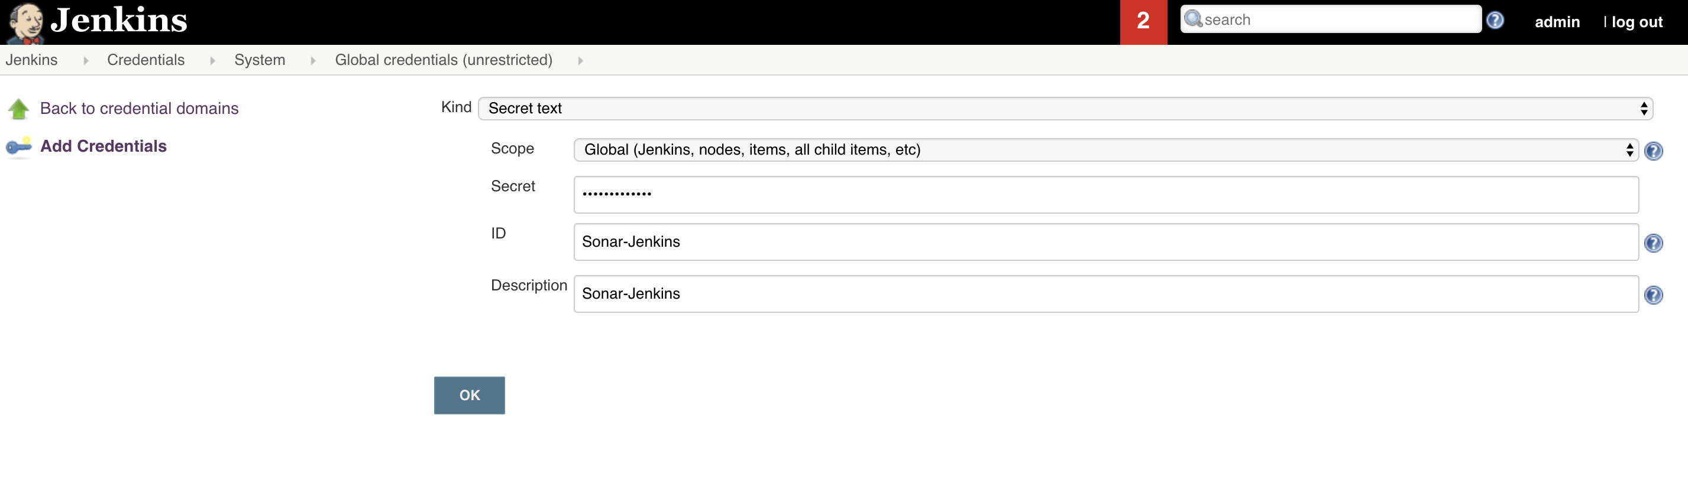
Jenkins Credentials Setup For SonarQube

Slide 9
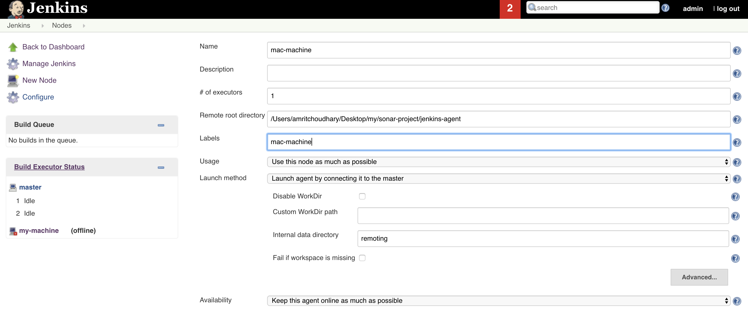
Install Jenkins Agent

Slide 10
Congrats !!!
Docker Setup Completed
SonarQube Setup Completed
Jenkins Setup Completed
What’s Next ?
Create Various projects in Jenkins and analyze using SonarQube.

