Slide 1
🍽
BistroSaaS
Restaurant Management & Online Ordering System
PROJECT PRESENTATION

Slide 2
Group Members
👥
▸ Mussa Afridi - Backend & Deployment
▸ [ Member 2 - role ]
▸ [ Member 3 - role ]
▸ [ Member 4 - role ]
▸ Course: ____________ Instructor: ____________
BistroSaaS | Restaurant Management System
2

Slide 3
Introduction
📖
▸ A full-stack web application for restaurant ordering & management.
▸ Built with the Django web framework (Python).
▸ Customers browse a menu, place orders, and track status.
▸ Admins manage the menu and confirm orders.
▸ Modern, responsive UI using Bootstrap 5.
BistroSaaS | Restaurant Management System
3

Slide 4
Problem Statement
❓
▸ Manual, paper-based order taking causes errors.
▸ No central searchable menu or order records.
▸ Customers cannot view the menu or order online.
▸ Hard to track live order status.
▸ Menu / price / availability updates are slow.
BistroSaaS | Restaurant Management System
4

Slide 5
Objectives
🎯
▸ Secure registration & login (Customer / Admin roles).
▸ Browse menu with search, filter & pagination.
▸ Online order placement + order history.
▸ Admin CRUD on menu items with image uploads.
▸ Order confirmation workflow with notifications.
▸ REST API for menu data + responsive UI.
BistroSaaS | Restaurant Management System
5

Slide 6
Tools & Technologies
🛠
▸ Python 3 + Django 6.0.5 (MVT framework).
▸ Django REST Framework (JSON API).
▸ SQLite database.
▸ Bootstrap 5 + HTML (frontend).
▸ Pillow (image uploads).
▸ Git & GitHub, deployed on PythonAnywhere.
BistroSaaS | Restaurant Management System
6

Slide 7
System Architecture (MVT)
🏗
▸ Model (models.py) - database tables.
▸ View (views.py) - page logic (FBV + CBV).
▸ Template (HTML) - Bootstrap pages shown to user.
▸ URLs (urls.py) - map addresses to views.
▸ Flow: URL -> View -> Model (data) -> Template -> Browser.
BistroSaaS | Restaurant Management System
7

Slide 8
User Roles
🔑
▸ Guest - browse menu & read API only.
▸ Customer - place orders, view history, edit profile.
▸ Admin (superuser) - full menu & order management + Django admin.
▸ Admin sign-up is protected by a secret key.
BistroSaaS | Restaurant Management System
8

Slide 9
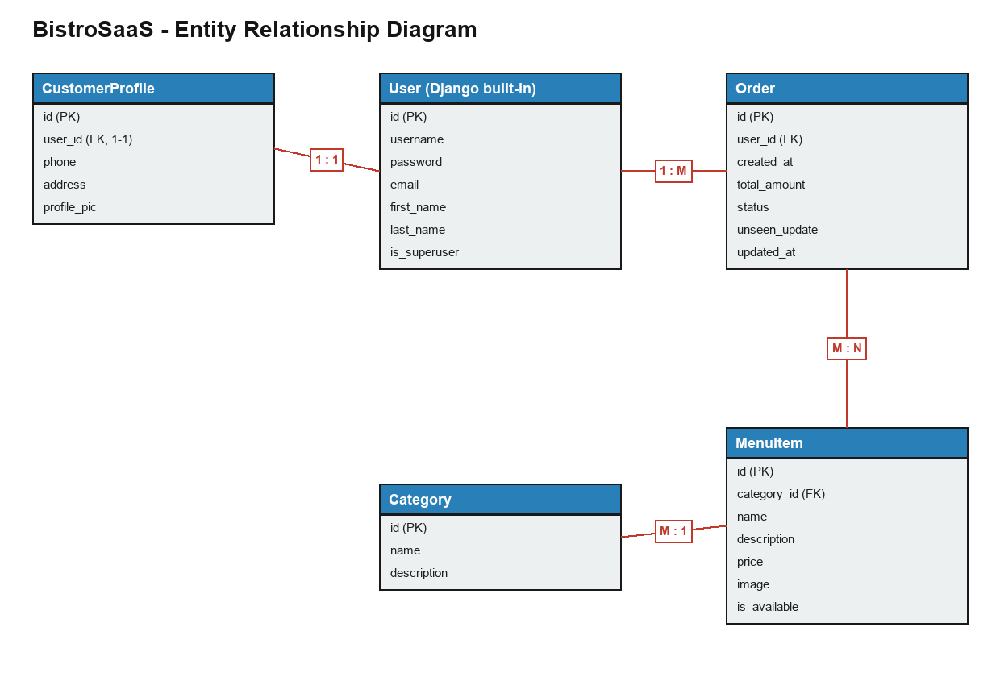
Database Design
🗄
▸ 4 main tables + Django User.
▸ User 1-1 CustomerProfile.
▸ User 1-M Order.
▸ Category 1-M MenuItem.
▸ Order M-N MenuItem.
BistroSaaS | Restaurant Management System
9

Slide 10
Features Overview
⭐
▸ Authentication with two roles.
▸ Menu browsing: search, filter, pagination.
▸ Menu CRUD with image uploads (admin).
▸ Online ordering with live total.
▸ Order confirmation & notifications.
▸ User profiles + REST API.
BistroSaaS | Restaurant Management System
10

Slide 11
Authentication & Roles
🔐
▸ Register, Login, Logout (Django auth).
▸ Role dropdown: Customer (default) or Admin.
▸ Admin requires Secret Key (admin123).
▸ Profile auto-created for every user (signal).
BistroSaaS | Restaurant Management System
11

Slide 12
Menu Management (CRUD)
🍔
▸ Admins add / edit / delete menu items.
▸ Image upload for each dish (Pillow).
▸ Items grouped by category.
▸ Class-Based Views + access control (admin only).
BistroSaaS | Restaurant Management System
12

Slide 13
Search, Filter & Pagination
🔍
▸ Search dishes by name or description (?q=).
▸ Filter by category buttons (?category=).
▸ 6 items per page with Previous / Next controls.
▸ Implemented in MenuListView.
BistroSaaS | Restaurant Management System
13

Slide 14
Order Placement Flow
🛒
▸ Customer selects items with checkboxes.
▸ Live JavaScript total updates instantly.
▸ Server recomputes the real total on submit.
▸ Order saved with status = Pending.
BistroSaaS | Restaurant Management System
14

Slide 15
Order Confirmation & Notifications
🔔
▸ Admin updates status: Pending -> Preparing -> Completed / Cancelled.
▸ Customer gets a red notification badge.
▸ Updated orders highlighted on 'My Orders'.
▸ Badge clears when the customer views orders.
BistroSaaS | Restaurant Management System
15

Slide 16
User Profile
👤
▸ Edit first name, last name, email.
▸ Edit phone, address, profile picture.
▸ Change password (new + confirm).
▸ Accessible from the navbar profile dropdown.
BistroSaaS | Restaurant Management System
16

Slide 17
REST API (Bonus)
🔗
▸ Built with Django REST Framework.
▸ GET /api/menu/ - list all items as JSON.
▸ GET /api/menu/<id>/ - single item.
▸ Browsable API in the browser.
▸ Permission: read for all, write for logged-in users.
BistroSaaS | Restaurant Management System
17

Slide 18
Django Admin Panel
⚙
▸ Manage Users, Categories, Menu Items, Orders.
▸ Search, filters, and inline editing.
▸ Custom red 'Cancel' button on all forms.
▸ Admins cannot see / delete their own account.
BistroSaaS | Restaurant Management System
18

Slide 19
Version Control & Deployment
🚀
▸ Source code hosted on GitHub.
▸ Live deployment on PythonAnywhere.
▸ Steps: clone -> venv -> install -> migrate -> configure web app.
▸ Live URL: mussa.pythonanywhere.com
BistroSaaS | Restaurant Management System
19

Slide 20
Project Demonstration
📸
▸ Live screenshots from the running application.
▸ Walking through the main pages and features.
▸ Customer journey + Admin management.
BistroSaaS | Restaurant Management System
20

Slide 21
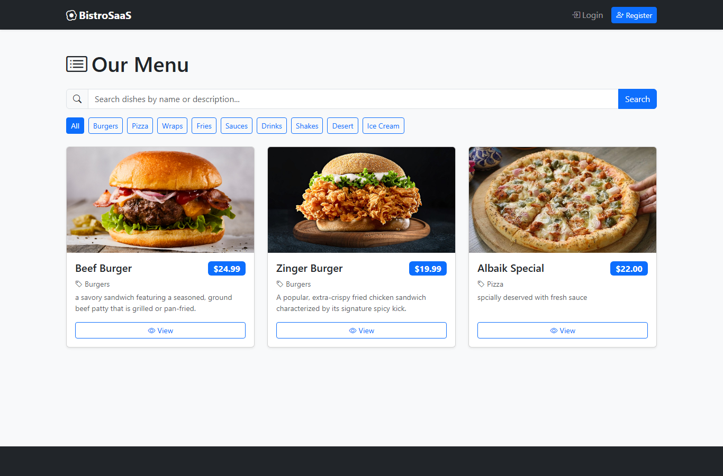
Home / Menu Page
📸
BistroSaaS | Restaurant Management System
21

Slide 22
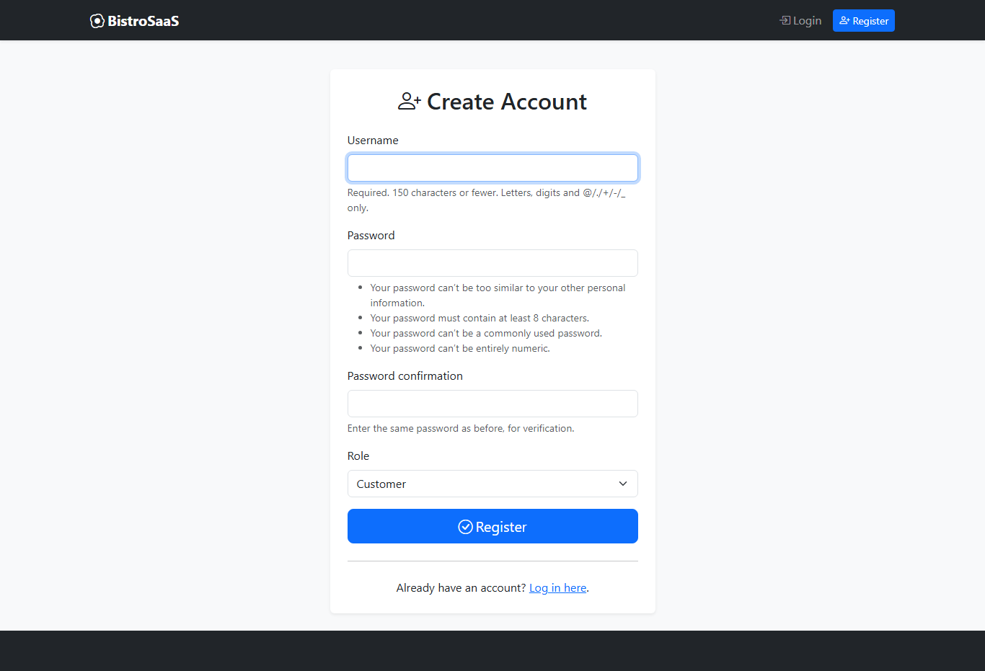
Registration
📸
BistroSaaS | Restaurant Management System
22

Slide 23
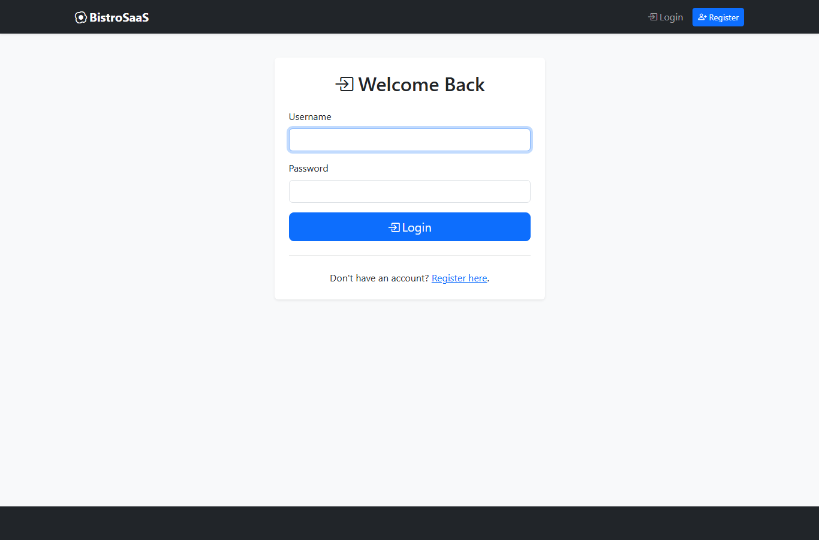
Login
📸
BistroSaaS | Restaurant Management System
23

Slide 24
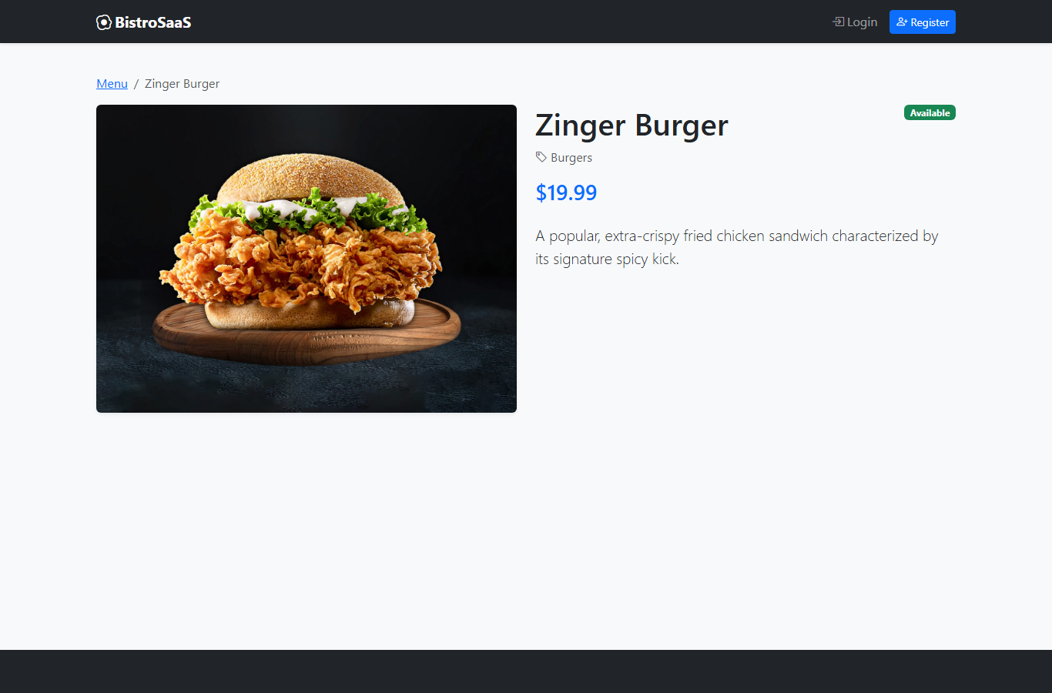
Menu Item Detail
📸
BistroSaaS | Restaurant Management System
24

Slide 25
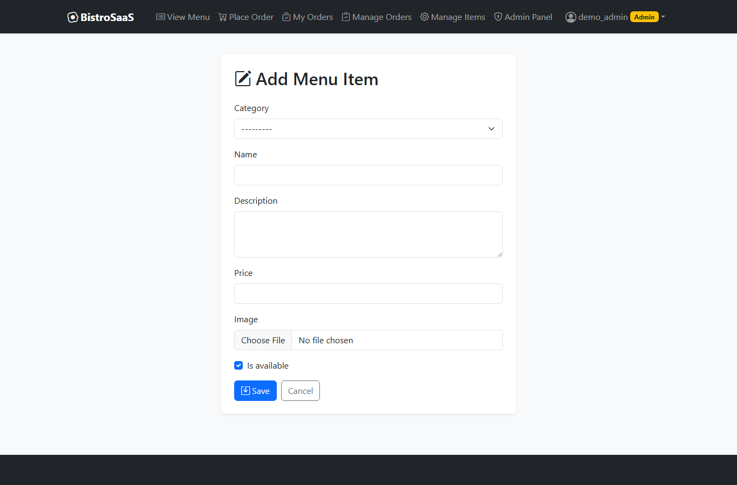
Add Menu Item (Admin)
📸
BistroSaaS | Restaurant Management System
25

Slide 26
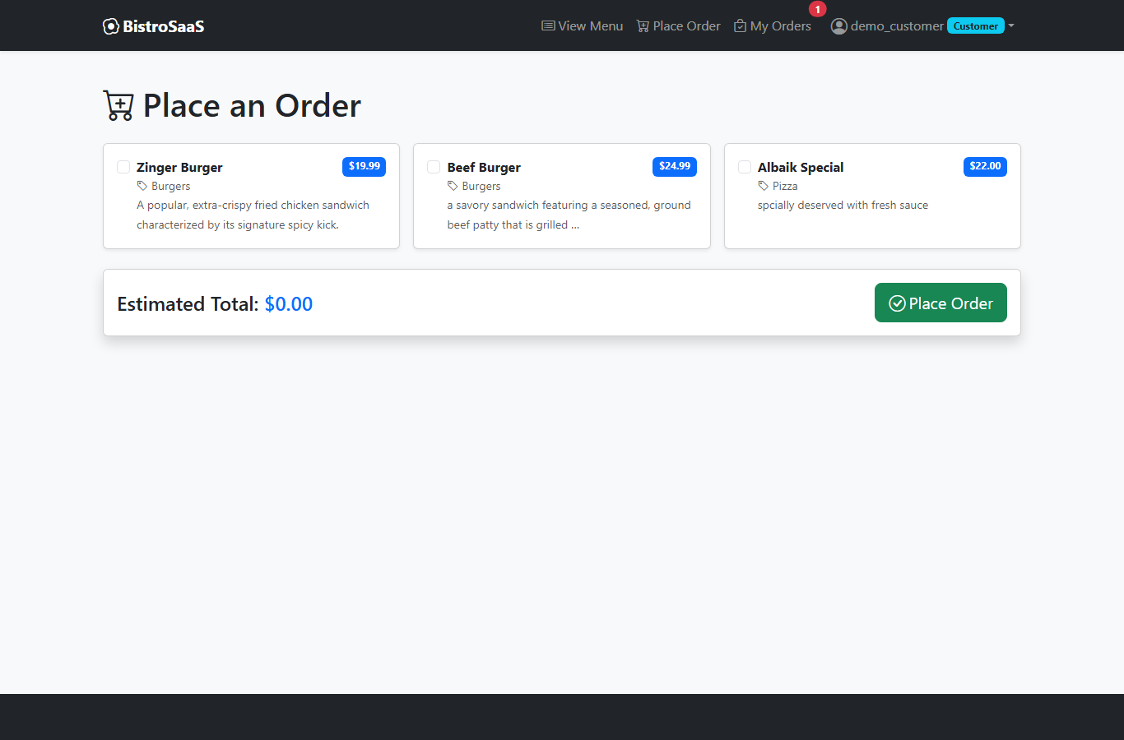
Place Order
📸
BistroSaaS | Restaurant Management System
26

Slide 27
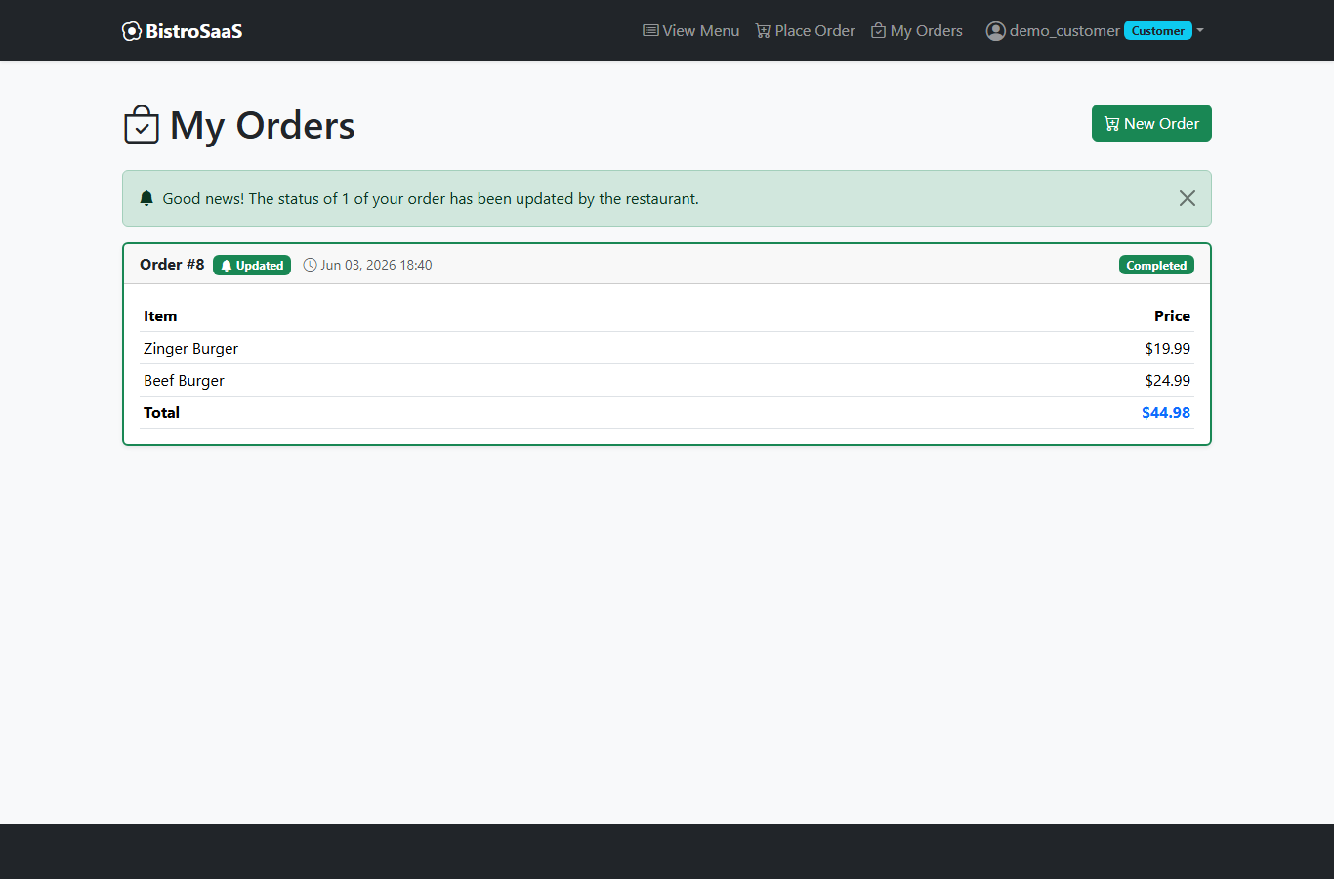
My Orders
📸
BistroSaaS | Restaurant Management System
27

Slide 28
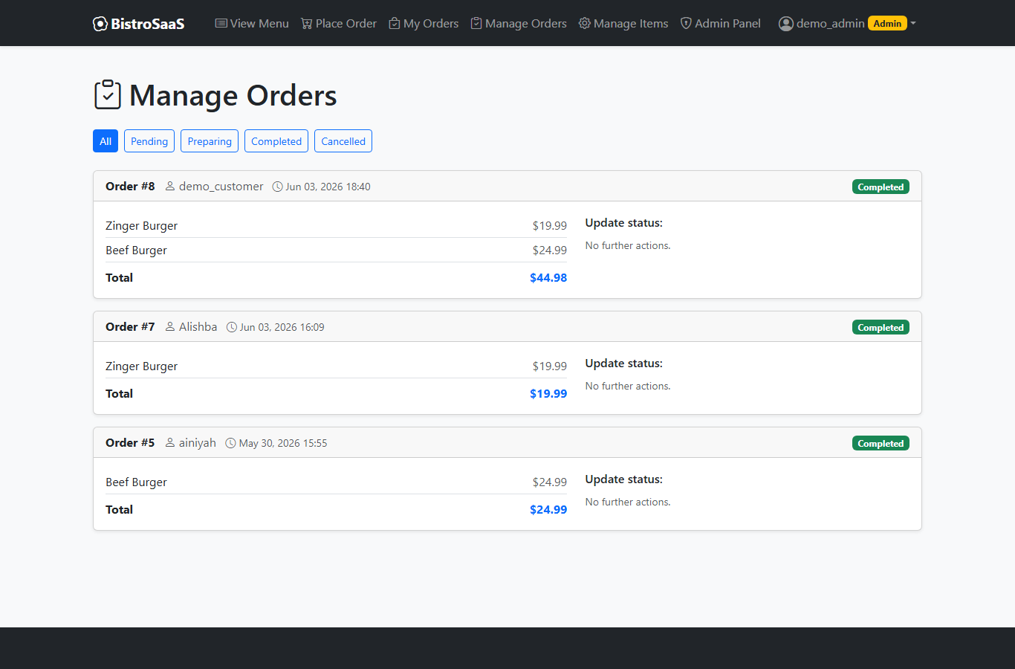
Manage Orders (Admin)
📸
BistroSaaS | Restaurant Management System
28

Slide 29
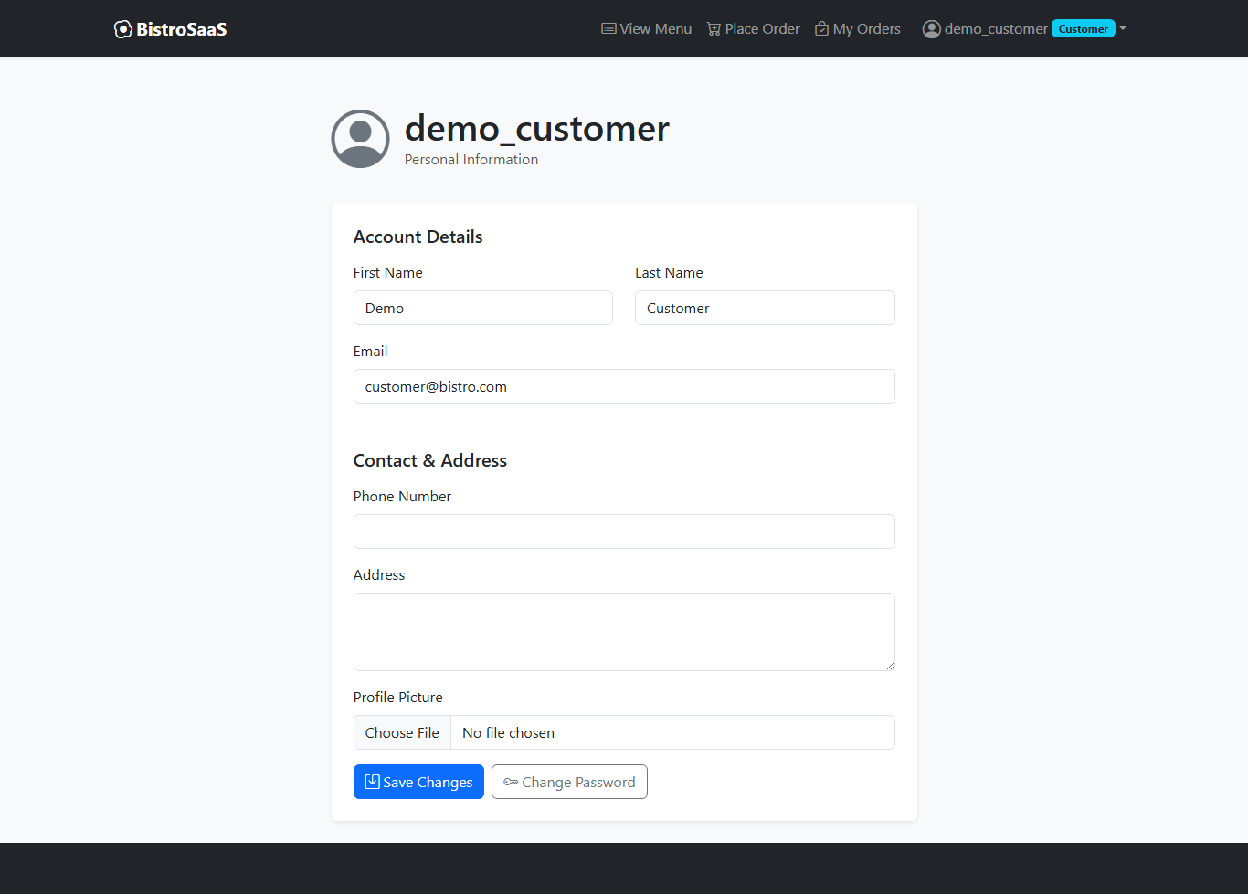
User Profile
📸
BistroSaaS | Restaurant Management System
29

Slide 30
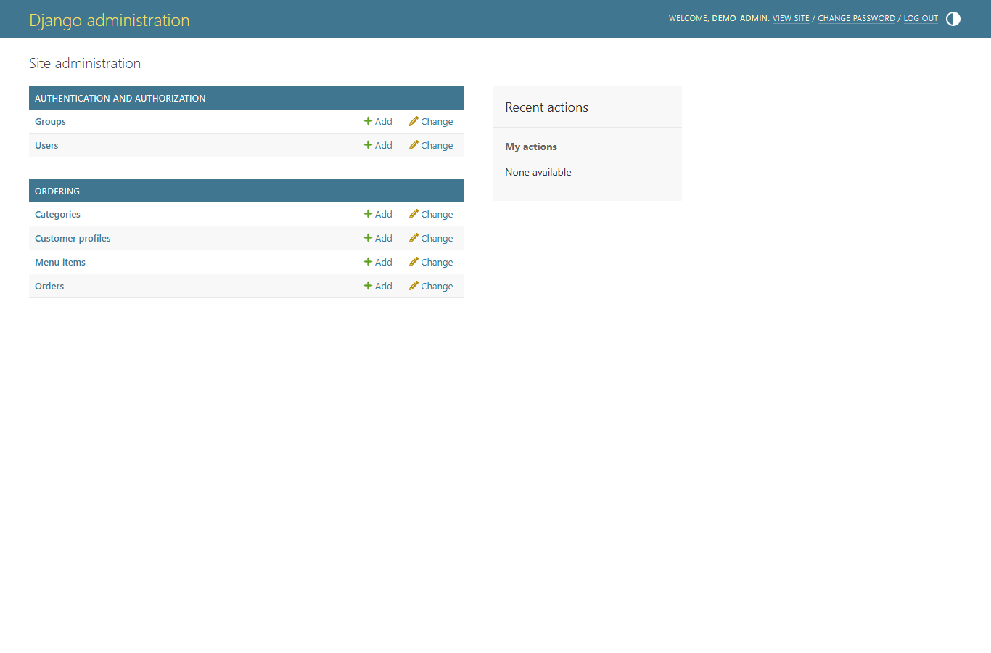
Django Admin Panel
📸
BistroSaaS | Restaurant Management System
30

Slide 31
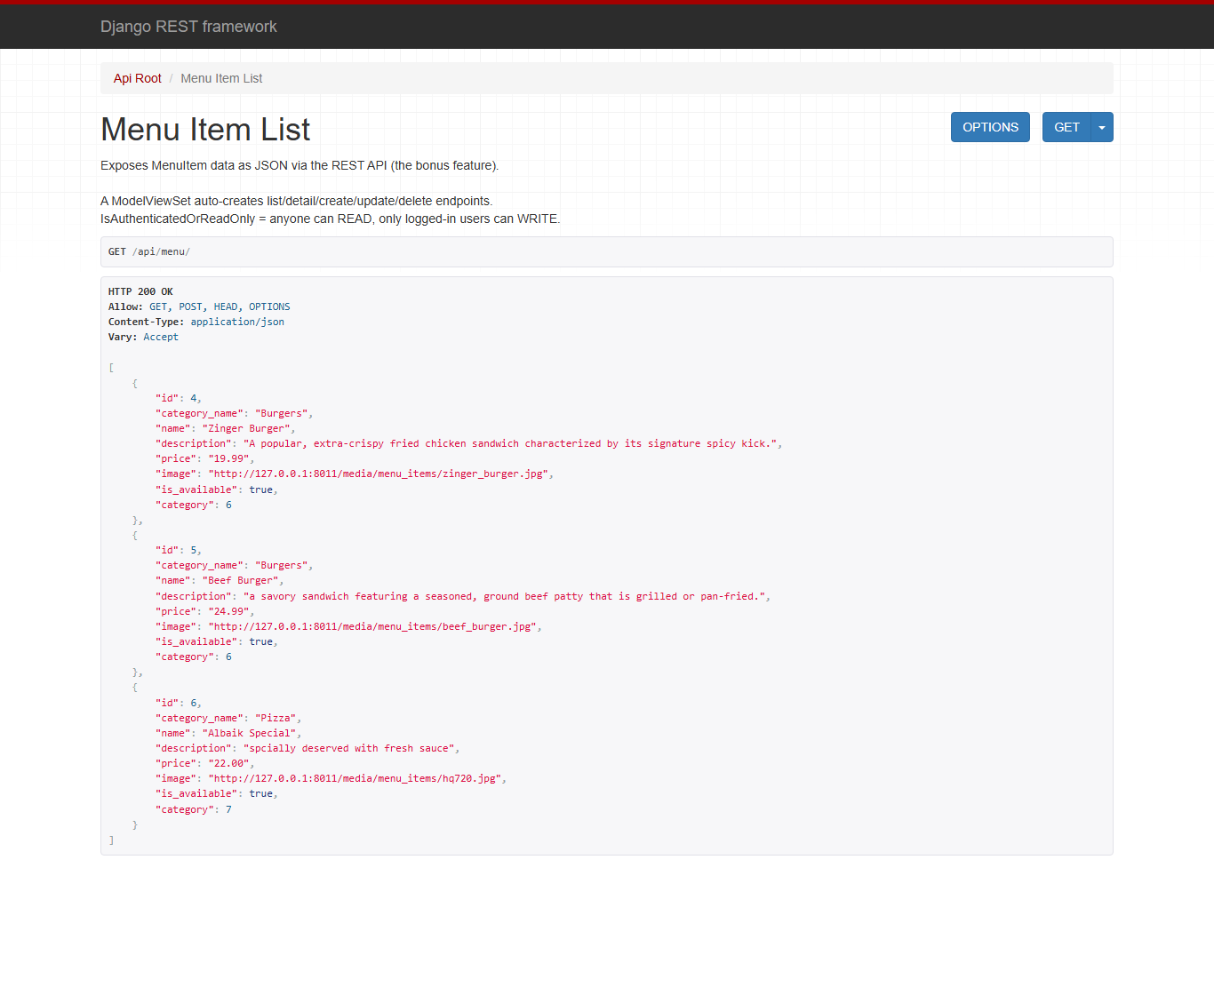
REST API (/api/menu/)
📸
BistroSaaS | Restaurant Management System
31

Slide 32
🍽
Conclusion
Thank You!
A complete full-stack Django app - live demonstration to follow.
QUESTIONS & DEMO

