Slide 1
Joint Modelling of Emotion and Abusive Language Detection

Slide 2
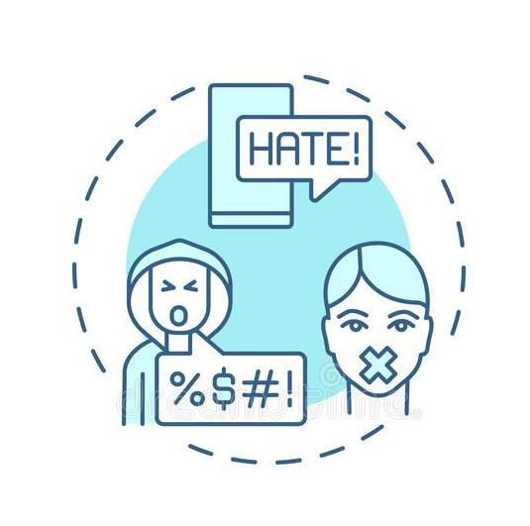
Introduction
By MD Jubayer ISlam, 16101196

Slide 3
Why Abusive Language Detection is Important ?
Why Modelling Emotional and Abusive Language together ?
Aggressive and abusive behaviour online can lead to severe psychological consequences for its victims
THe use of abusive language has been increased rapidly. This initiates cyber-bullying that targets individuals (celebrity, politician, and product) and a group of people (specific country, age, and religion). It is important to detect and analyze abusive language from online comments automatically.
Abuse can be expressed in many implicit and subtle ways, for instance, through the use of ambiguous terms and figurative language. Abusive language and behaviour are also inextricably linked to the emotional and psychological state of the speaker which is reflected in the affective characteristics of their language

Slide 4
Contribution
thE paper proposes to model The two phenomena, Abusive and Emotional Language detection jointly and present the first abusive language detection method that incorporates affective features via a multitask learning (MTL) paradigm. The paper mainly focuses on abuse detection; hence it refers to it as the primary task, while the task that is used to provide additional knowledge — emotion detection — is referred to as the auxiliary task. Furthermore, the paper proposes an MTL framework where a single model can be trained to perform emotion detection and identify abuse at the same time.

Slide 5

Related Works
By FARHAN, 17201109

Slide 6
Early Approaches
Gitari et al., 2015
Sood et al., 2012; Dinakar et al., 2011
Dadvar et al., 2013
Used lexicon-based features
Used user-specific features, age
Used Bag of-words (BOW) or n-gram features
Recent Approaches
Founta et al. (2019)
Zhang et al. (2018)
Mishra et al. 2018a, 2019a
used transfer learning to fine-tune features from the author meta data network to improve abuse detection.
took an MTL approach to detect emotion
used community-based author information as features in their classifiers with promising results

Slide 7

Datasets
By Farhan, 17201109

Slide 8
To ensure that the results are generalizable, the paper experimented with two different Abuse Detection Datasets
OffensEval 2019 (OffensEval)
Waseem and Hovy 2016 (Waseem&Hovy)
This dataset is from SemEval 2019 - Task 6: OffensEval 2019 - Identifying and Categorizing Offensive Language in Social Media (Zampieri et al., 2019a,b). As The paper focuses on involving offensive language identification. It contains 13, 240 annotated tweets, and each tweet is classified as to whether it is offensive (33%) or not (67%).
This dataset was compiled by Waseem and Hovy (2016) by searching for commonly used slurs and expletives related to religious, sexual, gender and ethnic minorities. The tweets were then annotated with one of three classes: racism, sexism or neither.

Slide 9
Emotion Detection Dataset
This dataset is from SemEval-2018 Task 1: Affect in Tweets (Mohammad et al., 2018).The dataset consists of around 11k tweets (training set: 6839; development set: 887; test set: 3260). It contains the TweetID and 11 emotion labels (anger, anticipation, disgust, fear, joy, love, optimism, pessimism, sadness, surprise, trust)

Slide 10

Approach
By Md.Asad Uzzaman Noor,
17301128 & Afridi iBn Rahman, 17201107

Slide 11
The paper takes two different approaches for its research - 1. STL & 2.LTL. For STL, the paper experiment with four different architecture variants:
MLP classifier
Attention classifier
1
2
3
4
Max Pooling
BiLSTM

Slide 12
However For LTL, the paper experiment with three different architecture variants:
Double Encoder Model
Attention classifier
1
2
3
4
Hard Sharing Model
Gated Double Encoder Model

Slide 13

Result and Conclusion
By Zebel-E-Noor Akhand, 17201124

Slide 14
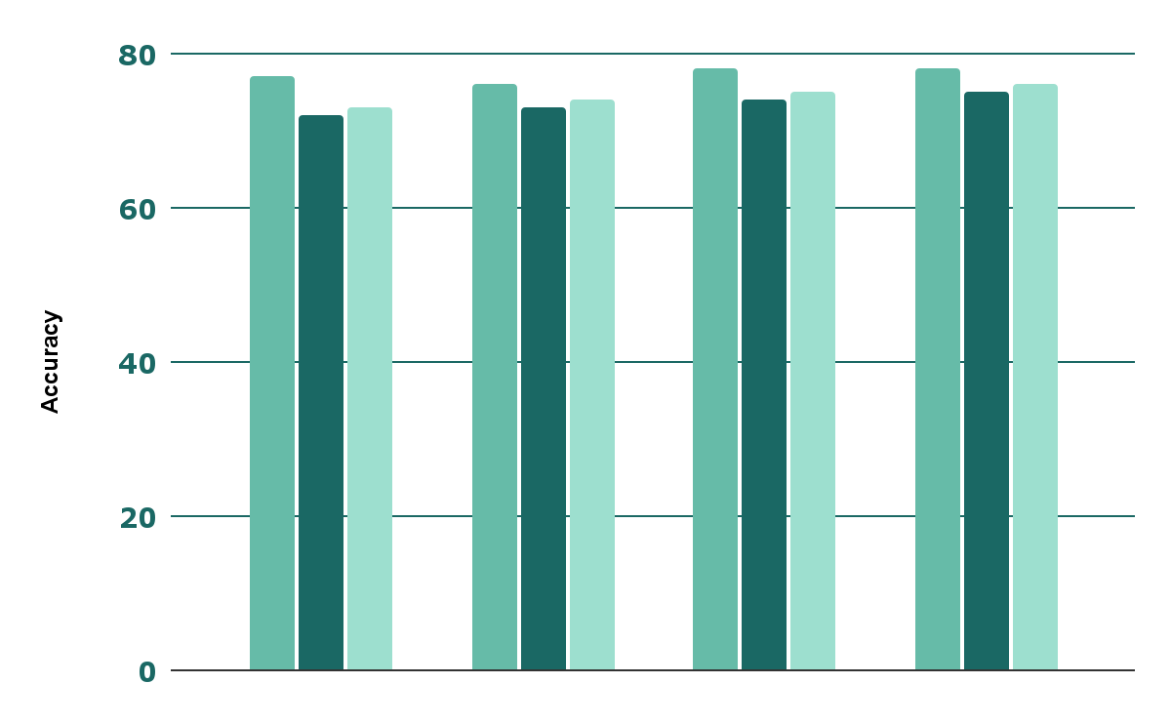
This chart presents the evaluation results of the STL models trained and tested on the OffensEval dataset,
77.47%
Precision
MTL-DEncoder
75.27%
Recall
MTL-GatedDEncoder
MTL(Hard)
76.03%
STL(BiLSTM)+attn
MTL(DEncoder)
MTL(GatedDEncoder)
F1-Score
MTL-GatedDEncoder

Slide 15
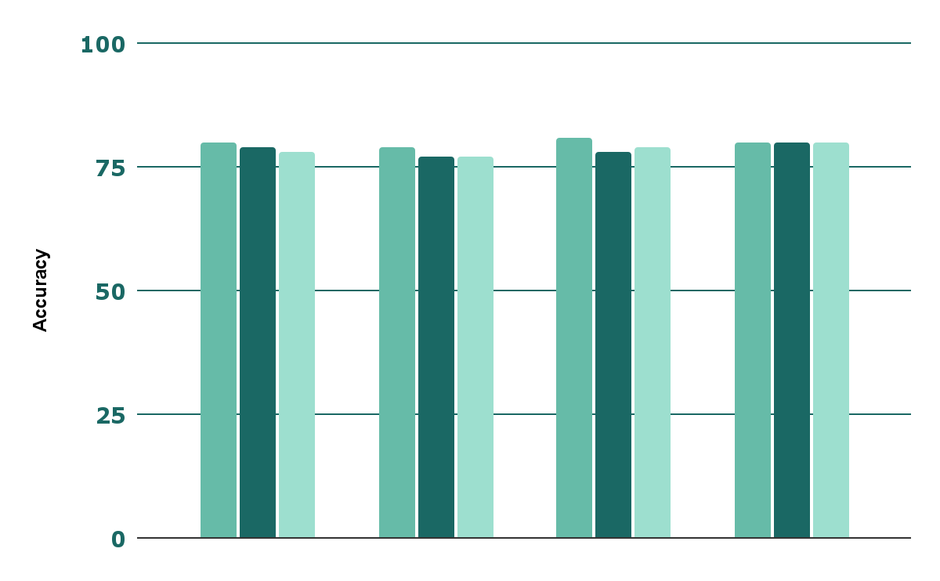
STL vs. MTL with emotion detection indicates statistically significant improvement over STL.
80.77%
Precision
MTL-DEncoder
79.60%
Recall
MTL-GatedDEncoder
MTL(Hard)
79.55%
STL(BiLSTM)+attn
MTL(DEncoder)
MTL(GatedDEncoder)
F1-Score
MTL-GatedDEncoder

Slide 16
MTL vs. transfer learning performance. OE refers to the OffensEval dataset and W&H to the Waseem&Hovy dataset
Dataset | Method | Precision | Recall | F1 Score
OE | MTL | 77.46% | 75.27% | 76.03%
OE | Transfer | 76.81% | 73.71% | 74.67%
W & H | MTL | 80.12% | 79.60% | 79.55%
W & H | Transfer | 81.25% | 77.72% | 79.07%

Slide 17
Thank You

