Slide 1

Smart Expense Tracking
& Earning Management
Mini Project Presentation
Presented by Patan Afrid Khan
BBA • Viswam Degree and PG College
1

Slide 2
1. Introduction
Managing money is an important skill for college students.
Students may receive money from family, scholarships, internships, part-time work or other sources.
Without planning, small daily expenses can become a large monthly cost.
This project connects expense tracking, budgeting, saving and responsible earning.
2

Slide 3
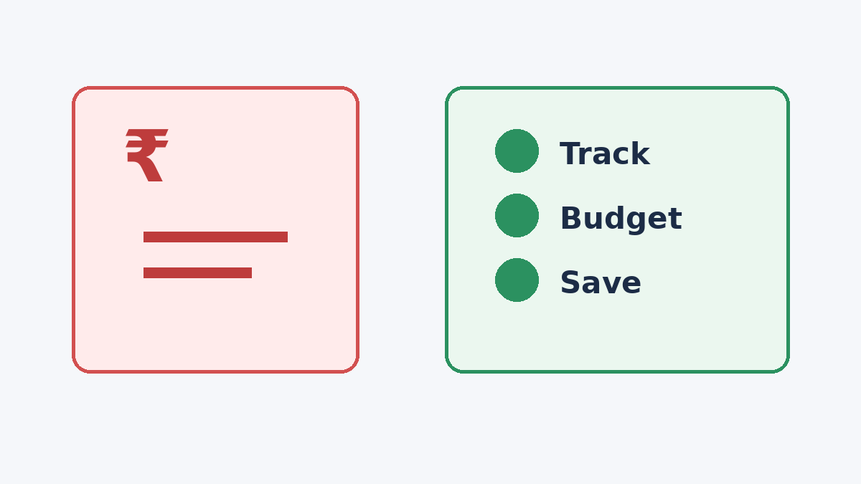
2. Problem Statement
Lack of proper expense tracking
Unplanned spending and impulse purchases
Difficulty separating needs from wants
Limited awareness of budgeting and saving
Dependence on family for regular expenses
Limited knowledge of suitable student earning opportunities
3

Slide 4
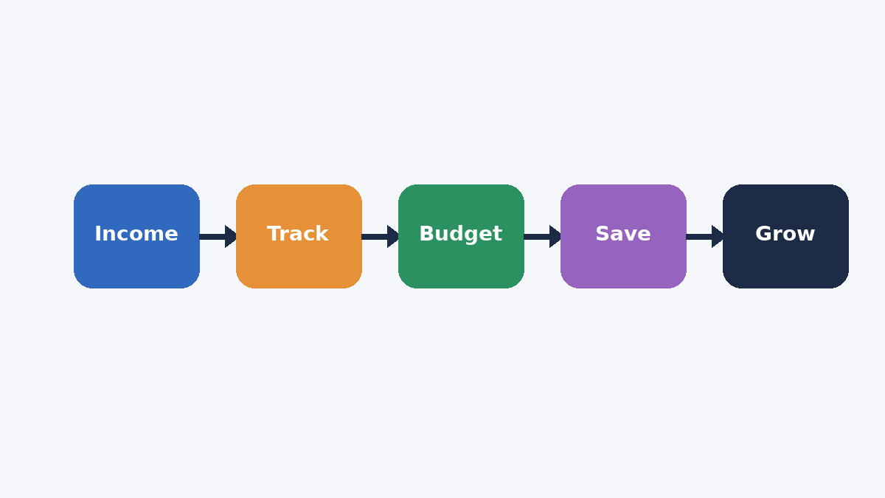
3. Project Objectives
Understand common sources of student income.
Identify major categories of student expenses.
Create a simple and practical expense-tracking method.
Encourage monthly budgeting and realistic saving.
Explore skill-based earning opportunities.
Promote responsible financial decision-making.
4

Slide 5
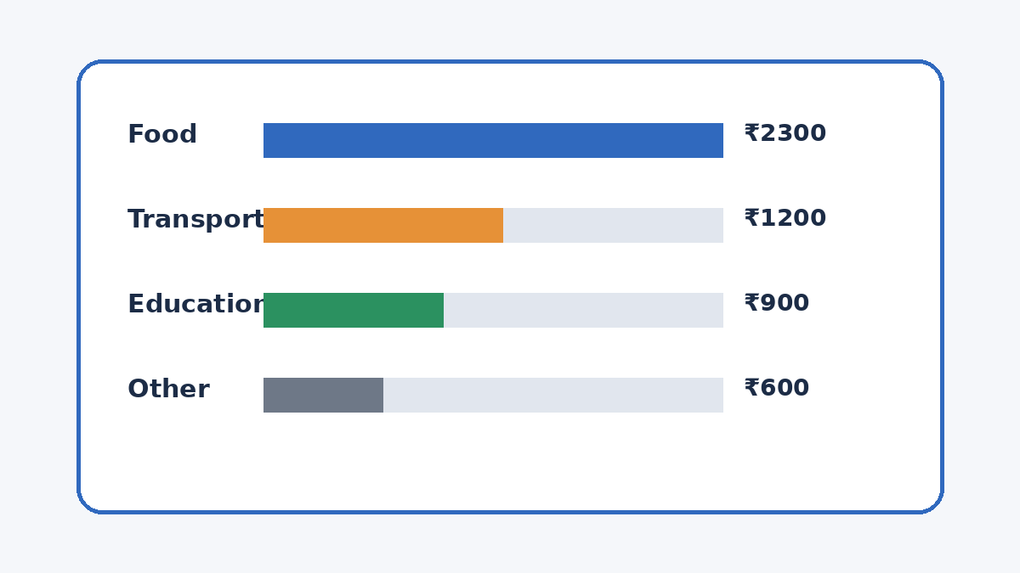
4. Expense Tracking
Record every expense, including small purchases.
Use categories such as food, transport, education, mobile, personal and entertainment.
Review spending weekly or monthly.
Compare actual spending with the planned budget.
Identify unnecessary expenses and adjust future spending.
5

Slide 6
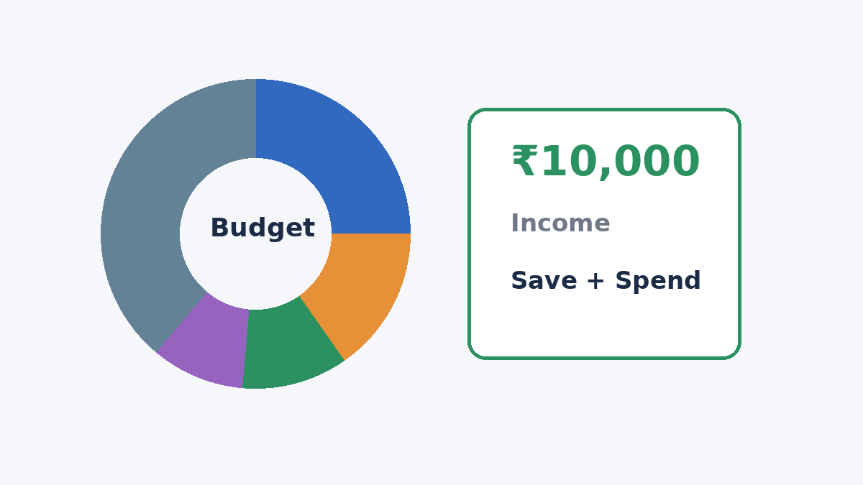
5. Sample Monthly Budget
Illustration: student monthly income of ₹10,000
Category | Amount
Food | ₹2,500
Transport | ₹1,500
Education | ₹1,000
Mobile/Internet | ₹500
Personal | ₹1,000
Entertainment | ₹500
Savings | ₹2,000
Emergency/Other | ₹1,000
6

Slide 7
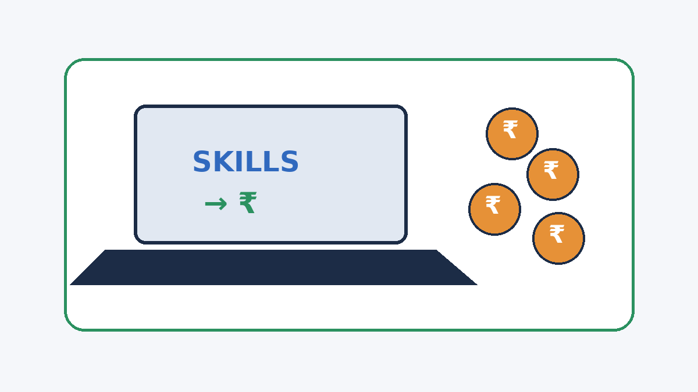
6. Ways Students Can Earn Money
Part-time jobs and internships
Tutoring or academic support
Freelance writing, design or video editing
Social media management
Selling useful digital products
Campus-related services or small businesses
Content creation and skill-based services
7

Slide 8
7. Proposed Money Management System
1. Record income — list every source of money received.
2. Record expenses — enter daily spending by category.
3. Analyze — identify high-spending areas.
4. Set a budget — create limits for essential and non-essential spending.
5. Save — set aside a realistic amount regularly.
6. Increase income — develop useful skills and explore suitable opportunities.
8

Slide 9
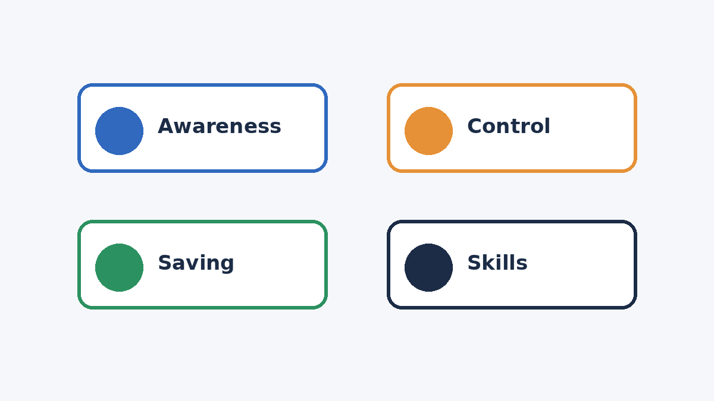
8. Benefits & Key Findings
Better awareness of spending habits
Reduced unnecessary expenses
Improved budgeting and saving discipline
Clearer financial goals
Encourages skill development and responsible earning
Supports more organized personal financial decisions
9

Slide 10
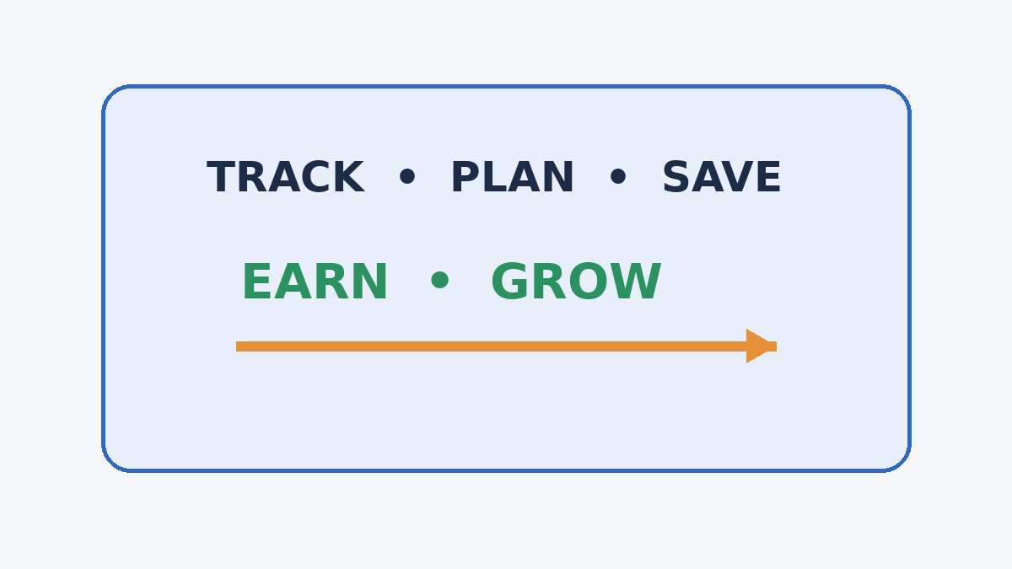
9. Conclusion
Managing money is not only about earning more; it is also about using money wisely.
A simple tracking system can make spending visible and easier to control.
Budgeting and saving can support short-term and long-term financial goals.
Students can strengthen their financial position by combining responsible spending with skill-based earning.
Key cycle: Track → Plan → Save → Earn → Grow
10

