Slide 1

EV Sales Analytics Platform
Transforming electric vehicle sales data into strategic intelligence through advanced machine learning and interactive visualization, empowering stakeholders to navigate the rapidly evolving EV marketplace with confidence.

Slide 2
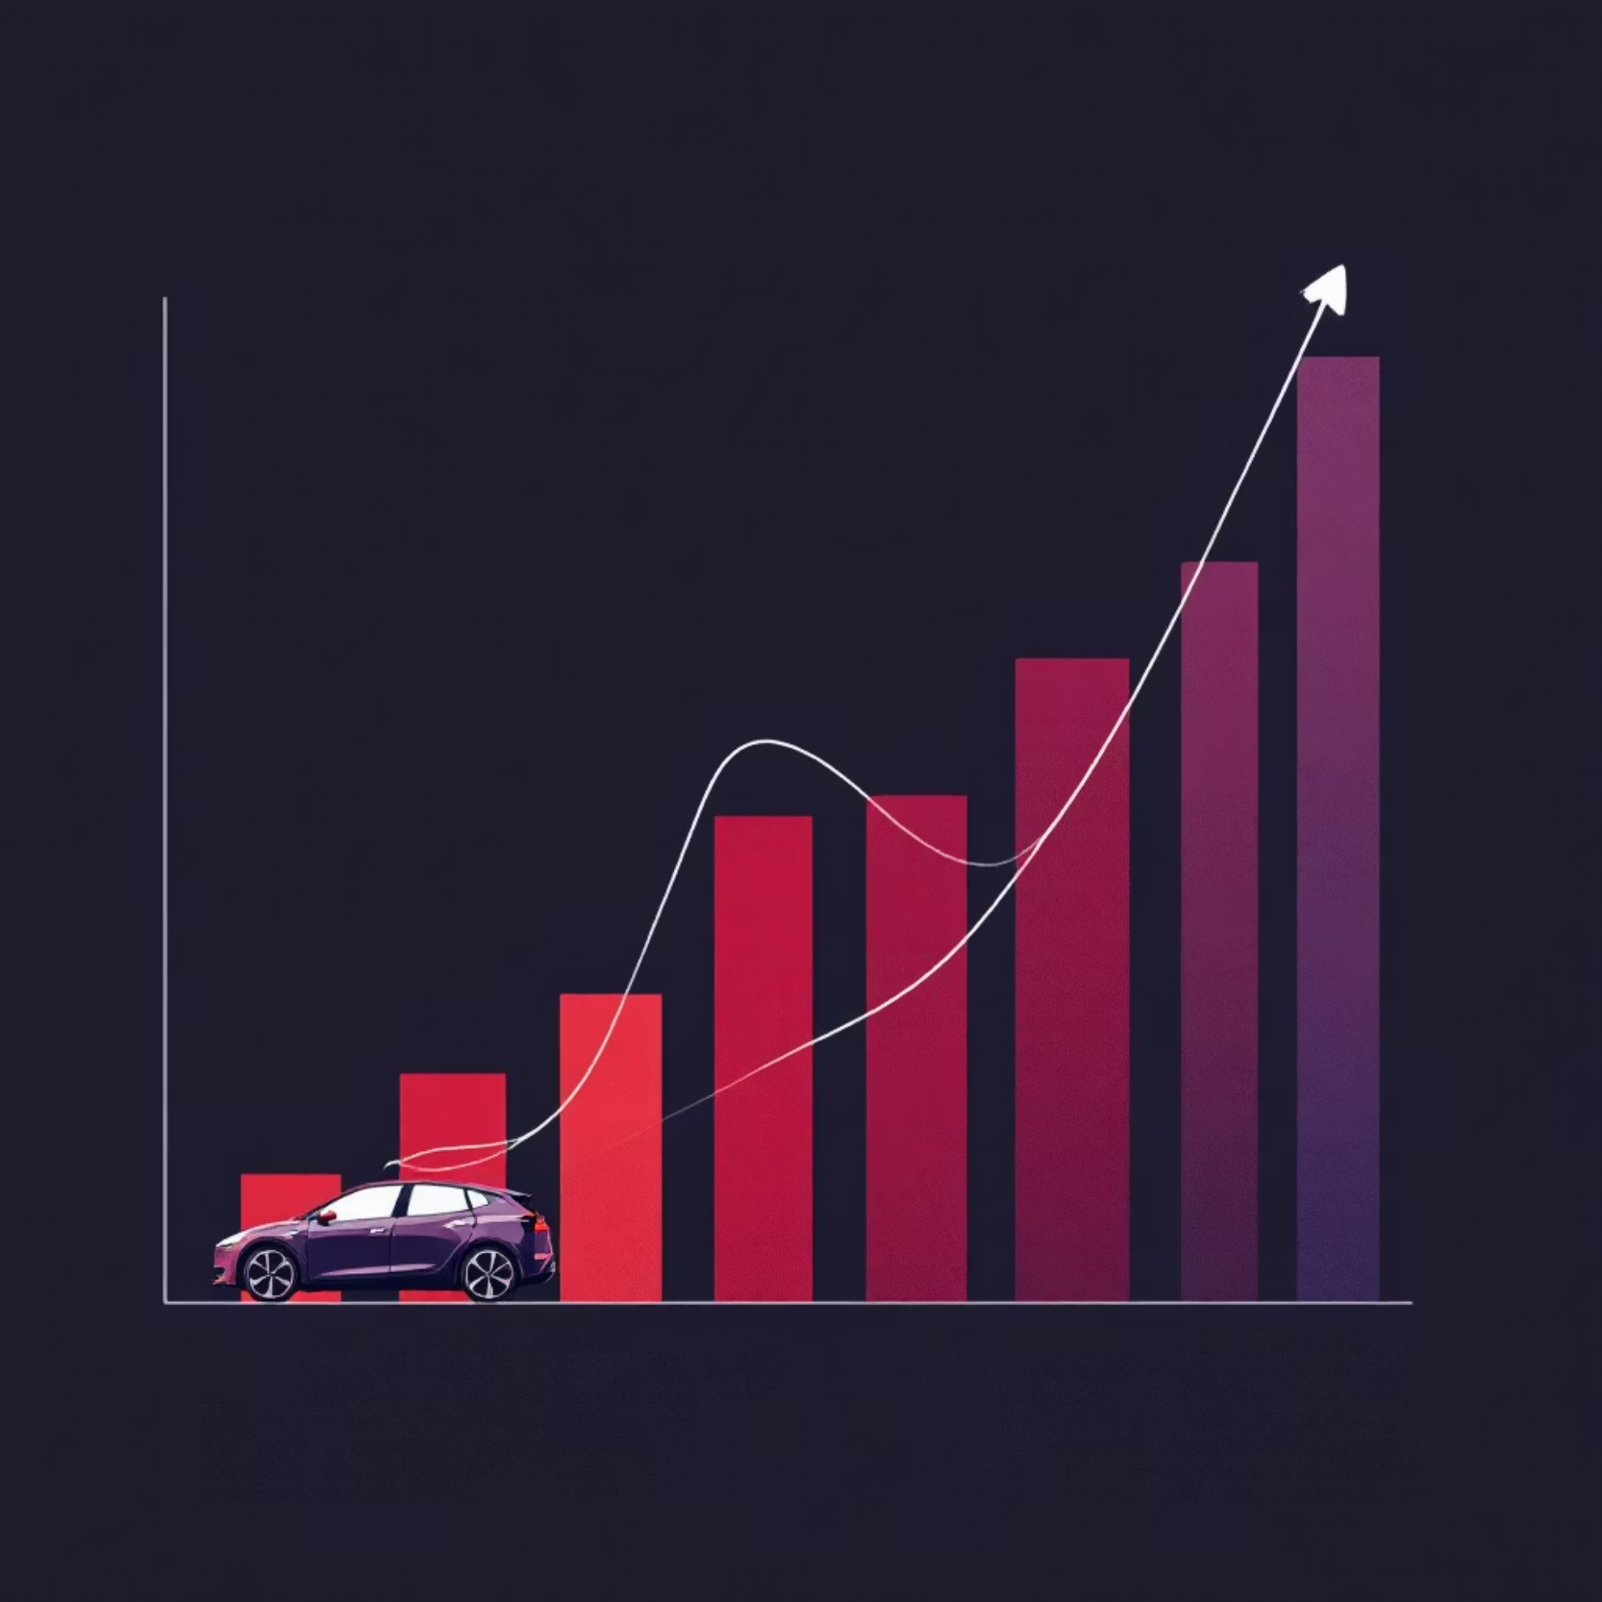

The Challenge
Market Intelligence Gap
The global EV market is experiencing unprecedented growth, but businesses and policymakers struggle with fragmented data sources and lack actionable insights.
Raw sales data exists, but converting it into strategic intelligence remains a significant challenge for industry decision-makers.

Slide 3
Project Objectives
Predictive Analytics
Data Visualization
Interactive Platform
Build ML-powered forecasting tools to predict EV sales trends and market performance across different segments and regions.
Create intuitive dashboards that transform complex datasets into clear, actionable visual insights for stakeholders.
Develop a user-friendly web application enabling real-time exploration of EV market dynamics and performance metrics.

Slide 4
Dataset Foundation
50K+
15
25
Sales Records
Key Features
EV Brands
Comprehensive transaction data spanning multiple years and markets
Vehicle type, brand, region, pricing, and performance metrics
Coverage across major manufacturers and emerging market players
Our robust dataset provides comprehensive coverage of the EV landscape, enabling deep analysis of market trends, consumer preferences, and regional adoption patterns across diverse vehicle segments.

Slide 5

Key Market Insights
Tesla dominates premium segment
Leading market share in luxury EV category with consistent growth trajectory across all regions.
Asia-Pacific drives volume growth
Fastest-growing regional market with 40% year-over-year increase in EV adoption rates.
SUV segment acceleration
Electric SUVs show strongest consumer preference, outpacing sedan growth by 3:1 ratio.

Slide 6



Technology Stack
Python Analytics
Flask Framework
Frontend Design
Pandas, NumPy, and Scikit-learn for comprehensive data processing, statistical analysis, and machine learning model development.
Lightweight web application framework enabling seamless integration between ML models and user interface components.
Responsive HTML/CSS interface with interactive visualizations providing intuitive user experience across devices.

Slide 7




Machine Learning Pipeline
Data Preprocessing
Feature engineering, normalization, and handling missing values to optimize model performance and accuracy.
Model Training
Advanced algorithms including Random Forest and Gradient Boosting for sales prediction and market segmentation.
Model Deployment
Serialized model.pkl file integrated with Flask backend for real-time predictions and analysis delivery.
Model achieves 87% accuracy in sales forecasting with robust cross-validation performance across multiple market conditions.

Slide 8

Application Features
01
02
Interactive Dashboard
Predictive Analytics
Real-time visualization of sales metrics and market trends
ML-powered forecasting with customizable parameters
03
Export Capabilities
Generate detailed reports and analysis summaries

Slide 9



Business Impact
Automakers
Investors
Policymakers
Optimize production planning and inventory management based on predictive demand forecasting and regional market analysis.
Make informed investment decisions using comprehensive market intelligence and growth trajectory predictions.
Design effective EV adoption incentives and infrastructure planning based on regional adoption patterns and consumer behavior.

Slide 10

Future Roadmap
Project Achievements
Successfully delivered a comprehensive EV analytics platform combining machine learning insights with interactive visualization, providing stakeholders with powerful tools for market analysis and strategic planning.
Next Steps
1
Q2 2024
Integrate real-time data feeds and expand dataset coverage
2
Q3 2024
Enhance ML models with deep learning algorithms
3
Q4 2024
Scale platform for enterprise deployment

