Slide 1
Pizza Sales Dashboard

Slide 2
Contents
Key KPIs
Sales Trend Analysis
Sales by Category & Size
Sales Performance Insights
Dashboard design Evaluation
Dashboard View: Best/Worst Sellers Overview
Dashboard View: Sales Trends & Performance

Slide 3
Key KPIs
Total Revenue: 817.86K
Average Order Value: 38.31
Total Orders: 21,350
Total Pizza Sold: 49,574
Average Pizzas per Order: 2.32

Slide 4
Sales Trend Analysis
Strong performance in July and August.
January also shows high order volume.
Time-series charts show consistent sales with periodic peaks.

Slide 5
Sales by Category & Size
Classic category contributes most to sales (26.91%).
Large size pizzas dominate sales (45.89%).
Chicken and Veggie are tied (~23.6%).

Slide 6
Sales Performance Insights
Busiest Days: Friday and Saturday.
Top Months: July and January.
Classic pizzas and large sizes are top performers.

Slide 7
Dashboard Design Evaluation
✅ Interactive filters available.
✅ Consistent warm color theme.
✅ Navigation with Home/Best Sellers tabs.
✅ KPI cards summarize key metrics.
✅ Time-series trends for performance analysis.

Slide 8
Conclusion
Dashboard effectively visualizes key sales data.
Identifies top-selling pizza types and sizes.
Helps optimize marketing and inventory strategies.
A complete and well-structured sales overview.

Slide 9
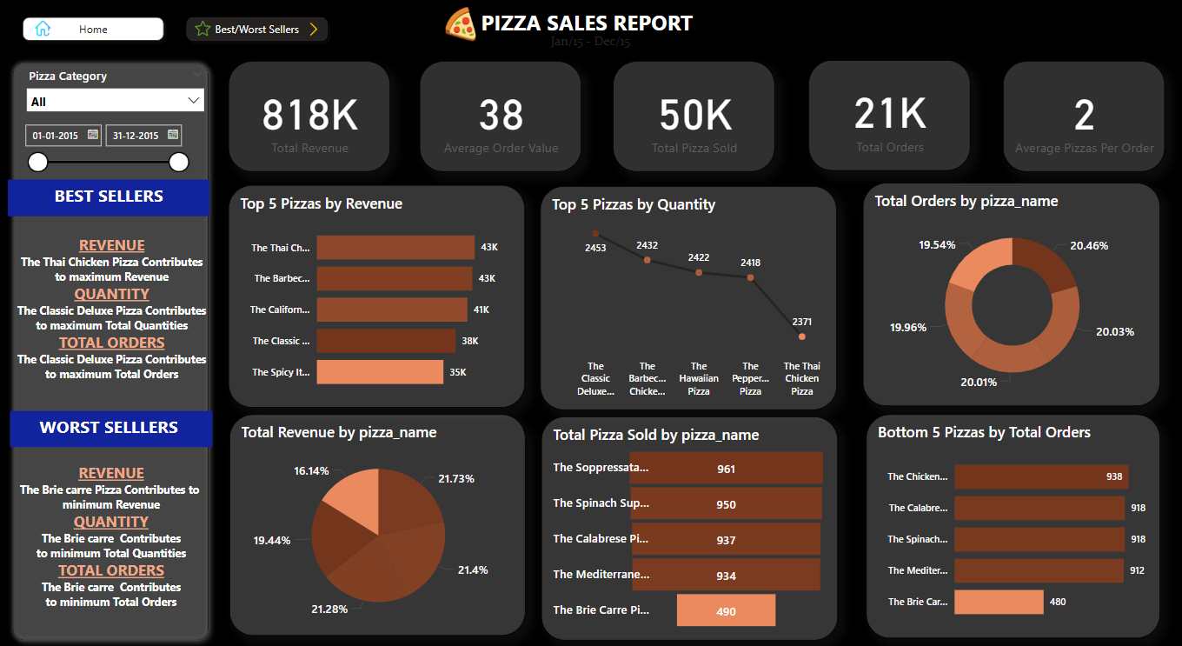
Dashboard View: Best/Worst Sellers Overview

Slide 10
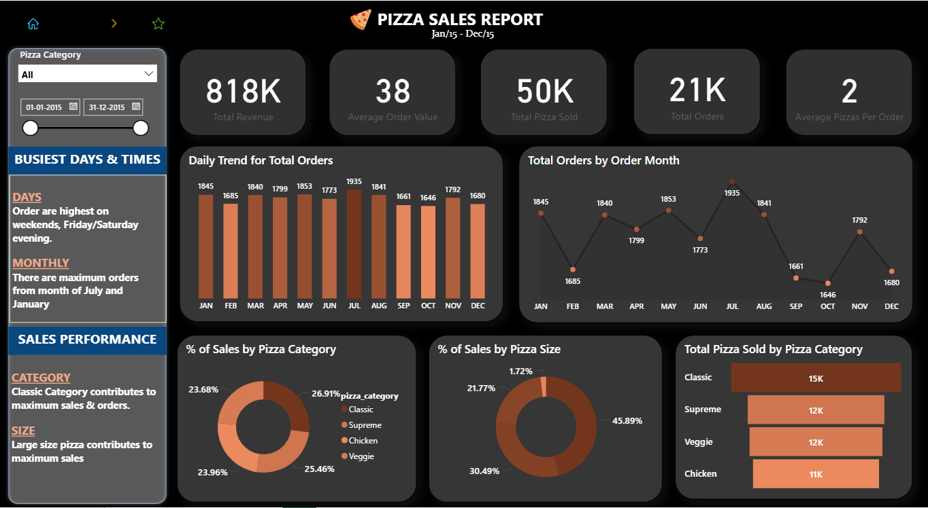
Dashboard View: Sales Trends & Performance

Slide 11
Thank You

