Slide 1



CITY ENGINEERING COLLEGE
Department of Computer Science and Engineering
TECHNICAL SEMINAR
ON
STAR-LINK
AFRID PASHA HP
1CE19CS003
UNDER THE GUIDANCE OF
MRS. SANGEETHA RAO S

Slide 2
PROBLEM STATEMENT
Despite advances in communication technology, there are still many areas around the world that lack reliable, high-speed internet connectivity.
Traditional communication infrastructure, such as wired and cellular networks, are often costly and difficult to deploy in remote or underserved areas.

Slide 3
TABLE OF CONTENTS
01
02
03
04
INTRODUCTION
HISTORY
SYSTEM DESIGN
HOW STARLINK WORKS?

Slide 4
01
INTRODUCTION

Slide 5
INTRODUCTION
Starlink is a satellite constellation launched by SpaceX with the goal of providing high-speed, low-latency internet access to users around the world.
Designed to overcome the challenges of traditional internet service providers, such as limited coverage in remote or rural areas, slow internet speeds, and high latency.

Slide 6
INTRODUCTION
Starlink's satellite network consists of thousands of small, low-orbiting satellites that communicate with ground stations and user terminals to provide high-speed internet access. With this global network, Starlink aims to provide internet connectivity to users in any location, from rural and underserved areas to maritime vessels, aircraft, and even in space.

Slide 7
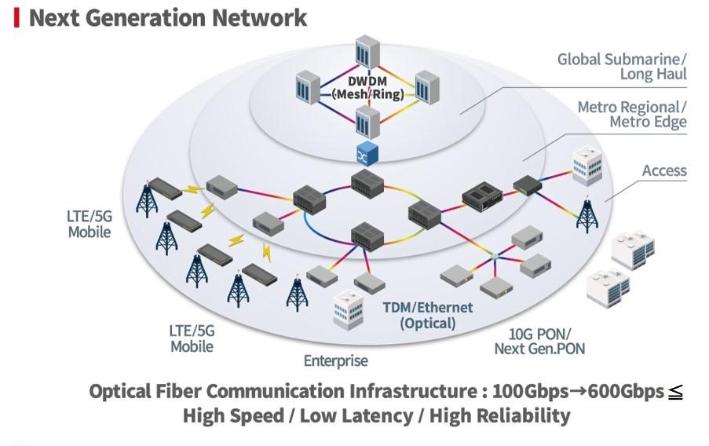
EXISTING SYSTEM

Slide 8
LITERATURE WORK
Sl.NO. | AUTHORS | YEAR | TITLE | REMARKS
1. | Pawan Kalyani | 2019 | Internet From Sky: Starlink”, An Empirical Study on The Introductory Offer from Starlink In Pandemic Situation - Its Competition, Opportunity and Future in one of the world’s biggest consumer Market - India | India is one of the world’s biggest market and there are ample opportunity of growth and development but with carefully devised strategically marketing can give the desired result.
2. | Tong Duan, Venkata Dinavahi | 2020 | Starlink Space Network-Enhanced Cyber–Physical Power System | The possibility of integrating the Starlink space network into the existing CPPS is explored. The three-layer CPPS architecture is first proposed and then implementation issues are discussed.

Slide 9
LITERATURE WORK
Sl.NO. | AUTHORS | YEAR | TITLE | REMARKS
3. | OGUTU B. OSORO , EDWARD J. OUGHTON | 2021 | A Techno-Economic Framework for Satellite Networks Applied to Low Earth Orbit Constellations: Assessing Starlink, OneWeb and Kuiper | a techno-economic modeling approach for the integrated assessment of data capacity and investment cost per user by constellation. The model presents the engineering and economic simulation results using a single framework
4. | AIZAZ U. CHAUDHRY, HALIM YANIKOMEROGLU | 2022 | Temporary Laser Inter-Satellite Links in Free-Space Optical Satellite Networks | The delay incurred in establishing an LISL between a pair of satellites can be referred to as LISL setup delay

Slide 10
02
HISTORY

Slide 11
HISTORY
SPACEX BEGINS
PRODUCT DEVELOPMENT
FIRST TWO PROTOTYPES LAUCHED
FCC AUTHORIZES STARLINK SYSTEM FOR 4425 SATELLITES
FIRST LARGE OPERATIONAL DEPLOYMENT ON FALCON 9
FCC AUTHORIZES AN ADDITIONAL 30K SATELLITES
LAUCHING 60 SATELLITES ON EVERY FALCON 9 LAUCH
FEB 2018
MAR
2018
MAY
2019
OCT
2019
2015
NOW

Slide 12
03
SYSTEM DESIGN

Slide 13
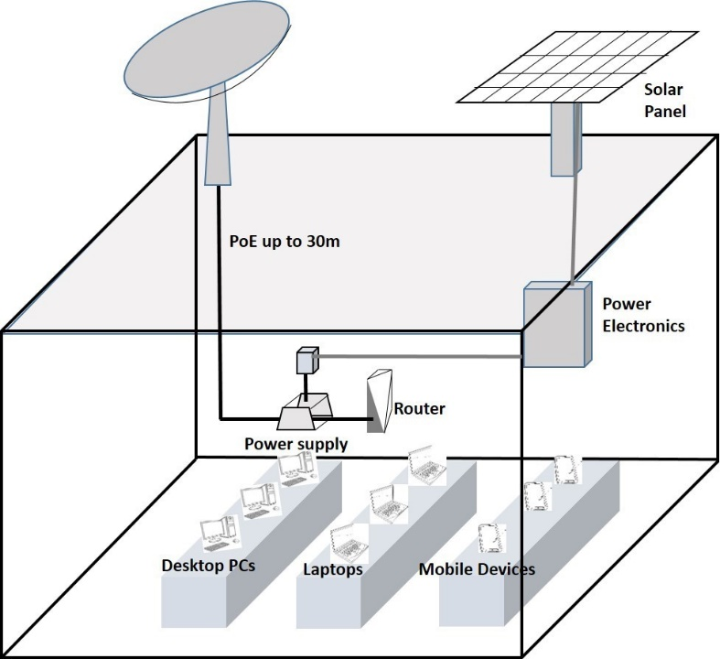
SYSTEM DESIGN

Slide 14
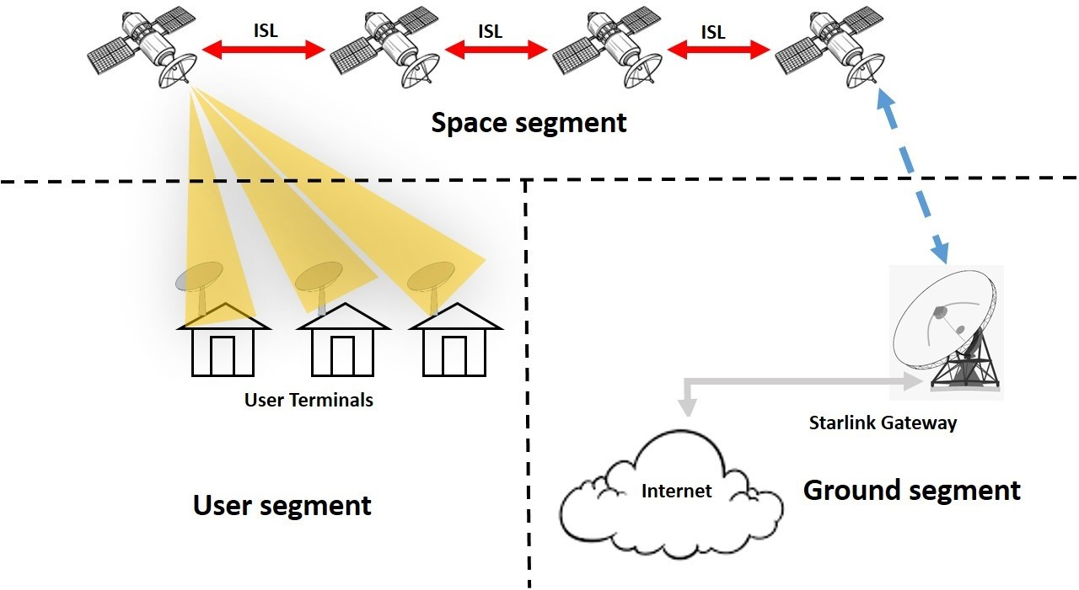
SYSTEM ARCHITECTURE

Slide 15
04
HOW STARLINK WORKS?

Slide 16
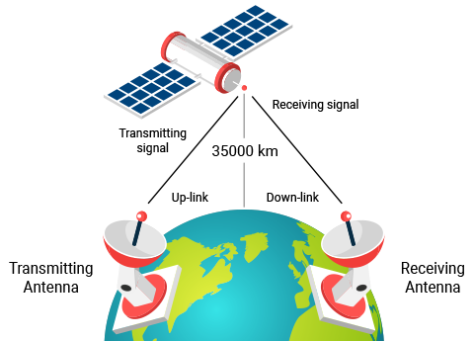
TV BROADCAST SATELLITE

Slide 17
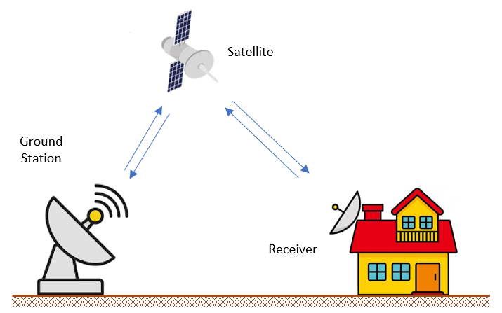
STARLINK SATELLITE

Slide 18
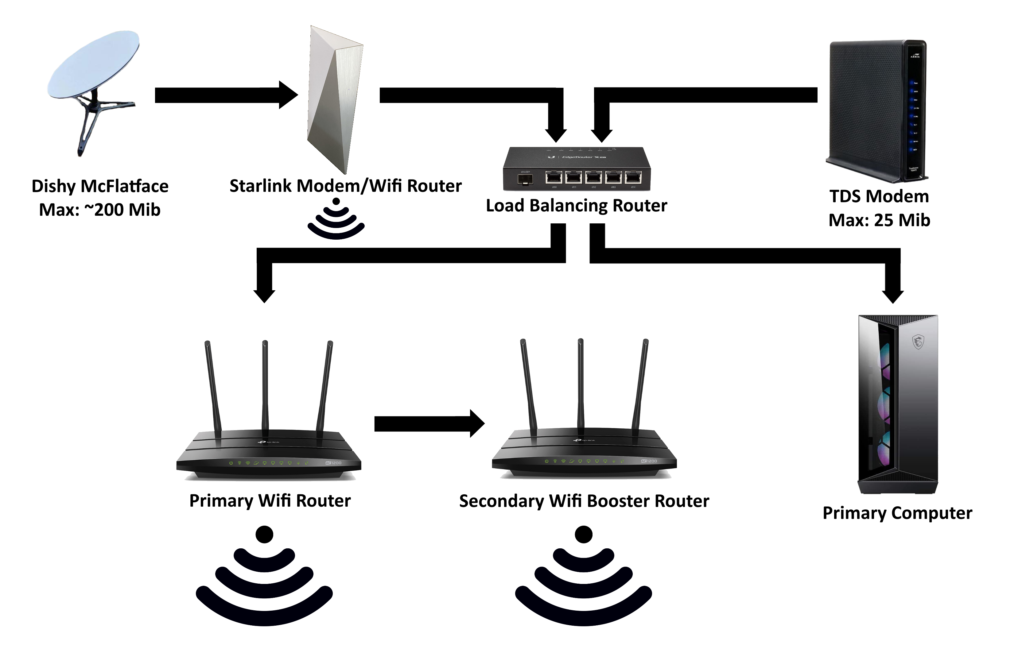
RECEIVER SIDE SCENARIO

Slide 19
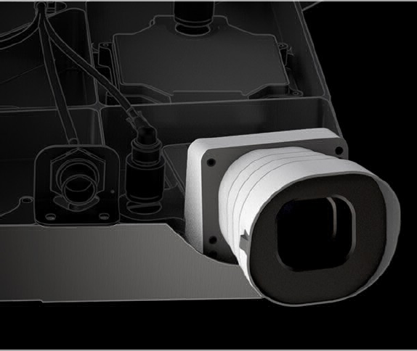
FEATURES
STAR TRACKER
It is an optical device that measures the positions of stars using a camera.

Slide 20
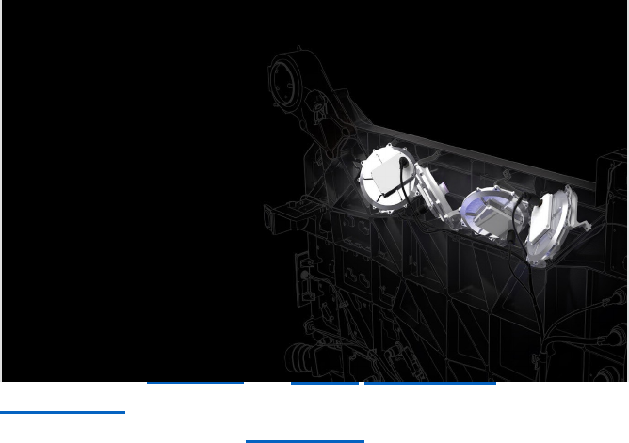
FEATURES
COLLISION DETECTION
It is the implementation and study of processes minimizing the chance of orbiting spacecraft inadvertently colliding with other orbiting objects.

Slide 21
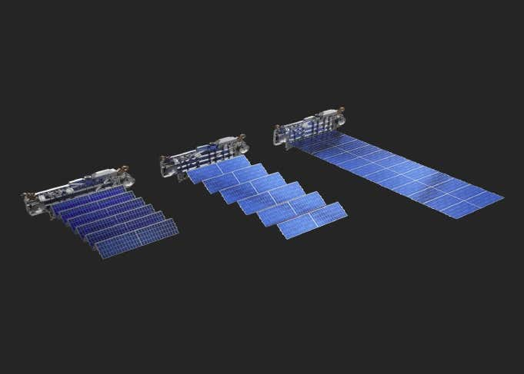
FEATURES
SOLAR ARRAY
Solar array environmental interaction is spacecraft charging.

Slide 22
MAJOR CRITICISM
LIGHT POLLUTION.
SPACE DEBRIS.
REQUIRES MORE NUMBER OF SATELLITES TO COVER MORE AREA.

Slide 23
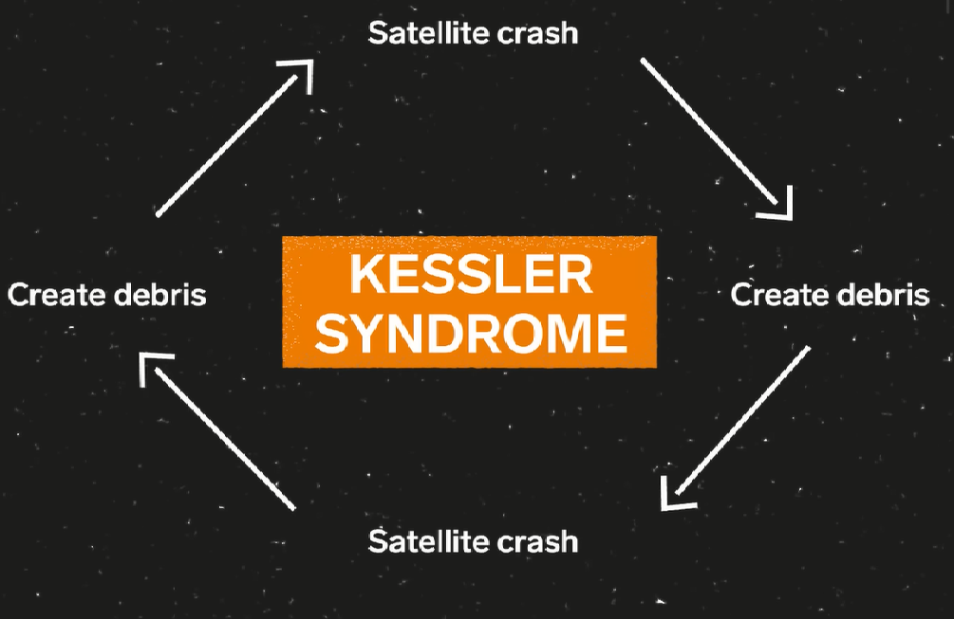
SPACE DEBRIS

Slide 24
FUTURE ENHANCEMENTS
Expansion of the Satellite Constellation
Higher Speeds
Lower Costs
Mobile Connectivity
Space-Based Internet
Improved Reliability

Slide 25
CONCLUSION
Starlink is a revolutionary satellite internet system that has the potential to bring high-speed internet access to users around the world, particularly in underserved and rural areas. By leveraging advanced satellite technology and innovative engineering, Starlink offers a fast, reliable, and affordable alternative to traditional internet service providers.

Slide 26
THANK YOU

