Slide 1

Adversarial Robustness of Contemporary Machine Learning Models
Presenter:
Afia Afrin

Slide 2
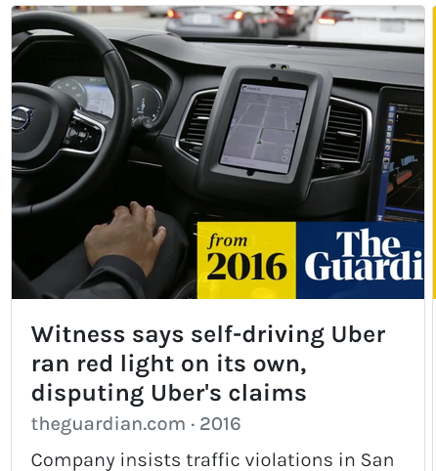
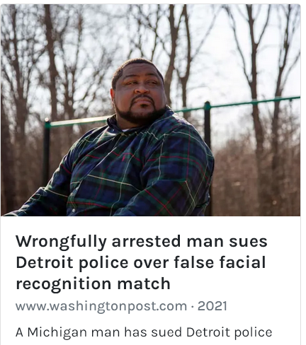

Adversarial Attacks
Trick the ML models by
Poisoning the dataset
Manipulating the training method
Image Source: https://incidentdatabase.ai/

Slide 3
Project Summary
Transferability of adversarial attacks
Text data,
Image data, and
Audio data

Slide 4
Project Summary
Transferability of adversarial attacks
Text data,
Image data, and
Audio data
Robustness of widely used ML libraries
Tensorflow. keras
Pytorch

Slide 5
Project Summary
Transferability of adversarial attacks
Text data,
Image data, and
Audio data
Robustness of widely used ML libraries
Tensorflow.keras
Pytorch
Analyze the effectiveness of the countermeasure: model hardening with adversarial training

Slide 6
Project Description: Dataset

Slide 7
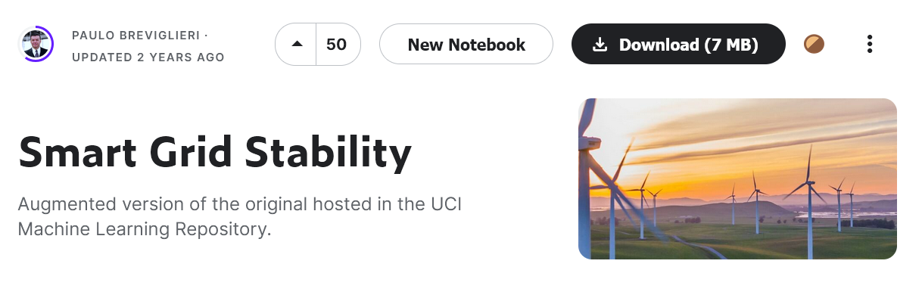
Project Description: Dataset
Voltage Stability
13 features
2 classes
Text dataset

Slide 8
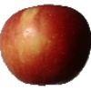
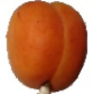
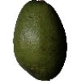
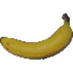
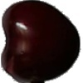
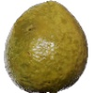
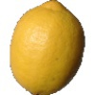
Project Description: Dataset
Text dataset
Fruits-360*
3,444 training images
7 classes
Image dataset

Slide 9
Project Description: Dataset
Text dataset
Fruits-360*
3,444 training images
7 classes
Image dataset
MNIST
60,000 training images
10 classes

Slide 10
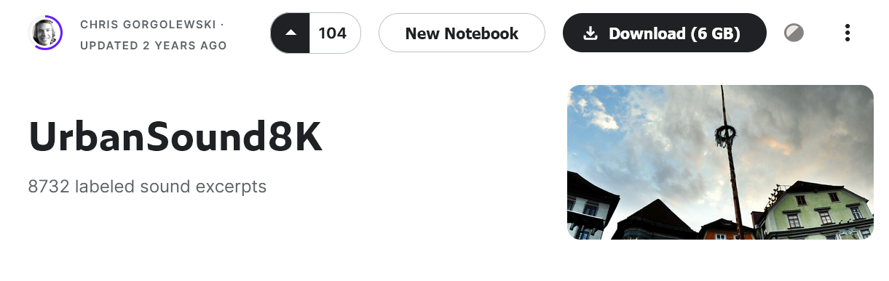
Project Description: Dataset
Text dataset
Image dataset
Audio dataset
Notes:
We chose the urbanSound dataset from Kaggle, which has 7 classes. We chose a minimal version of this dataset with 3 classes– dog barks, …

Slide 11
Project Description: Dataset
Text dataset
Image dataset
Dog bark
UrbanSound8K*
1,803 labeled data
3 classes
Audio dataset
Car horn
Gunshot

Slide 12
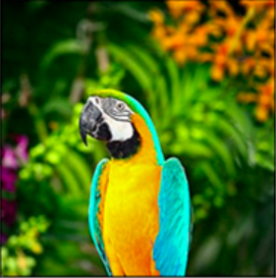
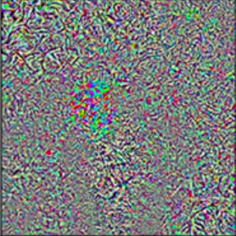
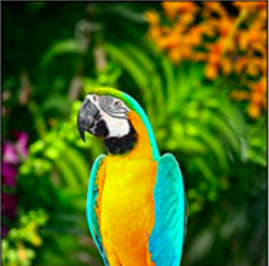



Project Description: Attacks Implemented
Fast Gradient Sign Method (FGSM)
+
=
Original image
Noise
Adversarial image
Projected Gradient Descent (PGD)
DeepFool
Notes:
Fgsm- single step approach which adds some noise whose direction is same as the gradient of cost function w.r.to the data and thus create the adv image
Pgd- updated version of fgsm, iterative
Deepfool – a popular attack algorithm which is capable of producing strong attacks with minimal perturbation

Slide 13
Project Description: Attacks Implemented
Fast Gradient Sign Method (FGSM)
+
=
Projected Gradient Descent (PGD)
Modified FGSM
Iterative approach
DeepFool
Notes:
Fgsm- single step approach which adds some noise whose direction is same as the gradient of cost function w.r.to the data and thus create the adv image
Pgd- updated version of fgsm, iterative
Deepfool – a popular attack algorithm which is capable of producing strong attacks with minimal perturbation

Slide 14
Project Description: Attacks Implemented
Fast Gradient Sign Method (FGSM)
+
=
Projected Gradient Descent (PGD)
Modified FGSM
Iterative approach
DeepFool
Iterative approach
Minimal perturbation
Notes:
Fgsm- single step approach which adds some noise whose direction is same as the gradient of cost function w.r.to the data and thus create the adv image
Pgd- updated version of fgsm, iterative
Deepfool – a popular attack algorithm which is capable of producing strong attacks with minimal perturbation

Slide 15
Project Description: Attacks Implemented
Fast Gradient Sign Method (FGSM)
+
=
Projected Gradient Descent (PGD)
Modified FGSM
Iterative approach
DeepFool
Iterative approach
Minimal perturbation
Notes:
Fgsm- single step approach which adds some noise whose direction is same as the gradient of cost function w.r.to the data and thus create the adv image
Pgd- updated version of fgsm, iterative
Deepfool – a popular attack algorithm which is capable of producing strong attacks with minimal perturbation

Slide 16
Project Description: Attacks Implemented
Fast Gradient Sign Method (FGSM)
ɛ
Noise added
Projected Gradient Descent (PGD)
DeepFool
Iterative approach
Minimal perturbation
Notes:
Fgsm- single step approach which adds some noise whose direction is same as the gradient of cost function w.r.to the data and thus create the adv image
Pgd- updated version of fgsm, iterative
Deepfool – a popular attack algorithm which is capable of producing strong attacks with minimal perturbation

Slide 17
Project Description: Attacks Implemented
DeepFool
Iterative approach
Minimal perturbation
Notes:
Fgsm- single step approach which adds some noise whose direction is same as the gradient of cost function w.r.to the data and thus create the adv image
Pgd- updated version of fgsm, iterative
Deepfool – a popular attack algorithm which is capable of producing strong attacks with minimal perturbation

Slide 18
Results
Dataset (image) | ML Model | Attack | Model Accuracy (%) | Model Accuracy
 |  |  | on benign data | on adversarial data
Fruits-360 | CNN |  | 91
 | Sequential NN |  | 89.74

Slide 19
Results
Dataset (image) | ML Model | Attack | Model Accuracy (%) | Model Accuracy
 |  |  | on benign data | on adversarial data
Fruits-360 | CNN | FGSM (ɛ= 0.2) | 91 | 26.87
 | Sequential NN | DeepFool | 89.74 | 20.55

Slide 20
Results
Dataset (image) | ML Model | Attack | Model Accuracy (%) | Model Accuracy
 |  |  | on benign data | on adversarial data
Fruits-360 | CNN | FGSM (ɛ= 0.2) | 91 | 26.87
 | Sequential NN | DeepFool | 89.74 | 20.55
 | Sequential NN | FGSM (ɛ= 0.2) | 97.17 | 28.82
 |  | PGD (ɛ= 5) | 97.17 | 16.00

Slide 21
Results
Dataset (image) | ML Model | Attack | Model Accuracy (%) | Model Accuracy
 |  |  | on benign data | on adversarial data
Fruits-360 | CNN | FGSM (ɛ= 0.2) | 91 | 26.87
 | Sequential NN | DeepFool | 89.74 | 20.55
 | Sequential NN | FGSM (ɛ= 0.2) | 97.17 | 28.82
 |  | PGD (ɛ= 5) | 97.17 | 16.00
MNIST | Sequential NN | FGSM (ɛ= 0.2) | 94.75 | 2.19
 | Sequential NN | DeepFool | 94.75 | 1.95

Slide 22
Results
Dataset (text & audio) | ML Model | Attack | Model Accuracy (%) | Model Accuracy
 |  |  | on benign data | on adversarial data
Smart Grid Stability | Sequential NN |  | 99.20
 | Sequential NN |  | 99.20
Notes:
Text data- 35% accu drop
audio- 78%

Slide 23
Results
Dataset (text & audio) | ML Model | Attack | Model Accuracy (%) | Model Accuracy
 |  |  | on benign data | on adversarial data
Smart Grid Stability | Sequential NN | FGSM (ɛ= 0.2) | 99.20 | 64.37
 | Sequential NN | PGD (ɛ= 0.2) | 99.20 | 64.37
Notes:
Text data- 35% accu drop
audio- 78%

Slide 24
Results
Dataset (text & audio) | ML Model | Attack | Model Accuracy (%) | Model Accuracy
 |  |  | on benign data | on adversarial data
Smart Grid Stability | Sequential NN | FGSM (ɛ= 0.2) | 99.20 | 64.37
 | Sequential NN | PGD (ɛ= 0.2) | 99.20 | 64.37
UrbanSound8K | Sequential NN | DeepFool | 82.62 | 17.93
Notes:
Text data- 35% accu drop
audio- 78%

Slide 25
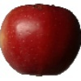
Results: amount of perturbation
Original Image
Label: apple, CNN accuracy: 91.33%
Notes:
Text data- 35% accu drop
audio- 78%

Slide 26

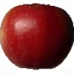
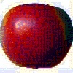
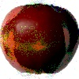
Results: amount of perturbation
Original Image
Label: apple, accuracy: 91.33%
FGSM
Notes:
Text data- 35% accu drop
audio- 78%

Slide 27
Results: amount of perturbation
Original Image
Label: apple, accuracy: 91.33%
ɛ= 0.005
ɛ= 0.01
ɛ= 0.1
ɛ= 0.2
FGSM
Notes:
Text data- 35% accu drop
audio- 78%

Slide 28
Results: amount of perturbation
Original Image
Label: apple, accuracy: 91.33%
ɛ= 0.005
apple, 88%
ɛ= 0.01
apple, 86%
ɛ= 0.1
cherry, 27%
ɛ= 0.2
avocado, 23%
FGSM
Notes:
Text data- 35% accu drop
audio- 78%

Slide 29
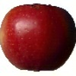
Results: amount of perturbation
Original Image
Label: apple, accuracy: 91.33%
ɛ= 0.005
apple, 88%
ɛ= 0.01
apple, 86%
ɛ= 0.1
cherry, 27%
ɛ= 0.2
avocado, 23%
avocado, 20%
FGSM
DeepFool
Notes:
Text data- 35% accu drop
audio- 78%

Slide 30
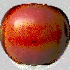
Results: amount of perturbation
Original Image
Label: apple, accuracy: 91.33%
ɛ= 0.005
apple, 88%
ɛ= 0.01
apple, 86%
ɛ= 0.1
cherry, 27%
ɛ= 0.2
avocado, 23%
avocado, 20%
banana, 16%
FGSM
DeepFool
PGD, ɛ= 5
Notes:
Text data- 35% accu drop
audio- 78%

Slide 31

Results: amount of perturbation
Original Audio
Model accuracy on test data: 82%
Notes:
Text data- 35% accu drop
audio- 78%

Slide 32

Results: amount of perturbation
Original Audio
Model accuracy on test data: 82%
Adversarial Audio (DeepFool)
Model accuracy on adversarial test data : 18%
Notes:
Text data- 35% accu drop
audio- 78%

Slide 33
Defense: model hardening with adversarial samples

Slide 34
Defense: model hardening with adversarial samples

Slide 35
Defense: model hardening with adversarial samples
Original training data

Slide 36
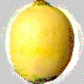
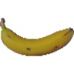
Defense: model hardening with adversarial samples
Original training data
Adversarial data
+

Slide 37
Defense: model hardening with adversarial samples
Original training data
Adversarial data
+
Training dataset

Slide 38
Defense: model hardening with adversarial samples
Dataset (text & audio) | Defense | Attack | Robust Model Accuracy (%) | Model Accuracy
 |  |  | on benign data | on adversarial data
Smart Grid Stability
UrbanSound8K | PGD hardened model

Slide 39
Defense: model hardening with adversarial samples
Dataset (text & audio) | Defense | Attack | Robust Model Accuracy (%) | Model Accuracy
 |  |  | on benign data | on adversarial data
Smart Grid Stability | PGD hardened model |  | 95.62
UrbanSound8K | PGD hardened model |  | 92.98

Slide 40
Defense: model hardening with adversarial samples
Dataset (text & audio) | Defense | Attack | Robust Model Accuracy (%) | Model Accuracy
 |  |  | on benign data | on adversarial data
Smart Grid Stability | PGD hardened model | FGSM (ɛ= 0.2) | 95.62
 |  | PGD (ɛ= 0.2)
UrbanSound8K | PGD hardened model | FGSM (ɛ= 0.2) | 92.98
 |  | PGD (ɛ= 0.2)

Slide 41
Defense: model hardening with adversarial samples
Dataset (text & audio) | Defense | Attack | Robust Model Accuracy (%) | Model Accuracy
 |  |  | on benign data | on adversarial data
Smart Grid Stability | PGD hardened model | FGSM (ɛ= 0.2) | 95.62 | 74.70
 |  | PGD (ɛ= 0.2) |  | 89.88
UrbanSound8K | PGD hardened model | FGSM (ɛ= 0.2) | 92.98 | 81.88
 |  | PGD (ɛ= 0.2) |  | 92.60

Slide 42
Reproducibility
git pull
docker build <image>
docker run <image>

Slide 43


