Slide 1

P R E S E N T A T I O N
Doctor’s
Consultation Fee
Analysis
Data-Driven Insights into
Doctor Consultation Fees Across Cities, Specializations and many more.

Slide 2


ABOUT US
Member - 01
Member - 02
Member - 03
AFROZ SHAMS
AFRIN
ABDALLAH
BSc. Biochemistry
B. Tech (CS)
MSc. Physics
We are a team of three members from diverse academic backgrounds who collaborated to complete this data analytics project. Each member contributed their skills in research, data processing, and visualization. Through effective coordination and clear task distribution, we successfully developed meaningful insights without overlapping work.

Slide 3
ABOUT US
Member - 01
Member - 02
Member - 03
AFROZ SHAMS
AFRIN
ABDALLAH
BSc. Biochemistry
B. Tech (CS)
MSc. Physics
We are a team of three members from diverse academic backgrounds who collaborated to complete this data analytics project. Each member contributed their skills in research, data processing, and visualization. Through effective coordination and clear task distribution, we successfully developed meaningful insights without overlapping work.

Slide 4
TABLE
OF CONTENT
4
TOOLS & LIBRARIES
Technologies and Python libraries used for data extraction and analysis.
3
5
OBJECTIVES
WEB SCRAPPING
Key goals defined to guide the analysis and insights.
Collecting doctor-level consultation fee, specialization, experience, and patient-rating data from an online healthcare platform.
2
6
BUSINESS PROBLEM
EXPL. DATA ANALYSIS
Understanding variations in doctor consultation fees across different factors.
Analyzing patterns, relationships, and pricing trends within the cleaned dataset.
1
7
INTRODUCTION
CONCLUSION
Brief overview of the healthcare consultation market and project context.
Final insights and key takeaways derived from the analysis

Slide 5
INTRODUCTION
Healthcare consultation costs vary widely across cities and medical specializations, making it difficult for patients to understand the pricing structure within urban healthcare markets.
2
Understanding these pricing variations is important for identifying market trends, affordability patterns, and premium healthcare segments.
4
Digital healthcare platforms have created large volumes of doctor-level data, enabling systematic analysis of consultation fee patterns across different regions and medical domains.
This project applies data-driven analysis to examine consultation fee patterns across multiple cities and specializations, providing insights into how urban healthcare pricing structures evolve.
1
3

Slide 6


BUSINESS PROBLEM -01
Consultation fee structures across cities and medical specializations vary considerably, making healthcare pricing difficult to compare and interpret.
BUSINESS PROBLEM -02
Patients may face uncertainty when choosing healthcare providers because consultation fees can differ significantly across doctors, cities, and specializations.
BUSINESS PROBLEM -03
The growing availability of doctor-level data on digital healthcare platforms creates an opportunity to identify meaningful patterns in consultation pricing.
BUSINESS PROBLEM -04
Without systematic analysis, it is difficult to understand regional pricing differences, specialization-wise variations, and premium consultation segments.
BUSINESS PROBLEM

Slide 7
OBJECTIVES
Examine the relationship between medical specialization, doctor experience, patient ratings, and consultation pricing.
Identify relationships between consultation fees, experience, and patient ratings.
Objective - 01
Objective - 02
Objective - 03
Objective - 04
Examine how consultation fees vary across multiple urban healthcare markets.
Identify patterns that distinguish budget, mid-range, and premium consultation segments.

Slide 8




TOOLS AND LIBRARIES

Slide 9
TOOLS AND LIBRARIES

Slide 10

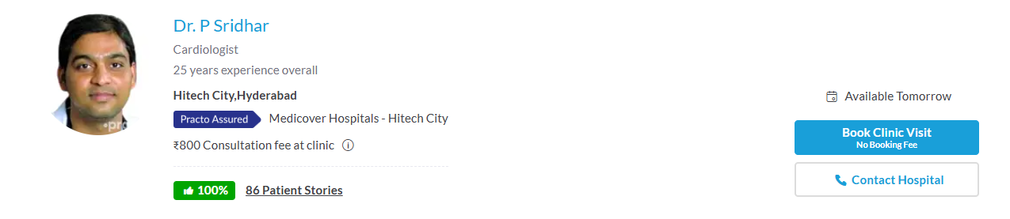
WEB SCRAPING
Source
Doctor’s Name
Specialization
Experience
City Name
Hospital Name
Consultation Fee(₹)
Patient Ratings(%)

Slide 11

STEP
STEP
3
2
STEP
STEP
4
1
DATA
VISUALIZATION
DATA
CLEANING
ANALYSIS/
INSIGHTS
DATASET
OVERVIEW
04
Data Structuring and Storage
The extracted information was organized into a structured dataset using Pandas and stored for the subsequent data cleaning and analysis stages.
03
Web Scrapping Process
Parsing and Extracting Data
The retrieved HTML content was parsed using BeautifulSoup to locate and extract relevant information such as doctor name, specialization, experience, consultation fee, and patient ratings.
02
Sending Web Requests
Python’s Requests library was used to send HTTP requests to Practo webpages and retrieve the HTML content of the doctor listings.
01
Target Website Identification
The Practo platform was selected as the data source to collect doctor-related information such as consultation fees, specialization, experience, and patient ratings across multiple cities.
EXPLORATORY DATA ANALYSIS

Slide 12
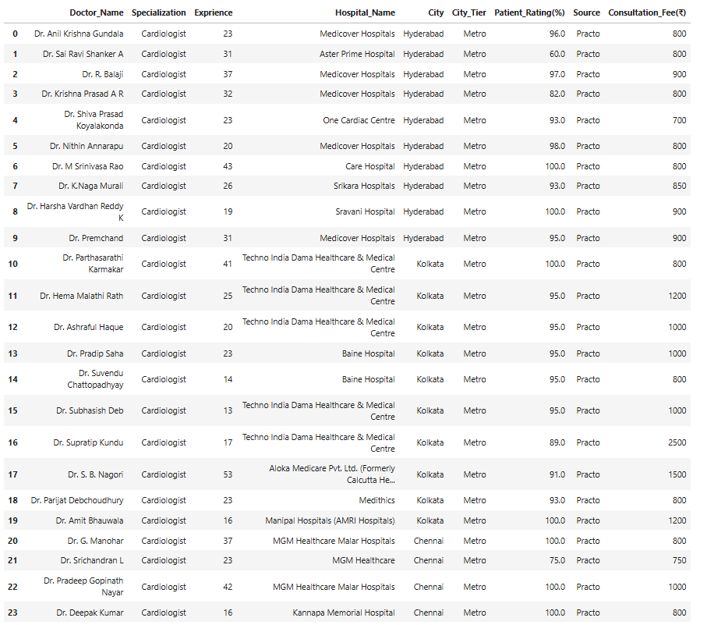
STEP
STEP
2
3
STEP
STEP
4
1
DATA
CLEANING
DATA
VISUALIZATION
ANALYSIS/
INSIGHTS
DATASET
OVERVIEW
EXPLORATORY DATA ANALYSIS

Slide 13
RAW DATASET

Slide 15

DATASET OVERVIEW
MUMBAI
CHANDIGARH
1
1
KOLKATA
2
2
PATNA
HYDERABAD
3
3
VISHAKHAPATNAM
Metro
CITIES
Non
Metro
BANGALORE
4
4
LUCKNOW
5
5
CHENNAI
6
6
AHMEDABAD
DELHI
PUNE

Slide 16
NUEROLOGIST
X 10
10 X
GENERAL SURGEON
1
9
2
CARDIOLOGIST
X 10
10 X
GENERAL PHYSICIAN
8
MUMBAI
3
DERMATOLOGIST
X 10
7
10 X
GYANECOLOGIST
4
6
ORTHOPEDICS
X 10
5
10 X
ENT
DENTIST
X 10

Slide 17
DATA STRUCTURE SUMMARY
6
Metro Cities
Total Cities Covered:
12
6
Non-Metro Cities
Specializations per City:
9
Each Carries
10
doctors
12
9
10
1080
Total Doctors/Data Entries/Rows:
x
x
=
6
Categorical Data
Total Variables (Columns):
9
3
Numerical Data
The dataset contains consultation fee information of 1080 doctors across multiple cities and specializations.

Slide 18
DATA CLEANING
05
Extremely high consultation fee values were identified using the IQR method. These outliers were retained in the dataset and reviewed through sensitivity analysis.
OUTLIER DETECTION
& REVIEW
ANALYSIS-READY
DATASET PREPARED
06
03
STANDARDIZING TEXT FIELDS
The cleaned and standardized dataset was prepared for accurate analysis and data-driven insights.
Hospital names containing inconsistent hyphen-separated text were standardized to maintain consistent naming across the dataset.
TYPE CASTING
04
Patient ratings and consultation fees were cleaned and converted into numeric formats to enable analysis and visualization.
01
DATA
UNDERSTANDING
The dataset was explored to understand its structure, key variables (doctor name, city, specialization, consultation fee), and overall data distribution.
HANDLING MISSING VALUES
02
Note:
No duplicate records were found in the dataset.
Missing patient-rating values were identified and imputed using the median to ensure a complete dataset for analysis.

Slide 19
VISUALIZATION
AND ANALYSIS
PHASE-04:
MARKET SEGMENT
1. Market Segment Pricing Analysis
PHASE-03:
MULTIFACTOR COMPARATIVE ANALYSIS
1. City & Specialization-wise Pricing Analysis
2. Premium Segment Pricing Analysis
PHASE-02:
FACTOR IMPACT ANALYSIS
PHASE-01:
DESCRIPTIVE MARKET OVERVIEW
1. Experience-wise Pricing Analysis
2. Patient rating-wise Pricing Analysis
1. Overall Fee Landscape
2. City-Wise Pricing Analysis
3. Specialization-Wise Pricing

Slide 20
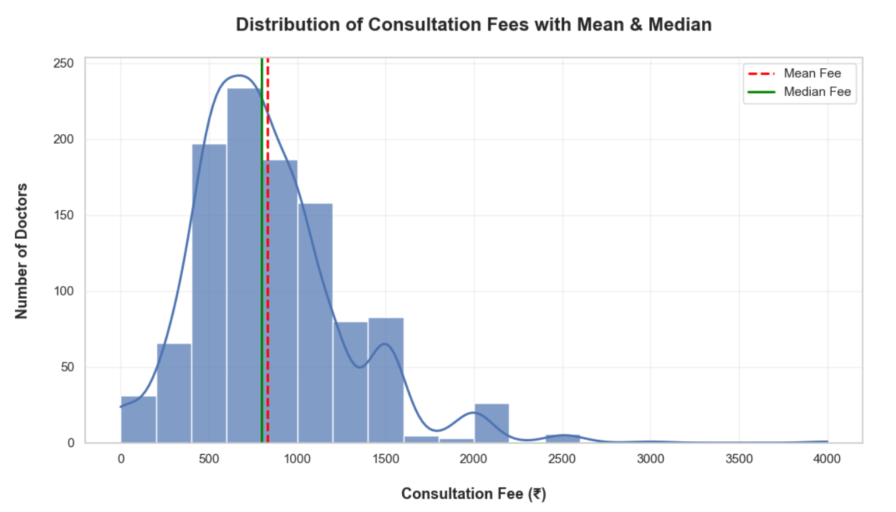

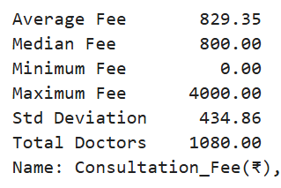
DESCRIPTIVE MARKET OVERVIEW
1
Overall Fee Landscape
1
Most doctors charge consultation fees roughly between ₹500 and ₹1000, indicating that the urban healthcare market largely operates within a mid-range pricing segment.
3
The mean fee is slightly higher than the median, suggesting that a relatively small number of high-fee doctors are pulling the overall average upward, reinforcing the existence of premium-priced providers.
2
The distribution has a long right tail, with some doctors charging ₹2000–₹4000, indicating the presence of a small premium segment that drives higher-end healthcare pricing.

Slide 21
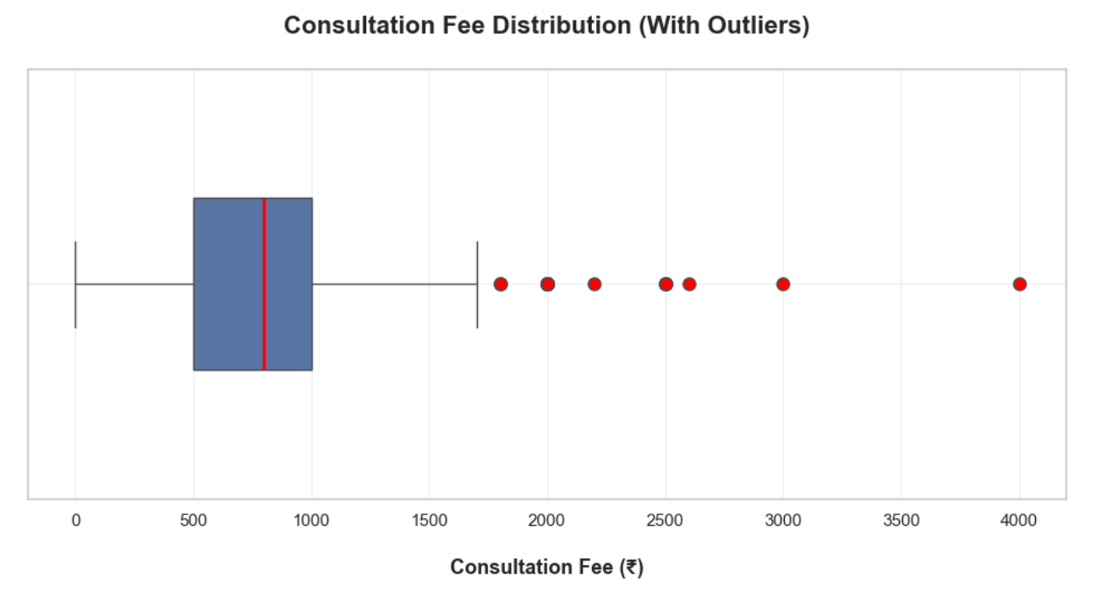
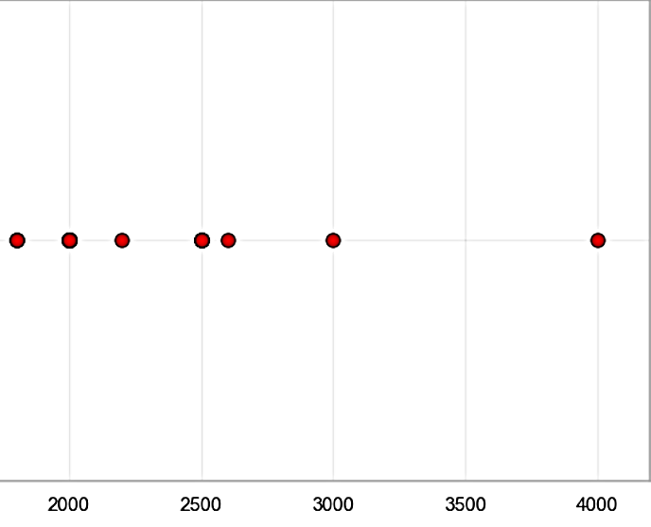
1
Overall Fee Landscape
Effects of Outliers on Consultation Fee
With Outliers
Outlier-Excluded Sensitivity View
Average/Mean Value = ₹829.35
Median Value =
₹800.00
Average/Mean Value = ₹779.54
Median Value =
₹750.00
2
1
Average consultation fee decreases to ₹779.54, suggesting that a small number of high-priced doctors significantly affect the overall market average.
The dataset contains extreme consultation fees reaching up to ₹4000, indicating the presence of premium healthcare providers.
Outlier Analysis through IQR Method:
Lower Bound = -250
Upper Bound = 1750
So, Doctors charging above ₹1750 are outliers.
Total Number of Outliers found = 39
3
The outlier-excluded view is used only as a sensitivity analysis to understand how extreme consultation fees affect the overall pricing distribution.

Slide 22
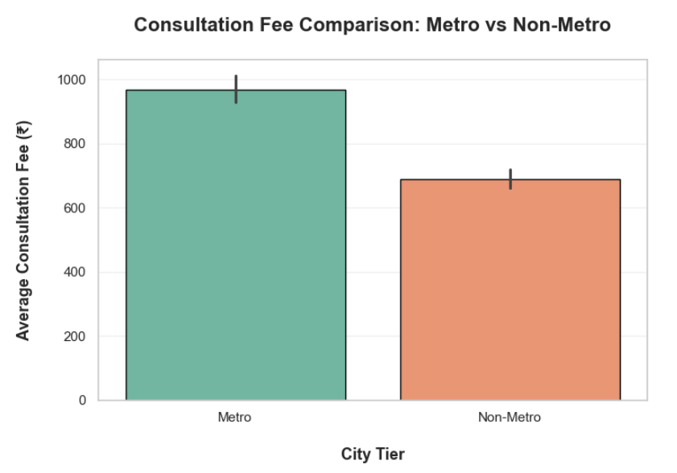
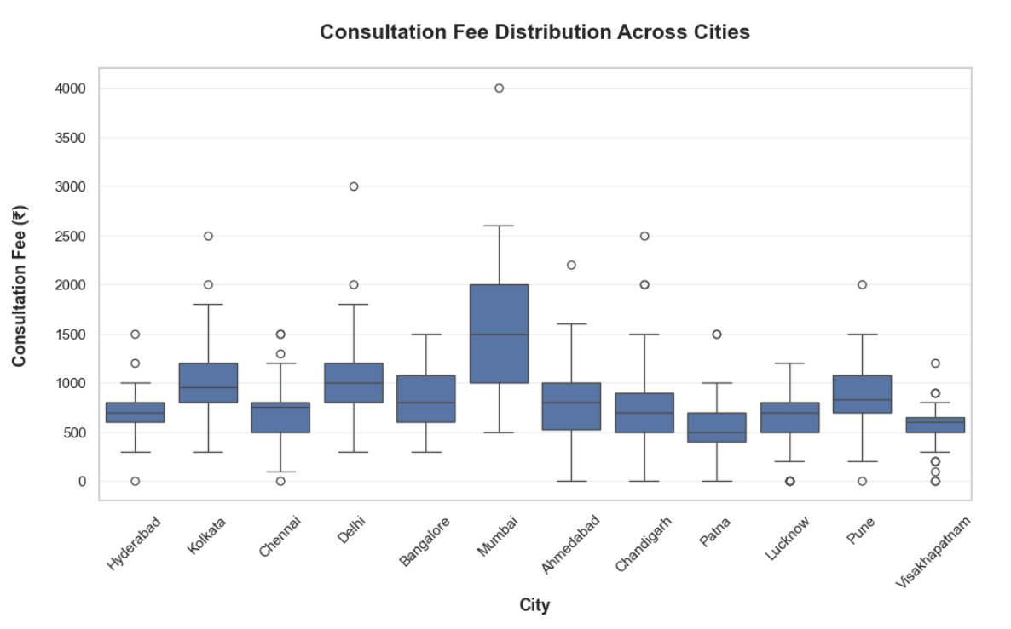
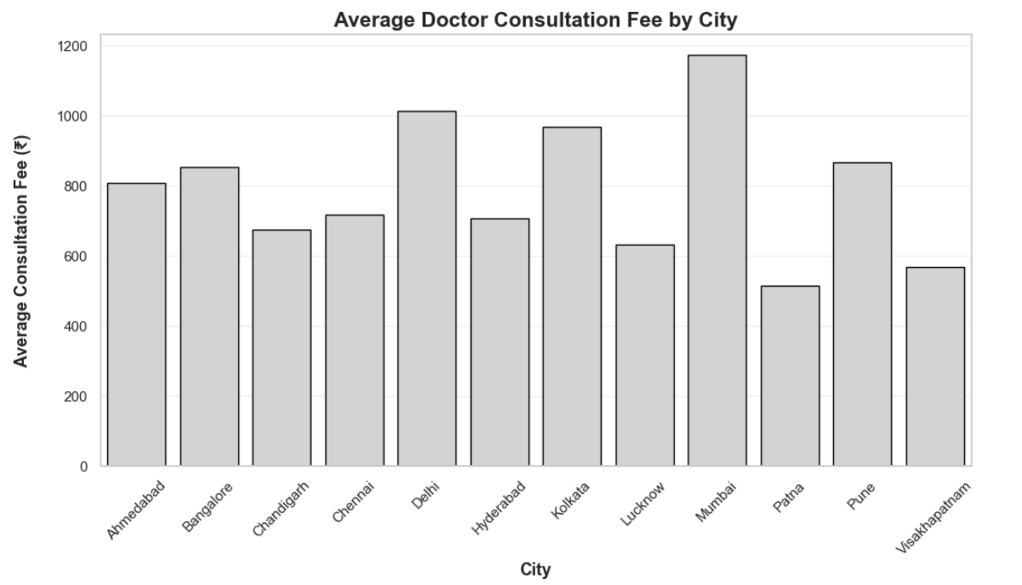

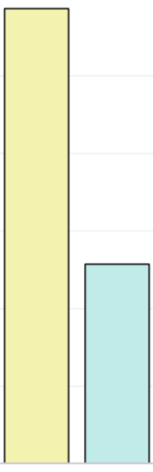
2
City-Wise Pricing Analysis
1
3
Consultation fees vary significantly across cities, indicating differences in healthcare market pricing across urban regions. Among all analyzed cities, Mumbai exhibits the highest average consultation fee, suggesting a premium healthcare market.
Patna has the lowest average consultation fee, indicating relatively more affordable healthcare access.
Metro cities demonstrate a higher average consultation fee compared to non-metro cities, indicating a possible urban premium effect in healthcare pricing.
2
The boxplot analysis shows that some cities have wider consultation fee distributions like Mumbai, indicating the presence of both budget and premium healthcare providers.

Slide 23
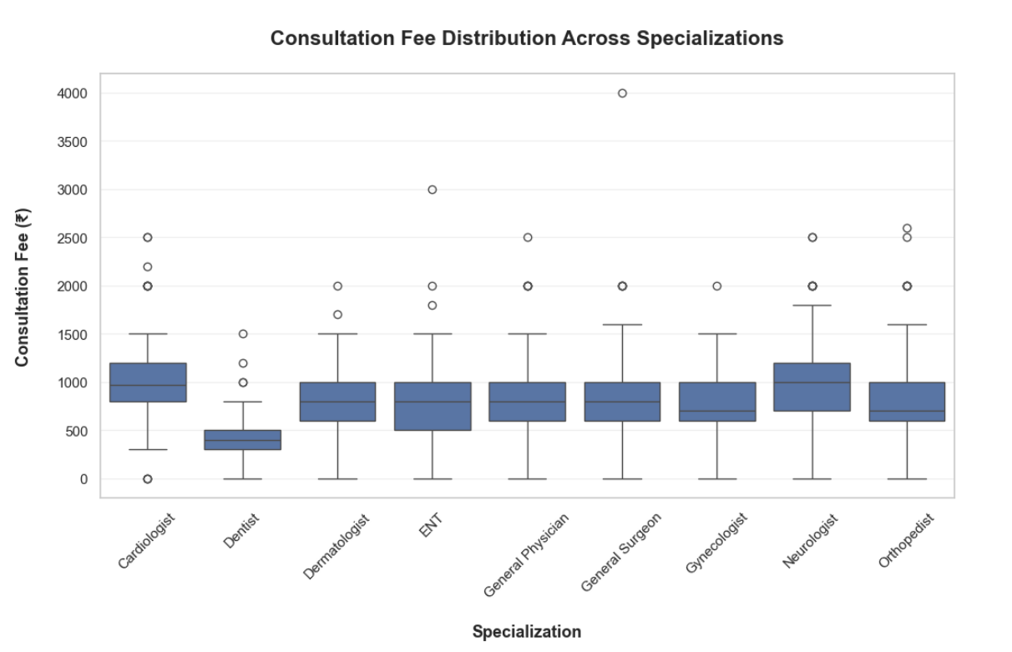
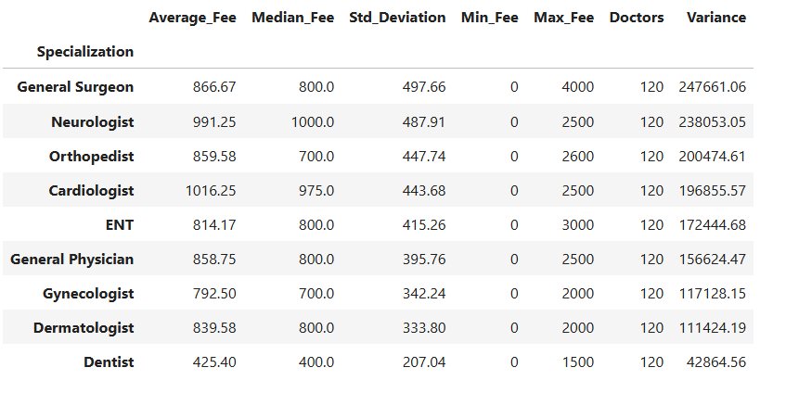
3
Specialization-Wise Pricing Analysis
Comparison between Specialization and Variance
1
General Surgeon shows the highest variance in consultation fees (247,661), indicating that fees vary widely across doctors within this specialization.
2
Dentists show the lowest variance in consultation fees (42,864), indicating relatively consistent pricing compared to other specializations.
3
Cardiologists and Neurologists have the highest average consultation fees among the specializations, while Dentists have the lowest, indicating comparatively more affordable consultation pricing.

Slide 24
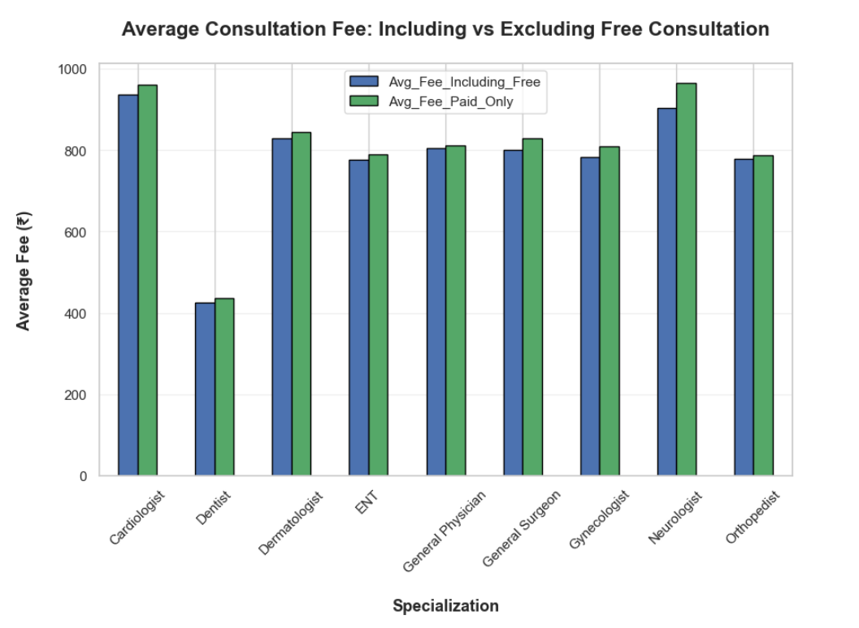
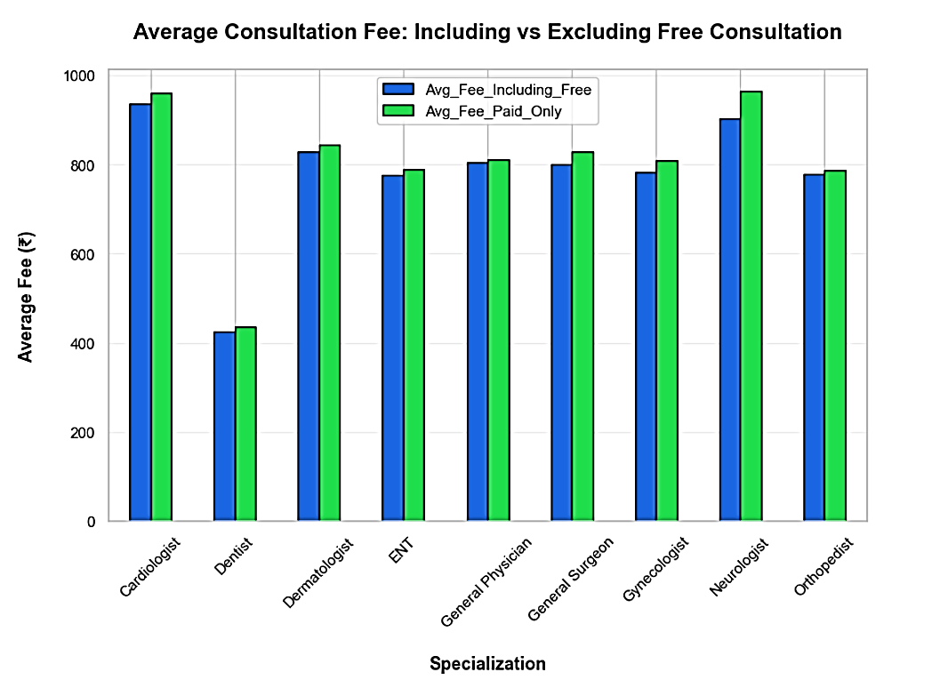
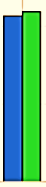
Comparing Average Consultation Fee (Outlier Free)
1
Neurologists and Cardiologists have among the highest average consultation fees, even when free consultations are excluded, highlighting their position in the higher-priced segment.
3
The difference between average fees including free consultations and paid-only consultations is relatively small across most specializations, suggesting that free consultations have a limited impact on overall pricing patterns.
2
Dentists consistently exhibit the lowest consultation fees among all specializations, reinforcing their position as the most affordable healthcare service in the dataset.

Slide 25
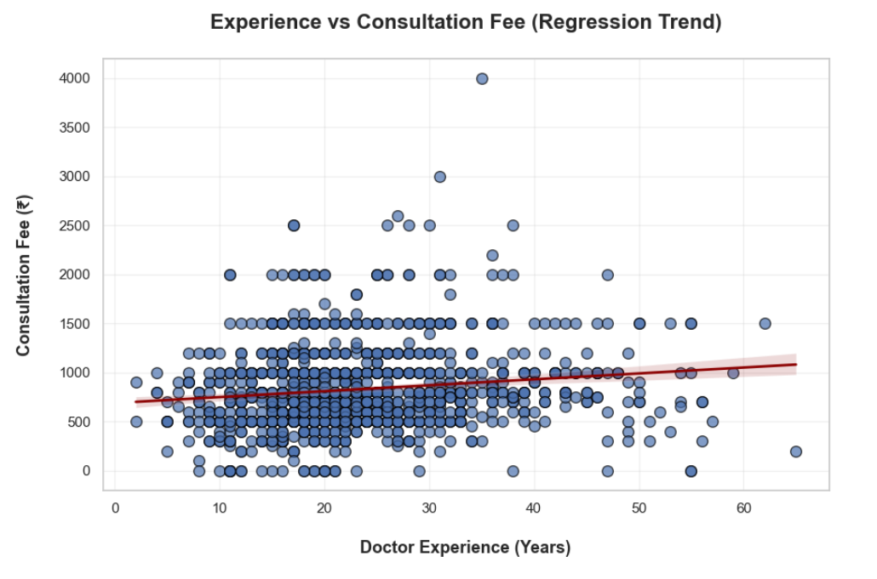
FACTOR
IMPACT ANALYSIS
1
Experience-Wise Pricing Analysis
1
The regression line indicates a positive relationship between doctor experience and consultation fees. Despite the upward trend, consultation fees show considerable variability across all experience levels.
Correlation: 0.142 — weak positive association
2
A few high-fee outliers suggest that certain highly reputed or specialized doctors charge significantly above the typical consultation range.
3
The majority of doctors cluster within the mid-experience range (10–30 years), with consultation fees mostly concentrated between ₹400 and ₹1200.

Slide 26
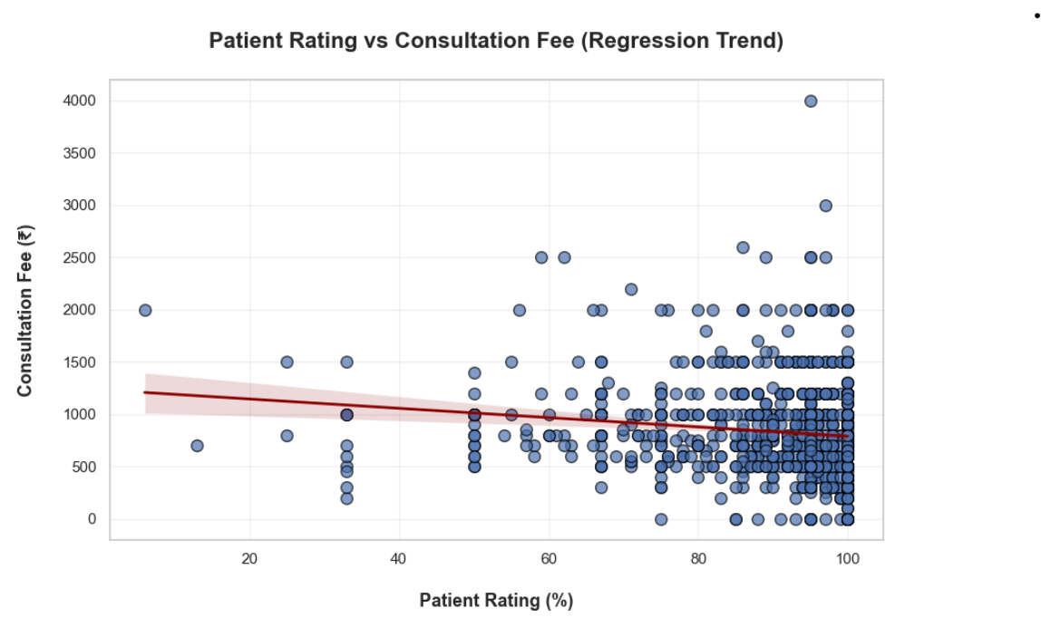
2
Patient Rating-Wise Pricing Analysis
1
The regression line shows a slight negative relationship between patient ratings and consultation fees. So, changes in one variable do not strongly influence or predict changes in the other variable.
Correlation: -0.133 — weak negative association
2
A few high-fee outliers indicate that some doctors charge significantly above the common consultation range.
3
Most doctors cluster in the high-rating range (80–100%) with consultation fees concentrated between ₹400 and ₹1200, indicating that higher patient ratings do not necessarily correspond to higher consultation fees.

Slide 27
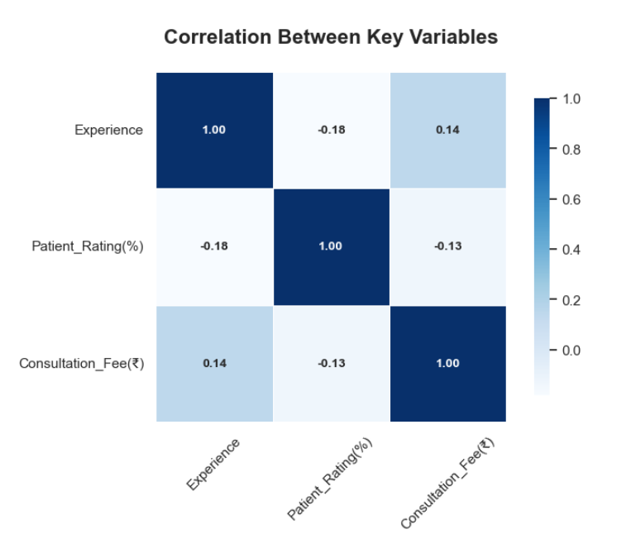
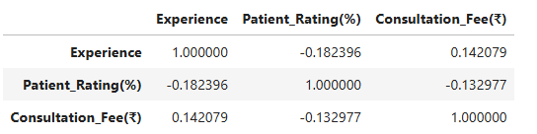
Correlation Analysis Between Variables
Experience and patient ratings show weak associations with consultation fees, while city and specialization exhibit stronger pricing differences in the analysis.

Slide 28
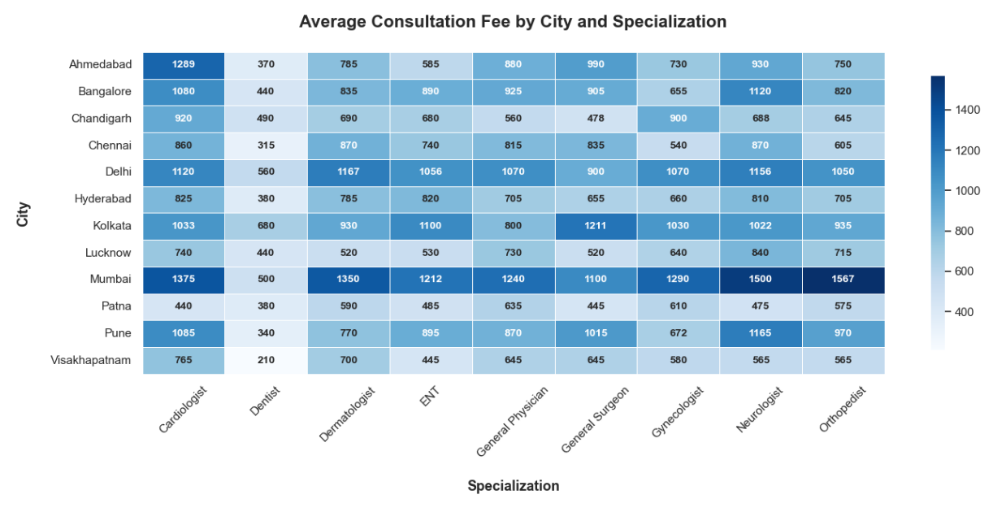
MULTIFACTOR
COMPARATIVE ANALYSIS
1
City and Specialization-Wise Pricing Analysis
1
Significant Pricing Variation Across Cities
The heatmap shows that the same medical specialization charges different consultation fees in different cities, indicating strong regional pricing differences in urban healthcare markets.
2
Certain Cities Act as Premium Healthcare Markets
Cities such as Mumbai, Delhi, and Kolkata consistently display higher consultation fees across multiple specializations, indicating higher-priced urban healthcare markets.
3
Specialization Pricing Is Not Uniform Nationwide
For the same specialization (e.g., Cardiologist), consultation fees vary across cities, highlighting substantial city-level differences in pricing.
4
Premium Healthcare Clusters Exist
The heatmap reveals city–specialization combinations with substantially higher consultation fees, highlighting localized pricing differences.

Slide 29
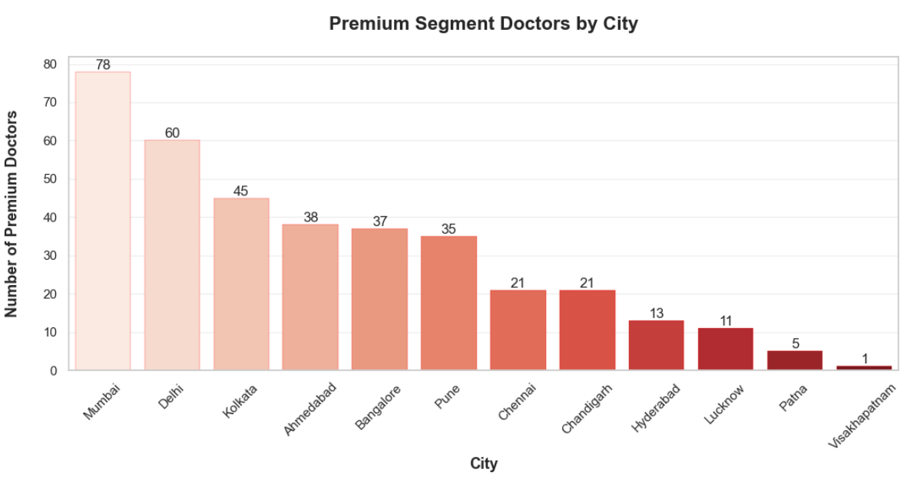
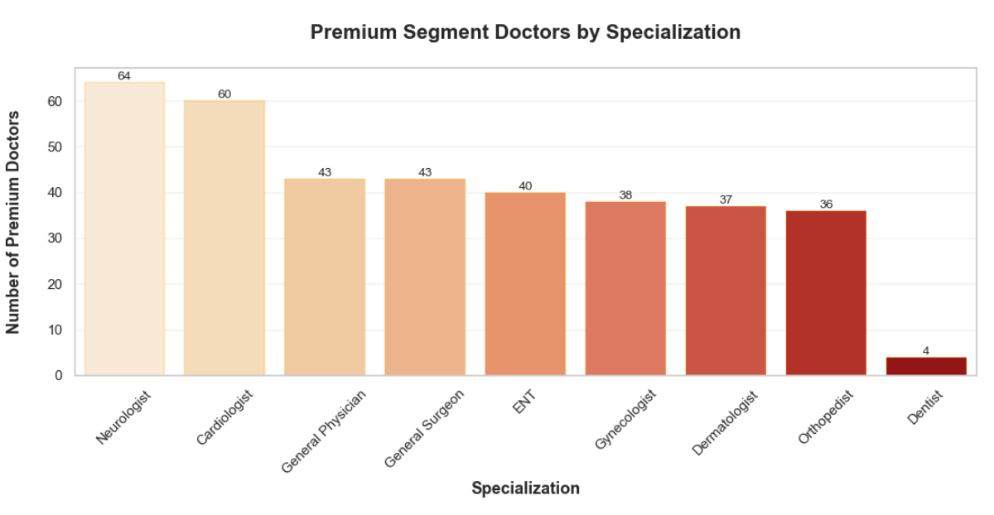
2
Premium Segment Pricing Analysis

Slide 30
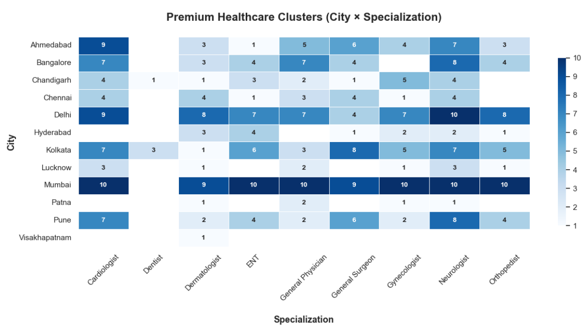
2
Premium Segment Pricing Analysis
1
Premium Healthcare Market Concentration
The premium segment includes doctors with consultation fees at or above the 75th-percentile threshold of ₹1,000.
365 doctors (33.8%) fall into this segment.
2
Premium Doctors Are Concentrated in Major Cities
Analysis shows that premium consultation providers are largely concentrated in major metropolitan cities such as Mumbai, Delhi, and Kolkata, indicating higher-priced healthcare markets in these cities.
3
Certain Specializations Dominate the Premium Segment
Specializations such as Cardiology, Neurology, and General Physicians appear more frequently in the premium segment, indicating that highly specialized medical services tend to command higher consultation fees.
4
Urban Premium Healthcare Clusters Exist
The distribution of premium doctors across cities and specializations reveals clear urban healthcare clusters, where certain cities and specialties dominate the high-fee segment.

Slide 31
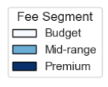
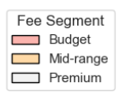
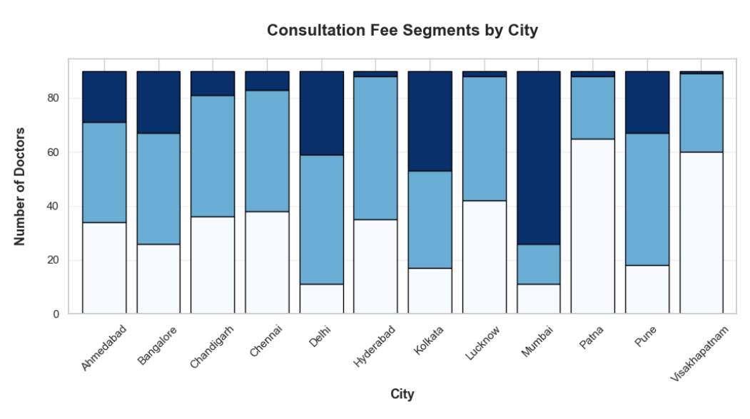
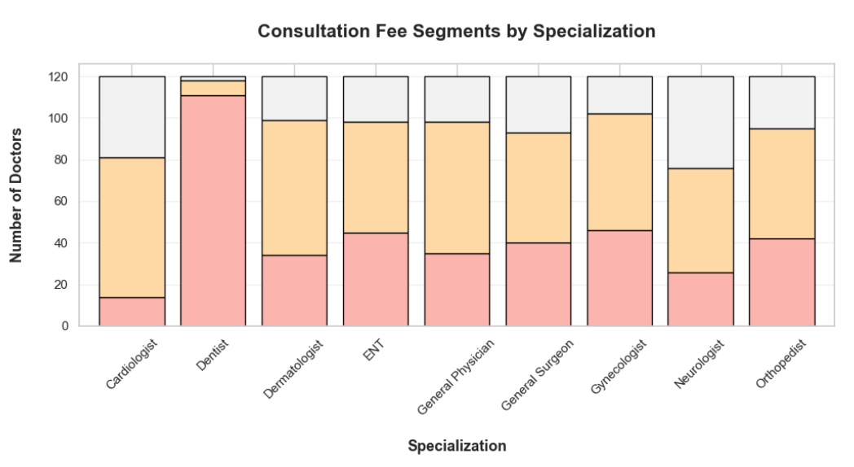
MARKET
SEGMENTATION
1
Market Segment Pricing Analysis
1
Healthcare Market Shows Clear Price Segmentation
The consultation fee distribution reveals a clear segmentation into budget, mid-range, and premium healthcare providers, indicating a structured pricing hierarchy within urban healthcare markets. Note: Segmentation is based on paid consultations; segment boundaries are relative to this dataset.
3
Certain Specializations Dominate Premium Healthcare
Neurology and other higher-priced specializations show a greater representation in the premium segment.
2
4
Budget Healthcare Is More Common in Emerging Cities
Smaller or emerging cities like Pune, Patna and Visakhapatnam tend to have a higher proportion of budget and mid-range healthcare providers, indicating more accessible consultation pricing.
Premium Healthcare Providers Are Concentrated in Certain Cities
Major metropolitan cities tend to have a higher proportion of doctors in the premium segment, indicating greater concentration of higher-priced consultations.

Slide 32
OUTCOME
CONCLUSION-05
CONCLUSION-04
CONCLUSION-03
CONCLUSION-02
CONCLUSION-01
Overall, the analysis highlights substantial variation in urban healthcare consultation fees across cities and medical specializations, along with clear premium pricing patterns.
Doctor experience and patient ratings show only weak relationships with consultation fees, while city and specialization exhibit stronger pricing differences in the analysis.
City-level differences play a major role in observed pricing patterns, with metropolitan cities generally showing higher consultation fees.
Medical specialization is associated with differences in consultation pricing, with some specialized fields showing higher average fees than others.
Urban healthcare consultation pricing shows strong variation across cities and medical specializations, while experience and patient ratings exhibit only weak associations with fees.

Slide 33

THANK
YOU!

