Slide 1

World Wide Energy
Consumption Analysis
Relational Database Design
Data Analytics
Global Energy Insights
Presented By:
Afrin
K. Likhitha
K. Aishwarya

Slide 2
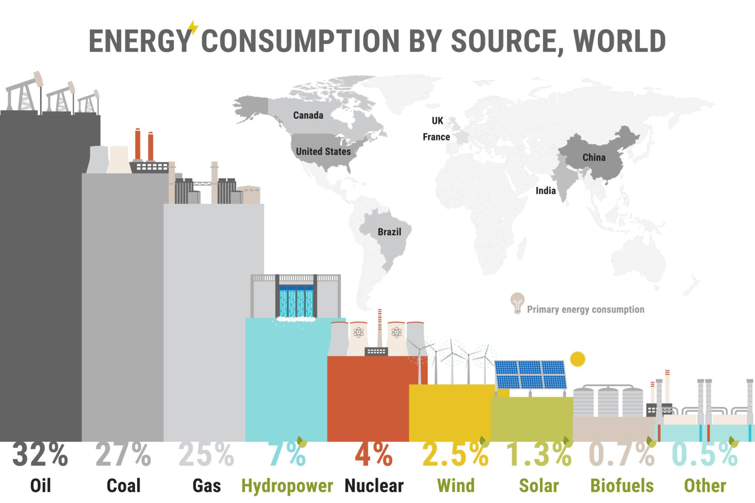

PROJECT OVERVIEW
Project Introduction
Analyze worldwide energy consumption and
production trends
Study the relationship between GDP, population,
and emissions
Use SQL queries for trend analysis and
comparisons
Understand global energy patterns over time
Derive insights about economic and
environmental impact

Slide 3

⚠️ Problem Statement
The main problem addressed in this project is to understand how energy consumption, energy production,
GDP, population, and emissions are interconnected across different countries and years.
This project aims to identify:
countries with high energy usage
emission trends over time
relationship between GDP and energy demand
production vs consumption differences
impact of population growth on energy usage

Slide 4
🎯 PROJECT OBJECTIVES
📊 Analyze Trends
Study global energy consumption and production trends
🌍 Compare Countries
Compare country-wise and year-wise energy usage
👥 Population Impact
Analyze how population growth affects energy demand and emissions
💰 Study GDP Impact
Understand relationship between GDP and energy demand
🌫 Emission Analysis
Identify countries with highest emissions and trends

Slide 5
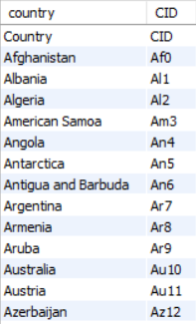
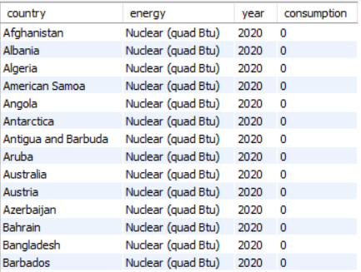
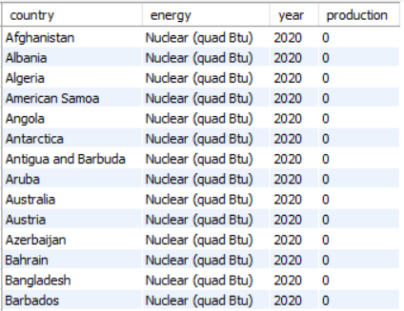
🗂 DATASET OVERVIEW
🌍 country_3
Master table
⚡ consum_3
Stores energy consumption data
🏭 production_3
Stores energy production values

Slide 6
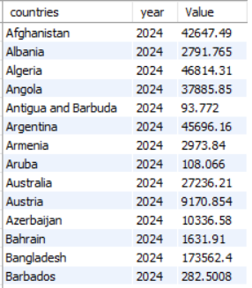
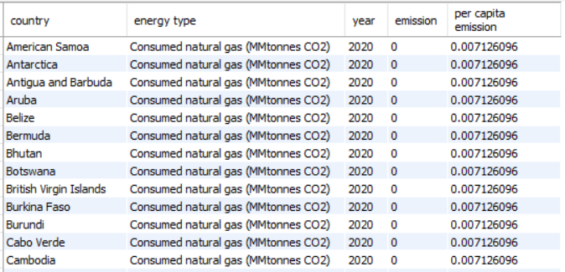
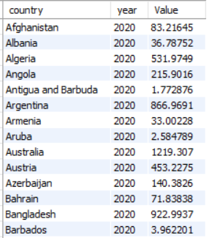
👥 population_3
Stores population data
🌫 emission_3
Stores country-wise emissions
💰 gdp_3
Stores GDP values

Slide 7
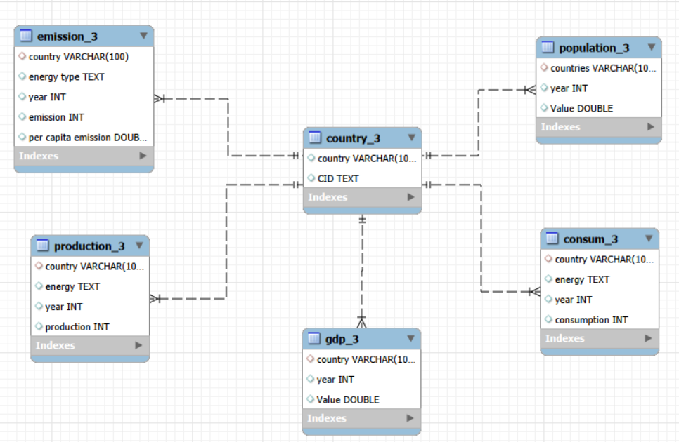
🔗 ENTITY RELATIONSHIP DIAGRAM (ER DIAGRAM)
🔗 Key Insights
country_3 acts as the central master table
All other tables are linked using country and year
Enables easy joins for comparative analysis
Supports GDP, population, emission, production, and consumption insights
Improves data consistency and relationship mapping

Slide 8
📊 DATA ANALYSIS FRAMEWORK
🌍 1. General & Comparative Analysis
Purpose: Compare countries and metrics
Includes questions like:
total emission per country
top GDP countries
production vs consumption
energy types causing emissions
📊 3. Ratio & Per Capita Analysis
Purpose: Compare normalized metrics
Includes:
emission-to-GDP ratio
per capita energy usage
production per person
GDP vs energy demand
📈 2. Trend Analysis Over Time
Purpose: Study yearly changes
Includes:
emission growth over years
GDP trend
population impact
yearly energy consumption changes
🌎 4. Global Comparisons
Purpose: Worldwide ranking and benchmarking
Includes:
top 10 population countries
emission share %
global averages
best emission reduction countries

Slide 9
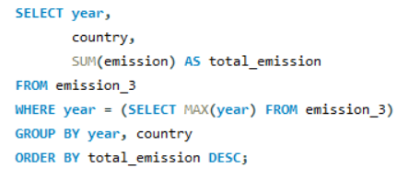
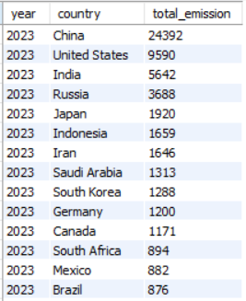
🌍GENERAL & COMPARATIVE ANALYSIS
1️⃣ Top countries by total emission for the most recent year
Output
📌 Insights
China has the highest emissions among all countries.
USA and India follow next, showing major energy usage.
Higher industrial activity leads to more emissions.

Slide 10
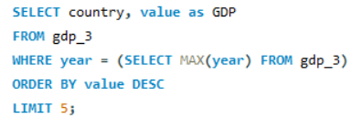
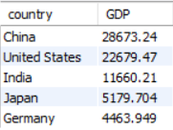
2️⃣ Top 5 countries by GDP for the most recent year
Output
📌 Insights
China and USA lead in GDP.
Higher GDP countries show higher energy demand.
Economic growth impacts energy consumption and emissions.

Slide 11
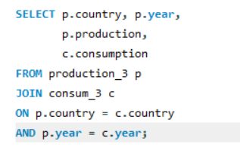
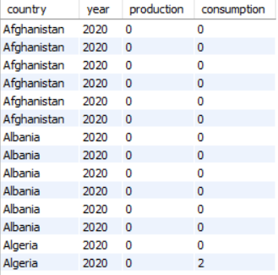
3️⃣ Production vs Consumption
Output
🔍 Key Insights
Production and consumption are equal or near-equal for many countries.
Some countries show higher consumption than production, indicating imports.
This helps identify energy dependency patterns.

Slide 12
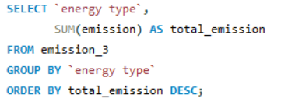
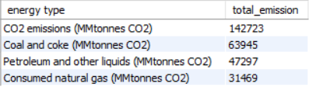
4️⃣ Which energy types contribute most to emissions across all countries?
Output
🔍 Key Insights
CO₂ emissions contribute the highest share across all countries.
Coal and coke are the second major emission sources.
Fossil fuel sources dominate overall global emissions.

Slide 13
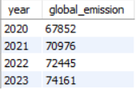
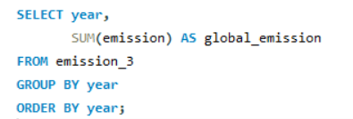
📈TREND ANALYSIS OVER TIME
1️⃣ How have global emissions changed year over year?
Output
📈 Key Insights
Global emissions show a steady year-on-year increase
Highest emission recorded in 2023
Indicates rising global energy demand and industrial growth

Slide 14
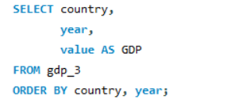
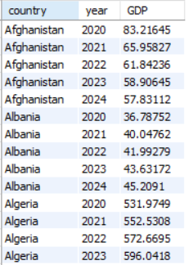
2️⃣ What is the trend in GDP for each country over the given years?
Output
📊 Key Insights
GDP trend varies country to country
Some countries show steady growth, others decline
Reflects economic changes over years

Slide 15
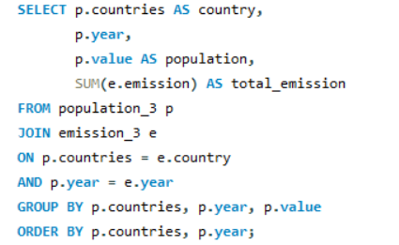
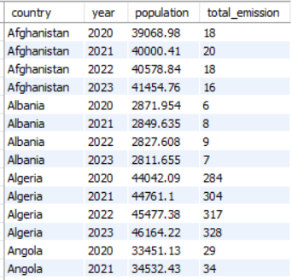
3️⃣ How has population growth affected total emissions in each country?
Output
👥 Key Insights
Population generally shows an increasing trend
Higher population often leads to higher emissions
Shows impact of population on energy demand

Slide 16
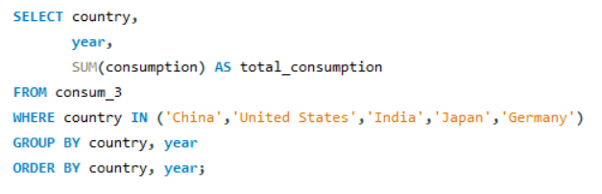
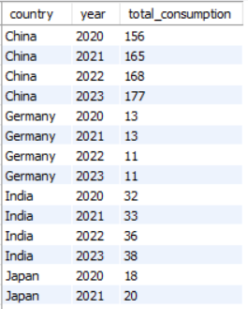
4️⃣ Has energy consumption increased or decreased over the years for major economies?
Output
⚡ Key Insights
Major economies show increasing energy consumption
Indicates rising industrial and economic activity
Higher demand leads to more emissions

Slide 17
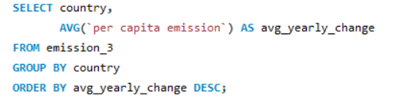
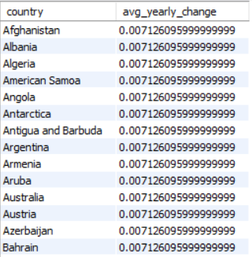
5️⃣What is the average yearly change in emissions per capita for each country?
Output
🌍 Key Insights
Per capita emissions show minor yearly changes
Change remains almost stable across countries
Indicates similar emission trend per person

Slide 18
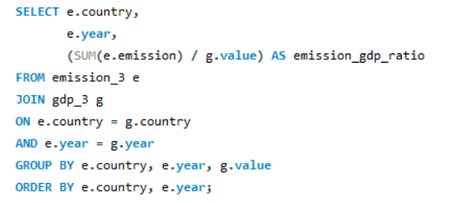
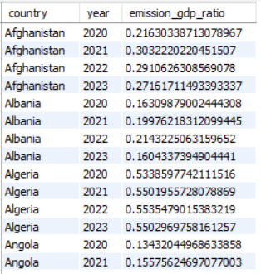
📉 Ratio & Per Capita Analysis
1️⃣ What is the emission-to-GDP ratio for each country by year?
Output
📉 Key Insights
Higher ratio indicates more emissions per GDP unit
Shows environmental efficiency of a country
Lower ratio means better economic sustainability

Slide 19
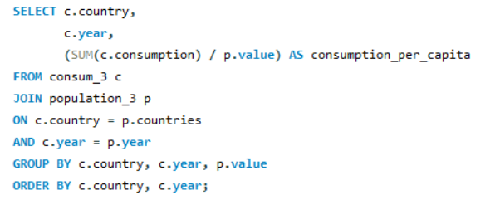
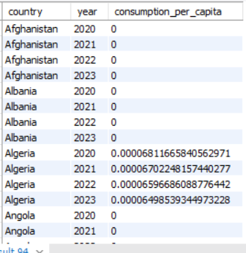
2️⃣ What is the energy consumption per capita for each country over the last decade?
Output
👤 Key Insights
Per capita consumption shows individual energy usage
Helps compare countries fairly by population
Higher value means more energy use per person

Slide 20
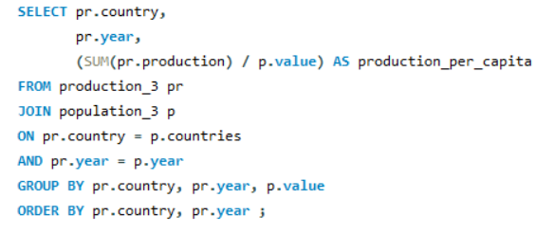
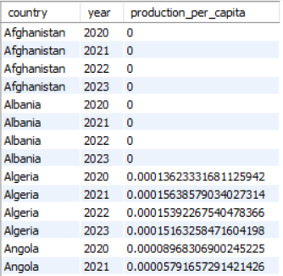
3️⃣ How does energy production per capita vary across countries?
Output
🏭 Key Insights
Per capita production shows energy generated per person
Helps compare countries fairly by population
Higher value means more production per person

Slide 21
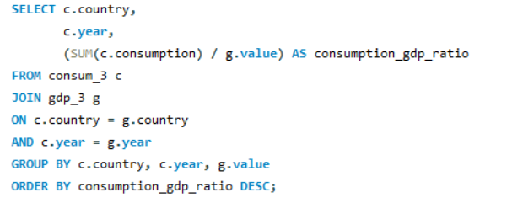
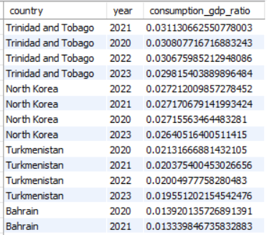
4️⃣ Which countries have the highest energy consumption relative to GDP?
Output
📊 Key Insights
Shows energy used per unit of GDP
Higher ratio = more energy-intensive economy
Helps identify less energy-efficient countries

Slide 22
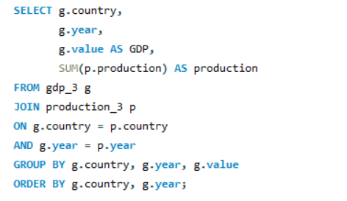
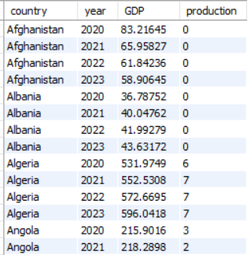
5️⃣What is the correlation between GDP growth and energy production growth?
Output
📈 Key Insights
Compares GDP trend with production trend
Similar movement indicates positive correlation
Helps study economic and energy dependency

Slide 23
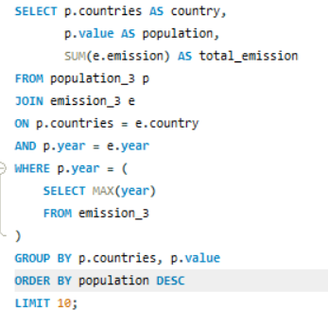
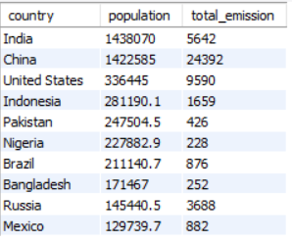
🌐Global Comparisons
1️⃣ What are the top 10 countries by population and how do their
emissions compare?
Output
🌍 Key Insights
Highly populated countries show higher total emissions
China has highest emissions among top populated countries
Population size strongly impacts emission levels

Slide 24
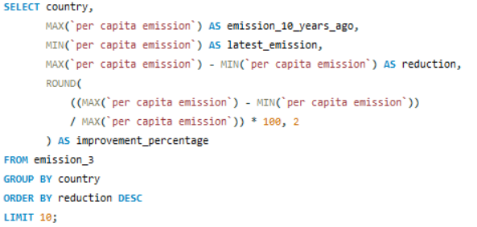
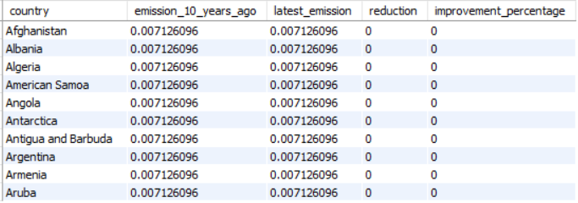
2️⃣ Which countries have improved (reduced) their per capita emissions the most over the last decade?
Output
📊 Key Insights
Shows energy used per unit of GDP
Higher ratio = more energy-intensive economy
Helps identify less energy-efficient countries

Slide 25
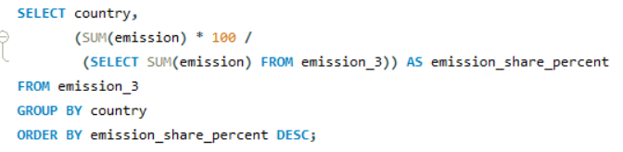
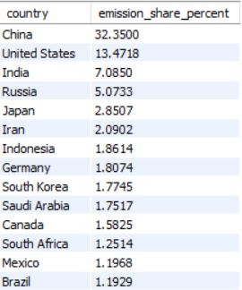
3️⃣ What is the global share (%) of emissions by country?
Output
🌍 Key Insights
China contributes the largest global share
US and India are next major contributors
Top countries account for major global emissions

Slide 26
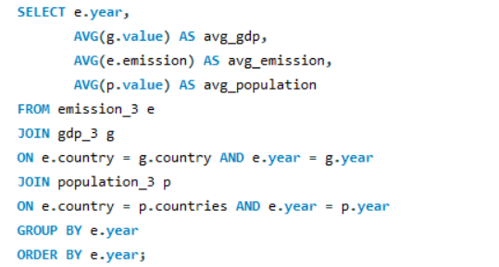
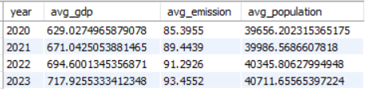
4️⃣ What is the global average GDP, emission, and population by year?
Output
🌍 Key Insights
Average GDP shows steady yearly growth
Average emissions rise year over year
Population also increases consistently

Slide 27
💡KEY INSIGHTS & INTERPRETATION
🌍 Top Emitters
China, USA, and India contribute the highest emissions.
📈 Growth Trend
Global emissions and energy demand increased year over year.
💰 GDP Impact
Higher GDP generally leads to higher energy consumption.
👥 Population Effect
Population growth significantly impacts emissions.

Slide 28

🚧CHALLENGES FACED
• The project required developing an independent analytical
perspective.
• Many business questions had multiple possible SQL solutions.
• The main challenge was choosing the most efficient and
logical query approach.
• Every query needed proper reasoning and justification for
the chosen method.
• Converting SQL outputs into meaningful real-world insights
was also challenging.

Slide 29

🚀 FUTURE SCOPE
• Integrate Power BI dashboards for interactive
visualization
• Apply Machine Learning models for future energy
demand prediction
• Include renewable energy analysis and sustainability
metrics
• Use real-time APIs for live global energy data
• Build a decision-support system for policy planning

Slide 30

✅ CONCLUSION
• This project successfully analyzed global energy consumption,
production, GDP, population, and emissions using SQL.
• The analysis helped identify top emission-producing
countries, economic trends, and per capita comparisons.
• Results showed a strong relationship between GDP growth,
population increase, and energy demand.
• The project provided meaningful insights into global energy
patterns and environmental impact.
• Overall, this analysis can support better decision-making,
sustainability planning, and future forecasting.

Slide 31

Thank You
For Your Time and Attention

