Slide 1

LIBRARY MANAGEMENT SYSTEM

Slide 2
AGENDA
Objective of the Project
ER Diagram and schema explanation
Key analysis questions (use cases)
SQL query results with screenshots or summaries
Final business insights and recommendations
Conclusion (Key finding overall)
Q&A Slide
Experience/Challenges working on SQL – Data Analysis Project.

Slide 3
OBJECTIVE
Project Goal :The project's main goal is to design and analyse relational database for a library. This involves using SQL to structure the data, ensure its integrity, and answer key business questions.
Key Objectives:
Database Design: Create a logical database schema by defining tables, columns, and relationships.
Data Integrity: Use primary and foreign keys to enforce relationships and ensure data consistency.
SQL Querying: Write complex queries to retrieve meaningful information, such as book availability and borrower activity.
Problem-Solving: Translate real-world business questions into effective SQL queries to provide actionable insights.

Slide 4
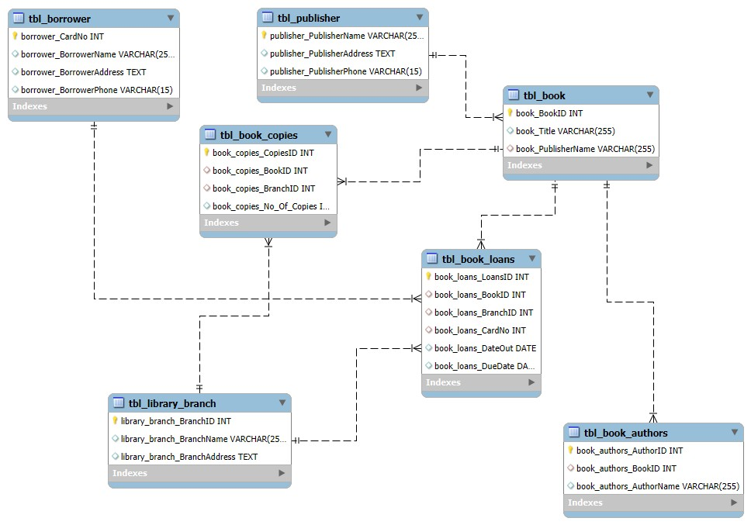
ER DIAGRAM

Slide 5
SCHEMA EXPLAINATION
This schema models a library management system, tracking books, authors, branches, borrowers, loans, publishers, and copies.
Key Entities:
tbl_book: Stores book details (BookID, Title, PublisherName).
tbl_book_authors: Links books to their authors.
tbl_publisher: Contains publisher contact information.
tbl_library_branch: Lists all library branches.
tbl_borrower: Stores borrower details such as name and contact.
tbl_book_loans : Stores the data of books borrowed with respective borrowed and due dates.
tbl_book_copies: Lists all the book with number of book copies among all library branches.

Slide 6
RELATIONSHIPS AND DATAFLOW
Relationships:
Book–Publisher: Each book is published by one publisher.
Book–Author: A Author can have multiple books(many-to-one via tbl_book_authors).
Book–Branch: tbl_book_copies links books to branches with quantity.
Borrower–Loan: Borrowers loan books via tbl_book_loans.
Loan–Book/Branch: Each loan references a book and the branch it's borrowed from.
Data Flow Example:
Borrower → Loans Book (from Branch) → Book Copy → Book Info → Author
& Publisher

Slide 7
KEY ANALYSIS QUESTIONS- USE CASES
Check how many copies of the book titled "The Lost Tribe" are available in the Sharpstown branch.
List all books that were loaned out from the Sharpstown branch and are due on February 3, 2018.
Find all books authored by Stephen King that are available in the Central branch.
List all books along with their branch name and the number of copies available. If the branch name is missing, display the branch ID instead.
List all books along with their corresponding publisher names.
Retrieve the complete list of all borrowers registered in the system.
Find the total number of book loans made by each borrower.
Display the total number of rows (records) present in each table of the database.
Identify borrowers who currently have books checked out.

Slide 8
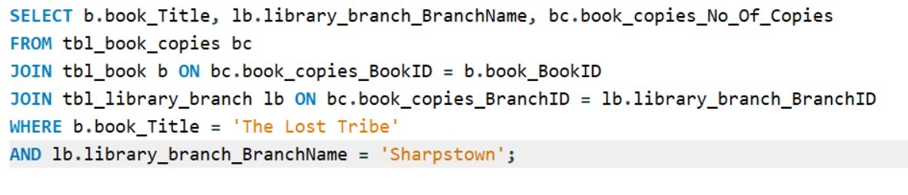

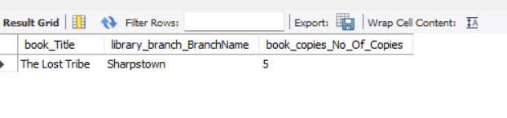
1. How many copies of the book titled "The Lost Tribe" are owned by the library branch whose name is "Sharpstown"?
Result Table:

Slide 9
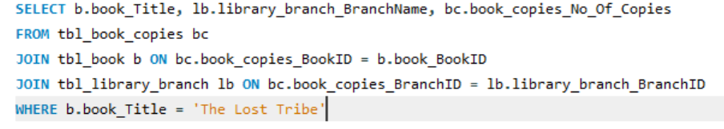

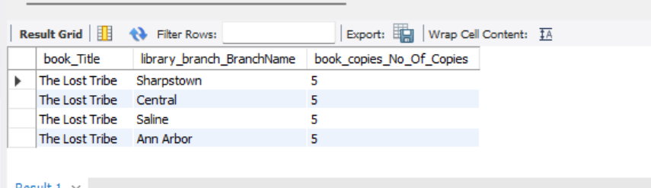
2.How many copies of the book titled "The Lost Tribe" are owned by each library branch?
Result Table:

Slide 10
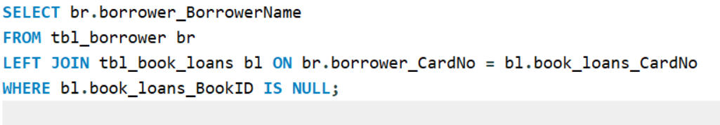
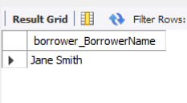
3.Retrieve the names of all borrowers who do not have any books checked out.
Result Table:
There are only one borrowers who do not checked out in the library system.
His name is “Jane Smith”.
To find this we have to left join two tables: “tbl_borrower” and “tbl_book_loans”

Slide 11
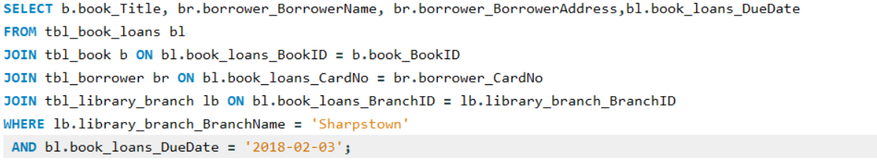
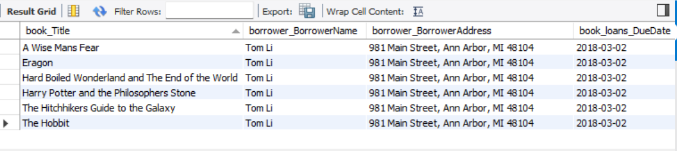
4.For each book that is loaned out from the "Sharpstown" branch and whose Due Date is 2/3/18, retrieve the book title, the borrower's name, and the borrower's address.
Result Table:
There are only one borrowers whose name is Tom Li borrowed 6 books with the due date 02/03/2018

Slide 12
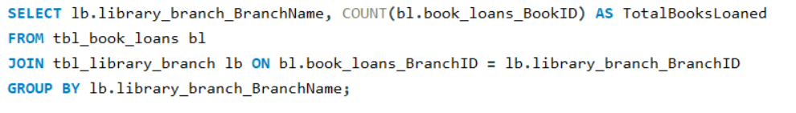

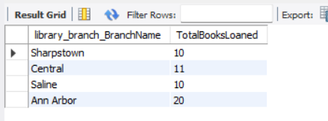
5. For each library branch, retrieve the branch name and the total number of books loaned out from that branch.
Result Table:

Slide 13
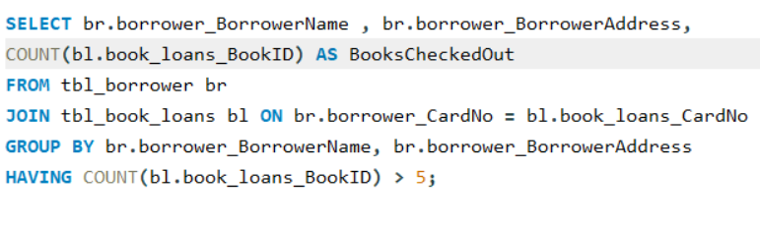
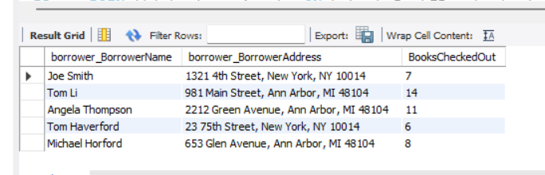
6. Retrieve the names, addresses, and number of books checked out for all borrowers who have more than five books checked out.
Result Table:
There are 5 borrowers who has borrowed more than 5 books.

Slide 14
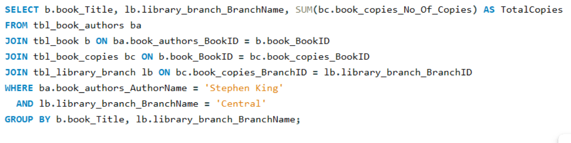
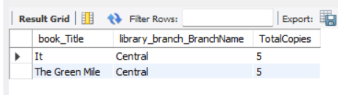
7.For each book authored by "Stephen King", retrieve the title and the number of copies owned by the library branch whose name is "Central".
Result Table:
There are 2 books with 5 copies each by the Author Stephen King in the Central branch

Slide 15
FINAL BUSINESS INSIGHTS
Book Availability & Demand
• “'The Name of the Wind’ is the most borrowed .6 books were borrowed across all branches.
Borrower Insights
• Some borrowers (e.g., Jane Smith, Angela Thompson, Haley Jackson) have no active loans.
• High-activity borrowers (e.g., Tom Li – 7 loans) drive circulation trends.
Branch-Level Trends
• Loan activity varies across branches, highlighting different usage patterns.
Operational Insights
• Total 20 books, 16 publishers, 8 borrowers in system.
• Enables tracking of popular titles, branch demand, and borrower behavior for better inventory planning

Slide 16
RECOMMENDATIONS
Optimize Inventory
• Add more copies of “'The Name of the Wind” at high-demand branches.
Borrower Engagement
• Target high-activity borrowers (e.g., Tom Li) with loyalty programs.
• Encourage inactive borrowers (e.g., Jane Smith, Angela Thompson) through reminders/promotions.
Branch Performance Monitoring
• Track loan activity per branch to identify under-utilized libraries.
• Use insights to allocate resources effectively.
Publisher & Author Insights
• Expand partnerships with popular publishers (e.g., Bloomsbury).
• Ensure availability of top authors (J.K. Rowling, Stephen King, J.R.R. Tolkien, Patrick Rothfuss ).
Operational Improvements
• Automate due-date reminders (e.g., Sharpstown loans due Feb 3, 2018).
• Regularly review data for usage trends & strategic decisions.

Slide 17
CONCLUSION
Resource Management
• Identified demand gaps ('The Name of the Wind) → supports smarter inventory allocation.
Borrower Insights
• Segmented active vs. inactive borrowers → helps design engagement & retention strategies.
Branch Performance
• Sharpstown shows time-sensitive loans; Central branch dominates in popular titles (Stephen King) → branches have unique usage patterns.
Publisher & Author Trends
• High circulation from popular publishers (Bloomsbury) and authors (J.K. Rowling, Stephen King, J.R.R. Tolkien, Patrick Rothfuss ) → guides future acquisitions.
Operational Impact
• System tracks loans, returns, copies, and borrowers effectively.
• Enables data-driven decision-making for improved efficiency, user satisfaction, and growth.

Slide 18
Experience / Challenges Faced During the Project
Database Design: Designing the ER diagram and defining relationships among Books, Authors, Borrowers, Publishers, and Branches was complex and required careful planning.
Data Integrity Issues: Ensuring accuracy through proper use of primary keys, foreign keys, and constraints was essential to maintain consistent data.
Translating Business Logic: Converting real-world problems (e.g., tracking book loans or availability) into SQL queries enhanced our problem-solving ability.
Debugging and Validation: Some queries initially gave empty or incorrect results, which required step-by-step debugging and validation of data relationships.

Slide 19

THANK YOU

