Slide 1

Protocol
The OSI Model

Slide 2
Refrensi OSI
Model Open Systems Interconnection (OSI) diciptakan oleh International Organization for Standardization (ISO) yang menyediakan kerangka logika terstruktur bagaimana proses komunikasi data berinteraksi melalui jaringan.
Standard ini dikembangkan untuk industri komputer agar komputer dapat berkomunikasi pada jaringan yang berbeda secara efisien.
Notes:
Before OSI it was difficult for the vendors to create network products OSI, why U need to study, its a structured approach to troubleshoot
Each has independent model
Before considering how to configure Cisco routers and switches, you must be introduced to basic networking concepts you’ll need to understand in order to grasp the advanced concepts discussed in later chapters
ISO developed the seven-layer

Slide 3
ISO dan OSI
ISO - International Organization for Standardization
OSI - Open System Interconnection
IOS - Internetwork Operating System

Slide 4
The OSI Reference Model
7 Application
Arsitektur OSI mendefinisikan 7 lapis fungsi kerja pada jaringan komputer
6 Presentation
5 Session
4 Transport
3 Network
2 Data Link
1 Physical

Slide 5
OSI Model
Application
Application
(Upper)
Layers
Presentation
Session
Transport
Network
Data Flow
Layers
Data-Link
Physical

Slide 6
Layer 7 - The Application Layer
7 Application
Menyediakan jasa untuk aplikasi pengguna.
Layer ini bertanggung jawab atas pertukaran informasi antara program komputer, dan service lain yang jalan di jaringan, seperti server printer atau aplikasi komputer lainnya
Contoh:
•Email
•Web browsers
PDU - User Data
6 Presentation
5 Session
4 Transport
3 Network
2 Data Link
1 Physical
Protocol Data Unit (PDU)
Notes:
top (seventh) layer of the OSI Reference Model is the application layer. It provides the user interface. Examples of TCP/IP applications include telnet, FTP, HTTP, and SMTP.

Slide 7
Layer 6 - The Presentation Layer
7 Application
Bertanggung jawab bagaimana data dikonversi dan diformat untuk transfer data. Contoh konversi format text ASCII untuk dokumen, .gif dan JPG untuk gambar.
Layer ini membentuk kode konversi, translasi data,
enkripsi dan
konpresi
PDU - Formatted Data
6 Presentation
5 Session
4 Transport
3 Network
2 Data Link
1 Physical
Notes:
The Presentation layer gets its name from its purpose: It presents data to the Application layer and is responsible for data translation and code formatting
Exam Watch The presentation layer determines how data is represented to the user. Examples of presentation layer protocols and standards include ASCII, BMP, GIF, JPEG, WAV, AVI, and MPEG.
ASCII (the American Standard Code for Information Interchange, used by most devices today) uses seven bits to represent characters. EBCDIC (Extended Binary-Coded Decimal Interchange Code, developed by IBM)
PICT A picture format used by Macintosh programs for transferring QuickDraw graphics.
TIFF Tagged Image File Format; a standard graphics format for high-resolution, bitmapped images.
JPEG Photo standards brought to us by the Joint Photographic Experts Group. Other standards guide movies and sound:
MIDI Musical Instrument Digital Interface (sometimes called Musical Instrument Device Interface), used for digitized music.
MPEG Increasingly popular Moving Picture Experts Group standard for the compression and coding of motion video for CDs. It provides digital storage and bit rates up to 1.5Mbps.
QuickTime For use with Macintosh programs; manages audio and video applications.
RTF Rich Text Format, a file format that lets you exchange text files between different word processors, even in different operating systems.
Categorize as file type

Slide 8
Layer 5 - The Session Layer
7 Application
Menentukan bagaimana dua terminal menjaga, memelihara dan mengatur koneksi,bagaimana mereka saling berhubungan satu sama lain.
Membentuk Virtual Circuit
Membentuk komunikasi antar sistem
Bentuk komunikasi :
  Simplex
  Half Duplex
  Full Duplex
contoh:
• Client Software
(untuk login)
PDU - Formatted Data
6 Presentation
5 Session
4 Transport
3 Network
2 Data Link
1 Physical
Notes:
Exam Watch The session layer is responsible for setting up and tearing down network connections. Examples include RPCs and NFS.
The actual mechanics of this process, however, are implemented at the transport layer. To set up connections or tear down connections, the session layer communicates with the transport layer. Remote Procedure Call (RPC) is an example of an IP session protocol; the Network File System (NFS), which uses RPC, is an example application at this layer.

Slide 9
Half Duplex
Komunikasi dua arah secara bergantian.
Digunakan pada sisten CSMA/CD untuk mengindari tabrakan station harus antri, menunggu sampai diijinkan menggunakan jalur.
Half-duplex biasanya digunakan untuk jaringan Ethernet 10BaseT dengan transfer data 30 sampai 40 %, karena 10BaseT untuk jaringan yang besar hanya 3 sampai 4 Mbps.

Slide 10
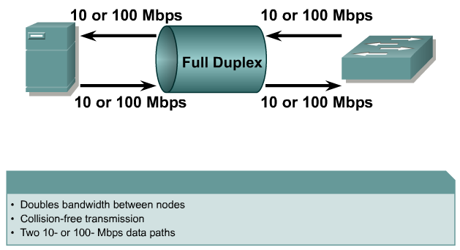
Full Duplex
Komunkasi dua arah secara bersama
Jalur transmisi, dan jalur penerima menggukanan jalur sendiri
Untuk jaringan Ethernet 100BaseT dan seri brkutnya.
Notes:
Full duplex means you can send and receive at the same time. This was impossible on coax, the original Ethernet media since it had only 1 conductor and Ethernet uses baseband signaling. However, 10BaseT and 100BaseT use a cable with 4 conductors. (Actually, there are typically 8 conductors but only 4 are used.) 1 pair of conductors is used to send data and the other to receive data. Each pair are also twisted around each other to help eliminate noise, hence the name unshielded twisted pair. With the right hardware you can theoretically double the speed of your network by sending and receiving simultaneously. Of course it’s a rare environment that has so much data to send in both directions but full duplex will give you a performance boost because you no longer have to wait for 1 host to finish sending before you start to send your data, i.e. a deferral

Slide 11
Layer 4 - The Transport Layer
7 Application
Bertanggung jawab membagi data menjadi segmen, menjaga koneksi logika “end-to-end” antar terminal, dan menyediakan penanganan error (error handling )
Pengiriman data yang handal antar jaringan.
Pengurutan
Keabsahan data
Transmisi ulang
Flow Control (mengontrol aliran)
PDU - Segments
6 Presentation
5 Session
4 Transport
3 Network
2 Data Link
1 Physical
Notes:
Protocol Data Unit. The term used to describe data as it moves from one layer of the OSI model to another.

Slide 12
Layer 3 - The Network Layer
7 Application
Bertanggung jawab menentukan alamat jaringan, menentukan route yang harus diambil selama perjalanan, dan menjaga antrian trafik di jaringan.
Data pada layer ini berbentuk paket.
Pengkapsulan
Packet forwarding
Packet Filtering
Fragmentation
PDU – Packets – IP/IPX
6 Presentation
5 Session
4 Transport
3 Network
2 Data Link
1 Physical

Slide 13
Layer 2 - The Data Link Layer
7 Application
Menyediakan link untuk data, memaketkannya menjadi frame yang berhubungan dengan “hardware” kemudian diangkut melalui media. komunikasinya dengan kartu jaringan, mengatur komunikasi layer physical antara sistem koneksi dan penanganan error.
Mengubah bit ke byte dan
byte kedalam frame
Akses ke media mengunakan MAC address
Error detection, not correction
PDU - Frames
6 Presentation
5 Session
4 Transport
3 Network
2 Data Link
1 Physical
Preamble | DMAC | SMAC | Data length | DATA | FCS
Notes:
Preamble is sequence of 1’s and 0’s signifies the beginning of a frame
DataLen decides the length of Data, can be 64 to 1500 Bytes is called as MTU
FCS is used for error detection
CRC run on the data field and and the values is kept in FCS

Slide 14
Layer 1 - The Physical Layer
7 Application
6 Presentation
5 Session
Bertanggung jawab atas proses data menjadi bit dan mentransfernya melalui media, seperti kabel, dan menjaga koneksi fisik antar sistem.
Encoding
PDU - Bits
4 Transport
3 Network
2 Data Link
1 Physical
Notes:
The data is in Bits bits are converted to signals known as encoding
The physical layer is also responsible for how binary information is converted to a physical layer signal. For example, if the cable uses copper as a transport medium, the physical layer defines how binary 1’s and 0’s are converted into an electrical signal by using different voltage levels. If the cable uses fiber, the physical layer defines how 1’s and 0’s are represented using an LED or laser with different light frequencies

Slide 15
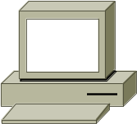
Data Encapsulation
Application
Presentation
PDU
Upper-Layer Data
Session
Transport
Segment
TCP Header
Upper-Layer Data
Network
Packet
IP Header
Data
LLC Header
Data
FCS
Data-Link
Frame
MAC Header
Data
FCS
Physical
Bits
0101110101001000010

Slide 16
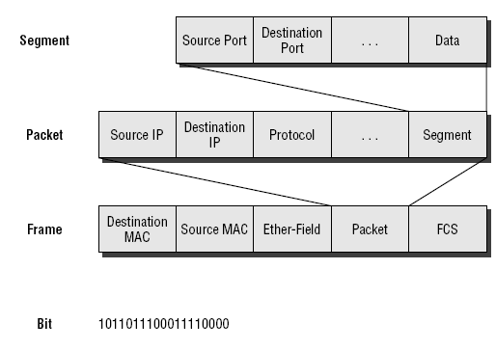
Data Encapsulation

Slide 17
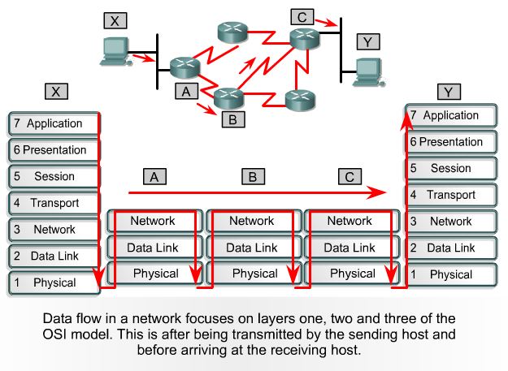
Aliran Data Antar Jaringan

Slide 18
Tipe Transmisi
Unicast
Multicast
Broadcast

Slide 19
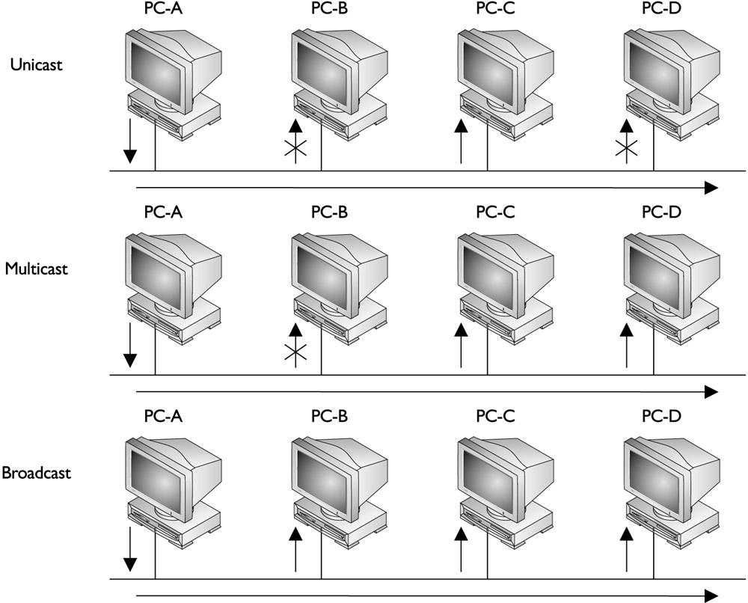
Tipe Transmisi

Slide 20
Broadcast Domain
Suatu kelompok perangkat jaringan meneriman penyebaran sejumlah frame, diinisialsasi dari beberapa device kedalam kelompok.
Router tidak meneruskan penyebaran frame, wilayah penyebaran tidak diteruskan ke wilayah penyebaran lainya.

Slide 21
Collision
(Tabrakan)
Efek dari dua node mengirim transmisi secara simultan ke dalam Ethernet.
Sehingga terjadi kemacetan trafik dalam media.
Notes:
Exam Watch Make sure you understand the mechanics of Ethernet: CSMA/CD. No device has priority over another device. If two devices transmit simultaneously, a collision occurs. When this happens, a jam signal is generated and the devices try to retransmit after waiting a random period.

Slide 22
Collision Domain
Didalam wilayah satu jaringan/jaringan yang sama
Tabrakan dilakukan penyebaran data oleh peralatan hub dan repeaters
Tabrakan saat penyebaran data, tidak lakukan oleh switche, router, atau bridge
Notes:
If two or more machines simultaneously sense the wire and see no frame, and each places its frame on the wire, a collision will occur. In this situation, the voltage levels on a copper wire or the light frequencies on a piece of fiber get messed up. For example, if two NICs attempt to put the same voltage on an electrical piece of wire, the voltage level will be different than if only one device does so. Basically, the two original frames become unintelligible (or undecipherable). The NICs, when they place a frame on the wire, examine the status of the wire to ensure that a collision does not occur: this is the collision detection mechanism of CSMA/CD.
If the NICs see a collision for their transmitted frames, they have to resend the frames. In this instance, each NIC that was transmitting a frame when a collision occurred creates a special signal, called a jam signal, on the wire, waits a small random time period, and senses the wire again. If no frame is currently on the wire, the NIC will then retransmit its original frame. The time period that the NIC waits is measured in microseconds, a delay that can’t be detected by a human. Likewise, the time period the NICs wait is random to help ensure a collision won’t occur again when these NICs retransmit their frames.
The more devices you place on a segment, the more likely you are to experience collisions. If you put too many devices on the segment, too many collisions will occur, seriously affecting your throughput. Therefore, you need to monitor the number of collisions on each of your network segments. The more collisions you experience, the less throughput you’ll get. Normally, if your collisions are less than one percent of your total traffic, you are okay. This is not to say that collisions are bad—they are just one part of how Ethernet functions.

Slide 23
Physical Layer
Definisi
  Tipe Media
  Tipe hubungan
  Tipe Signal
Ethernet
EIA/TIA-232
802.3
V.35
Physical
802.3 adalah metode akses LAN dengan carrier sense multiple access
collision detect (CSMA/CD). Contoh metode ini adalah jaringan Ethernet

Slide 24

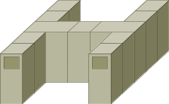
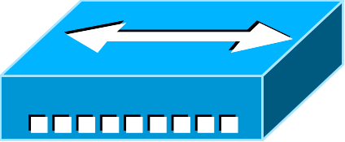
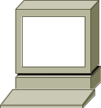
Physical Layer: Ethernet/802.3
10Base2—Thin Ethernet(kabel tipis)
10Base5—Thick Ethernet(Kabel tebal)
Host
Hub
10BaseT—Twisted Pair
(UTP)
Hosts

Slide 25
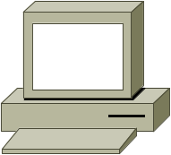
Device Used At Layer 1
Physical
A
B
C
D
  Semua device didalam collision domain yang sama.
  Semua device didalam broadcast domain yang sama.
  Barbagi pakai bandwidth dalam Device.

Slide 26


Hubs & Collision Domains
Ada dua stations melakukan transmisi bersama, terjadi tabrakan.
Pada metode CSMA/CD.
Notes:
Tk-10-7

Slide 27
Layer 2
MAC Layer—802.3
Number of Bytes
8
6
6
2
Variable
4
Preamble
Destination Address
Source Address
Length
Data
FCS
Ethernet II uses “Type” here and
does not use 802.2.
  0000.0C xx.xxxx
IEEE Assigned
Vendor Assigned
  MAC Address
synchronize senders and receivers
Notes:
IEEE’s Version of Ethernet
There are actually two variants of Ethernet: IEEE’s implementation and the DIX implementation. Ethernet was developed by three different companies in the early 1980s: Digital, Intel, and Xerox, or DIX for short. This implementation of Ethernet has evolved over time; its current version is called Ethernet II. Devices running TCP/IP typically use the Ethernet II implementation.
The second version of Ethernet was developed by IEEE and is standardized in the IEEE 802.2 and 802.3 standards. IEEE has split the data link layer into two components: MAC and LLC. These components are described in Table 2-5. The top part of the data link layer is the LLC, and its function is performed in software. The bottom part of the data link layer is the MAC, and its function is performed in hardware.
Logical Link Control (LLC) 802.2
Defines how to multiplex multiple network layer protocols in the data link layer frame. LLC is performed in software.
MAC 802.3 Defines how information is transmitted in an Ethernet environment, and defines the framing, MAC addressing, and mechanics as to how Ethernet works. MAC is performed in hardware

Slide 28

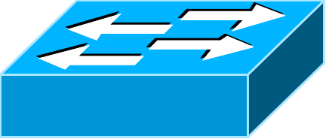
Devices On Layer 2
(Switches & Bridges)
Data-Link
OR
1
2
3
4
1
2
  Satu segment mempunyai collision domain.
  Semua segment didalam broadcast domain yang sama

Slide 29
Switches
Switch
Memory
Sebuah segment memiliki collision domain.
Penyebaran (broadcast) diteruskan ke selurah segment.
Notes:
TK16-15

Slide 30
Layer 3 : Network Layer
  Mendefiniskan alamat sumber dan tujuan
  Pengelompokan dengan specifikasi protocol
  Mendefinisikan bagian ke jaringan
Network
IP, IPX
802.2
Data-Link
Frame Relay
HDLC
Ethernet
802.3
Physical
EIA/TIA-232
V.35
Notes:
Logical Addressing – scenario Explain

Slide 31
Layer 3 : (cont.)
Network Layer End-Station Packet
IP
Header
Source
Address
Destination
Address
Data
  Logical Address
  172.15.1.1
Network
Node
Penetapan jalur di lapisan ini, juga sejumlah packet termasuk alamat sumber dand tujuan.
Lapisan Network terdapat dua komponen : untuk melakukan penjaluran dalam jaringan, dan nomor node untuk alamat device secara spesifik. Contoh: gambar IP packet dan alamat.

Slide 32
Layer 3 (cont.)
Address
Mask
172.16.122.204 255.255.0.0
172
16
122
204
Binary
Address
10101100
00010000
01111010
11001100
255
255
0
0
Binary
Mask
11111111
11111111
00000000
00000000
Network
Host

Slide 33
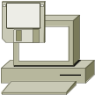


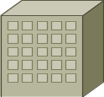

Device On Layer 3
Router
Pengedalian Broadcast
Pengendalian Multicast
Penetapan arah secara optimal
ManajemenTraffic
Pengalamatan secara logika
Koneksi ke layanan WAN

Slide 34
Layer 4 : Transport Layer
Membedakan antara lapisan atas aplikasi
Membuat koneksi end-to-end antara aplikasi
Mendefinisikan Pengaturan aliran
Layanan trasnfer data yang handal atau tidak handal
Transport
TCP
UDP
SPX
Network
IP
IPX
Notes:
Another function of the transport layer is to set up and maintain connections for the session layer. The information transferred to devices at the transport layer is called a segment. Because multiple connections may be established from one device to another device or devices, some type of multiplexing function is needed to differentiate between the various connections. This ensures that the transport layer can send data from a particular application to the correct destination and, when receiving data from a destination, get it to the right application.
To accomplish this feat, the transport layer assigns a unique set of numbers for each connection. These numbers are called port or socket numbers. There is a source port number and a destination port number for each connection. The destination port numbers assigned by the source device are referred to as well-known port numbers. The source device uses an appropriate port number in the destination port field to indicate to the destination which application it is trying to access. For example, the TCP/IP protocol stack gives each application a unique port number.

Slide 35
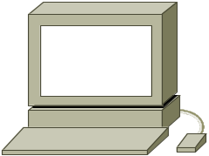

Reliable Service
(Layanan Handal)
Sender
Receiver
Synchronize
Acknowledge, Synchronize
Acknowledge
Connection Established
Data Transfer
(Send Segments)
Notes:
A DNS query is a good example where using a connection-oriented service doesn’t make sense. With a DNS query, a device is trying to resolve a fully qualified domain name to an IP address. The device sends the single query to a DNS server and waits for the server’s response. In this process, only two messages are generated: the client’s query and the server’s response. Because of the minimal amount of information shared between these two devices, it makes no sense to establish a reliable connection first before sending the query. Instead, the device should just send its information and wait for a response. If a response doesn’t come back, the application can send the information again or the user can get involved. Again, with DNS, you can configure two DNS servers in the Microsoft Windows operating system. If you don’t get a reply from the first server, the application can use the second configured server.

Slide 36

How They Operate
Hub
Bridge
Switch
Router
Collision Domains:
1 4 4 4
Broadcast Domains:
1 1 1 4

