Slide 1
Jargon
Partition: a subsection of the mesh (often 1-to-1 match with number of processors that will be used to conduct the simulation)
  Note: some nodes/elements contained in the partitions may overlap but each node/element has exactly one parent partition (partitions can contain nodes/elements with a different parent partition if needed as ghost nodes/elements)
Partitioning algorithm: algorithm that takes the domain and partitions into the partitions by assigning a parent partition for each node/element (preferably with each partition having about the same number of nodes/elements)
Component: an region of the mesh that represents a physical entity, such as a constituent
Subcomponent: a part of a component that is contained within a partition
LCS: local (material) coordinate system (the coordinate system that oriented to align with underlying features of the material, such as fibers)

Slide 2
Current Problem
Fragmentation
  BSAM Classic:
    Uses ASCII .dat file for output (slow I/O)
    Includes mesh information in input file (slow parsing of input file and large files)
    Requires converters to visualize in ParaView and get data into Python data structures
  BSAM++:
    Requires a new format with parallel I/O and suitable for distributed data
    Would benefit from native method for visualizing in ParaView and processing with Python libraries (Numpy, Pandas, etc.)
  Beta:
    Offers performant parallel I/O library with ParaView plugin (Partitioned-based Finite Element Compound file format)
    Requires converters for Python data structures
    Used by only four people
Redundant efforts
  Significant redundant code for I/O
  Everyone creates their own scripts or workflow to create common plots or visualizations

Slide 3
Proposed Solution
Develop an open-source file format that seeks to be adopted by the high-performance computing finite element community
Necessary features:
  Parallel I/O (not just parallel read)
  Seamlessly work with ParaView (requires plugin)
  Seamlessly work with popular Python libraries (requires small Python package)
  Light-weight C++ library that is heavily documented (to secure support of other devs)
  Balance number of files, size of files, and human readability

Slide 4
File Structure
Four categories of data:
  Meta data: ties all the files together
  Mesh data: includes nodes, elements, and local coordinate systems
  Whole-model data: all fields that are output for the entire domain
  Node/element set data: a combination of the node/element sets along with any data output
Two components for each (except meta data):
  JSON file: describes high-level information about what is in the file
  Binary file: compact with “coarse” random access (can jump to a specific component but not node/element)
Analysis folder
Input script
Pre-analysis meta
Mesh
Preprocessed data
Subfolder for one set of results
Post-analysis meta
TS 1 Data
TS 2 Data
TS 2 Cracked element set data

Slide 5
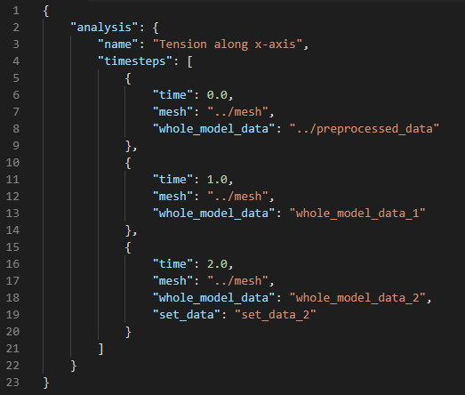
Meta data
Only has a JSON component
Example of Post-analysis meta:
Analysis folder
Input script
Pre-analysis meta
Mesh
Preprocessed data
Subfolder for one set of results
Post-analysis meta
TS 1 Data
TS 2 Data
TS 2 Cracked element set data

Slide 6
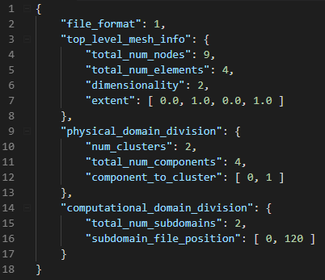
Mesh data
Has JSON and binary component
See example of JSON
Binary file contains:
  List of partition entries
  For each partition:
    Subdomain-level statistics
    Node and element information
    List of components entries
    For each component:
      List of element indices (partition numbering) that belong to component
      List of node indices (partition numbering) that are connected to an element in the component
      Local coordinate system definitions:
        Component, element, or nodal level
        Quaternion, angle-axis, Euler angle (some), 2-vector, and 3-vector parameterization
Example of JSON:

Slide 7
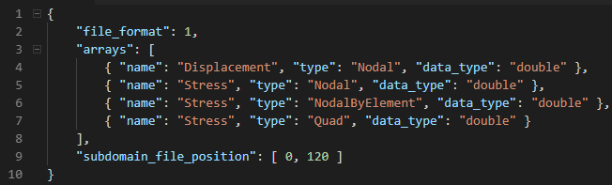
Mesh data
Example of JSON:
Has JSON and binary component
See example of JSON
Binary file contains:
  List of partition entries
  For each partition:
    Subdomain-level statistics
    Node and element information
    List of components entries
    For each component:
      List of element indices (partition numbering) that belong to component
      List of node indices (partition numbering) that are connected to an element in the component
      Local coordinate system definitions:
        Component, element, or nodal level
        Quaternion, angle-axis, Euler angle (some), 2-vector, and 3-vector parameterization

Slide 8
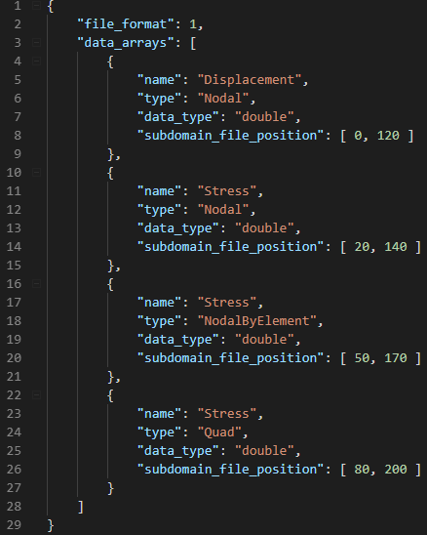
Whole-model data
Example of JSON:
Has JSON and binary component
See example of JSON
Requires mesh to read binary file (same ordering of nodes/elements for each component)
Still deciding whether the component level look-up should be in the JSON or binary (leaning towards JSON)

Slide 9
Node/Element set data
Has JSON and binary component
JSON:
  Names of sets
  Types of sets (element, nodes, etc.)
  Description of any data output for each set
Binary:
  Includes the list of nodes/elements in each set for each partition
  Data output for each set (if any)
Requires mesh to read binary file (same ordering of nodes/elements for each component)

Slide 10
Detailed Description of Mesh Data

Slide 11
Mesh Info (in JSON)
Description | Type | # of Values
File format version | Int32_t | 1
Total # of nodes | GlobalIndex | 1
Total # of elements | GlobalIndex | 1
Dimensionality | LocalIndex | 1
Extent (min x, max x, etc.) | CoordType | 2*dimensionality
# of components | LocalIndex | 1
Component IDs | LocalIndex | # of components
Component Names | String | # of components
Level at which LCS is assigned | Class enum LCSAssignment : char (component = 0, element = 1, node = 2) | 1
Parameterization of LCS | Class enum LCSParameterization : char (Quaternion = 0, AxisAngle = 1, EulerAngleXXX = …) | 1
Total # of partitions | LocalIndex | 1
Position in file for start of partition data (partition indexing implied, 0-based) | StreamPos | # of partitions
Top-level statistics about the mesh
Physical division of domain
Computational division of domain
Notes:
Note: the position in file was chosen to reside in this so that only the meta info needs to be updated across ranks

Slide 12
Partition Info
(JSON)
Description | Type | # of Values
Partition ID | LocalIndex | 1
# of nodes in partition | LocalIndex | 1
# of elements in partition | LocalIndex | 1
Total # connectivity entries | LocalIndex | 1
Extent of partition (min x, max x, etc.) | CoordType | 6
# of subcomponents within partition | LocalIndex | 1
Subcomponent info’s for this partition | Subcomponent | # of subcomponents within partition
Top-level statistics about the partition mesh
Component Information
Description | Type | # of Values
Component ID | LocalIndex | 1
# of nodes in subcomponent | LocalIndex | 1
# of elements in subcomponent | LocalIndex | 1
Subcomponent offset (offsets are relative to the end of “# of subcomponents within partition” in last slide) | StreamPos | # of subcomponents within partition
Subcomponent Info (JSON)

Slide 13
Description | Type | # of Values
Partition index | LocalIndex | 1
Node information | Node | # of nodes in partition
Element information | Element | # elements in the partition
Subcomponents | Subcomponent | # of components within partition
Partition
Description | Type | # of Values
Global number | GlobalIndex | 1
Parent partition | LocalIndex | Subdomain responsible for the node
Coordinates | CoordType | Dimensionality
Node
Description | Type | # of Values
Global number | GlobalIndex | 1
Element type (topology) | Class enum ElementType : char { … } | 1
Parent partition | LocalIndex | Subdomain responsible for the element
Connectivity of nodes using local indexing relative to partition list | LocalIndex | # nodes in element for element type (For types with an unspecified number of nodes, such as a polygon, the first index in the connectivity list will actually be # nodes)
Element

Slide 14
Subcomponent
Description | Type | # of Values
Subcomponent index (for error checking) | LocalIndex | 1
List of local indices of the nodes within subcomponent | LocalIndexList | 1
List of local indices of the elements within subcomponent | LocalIndexList | 1
# of LCS Parameters | LocalIndex | 1
LCS Parameters | CoordType | # of LCS Parameters
Mesh information
Local coord. system
Notes:
Excluding LCSAssignment::quad because the quadrature should not be specified this early. Just interpolate from nodes.
The number of LCS parameters could be calculated, but it is easier to store it.
The nodes and elements are provided for each component to allow the same ordering in the data file. It could be recalculated easily, but unless everyone agrees on the algorithm, then it could be difficult to keep everything consistent. It is easier to just provide the ordering for each component.
LocalIndexList contains [# of values, values…]

Slide 15
Detailed Description of Set Data

Slide 16
Description | Type | # of Values
Nodes or element indices in the partition (local numbering) | LocalIndex | # of nodes/elements in partition in group
Element information | Element | # elements in the partition
Subcomponents | Subcomponent | # of components within partition
Partition
Description | Type | # of Values
Global number | GlobalIndex | 1
Parent partition | LocalIndex | Subdomain responsible for the node
Coordinates | CoordType | Dimensionality
Node
Description | Type | # of Values
Global number | GlobalIndex | 1
Element type (topology) | Class enum ElementType : char { … } | 1
Parent partition | LocalIndex | Subdomain responsible for the element
Connectivity of nodes using local indexing relative to partition list | LocalIndex | # nodes in element for element type (For types with an unspecified number of nodes, such as a polygon, the first index in the connectivity list will actually be # nodes)
Element

