Slide 1


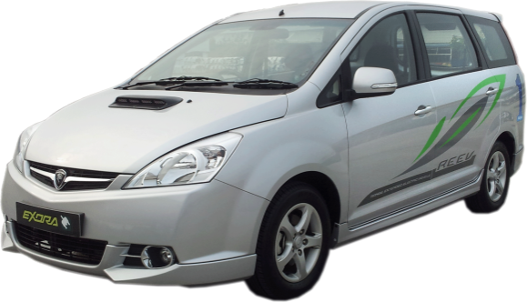
The Technology Behind The Charging Stations

Slide 2
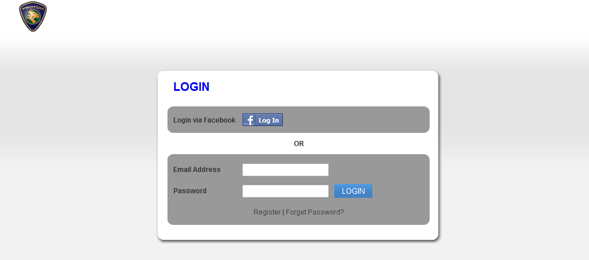
Charging station backend software
– SKY Driver web portal
www.greenlots.com/proton
Email address & Password : Will be given
Assessable through any internet connection. Mediums can be :
Laptop / PC
Smartphones
iPad

Slide 3
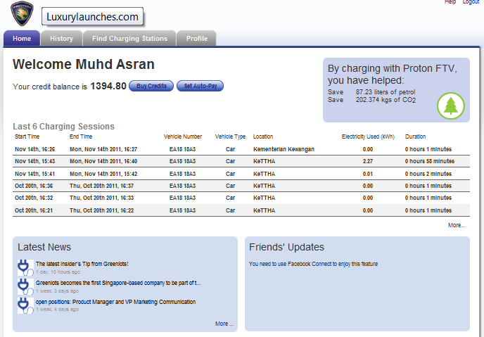
Charging station backend software
– SKY Driver web portal
Homepage shows:
Last 6 charging sessions
Latest News in FTV
Link to Facebook
Credit Balance
5. History tab
6. Find Charging Stations– locations of charging stations tab
7. Driver’s profile tab

Slide 4
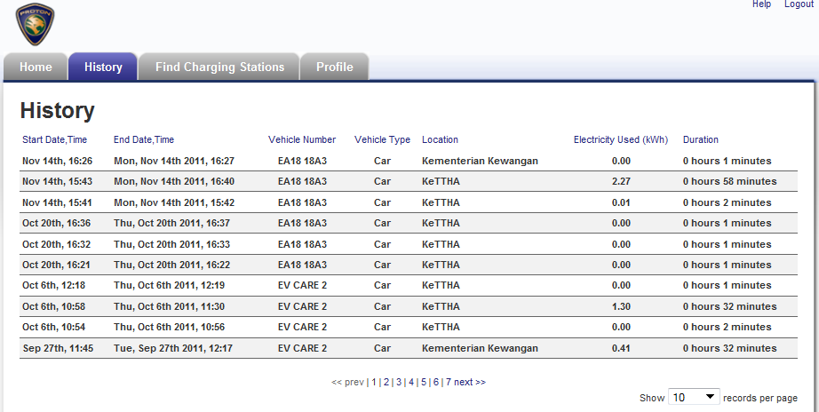
Charging station backend software
– SKY Driver web portal
History page shows:
Months of charging stations usage
Energy used
Duration charged

Slide 5
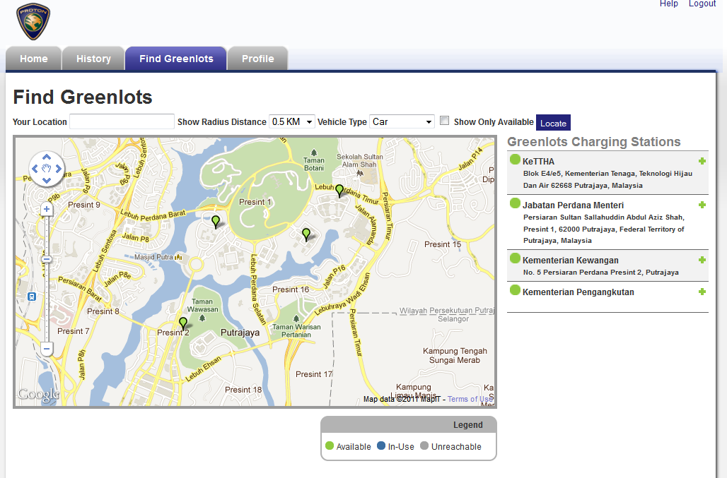
Charging station backend software
– SKY Driver web portal
Find Greenlots shows:
List of available charging stations in FTV
Status of each charging station ( Available, In use, Fault)
Shows direction from current location towards desired charging station

Slide 6
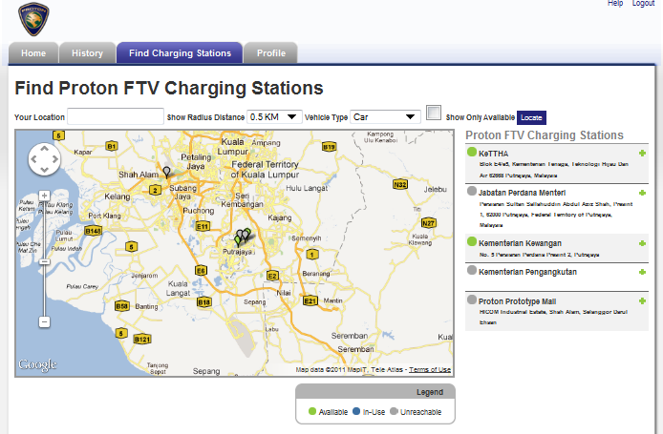
Charging station backend software
– SKY Driver web portal
Find PROTON FTV charging stations shows:
List of available charging stations in FTV
Status of each charging station ( Available, In use, Fault)
Shows direction from current location towards desired charging station

Slide 7
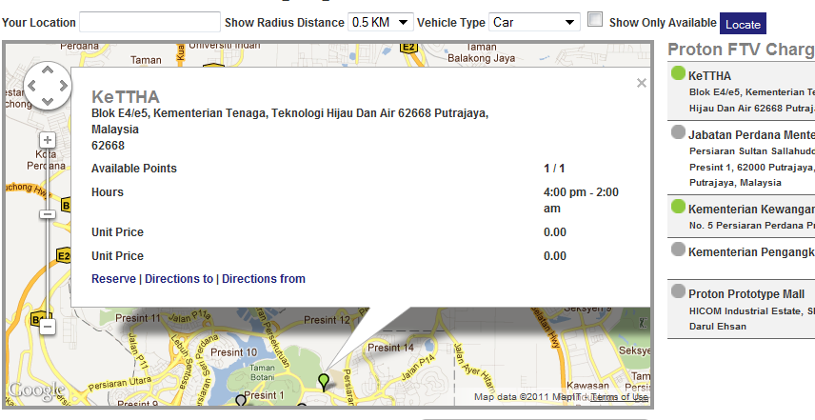
Charging station backend software
– SKY Driver web portal
Click “Directions to” to see route from your current location to the desired location. [applicable only using smartphone]
Click any desired charging station to reveal the details as shown above

Slide 8
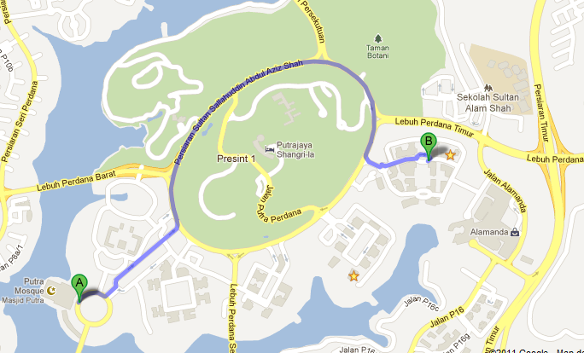
Charging station backend software
– SKY Driver web portal
The map will direct you to the desired (nearest charging station) effectively !

Slide 9
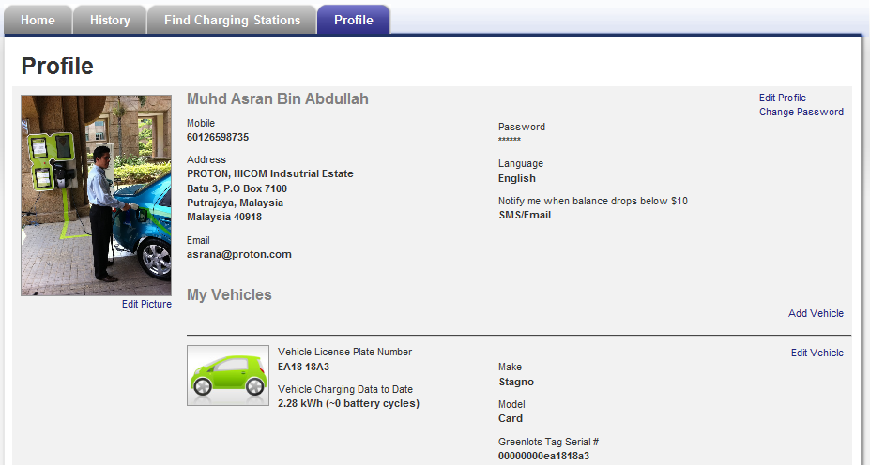
Vehicle Charging Overview
– Driver web portal
SMS will be sent to driver’s mobile number notifying start of charge & end of change.

