Slide 1

Storage Strategies
Name
Title
Microsoft Corporation

Slide 2

Presentation Summary
Version: Jul 2010
Technical Level: 300/400
Intended Audience: Developers, Architects
Intended Time: 60 minutes
Objectives (what do you want the audience to take away):
Understand the goals of a data partitioning strategy
Deal with very large volumes of data
Deal with very high transaction load
Understand the types of partitioning and how they apply to the Windows Azure Platform
Vertical and Horizontal Partitioning
Key selection, modulo partitioning and the need for hashing
Understand concepts of data modeling in Windows Azure Storage Tables

Slide 3
Outline
Data Partitioning
Vertical Partitioning
Horizontal Partitioning
Partitioning in
Windows Azure Storage
SQL Azure
Windows Azure Tables
Data modelling
Upgrade scenarios
Notes:
Slide Objective Introduce the session
Introduce partitioning as the scale out mechanism for the data tier
Speaking notes
Partitioning is the key to scale out in the data tier
Scale out is different here because by definition we can’t be stateless
Approach is to rather than have a bunch of homogenous machines to instead have each machine take responsibility for just a portion of the data
We’ll look at how to approach partitioning in both Windows Azure storage and SQL Azure
We’ve seen already that Windows Azure tables are not a relational database.
We’ll look at how to handle data modeling here
Finally we’ll look at the challenges of upgrading the data tier
It’s trivial to do a VIP Swap in Windows Azure as it’s stateless… Things are a bunch harder in the data tier
Notes

Slide 4
Why Partition
Traditional Reasons
Data Volume (too many bytes)
Work Load (too many transactions/second)
New ‘Cloud Focused’ Reasons
Cost (using different cost storage)
Elasticity (just in time partitioning for high load periods)
Notes:
Slide Objective
Understand why we need to partition
Understand the cloud specific drivers
Speaking notes
Partitioning is hardly a new topic
DBAs have been partitioning databases for a long long time
Two main reasons to partition
Data volume. There are just too many bytes to fit. For example SQL Azure has a maximum DB size of 50GB. If you have more data than that then you’ll need to partition
Work load Each partition can only handle so many transactions per second In Windows Azure tables for example partitioning is used to spread the request load over nodes in the storage system
There are some new cloud focussed reasons too
Cost Different types of storage have different costs Arguably we’ve been doing cost driven partitioning on premise for some time too- for example partitioning a table across both expensive 15k RPM drives and cheaper 7200 RPM drives In the cloud the cost difference can be far more pronounced
The cloud also provides a concept of elastic partitioning Whereas on premise a partition is often a separate server or separate disks with the related capital cost and lead time A partition in the cloud can be created and destroyed in a matter of seconds This presents the opportunity to create partitions just for a short period of time- say a period of peak load
Notes

Slide 5
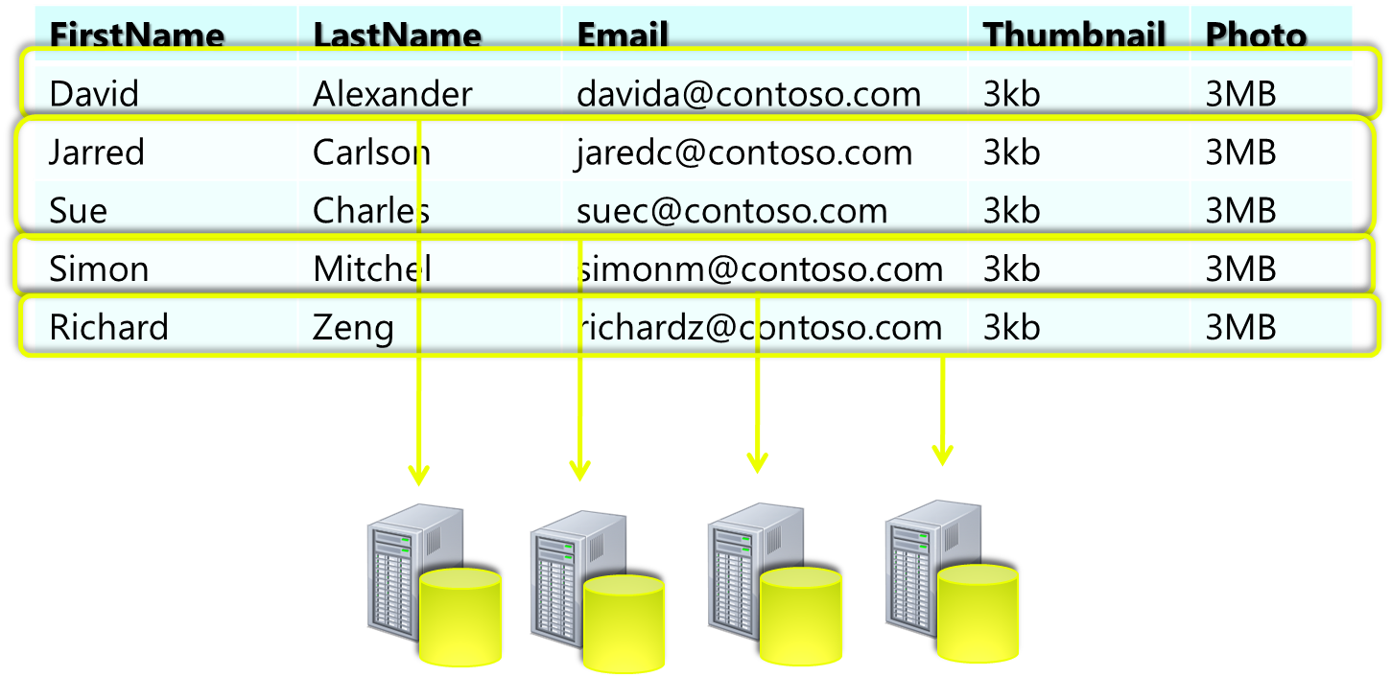
Horizontal Partitioning
Notes:
Slide Objective
Get a graphical overview of horizontal partitioning
Speaking notes
Horizontal partitioning involves taking horizontal slices through a data set
Each slice is placed onto a separate node
The schema on each node is the same
This example is partitioning by the first letter of the last name
Worth asking attendees if this is a good approach… It should spark some discussion and allude to some topics to come in the deck
Notes

Slide 6
Horizontal Partitioning (Sharding)
Spread Data Across Similar Nodes
Achieve Massive Scale Out (Data and Load)
Intra-Partition Queries Simple
Cross-Partition Queries Harder
Notes:
Slide Objective
Provide more detail on partitioning
Speaking notes
Horizontal partitioning involves taking horizontal slices through a data set
Each slice is placed onto a separate node
The schema on each node is the same
Horizontal partitioning allows us to achieve massive scale out
Queries within a partition are simple
Queries across partitions are hard
In most cases transactions cannot span partitions
In big systems a cross partition query may have to touch 100’s or even 100’s of machines
Does it do it in series? Parallel?
Can you ever actually get an authoritative result? Think of count(*) across 1000 partitions
You don’t want to hold locks across partitions as it’ll kill scalability
Notes
SQL Azure Horizontal partitioning
http://blogs.msdn.com/b/sqlazure/archive/2010/06/24/10029719.aspx

Slide 7
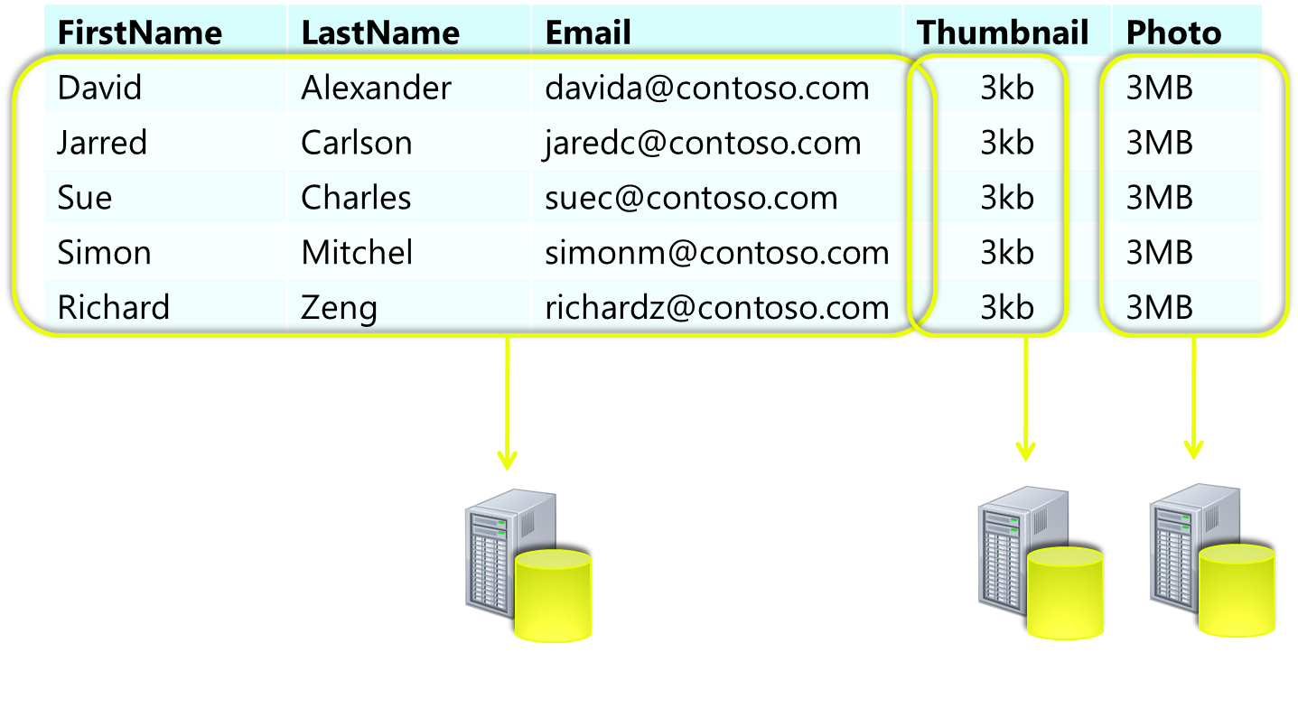
Vertical Partitioning
Notes:
Slide Objective
Get a graphical overview of vertical partitioning
Speaking notes
Vertical partitioning involves taking vertical slices through a data set
Each slice is placed onto a separate node
The schema on each node is different
Nodes will typically be quite different in character and cost
This example is partitioning indexed data onto SQL Azure and the larger binary parts of the data set into cheaper Windows Azure storage
Notes

Slide 8
Vertical Partitioning
Spread Data Across Dis-Similar Nodes
Place frequently queried data in more ‘expensive’ indexed storage
Place large data in ‘cheap’ binary storage
Retrieving a whole row requires >1 query
Notes:
Slide Objective
Provide more detail on vertical partitioning
Speaking notes
Vertical partitioning involves taking vertical slices through a data set
Each slice is placed onto a separate node
The schema on each node is different
Nodes will typically be quite different in character and cost
Because we need to query more than one partition it will always take more than one query to return a single row.
Notes
SQL Azure Vertical Partitioning
http://blogs.msdn.com/b/sqlazure/archive/2010/05/17/10014011.aspx

Slide 9
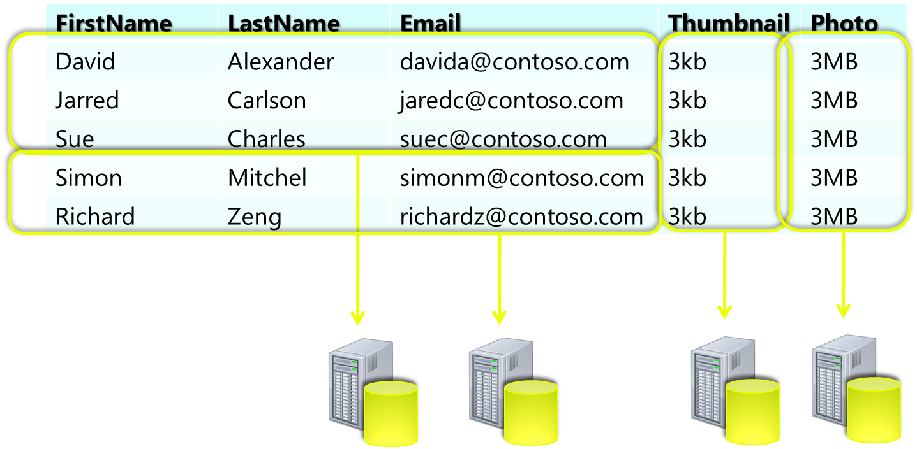
Hybrid Partitioning
Notes:
Slide Objective
Get a graphical overview of hybrid partitioning
Speaking notes
Hybrid partitioning combines both vertical and horizontally partitioning
IN this example the large data is first partitioned off into Windows Azure Storage
Then the data remaining in SQL Azure is horizontally partitioned
Notes

Slide 10
Horizontal Partitioning
Notes:
In this section we’ll drill into Horizontal Partitioning in quite some detail

Slide 11
Table Storage – Key Points
Partitions are Auto-Balanced
No need to partition into equal bins
Hot partitions may be scaled up
Windows Azure fabric may dedicate more resources to partitions with high Tx load
Partition Key AND Row Key = Unique ID
Must include PartitionKey for Create,Update,Delete
Select queries across partitions run sequentially
Don’t use sequential partition keys
Notes:
Slide Objective
Discusses horizontal partitioning in Windows Azure Table storage
Speaking notes
Table storage supports partitioning out of the box.
It is a key to scalability of table storage
The storage fabric can then load balance your partitions and potentially move ‘hot’ partitions to a dedicated node
There is no need to partition data into equal sized partitions
Rather just partition as aggressively as your application will permit- remembering that your scope of a transaction (and ideally of any query) is a single partition
Create Read and Update operations always act within the scope of a partition and need the partition key. This means if you want to delete entities from a table without the partition key you’ll have to iterate over all the partitions yourself
Select queries across partitions run sequentially- you’ll receive the data off each partition in sequence;
Notes
Queue storage is partitioned by Queue name
Blob storage is partitioned by Bob name (i.e. partition size of 1)

Slide 12
Table Storage – Key Points
Continuation Tokens May Be Returned from Cross Partition Queries
Any query not including the Rowkey and PartitionKey (only those as well) needs to handle Continuation tokens http://tinyurl.com/ContToken
Key Columns Up to 1KB in size
Should aim to keep to 260 char URI limit
Be aggressive e.g. Only ever query by an ID? Use Unique partition key and RowKey = ‘ ‘ for a partition of 1
Notes:
Slide Objective
More detail that Discusses horizontal partitioning in Windows Azure Table storage
Speaking notes
Understanding the sequential nature of cross partition queries is important
Continuation tokens may be returned at any time (i.e. data comes back in multiple pages)
You will always get a continuation token if you cross a hardware boundary- i.e. you move between partitions that sit on different nodes
The Storage API handles continuation tokens elegantly, but, it may mask a poor architecture- YOU DO NOT WANT TO RUN A QUERY THAT CROSSES HUNDRED OF SERVERS!
Be aggressive with partitioning- if you’ll only ever query something by a single key use an empty Row key and a unique partition key for a partition of 1.
Can also just use blob storage which is already partitioned by Blob name
Notes
Queue storage is partitioned by Queue name
Blob storage is partitioned by Bob name (i.e. partition size of 1)
http://www.syringe.net.nz/2009/08/08/SimplePartitioningWithWindowsAzureTableStorage.aspx
http://nmackenzie.spaces.live.com/Blog/cns!B863FF075995D18A!417.entry
Good article from Julie Lerman. Worth reading when discussing table storage
http://msdn.microsoft.com/en-us/magazine/ff796231.aspx

Slide 13
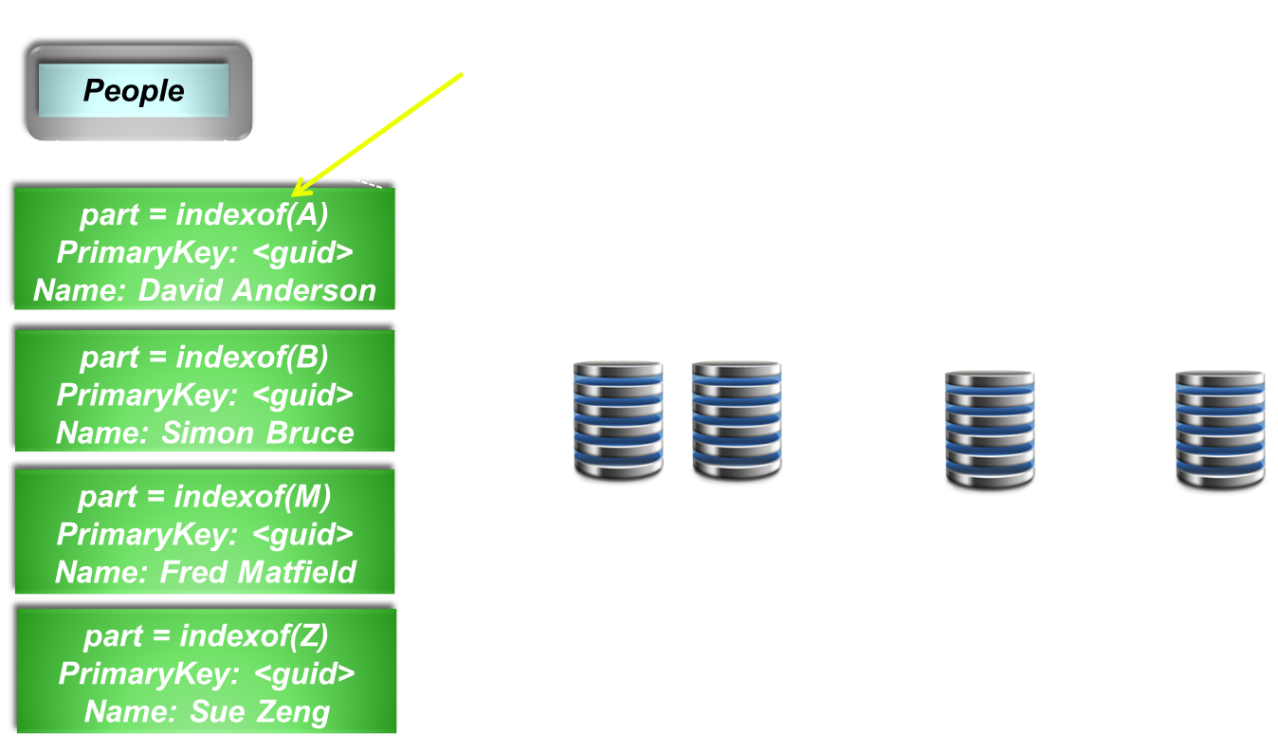
Horizontal– SQL Azure
Notes:
Slide Objective
Describes the fact that in SQL Azure out partitions actually sit in individual databases
Speaking notes
In SQL Azure each partition is a separate SQL Azure database
In our application layer we need to write some sort of heuristic to route the query to the correct location
In this case we’re partitioning our data by first letter of last name
Is this a good approach?
Notes
SQL Azure Horizontal partitioning
http://blogs.msdn.com/b/sqlazure/archive/2010/06/24/10029719.aspx

Slide 14
SQL Azure – Key Points
Partition for
Data volume > 50GB
Transaction throttle (non deterministic) Always code for retry
All partition logic up to the developer
Algorithmic
Lookup based
Partitions are not Auto-Balanced
Need to aim for ‘equal’ partitions
‘Equal’ not necessarily the same size
Notes:
Slide Objective
Provide detail on SQL Azure Horizontal Partitioning
Speaking notes
In SQL Azure each partition is a separate SQL Azure database
We partition in SQL Azure for two key reasons
We have more than 50GB of data and are therefore too large for the biggest Business Edition database
We have a very high transaction load and therefore we are frequently throttled
In our application layer we need to write some sort of heuristic to route the query to the correct location
Can use some sort of algorithm
May store a separate lookup table to help I routing requests
Because we pay for SQL Azure in whole 1GB+ increments we want to have our partitions be as equal as possible
If we are partitioning for size, equal means equal size
If we are partitioning for load, equal means equal load
Notes
SQL Azure Horizontal partitioning
http://blogs.msdn.com/b/sqlazure/archive/2010/06/24/10029719.aspx

Slide 15
Choosing a Partition Key
Natural Keys
Country
First letter, last name
Date
Mathematical
Hash functions
Modulo operator
Lookup Based
Lookup table to resolve value to partitions
Notes:
Slide Objective
Discusses how to choose a partition key
Speaking notes
Natural keys are often very good for partitioning.
For example you may choose to break up data by geographical region
Natural keys can also cause problems
Partitioning by things like first letter last name can be bad Your ‘S’ partition will be too full and your ‘Z’ partition will be all but empty… unless you’re in an Asian country where the opposite is true
You may want to use a mathematical operator to assist in partitioning
We’ll discuss these shortly
Finally you may want to use a lookup table
You may for example in an SaaS application partition each customer into their own database and then lookup the database to use at runtime based on the host header that was used to visit the site
Notes
SQL Azure Horizontal partitioning
http://blogs.msdn.com/b/sqlazure/archive/2010/06/24/10029719.aspx

Slide 16
Using Modulo
The remainder of a division
Nice properties for partitioning:
Given two positive integers M and N
M mod N will return a number between 0 and N-1
Want equi-sized partitions?
Given an appropriate distribution of M we will get N ‘equally full’ buckets.
Notes:
Slide Objective
Describes Modulo partitioning
Speaking notes
The module operator is very useful for partitioning exercises
The important thing here is having a good distribution
Notes
http://social.msdn.microsoft.com/Forums/en-US/windowsazure/thread/985a3198-ba54-4dcc-932c-0e6bdb166a46

Slide 17
Distributions and Partitioning Approaches
demo
Name
Title
Group

Slide 18
Using Hash Values
Using A Hash Function Projects One Distribution into Another
Use a hash function that projects a random distribution
Do NOT use a cryptographic hash function
Be careful if using Object.GetHashCode()
Boxed types may return different value to un-boxed equivalent
Notes:
Slide Objective
Describes the use of hash functions
Speaking notes
If you haven’t got a good distribution, as we saw in the demo, you need to has your data
You want a hash function that projects any distribution into a random distribution
Using Crypto has functions is bad because, while they produce a random distribution, they have other properties like being very hard to reverse which leads them to be quite expensive to compute
Use a Hashtable focused function
Be careful when working with types that may be boxed or unboxed – that is represented as either a reference type or a value type
These will return a different hash code for the same value
Also be careful with reference types generally as the default Object.GetHashCode() method will return a hash of the memory address that is referenced which means that the same value (stored in two different reference types) will return two different hash values
Notes
Good post on Hashing including code in C#
http://home.comcast.net/~bretm/hash/

Slide 19
Re-Distribution via a Hash
demo
Name
Title
Group

Slide 20
Partition Stability over Time
May need to change partitioning scheme
Two options
Re-partition all data or;
Version partitioning scheme e.g. <Version><PartitionKey> <v1><A3E567D7D8C68789> <v2><A8B978C8B6D77836> where v1 = GUID mod 4 v2 = GUID mod 10
Notes:
Slide Objective
Describes the challenge of managing partitions over time
Speaking notes
As applications grow and change so may our partitioning needs
How do we deal with this
What happens if we need to re-partition our data?
We will need to process it into a new partitioning scheme
We can also version our partitioning scheme such that our partition keys include an identifier to resolve the partition scheme to be used
IN the example above we’ll end up with 14 partitions- 4 for the v1 scheme, 10 for the v2 scheme
Notes

Slide 21
Just in time Partitioning
In SQL Azure Partitions Cost Money
In highly elastic scenarios partitions may be needed for just a few hours or days
If load is predictable
Partition before load commences
De-partition after load has subsided
Notes:
Slide Objective
Discusses just in time Partitioning
Speaking notes
Cloud computing is unique in that we can take advantage of the pay as you go business model and only create partitions for the short period of time we need them
If we have periods of peak load we can partition our data out of a single SQL Azure database for example, into a couple of hundred databases.
We can then deal with the load
Then reconsolidate the data back into a single database’
Notes

Slide 22
Vertical Partitioning

Slide 23
Goals for Vertical Partitioning
Balance Performance vs. Cost
Use appropriate storage for type of data
SQL Azure
Fully indexable
No query transaction charge
$9.99/GB/Month
Windows Azure Storage
Limited Indexing
Pay per Query
$.15/GB/Month
Notes:
Slide Objective
Discusses vertical partitioning
Speaking notes
It doesn’t make sense to talk of vertical partitioning in relation to each of the types of storage specifically
Reason is that vertical partitioning will usually span two or more types of storage
Vertical partitioning in the Windows Azure Platform is all about placing the appropriate data into the appropriate storage type.
Small, frequently queried data is suited to SQL Azure
Very large data is well suited to Windows Azure storage
Notes

Slide 24
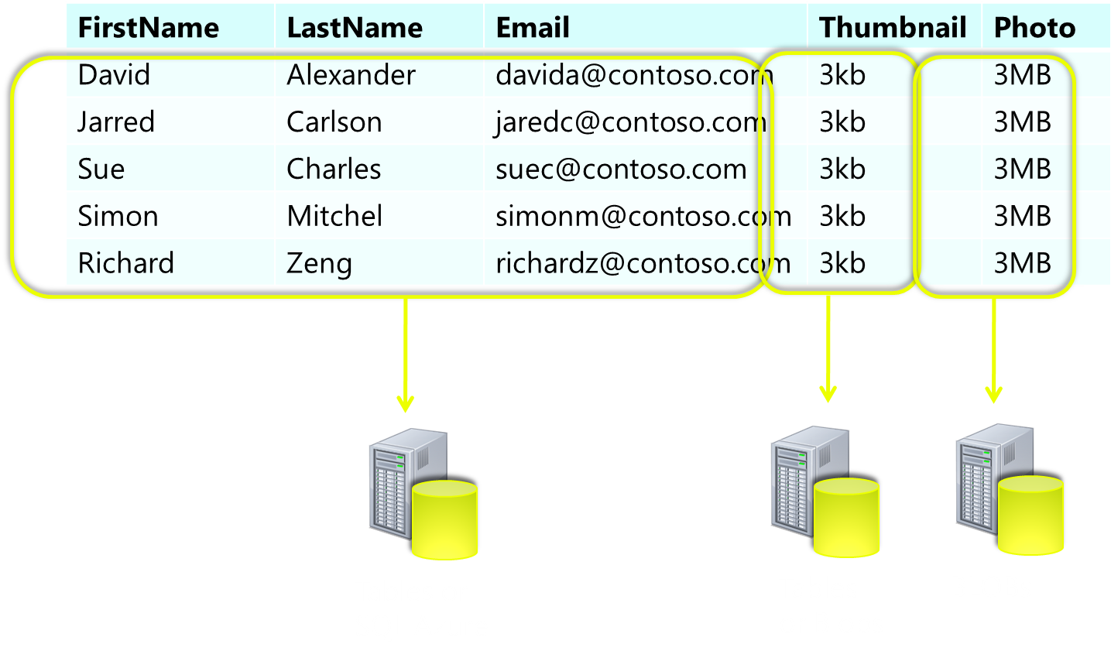
Vertical Partitioning
Notes:
This example will be described in more detail on the next slide

Slide 25
Worked Example
Searchable Data in Table Storage or SQL Azure
Indexed (SQL Azure)
No cost per query (SQL Azure)
Lower cost storage (Windows Azure Table Storage)
Thumbnails in Tables
Binary Properties < 64kb
Batch queries saves transaction costs
Full Photos in Windows Azure Blob Storage
Can handle large data
Can stream full sized files direct back to HTTP client via CDN if needed
Notes:
Slide Objective
Discusses vertical partitioning in a worked example
Speaking notes

Slide 26
Non-Relational Data Modelling

Slide 27
Tables != RDBMS
Storage is cheap
Cross partition queries are resource intensive
Aggressive data duplication can save money and boost performance
Goal: To be able to include Partition Key in all queries
Notes:
Slide Objective
Introduces the challenges of data modeling for non relational data stores like Windows Azure tables
Speaking notes
The cloud is all about different ways of buying resources.
Storage is very very inexpensive.
Queries can become quite expensive, particularly in very large systems
In many cases performing aggressive data duplication (in effect building your own indexes) can save money and greatly improve performance
The GOLDEN RULE of Windows Azure Tables data modeling is to endeavor to include your partition key in every query
Notes
http://msdn.microsoft.com/en-us/magazine/ff796231.aspx

Slide 28
E.g. Tweet Storage
Tweet
TweetID
UserID
DateTimeStamp
Message
With an RDBMS you’d probably start something like this.
SELECT * FROM Tweet WHERE Message Like %SearchTerm%
Notes:
Slide Objective The next few slides build on each other
Run through the worked example
Speaking notes
Suppose we want to build a tweet search engine
Twitter creates quite a bit of data; it’s well suited to storing in Windows Azure tables
In SQL land we might start with a simple like query.
This table scans every time…. We soon realize this is no good
Notes
See also Sririam Krishnans Programming Windows Azure title from O’Reilly which contains a more detailed example of this

Slide 29
E.g. Tweet Storage
You’d soon realize that LIKE isn’t so wonderful. You’d do a little normalization
Tweet
…
Message
TweetWord
TweetID
WordID
Word
WordID
Word (IX)
Which quickly becomes this as len(key) approaches AVG len(word)
Tweet
…
Message
Word
TweetID
Word (IX)
Notes:
Next we’d probably pull the words out into a separate table, i.e. spit each tweet into separate words
We’d soon realize that we could collapse the Word table back into the index as we’d end up in a situation where the primary keys on the associative table were longer than the word itself- so we’re better to duplicate the word as rows in the word table

Slide 30
E.g. Tweet Storage
With Tables we go the whole way
Tweet
TweetID (RK)
UserID (PK)
DateTimeStamp
Message
TweetIndex
TweetID (RK)
UserID
DateTimeStamp
Message
Word (PK)
Worker Role Creates
GET All Entities in Partition ‘DavidA’ from Tweet
GET All Entities in Partition ‘Foo’ from TweetIndex
Notes:
IN Windows Azure tables we take this one step further.
We basically use worker roles to create indexes for us
So in the above example I can
Retrieve all the Tweets made y a certain user by querying the Tweet table and including the user ID (there is a partition per user)
Retrieve all the Tweets that contain a particular word by querying from the TweetIndex table and including the Word (there is a partition per word)

Slide 31
E.g. Tweet Storage
We may create multiple indexes.
Tweet
TweetID (RK)
UserID (PK)
DateTimeStamp
Message
MentionIndex
TweetID (RK)
UserID
DateTimeStamp
Message
UserID (PK)
Worker Role Creates
GET All Entities in Partition ‘DavidA’ from TweetIndex
Notes:
We may the choose to create a MentionIndex where the data is not partitioned by the person who wrote the tweet but rather by the person(s) who were mentioned in a tweet. If a tweet mentions 4 users it’ll appear 4 times in the MentionIndex table in four different partitions

Slide 32
Modelling In Tables
Currently no secondary indexes (coming)
Be careful to minimize cross partition queries
Build indexes yourself
Concentrate on useful partition keys
If associated data is small enough
Save additional queries
Duplicate data with each index
Notes:
Slide Objective Provide some final notes on Tables data modeling
Speaking notes
There are no secondary indexes so querying on any variable other than the Row key will result in a partition scan- keep partitions of manageable size for this
You should ALWAYS include the partition key in your queries- build your data model top support this
If you are building your own indexes then you can often include related data if it is small enough- Tweets are conveniently small for our example!
Notes
See also Sririam Krishnans Programming Windows Azure title from O’Reilly which contains a more detailed example of this

Slide 33
Upgrade Scenarios for the Data Tier

Slide 34
Entity Shape Change
Have a version property in each entity
Types of Shape Change
Adding non-key properties
Two step upgrade process
Use ADO.NET’s “IgnoreMissingProperties”
Removing non-key properties
Similar two step process to adding
In addition use ADO.NET’s “ReplaceOnUpdate”
Changing Partition key or Row key
Copy entities to a new table
Notes:
Slide Objective These next few slides build and tell a story one after the other Introduces the challenge of upgrading the data tier
Speaking notes
Because it’s stateful, by definition, it’s hard to modify the state tier of an application
It’s important to version your data model and write version aware code that can understand and deal with data structure changes
Because they are schema less Windows Azure Tables provide a good degree of flexibility for change over time- need to be careful that change does not cause exceptions or other undesirable behavior in the application tier
IN this next section we’ll discuss how to approach situations where you need to
Notes

Slide 35
Adding Additional Property
Partition Key | Row Key | Version | …
PK1 | RK1 | 1
PK2 | RK2 | 1
PK3 | RK3 | 1
... | … | …
NEW Property
Client v1
Client v1
Release new version of Table Schema with NEW Property
Notes:
Most common type of schema change a service has to deal with is adding non-key properties
So we add a new property to the table schema and deploy that to storage, effectively upgrading our schema to v2

Slide 36
Upgrade Client to v1.5
Partition Key | Row Key | Version | …
PK1 | RK1 | 1
PK2 | RK2 | 1
PK3 | RK3 | 1
... | … | …
NEW Property
Client v1
Default
Client v1.5
V1.5 Client
If entity is v1
Store a default value
Do not upgrade the entity
V1 Client
Ignores new property, because it uses “IgnoreMissingProperties”
Notes:
Then we begin upgrading our clients, each upgrade domain at a time or via a VP swap
Now we may have two versions running side by side until the second upgrade domain gets upgraded.
Whilst we’re in this state of flux,
The V1.5 of client understands v1 & v2 of the entity
If this client gets a v1 entity it will set the new property to a default value because it understands that there is a new property there but does not upgrade the entity.
If V1 of the client picks up a v1 entity, all the properties are returned by the server but because it uses “IgnoreMissingProperties” ADO.NET strips the new property off before
presenting the entity to the client. As far as the client is concerned, the new property is not there.

Slide 37
Upgrade Client to v2
Partition Key | Row Key | Version | …
PK1 | RK1 | 1
PK2 | RK2
PK3 | RK3 | 1
... | … | …
NEW Property
Client v1.5
Default
Value 1
Value 2
2
Default
1
Client v1.5
Client v2
V2 Client
Starts using real values for new property
Updates entity to v2
V1.5 Client
Understands v1 and v2
Notes:
In time second upgrade domain will also get upgraded to v1.5
Then we can proceed to begin the upgrade to v2 of the client.
In a similar fashion to before we once again have 2 versions of the client.
Now if v2 of the client reads the entity it can update the new property to a real value and it upgrades the entity version to v2
At this stage if the v1.5 client reads an entity that is still v1 it behaves as before and stores a default but does not upgrade the version number.
If the v1.5 client reads an entity that is already upgraded it continues happily because it completely understands v2 entities.
But this client also understands how to deal with v2 entity when it sees it,
So if it reads a v2, here it can update the new property with real values instead of defaults

Slide 38
Upgrade Entities to v2
Partition Key | Row Key | Version | …
PK1 | RK1
PK2 | RK2
PK3 | RK3
... | … | …
NEW Property
Client v2
1
2
2
Value 2
Client v2
2
1
Use a background job to update version number of all entities
Notes:
The upgrade of all entities to v2 will happen naturally over time as v2 clients start working with the entities, but it may be useful to complete your upgrade by running a background job that goes through all entities and upgrades them to v2.

Slide 39
Summary
Partitioning Data Key to Cloud Scale Apps
Horizontally Partition for Scale Out
Vertically Partition for Cost/Performance
Choose appropriate partition keys
Table storage requires different approach to data modeling.
Don’t be afraid to aggressively de-normalize and duplicate data

Slide 40

© 2010 Microsoft Corporation. All rights reserved. Microsoft, Windows, Windows Vista and other product names are or may be registered trademarks and/or trademarks in the U.S. and/or other countries.
The information herein is for informational purposes only and represents the current view of Microsoft Corporation as of the date of this presentation. Because Microsoft must respond to changing market conditions, it should not be interpreted to be a commitment on the part of Microsoft, and Microsoft cannot guarantee the accuracy of any information provided after the date of this presentation. MICROSOFT MAKES NO WARRANTIES, EXPRESS, IMPLIED OR STATUTORY, AS TO THE INFORMATION IN THIS PRESENTATION.

