Slide 1

Introduction to SQL Azure Reporting
Name
Title
Company

Slide 2
Notes (hidden)
This version of the deck was built for the Windows Azure Platform Training Workshop hosted Dec-2011 in Redmond WA by the DPE Platform Evangelism Team
The content is up to date as of SQL Azure Service Update 5 which shipped 22-Oct-2010, and SQL Azure Reporting CTP1 which shipped in Nov-2010

Slide 3
Session Objectives and Takeaways
Session Objectives:
Overview of SQL Server Reporting Services
Get up to speed on SQL Azure Reporting
Key Takeaways
SQL Azure Reporting lets you innovate faster because it’s a managed service that lets you scale on demand
SQL Azure Reporting is uniquely positioned as an ideal reporting service for Windows Azure applications

Slide 4

Introducing Reporting Services 2008 R2
Delivers enterprise, Web-enabled reporting functionality
Queries a wide variety of data sources
Publishes reports in various formats
Manages security on content and tasks centrally
Supports pull- or push-driven report delivery
Scales to support thousands of users
Enables extensions to core functionality
Delivers ad hoc reporting capabilities
Available in all editions of SQL Server, except Compact
Notes:
Use this slide to introduce Reporting Services and to paint a broad picture of what Reporting Services does. Elaborate that Reporting Services is delivered as a series of Web services and a Windows service. Many of the points raised in this slide are elaborated in later slides; a more in depth discussion will be delivered immediately following this slide in the Reporting Life Cycle series of slides.

Slide 5
The Reporting Life Cycle - Authoring
Data access to a variety of sources
SQL Server, Analysis Services (cubes and data mining), Reporting Services Report Models, SharePoint Lists
Oracle, Teradata, Hyperion Essbase, SAP NetWeaver BI
OLE DB, ODBC, XML
Report Definition Language (RDL)
Report authoring options
Report Designer (hosted in BIDS)
Report Builder 3.0
Notes:
A strength of Reporting Services is that it can source data from practically any data source. Most popular common data sources are natively supported and are enumerated in the slide.
Introduce Report Definition Language (RDL) briefly here as it is covered in detail in the next slide. Mention that the language has been designed to define the entire definition of a report.
Microsoft provide three report authoring options but Report Builder 1.0 is out of scope for this course – just mention the two: Report Designer and Report Builder 3.0.

Slide 6
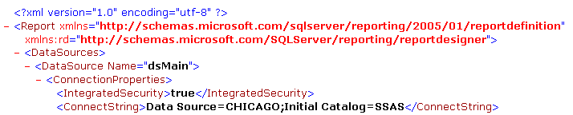
Report Definition Language (RDL)
RDL is an XML representation of report definition
Open and publicly documented schema used to:
Programmatically generate reports
Extend RDL with additional attributes and elements
Commonly graphic designers produce RDL
Notes:
A report is completely defined by an RDL document which is an XML grammar. It is a published standard that is supported by an XSD schema. Custom tags can be passed through to rendering extensions. The Report Definition specification is included in the resources slide at the end of this module.

Slide 7
The Reporting Life Cycle – Managment
Scalable Web service architecture
Managed report execution:
On-demand
Multi-user shared cache
Scheduled
Historical snapshots
Role-based security model
Object Explorer and Report Manager
Notes:
A central Report Server means that reports and their configurations (permissions, execution method etc.) are managed from one location. The Web service architecture was introduced in the Reporting Services 2008 R2 introductory slide. Principally the Report Server is scalable because in deployment it can be scaled out over multiple servers. From a “Managing” perspective, it is scalable because it can handle greater loads of users through the caching of report data.
Managed report execution will be presented specifically in later module. At this stage it is sufficient to provide examples of each of the bullet points:
On-demand: Use execute a report based on current data.
Multi-user shared cache: The report data can be temporarily stored and shared across all users – ideal for increased performance and/or to reduce the load on the database server, where the data in reasonably non-volatile.
Scheduled: Execution can be scheduled and the results saved temporarily on the Report Server to prepare the data for end-user reporting. This discussion could also be extended to subscriptions which are covered on the next slide.
Historical snapshots: The report data is permanently stored and made available as a history report. Use the example of monthly financial reports from the OLTP systems that you may need to go back and refer to over time.
Role-based security allows administrators to use predefined roles for securing reports and resources. Administrators can define their own roles also.
Report Manager and the Object Explorer feature of SQL Server Management Studio provide a convenient management interface of the Report Server instance.

Slide 8
The Reporting Life Cycle - Delivery
Runtime report rendering:
Hard page-break: PDF, TIFF (Image)
Soft page-break: Excel, Word, HTML, MHTML
Data renderers: CSV, XML, OData
Pull delivery: Report requested by user
URL Access (Report Manager or Report Server)
VisualStudio 2010 ReportViewer Control via WinForms or WebForms apps
SharePoint document library and Web parts
Push delivery: Report delivered by Report Server
Standard subscriptions
Data-driven subscriptions
Delivery to email, folder or document library
Notes:
Emphasize that the rendering process is a runtime concept: for on-demand reports the user selects the report and the format. This slide introduces the different rendering formats. Ensure students are familiar which each type. During the presentation of the different data regions and report items be sure to mention the appropriateness of each rendering format.
Make specific note about the ATOM render format. It enabled a report to be exported as data feeds. One common use of this rendering format is to allow the PowerPivot Add-in for Excel to import data from a Reporting Services report. This will be covered in the final module of this course.
Pull delivery refers to an external process or user requesting the report.
Push delivery refers to an internal process requesting the report. Discuss the two types of subscriptions here: Standard can be configured by users. The Data driven subscriptions are configured by administrators and allows the distribution of reports to multiple channels.

Slide 9
Reporting Services and SQL Azure
SQL Server Reporting Services hosted on premise
Support for SQL Azure as a data source
All SSRS tools and features work for reports against SQL Azure

Slide 10
Introducing SQL Azure Reporting
Who: Developers, System Integrators, Consultants and IT departments
Benefits: elasticity, scalability and reliability of cloud computing
Cost effective: Decrease Capital expenditure and time-to-solution
Symmetrical: Design, develop and deploy your BI solutions using the tools and expertise you already have and don’t worry about

Slide 11
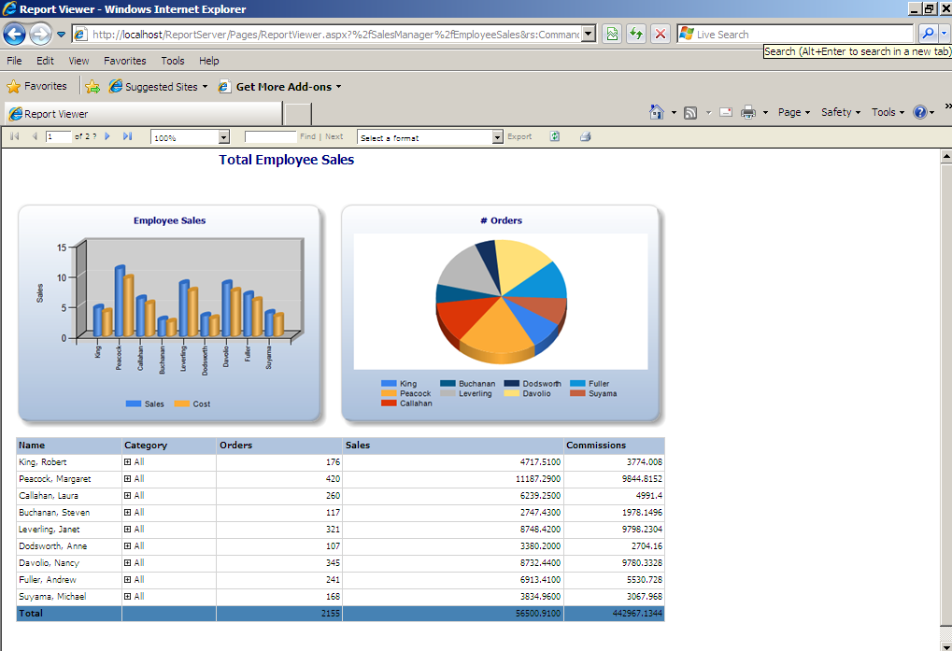
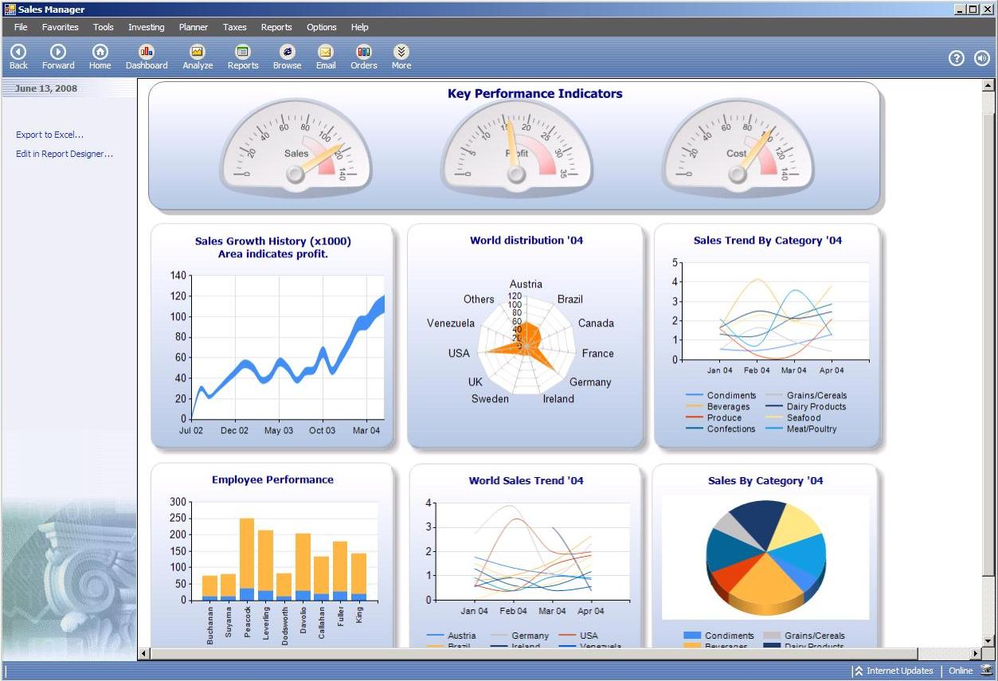
SQL Azure Reporting V1 Scenarios
“Operational reports over SQL Azure data” – Customers can report over their SQL Azure data, not necessarily with the intent to embed them into an application.
“Embedding reports into my Windows or Azure application” - Developers can use same patterns and tools they use today to embed reports into their applications in connected mode against Azure RS service.

Slide 12
SQL Azure Reporting V1 Feature Summary
 | Reporting Services | SQL Azure Reporting
Tooling | Business Intelligence Design Studio (BIDS) Report Builder | Business Intelligence Design Studio (BIDS) Report Builder*
Supported data sources | Diverse data sources | SQL Azure databases
Report Management | Report Manager or SharePoint display reports rendering to multiple formats subscriptions scheduled delivery | Windows Azure Developer Portal URL browsing
Developer Extensibility | Custom data sources, assemblies, report items, authentication, etc. | Extensibility is not yet enabled
Security Model | Windows Authentication | SQL Azure Username/password
*Authoring only - deployment to SQL Azure Reporting through BIDS

Slide 13
Architecture
https://[tenant].reports.windows.net/reports/report1.rdl
Multi-tenant: RS Gateway for “smart” routing, separated tenant DBs
Availability: SQL Azure will be the data tier for Azure Reporting
Elasticity: Built on Windows Azure
Supportability: Entire service captures monitoring and trace event data, runs on common management fabric
Security: SQL Server authentication and authorization model
Load Balancer
Gateway nodes
RS nodes
database.windows.net
Catalog
TempDB
Data Source
…
Notes:
QUESTIONS: If you had access to the execution log and other important logging data from the catalogDB, would you need access to these databases?

Slide 14

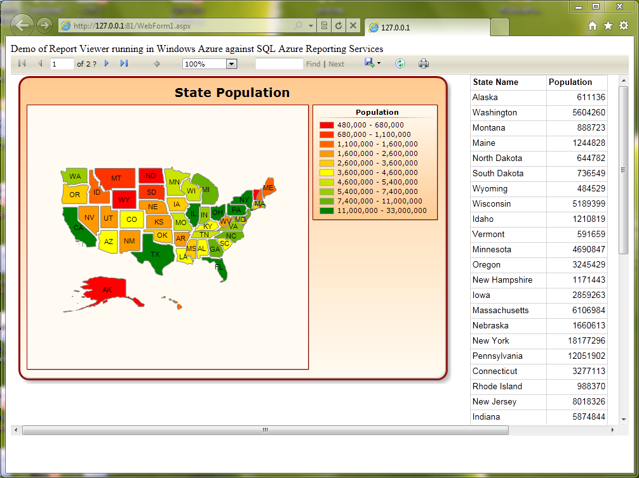
Security Model
Using the same roles and permission model as SSRS
Supports username/password (basic auth)
Windows Azure/Rich Client
Browser access
SQL Azure Reporting

Slide 15
SQL Azure Reporting in the Azure Developer Portal
Integrated with Windows and SQL Azure
Only the Azure Service Admin and Account Admin can access (similar to Windows and SQL Azure)
Provision the service
Select geo-location
Manage additional users
Assigning them to default roles of SSRS
Browse and manage items
Reports
Data sources

Slide 16
Developing Embedded Reports with SQL Azure Reporting
demo

Slide 17
Roadmap
CTP2 Available in Dec-2010
www.microsoft.com/sqlazure
http://blogs.msdn.com/sqlazure
Notes:
Common patterns
Do you expect more reads of cached reports vs querying every report execution in your application?
Do you expect to render an Azure report in a local win32 app?
How important are the custom extension capabilities to your adoption?
How important are subscriptions (jobs to schedule report execution) and delivery of those via email?
How many reports executed per day/month does your app currently undertake?

Slide 18
Summary
SQL Azure Reporting provides a highly available
cloud reporting service.
Managed Service
Scale On Demand
Innovate Faster

Slide 19

© 2010 Microsoft Corporation. All rights reserved. Microsoft, Windows, Windows Vista and other product names are or may be registered trademarks and/or trademarks in the U.S. and/or other countries.
The information herein is for informational purposes only and represents the current view of Microsoft Corporation as of the date of this presentation. Because Microsoft must respond to changing market conditions, it should not be interpreted to be a commitment on the part of Microsoft, and Microsoft cannot guarantee the accuracy of any information provided after the date of this presentation. MICROSOFT MAKES NO WARRANTIES, EXPRESS, IMPLIED OR STATUTORY, AS TO THE INFORMATION IN THIS PRESENTATION.

