Slide 1
AUTOMATION TESTING ON JpetStore
PRESENTED BY:
SHAIK AFROZ
TRAINER:
ANAND

Slide 2
INTRODUCTION
JPetStore is a user-friendly e-commerce website designed for pet lovers, offering a wide range of pet supplies, including food, accessories, and pet care products. It provides a seamless shopping experience with features such as detailed product listings, an intuitive shopping cart, and a hassle-free checkout process. Users can explore various pet categories, search for specific products, and make secure purchases. The website also includes user account management, allowing customers to register, log in, and manage their orders efficiently.

Slide 3
PROJECT OVERVIEW
Automated test framework for JpetStore.
Built using Selenium WebDriver, TestNG, Cucumber, Junit.
Implements Page Object Model (POM) and Page Factory.
Ensures seamless shopping experience by testing login, signup, cart management, and checkout functionalities.

Slide 4
PROBLEM STATEMENT & OBJECTIVE
Challenges with Manual Testing:
Time-consuming and labor-intensive.
Prone to human errors.
Inefficient for frequent UI changes and feature updates.
Project Objective:
Enhance testing efficiency and reduce execution time.
Automate workflows like login, product selection, cart management, and checkout.

Slide 5
TOOLS AND TECHNOLOGIES
Programming Language: Java
Build Tool: Maven
Testing Frameworks: TestNG, Cucumber
Automation Tool: Selenium WebDriver
Design Pattern: Page Object Model (POM), Page Factory
Reporting Tools: Extent Reports, Cucumber Reports, Allure Reports
Exception Handling: Try-catch blocks
Test Execution: TestNG XML, POM.XML

Slide 6
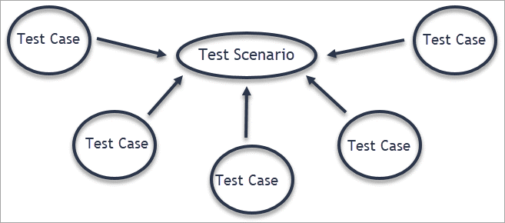
TEST SCENARIOS
SIGN UP
LOGIN
HOME PAGE
PRODUCT SELECTION
CART MANAGEMENT
CHECKOUT

Slide 7
REPORTS AND CONCLUSION
Test Reports:
Extent Reports: HTML-based detailed test logs.
Cucumber Reports: BDD-style execution details.
Allure Reports: Interactive and visual test execution insights.
Conclusion:
The framework effectively automates JpetStore’s core functionalities.
Ensures maintainability, scalability, and efficiency.
Future enhancements: API automation, performance testing, and CI/CD integration.

Slide 8


