Slide 1
ARCHITECTURE FOR RECOMMENDATION ENGINE OF E-COMMERCE PLATFORM
Name : Afroza Bilquis Happy

Slide 2
OBJECTIVE
As per assignment I am supposed to be running a start up since last one year and now I am able to gather some customer data and want to build a recommendation engine. Based on certain features I have clustered the customers into two different groups so that I can recommend the correct products based on the customer's cluster.
I have designed a model to predict the category of a new customer so that items can be recommended based on the category.
But there are some pros and cons in this technique which I have discussed.
Also I have proposed an architecture that will work more efficiently when building a recommendation engine for an e-commerce platform

Slide 3
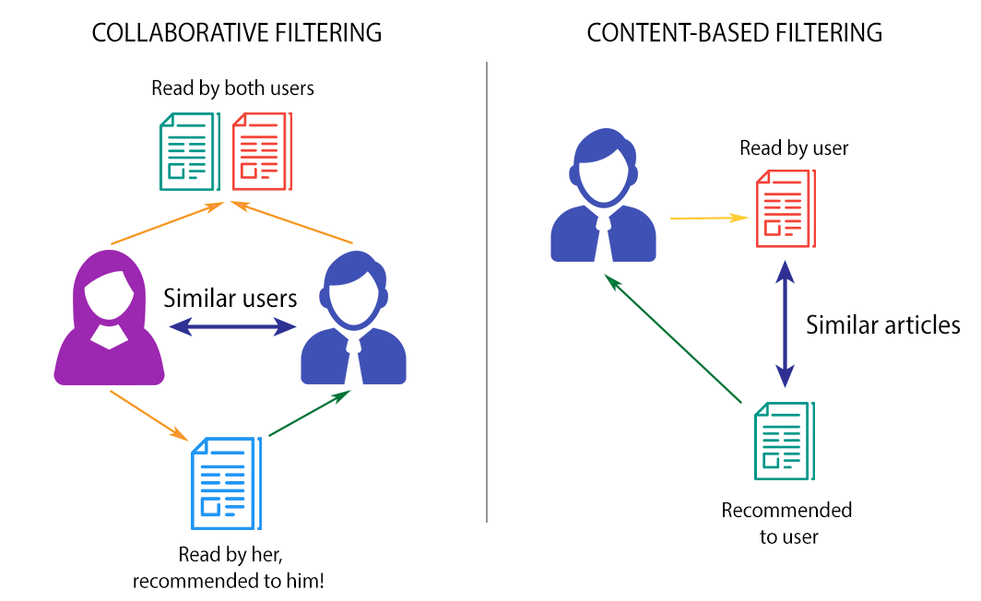
Types of Recommendation Systems
RECOMMENDATION
ENGINE
COLLABORATIVE​
FILTERING​
- Based on the user's
behaviour​
CONTENT-BASED​
FILTERING​
- Based on the
description of the item
USER - BASED
- Based on what similar
users like
ITEM - BASED
- Based on similar items
to users's previous likings.

Slide 4
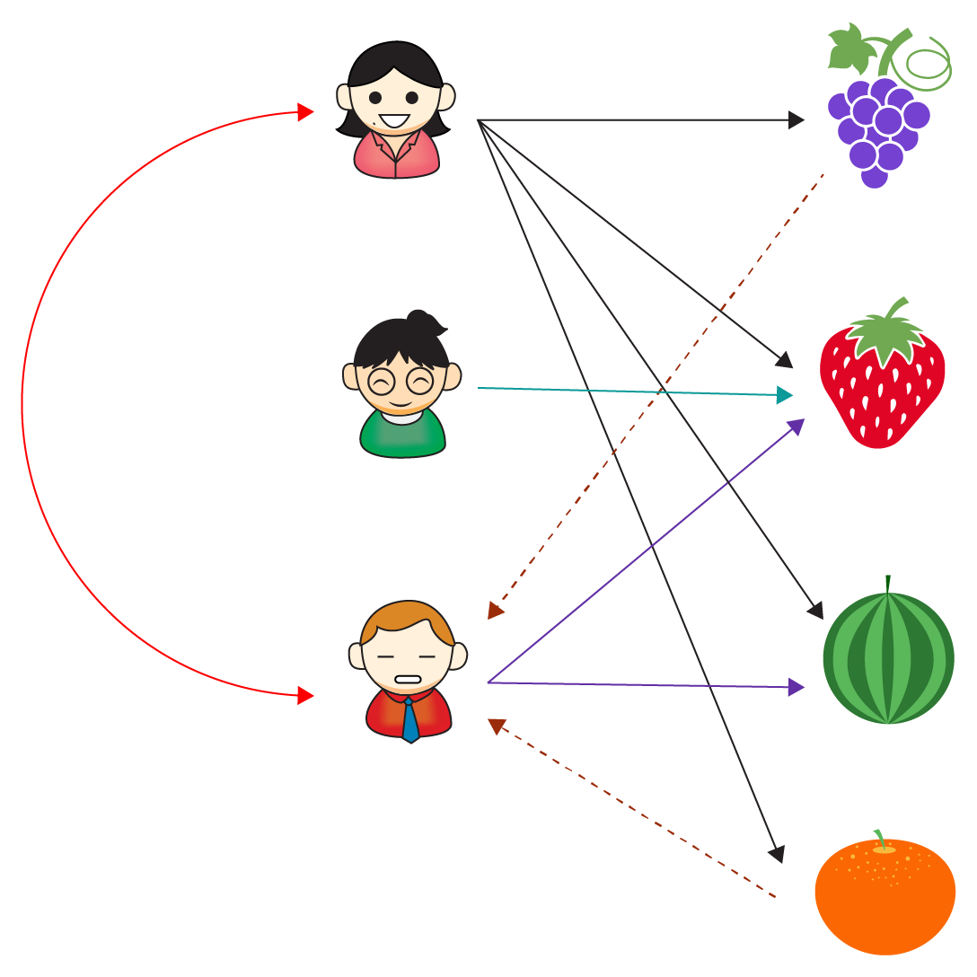
Problem Solving Methodology
In this assignment, we have all features related to the
users's history of purchase and no information about
the items that has been purchased by the user.
User- based collaborative filtering approach is being
used in this problem which predicts/ recommends the
items based on the behaviour of the user
Steps
- checks the ratings/ history/ behaviour of the customer.
- finds other users with similar behaviour/history of
purchase
- checks the items liked/ purchased by the other similar
customers and recommend those items to the target
customer.
In the assignment based on the user features provided,
the category of the customer is predicted based on
the category of other customers with similar nature.
Items liked/bought by customers
Items predicted based on user-
based collaborative filtering
Customers with similar nature

Slide 5
User-Based Collaborative Filtering
PROS
CONS
No Domain Knowledge​ required
User Item interaction​
Easy to implement​
Helps in understanding recent trends​ of the item
No information about the item is required​
Captures common changes in user's interest​
Expensive since there will be lots of user information​
Time consuming to train​ the model
Can't handle newly added item which have less customer interaction​
User nature changes very often and the entire model needs to be retrained​.

Slide 6
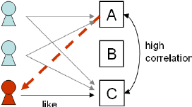
Item-Based Collaborative Filtering
To overcome the cons of user-based collaborative filtering , item-based collaborative filtering can be used.
In this method, recommendation system looks for similar
items based on items users have already liked or
positively interacted or purchased.
Computationally less expensive​
Needed to be trained less often ​
Less error​
More consistent since​ item's neighbourhood changes
slower compared to user's neighbourhood
Advantages

Slide 7
Content-Based Filtering
Another approach to recommendation systems is to use content based filtering.
This approach uses item features to recommend other items similar to what the user likes, based on their previous actions
For example:- a customer buys/likes a shirt on an e-commerce retail platform. Based on the colour, pattern, material etc. of that shirt, other similar shirts of same features will be recommended.
Pros
Cons
Shows similar items to what user likes/ purchases​
Doesn't need data from previous users.​
Works well for fresh items​ which have no user history.
Captures user-specific likes which maybe of interest to very few other users.​
Lot of domain knowledge is required​
Limited ability to expand​ for new users or those who do not explore variety of items
User will not have any knowledge of the recent trends of the items purchased.​

Slide 8
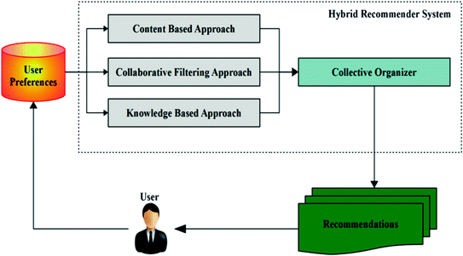
Hybrid Filtering
To overcome the cons of each technique, a Hybrid approach can be used , combining collaborative filtering and content-based filtering.
Such an approach will overcome the problems faced in collaborative filtering- where the model becomes unstable and is needed to retrain often. Also it overcomes the problems in content based filtering - where the model requires lot of domain knowledge and does not recommend the recent trends of other customers.

Slide 9
Hybrid Filtering
Let us consider the previous example used in content based filtering, where a customer buys a shirt fom a retail ecommerce platform and he is recommended a shirt having similar features(colour, pattern, sleeves etc.). Using hybrid filtering, the search engine will also check the history of other customers who have bought the same shirt. Suppose customers have liked/bought a pair of jeans or shoes with the shirt, the rcommendation engine in this case will recommend the similar shirt(content choice) as well as the pair of jeans or shoes (customer choice).
So, in this approach, our model will become more stable, consistent and accurate since it considers both customer behaviour and item behaviour and does not depend only on history of customers or domain knowledge of the item.

Slide 10
THANK YOU

