Slide 1
television
Presented by Team BITA

Slide 2
MEMBERS:
KAZI AMIRA ID;20-43546-1
SADIA ISLAM SAFINA ID;20-43539-1
KAJZZI MRIDUL ID;20-43531-1
AFROZA MAHOMUDA ID;20-43554-1

Slide 3
PRESENTED TO :
FARHAT TASANNUM FARAH
Course : English Reading Skills & Public Speaking

Slide 4
Contets ;
What is Television ?
How Television invented ?
Types of television
Advantages of Television
Disadvantages of Television
Television contribution in modern world
Future of Television
Conclution

Slide 5
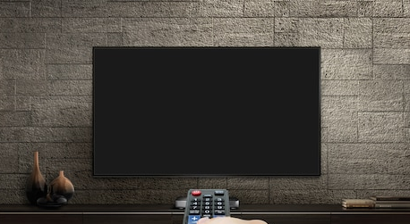
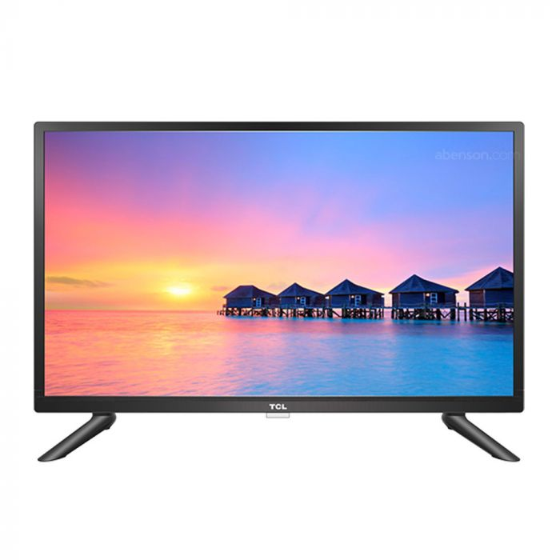
What is television :
The word television comes from Ancient Greek τῆλε (tèle), meaning 'far', and Latin visio, meaning 'sight’.
A system for converting visual images (with sound) into electrical signals, transmitting them by radio or other means, and displaying them electronically on a screen.
A device with a screen for receiving television signals.
Televisions receive broadcasting signals and change them into pictures and sound.
Television (TV), sometimes shortened to tele or telly, is a telecommunication medium used for transmitting moving images in monochrome (black and white)

Slide 6
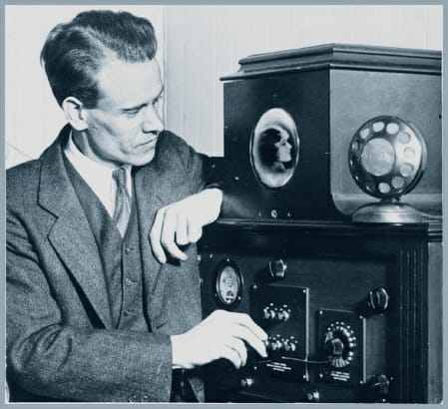
How television invented :
One of the first mechanical televisions used a rotating disk with holes arranged in a spiral pattern.
This device was created independently by two inventors: Scottish inventor John Logie Baird and American inventor Charles Francis Jenkins. Both devices were invented in the early 1920s.
Prior to these two inventors, German inventor Paul Gottlieb Nipkow had developed the first mechanical television.
That device sent images through wires using a rotating metal disk.
Ultimately, the early efforts of these inventors would lead to the world’s first electrical television a few years later.

Slide 7
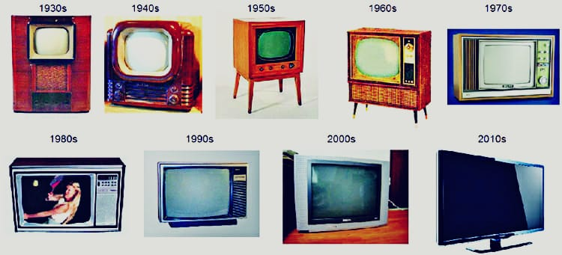
Types of television :
Direct View TVs are a rebranding of the classic, century-long dominance of the cathode-ray tube TVs. ...
Plasma Display Panels. ...
Digital Light Processing (DLP) ...
Liquid Crystal Display (LCD) ...
Organic Light-Emitting Diode (OLED) Display. ...
Quantum Light-Emitting Diode (QLED)

Slide 8
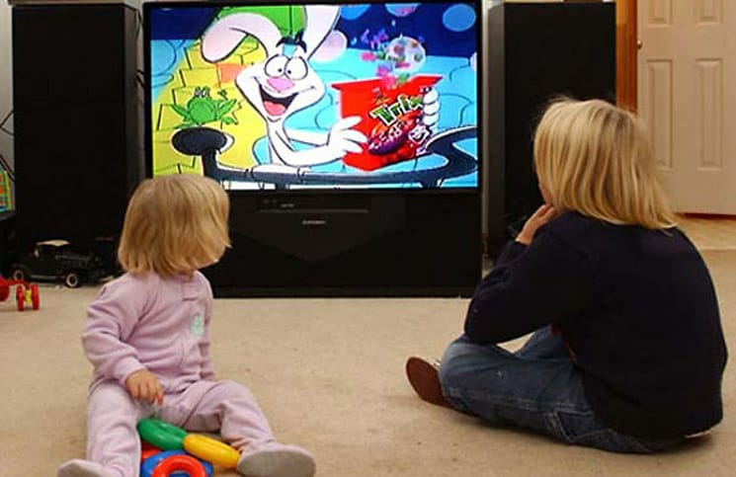
Advantages of television :
The first and most obvious advantage of TVs is that it is a source of entertainment.
Secondly, it offers career opportunities for people. Apart from people employed in the manufacturing, transportation and retail sectors of the television business, there are many professionals employed in the television channels, such as news anchors, cameramen, journalists and editors.
Thirdly, it is a source and a medium of information. Thanks to the television, we are virtually aware of what happens in the world.
Television is also used for educational purposes. There are television channels created solely for education and nothing else.

Slide 9
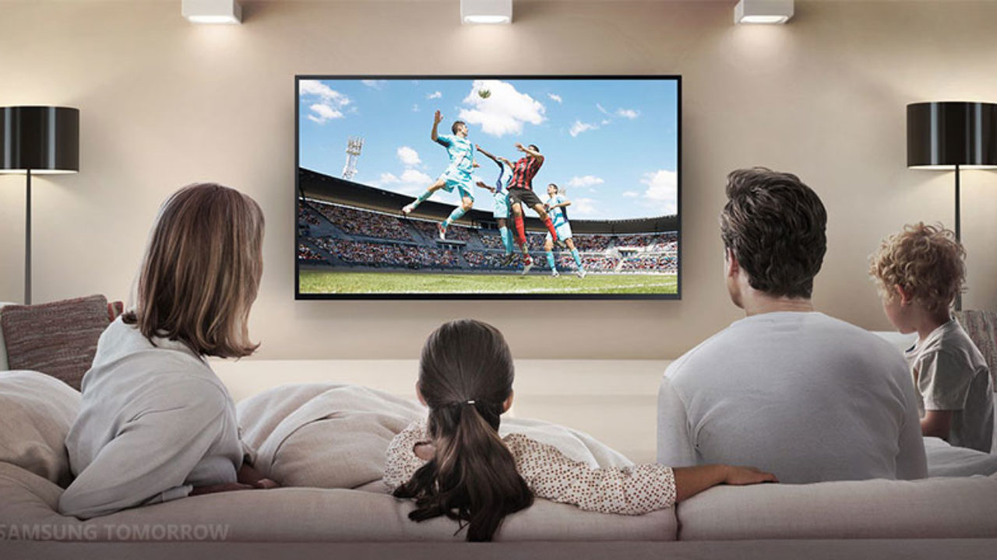
Advantages of television :
Television can be our companion whenever we are lonely.
Television facilitates bonding and unity both at family and national levels.
Television can facilitate creativity. People learn new ways of solving problems.
There are programs also that are dedicated to create disease awareness and prevention.

Slide 10
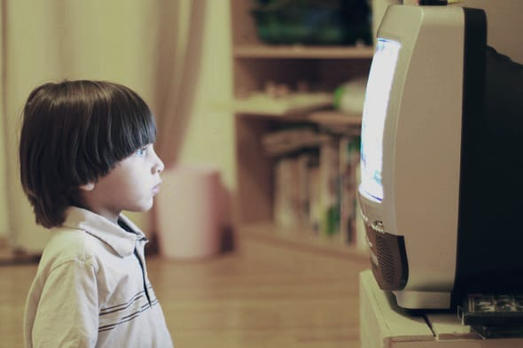
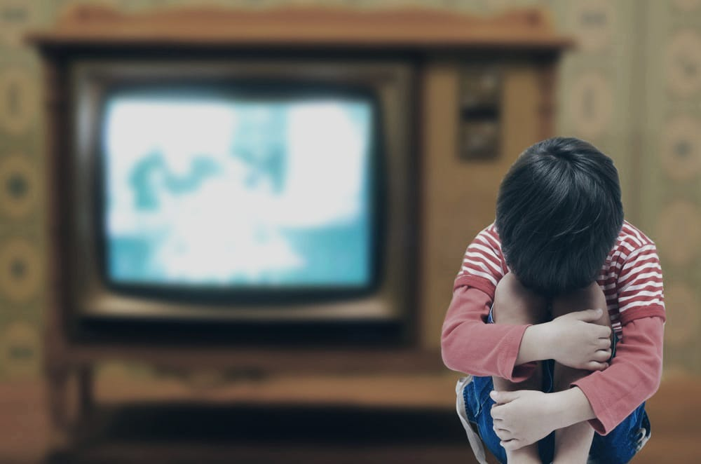
DISADVANTAGES OF TELEVISION :
On the flipside, television has its own setbacks.
The first disadvantage is that there is too much vulgarity and illicit content on television.
There are many instances of kids or teenagers using foul language, Too much TV is linked to serious health hazards. Sitting on the couch watching television all day does little to burn excess calorie intake in the bodyIt also affects social interactions.
People who watch too much TV are socially inept. If the situation is not corrected early, they may not be able to enjoy fulfilling relationships in adulthood.
Furthermore, it can ruin relationships. As stated earlier, people who watch too much television are social outcasts.

Slide 11
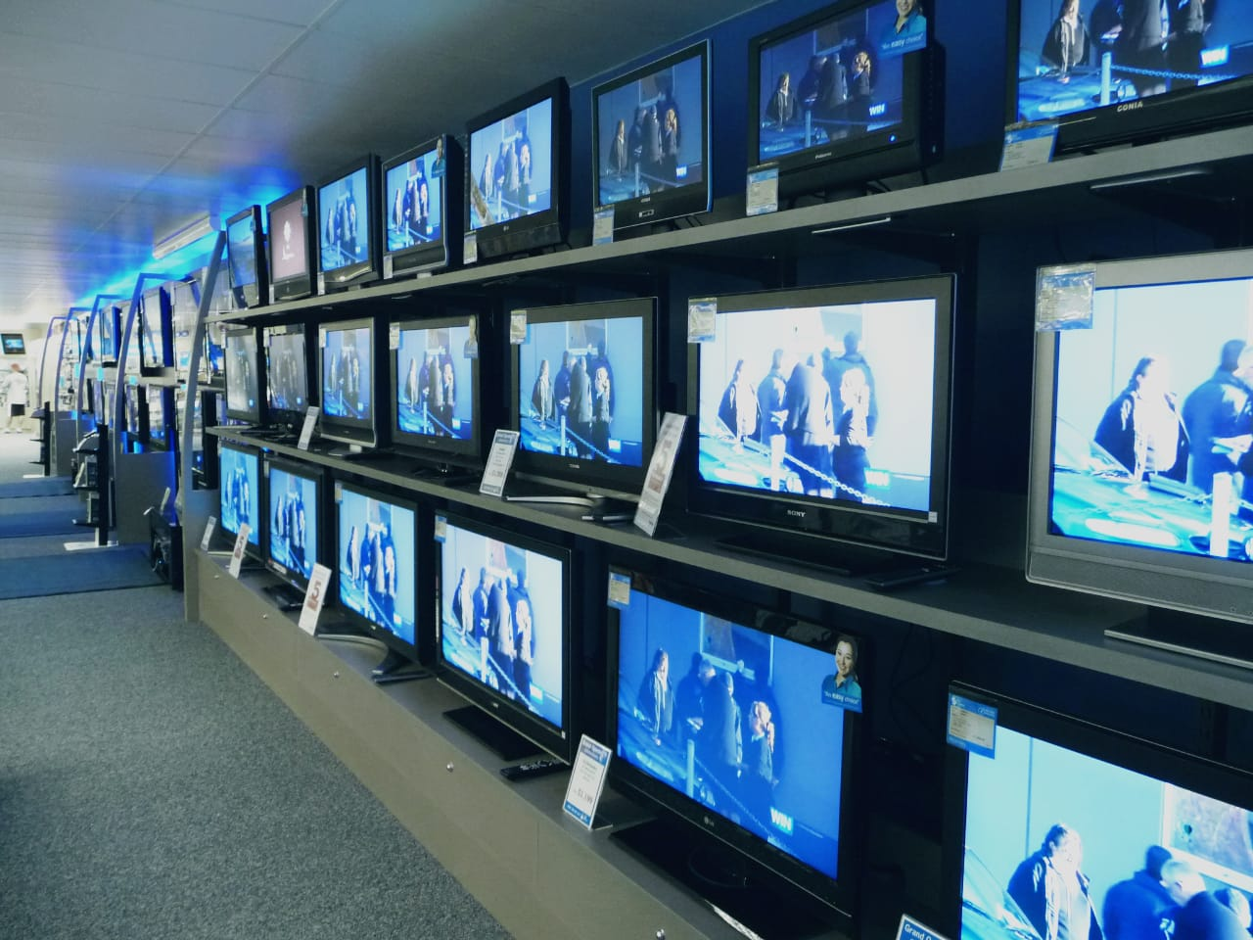
TELEVISION CONTRIBUTION IN MODERN WORLD :
Television plays a very important role in the building of a society. ...
Television is a source of information or communication and media plays a very significant role in everyone's life. In today's modern society, media has become a very big parts of our life.
Its duty is to inform, educate and entertain.Television is a fantastic educational tool. It broadens knowledge of different cultures, promotes tolerance and global understanding of international issues.
Through current affairs, discovery, lifestyle, cooking shows and children's programmes, television encourages scientific and cultural curiosity

Slide 12
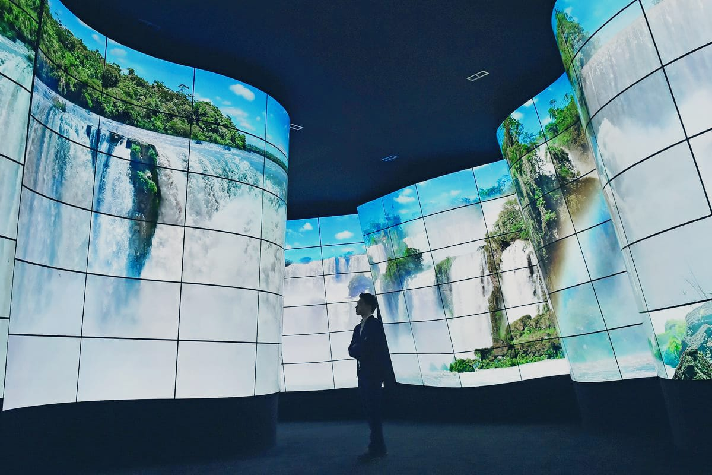
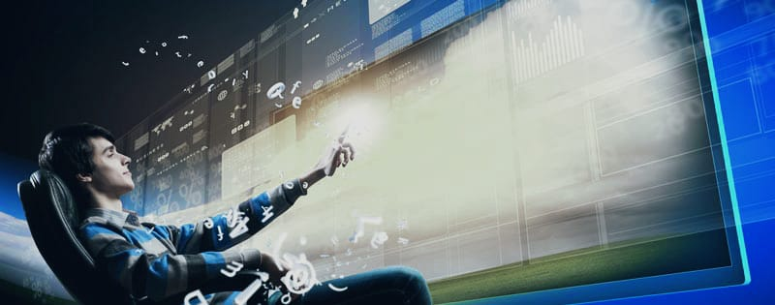
Future of television:
The Future of Television is the leading event for senior representatives from television broadcasters.
Such as digital studios, cable networks, digital distribution networks, brands, advertising firms, VCs, social networks, technology providers, analysts and press

Slide 13
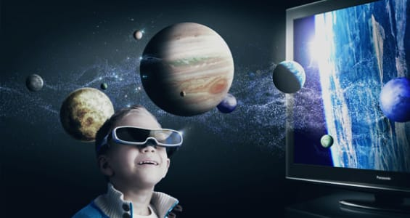
Conclusion :
Television can have both positive and negative effects on children.
However, I believe that we as parents have the greatest effect on how our children learn from the television. Setting restrictions and time limits on what children can watch and how much time they can watch it will reduce the negative and increase the positive effects from watching television.
Children should be motivated to watch more educational channels that have good influence on them.
Parents should also supervise their children when watching television to ensure there is no negative content being shown.

Slide 14


Slide 15


