Slide 1
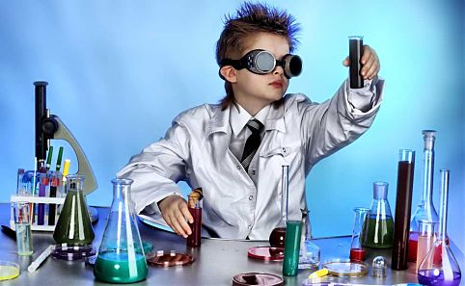
Generative Models

Slide 2
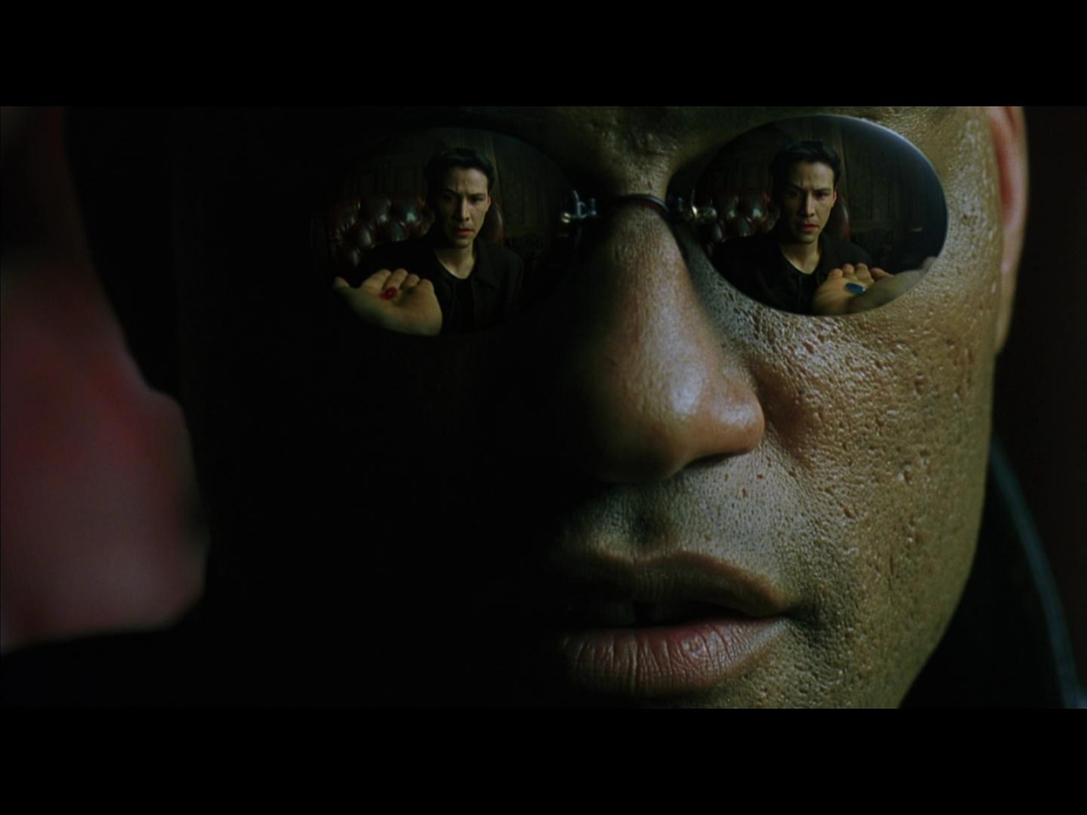
Notes:
I imagine that right now, you're feeling a bit like Alice. Hmm? Tumbling down the rabbit hole? Let me tell you why you're here. You're here because you know something. What you know you can't explain. But you feel it. You've felt it your entire life. That there's something more in the world. You don't know what it is, but it's there. Like a splinter in your mind, driving you mad. It is this feeling that has brought you to CS221. Unfortunately, no one can be told what the Bayesian Networks are. You have to see it for yourself. You take the blue pill. The story ends. You wake up in your bed and believe…whatever you want to believe. You take the red pill. You stay in Wonderland and I show you how deep the rabbit hole goes.

Slide 3
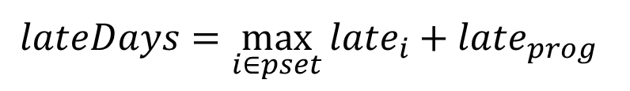
Announcements
Probability Review (Friday, 1:15 Gates B03)
Late days…
To be fair…
double late days.
Start the p-set early

Slide 4
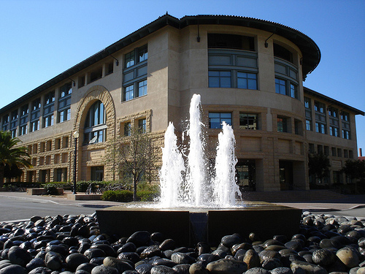
Where we are

Slide 5
CS221
Search
Machine Learning
Variable Based

Slide 6

CS221
Search
Machine Learning
Variable Based

Slide 7
CS221
Search
Machine Learning
Variable Based

Slide 8
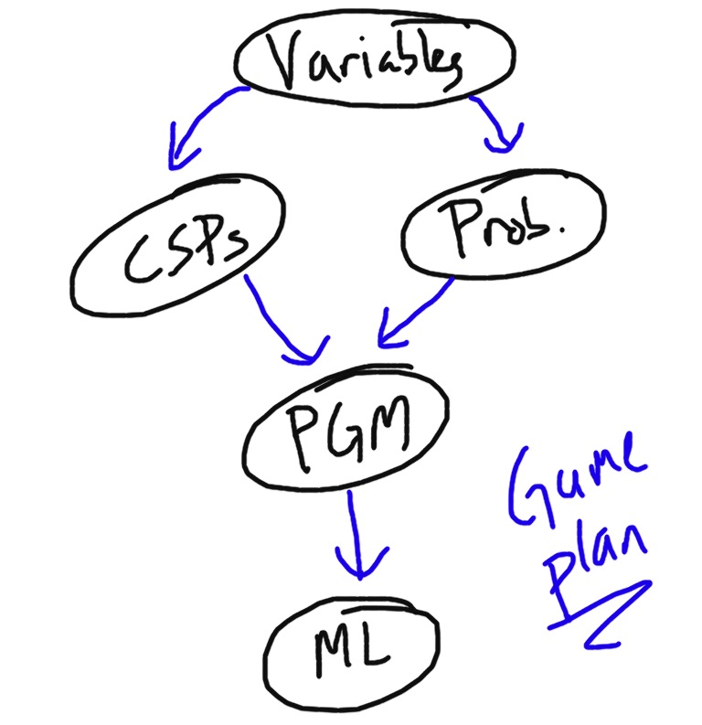

Slide 10
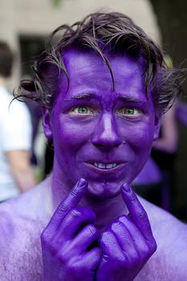
Where We Left Off

Slide 11
Where We Left Off
 | Loopy |  | Not loopy
 | Purple | Not Purple | Purple | Not Purple
Drugged | 0.108 | 0.012 | 0.072 | 0.008
Not Drugged | 0.016 | 0.064 | 0.144 | 0.576

Slide 12

Key Idea
If we have a joint distribution over all variables, then given evidence (which could be multiple variables) E = e, we can find the probability of any query variable X = x.

Slide 13
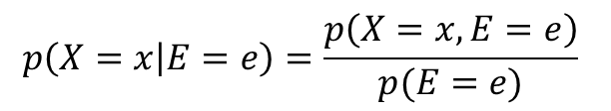
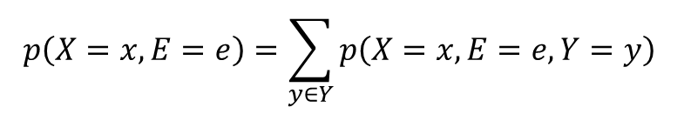
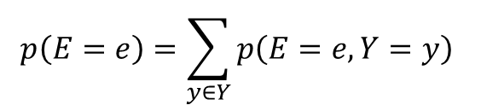
Key Idea
If we have a joint distribution over all variables, then given evidence (which could be multiple variables) E = e, we can find the probability of any query variable X = x.
Y is all variables that aren’t in X or E
These are values in our table!
Y is all variables that aren’t in E

Slide 14
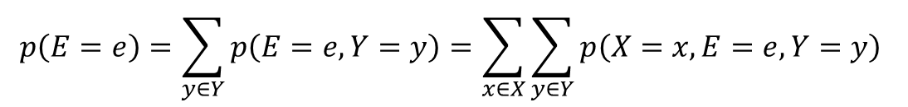
Key Idea
If we have a joint distribution over all variables, then given evidence (which could be multiple variables) E = e, we can find the probability of any query variable X = x.
Since we know that p(x | e)’s must sum to 1

Slide 15
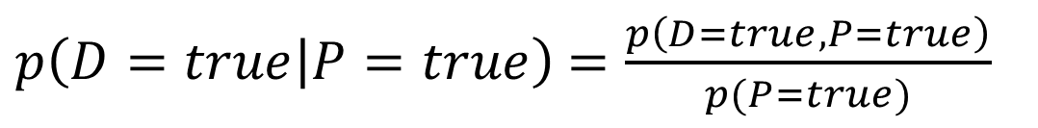
Key Idea
 | Loopy |  | Not loopy
 | Purple | Not Purple | Purple | Not Purple
Drugged | 0.108 | 0.012 | 0.072 | 0.008
Not Drugged | 0.016 | 0.064 | 0.144 | 0.576

Slide 16
Key Idea
 | Loopy |  | Not loopy
 | Purple | Not Purple | Purple | Not Purple
Drugged | 0.108 | 0.012 | 0.072 | 0.008
Not Drugged | 0.016 | 0.064 | 0.144 | 0.576

Slide 17
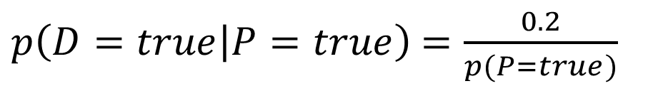
Key Idea
 | Loopy |  | Not loopy
 | Purple | Not Purple | Purple | Not Purple
Drugged | 0.108 | 0.012 | 0.072 | 0.008
Not Drugged | 0.016 | 0.064 | 0.144 | 0.576

Slide 18
Key Idea
 | Loopy |  | Not loopy
 | Purple | Not Purple | Purple | Not Purple
Drugged | 0.108 | 0.012 | 0.072 | 0.008
Not Drugged | 0.016 | 0.064 | 0.144 | 0.576

Slide 19
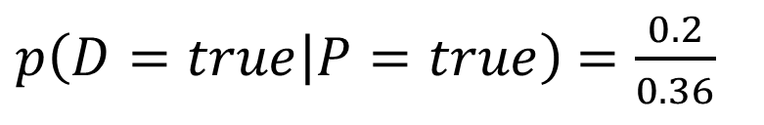
Key Idea
 | Loopy |  | Not loopy
 | Purple | Not Purple | Purple | Not Purple
Drugged | 0.108 | 0.012 | 0.072 | 0.008
Not Drugged | 0.016 | 0.064 | 0.144 | 0.576

Slide 20
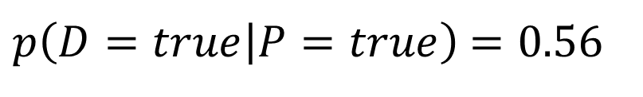
Key Idea
 | Loopy |  | Not loopy
 | Purple | Not Purple | Purple | Not Purple
Drugged | 0.108 | 0.012 | 0.072 | 0.008
Not Drugged | 0.016 | 0.064 | 0.144 | 0.576

Slide 21

Key Idea

Slide 22
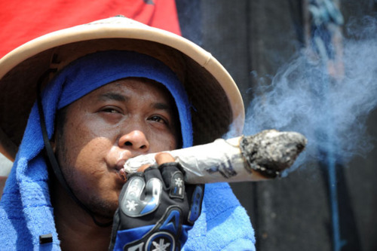
Our joint gets too big

Slide 23
Where We Left Off
 | Loopy |  | Not loopy
 | Purple | Not Purple | Purple | Not Purple
Drugged | 0.108 | 0.012 | 0.072 | 0.008
Not Drugged | 0.016 | 0.064 | 0.144 | 0.576
Add variable
Snowden location: {
Hong Kong,
Sao Paulo,
Moscow,
Nairobi,
Caracas,
Guantanamo
}
Size of the table is now 2*2*2*6 = 48
Joint is exponential in size.
But what does Snowden have to do with drugged out rockstars?
Really are independent…

Slide 24
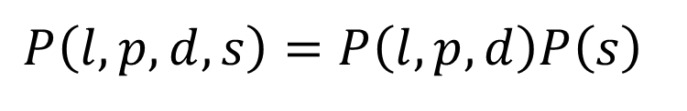
Independence
l = loopy
p = purple
d = drugged
s = snowden
If we have two tables, one over l, p, d and one for s, we could recreate the joint.

Slide 25
What else is independent?
Snowden
Drugged
Purple
Loopy

Slide 26
What else is independent?
Snowden
Drugged
Purple
Loopy
Purple and loopy?

Slide 27
What else is independent?
Snowden
Drugged
Purple
Loopy
Both caused by drugged

Slide 28
What else is independent?
Snowden
Drugged
Purple
Loopy
If you know drugged, purple and loopy are independent!

Slide 29
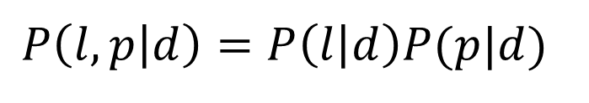
Conditional Independence
If you know drugged, purple and loopy are independent!

Slide 30
Conditional Independence
Joint
If you know drugged, purple and loopy are independent!

Slide 31
This is important!

Slide 32
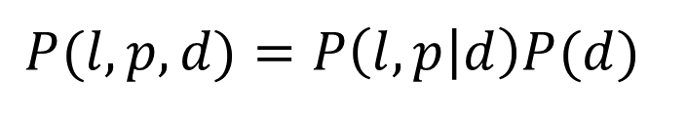
Conditional Independence
Joint
$$P(l,p,d)=P\left(l,p | d\right)P(d)$$
If you know drugged, purple and loopy are independent!

Slide 33
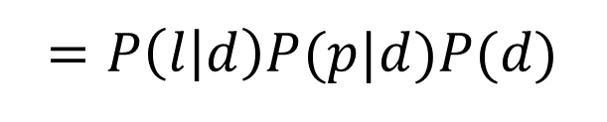
Conditional Independence
Joint
If you know drugged, purple and loopy are independent!

Slide 34
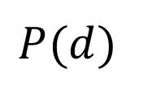
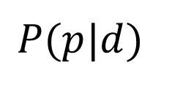
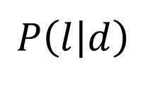
Conditional Independence
Drugged
Purple
Loopy
No longer need the full joint.

Slide 35
We only need p(var | causes) for each var.

Slide 36
Model the world with variables

Slide 37
And what causes what

Slide 38
Bayesian Network

Slide 39

Bayesian Network

Slide 40
Bayesian Network
Stomach Bug
Flu
Vomit
Cough
Fever

Slide 41
Bayesian Network
Stomach Bug
Flu
Vomit
Cough
Fever

Slide 42
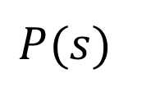
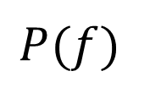
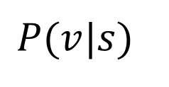
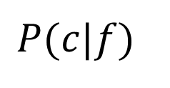
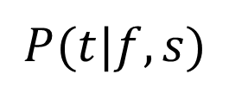
Bayesian Network
Stomach bug (s)
Flu (f)
Vomit (v)
Cough (c)
Fever (t)

Slide 43
Bayesian Network
Stomach bug (s)
Flu (f)
Vomit (v)
Cough (c)
Fever (t)
Joint

Slide 44
Bayesian Network
Joint

Slide 45
Bayesian Network
Stomach bug (s)
Flu (f)
Vomit (v)
Fever (t)
Cough (c)
Joint

Slide 46
Formally
Definition: Bayes Net = DAG
DAG: directed acyclic graph (BN’s structure)
Nodes: random variables (typically discrete, but methods also exist to handle continuous variables)
Arcs: indicate probabilistic dependencies between nodes. Go from cause to effect.
CPDs: conditional probability distribution (BN’s parameters) Conditional probabilities at each node, usually stored as a table (conditional probability table, or CPT)
Root nodes are a special case – no parents, so just use priors in CPD:

Slide 48
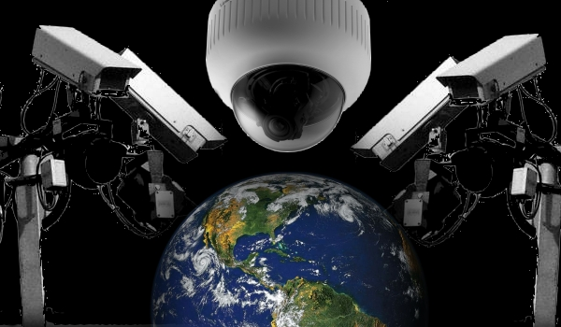
What does NSA do with our data?

Slide 49
The AI Pipeline
Real World Problem
Model the problem
Formal Problem
Apply an Algorithm
Evaluate
Solution

Slide 50
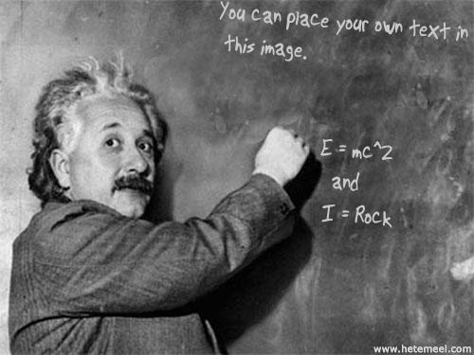

Slide 51

Live Research

Slide 52

Research Project
g₁
g₂
g₃
b
t₁
t₂
t₃
i
e₁
e₂
e₃
?

Slide 53
Research Project
g₁
g₂
g₃
b
t₁
t₂
t₃
i
e₁
e₂
e₃
?

Slide 54


Research Project
g₁
?
g₁*
$$≃$$

Slide 55
Modeling Surprise
g₁
?
g₁*
$$≃$$

Slide 56
Competition
TA Review
Chose top 5
Test how well they predict grades
Select a finalist (gets +)
Actually re-grade
Publish?

Slide 57
+
Prize
On worst pset question
Due Tuesday before class (email staff. Subject: Modeling Regrades)

Slide 58

Novel Science

Slide 59

http://vimeo.com/60381274

Slide 60
What does NSA do with our data?

Slide 62
Research Project
g₁
g₂
g₃
b
t₁
t₂
t₃
i
e₁
e₂
e₃
?

Slide 63
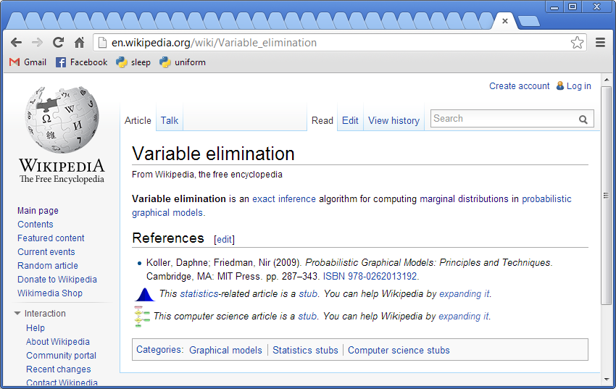
Can someone fix this?

Slide 64
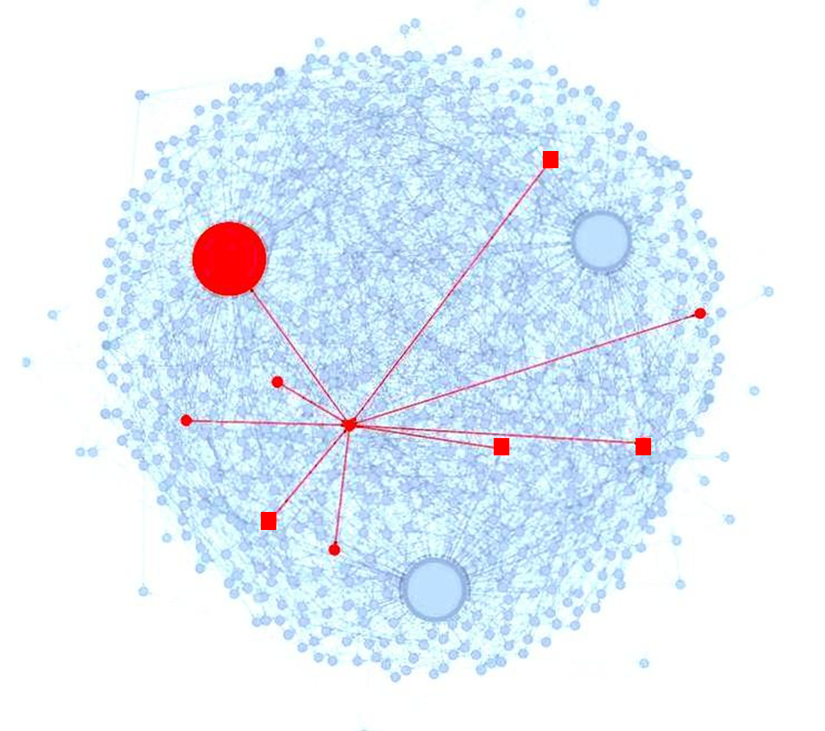
Peer Graders

