Slide 1







ABOUT US
INNOMATICS
RESEARCH LAB
SQL PROJECT ON
Employee
management
system
Member - 01
Member - 03
AFROZ SHAMS
VINAY KUMAR
BSc. Biochemistry
B.Tech CSE/AI/ML
Member - 02
MOHD RAHMAN
MBA Bus. Analyst
We are a team of passionate learners with diverse academic backgrounds, working together to build impactful data-driven projects.
We combine our skills in SQL, analytics, and problem-solving to develop efficient and practical solutions. Our team has consistently performed well, earning Gold, Silver, and Bronze recognitions in previous projects. We aim to continuously improve our technical expertise and deliver high-quality, real-world solutions.

Slide 2
ABOUT US
Member - 01
Member - 02
Member - 03
AFROZ SHAMS
MOHD RAHMAN
VINAY KUMAR
BSc. Biochemistry
MBA Bus. Analyst
B.Tech CSE/AI/ML
We are a team of passionate learners with diverse academic backgrounds, working together to build impactful data-driven projects.
We combine our skills in SQL, analytics, and problem-solving to develop efficient and practical solutions. Our team has consistently performed well, earning Gold, Silver, and Bronze recognitions in previous projects. We aim to continuously improve our technical expertise and deliver high-quality, real-world solutions.

Slide 3
INTRODUCTION
01
02
System
Overview
Data Management
This project is an
Employee Management System developed using SQL.
It is designed to
store and manage employee-related data in a database.
03
04
Data Coverage
Database Structure
It includes information about employees, departments, salary, leaves, and payroll.
All data is connected through a relational database structure
for easy access and management.

Slide 4
1
2
Data Fragmentation
Lack Of Centralized Tracking
Organizations face difficulty in managing employee data across multiple systems, leading to inefficiency and inconsistency.
It is difficult to track employee roles, salaries, leaves, and performance effectively.
PROBLEM
STATEMENT
3
4
Data Redundancy
Need for Centralized System
Without proper relationships and constraints, duplicate and inconsistent data can occur.
A system is required to store, manage, and analyze employee data efficiently.

Slide 5
OBJECTIVE

Slide 6
Database Design
To design a structured relational database for managing employee data.
Data Integrity
To design a structured relational database for managing employee data.
Decision Support
To support better decision-making through employee, salary, and payroll analysis.
Data Analysis
OBJECTIVE
To perform data analysis using SQL queries for meaningful insights.

Slide 7
DATASET OVERVIEW
Provided by:
Innomatics Research Lab
in CSV extension
Name of Dataset :
Employee Management System
JobDepartment.csv
Qualification.csv
Employee.csv
CONTAINS
6 CSV FILES
Salary_Bonus.csv
Leaves.csv
Payroll.csv

Slide 8

WORKBENCH
INTERFACE OVERVIEW

Slide 9
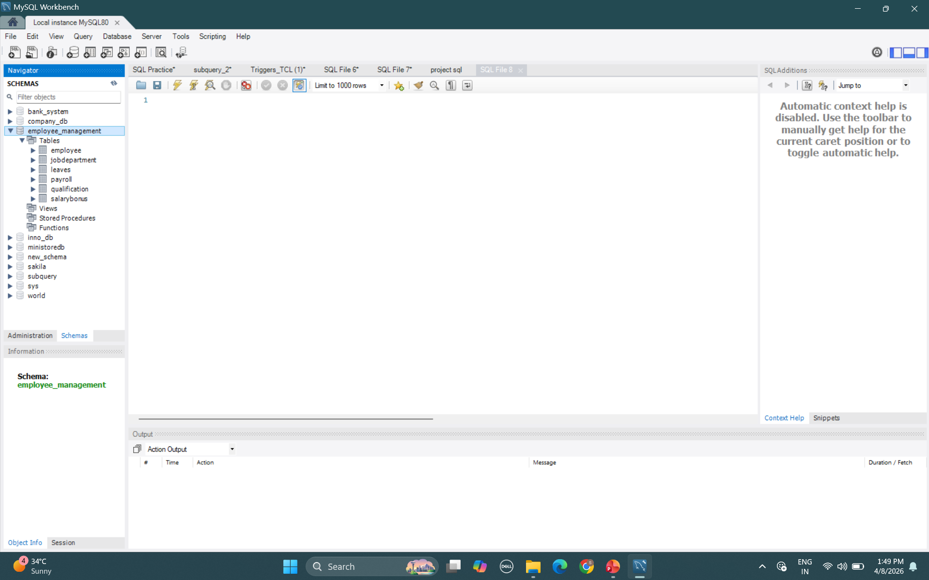

Slide 10
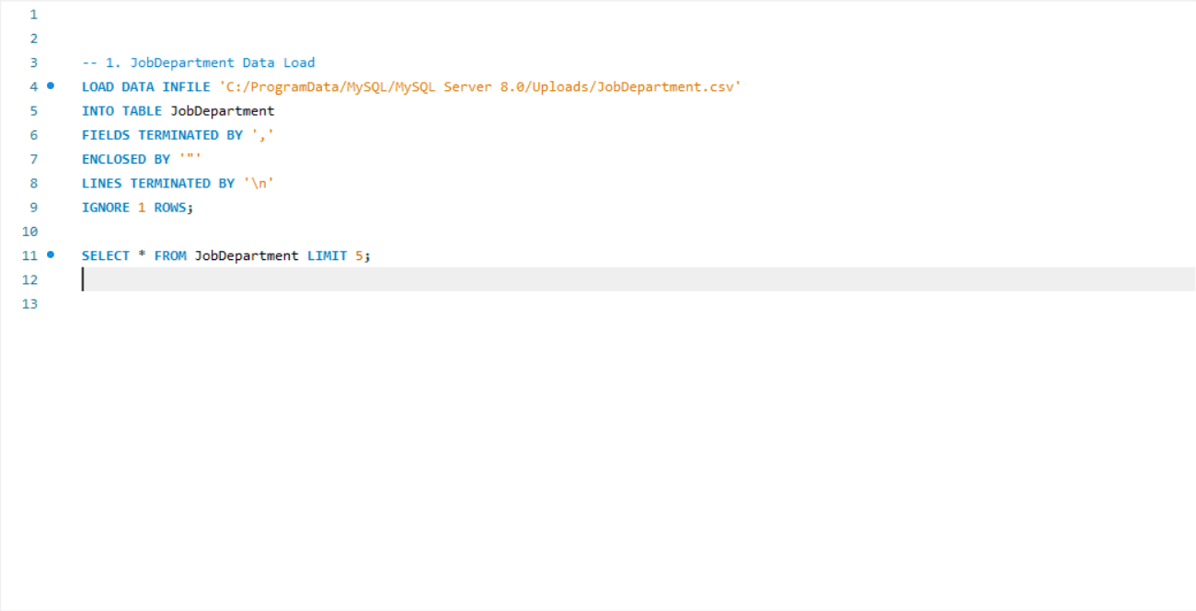
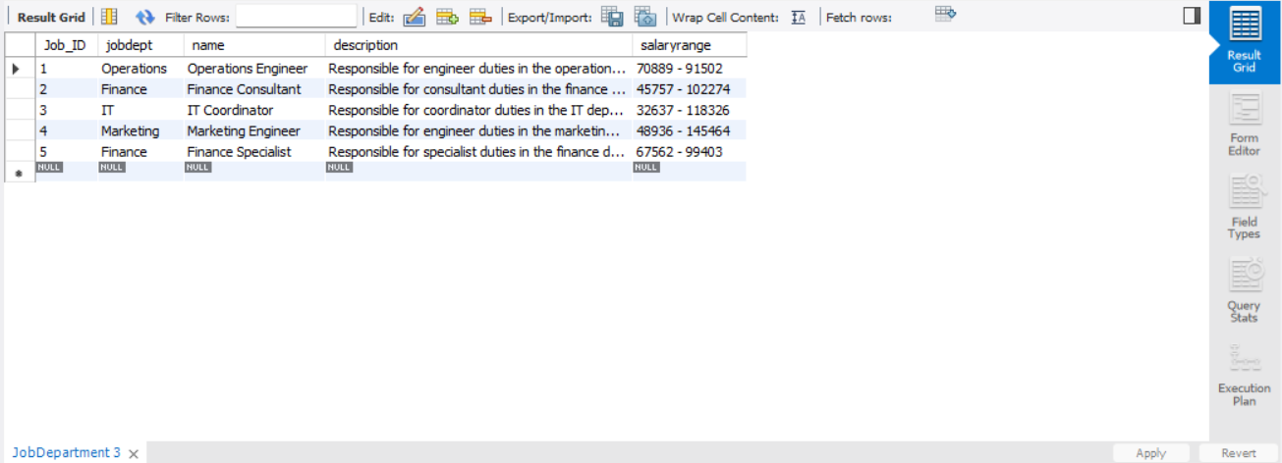
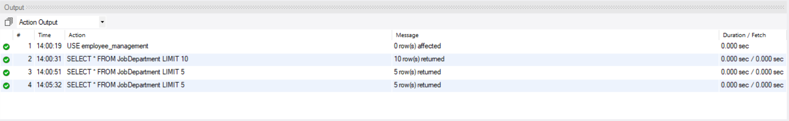

Slide 12
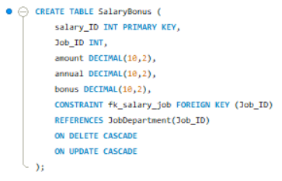
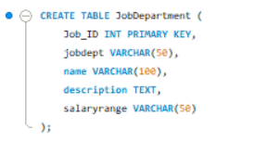
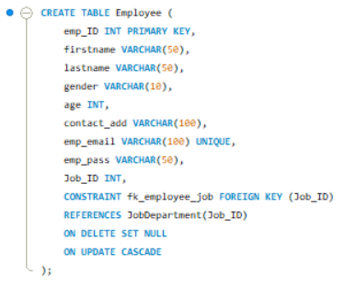
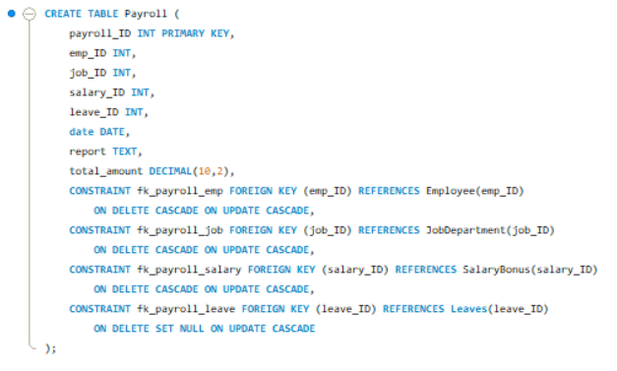
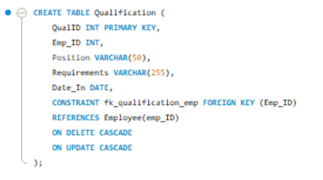
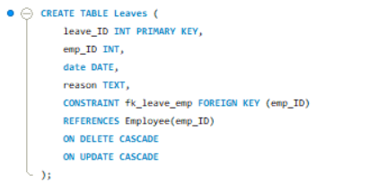
T-02: SalaryBonus
T-01: JobDepartment
T-03: Employee
DATABASE & TABLES CREATION
CREATE DATABASE employee_management;
USE employee_management;
T-06: Payroll
T-04: Qualification
T-05: Leaves

Slide 13
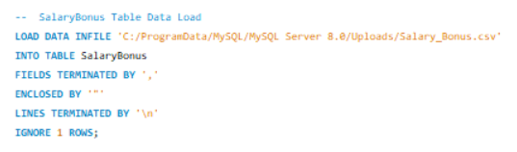
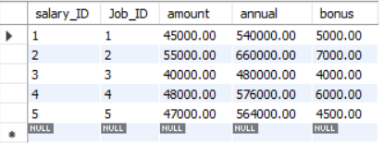
TABLE DATA LOADING
SELECT * FROM SalaryBonus LIMIT 5;
⚙️ DATA LOADING STEPS
Step 1: Prepare CSV Files
Ensure all dataset files (Employee, SalaryBonus, etc.) are in CSV format.
Step 2: Place Files in MySQL Directory
Move CSV files to the MySQL secure upload folder (e.g., Uploads folder).
Step 3: Use LOAD DATA INFILE Command
LOAD DATA INFILE 'file_path' INTO TABLE table_name;
Step 4: Define File Format
FIELDS TERMINATED BY ','
LINES TERMINATED BY '\n'
IGNORE 1 ROWS;
Step 5: Verify Data Load
Run SELECT * FROM table_name; to confirm successful data import.

Slide 14
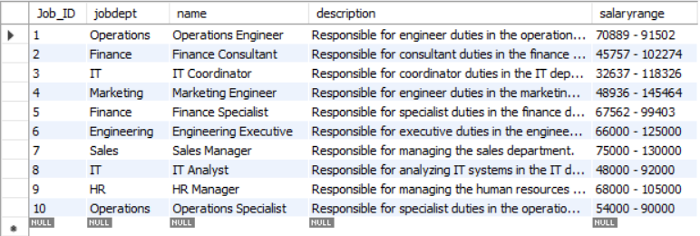
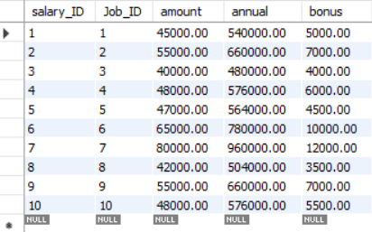
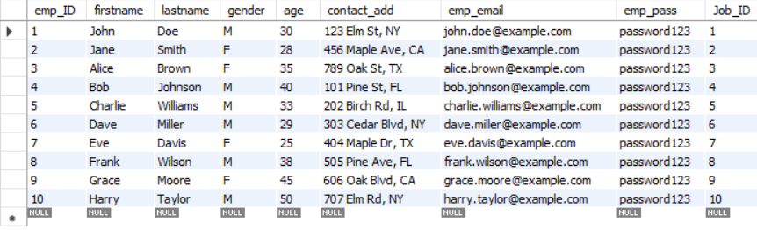
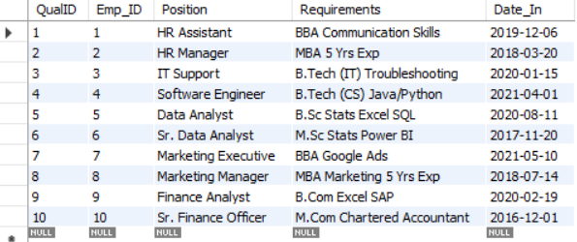
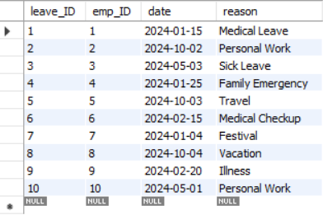
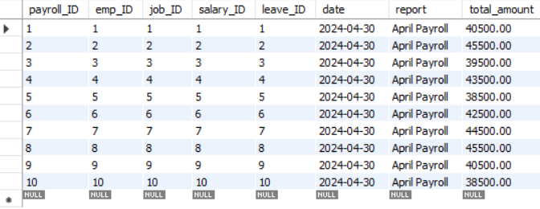

Slide 15
DATA TABLES
Table: JobDepartment
Table: Employee
Table: Qualification
Table: Payroll
Table: SalaryBonus
Table: Leaves

Slide 16
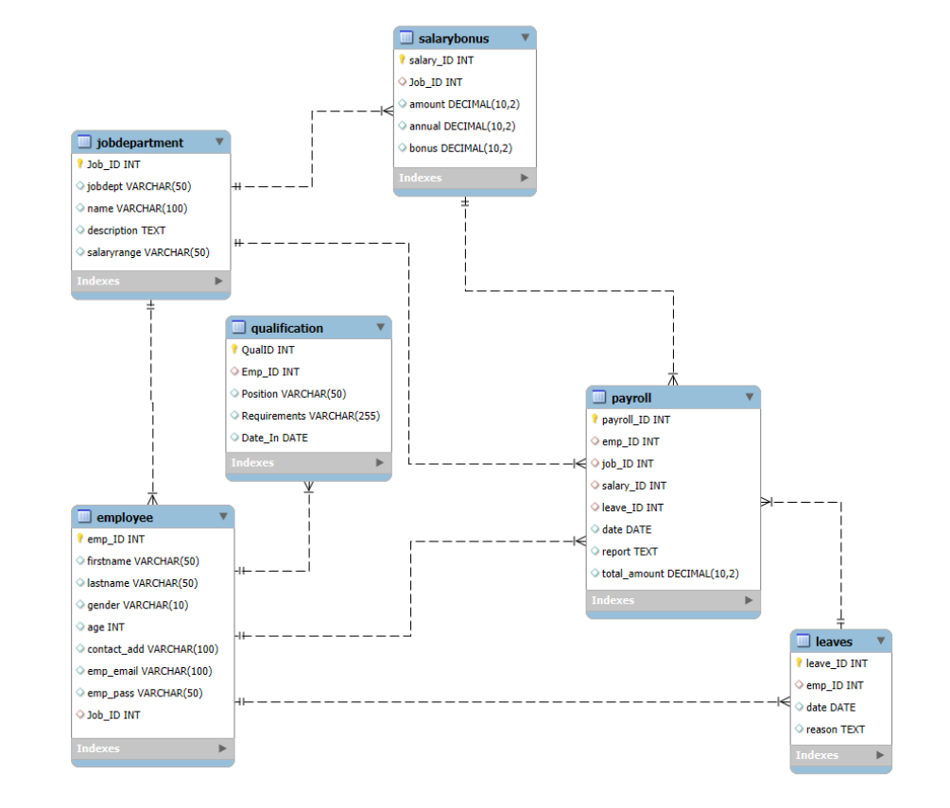
ER DIAGRAM
ER Diagram Observations:
The system consists of 6 interconnected tables, forming a complete relational structure for employee management.
The Employee table acts as a central entity, connected with Qualification, Leaves, and Payroll tables.
The Payroll table serves as a hub, integrating employee, job, salary, and leave data for final calculations.
Proper use of primary keys and foreign keys ensures data integrity and maintains relationships between tables.

Slide 17


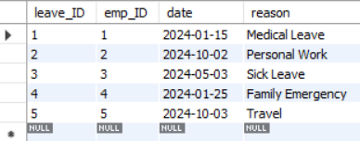
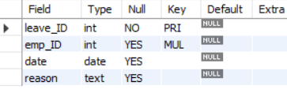
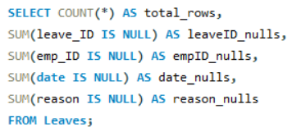


DATA CLEANING
1
Understanding Data
2
Checking Data Types
Steps
3
Checking Null Values
4
Cleaning Space & Mail

Slide 18
DATA ANALYSIS
SECTION-01:
SECTION-05:
EMPLOYEE
INSIGHTS
PAYROLL AND COMPENSATION ANALYSIS
SECTION-02:
SECTION-04:
JOB ROLE AND DEPARTMENT ANALYSIS
SECTION-03:
LEAVES AND ABSENCE PATTERNS
QUALIFICATION AND SKILLS ANALYSIS

Slide 19


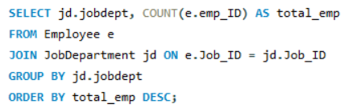
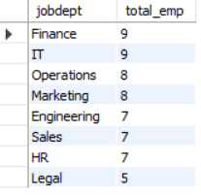
SECTION-01: EMPLOYEE INSIGHTS
Q-01: How many unique employees are currently in the system?
Queries :
Insight
Output :
The organization has a total of
60 employees, indicating the overall workforce size.
Q-02: Which departments have the highest number of employees?
Queries :
Output :
Insight
Finance and IT departments have the highest number of employees, showing higher resource allocation in these areas.

Slide 20
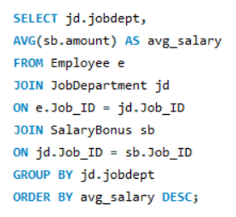
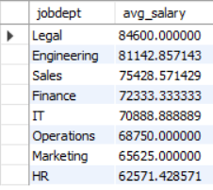
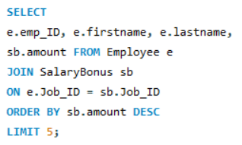
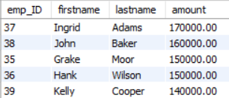
Q-03: What is the average salary per department?
Queries :
Output :
Insight
The Legal and Engineering departments have the highest average salaries, indicating higher compensation in these roles.
Q-04: Who are the top 5 highest-paid employees?
Queries :
Output :
Insight
The top 5 highest-paid employees are from high-paying roles, highlighting key talent with premium compensation.

Slide 21


Q-05: What is the total salary expenditure across the company?
Queries :
Output :
Insight
The total salary expenditure of the company is 4,321,000, reflecting the overall cost of employee compensation.

Slide 22
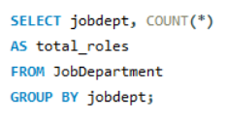
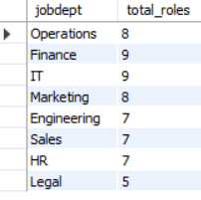
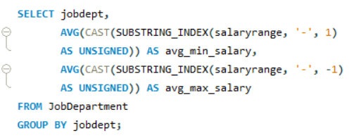
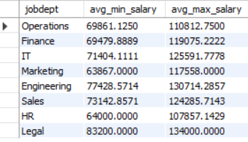
SECTION-02: JOB ROLE AND DEPARTMENT ANALYSIS
Q-01: How many different job roles exist in each department?
Queries :
Output :
Insight
Finance and IT departments have the highest number of job roles, indicating more role diversity in these areas.
Q-02: What is the average salary range per department?
Queries :
Output :
Insight
Legal and Engineering departments offer higher salary ranges, showing better pay scales compared to other departments.

Slide 23
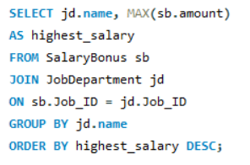
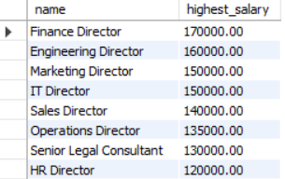
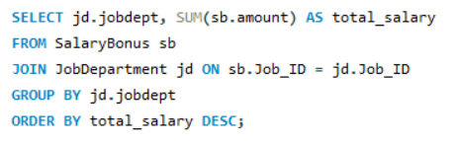
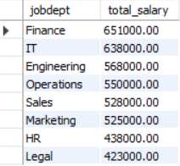
Q-03: Which job roles offer the highest salary?
Queries :
Output :
Insight
Finance Director role offers the highest salary, followed by Engineering and Marketing Directors, indicating leadership roles have top compensation.
Q-04: Which departments have the highest total salary allocation?
Queries :
Output :
Insight
Finance and IT departments have the highest total salary allocation, showing higher budget and investment in these areas.

Slide 24


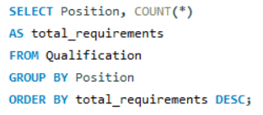
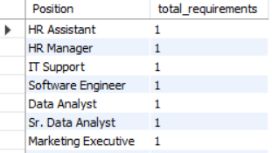
SECTION-03: QUALIFICATION AND SKILLS ANALYSIS
Q-01: How many employees have at least one qualification listed?
Queries :
Insight
Output :
All 60 employees have at least one qualification, indicating a fully skilled workforce.
Q-02: Which positions require the most qualifications?
Queries :
Output :
Insight
All positions have equal qualification requirements, showing uniform skill expectations across roles.

Slide 25
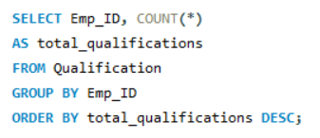
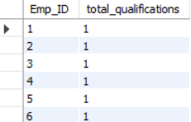
Q-03: Which employees have the highest number of qualifications?
Queries :
Output :
Insight
All employees have an equal number of qualifications, indicating a consistent skill distribution across the workforce.

Slide 26
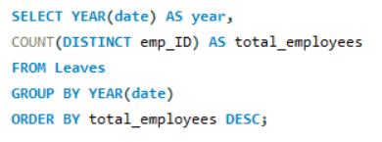

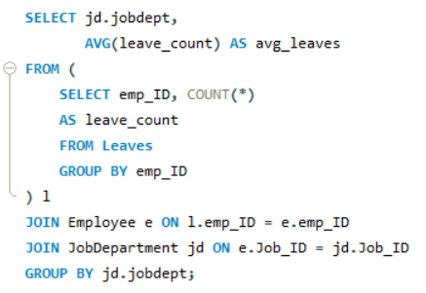
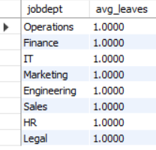
SECTION-04: LEAVE & ABSENCE PATTERNS
Q-01: Which year had the most employees taking leaves?
Queries :
Insight
Output :
The year 2024 has the highest number of employees taking leaves, indicating peak leave activity in that year.
Q-02: What is the average number of leave days taken by its employees per department?
Queries :
Output :
Insight
All departments have an average of 1 leave per employee, showing uniform leave distribution across the organization.

Slide 27
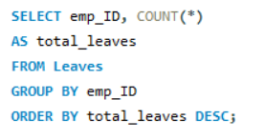
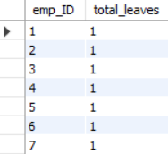


Q-03: Which employees have taken the most leaves?
Queries :
Output :
Insight
All employees have taken equal number of leaves, indicating no significant variation in leave patterns.
Q-04: What is the total number of leave days taken company-wide?
Queries :
Output :
Insight
The company has a total of 60 leave days, reflecting overall employee absence during the period.

Slide 28
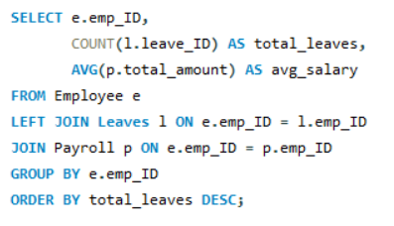
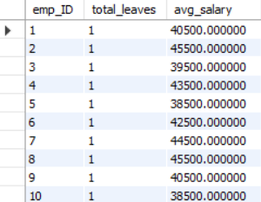
Q-05: How do leave days correlate with payroll amounts?
Queries :
Output :
Insight
Leave days show no significant impact on payroll amounts, as all employees have similar leave counts with varying salaries.

Slide 29
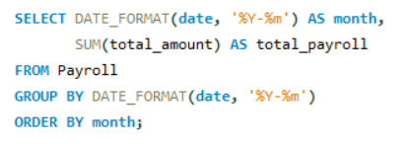

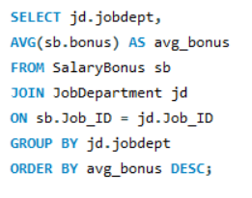
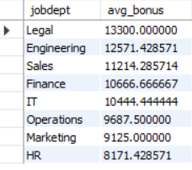
SECTION-05: PAYROLL AND COMPENSATION ANALYSIS
Q-01: What is the total monthly payroll processed?
Queries :
Output :
Insight
The total monthly payroll for April 2024 is 2,778,000, showing the overall salary payout for that period.
Q-02: What is the average bonus given per department?
Queries :
Output :
Insight
The Legal and Engineering departments receive the highest average bonuses, indicating higher incentives in these areas.

Slide 30




Q-03: Which department receives the highest total bonuses?
Queries :
Output :
Insight
The Finance department receives the highest total bonuses, indicating strong incentive allocation in this area.
Q-04: What is the average value of total amount after considering leave deductions?
Queries :
Output :
Insight
The average net salary after deductions is 46,300, reflecting the typical employee take-home pay.

Slide 31




CTE (Common Table Expression)
Top Paid Employees using CTE
Identifying Above-average salary earners
Queries :
Output :
Queries :
Output :
Insight
The highest-paid employee earns 170,000, followed by others earning 160,000 and 150,000, showing a clear salary gap at the top level.
Insight
Employees earning above average have salaries ranging from 85,000 to 115,000, indicating a group of consistently high-performing and well-compensated employees.

Slide 32




WINDOW FUNCTIONS
Rank Employees by Salary
Department-wise Ranking
Queries :
Output :
Queries :
Output :
Insight
The highest-paid employee earns 170,000 and is ranked 1, followed by others with slightly lower salaries, showing a clear salary hierarchy.
Employees with the same salary share the same rank, indicating tie handling in ranking (e.g., rank 3 appears twice).
Insight
For example, in Engineering and Finance, the top-ranked employees earn significantly higher than others, showing salary variation within departments.
In each department, employees are ranked based on salary, helping identify top performers within each department.

Slide 33




SUBQUERIES
Employees earning more than avg
Employees with max leaves
Queries :
Output :
Queries :
Output :
Insight
Employees earning above average have salaries ranging from 80,000 to 115,000, showing a group of high-performing and well-compensated employees.
Insight
This indicates a salary gap between average earners and top performers.
All listed employees have taken the same maximum number of leaves (1), indicating no single employee has significantly higher leave usage.
This shows a uniform leave pattern across employees.

Slide 34
Data Analysis & Insights
Key findings derived from SQL queries
60
6
₹43.2L
₹96K
Total Employees
Departments
Total Salary Cost
Max Dept Bonus
(Finance)
Employee & Department
Salary & Payroll
Leave & Qualification
Finance & IT are largest departments — 9 employees each
Operations & Marketing have 8 employees each
Legal is the smallest dept (5 employees) but highest paying
All 60 employees hold at least one qualification
Total salary cost: ₹43,21,000 across the organization
Monthly payroll (April 2024) totaled ₹27,78,000
Legal dept commands the highest average salary
Finance dept leads in total bonus distribution (₹96,000)
All 60 employees recorded exactly 1 leave — uniform pattern
Average leave days per department = 1 (2024 data only)
Every employee holds exactly 1 qualification — no multi-skilled outliers
Leave-salary correlation analysis not meaningful with this dataset

Slide 35
SQL CONCEPTS USED
Techniques & functions applied in this project
JOINS
Aggregate Functions
Window Functions
INNER JOIN — Employee ↔ JobDepartment
Multi-table JOINs (Employee + JobDept + SalaryBonus)
LEFT JOIN — Leave vs Payroll correlation
3-way JOIN in payroll analysis
COUNT() — Total employees, leaves
SUM() — Total payroll, salary budget
AVG() — Avg salary, avg bonus per dept
MAX() / MIN() — Highest salary role
RANK() — Rank by salary
DENSE_RANK() — No ranking gaps
PARTITION BY — Dept-wise ranking
ORDER BY inside OVER clause
CTEs & Subqueries
Data Cleaning
DDL & DML
WITH clause — Top paid employees CTE
Nested SELECT — Above-avg earners
Correlated subquery — Max leave finder
Subquery in WHERE clause
TRIM() — Remove extra whitespace
REPLACE() — Remove '$' symbols
LOWER() — Email normalization
NULL checks via SUM(col IS NULL)
CREATE TABLE with constraints
FOREIGN KEY with CASCADE rules
LOAD DATA INFILE for bulk import
UPDATE with SET SQL_SAFE_UPDATES

Slide 36
Challenges Faced
Obstacles encountered and how they were resolved
🗂 LOAD DATA INFILE Path Errors
💱 Currency Symbol in Data ($)
Solution
Used SHOW VARIABLES LIKE 'secure_file_priv' to locate the exact allowed upload directory on the MySQL server
Solution
Applied REPLACE(salaryrange, '$', '') in UPDATE statement to strip currency symbols before numeric analysis
📧 Duplicate & Inconsistent Emails
📊 Limited Dataset Scope
Solution
Used LOWER() + REPLACE() to normalize emails, then GROUP BY + HAVING COUNT(*) > 1 to detect duplicates
Solution
Data spans only April 2024 with each employee having 1 leave — insights were documented as observations rather than patterns
🔗 Foreign Key Constraint Ordering
🔒 SQL_SAFE_UPDATES Blocking
Solution
Created parent tables (JobDepartment, Employee) before child tables (Payroll, Leaves) to avoid FK reference errors
Solution
Temporarily disabled safe update mode before bulk UPDATE/TRIM operations and re-enabled after to maintain security

Slide 37
CONCLUSION
01
02
03
04
HR Insights Delivered
Data Pipeline Built
Database Architecture
Advan SQL Mastered
Identified top-paid departments, ranked employees by salary, traced payroll trends, and surfaced Finance as highest-bonus department
End-to-end pipeline from CSV import → data cleaning → transformation → analytical queries fully implemented in MySQL
Successfully designed a normalized, 6-table relational schema with enforced referential integrity via FK constraints and CASCADE rules
Demonstrated CTEs, Window Functions (LIKE RANK), nested subqueries, and multi-table JOINs in real scenarios

Slide 38

THANK
YOU!

