Slide 2
Functional Programming
Key principle
All computation is execution of mathematical function
Function
Mapping from input to output
f(x) = x*2
G(x,y) = f(x) + f(y)
Can’t change their input

Slide 3
Can’t change any variable I immutability )
X = x+1 cant’ have this kind of statement
For( I =0 ; i<10 ; i++)
Programming without variable assignment
How to solve the problem ?
All computation are reprresented by mathematical function
Programs are more logical or predictable
Build for distributed computation

Slide 4
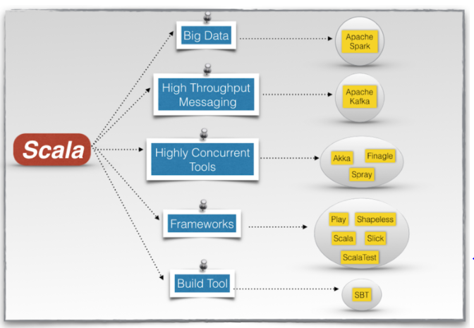

Slide 5
Functional programming is a programming paradigm, a style of building the structure and elements of computer programs, that treats computation as the evaluation of mathematical functions and avoids changing-state and mutable data.
Functional programming is a language consist of only PURE functions with no side-effects and nothing but just only functions, those are pure.
A function with input type A and output type B is a computation which relates every value a of type A to exactly one value b of type B such that b is determined solely by the value of a.

Slide 6
Pure functions are those which takes argument list as a input and whose output is some return value. Now you must be thinking that all functions are pure. After all, any function takes in values and returns a value but no, it’s not like that. For example, if function rely on the global variable or class member’s data, then it is not pure. And in such cases, return value of that function is not entirely depended on the list of arguments received as a input and can also have side effects.
Why use only pure function? And answer itself is in definition of impure function and it’s properties. And it’s because, pure function has a referential transparency, means it will return the same value every time for a given set of input, despite of depending on other things like system time, database state, from where it is called, etc.
Functional programming seeks to describe what you want to do instead of specifying how you want to do.

Slide 7
HIGHER-ORDER FUNCTIONS
Functional languages treat functions as first-class values.
This means that, like any other value, a function can be passed as a parameter and returned as a result.
This provides a flexible way to compose programs.
Functions that take other functions as parameters or that return functions as results are called higher order functions.

