Slide 1


K.RAMAKRISHNAN COLLEGE OF TECHNOLOGY
(AUTONOMOUS), TRICHY
Weather Forecasting System
PRESENTED
R. MOHAMED AFSAL
2303811720521029
SUPERVISOR
Ms.S.UMA MAGESHWARI, M.E.,
AP/CSE.

Slide 2
PRESENTATION OVERVIEW
Objective
Project Introduction
Problem Statement
Methodologies (Programming concepts relevant to problem statement)
Architecture of the proposed system
List of Modules
7. Merits
8. Results and Discussion
9. Queries

Slide 3
Objective
The objective of this project is to develop a Weather Forecasting System that provides accurate and real-time weather predictions for various locations. It aims to assist both general users and specialized industries in making informed decisions by offering 10-day forecasts, weather conditions. By catering to general users and specialized industries such as agriculture, logistics, and aviation, the system supports informed decision-making

Slide 4
Project Introduction
This Weather Forecasting System is a Java-based desktop application that simulates a weather prediction tool.
It allows users to input a location and retrieve weather details such as temperature, humidity, and condition for the next 10 days.
The system uses graphical components from the AWT library to create an interactive and user-friendly interface.

Slide 5
Problem Statement
Unavailability of localized weather data: Users often lack accessible and tailored weather forecasts for specific locations.
Decision-making challenges: Industries like agriculture, aviation, and logistics rely on precise weather predictions but face limitations in easily accessible tools.
Data complexity: Real-time weather details need an easy-to-understand and structured representation.

Slide 6
Methodologies (Programming Concepts)
Object-Oriented Programming (OOP): Utilized for modular code structure and reusability.
Event Handling: Implemented for user interaction with buttons and text fields.
AWT Components: Used for GUI creation, including labels, buttons, and text areas.
Validation: Input validation ensures meaningful and accurate results.
Data Simulation: Randomized weather generation using the Random class.

Slide 7
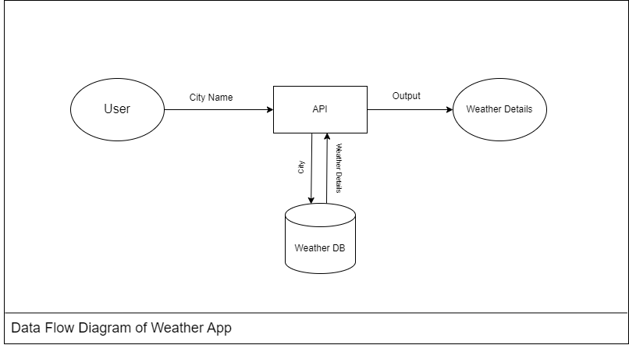
Architecture of the Proposed System

Slide 8
List of Modules
Input Module: Handles user input for location.
Validation Module: Ensures location input meets specified criteria.
Weather Generation Module: Creates forecast data using simulation.
Output Module: Displays weather forecasts in a readable format.
Event Handling Module: Facilitates user interaction with buttons and window events.

Slide 9
Merits
User-Friendly Interface: Simplified design for seamless interaction.
Simulated Offline Functionality: Provides weather forecasts without internet reliance.
Cross-Platform Compatibility: Built using Java, making it platform-independent.
Interactive Features: Clear, fetch, and close buttons for better control.
Scalability: Potential for integration with real-world weather APIs.

Slide 10
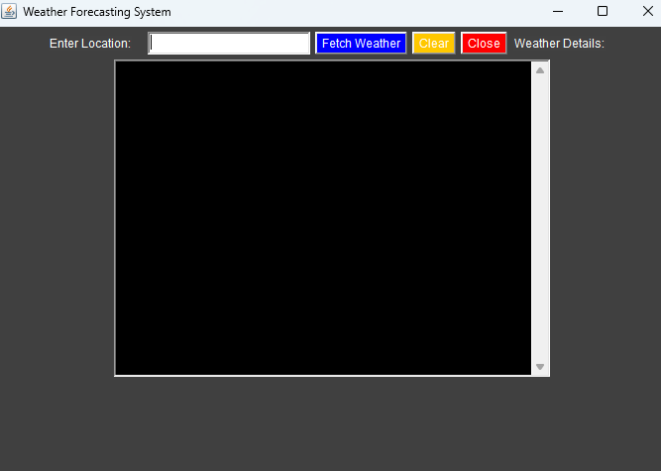
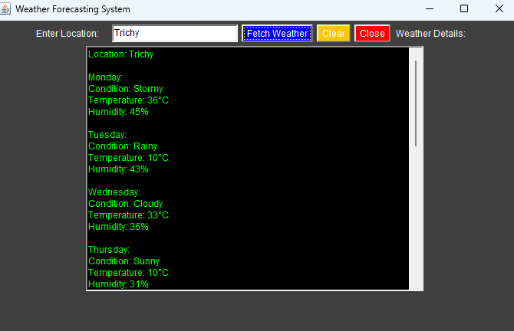
Results and Discussion

Slide 11
QUERIES ?

