Slide 1

Data Modelling Using Graphs and Comparison of
Graph Model and Relational Model

Slide 2
Data Modelling
Process of creating a visual representation of either a whole information of system or parts of it to communicate connections between data points and structures.

Slide 3
Graph Modelling
As the name suggests graph- based data model where each element is stored here as nodes and nodes are connected with edges

Slide 4
Why Graph Databases ?
Relational Databases are used to store structured data. They do not store the relationship between the data.
Relationship between the data is more valuable than the data itself.
Graph databases store the relationships and connections also.
Data model for graph databases are simpler compared to other databases.

Slide 5
Elements in Graph Based Model
Nodes - instances of data that represent
objects which is to be tracked
Edges - represent relationships between nodes
Properties - represent Information Associated with Nodes

Slide 6
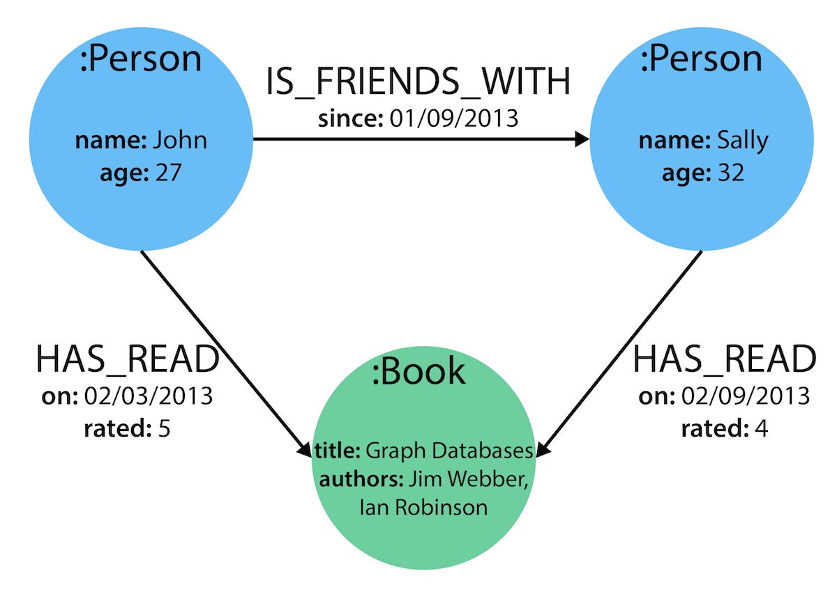

Slide 7
In these data models, the nodes which are connected together are connected physically.
Physical connection among them also taken as a piece of data, make it easy to query a relationship.
This data model reads the relationship from storage directly instead of calculating and querying the connections steps.
This data model don’t have any schema ( schema is important because, schema make the model well and good and easy to edit )

Slide 8
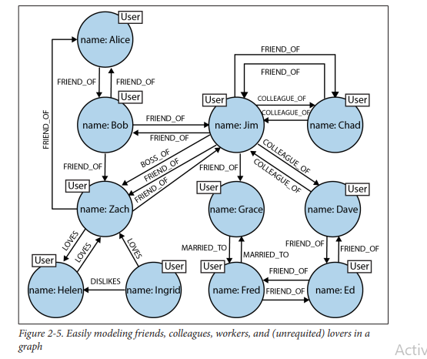
Social Network Example
The graph offers a much richer picture of the network.
We can see who is a COLLEAGUE_OF whom.
who is BOSS_OF them all.
Who MARRIED_TO whom.
The flexibility of the graph model has allowed us to add new nodes and new relationships without compromising the existing network or migrating data

Slide 9
Examples of Graph Data Model
Neo4j - ( Network Exploration and Optimization 4 Java )
This Graph Database is written in Java with native graph storage and processing

Slide 10
Examples of Graph Data Model
2. DGraph
An Open Source distributed graph database system designed with scalability.
3. JanusGraph
These are very helpful in big data analytics. It is a scalable graph database system
With open source too.

Slide 11
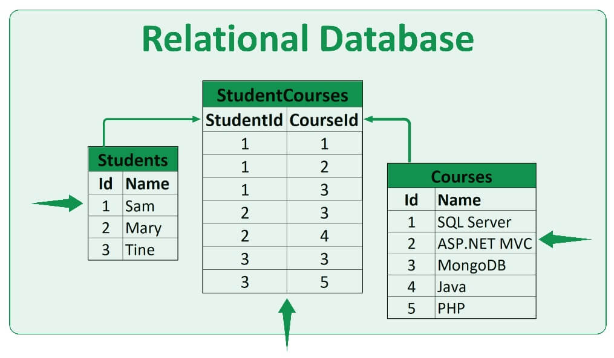
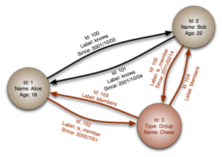
Graph Database vs Relational Database

Slide 12
Graph Database vs Relational Database
 | Graph Database | Relational Database
1 | Data is stored in graphs | Data is stored in tables
2 | There are Nodes | There are Rows
3 | There are properties and their values | There are columns and data
4 | Connected Nodes are defined by relationships | Constraints are used here
5 | Traversal is used instead of join | Join is used instead of traversal

Slide 13
Challenges of Graph Data Model
For Complex Relationships: for complex relationships speed becomes slower in searching.
Unprofessional Graphs: It seems to be noted that, graphs are very unprofessional in different system especially when we consider the transnational based system.
Small User Base: The user base is small which makes it very difficult to get support when running into a system
Specialized knowledge: Graph databases may require specialized knowledge and expertise to use effectively, including knowledge of graph theory and algorithms.

Slide 14
Conclusion
Relational Databases are used to store structured data. They do not store the relationship between the data.
Graph databases store the relationships and connections also.
Different elements of a graph are there like nodes, edges, properties.
There are different graph data models like Neo4j, DGraph, JanusGraph etc.
There are lot of differences between Graph database and Relational database which can be classified.
There is no certain standard query language for graph databases which is a challenge faced by the system

Slide 15
References
“Graph Databases”: Ian Robinson, Jim Webber and Emil Eifrem
Graph Based Data Model in NoSQL - Article published by priyan shagupta- Geeksforgeeks online platform.
Malgorzata Lazarska, Olga Siedlecka-Lamch: “Comparative study of relational and graph databases”( 2019 IEEE 15th International Scientific Conference on Informatics).
Graph Database vs. RDBMS” - Online article published by JavaTpoint online learning platform

Slide 16
THANK YOU !!

