Slide 1
DIY PROJECT SHARING PLATFORM
MINI PROJECT
PROJECT GUIDE : Harikumar K

Slide 2
INTRODUCTION
A DIY project sharing platform is a website where people can share their projects, ideas, and tutorials with others.
Users can upload photos ,video links and written instructions in pdf format to showcase their creative projects such as handmade craft, papercraft, home decor, wood craft etc.

Slide 3
Types of users
USER
ADMIN

Slide 4
FUNCTIONAL REQUIREMENTS
USER LEVEL
User Authentication
Profile Management
Project Management
Media Management
ADMIN LEVEL
Manage user
Manage projects
Manage project category

Slide 5
Server Hardware Specifications
Processor (CPU):
11th Gen Intel(R) Core(TM) i5-11300H @ 3.10GHz
Memory (RAM):
8 GB DDR4
Storage:
512 GB SSD (Solid State Drive) for faster read/write operations

Slide 6
Client Hardware Specifications
Processor (CPU):
Dual-core processor
Memory (RAM):
4 GB RAM
Storage:
200 MB available disk space (for browser cache and temporary files)
Display:
1024x768 resolution

Slide 7
Minimum Software Specifications
Server Software Specifications
Operating System:
Ubuntu Server 20.04 LTS (or a similar lightweight Linux distribution)
Web Server:
Apache HTTP Server 2.4 or
Nginx 1.18
Database Server:
PostgreSQL 12
Programming Language:
PHP 7.4
Additional Software:
phpPgAdmin for managing PostgreSQL databases (optional but useful for beginners)

Slide 8
Development Environment Specifications
Integrated Development Environment (IDE) / Code Editor:
Visual Studio Code
Sublime Text
Front-End Frameworks and Libraries:
Bootstrap 4 or 5 for responsive design and pre-designed components

Slide 9
Client Software Specifications
Operating System:
Any modern OS such as Windows 10, macOS 10.15, Linux, iOS, or Android
Web Browser:
Google Chrome 88 or higher
Mozilla Firefox 85 or higher

Slide 10
Process Flow
Home Page:
•Home: The landing page that provides an overview of the application and its features.
•Register: Registration page for new users to create an account.
•Login: Login page for existing users to access their dashboard.
•Projects: Browse projects by category.
•Contact: Page with contact information and a form for users to get in touch with support.

Slide 11
USER
User Authentication:
Register new users
If username exists , system give message “Username already exists”
Registered user details are stored in Registration table and username and password are stored in Login_table
Password is encrypted using hashing algorithm and stored
Login and authenticate users
If username and password matches with database values, login is authenticated User is redirected to User Dashboard
The username is stored a SESSION VARIABLE to access it in all pages
Logout functionality
User is redirected either to Login page Once LOGOUT button is clicked , user will not be able to go back to User Dashboard using browser button

Slide 12
Project Management:
Add new projects to the user's project collection
Users can add new projects with all necessary details and stored in project table
While adding project details, project category is retrieved from category table and displayed in dropdown
View details of projects in the project collection
All projects details added by the current logged in user are displayed in a table format from the project table
Edit project details
All projects details added by the current logged in user are listed in a table format from the project table
On clicking the EDIT button , the project details of the selected row are automatically displayed in the form in another page
User can Edit the necessary details and store the updated details in the Project table
Delete projects from the project collection
All projects details added by the current logged in user are listed in a table format from the project table
A DELETE button is placed at the end of each row , so that user can delete the selected project details
On clicking the DELETE button , the project details of the selected row are automatically deleted.

Slide 13
Account Settings
View user profile information
Using SESSION Variable user details are displayed from Registration Table
Update user profile information
Using SESSION Variable Edit the details and update the Registration table

Slide 14
ADMIN
Admin Functionalities:
Manage user accounts (view, edit, deactivate Users).
Manage project database (view, edit, delete projects).
Manage project categories (view, add, delete categories).

Slide 15
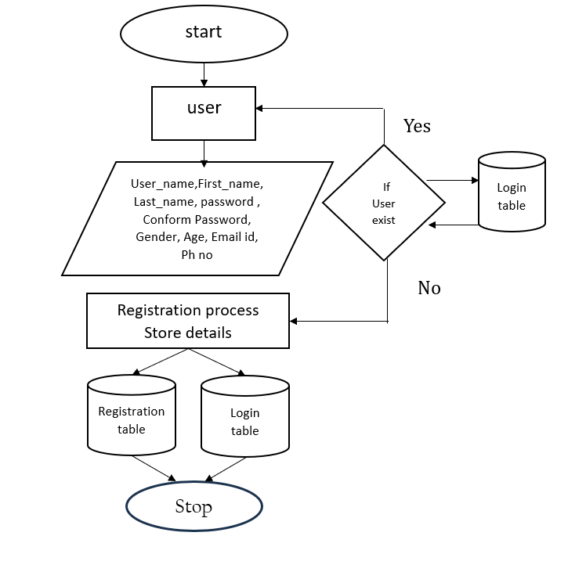
REGISTRATION

Slide 16
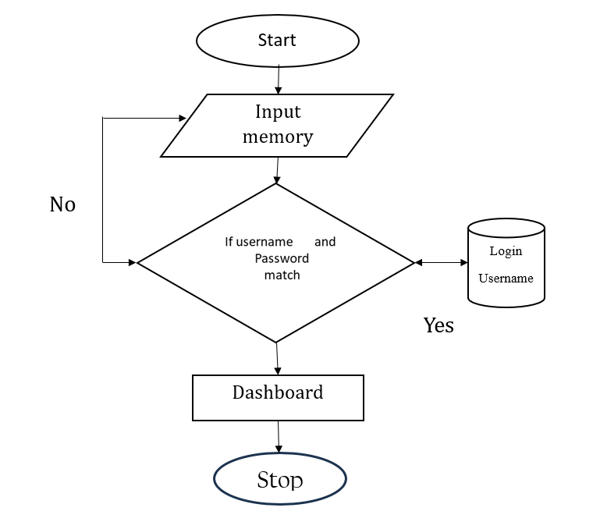
LOGIN

Slide 17
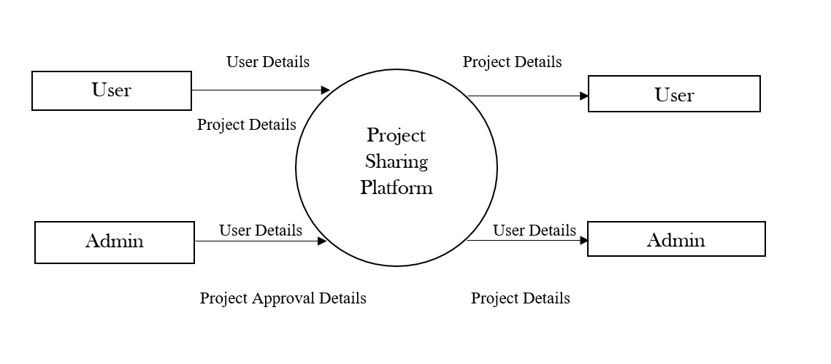
CONTEXT LEVEL DIAGRAM

Slide 18
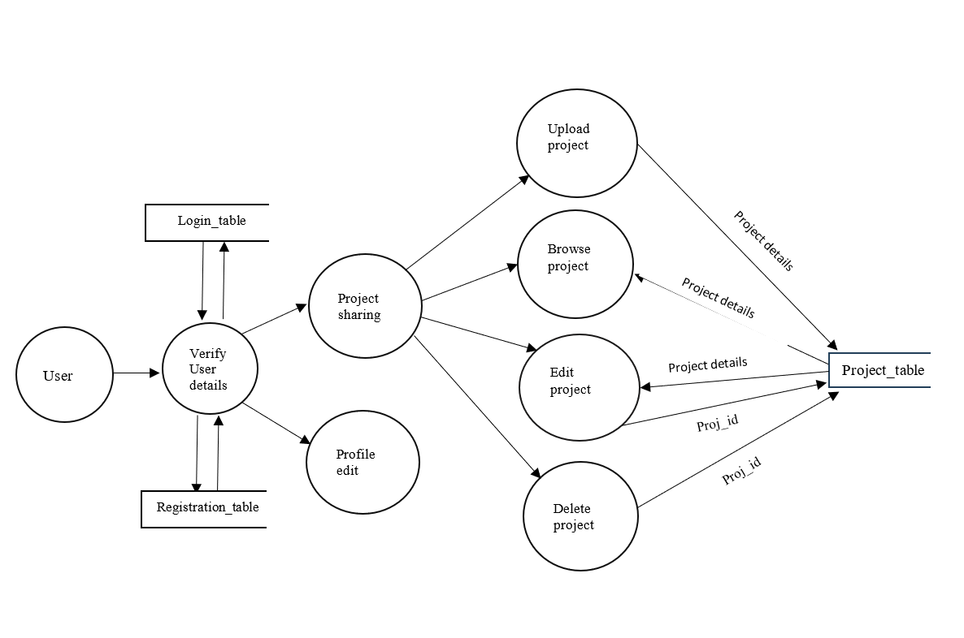
DFD FOR USER

Slide 19
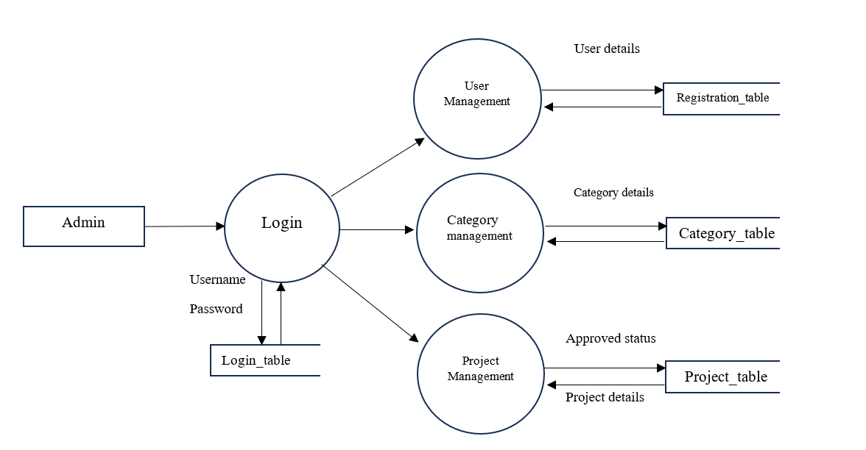
DFD FOR ADMIN

Slide 20
Home page menus
home
Projects
Browse Projects (By category)
Register
login
contact

Slide 21
User dashboard
User Profile
View Profile
Edit Profile
Projects
Create Project
All Projects
Project
View
Edit
Delete
Logout

Slide 22
Admin dashboard
Users
View User
Edit User
Projects
View Projects
Add Category
Edit Projects
Logout
Delete Projects

Slide 23
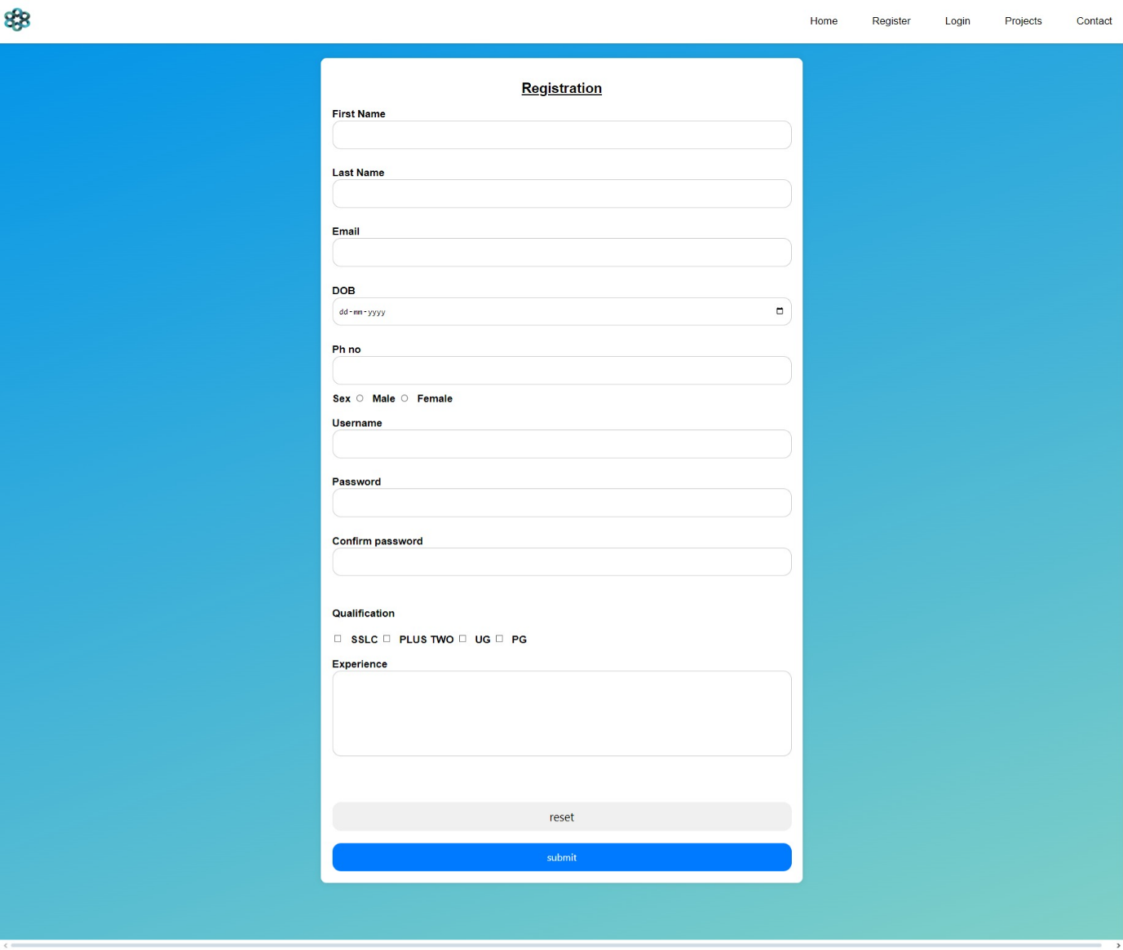

Slide 24
SL.NO | FIELD NAME | DATA TYPE | SIZE | CONSTRAINTS | CRITERIA
1 | first_name | text | 10 | Not null | mandatory
2 | last_name | text | 10 | Not null | mandatory
3 | email | text | 30 | Not null | mandatory
4 | dob | text |  | Not null | mandatory
5 | phone | numeric | 10 | Not null | mandatory
6 | sex | text | 5 | Not null | mandatory
7 | username | varchar | 10 | Primary key | mandatory
8 | user_password | text | 8 | Not null | mandatory
9 | experience | text | 100 | Not null | mandatory
10 | qualification | text | 30 | Not null | mandatory

Slide 25
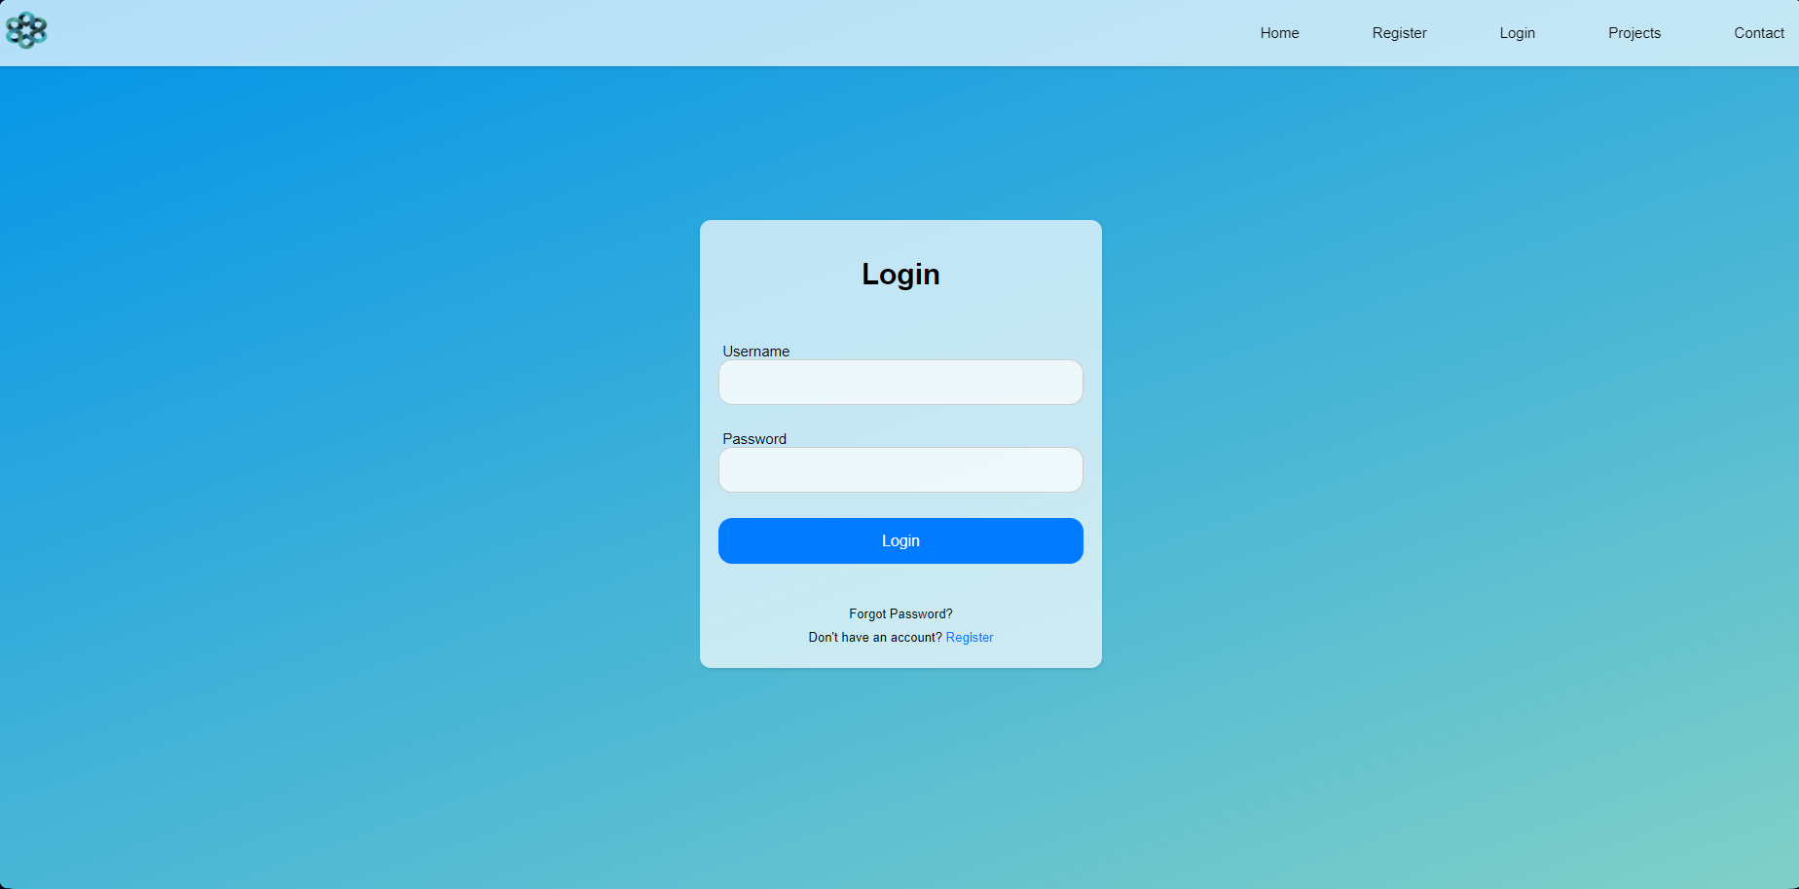

Slide 26
SL.NO | FIELD NAME | DATA TYPE | SIZE | CONSTRAINTS | CRITERIA
1 | username | varchar | 20 | Not null | mandatory
2 | user_password | varchar | 20 | Not null | mandatory

Slide 27
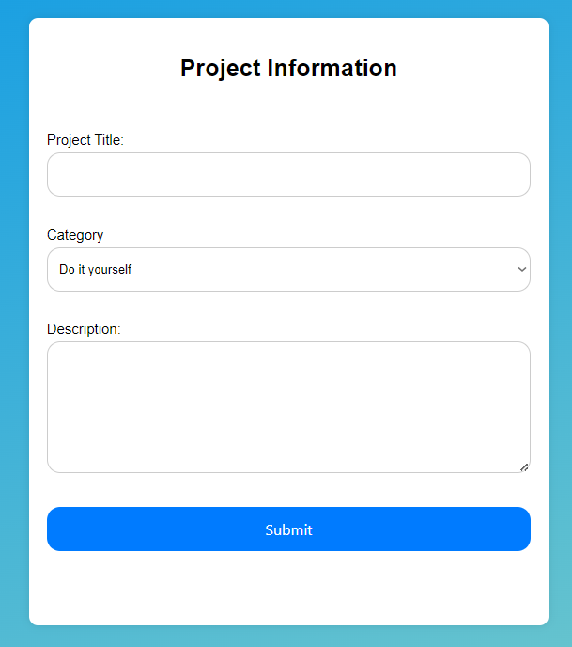
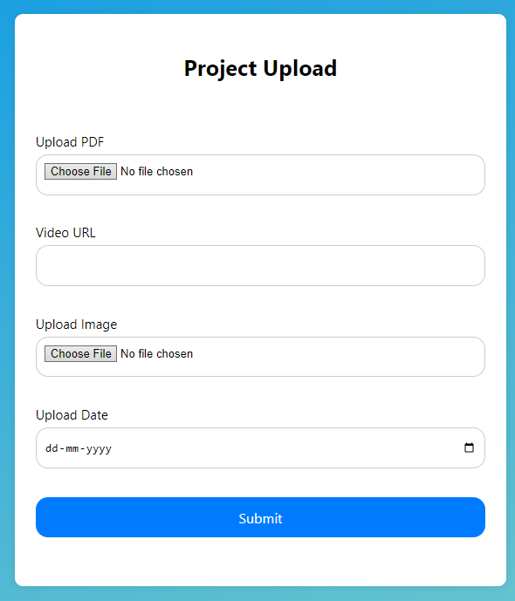
PROJECT UPLOAD FORM

Slide 28
SL.NO | FIELD NAME | DATA TYPE | SIZE | CONSTRAINTS | CRITERIA
1 | Proj_id | bigint | 20 | Primary key | mandatory
2 | project_title | Char | 100 | Not null | mandatory
3 | category | Char | 100 | Not null | mandatory
4 | description | Varchar | 300 | Not null | mandatory
5 | status | Char | 10 | Not null | mandatory
6 | Upload_pdf | bytea |  | Not null | mandatory
7 | Video_url | varchar | 100 | Not null | optional
8 | Upload_date | date |  | Not null | mandatory
9 | image1 | bytea |  | Not null | optional
10 | username | varchar | 10 | Not null | Optional

Slide 29
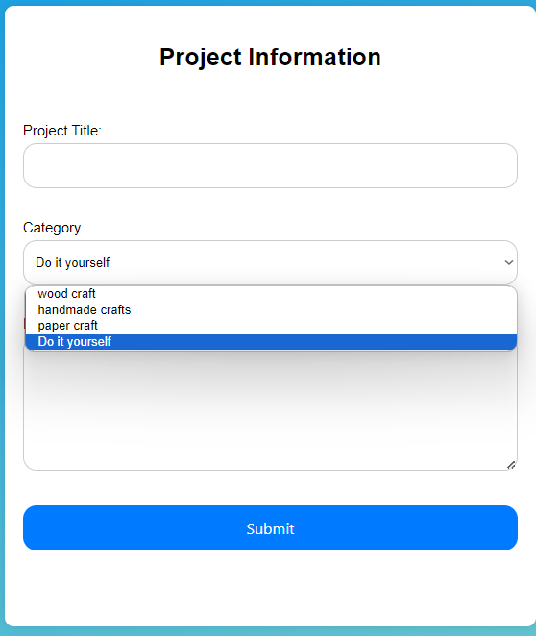
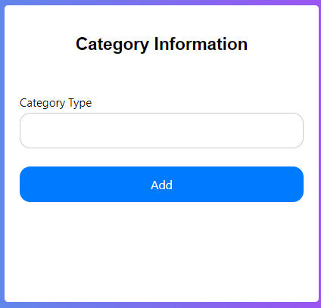
CATEGORY ADDING BY ADMIN

Slide 30
SL.NO | COLUMN | DATATYPE | SIZE | CONSTRAINTS | CRITERIA
1 | category_id | int | 10 | Primary key | mandatory
2 | category_type | text | 30 | Not null | mandatory

